Slide 1
Infographics
Design

Slide 2
getting started
An infographic pairs solid reporting with attractive, purposeful design. Done well, an infographic can convey important information in a simple form or break down complex material for readers.
Today we’ll look at infographic types in the context of design. Refer to other curriculum modules like News Gathering to learn about how to collect reliable data.

Slide 3
benefits
infographics break information into smaller parts, making it easier to understand and more likely to be remembered
they create additional entry points, breaking up text-heavy pages

Slide 4
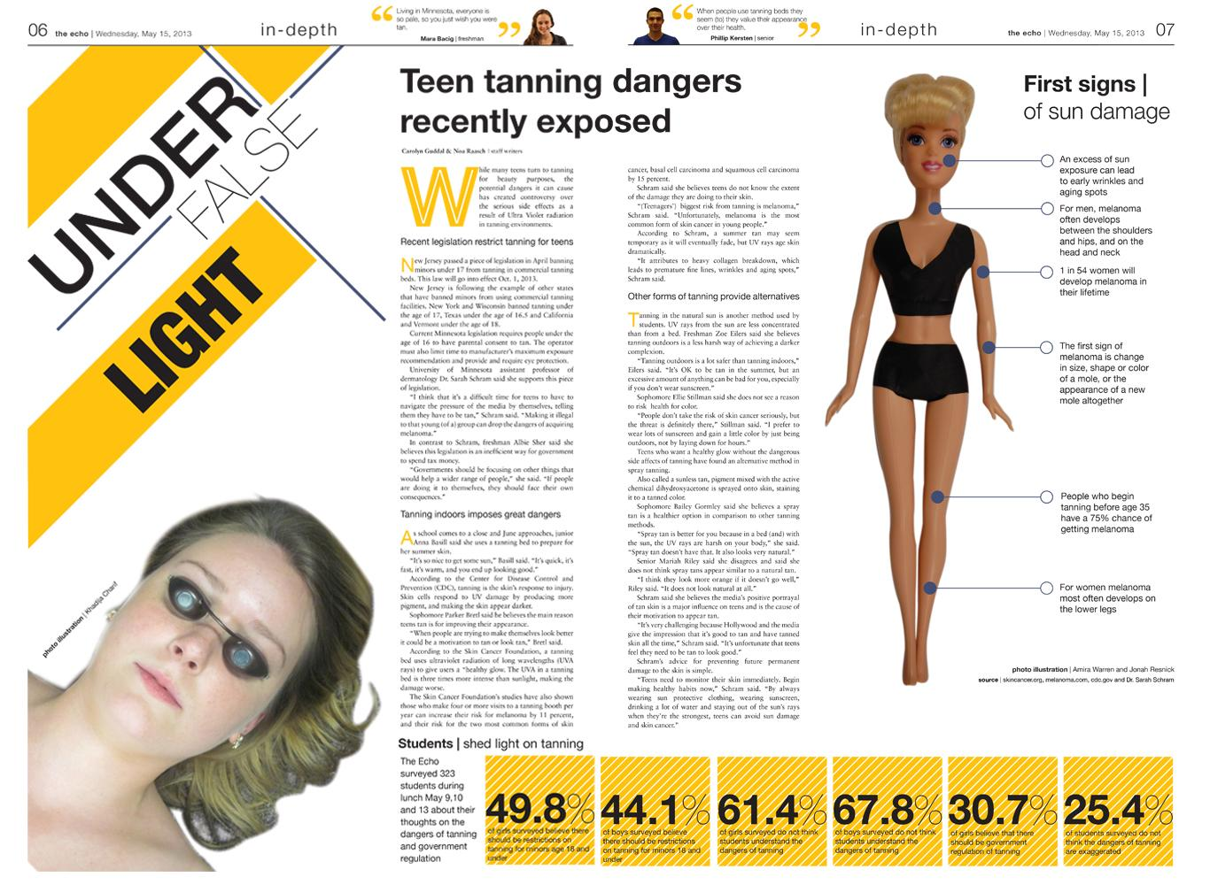
The Echo; St. Louis Park (Minn.) High School

Slide 5
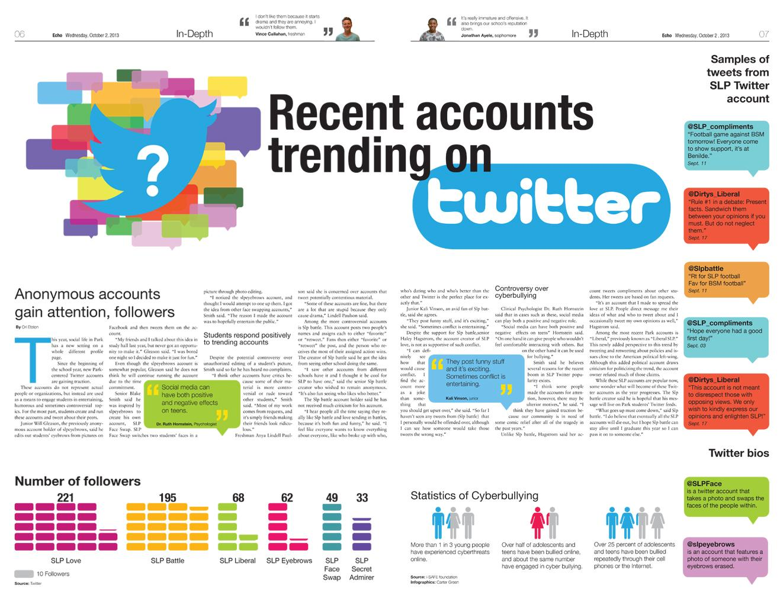
The Echo; St. Louis Park (Minn.) High School

Slide 6
by definition
An infographic combines text and illustrations to convey information visually. An infographic generally has four parts:
headline (a title to indicate topic/subject)
data (the “info” part: numbers, statistics, terms or key content to deliver)
visual (icon, photo, illustration or art element: the “graphic” aspect)
source (credible origin of information)

Slide 7
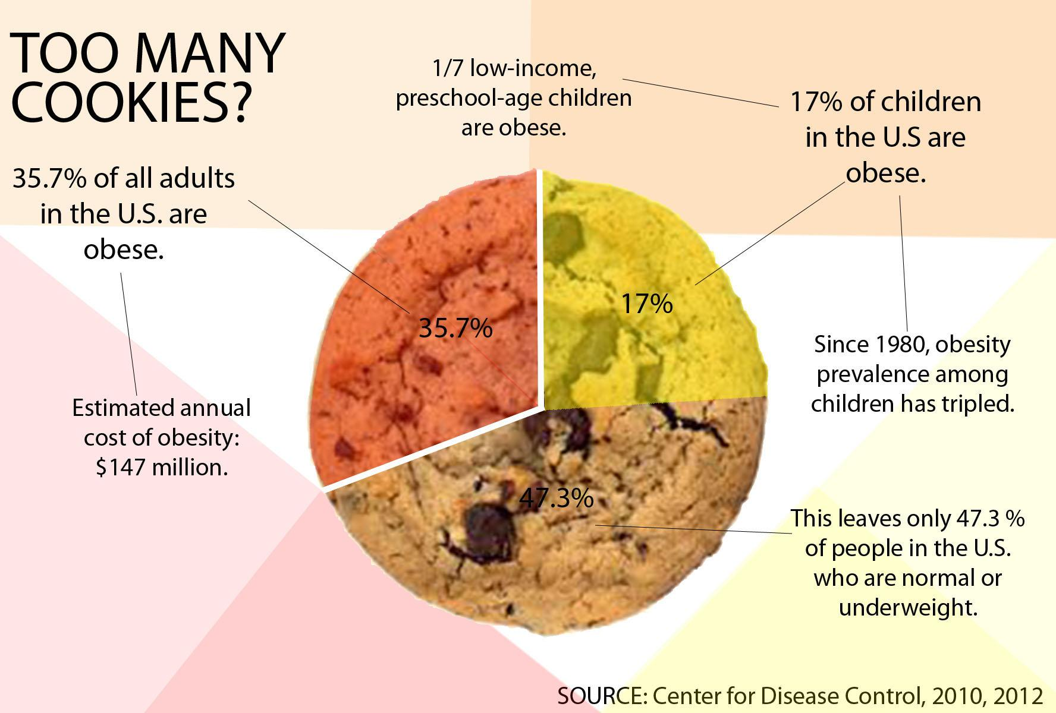
pie chart
Whitney High Student Media, Rocklin, Calif.

Slide 8
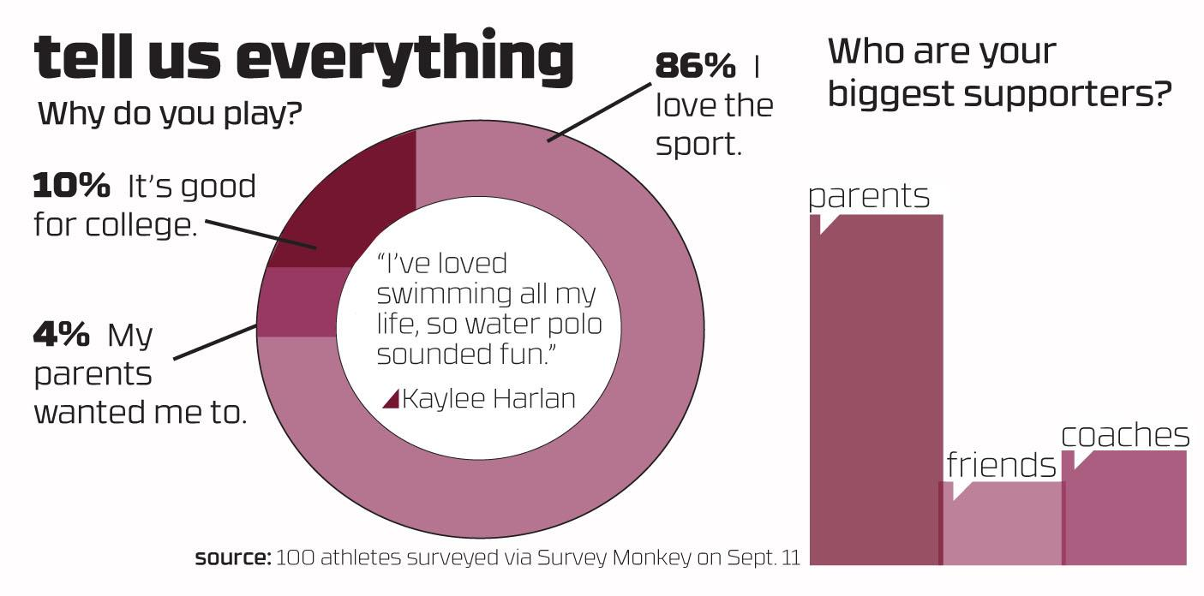
public opinion poll
Whitney High Student Media, Rocklin, Calif.

Slide 9
timeline
presents key events in the order they occurred
The Echo; St. Louis Park (Minn.) High School

Slide 10
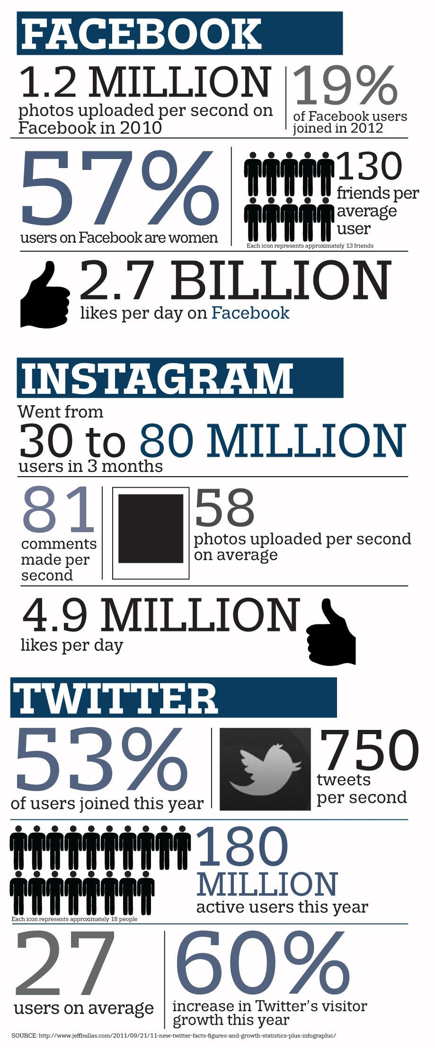
fast fact box
delivers information
in bite-size “chunks” based on facts or statistics
Whitney High Student Media, Rocklin, Calif.

Slide 11
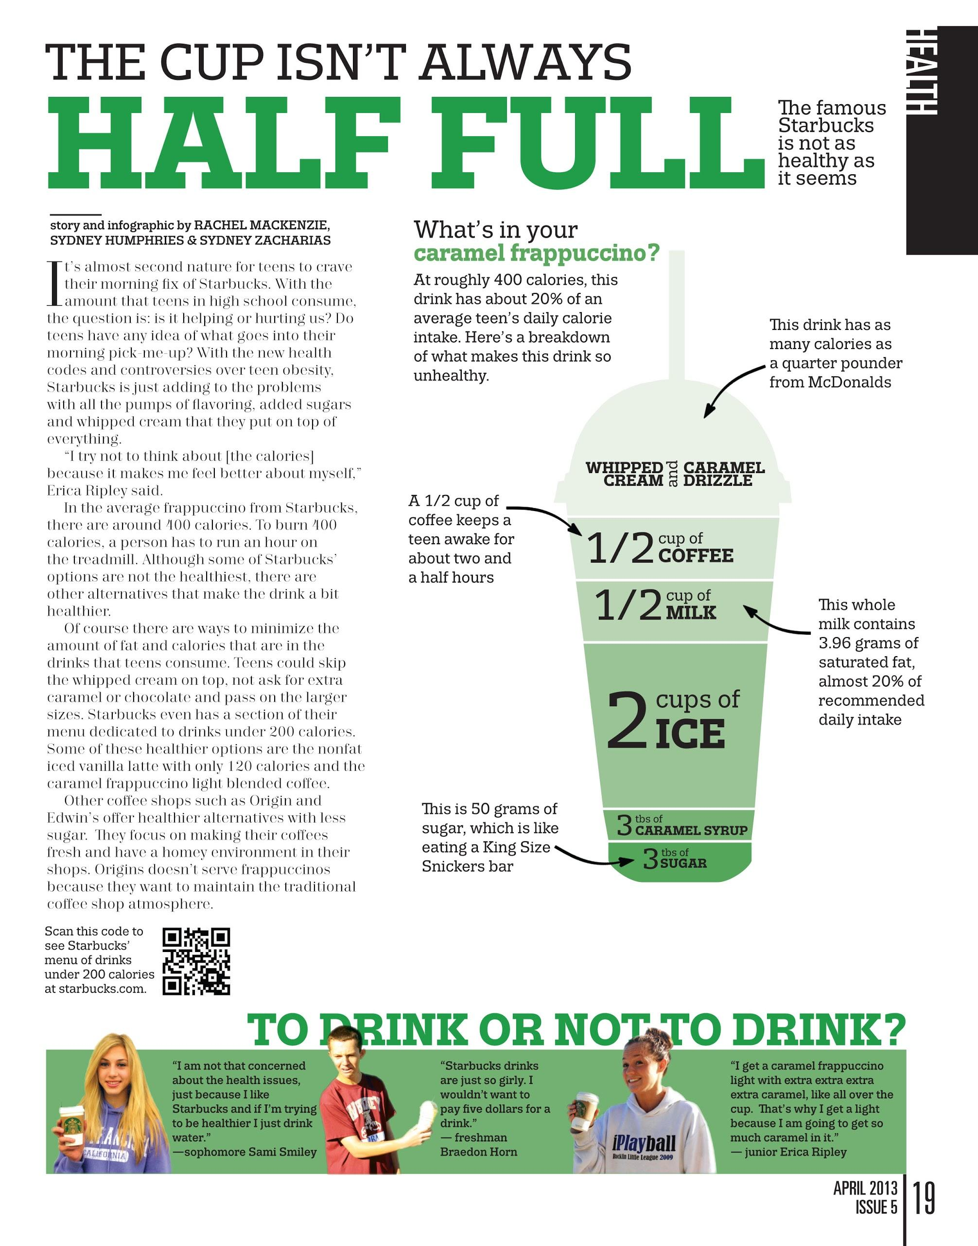
diagram
labels parts of a whole or breaks down something complex into smaller pieces
Whitney High Student Media, Rocklin, Calif.

Slide 12
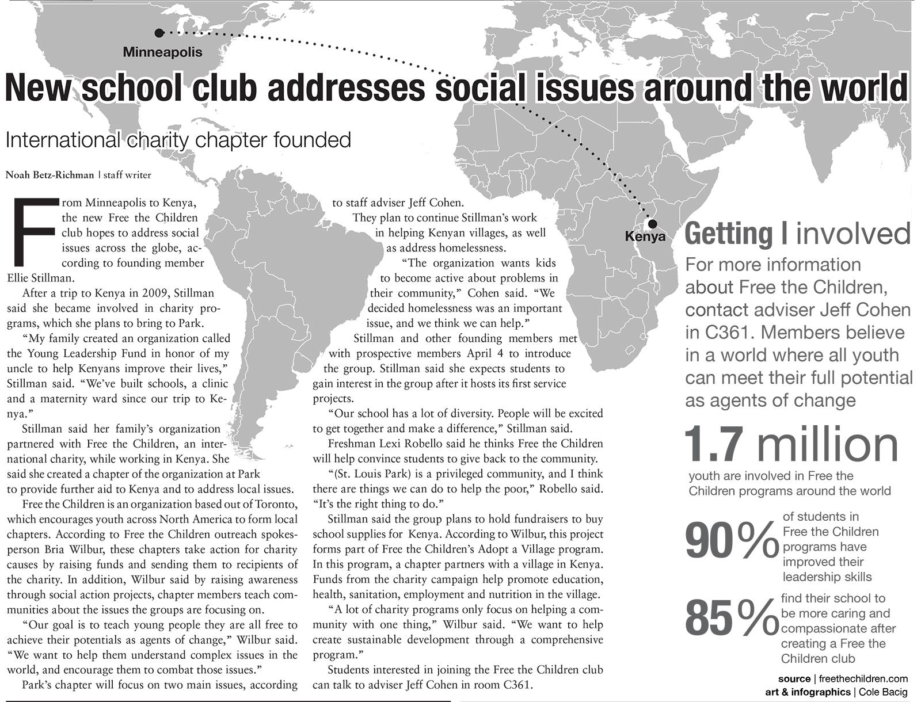
map
The Echo; St. Louis Park (Minn.) High School

Slide 13
two main types
Infographics generally fall into these two types:
supplemental
an infographic that accompanies a traditional story; usually placed beside it on a page to provide additional information or to break down complex ideas from the copy block
standalone
an infographic presented by itself as the story; readers should be able to take away complete information (infographic provides full context)

Slide 14
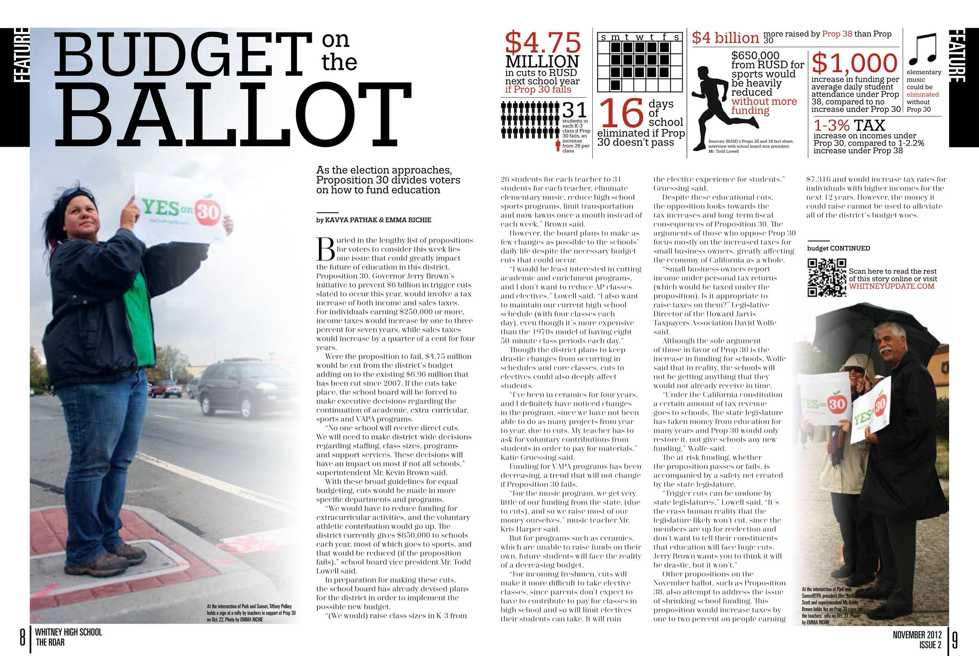
Whitney High Student Media, Rocklin, Calif.

Slide 15
supplemental
this infographic accompanies the main story
(see previous slide)

Slide 16
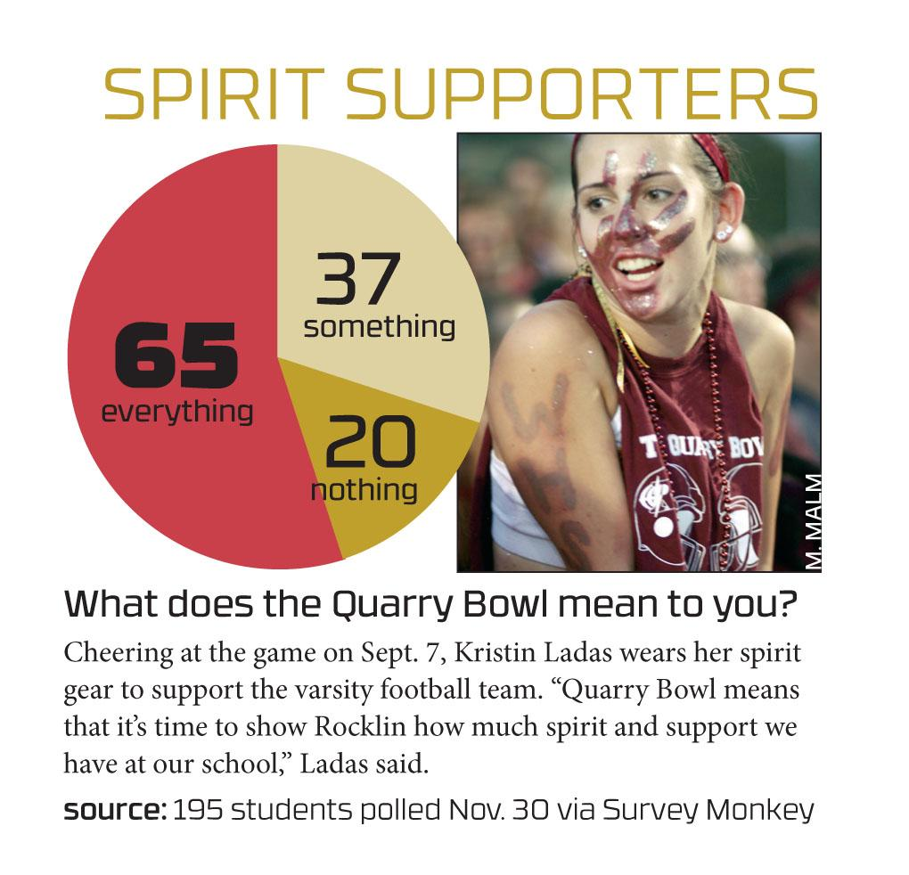
standalone
Whitney High Student Media, Rocklin, Calif.

Slide 17
design decisions
coordinate color
follow visual hierarchy
focus on readability
Whitney High Student Media, Rocklin, Calif.

Slide 18
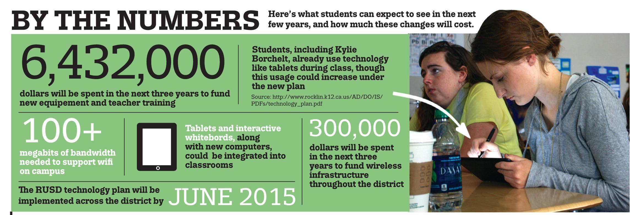
keep type simple, consistent
Whitney High Student Media, Rocklin, Calif.

Slide 19
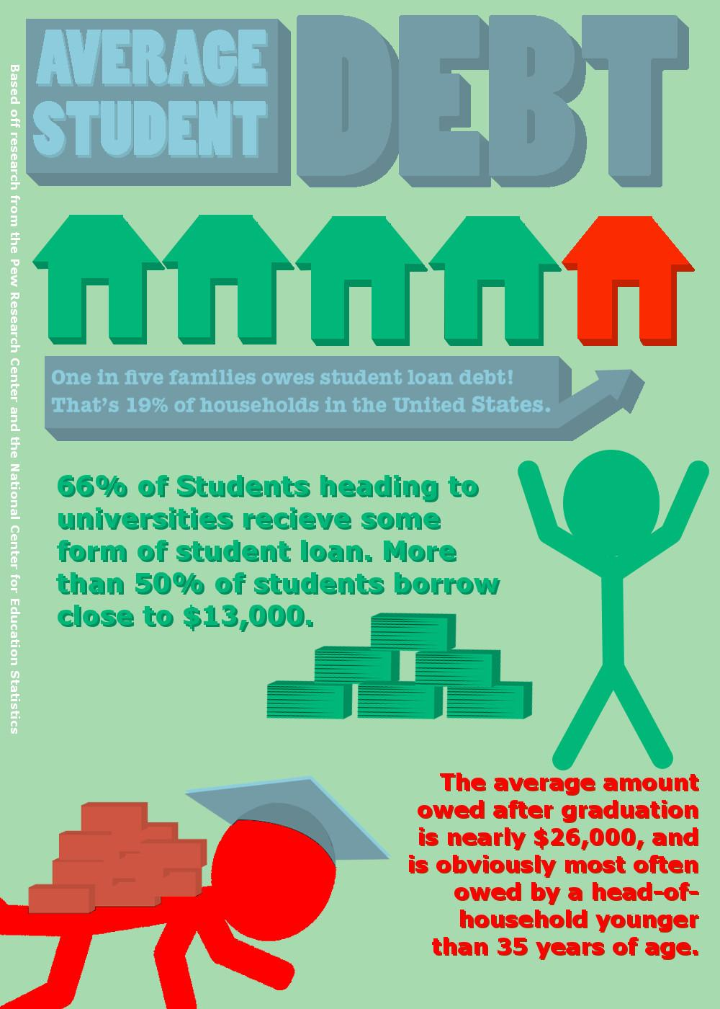
small text in color is difficult to read
pay attention to alignment, case, hyphenation and other type considerations
as with all design decisions, remember: “form follows function”
readability
Whitney High Student Media, Rocklin, Calif.

Slide 20
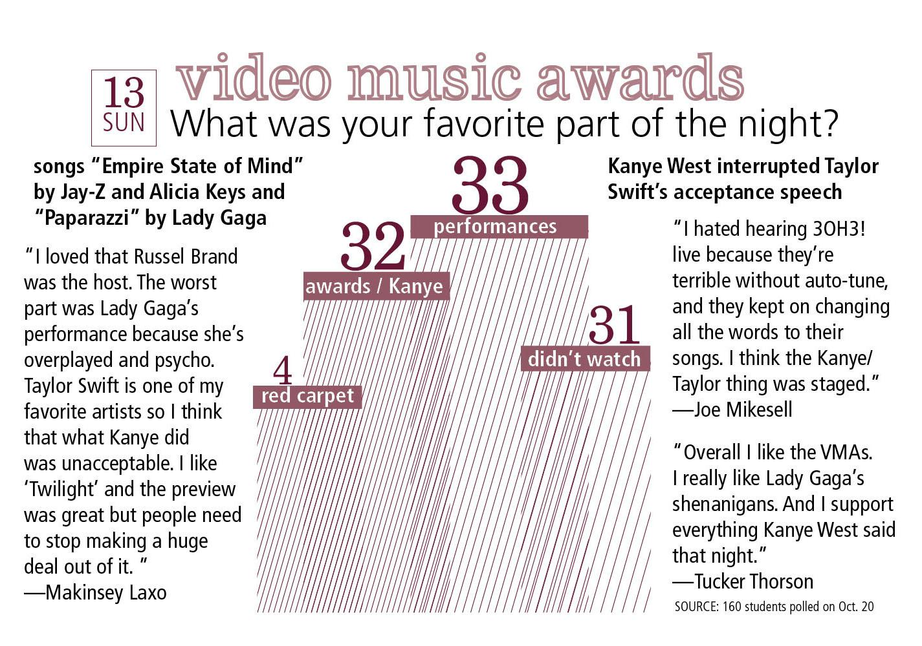
graphic element such as lines (diagonal lines, outline date box, type outline in headline
repeating color use
design unity
Whitney High Student Media, Rocklin, Calif.

Slide 21
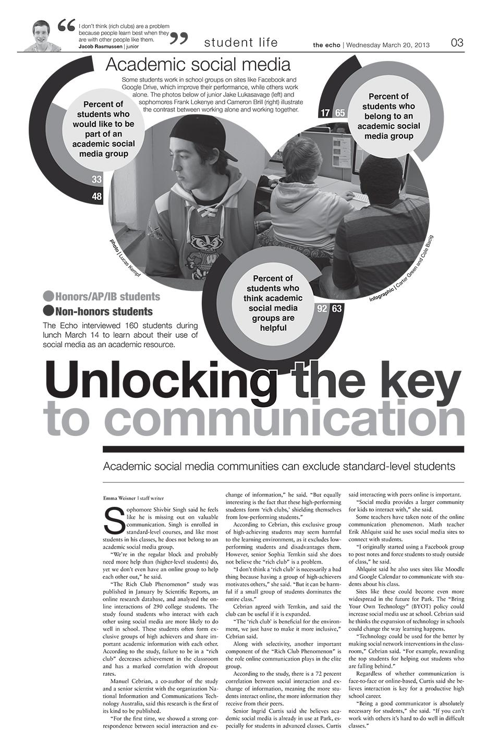
repeating shapes from rounded graphic to circle photos
use of tints to create visual variety on black-and-white page
design unity
The Echo; St. Louis Park (Minn.) High School

Slide 22
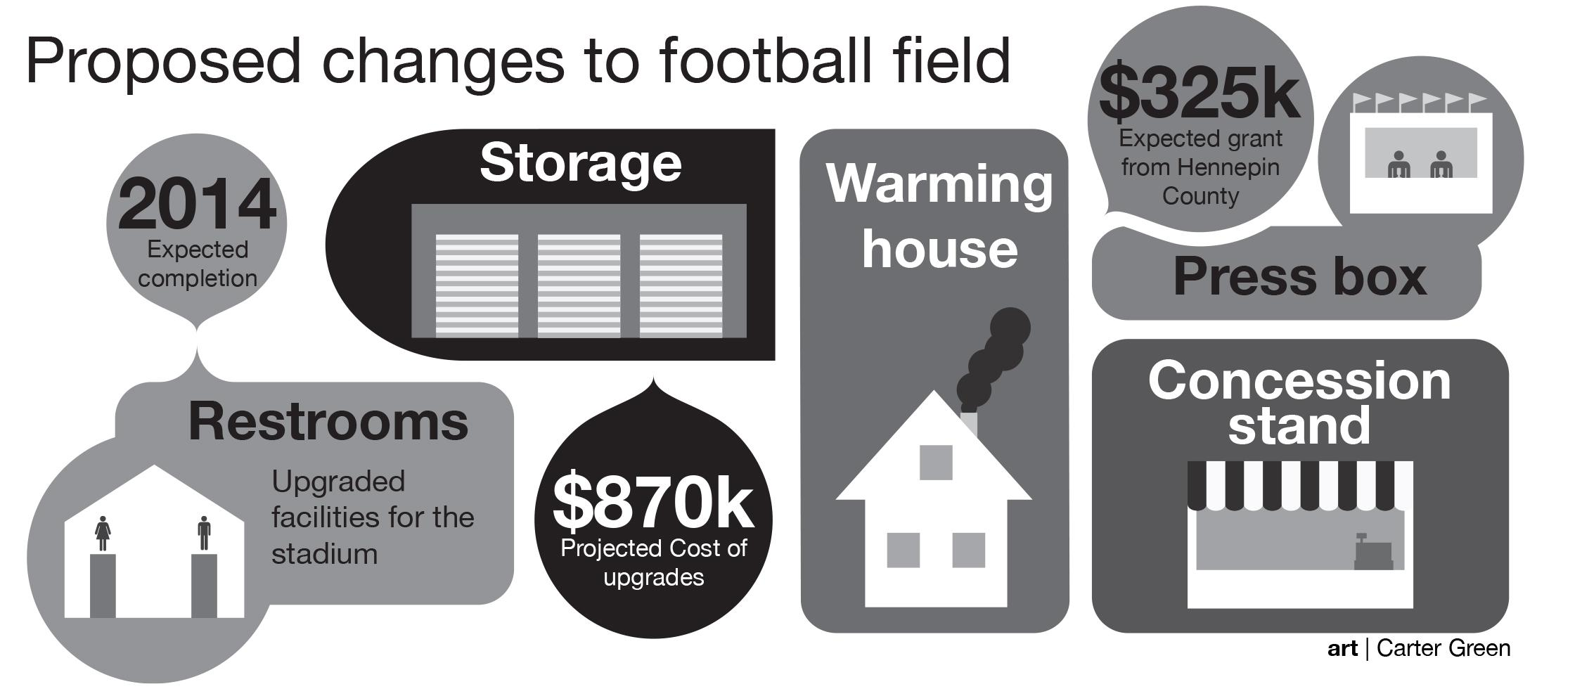
tight space (packaging proximity)
The Echo; St. Louis Park (Minn.) High School

Slide 23
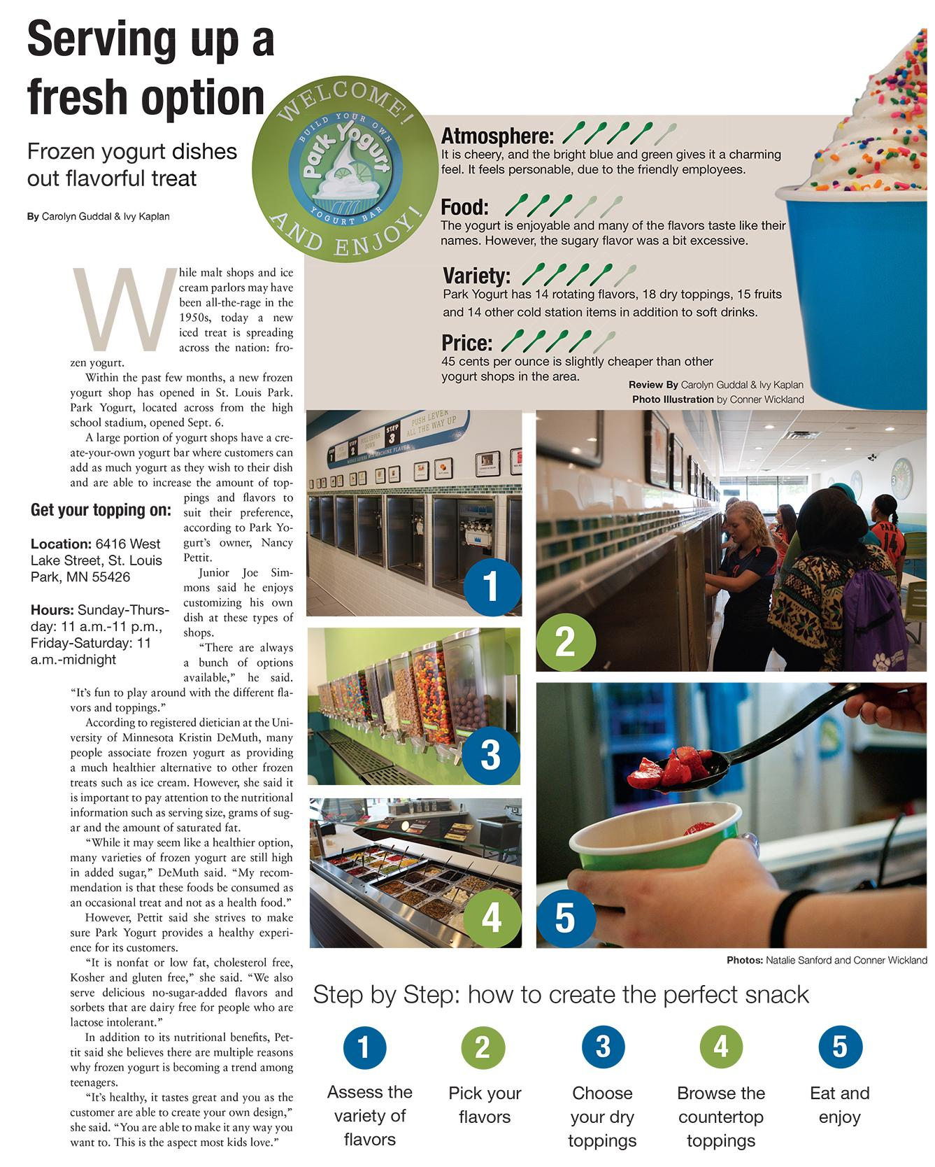
combination
this supplemental infographic combines ratings with a step-by-step guide
The Echo; St. Louis Park (Minn.) High School

Slide 24
content-inspired
let the topic take you outside the box
The Echo; St. Louis Park (Minn.) High School

Slide 25
exploration
Use your mobile devices or classroom computers to search online.
What sites have collections of infographics?
What sites help you create infographics online?
Which news websites incorporate infographics on their front page?
Any other interesting findings?

Slide 26
brainstorm
What topics would make for good infographics for readers at this school?
Two-minute brainstorm as you make a list.
Two-minute pair share with the person sitting next to you. Pick your best idea to share with the class.
Class discussion with list on the board.
Which one do you want to create?

