Slide 1
Newspaper
Layout
Design

Slide 2
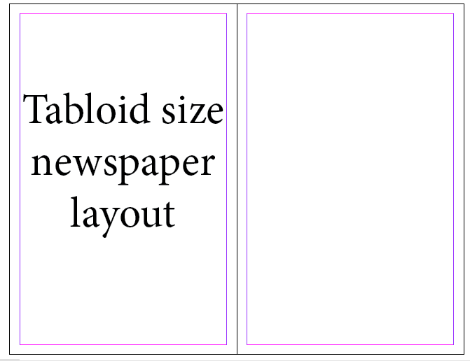
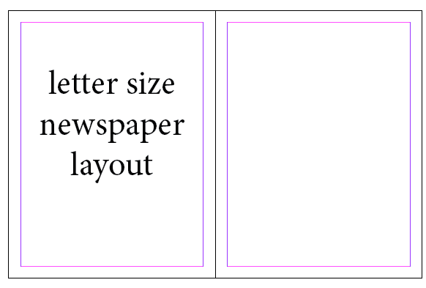
Newspaper sizes
Letter
Tabloid

Slide 3
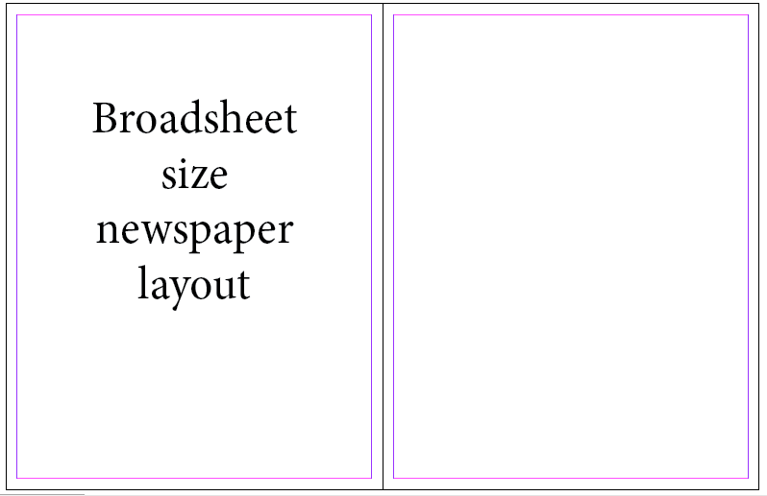
Newspaper sizes
Broadsheet

Slide 4
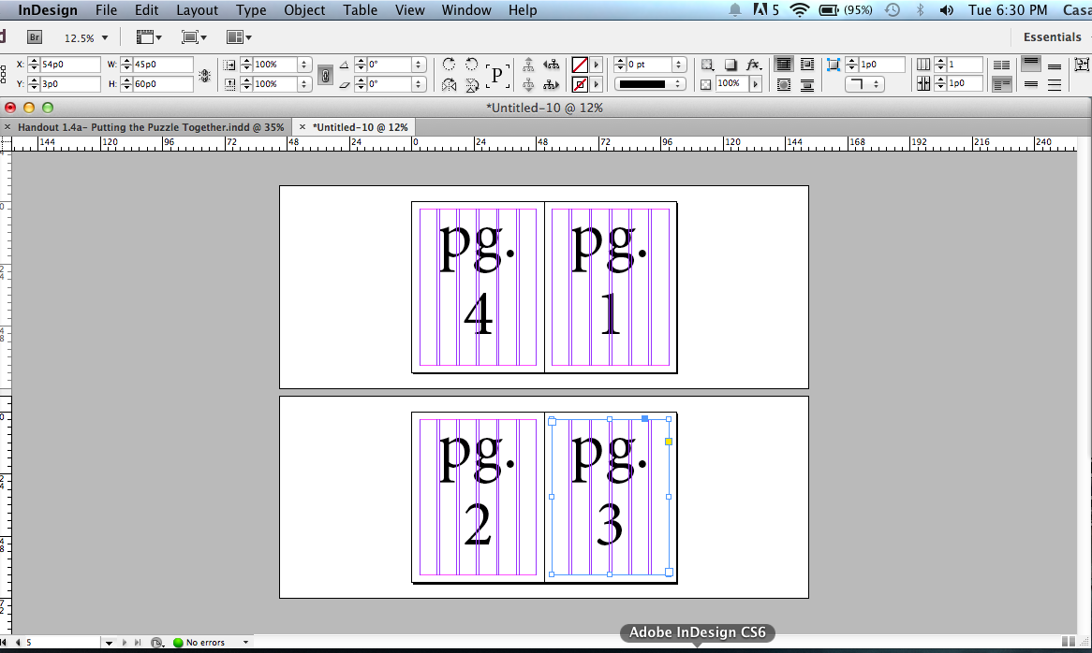
Print layout
4-page setup

Slide 5
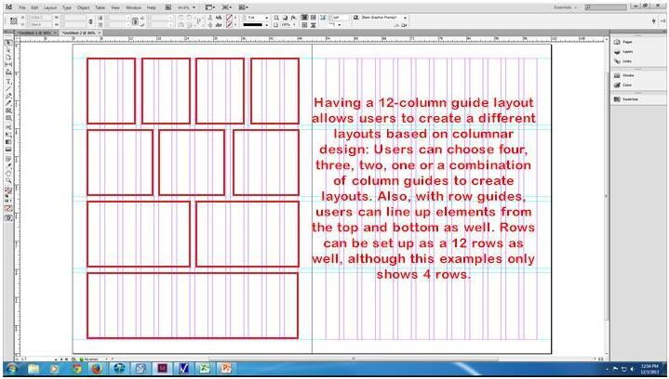
Column guides

Slide 6
Parts of a newspaper
Nameplate
Byline
The nameplate identifies the publication and gives the address and publication information such as issue and volume.
The byline gives credit to the author of an article in a newspaper or magazine. It may also include a title such as editor.

Slide 7
Parts of a newspaper
Columns
Column Inches
Vertical divisions of a spread allowing components to be aligned and placed precisely.
News stories and images measured as number of columns wide and number of inches long.

Slide 8
Parts of a newspaper
Cutline
Dateline
A written explanation of what is occurring in a photo or illustration.
The location, and sometimes the date, from which the story was sent, usually included at the beginning of the article.

Slide 9
Parts of a newspaper
Flag
Folio
A display indicating section or specialty pages.
A header at the top of each section indicating page number and date.

Slide 10
Parts of a newspaper
Primary Headline
Secondary Headline
The main title of an article, meant to draw readers’ attention
A longer title tied to the primary headline that gives additional information about an article

Slide 11
Parts of a newspaper
Index
Jumpline
Table of contents telling readers where sections can be found (usually located on front page)
A line of text that tells readers what page on which a story is continued

Slide 12
Parts of a newspaper
Lead
Masthead
The beginning of an article, which grabs readers’ attention and in a news story provides the most important detail first
The formal statement of a newspaper’s name, officers, management and place of publication

