Slide 1
Digital Publicity
Entrepreneurship

Slide 2
What are social media?
What are social media? According to Merriam-Webster, … “Electronic communications … through which users create communities to share information, ideas, personal messages and other content”
Three basic functions according to Boyd and Ellison at Microsoft/Michigan State:
­Create a personal profile on a public system
­Find others who have something in common with you (interest, location, etc)
­Share connections and ideas with others

Slide 3
Why is this good for journalism?
Journalists can capitalize on these functions by using social media to cultivate online communities and invite users to go deeper into content by clicking links to their website

Slide 4
5 Uses in Journalism
Journalists use social media to find and publish information
­Many see social media as a way to begin a discussion and go deeper
­Alerting — Tell people about new information in a given moment
­Searching — Find a source for a story or look for story tips from others

Slide 5
5 Uses in Journalism
Journalists use social media to find and publish information
You can also use social media to build an audience and establish relationships
­Verifying — Check if your information is correct
­Feedback — Get opinions and angle ideas for how to continue the story
­Inviting — Drive reader traffic to published content on a website

Slide 6
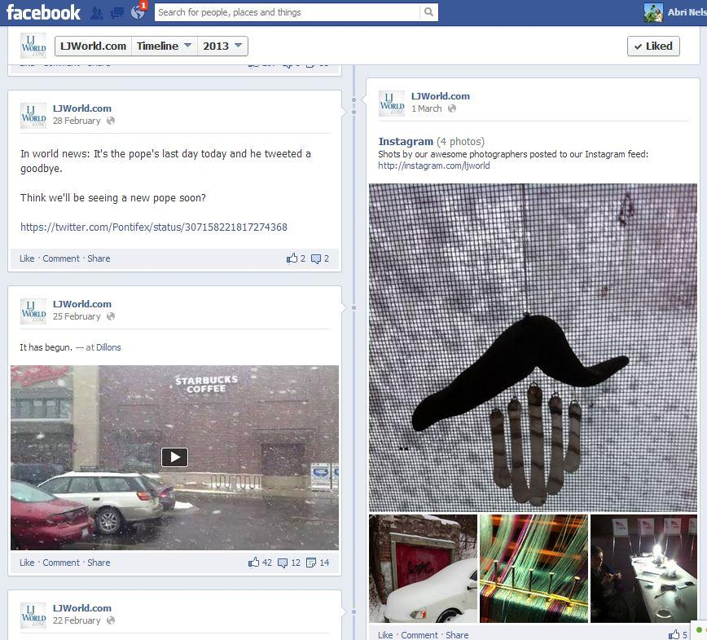
Alerting: Snow Days
The Lawrence Journal-World in Lawrence, Kan.
Winter Storm Q and Rocky, Feb/March 2013
Tracked storm conditions, snow plow progress, injuries
Uploaded user content to create photo galleries and videos and tell stories
Kept users in contact with one another and with authorities to improve safety

Slide 7
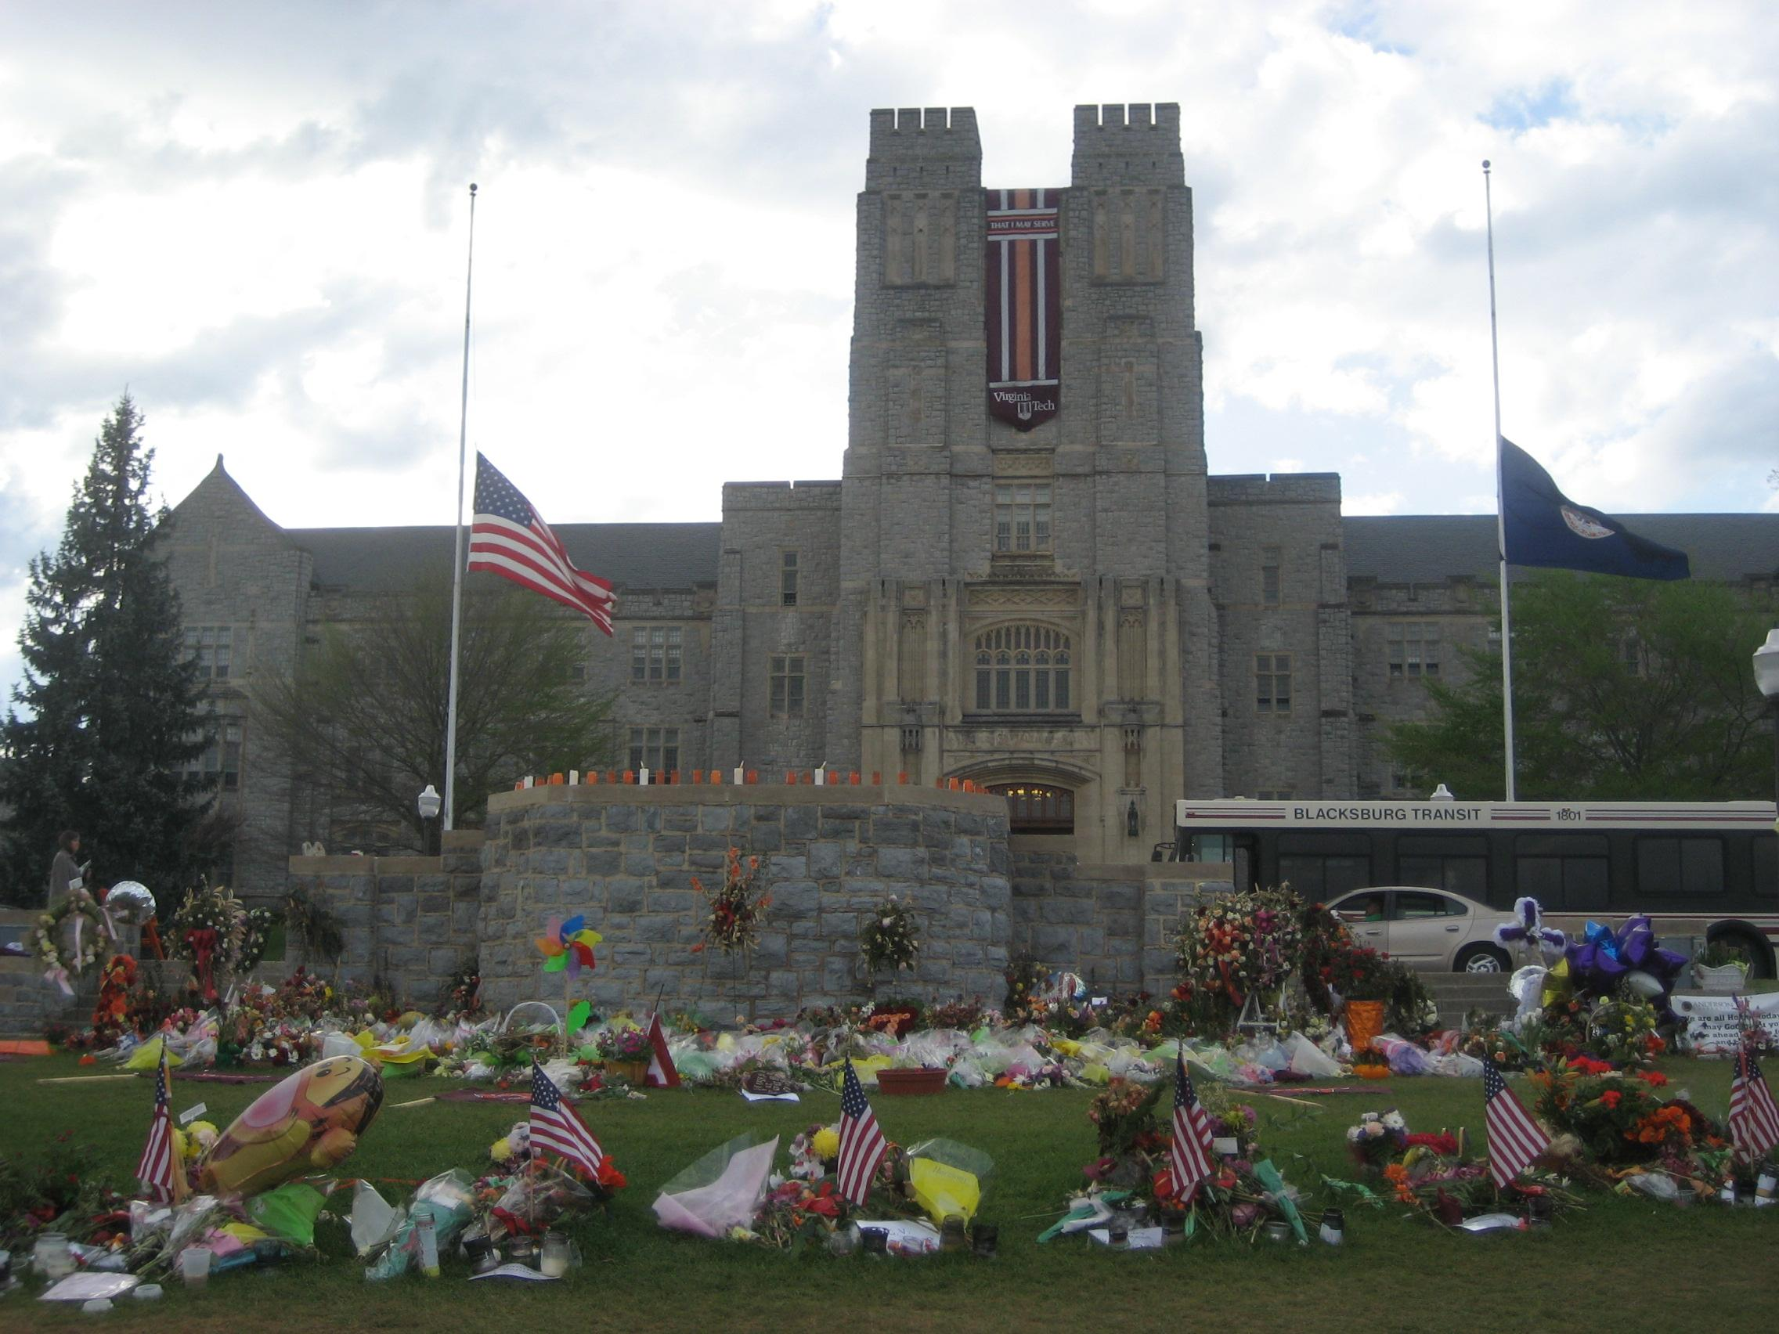
Searching and Verifying: Virginia Tech Massacre
USA Today
Virginia Tech Massacre, April 16, 2007
Reporters (and families) who were unable to reach students for their up-to-date status due to cell phone traffic turned to social media to verify information
Reporters at USA Today created a Facebook group to connect with student sources and share experiences
Photo Copyright Abrianna Nelson 2007

Slide 8
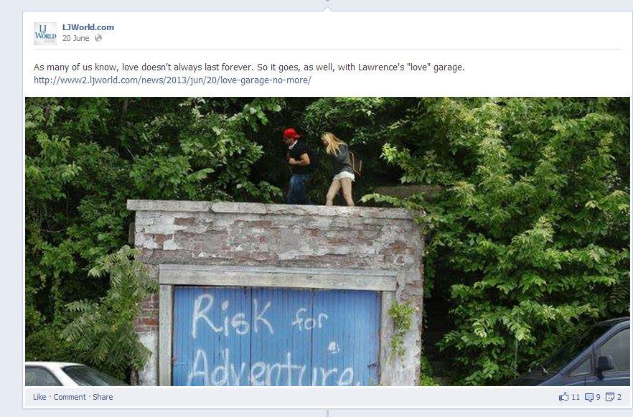
Feedback and Inviting: The “Love” Garage
The Lawrence Journal-World in Lawrence, Kan.
A garage in Lawrence used to be painted with the word “Love” but was repainted over the summer of 2013
The LJ World solicited reader photographs taken by the “love” garage via Facebook in advance of the story to create a photo gallery, then posted a link to the story as usual from their Facebook page

Slide 9
What platforms do we use?
Consideration #1 – What does the audience use?
Consideration #2 – What do we want to do?
­Facebook
­Twitter
­Instagram
­Vine
­Tumblr
­Pinterest
­Others?

Slide 10
Choosing a Platform
Facebook is best for starting conversations and getting feedback.
Designed for interaction and discussion
Users can submit and react to content in real-time
Easy to solicit responses
Twitter is best for breaking news and immediacy.
Difficult to have an ongoing conversation
An excellent way to get information out to an audience

Slide 11
Choosing a Platform
Instagram, Vine, and Tumblr are great ways to get readers involved and create an experience.
Submit their own content
Pinterest is good for curating articles or other online content in topical lists.
­Archives for … sports teams, graduating classes, videos, photo galleries, interviews with the principal, all stories related to a BIG topic (e.g. a new building), daily announcements … whatever you think readers might want.

Slide 12
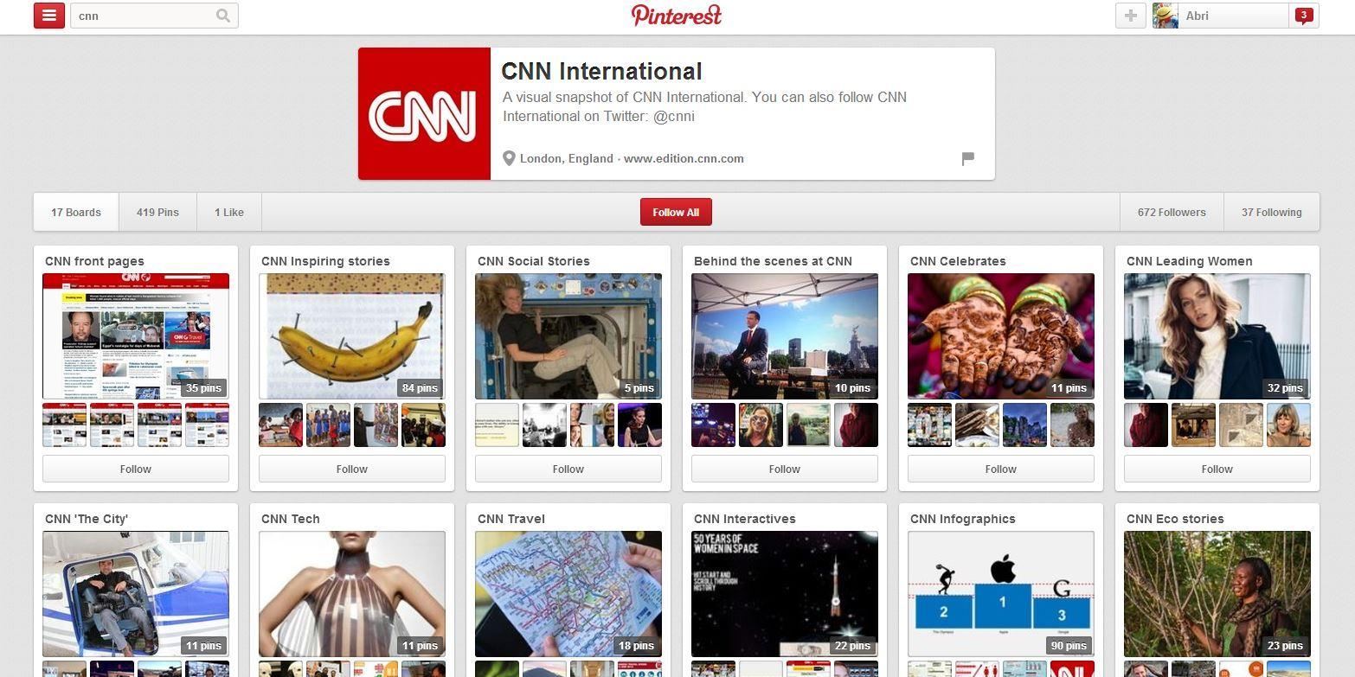
Pinterest: CNN International

Slide 13
Effective or Ineffective?
An effective post …
Fulfills at least one of the five uses, if not more than one
Invites the audience to respond
Is clear and concise
Written in present tense with active verbs and specific nouns
Summarizes the information in a catchy way
Is accurate, balanced, fair, tasteful, legal
An ineffective post …
Does not fit neatly into at least one of the five uses
Does not communicate a clear message
Confuses the reader about what they are being asked to do
Includes unnecessary words or words that may be unfamiliar to the majority of the audience
Fails to engage the audience in some way

Slide 14
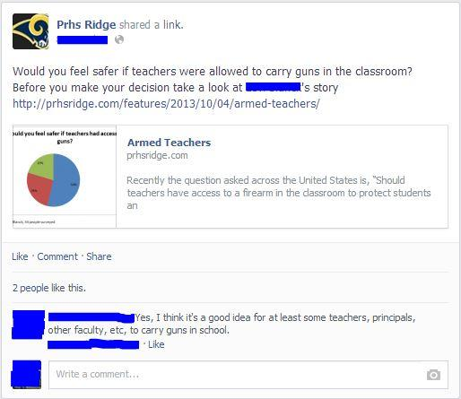
Reporter was tagged in the post
The Ridge Online
Pleasant Ridge HS
Easton, Kan.
Effective or Ineffective? Why?

Slide 15
Candidates were tagged in the post
The Ridge Online
Pleasant Ridge HS
Easton, Kan.
Effective or Ineffective? Why?

Slide 16
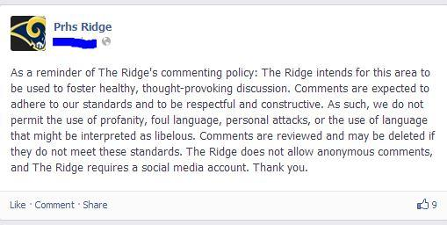
The Ridge Online
Pleasant Ridge HS
Easton, Kan.
Effective or Ineffective? Why?

Slide 17
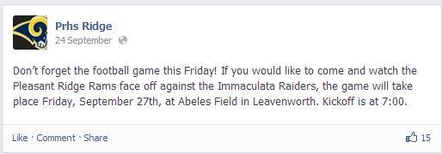
The Ridge Online
Pleasant Ridge HS
Easton, Kan.
Effective or Ineffective? Why?

Slide 18
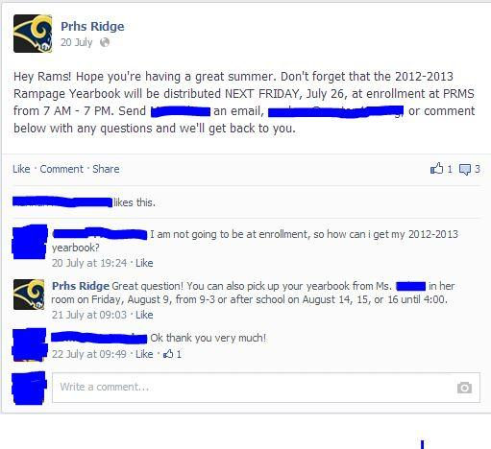
The Ridge Online
Pleasant Ridge HS
Easton, Kan.
Effective or Ineffective? Why?

