Slide 1
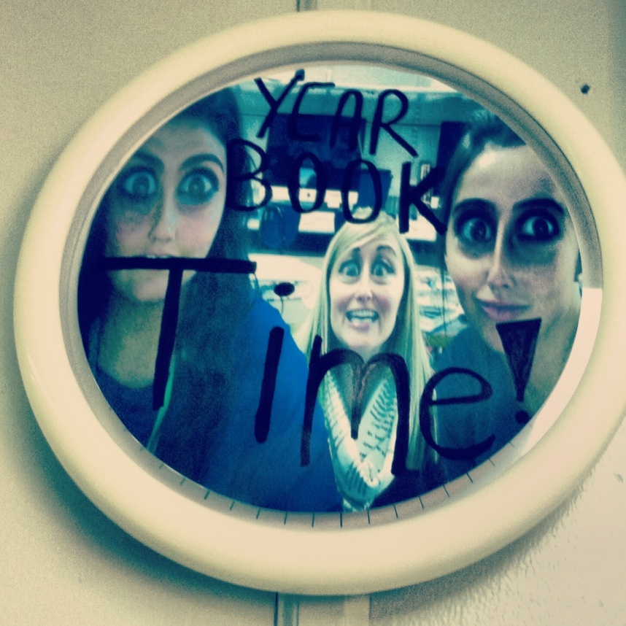
Publication Marketing Case Study
Grand Blanc High School
2013/14
Attribution: Adviser Ava Butzu of Grand Blanc High School contributed to this PowerPoint

Slide 2
Summer Advertising Blitz
Idea #1

Slide 3
Prepare before the day…
Staffers sell in groups of 2-3;
Each person sells 2 ads
Ads editor creates a list of feasible leads and divides them up for each group.
Each group MUST earnestly sell to the businesses on their list
Groups may claim other businesses not on the list by contacting the ads editor, who will make sure no one else sells there.

Slide 5
Lots of Awards with cheesy prizes
Most ads sold before the scavenger hunt, most ads sold on the day of the scavenger hunt, best scavenger hunt photos

Slide 6
Create Fun Experiences With Audience
Idea #2:

Slide 7
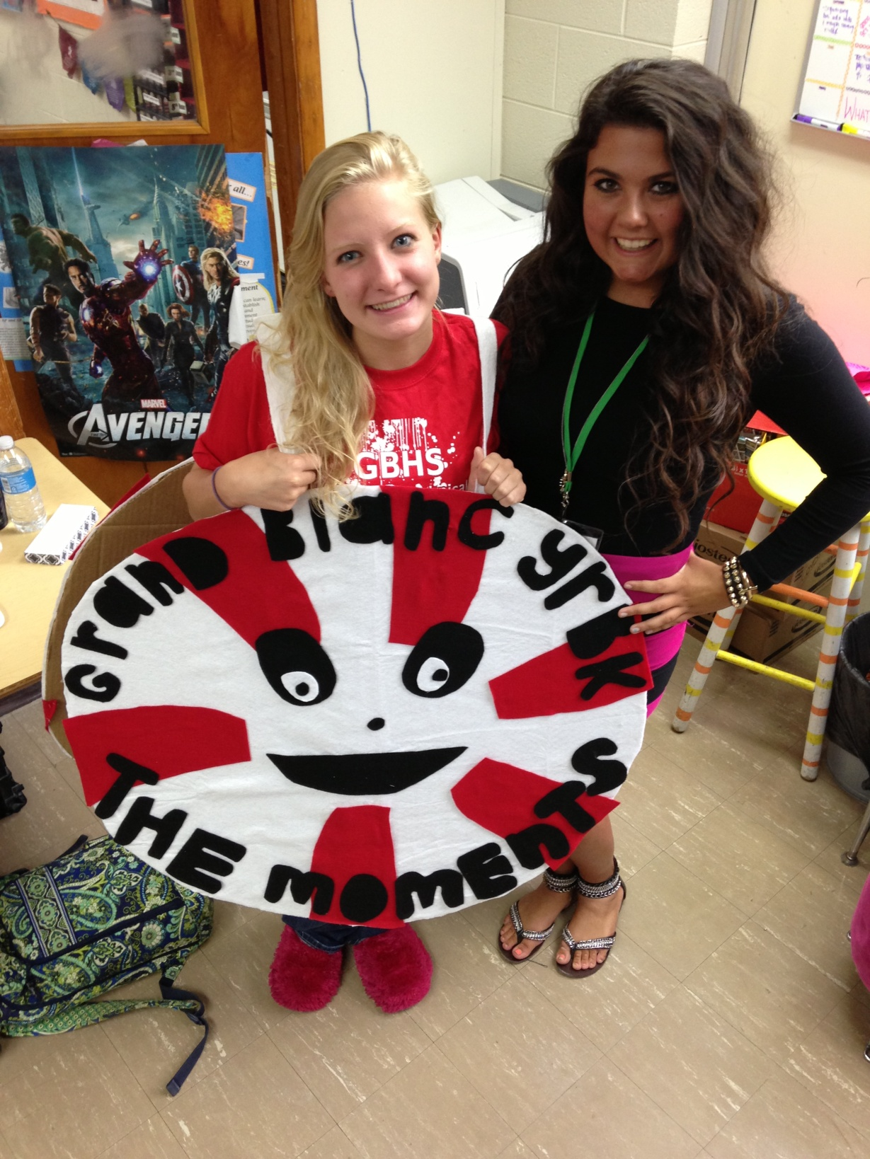
Annual Mascot based on them
Our theme was “The Moments.” This is Mo, the Mint. We passed out mints at the homecoming parade with order forms. We also greeted parents as they dropped off kids in the morning and gave them order forms and our mission statement.

Slide 8
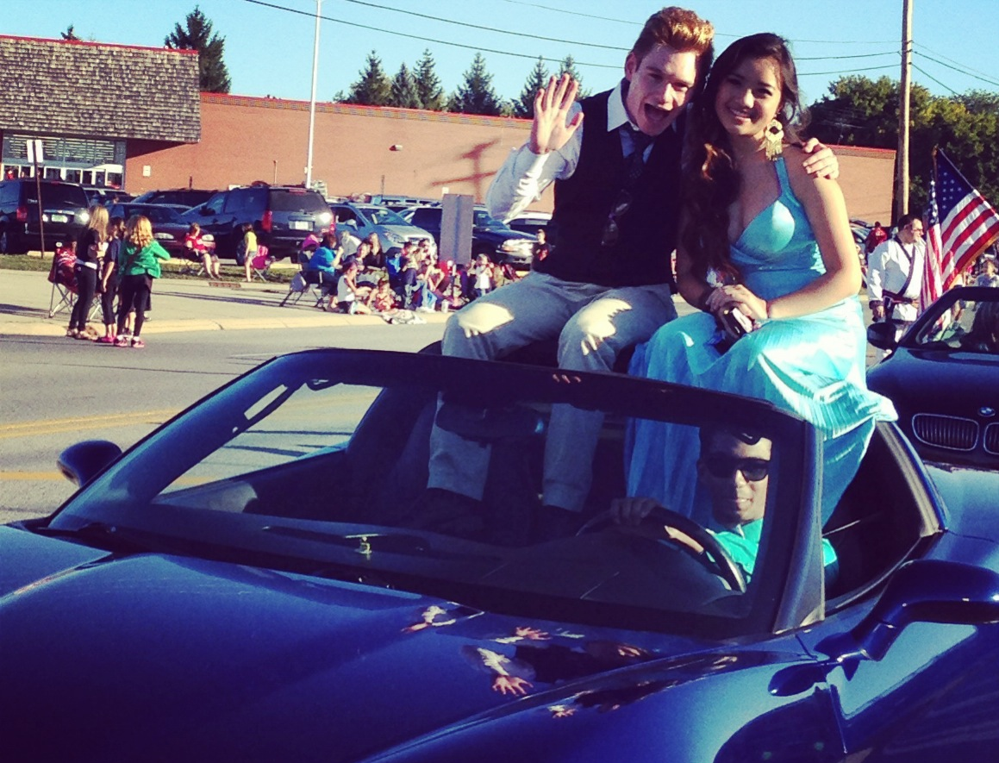
Yearbook King and Queen
Voted on by the class among editors for fun (great for P.R.)

Slide 9
Evaluate, Reward, and Display Excellent Work
Provides Sneak Peaks to audience and Inspires Staffers for each deadline.

Slide 10
Yearbook Week Blitz
Idea #3

Slide 11
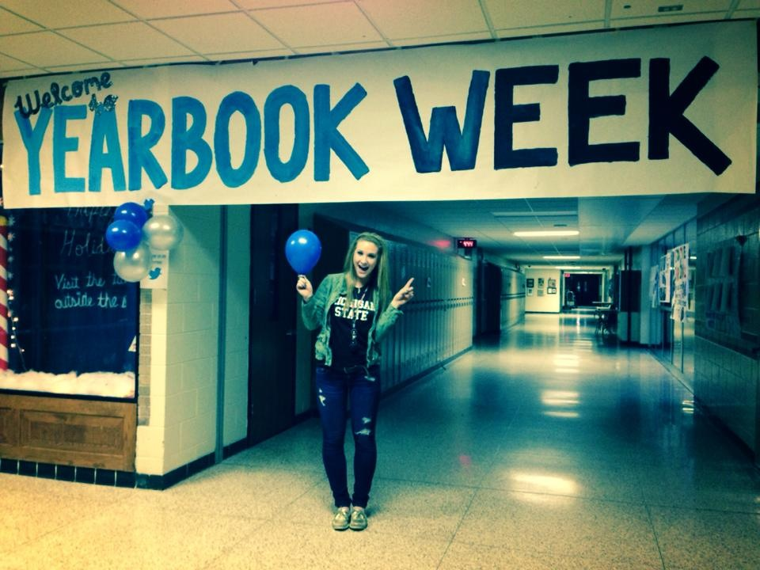
One-week marketing blitz campaign
Marketing editors develop a plan for the week;
Staffers embellish and add to the plan as they get involved and excited

Slide 12
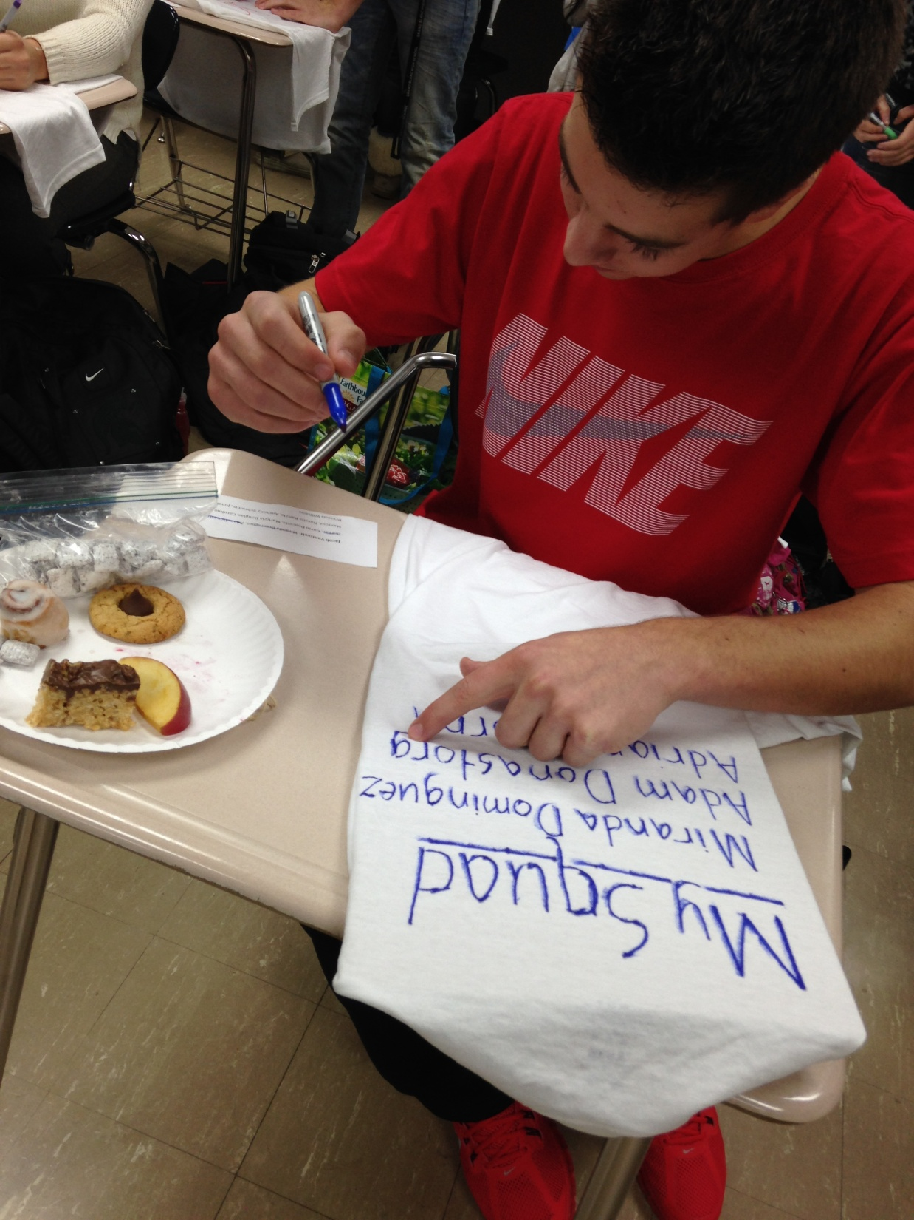
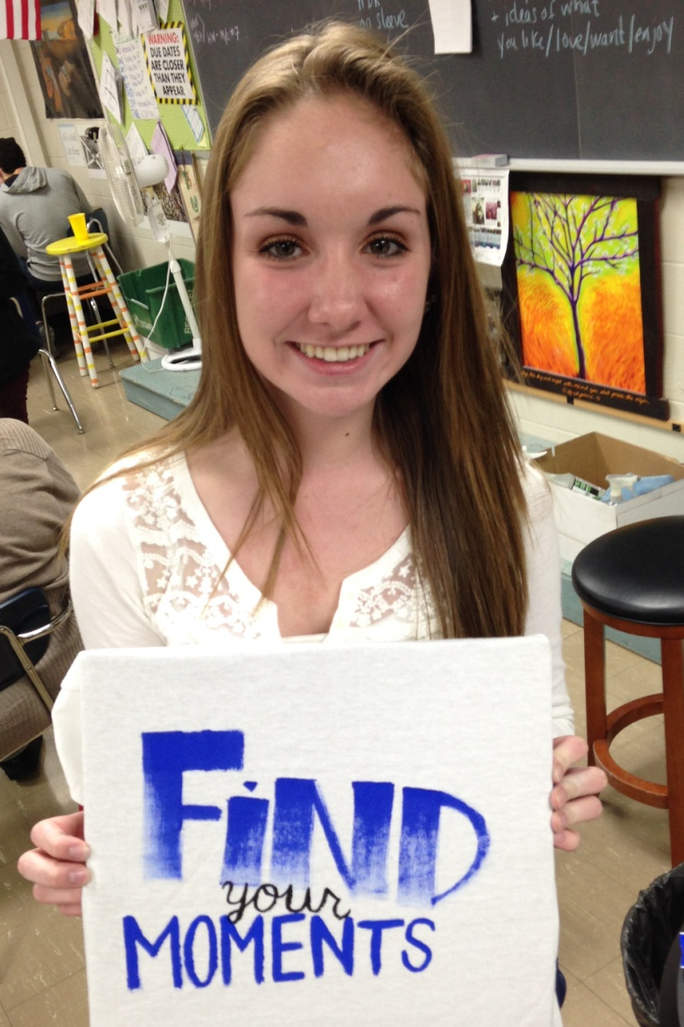
Yearbook Week Preparation
Staff Reward – Index T-shirts
Featuring a slogan based on our theme on the front
Each staffer given specific names of students who have been featured in our book
Worn to kick off yearbook week

Slide 13
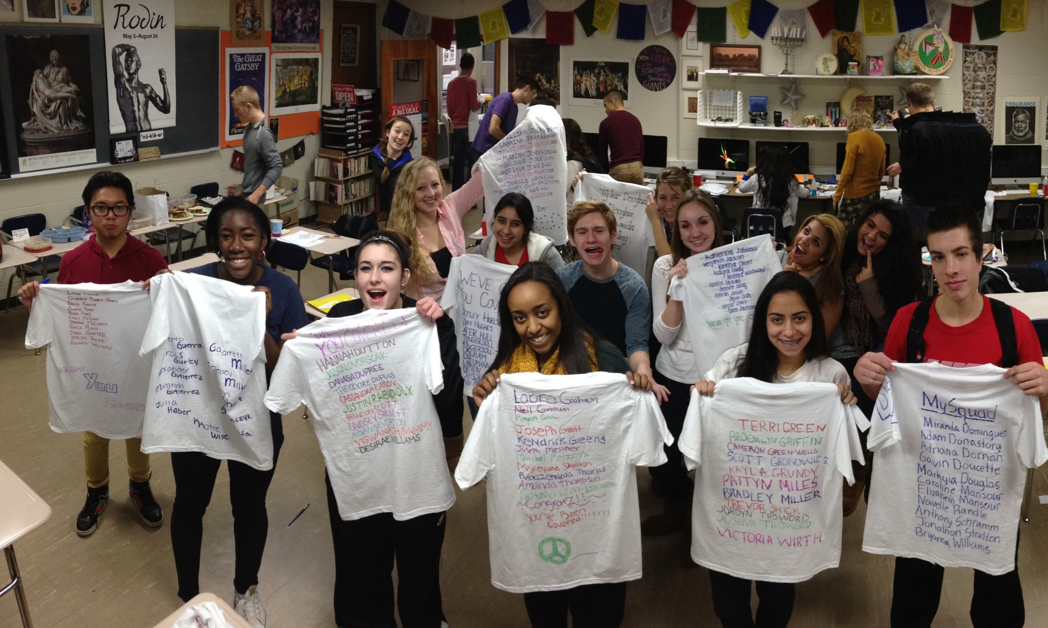

Slide 14
Yearbook Staff Assumes the role of promoters all week
Competition: The staffer who sells the most yearbook gets released from the next deadline to job shadow the editor of his/her choice

Slide 15
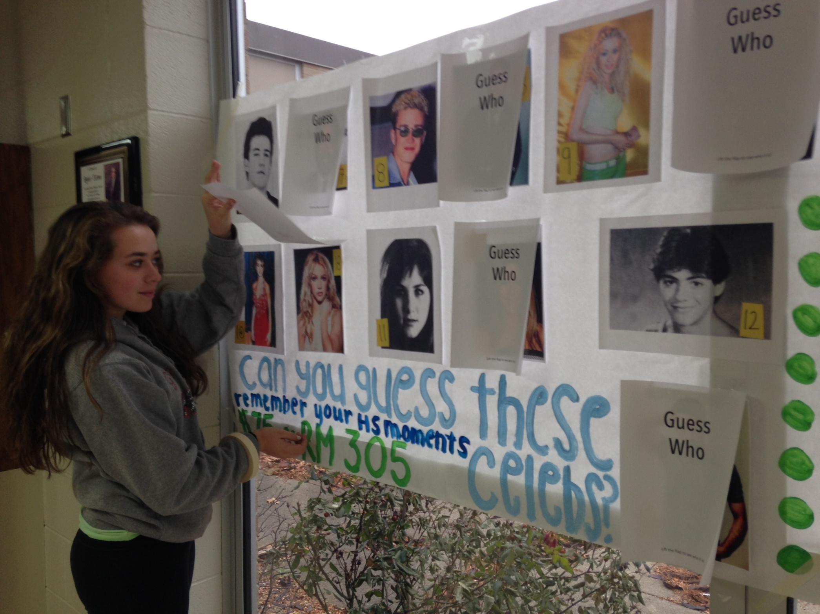

Slide 16
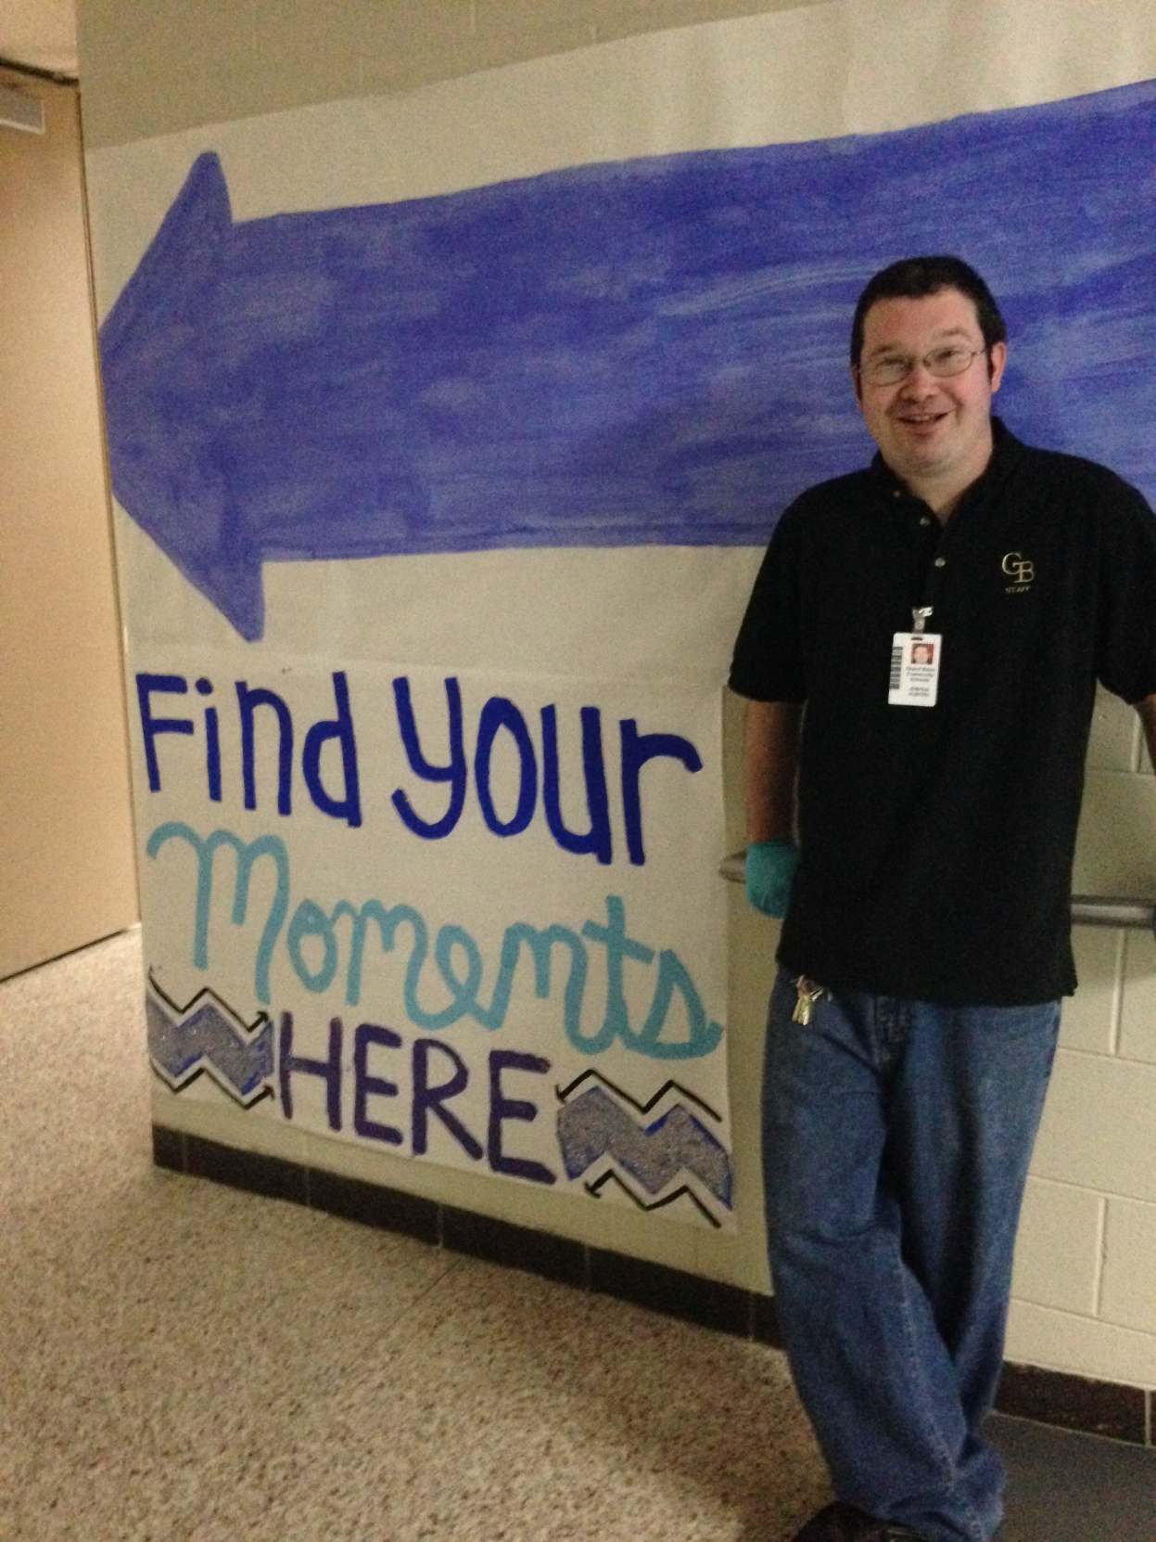

Slide 17
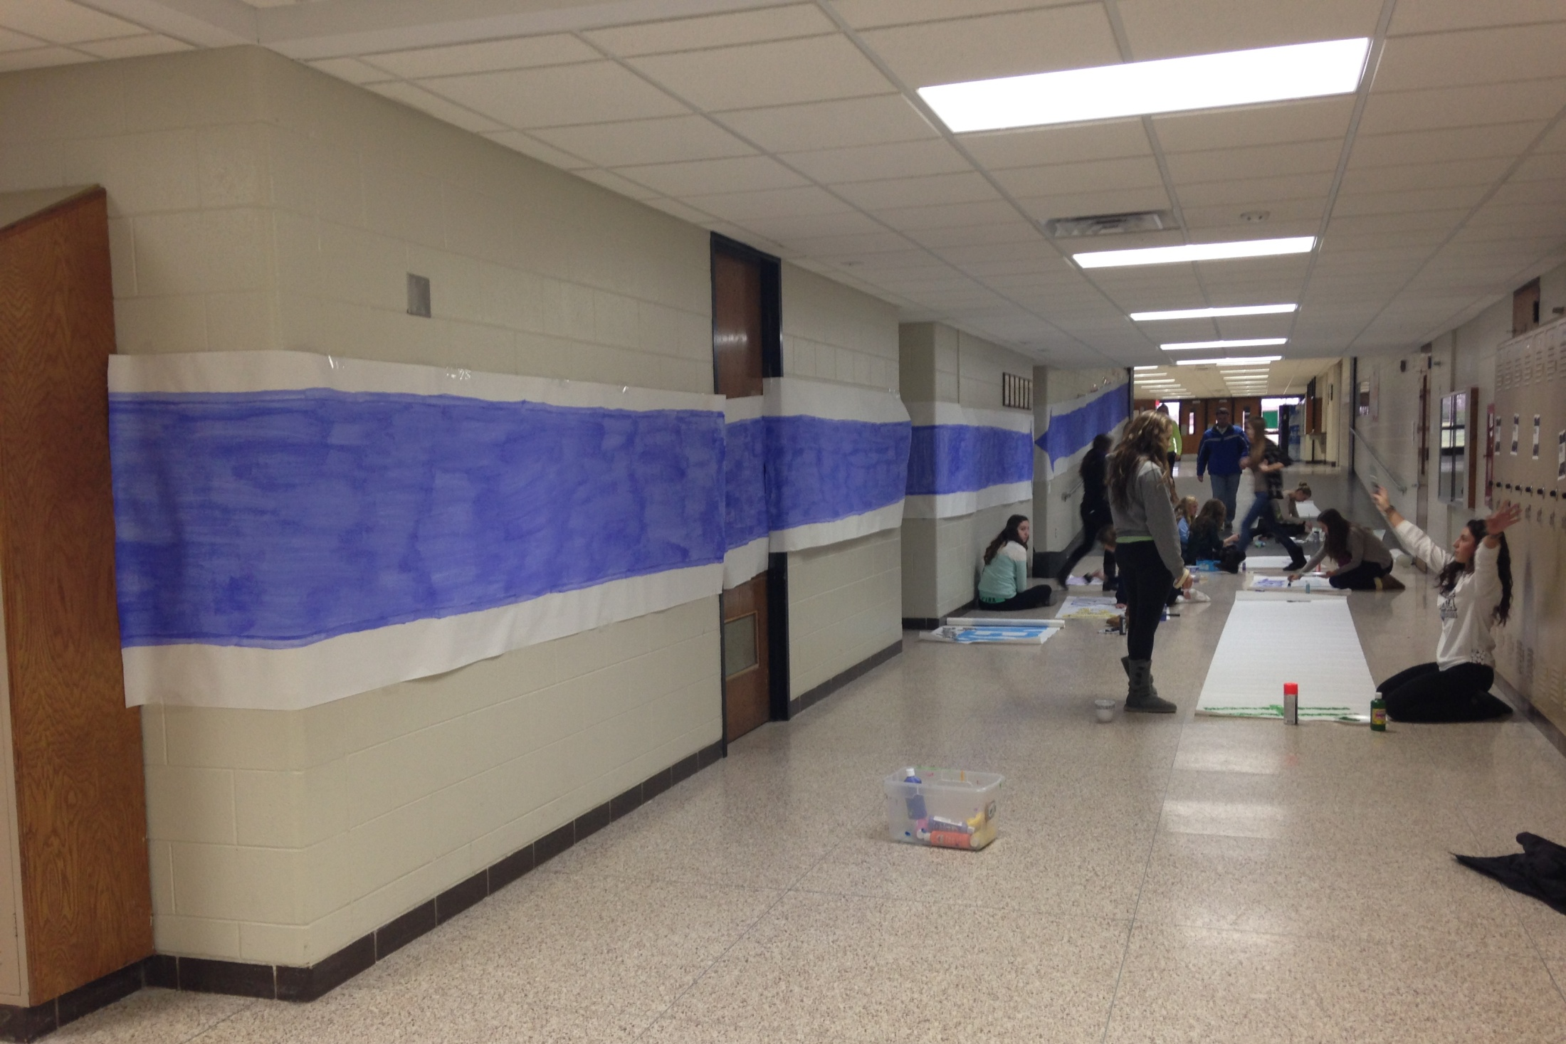

Slide 18
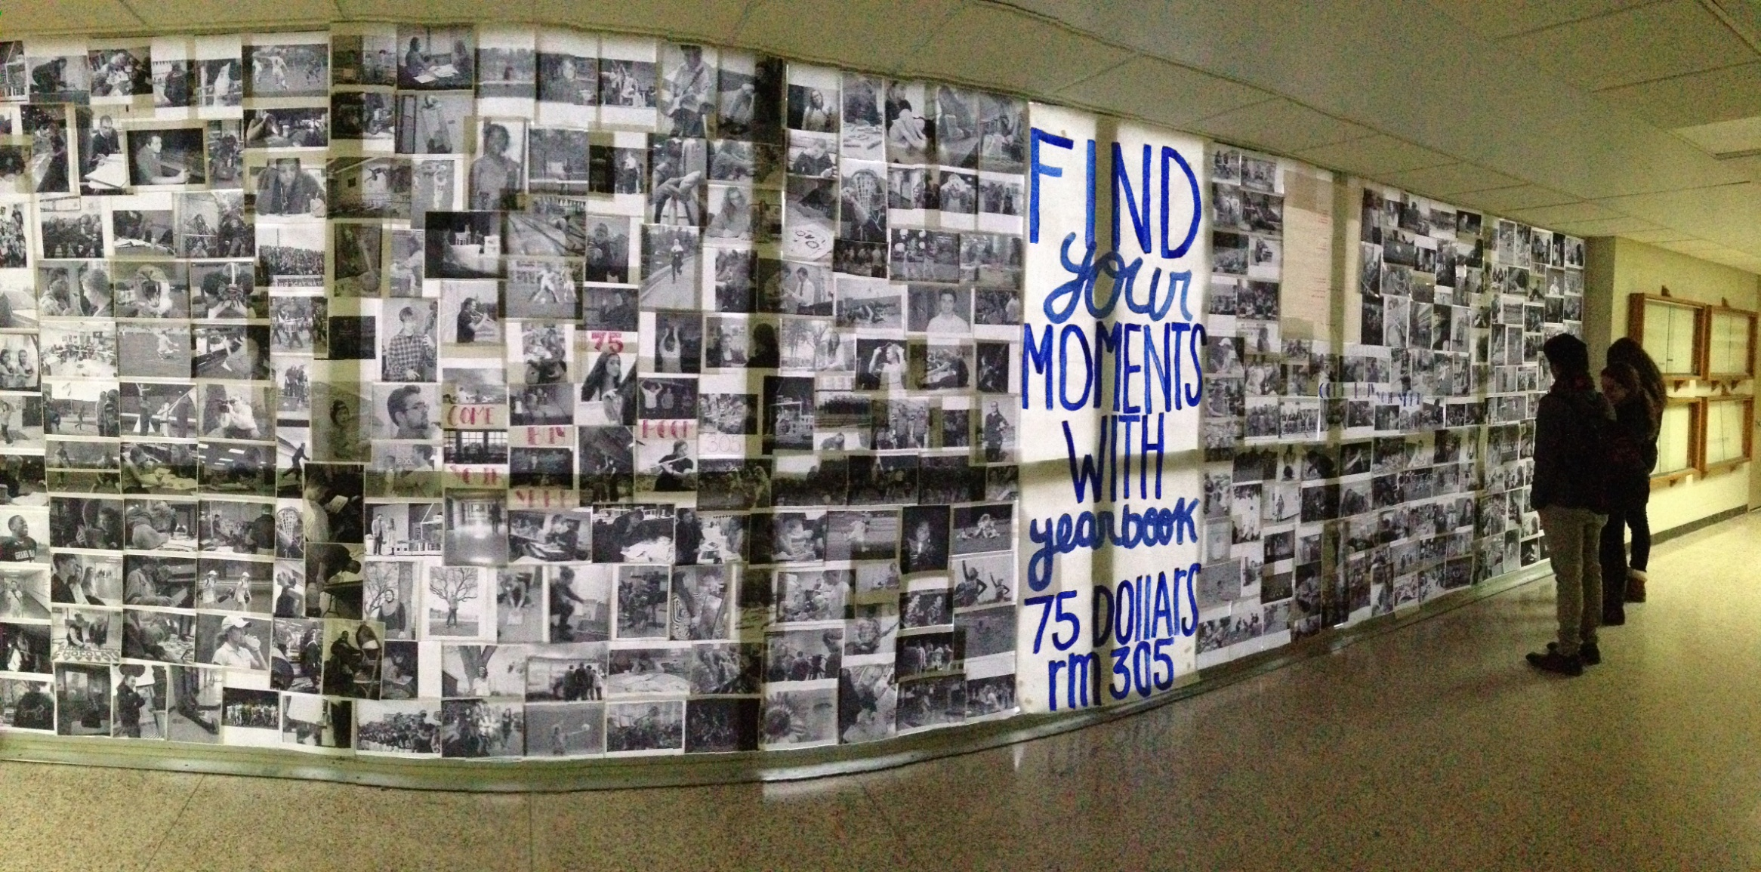
Each Staffer prints their favorite photos to be displayed for this week only

Slide 19
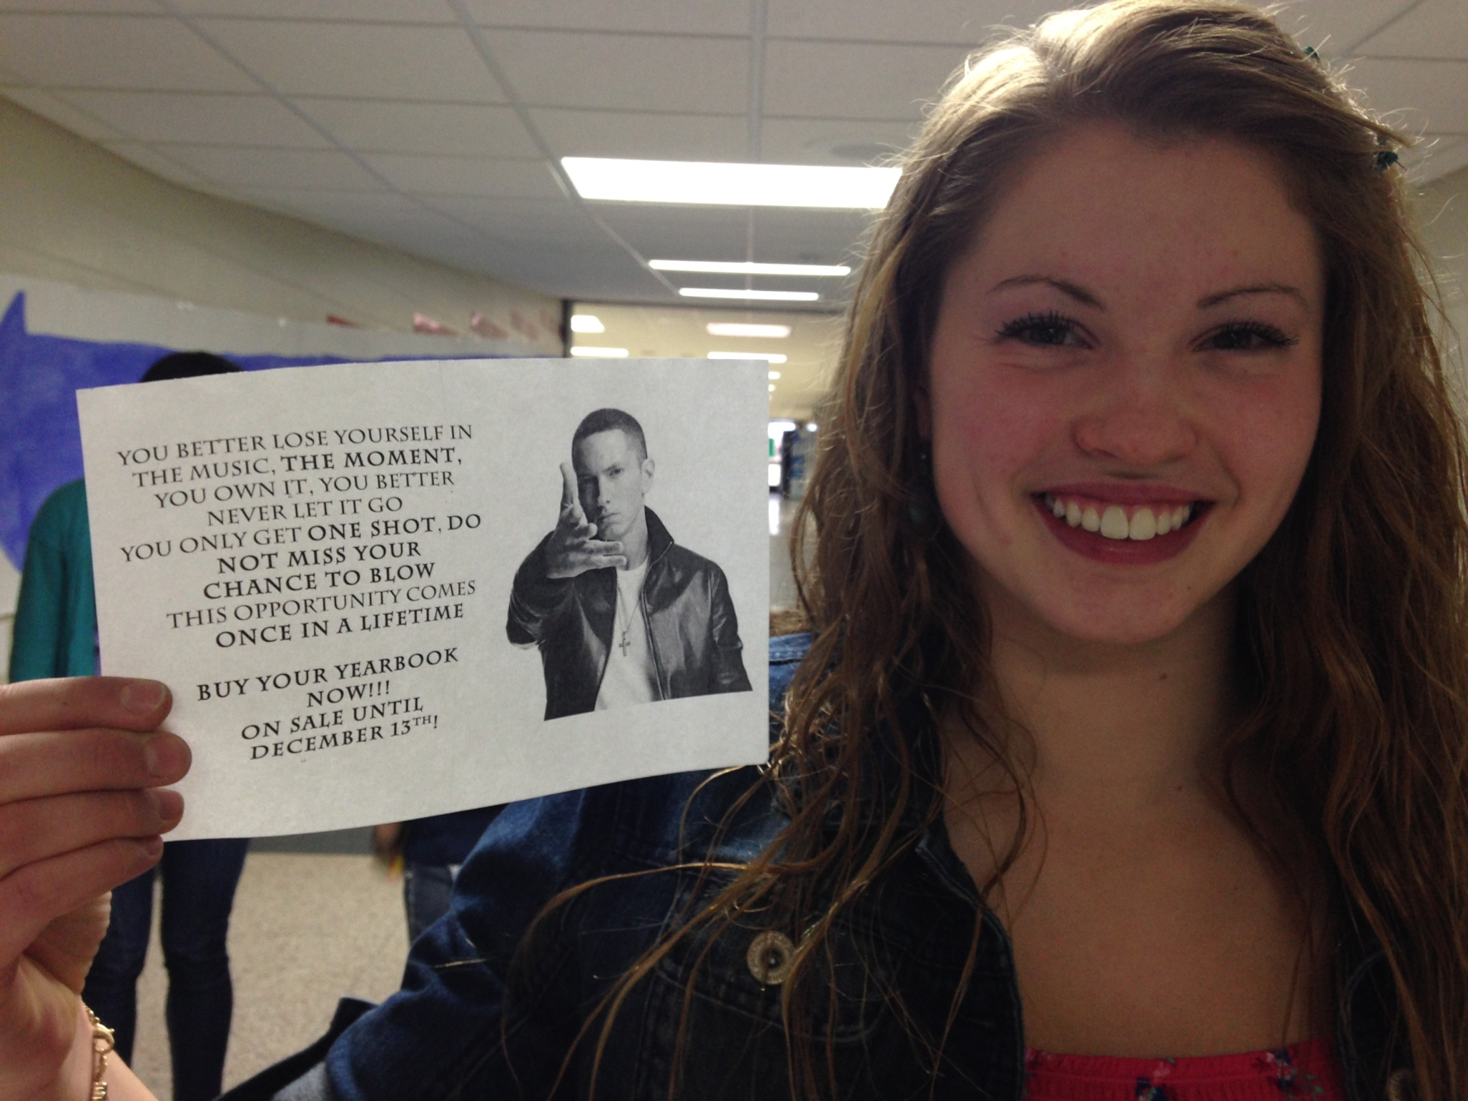

Slide 20
Flyer on every other locker at both campuses

Slide 21
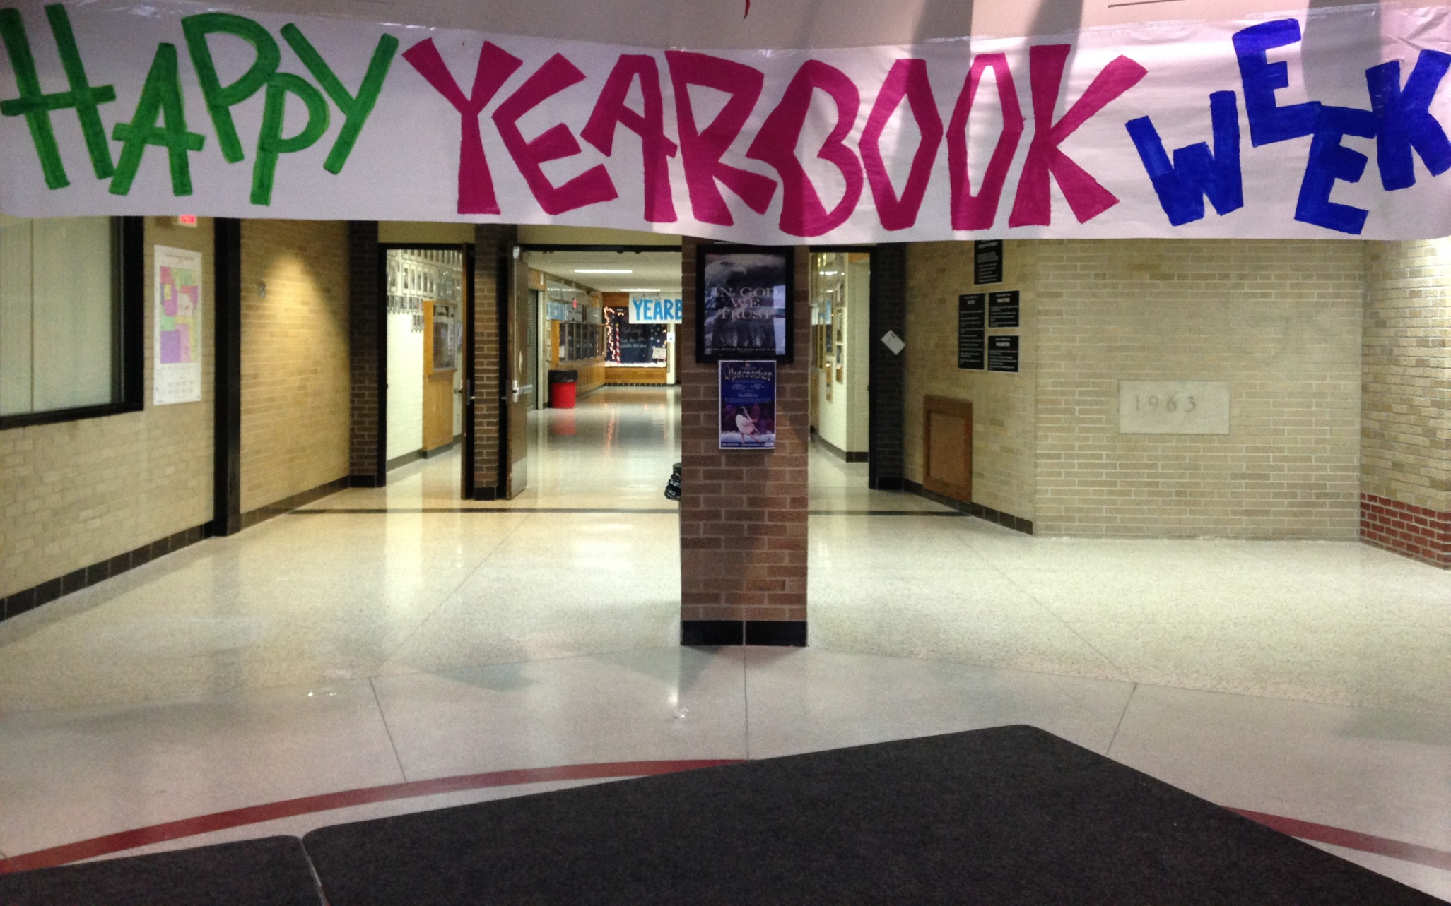
Determining Prime Locations to Display Info

Slide 22
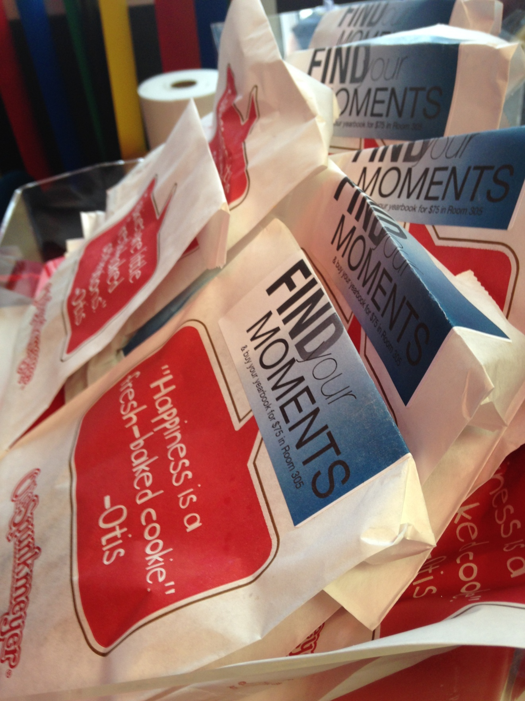
Stickers on our school’s most popular lunch item (cookies)

Slide 23
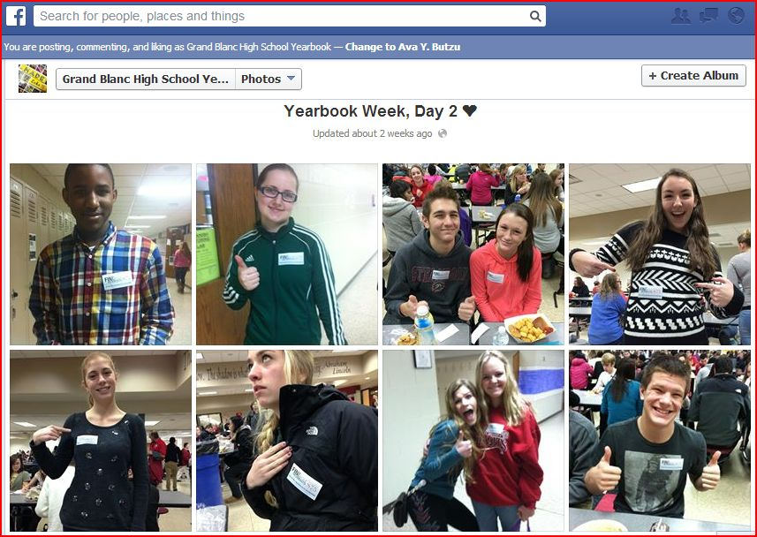
“Find Your Moments” Stickers for school community

Slide 24
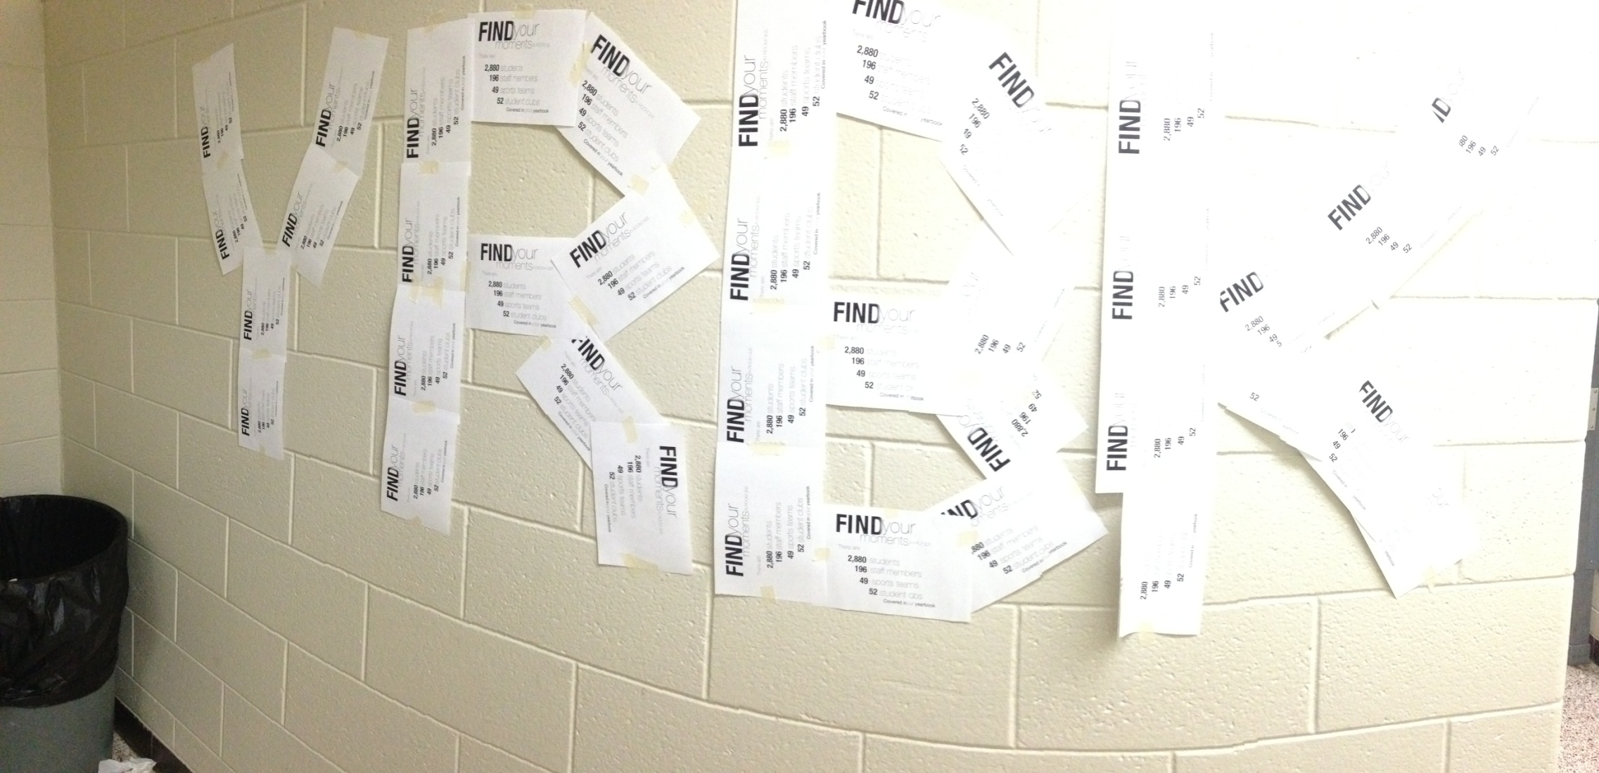
Displaying traditional flyers creatively

Slide 25
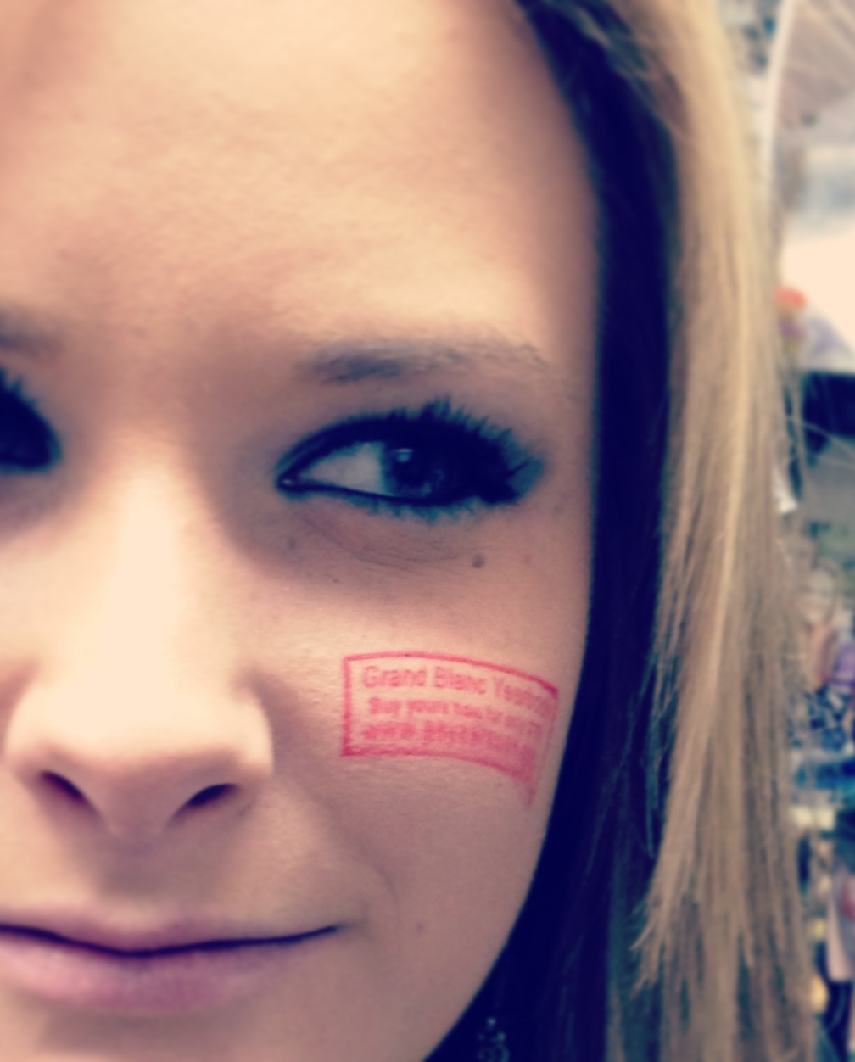
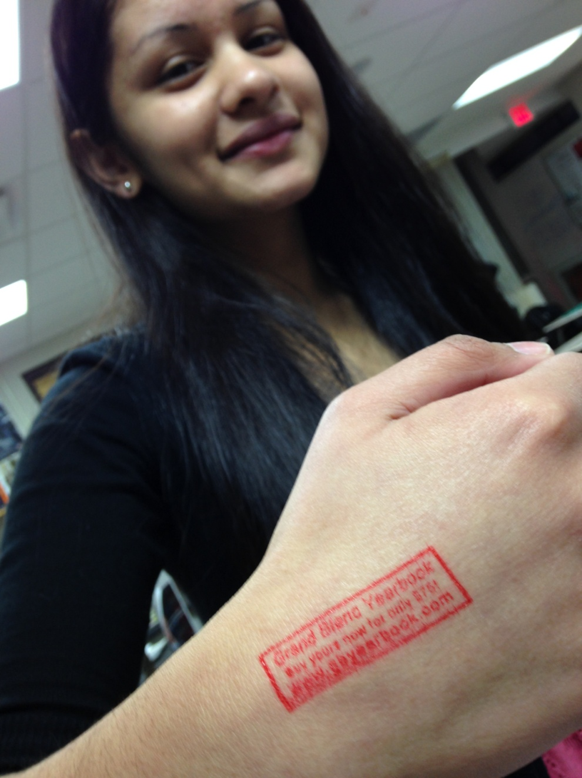
Buy your yearbook (and how) stamp

Slide 26
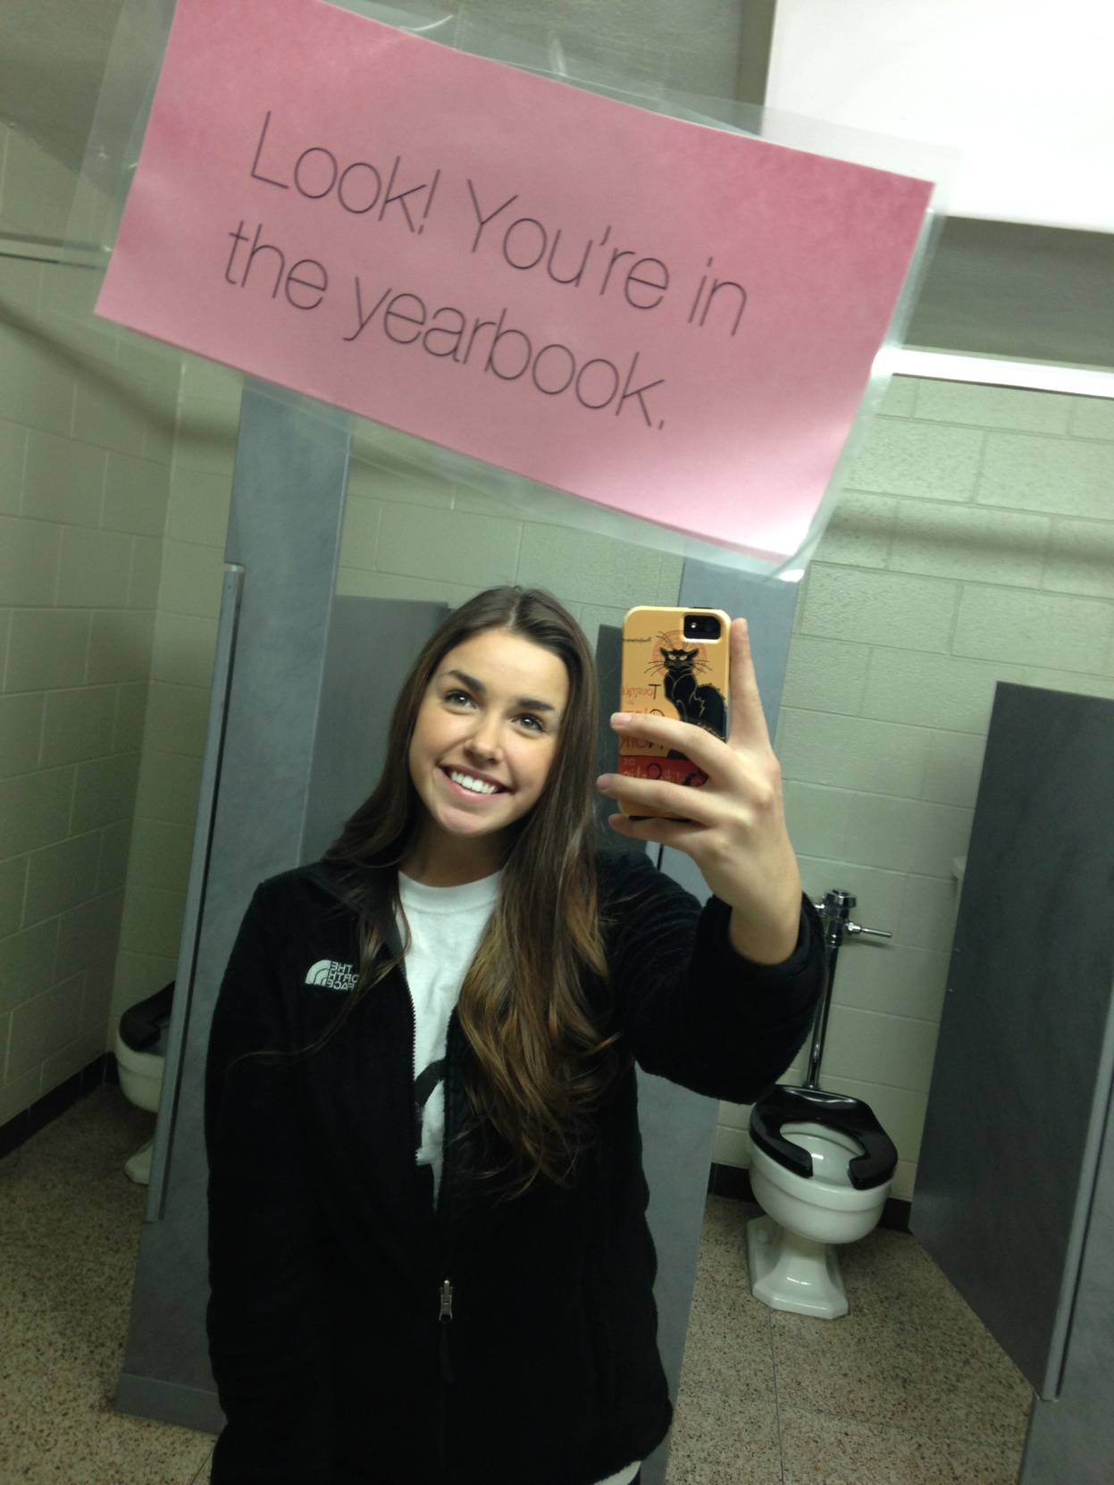
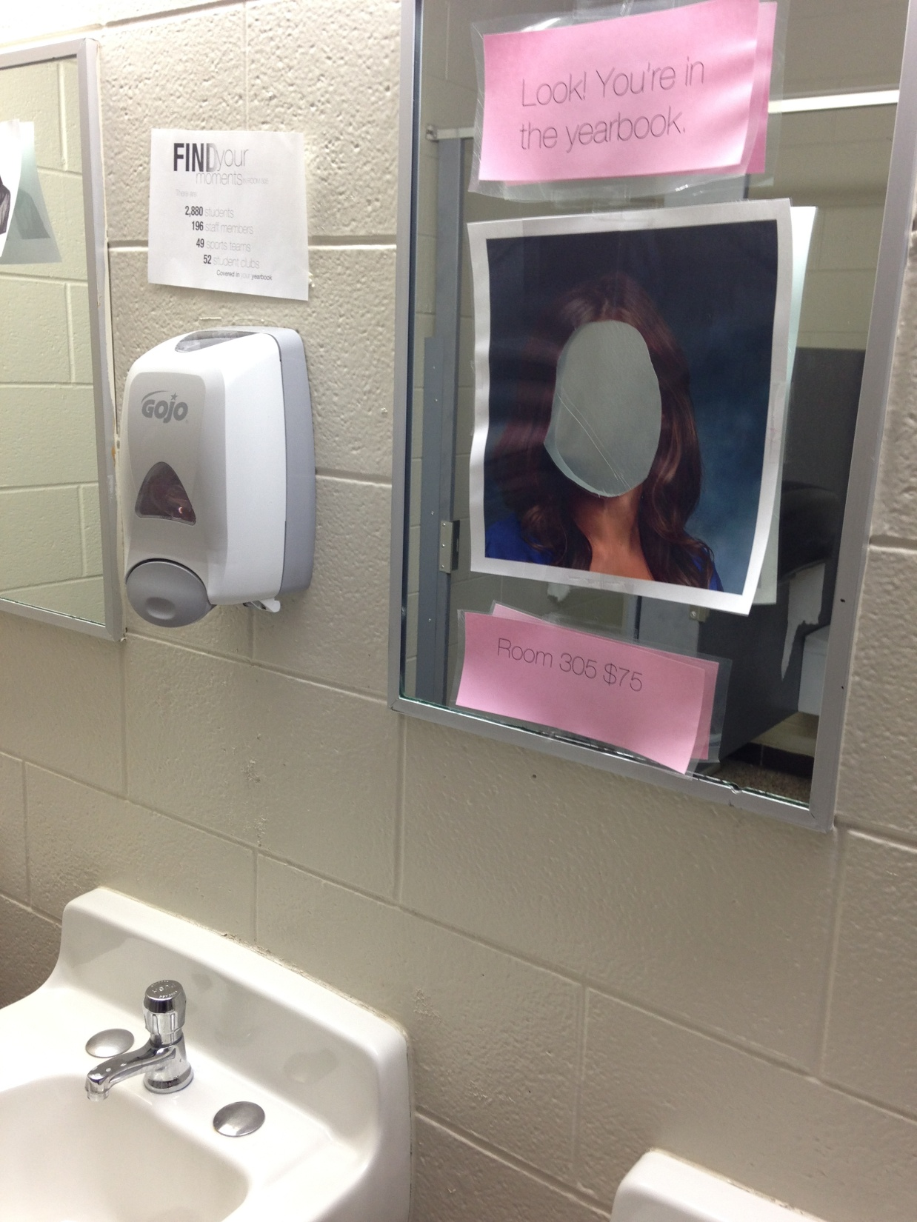

Slide 27
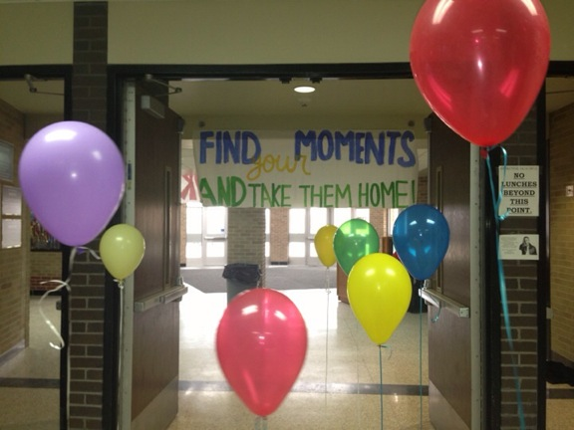
Photographs hanging from helium balloons at the main school exit at the end of the day

Slide 28
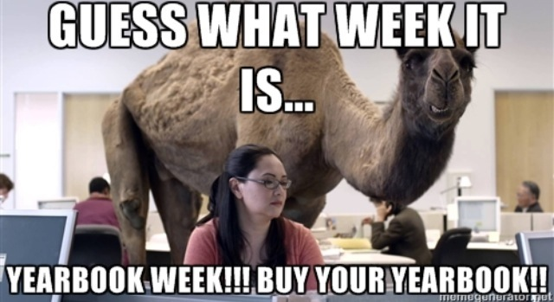
Staffers Chance their Profile Pic and Wallpaper on Social Media

Slide 30
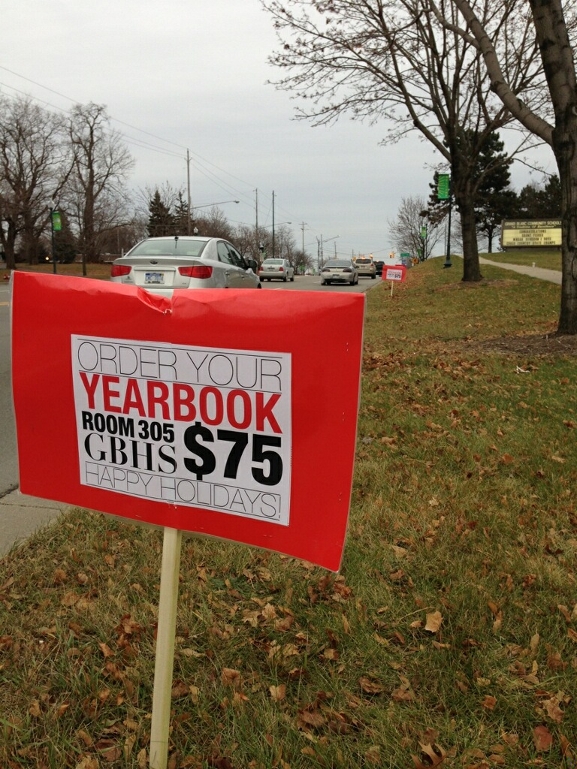
Marketing to the Greater Community

Slide 31
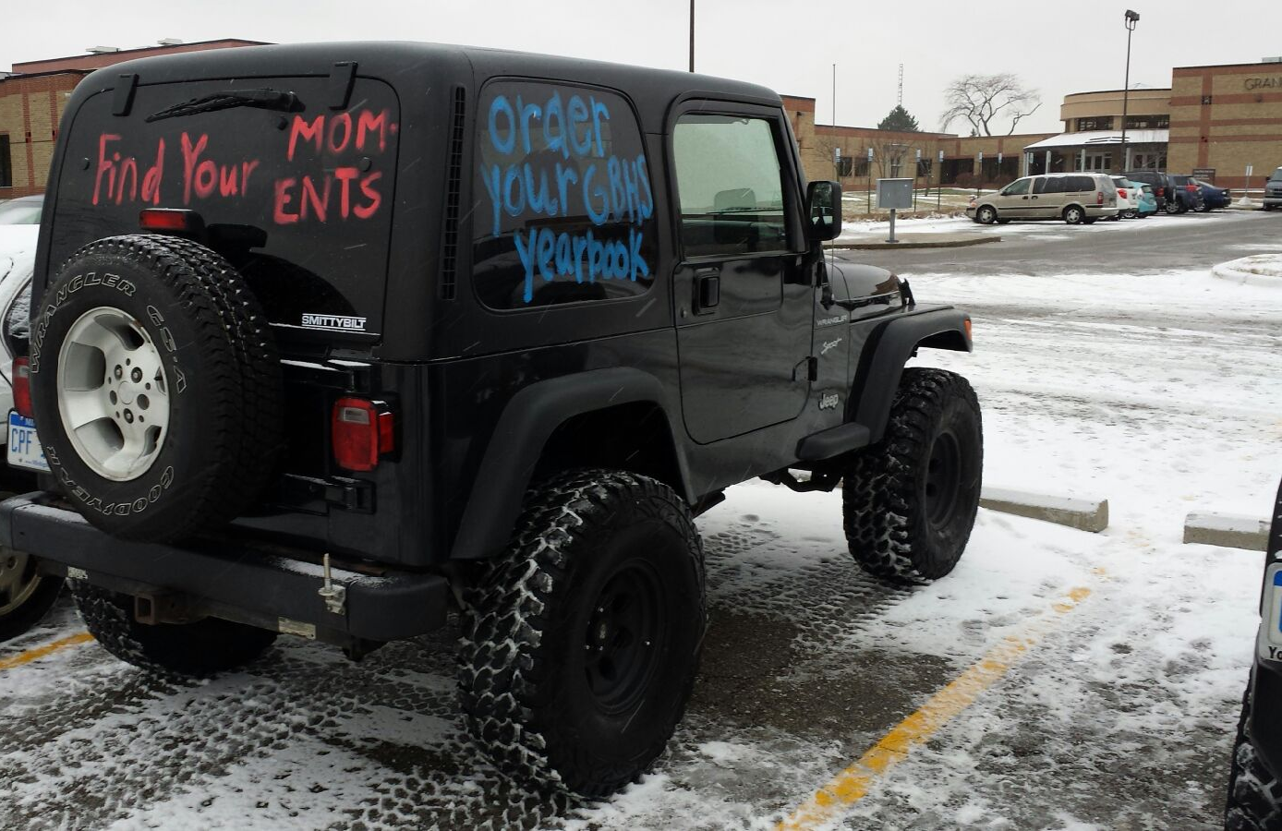

Slide 32
Yearbook Week Schedule
Monday
Wear “Find your moments” tees
Post a creative photo of yourself wearing the shirt on social media of your choice
Tuesday
Stickers
On cookies
To give to students to wear on clothes, backpacks, notebooks, etc.
Post a creative photo of yourself on social media

Slide 33
Yearook Week Schedule
Wednesday
Bookmarks
Classroom visits to distribute bookmarks and order forms
Staffers assigned to classrooms and can bring treats for them
Thursday
Ink stamps
“The Moment” Video on announcements (based on Eminem/Chrysler commercial)

Slide 34
Yearbook Week Schedule
Friday
Wear official yearbook tee shirt
Post a creative photo of yourself wearing the shirt on social media of your choice

Slide 35
Use Theme For Branding
Idea #4

Slide 36
Is your theme VERSATILE?
Is it a logical theme for
YOUR school?
Can it bend in several directions to create a buzz?

Slide 37
Grand Blanc High School’s yearbook theme from 2012:
WIRED

Slide 38
Theme previews
Posters
(unique places, unique features)
Sidewalk chalk
Window paint
Can it bend in several directions to create a buzz?

Slide 39
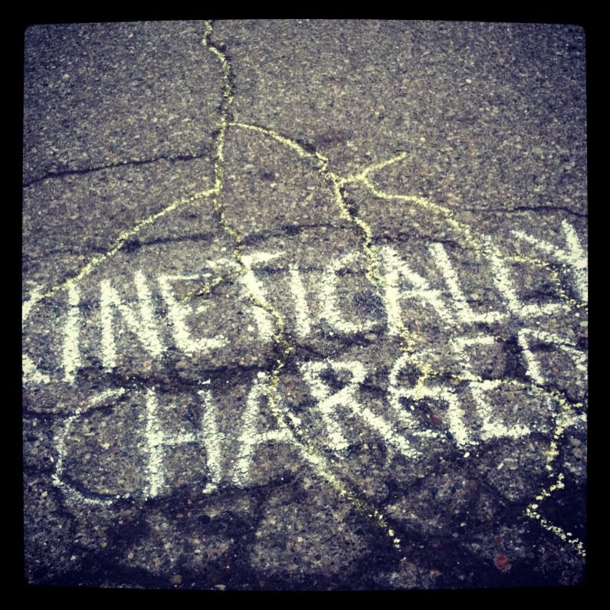
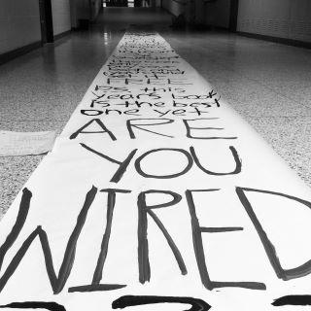
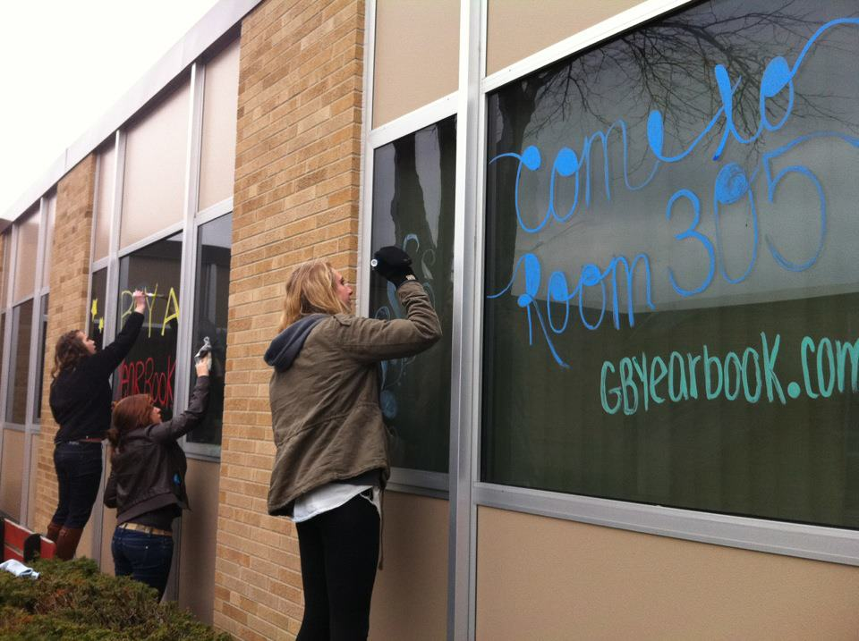
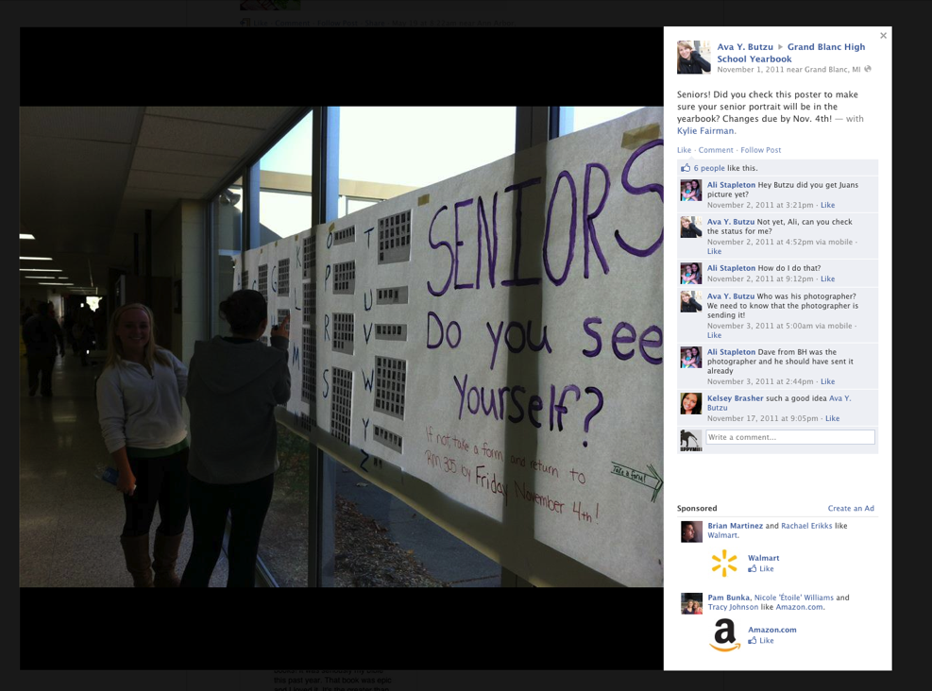
in school campaign
GRAND BLANC
Notes:
The staff found every unique opportunity to reinforce the notion that they were always around and always working on the yearbook.

Slide 40
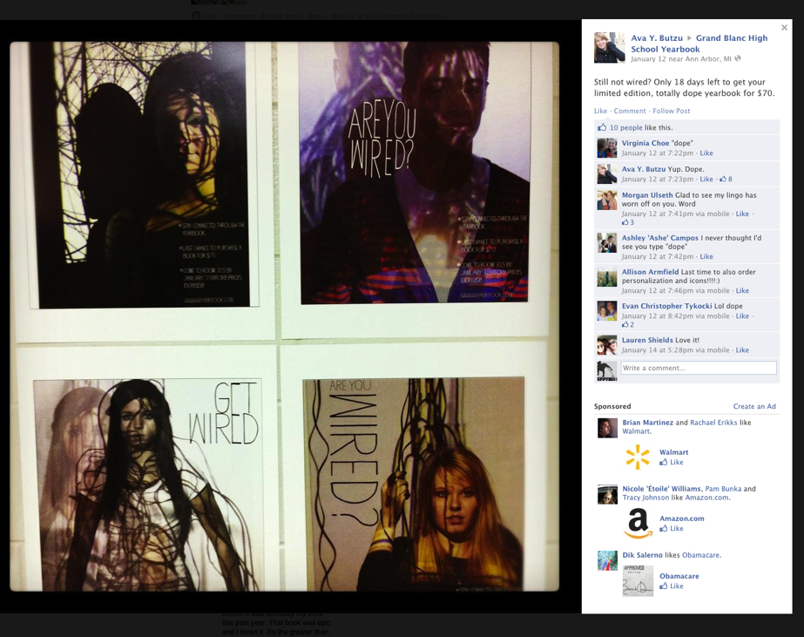

Slide 41
Grand Blanc High School’s yearbook theme from 2013:
MADE

Slide 42
The staff invited students at the school to submit their own photos and featured user content throughout the yearbook

Slide 43
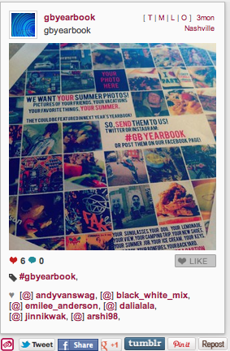

Slide 44
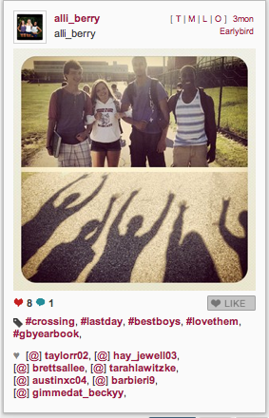
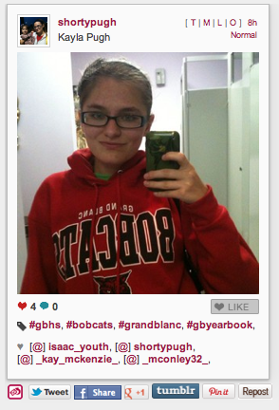

Slide 45
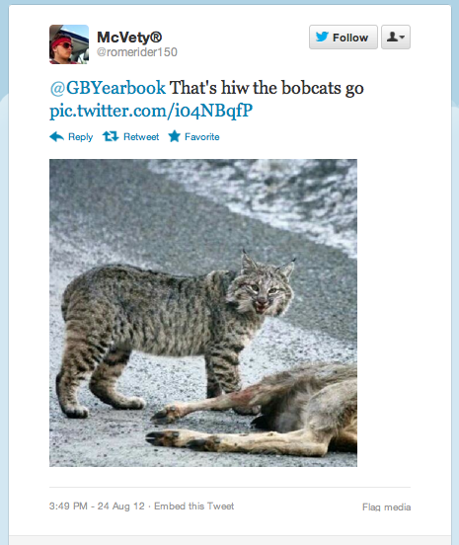
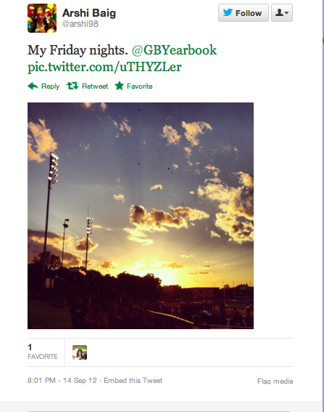

Slide 46
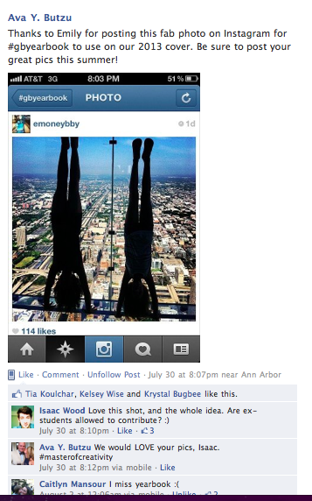
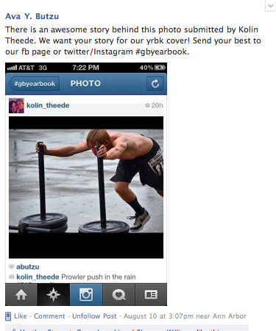
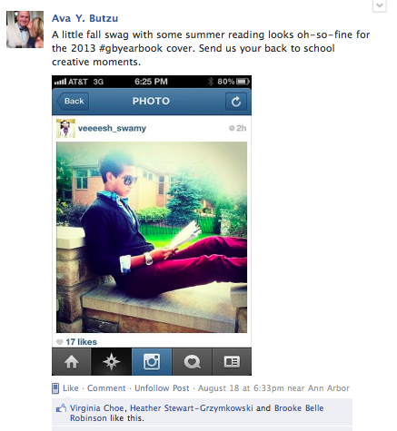
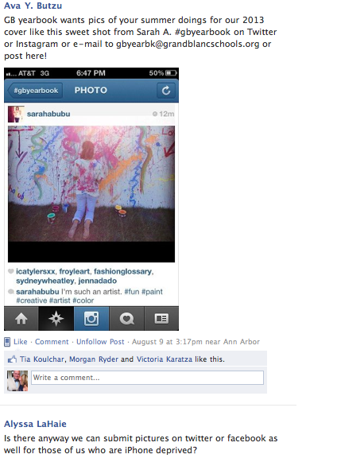
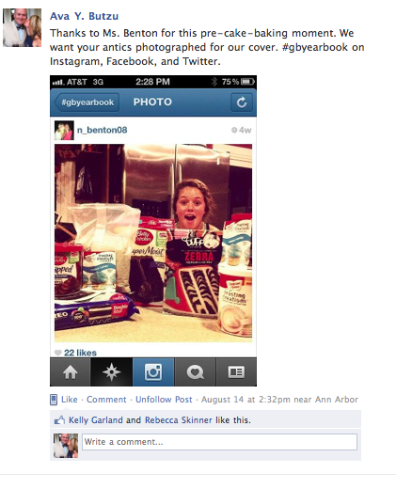

Slide 47
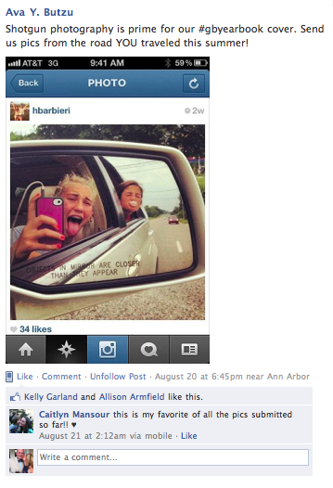
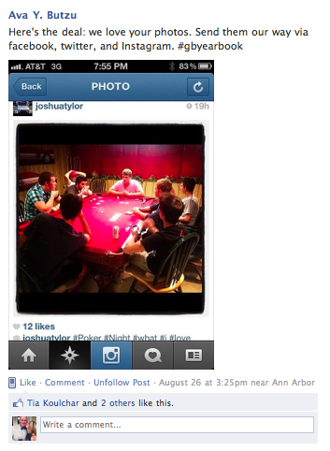
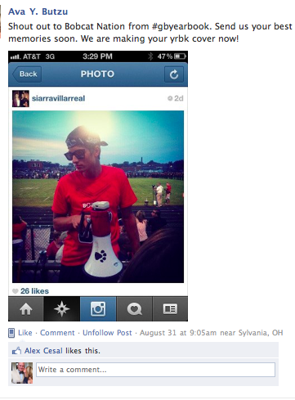
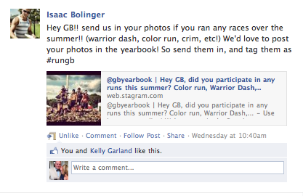

Slide 48
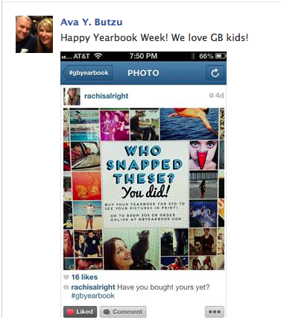

Slide 49
Create a Yearbook Mascot
Idea #5

Slide 50
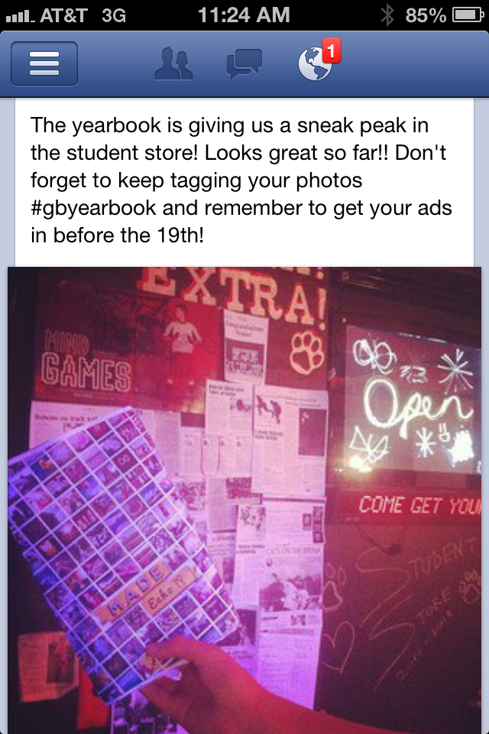
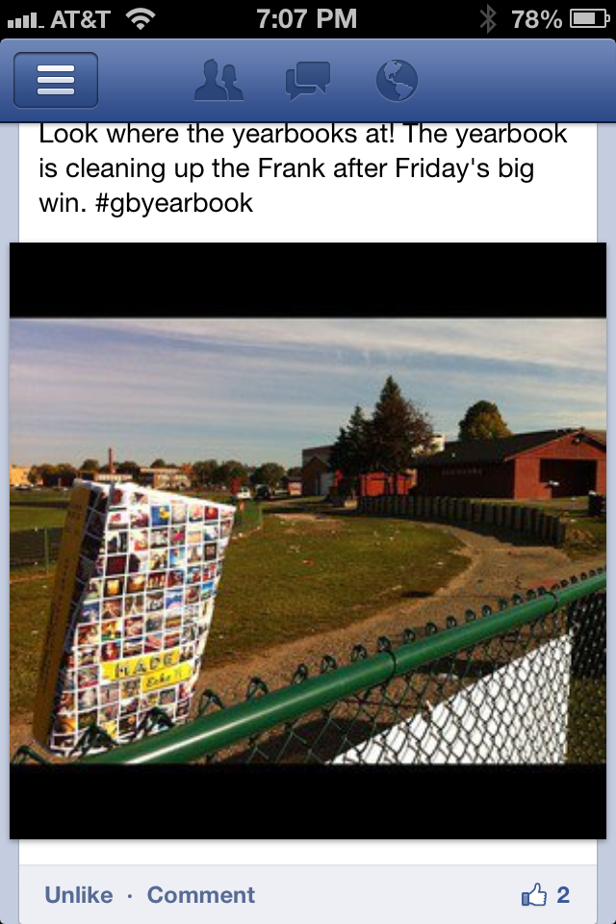

Slide 51
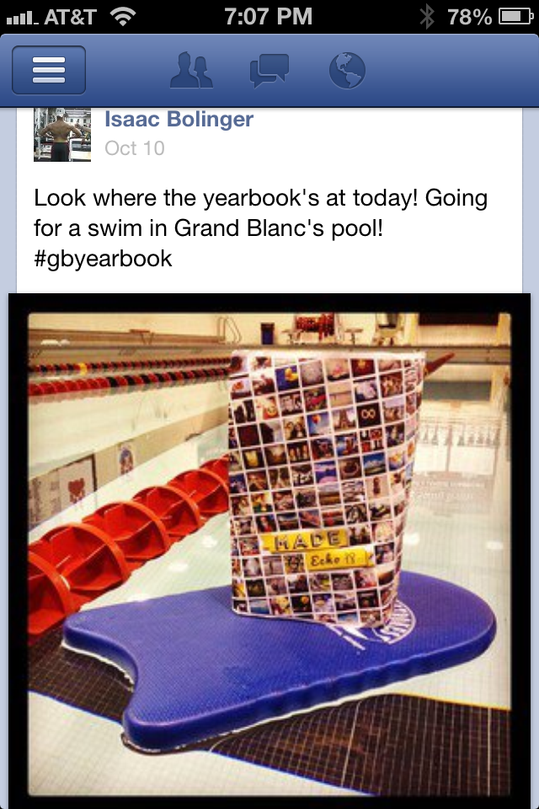
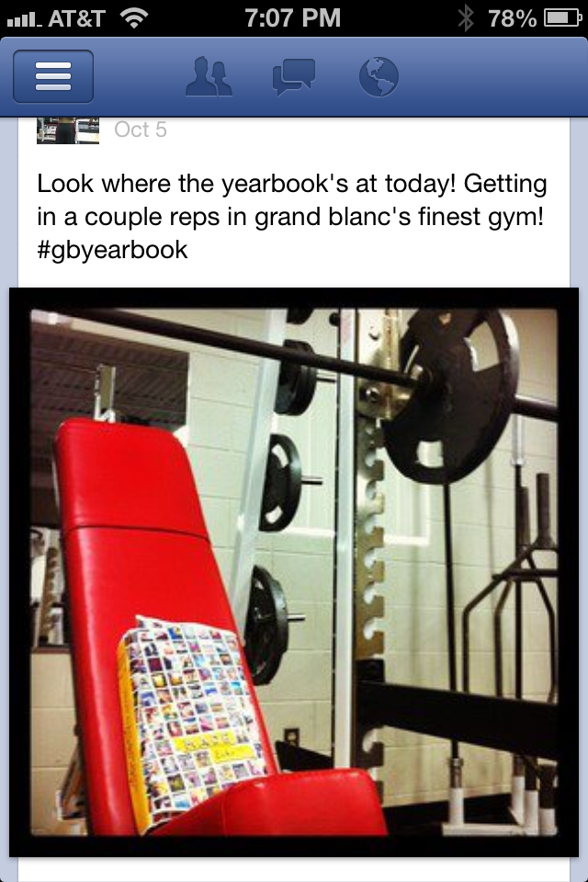

Slide 52
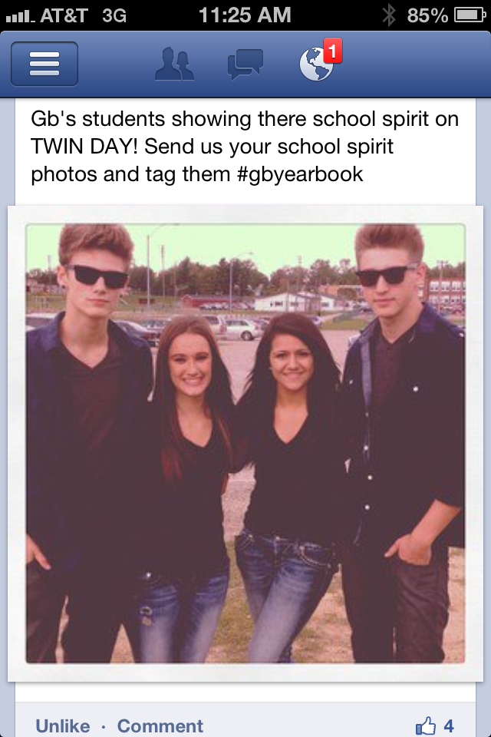
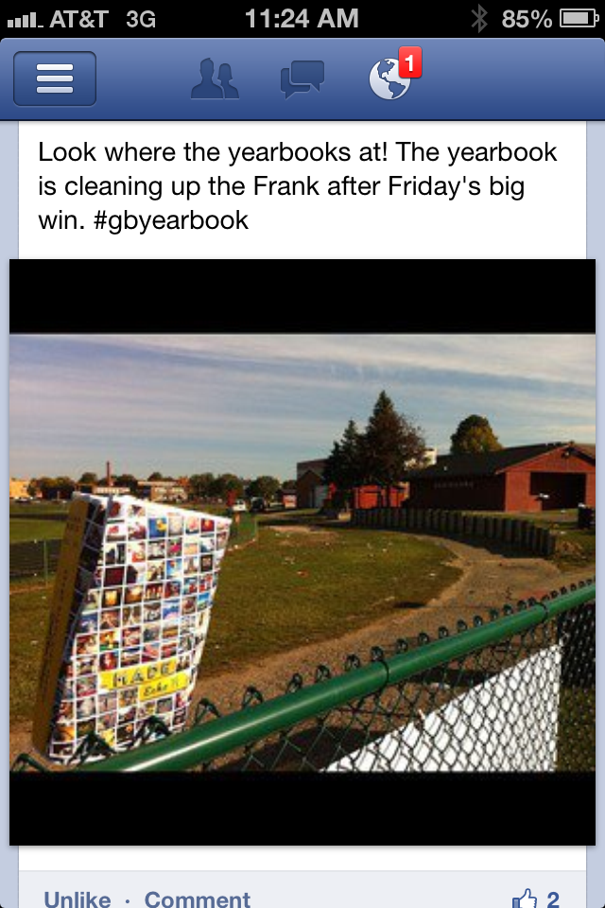
their

Slide 54
Reveal the Cover
Idea #6

Slide 57
Interview Business Card
Idea #7
Given to students after interviews, showcasing ways to be involved with the yearbook

Slide 58
Interview Business Card

Slide 59
Solicit Content Ideas
Idea #8

Slide 63
Give students the chance to speak about what matters to them, not just to you.

