Slide 1
Selling Yearbooks
Entrepreneurship
Attribution: Adviser Sarah Nichols of Whitney High School contributed photos to this slideshow

Slide 2
Warm Up
How is a physical yearbook still relevant and necessary for today’s high school students living in a user-generated content and media-saturated environment?

Slide 3
Increase Demand
Your job is to show your audience that a yearbook is a necessary and useful product

Slide 4
Increase Demand
Your job is to show your audience that a yearbook is a necessary and useful product
Why?
Competition includes social media and other types of user-generated content (e.g. blogs, smartphones, apps that consolidate content from multiple sources)

Slide 5
Increase Demand
Your job is to show your audience that a yearbook is a necessary and useful product
How?
A yearbook is beneficial because it packages content to tell a story
The longevity of social media platforms is uncertain
No single student can capture everything that happens

Slide 6
Increase Demand
Your job is to show your audience that a yearbook is a necessary and useful product
How?
Your social network is limited to those with whom you are closest
Most electronic yearbook opportunities are not well-developed yet

Slide 7
Timelines
Provide multiple opportunities for your audience to buy the book

Slide 8
Timelines
Provide multiple opportunities for your audience to buy the book
Why?
Families will be able to buy yearbooks at different times due to varying circumstances
Keep a buzz going about the yearbook all the time

Slide 9
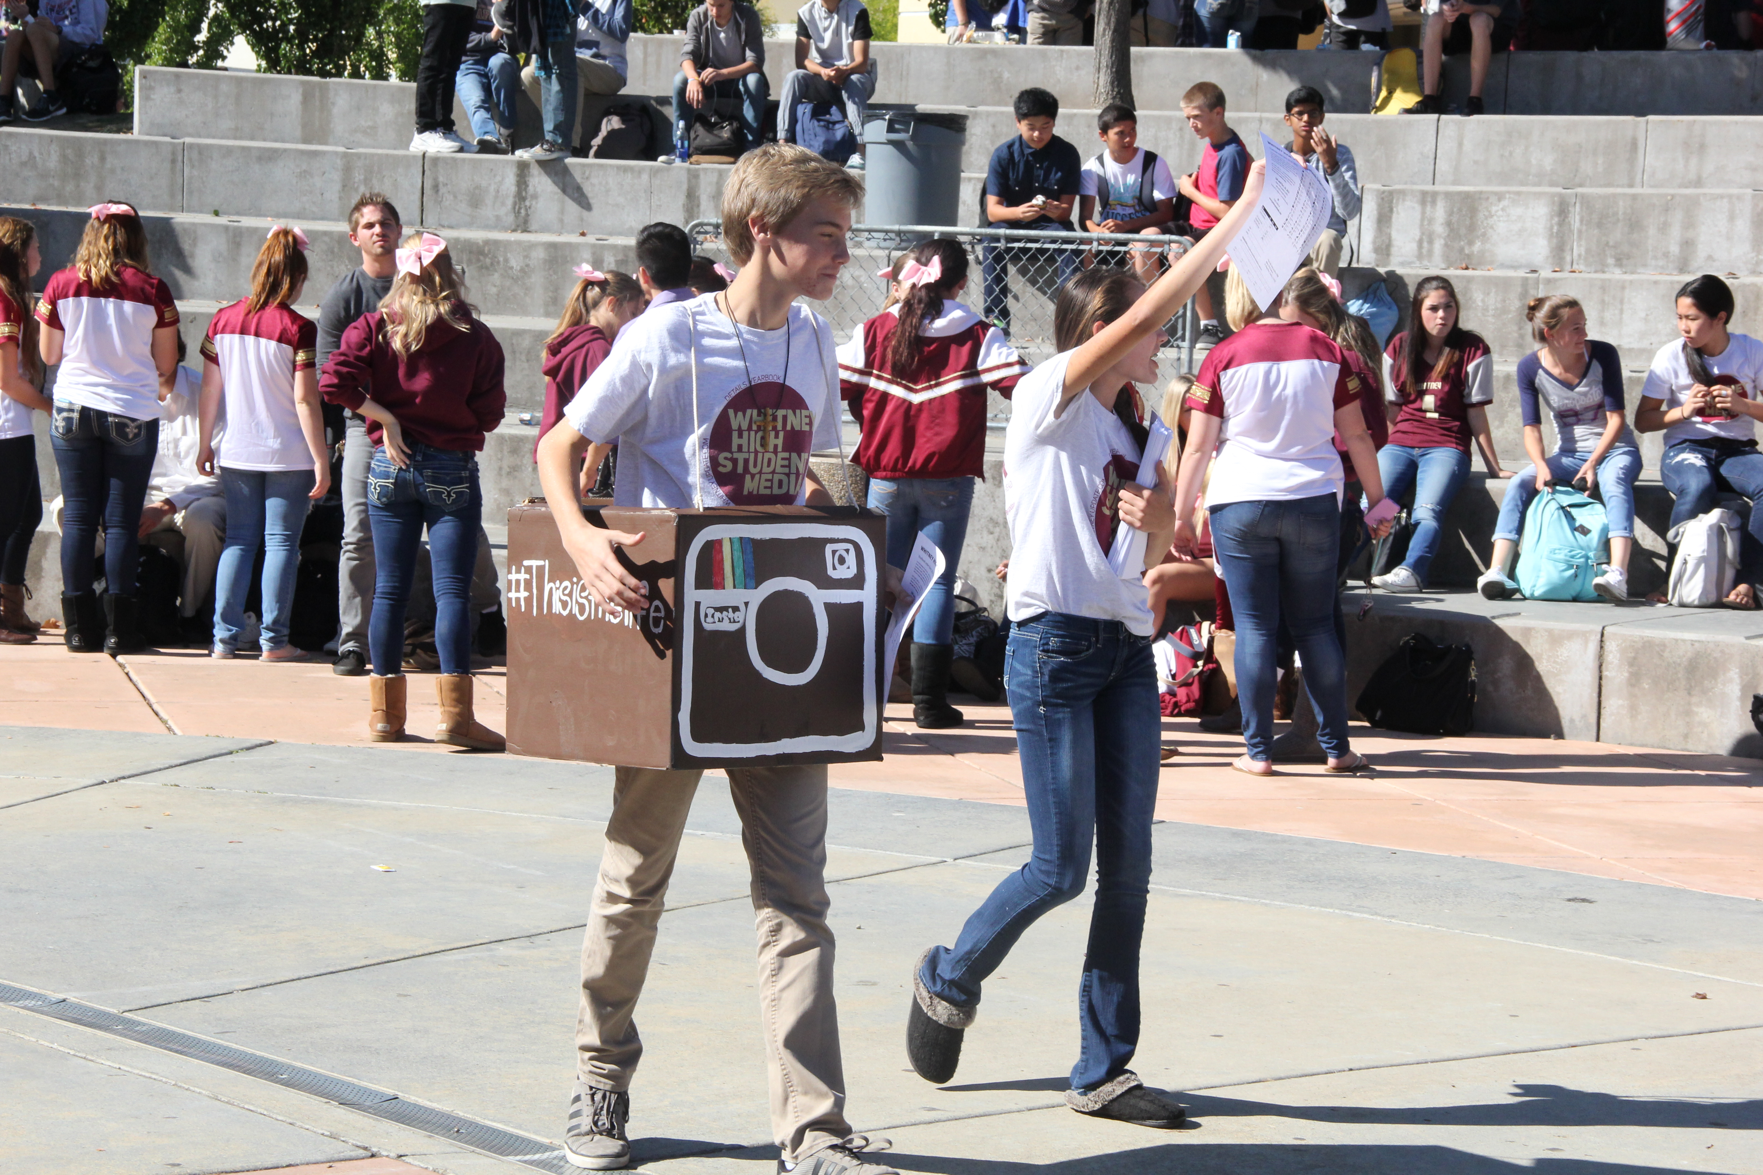
Hold a sales event for buyers at a time when many students will be able to attend

Slide 10
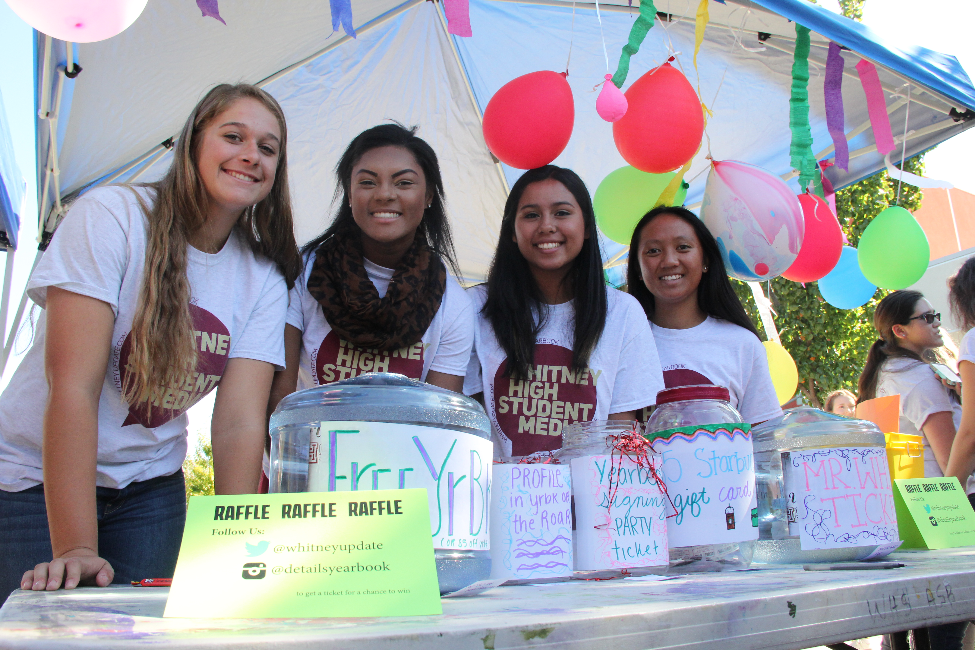
Offer items for raffle such as a free yearbook, gift cards, or parking passes

Slide 11
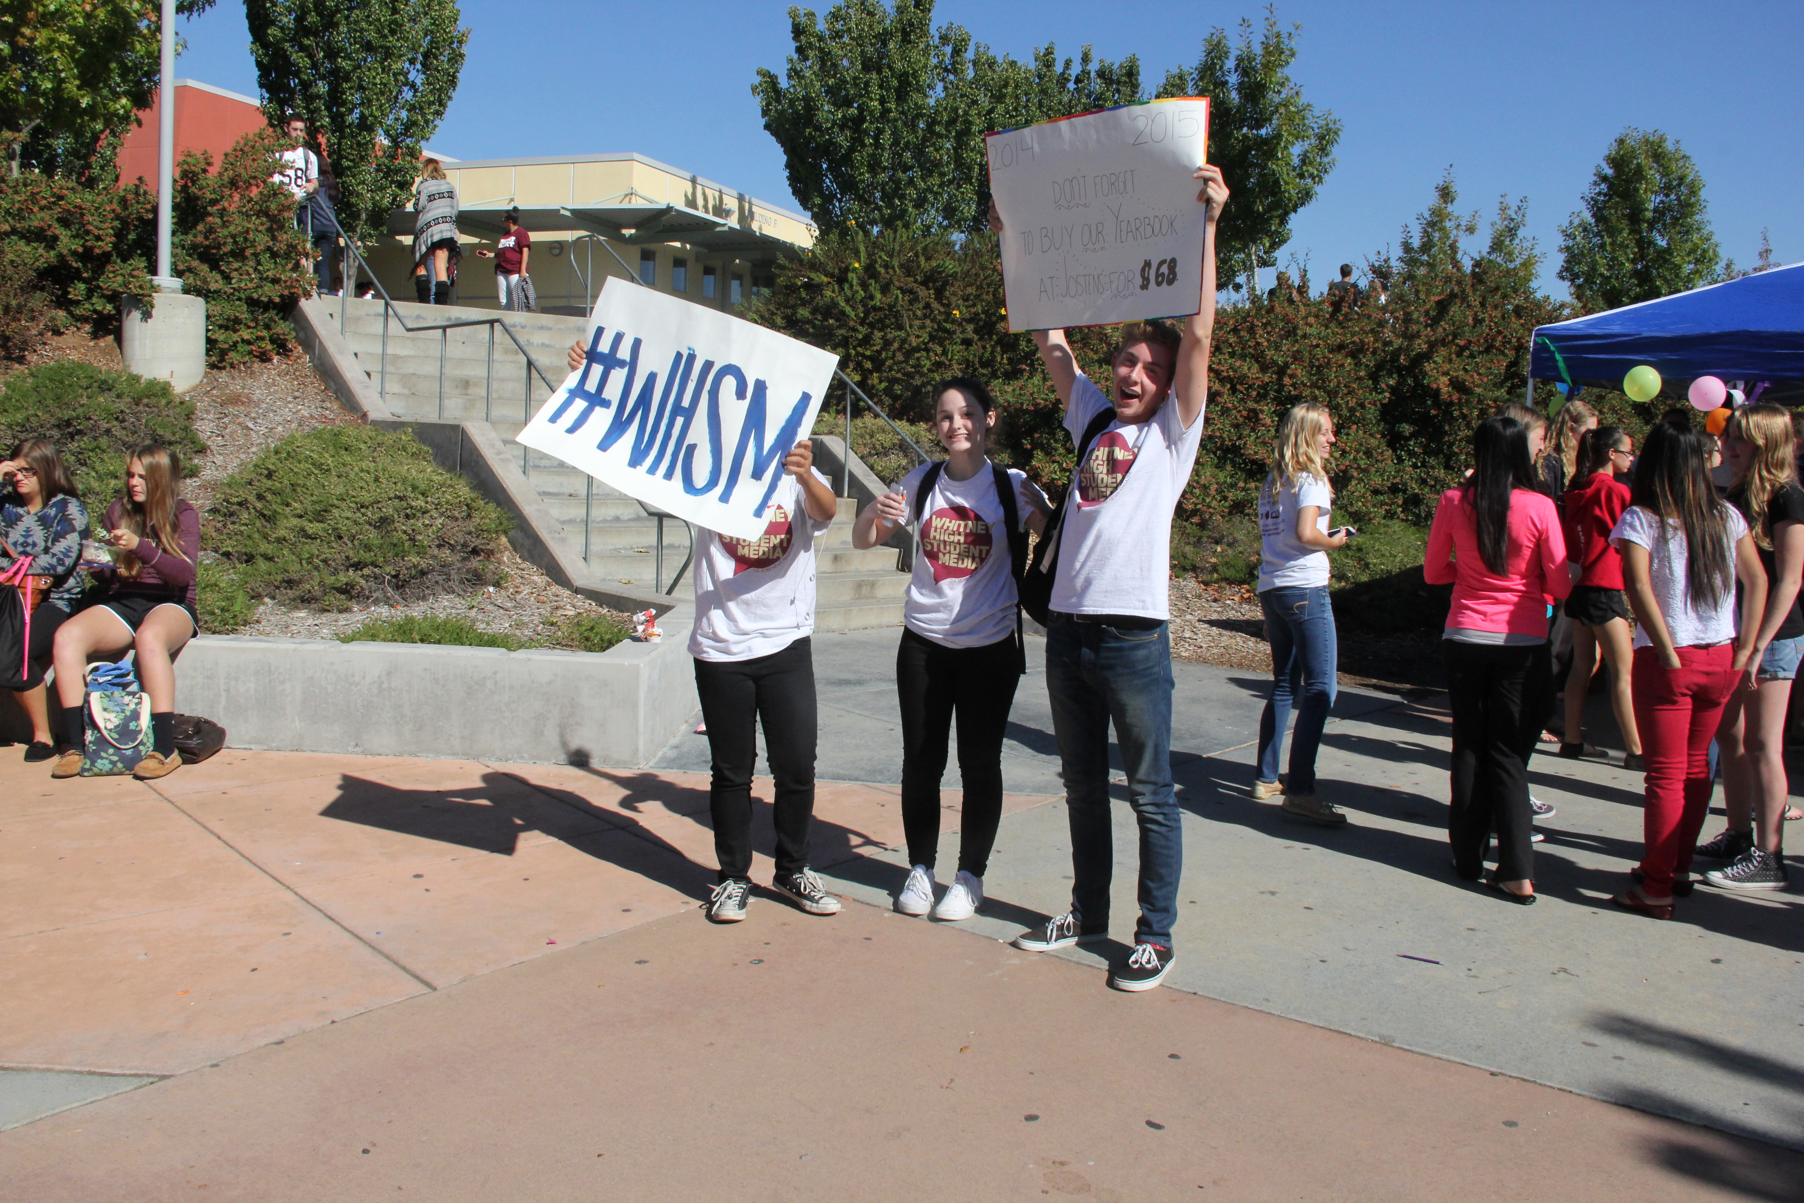
Have staff members with signs to remind students to purchase the book

Slide 12
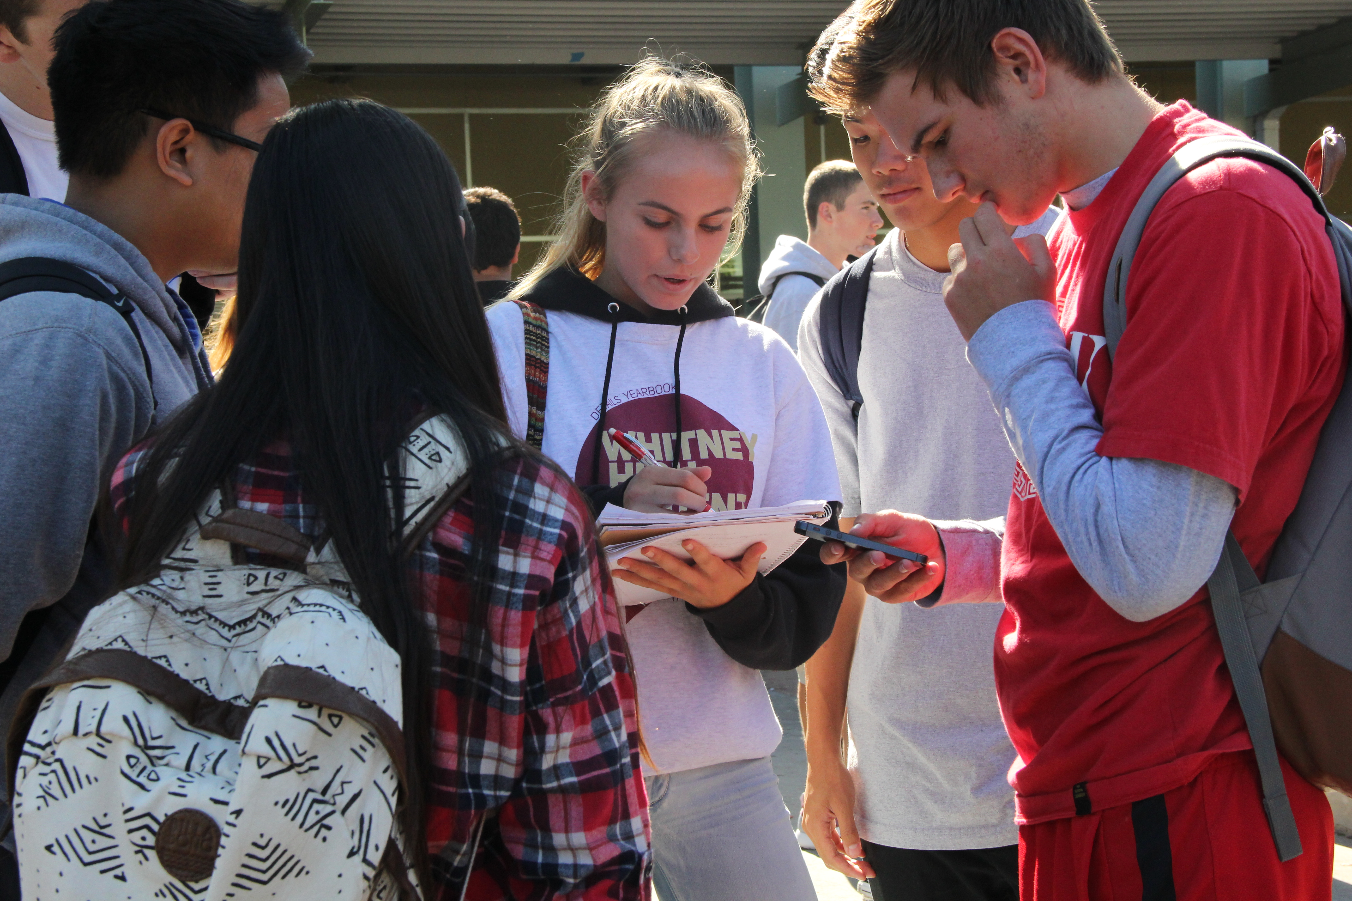
Staff members can conduct interviews during the event

Slide 13
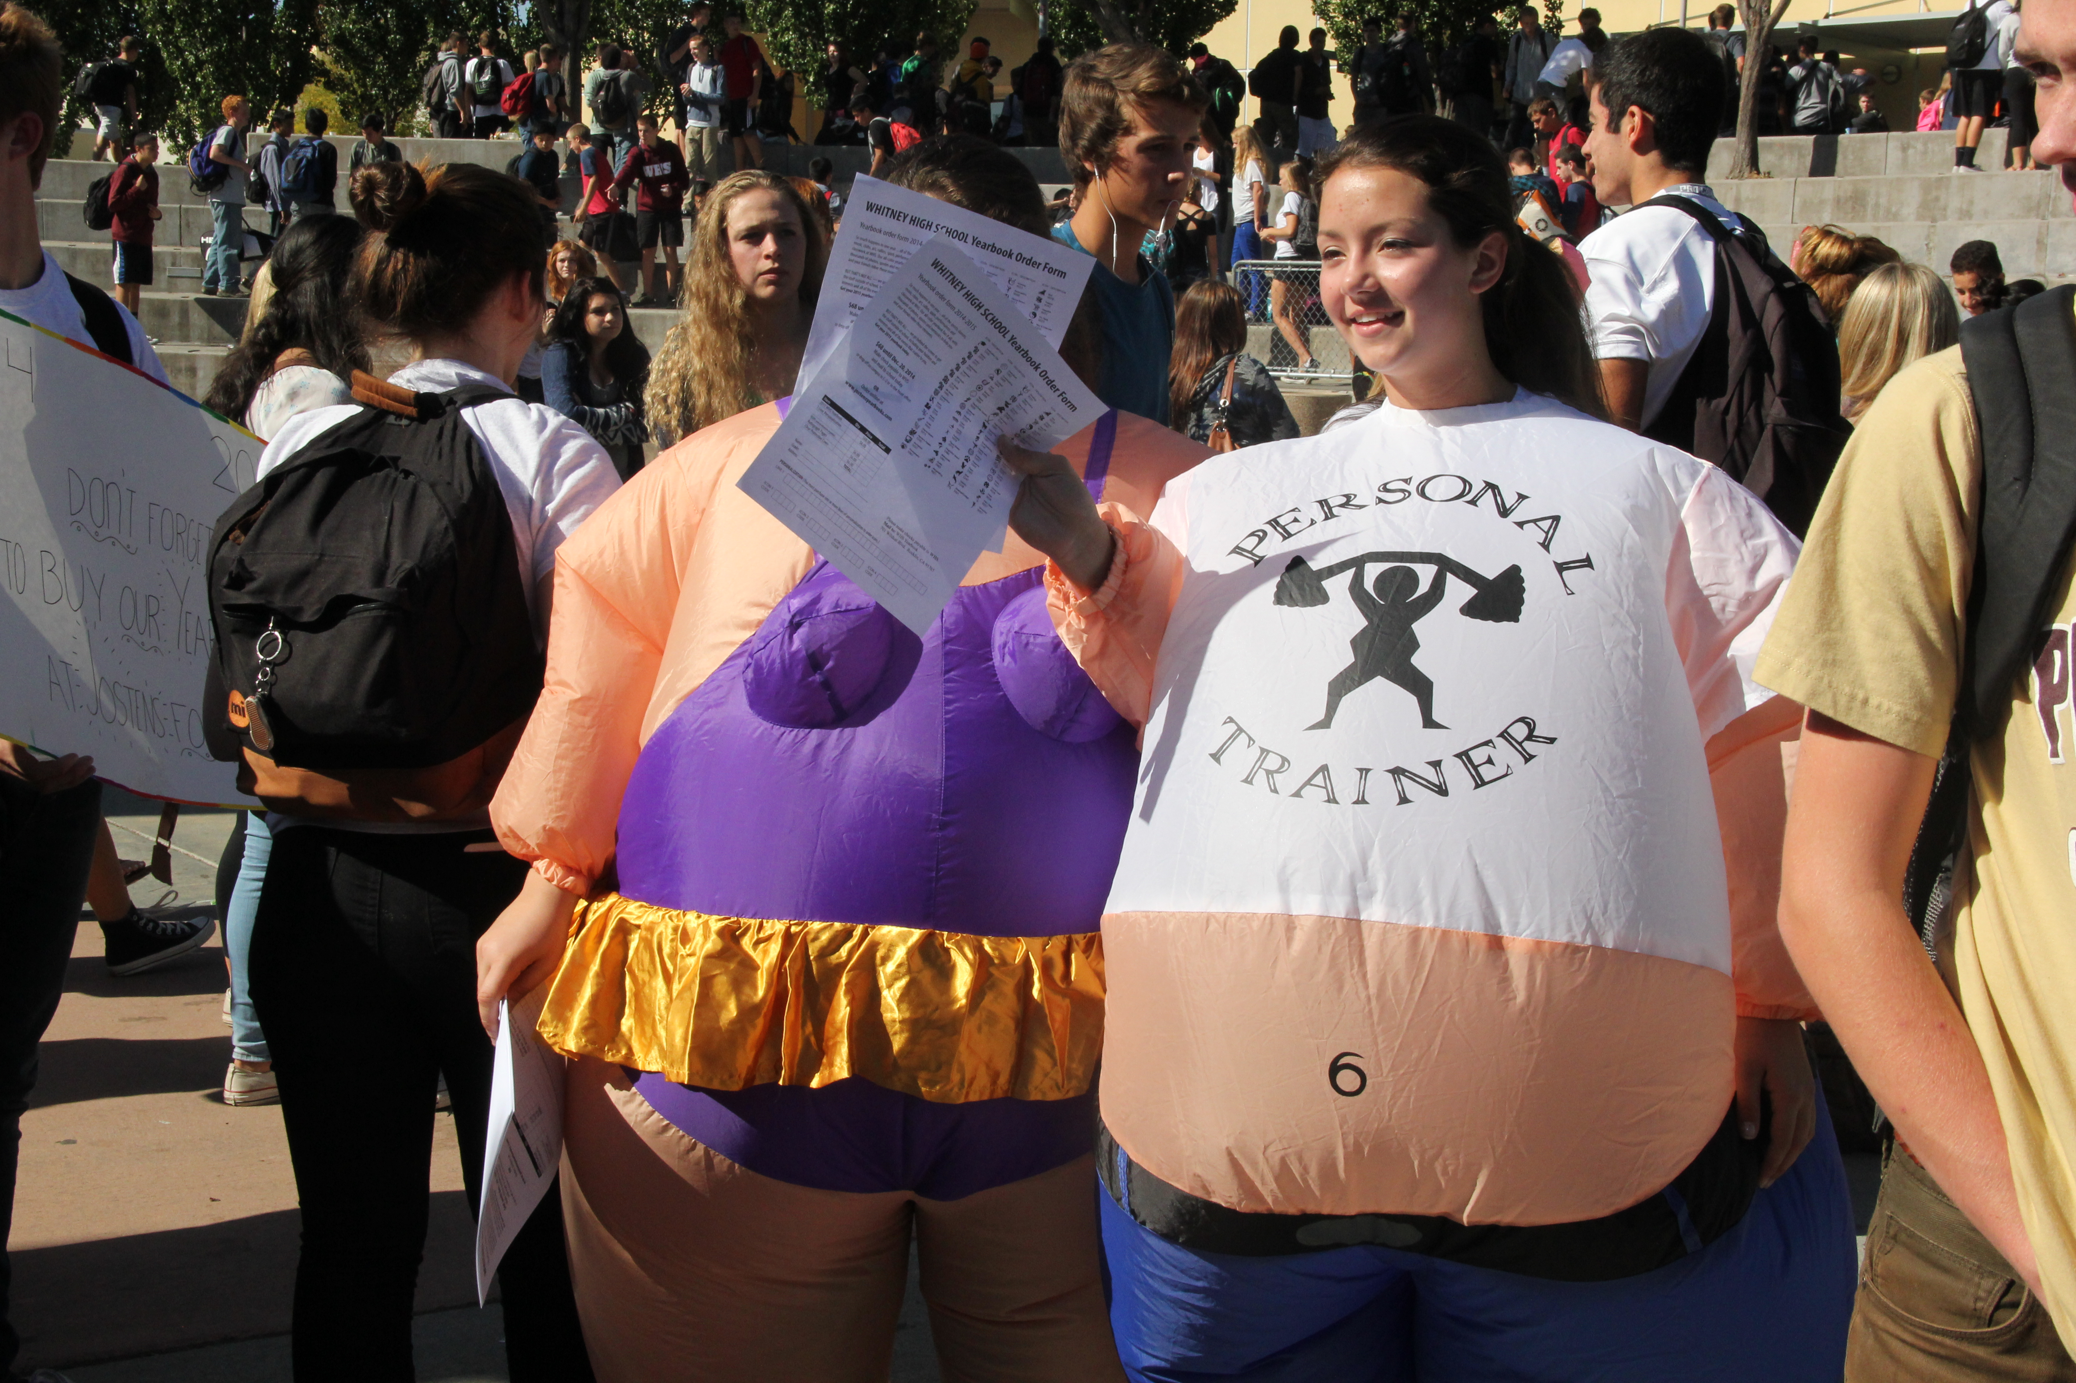
Have staff members on hand with order forms

Slide 14
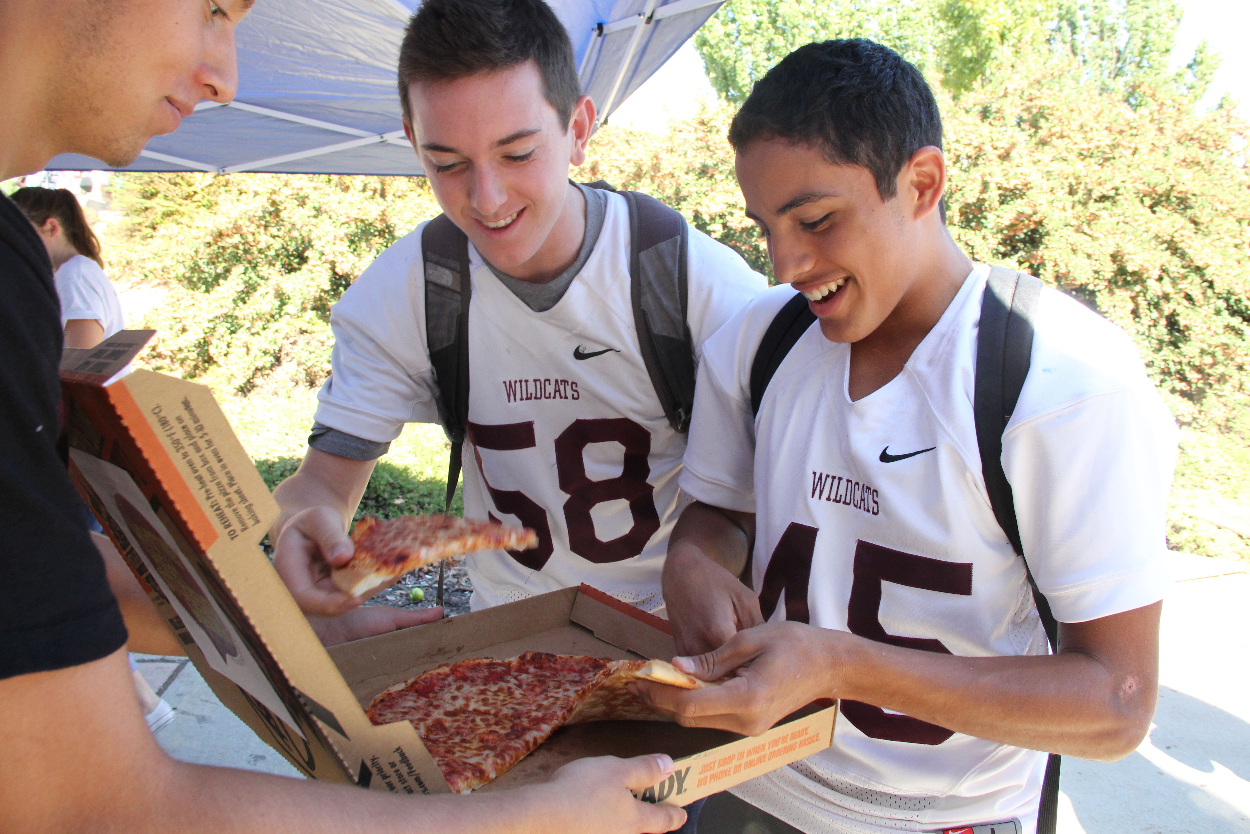
Don’t forget food!

Slide 15
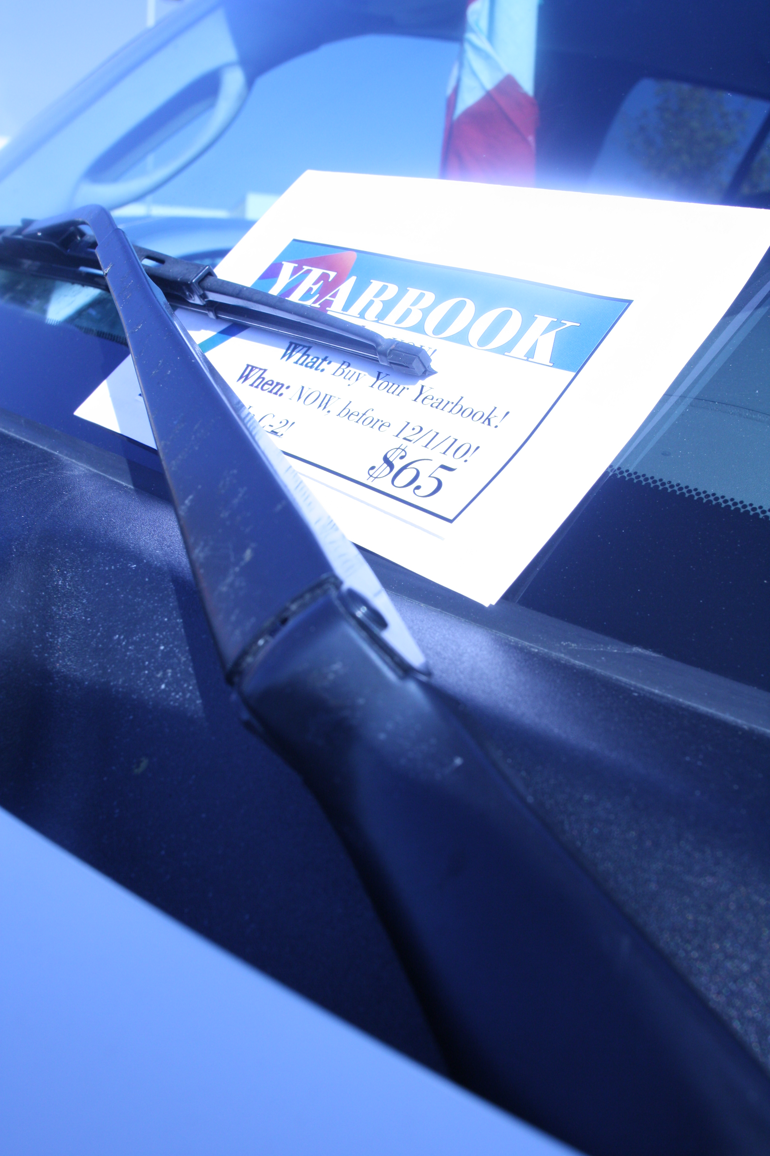
Place reminder cards on cars (or lockers)

Slide 16
Timelines
Provide multiple opportunities for your audience to buy the book
How?
Summer: Enrollment/registration days, new student orientation, sports practices, schedule distribution day, senior photo days

Slide 17
Timelines
Provide multiple opportunities for your audience to buy the book
How?
Fall: first day of school packets, Homecoming, picture day, back to school night, parent/teacher conference

Slide 18
Timelines
Provide multiple opportunities for your audience to buy the book
How?
Winter: basketball games, winter dance, flu shot clinics, Christmas sales, 8th grade parent orientation

Slide 19
Timelines
Provide multiple opportunities for your audience to buy the book
How?
Spring: prom, athletic banquet, academic awards night, advanced placement classes information night

Slide 20
Timelines
Provide multiple opportunities for your audience to buy the book
How?
Distribution Event: bring extra copies to sell and have order forms available for the next year

Slide 21
Incentives
Run at least one promotion each grading period

Slide 22
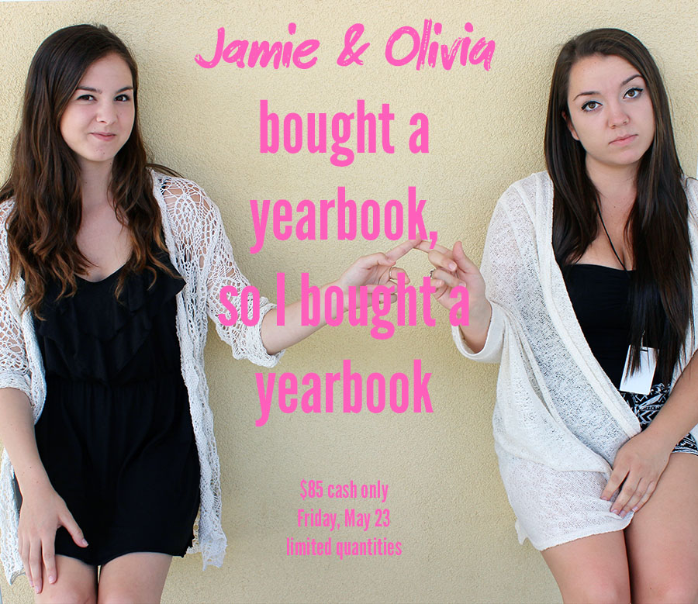
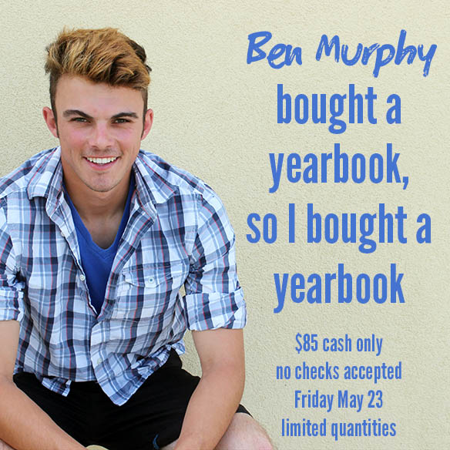
Don’t be afraid to use buyers (with permission!) in promotional materials

Slide 23
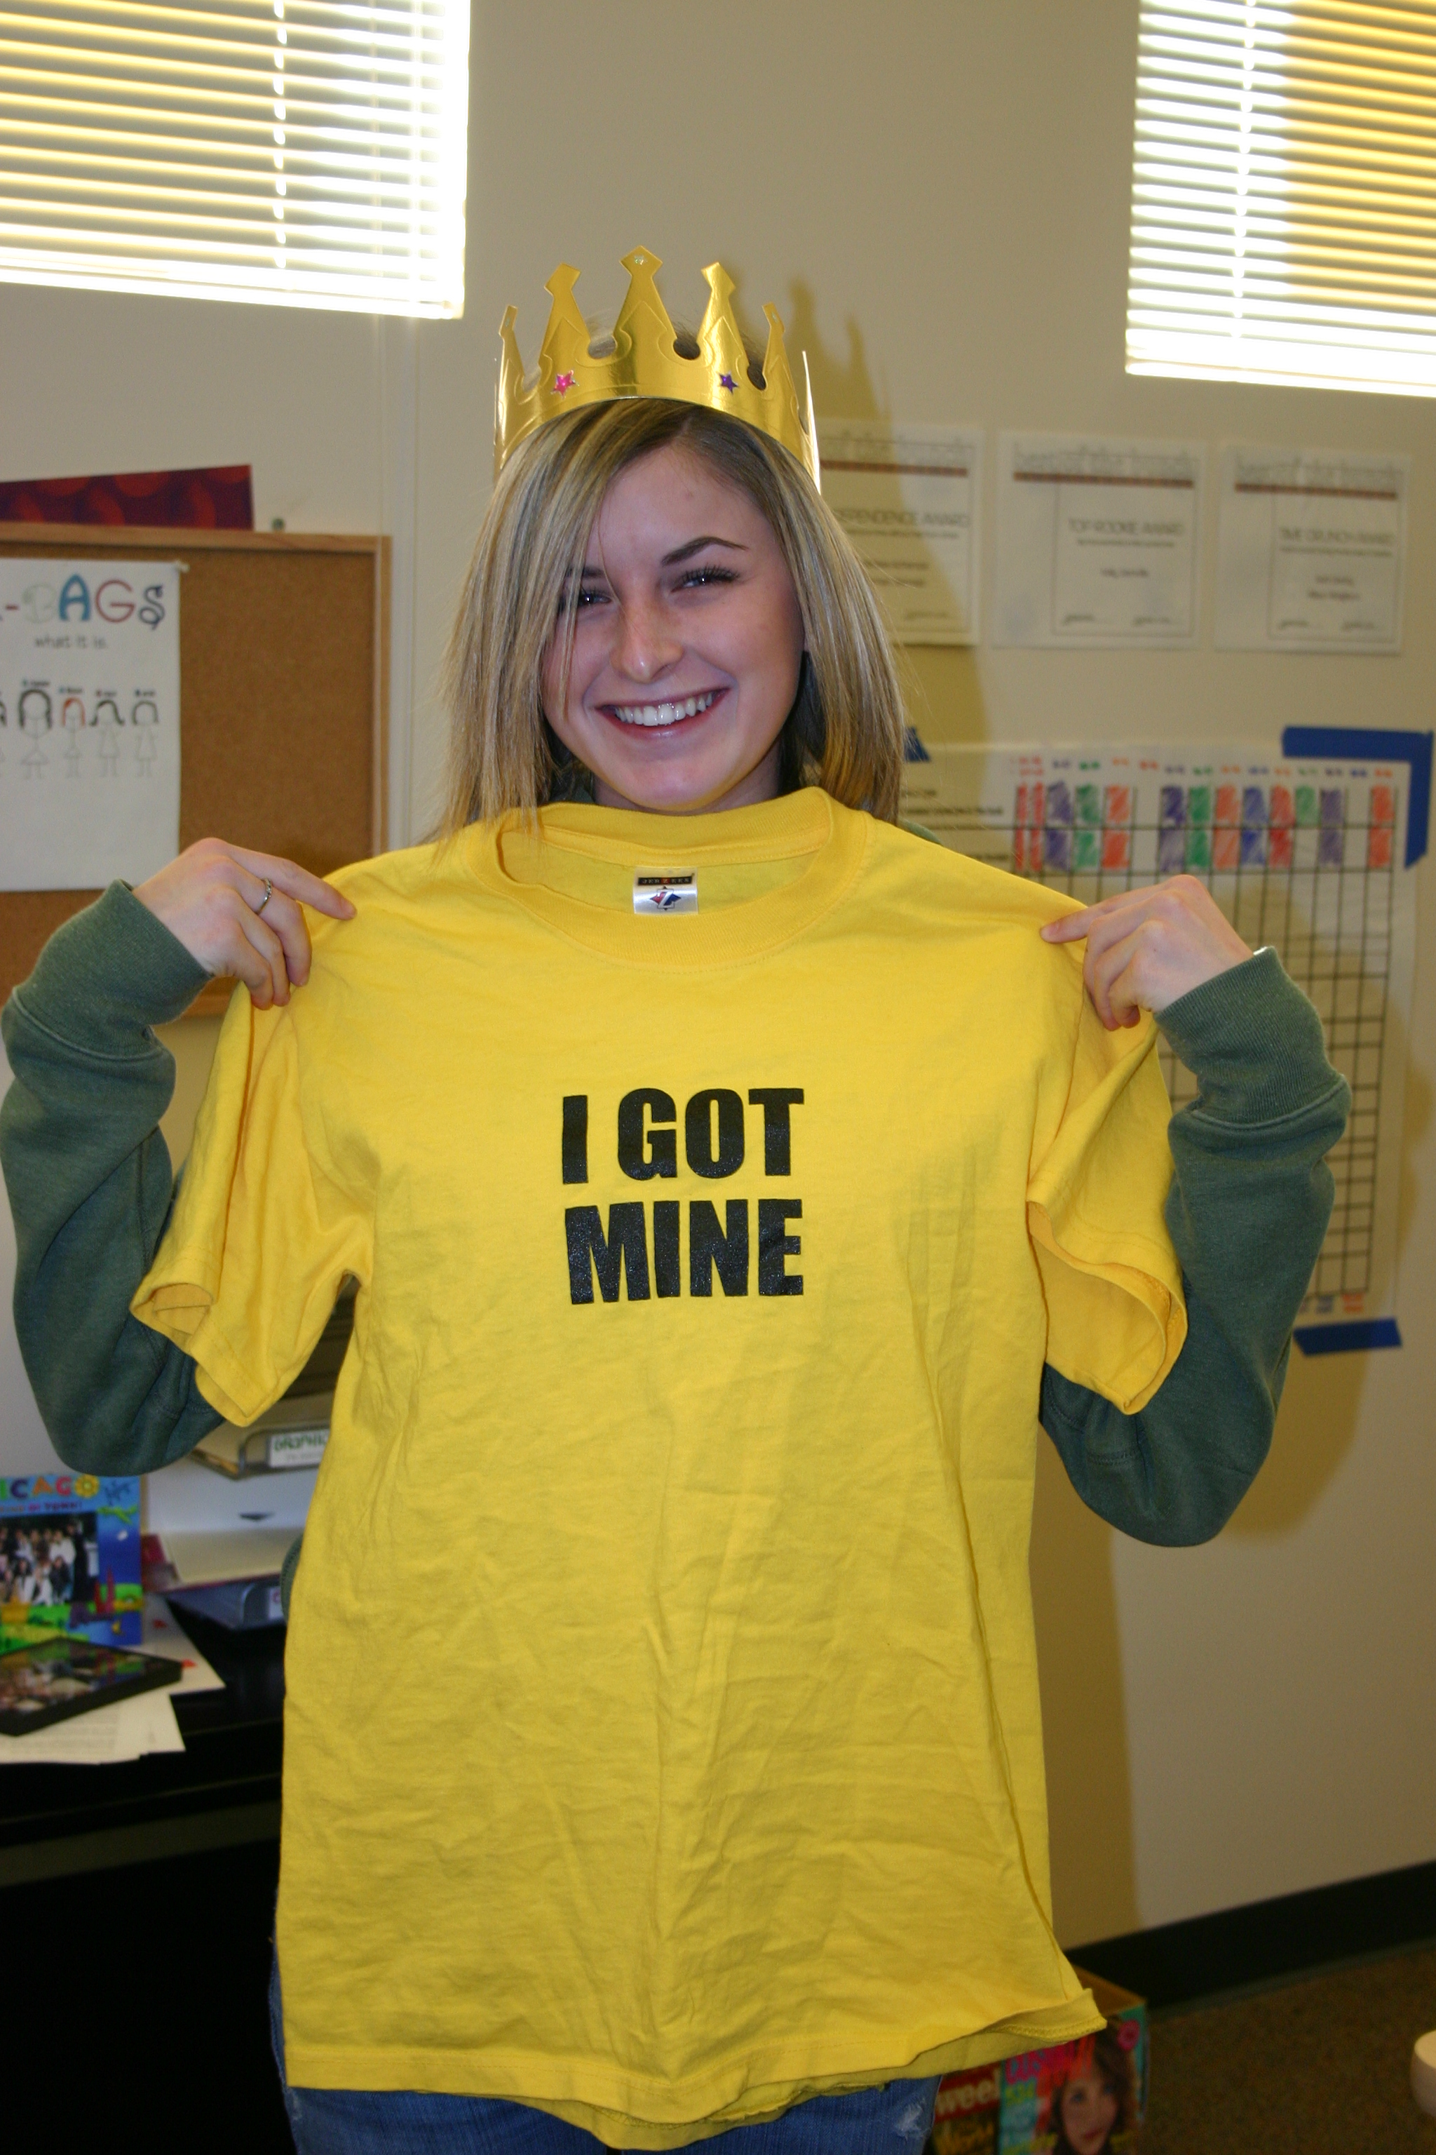
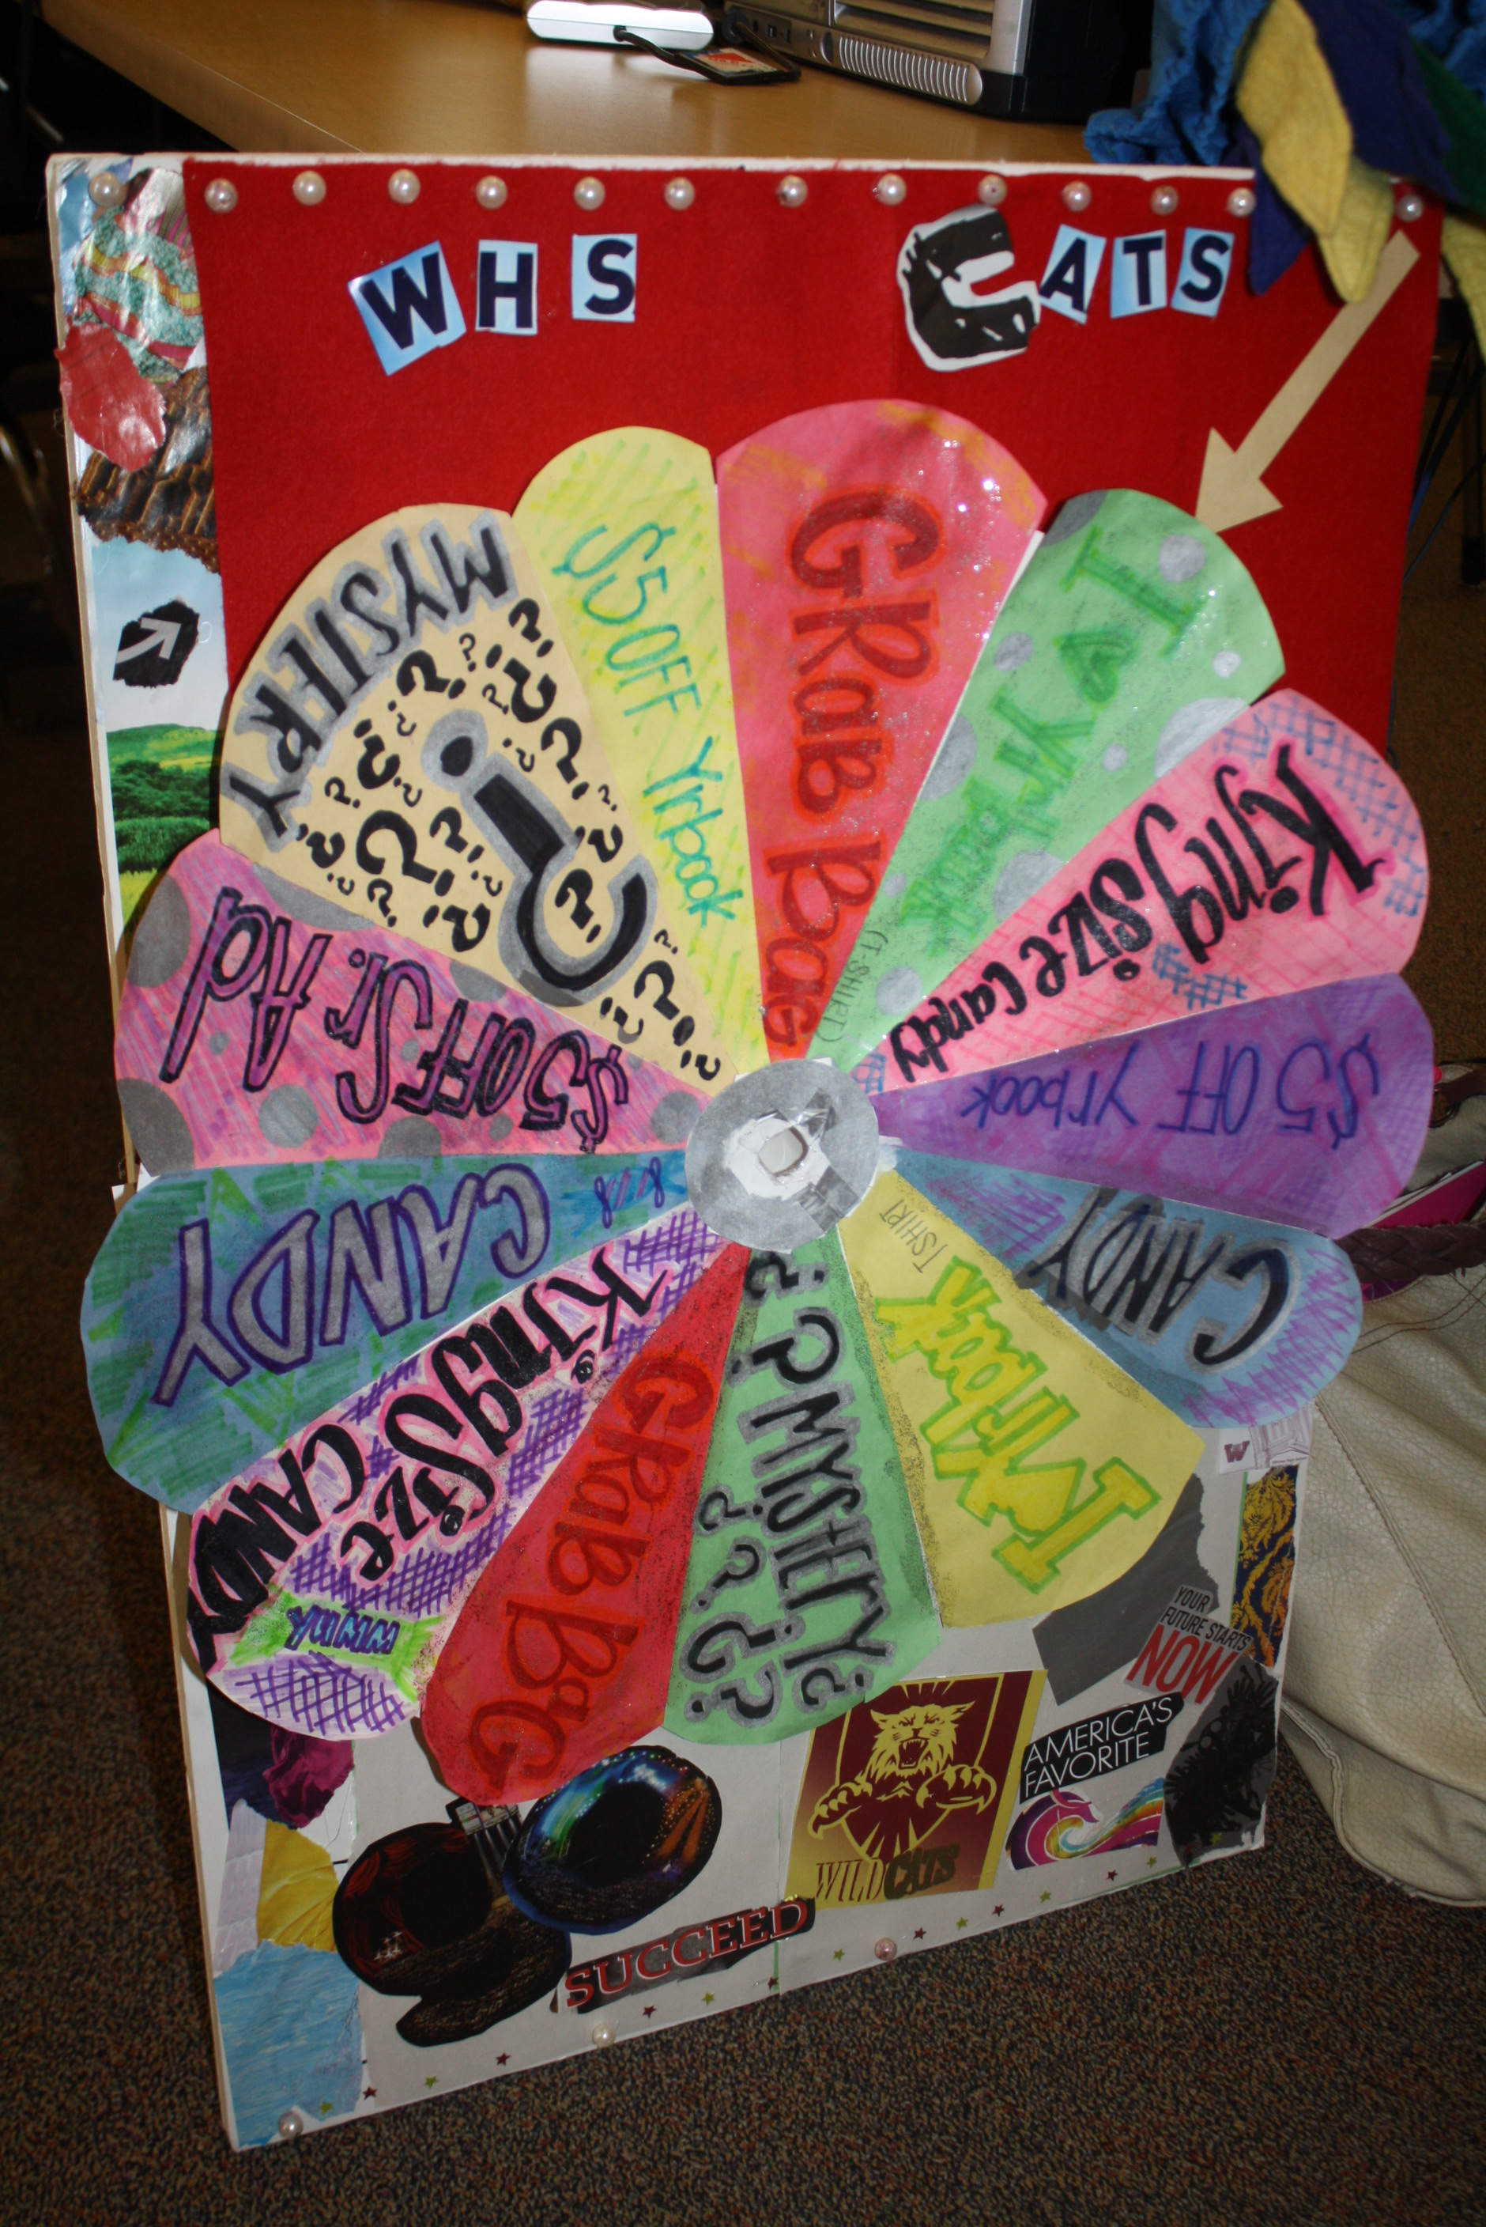
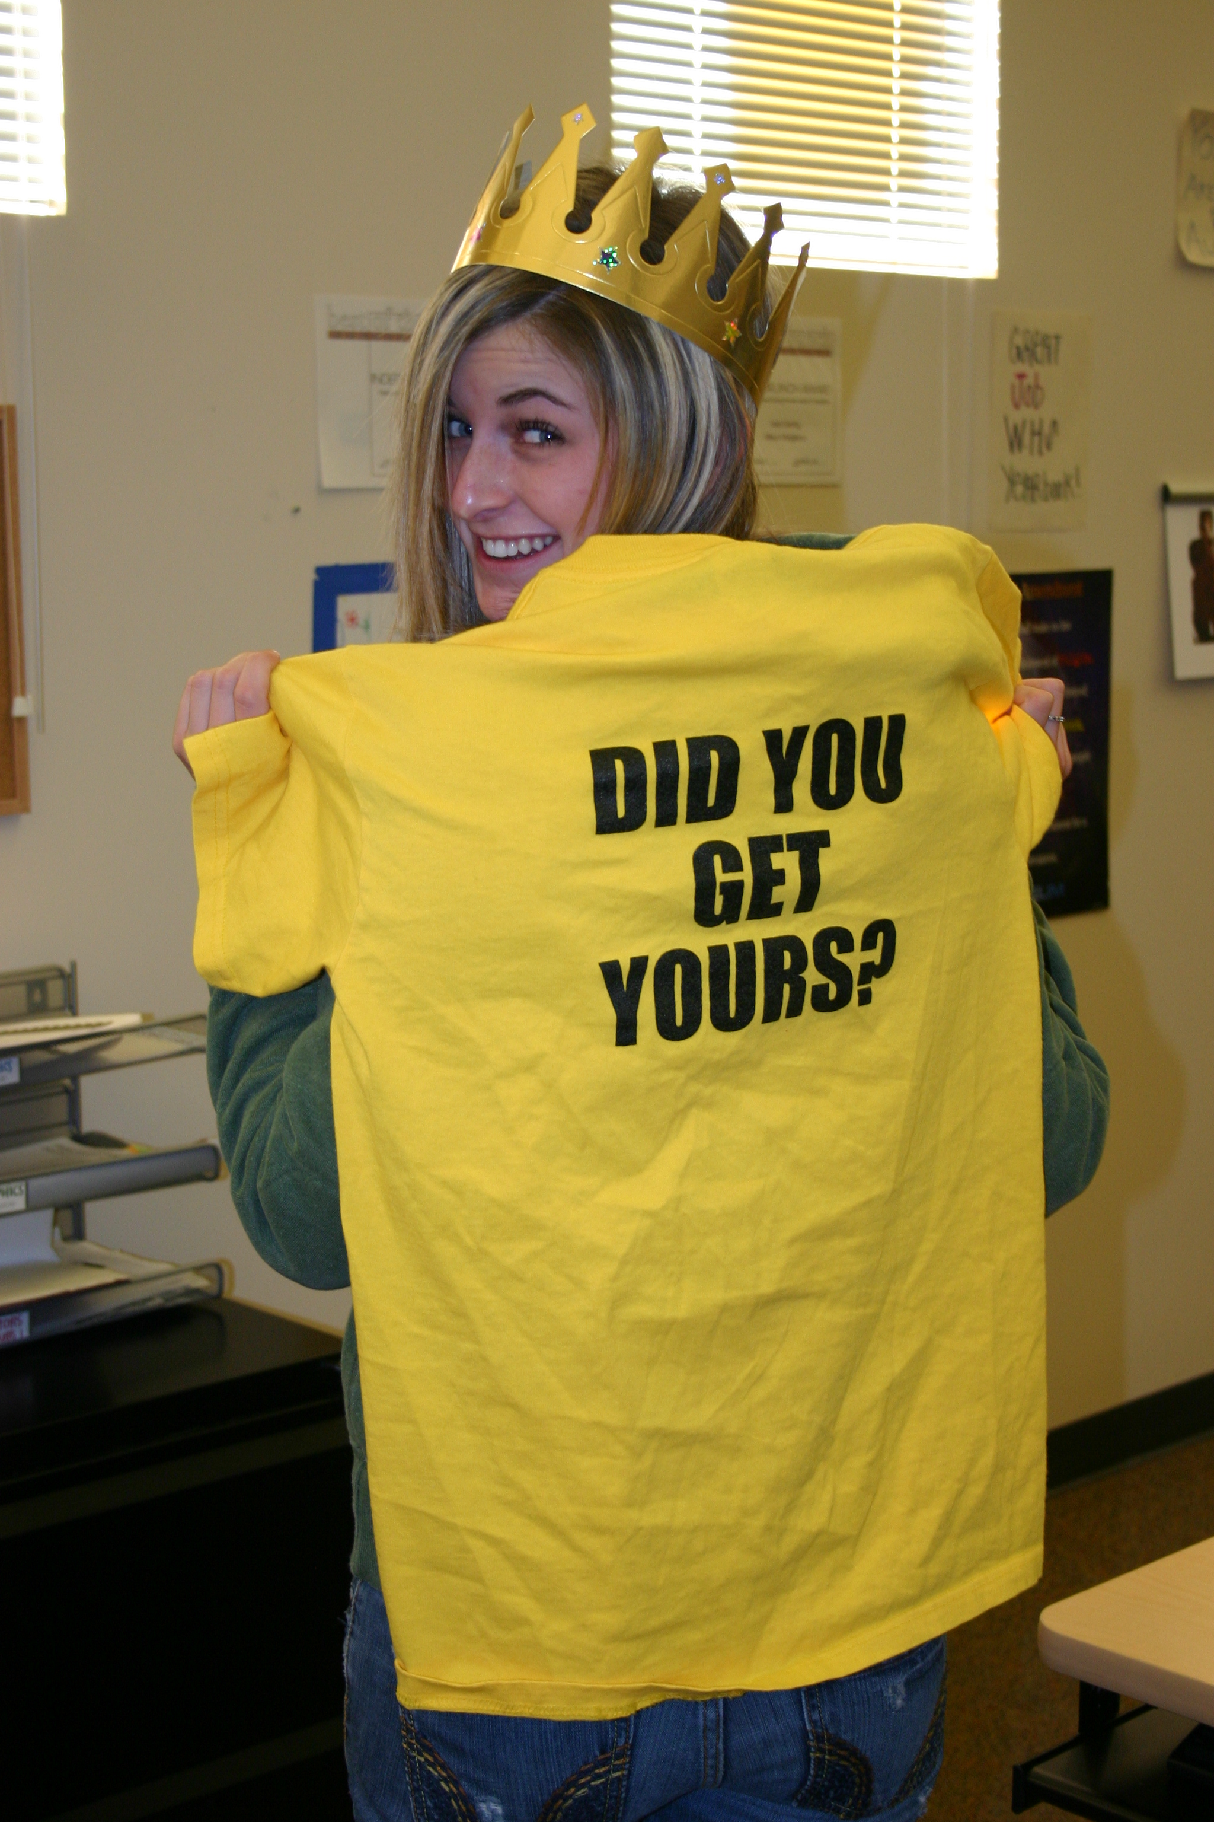
Offer inexpensive incentives for buyers

Slide 24
Incentives
Run at least one promotion each grading period
Why?
Incentives drive consumer behavior
Your job is to convince them

Slide 25
Incentives
Run at least one promotion each grading period
How?
Designate sales weeks during which to contact non-buyers directly
Handouts, email, phone call
Attach an order form for each point of contact

Slide 26
Incentives
Run at least one promotion each grading period
How?
Increase the price of the book by a small amount ($5-10) every two to three months

Slide 27
Incentives
Run at least one promotion each grading period
How?
Use “wanted” posters for non-buyers that indicate how many times photos of them appear in the yearbook

Slide 28
Incentives
Run at least one promotion each grading period
How?
Plan a contest to encourage groups of buyers (e.g. boys, girls, grade levels) to purchase the book for a small incentive (e.g. candy, stickers, getting to “pie” a member of the group in the journalism class)

