Slide 1
This Brand Is Your Brand
Entrepreneurship

Slide 2
“A brand conveys a story while a label simply identifies.”
- Steven Heller, designer and cofounder of the School of Visual Arts MFA Design program.

Slide 3
This brand is…
All great publications work with visual and verbal themes to create an identity that distinguishes not only their content, but who they are - their ethos (credibility), their type of storytelling and their vision.
Let’s look at WIRED magazine, known for its trendy reporting on up-and-coming tech issues and trends, as our professional example.

Slide 4
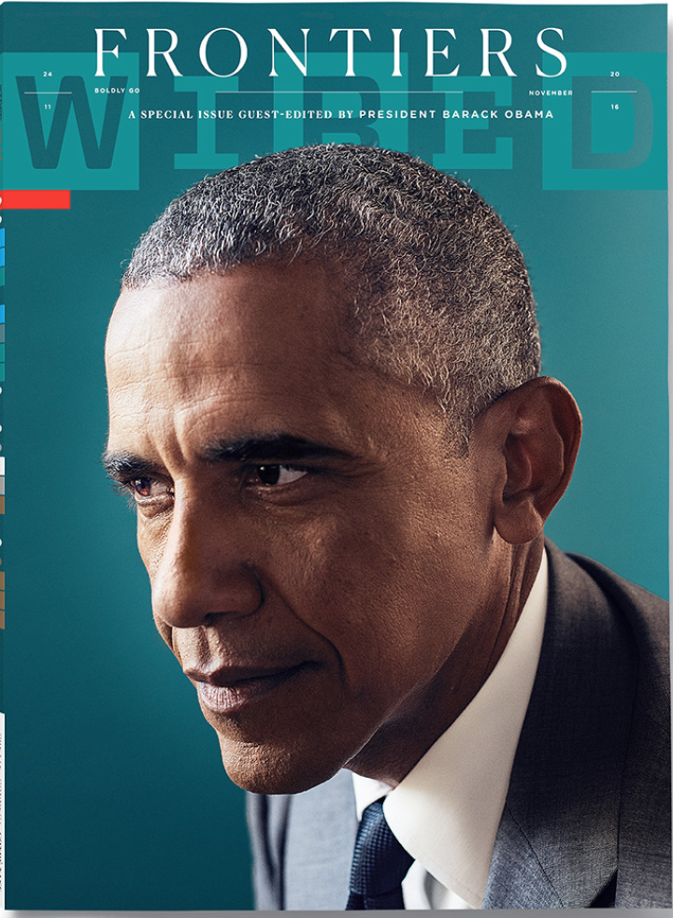
This issue asked then President Obama to be the guest editor.
This is their statement about this issue:
“Like WIRED, our 44th president is a relentless optimist. President Barack Obama focuses on the future and the next hurdles that humanity will need to overcome to move forward.”
Task:
Analyze the tone created by the theme title, “Frontiers,” and the visual elements that contribute to this feeling…

Slide 5
While this issue also focuses on the future and hurdles that humanity will need to overcome, it creates a different feeling.
Task:
Analyze the tone created by the theme title, “The Ultimate Survival Guide,” and the visual elements that contribute to this feeling…

Slide 6
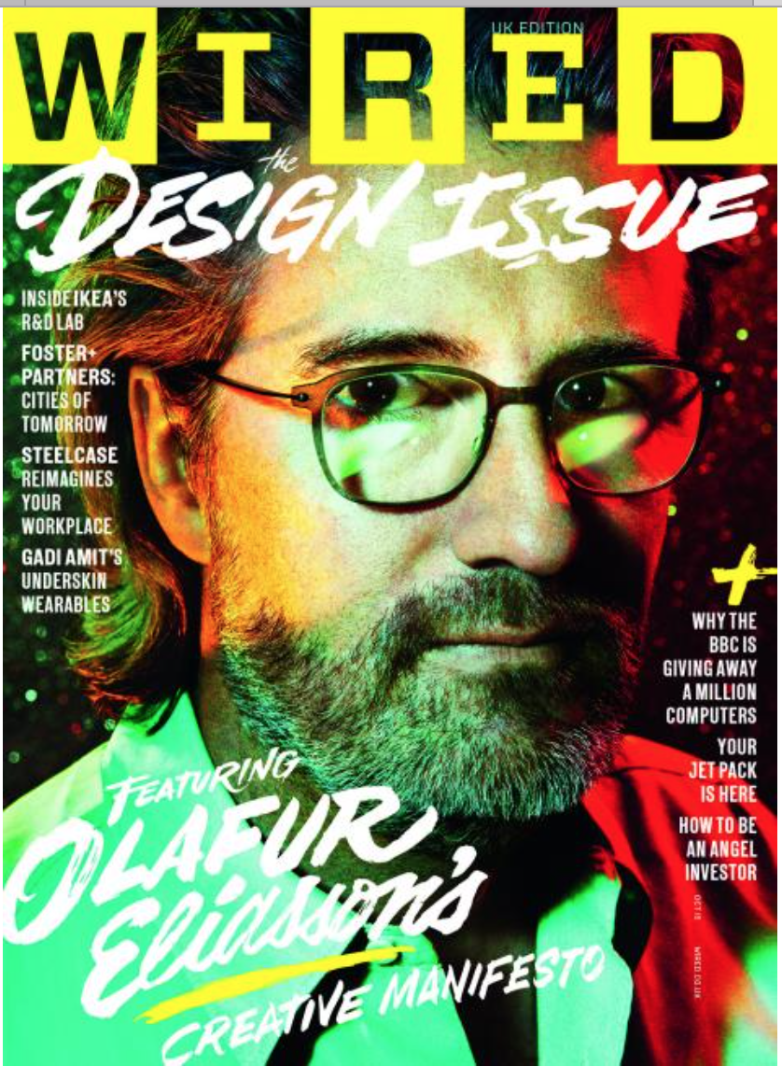
This issue is packaged with a label theme, “The Design Issue.”
Task:
What are some of the visual design choices and how do they contribute to the sense of how the content will appear within the magazine.

Slide 7
This brand is YOUR brand....
Consider your yearbook theme as an opportunity to teach your readers who you are as a staff and publication.

Slide 8
Lesson:
We will use the 2016 Grand Blanc High School Echo yearbook theme, “Callings: discover who you truly are” as a case study for developing a theme into a brand and identity.

Slide 9
How can you teach your theme to readers?
synonyms, idioms, philosophies that relate to your theme
quotes that relate to your theme

Slide 10
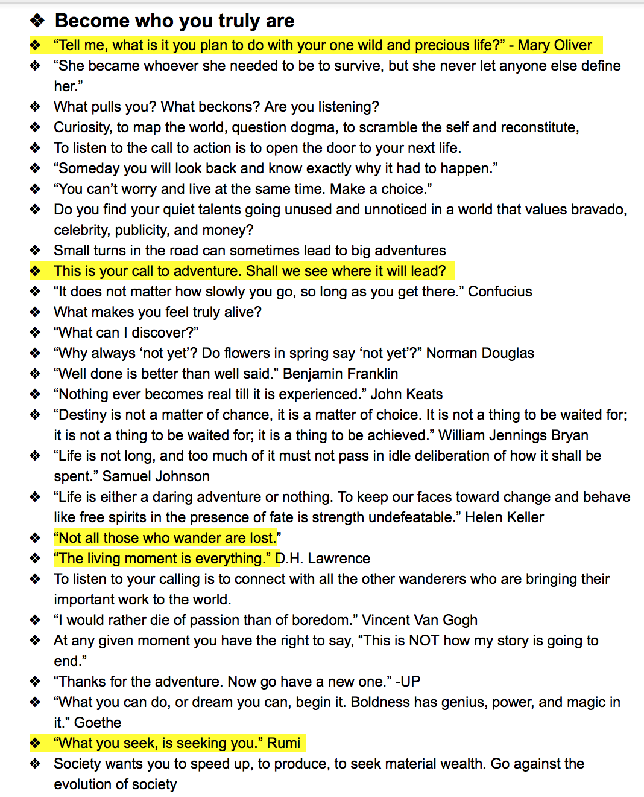
Shared google doc with collaboration of theme development

Slide 11
Goal: Teach that our theme is about taking chances and self-discovery.
Plan: Tweet inspirational quotations each Friday.

Slide 12
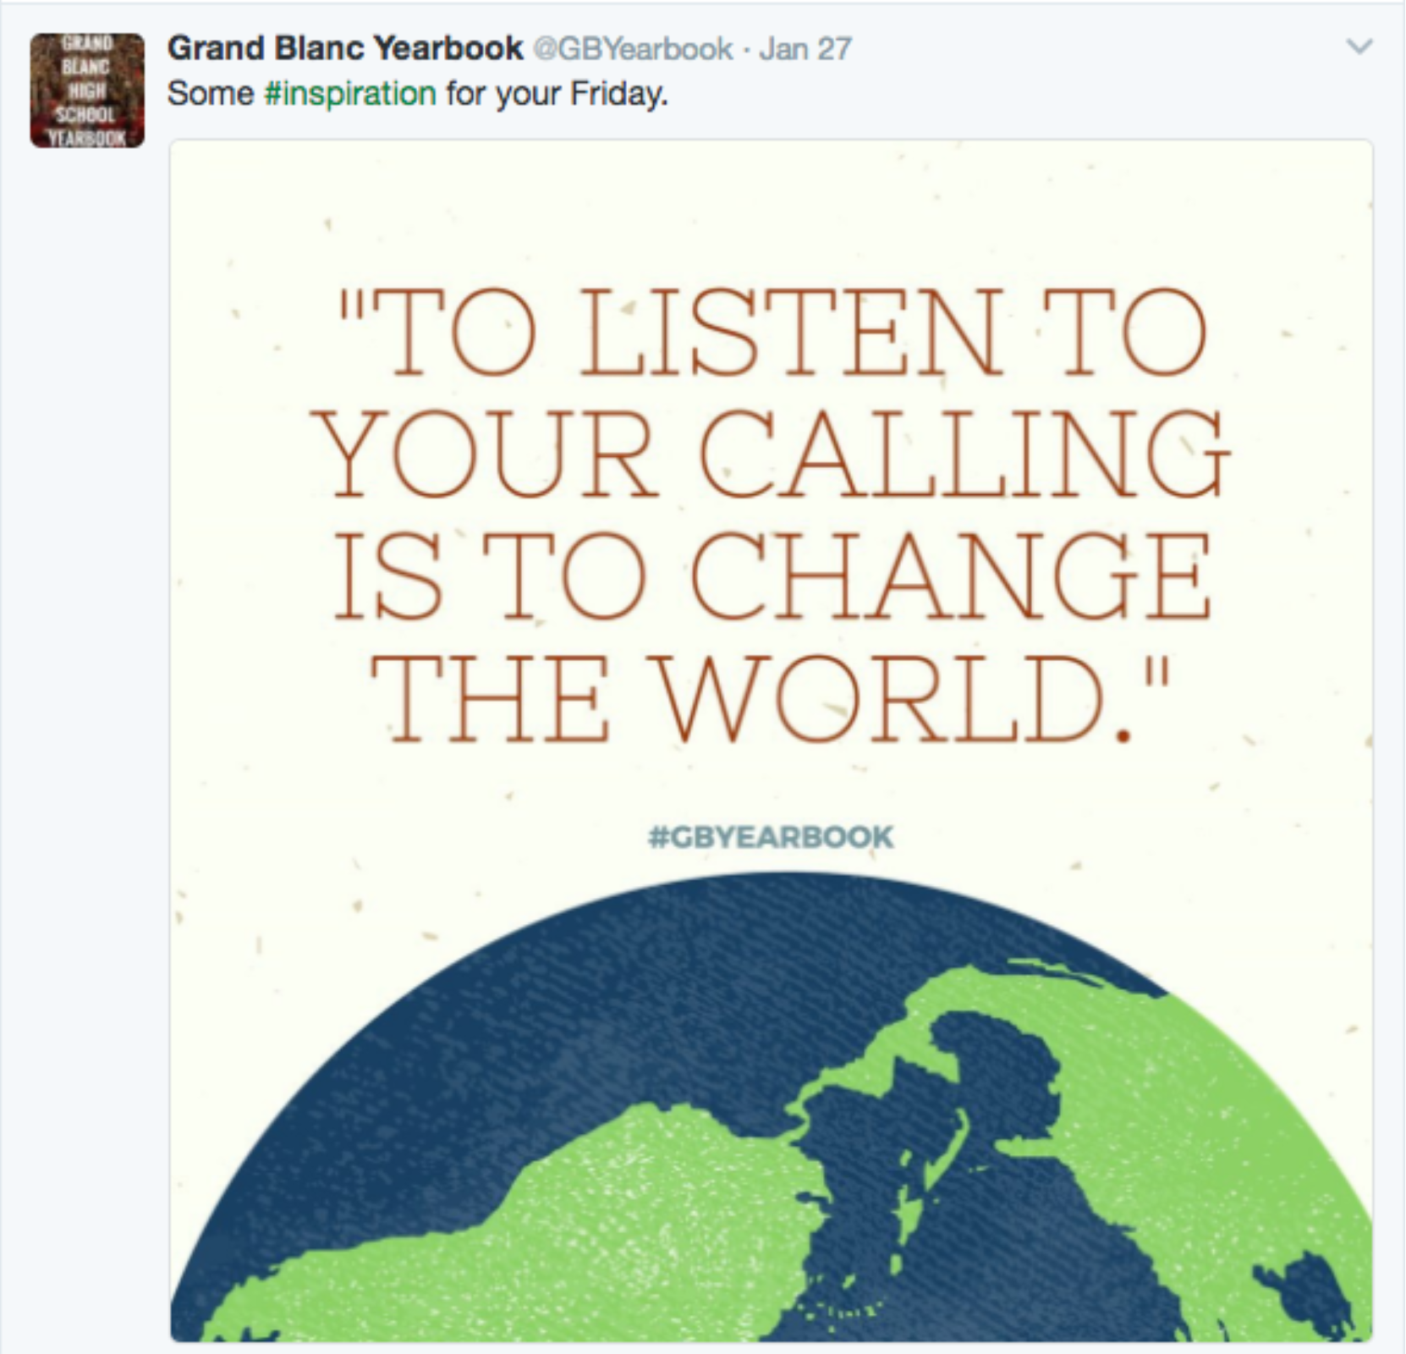

Slide 13
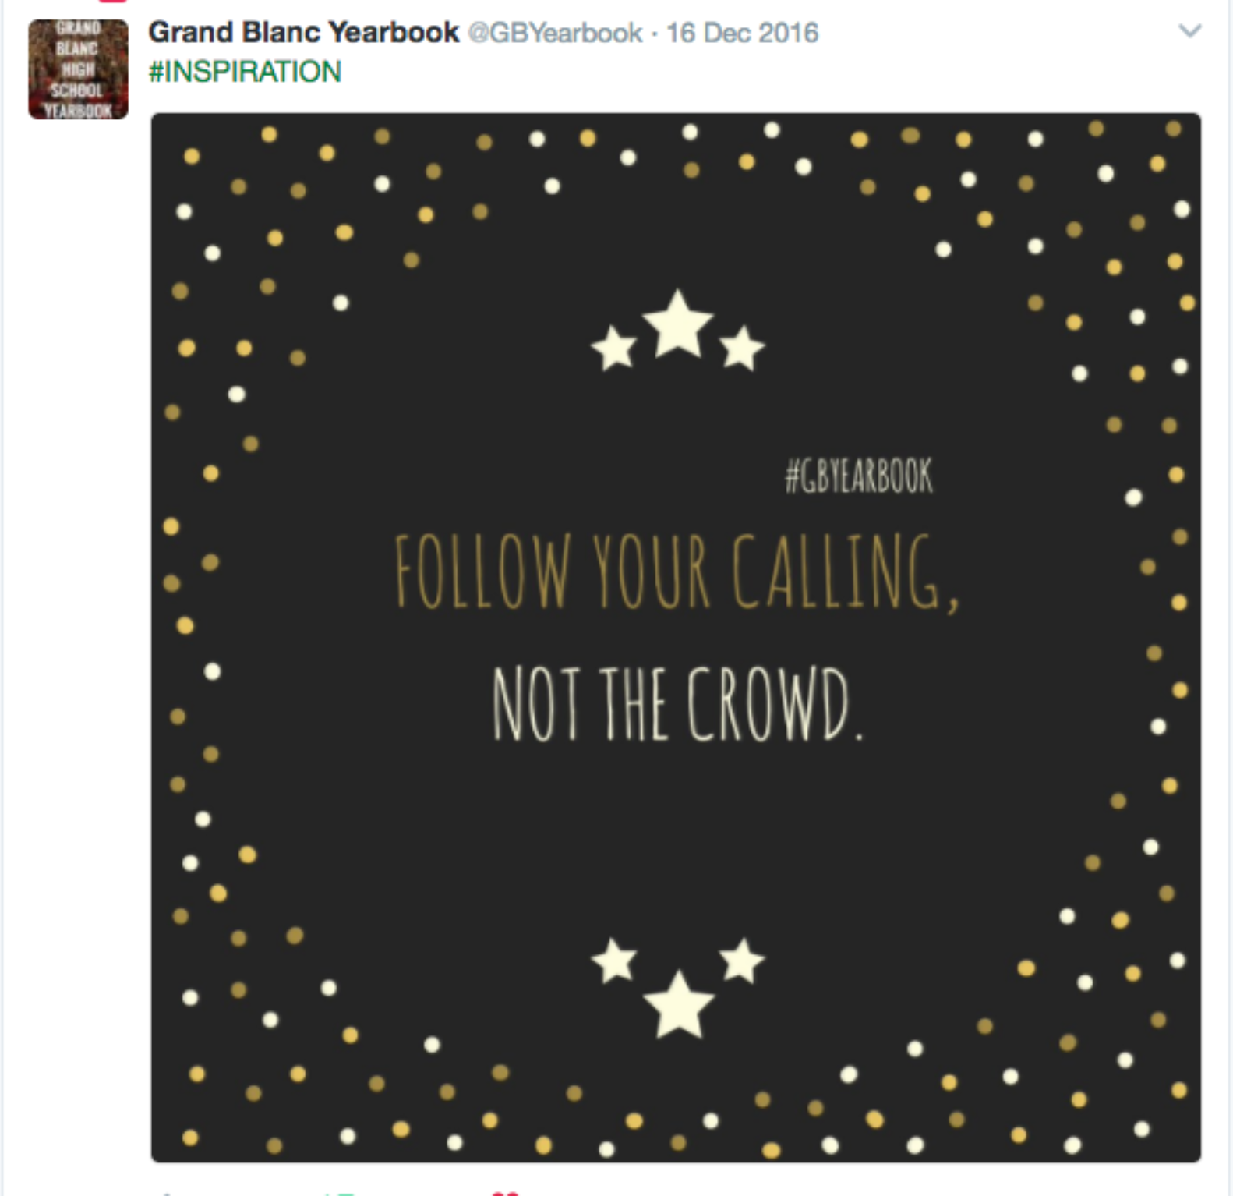

Slide 15
Goal: Teach the opening copy of our yearbook through video.
Plan: Showcase the work of someone who is engaged in their calling.

Slide 16
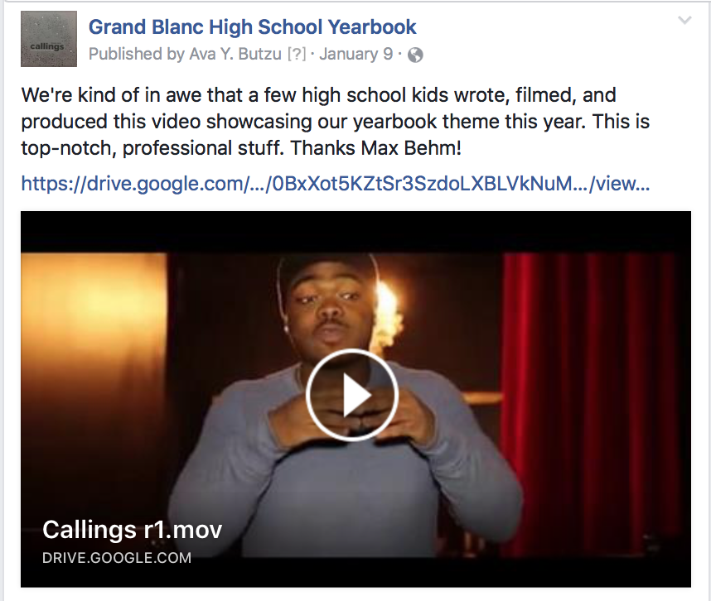
https://drive.google.com/file/d/0BxXot5KZtSr3SzdoLXBLVkNuMEE/view

Slide 17
Goal: Teach that our theme is about finding what you love to do, or searching for it.
Plan: Use posters and social media to tell stories of alumni who have found their callings.

Slide 18
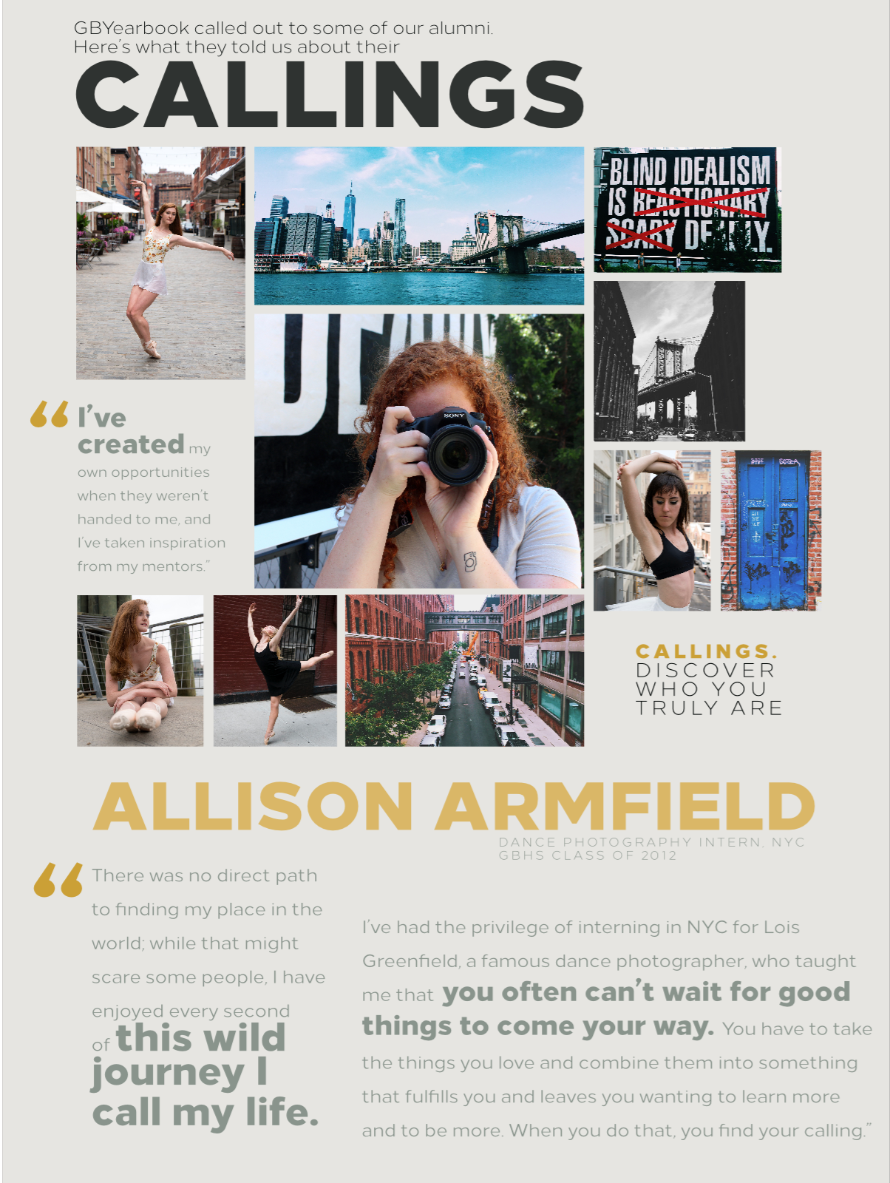

Slide 20
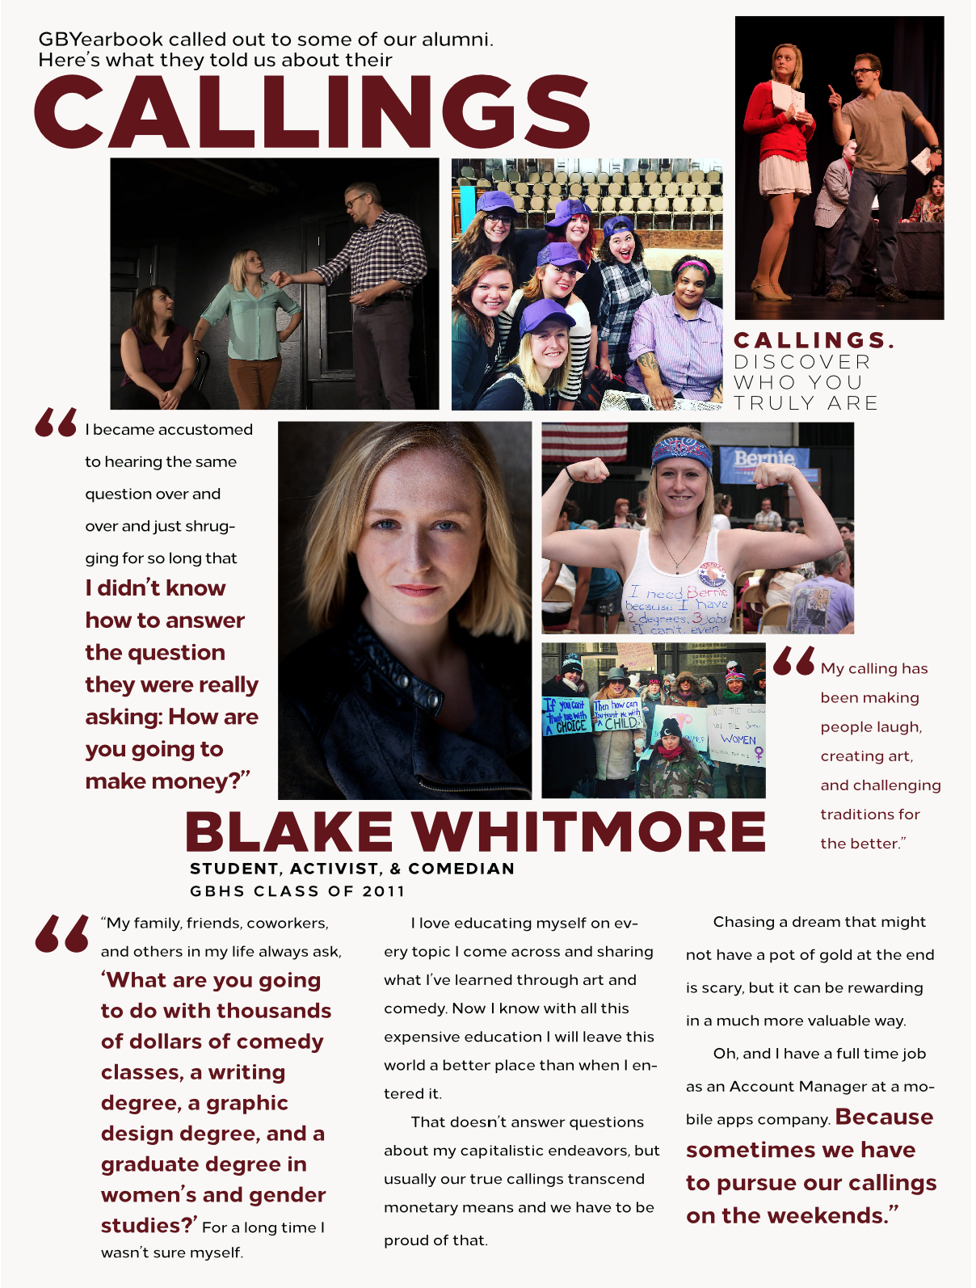

Slide 21
Goal: Teach that our theme is about considering the qualities you already have as assets to help you reach your goals.
Plan: Pass out colored ribbons for wristbands with “fortunes” to explain what each color represents.

Slide 22
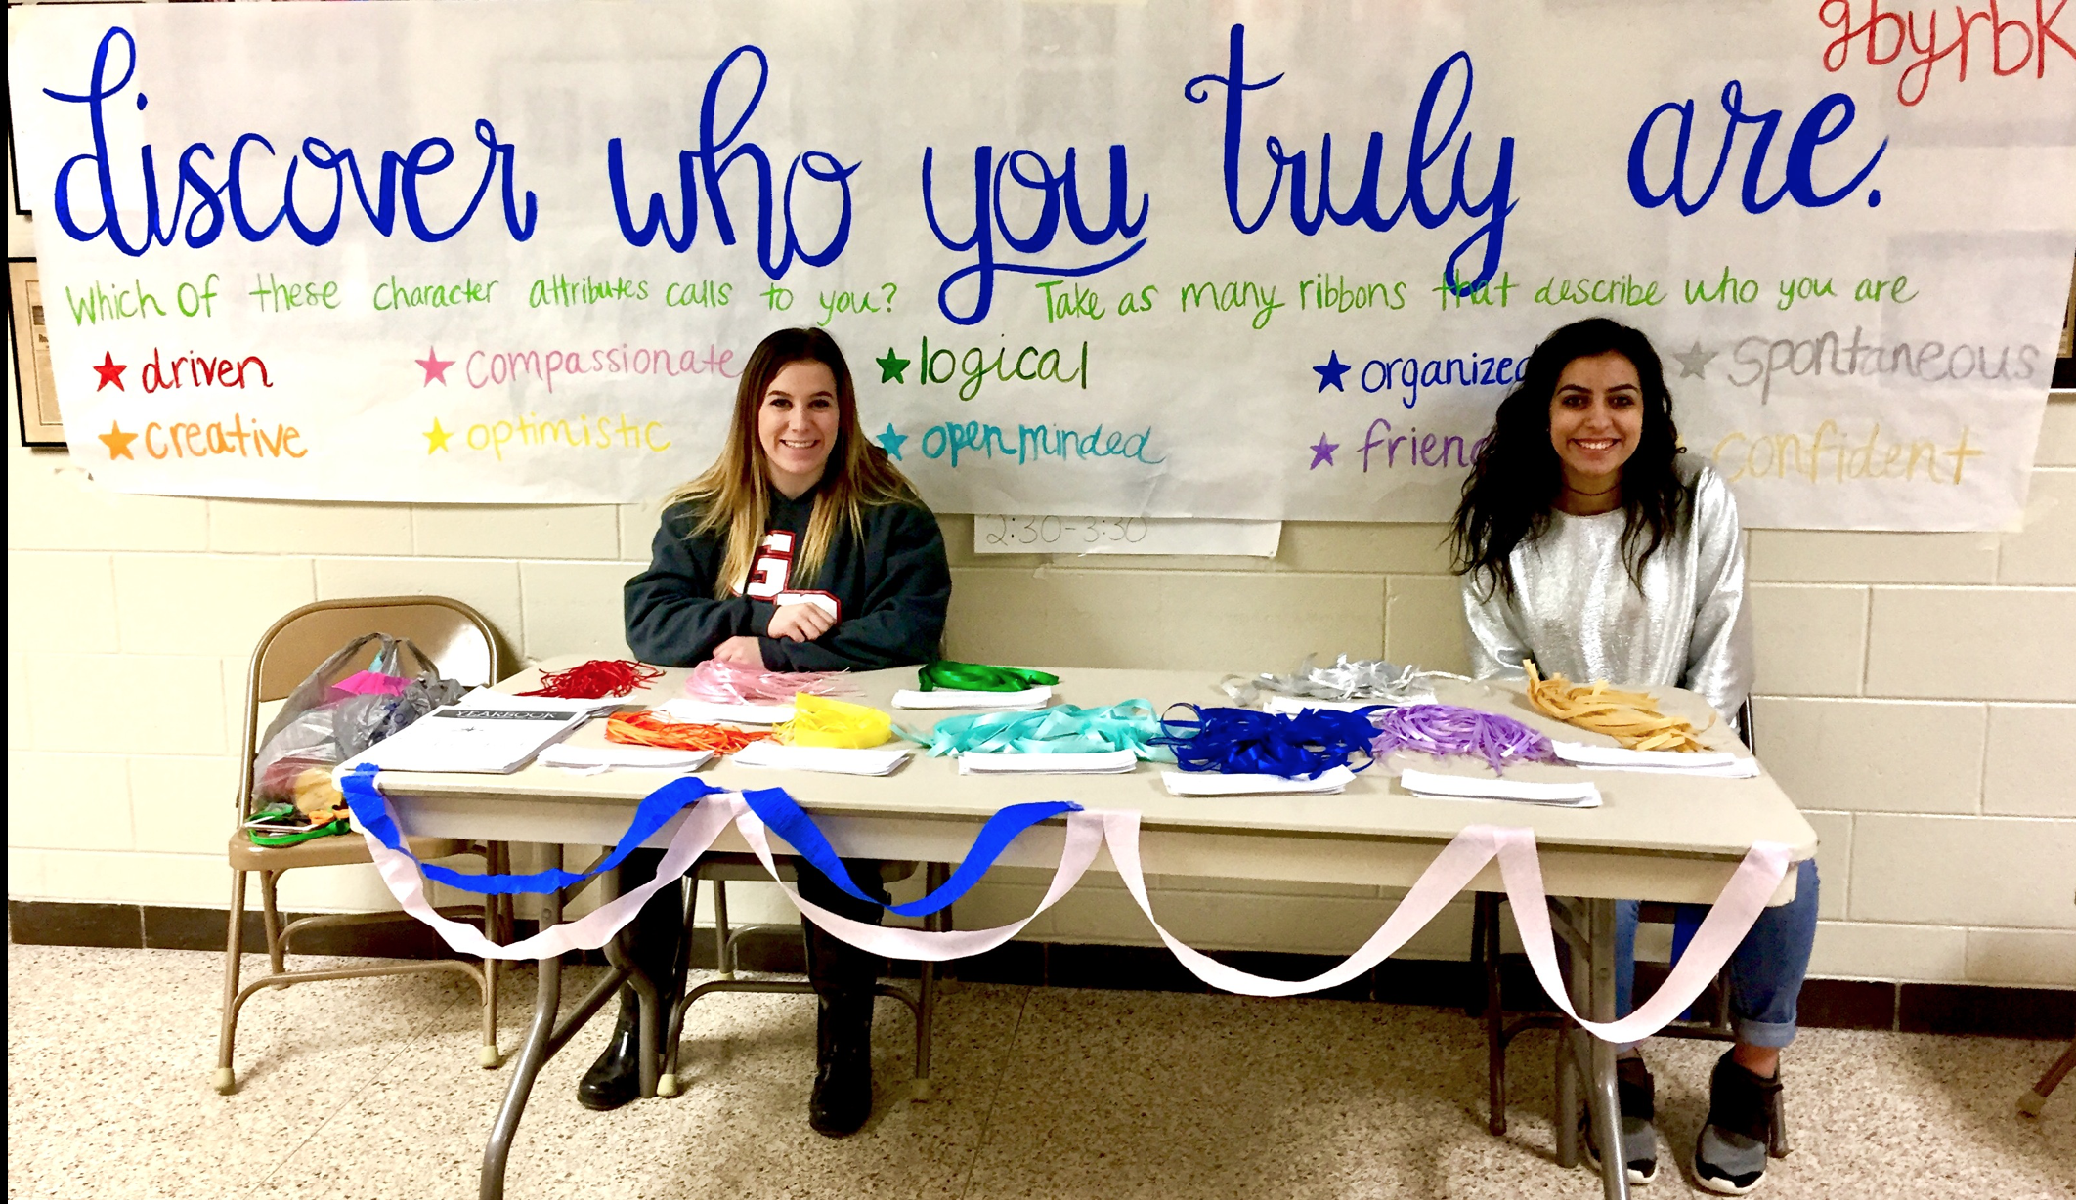
Display table at lunch

Slide 23
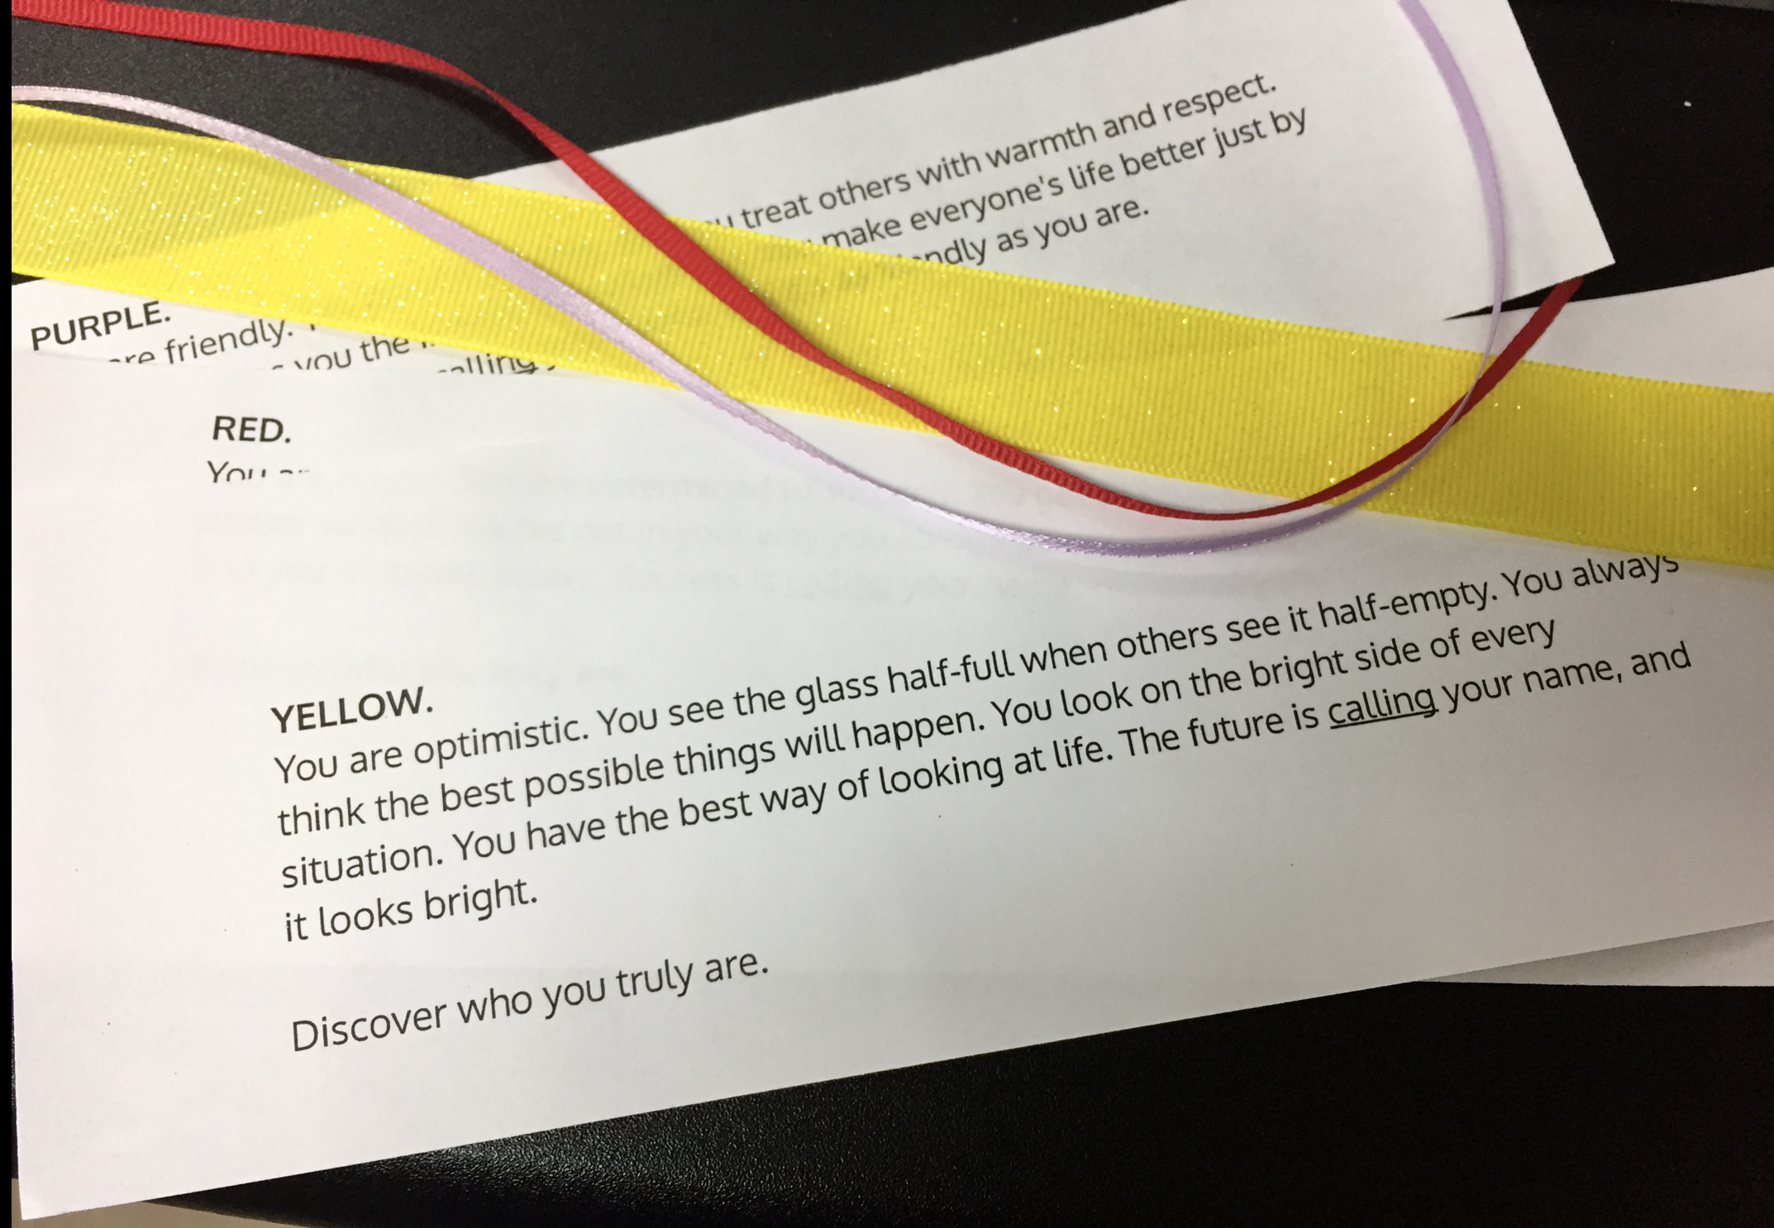
Sample wristband explanations

Slide 24
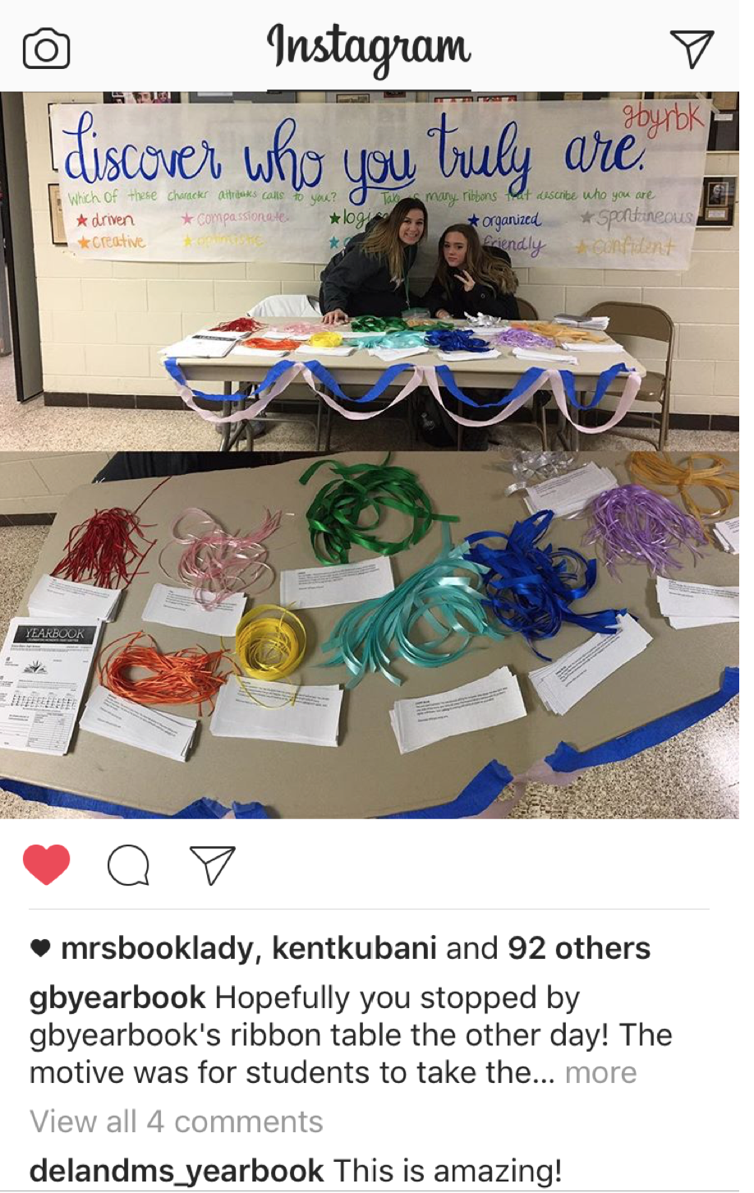
Share what you do on social media

Slide 25
Goal: Teach that our theme can be seen in the photos that the yearbook staff is taking every day.
Plan: Each staffer prints their 10 favorite photos they’ve taken so far in the year and their favorite theme-related quote. Materials are used to create a theme promotion wall.

Slide 26
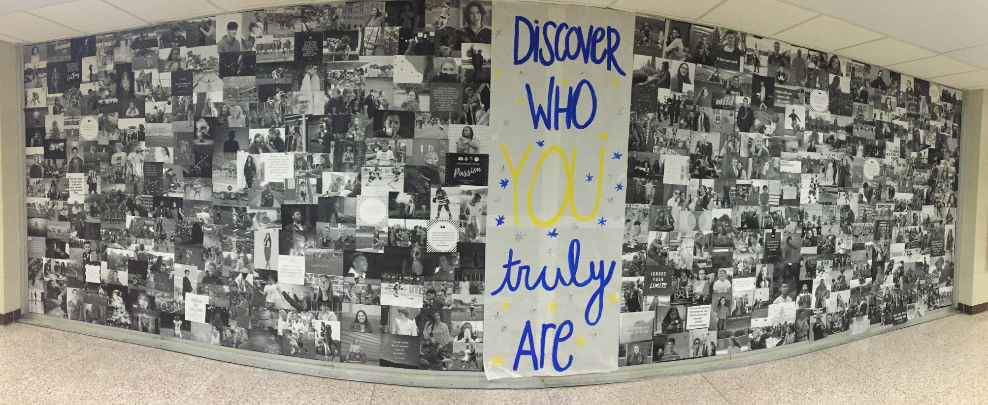
sample photo wall (with theme quotes)

Slide 27
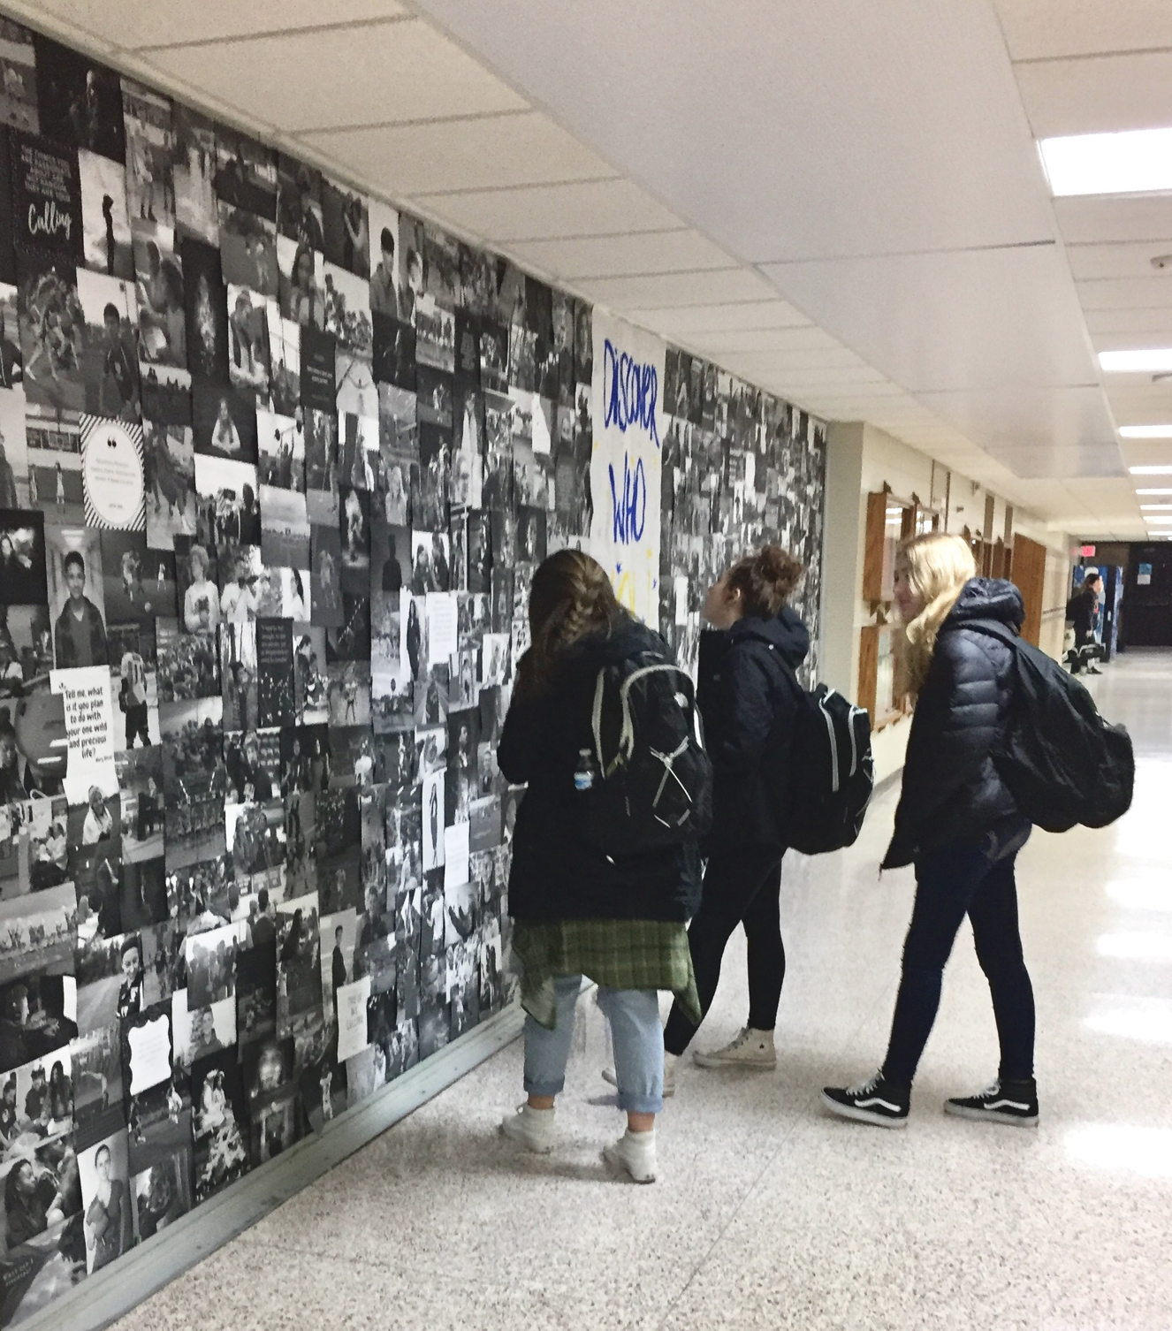

Slide 28
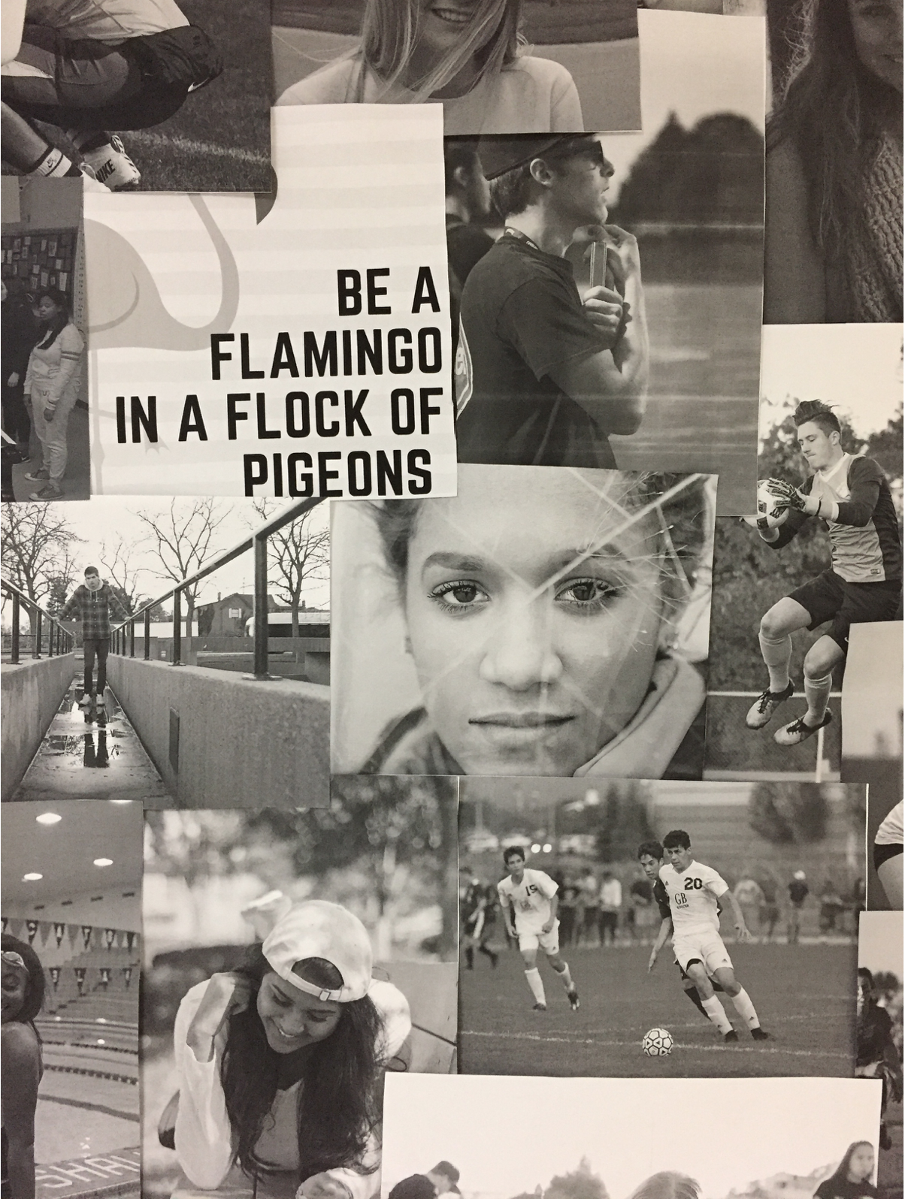

Slide 29
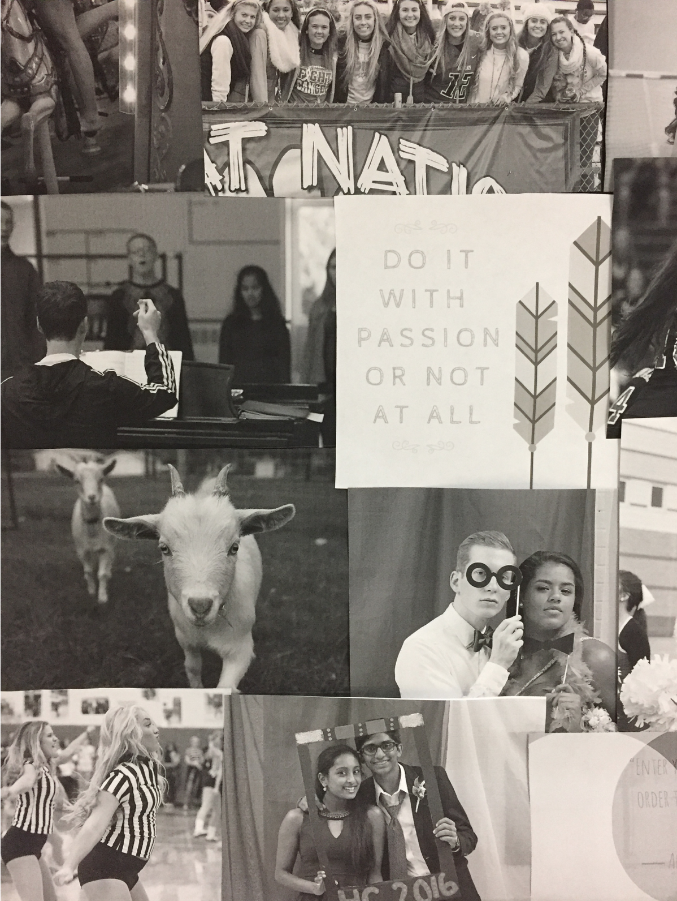

Slide 30
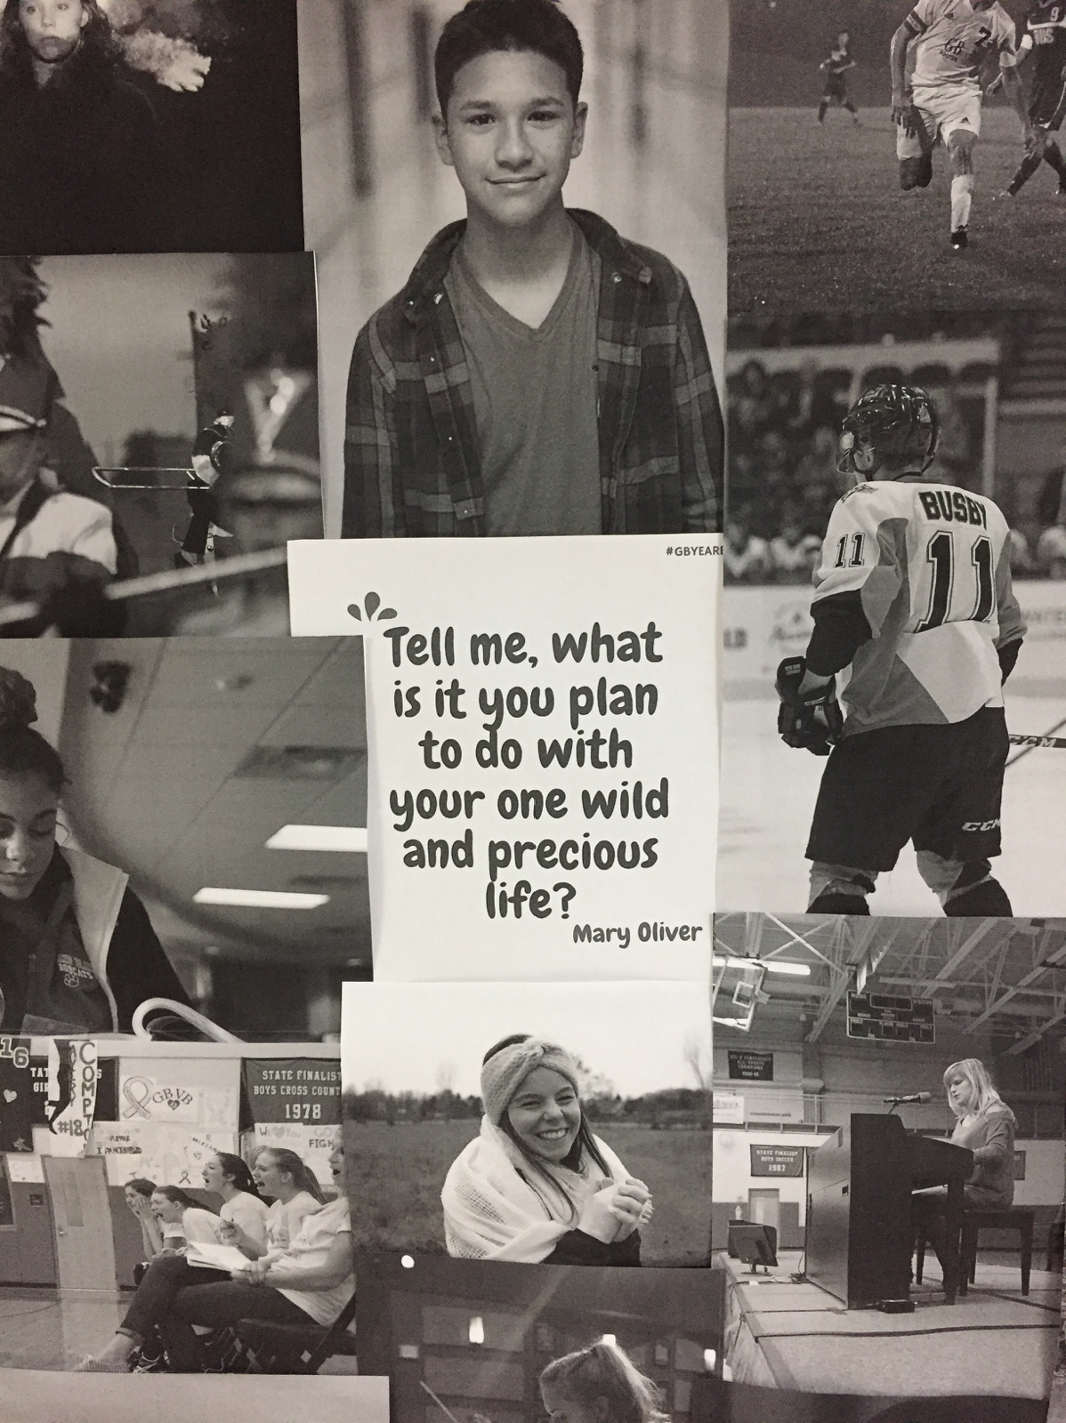

Slide 32
How can your theme define
your staff?
photo contest
website
press pass
t-shirt

Slide 33
Goal: Teach that our staff has made it our calling to take great portrait photos.
Plan: Hold periodic staff challenges, critiques, and vote for the best of. Post photos on small posters in the school.

Slide 34
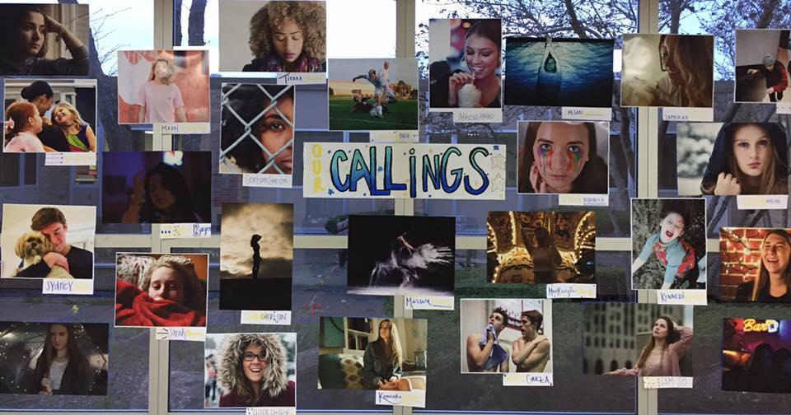

Slide 35
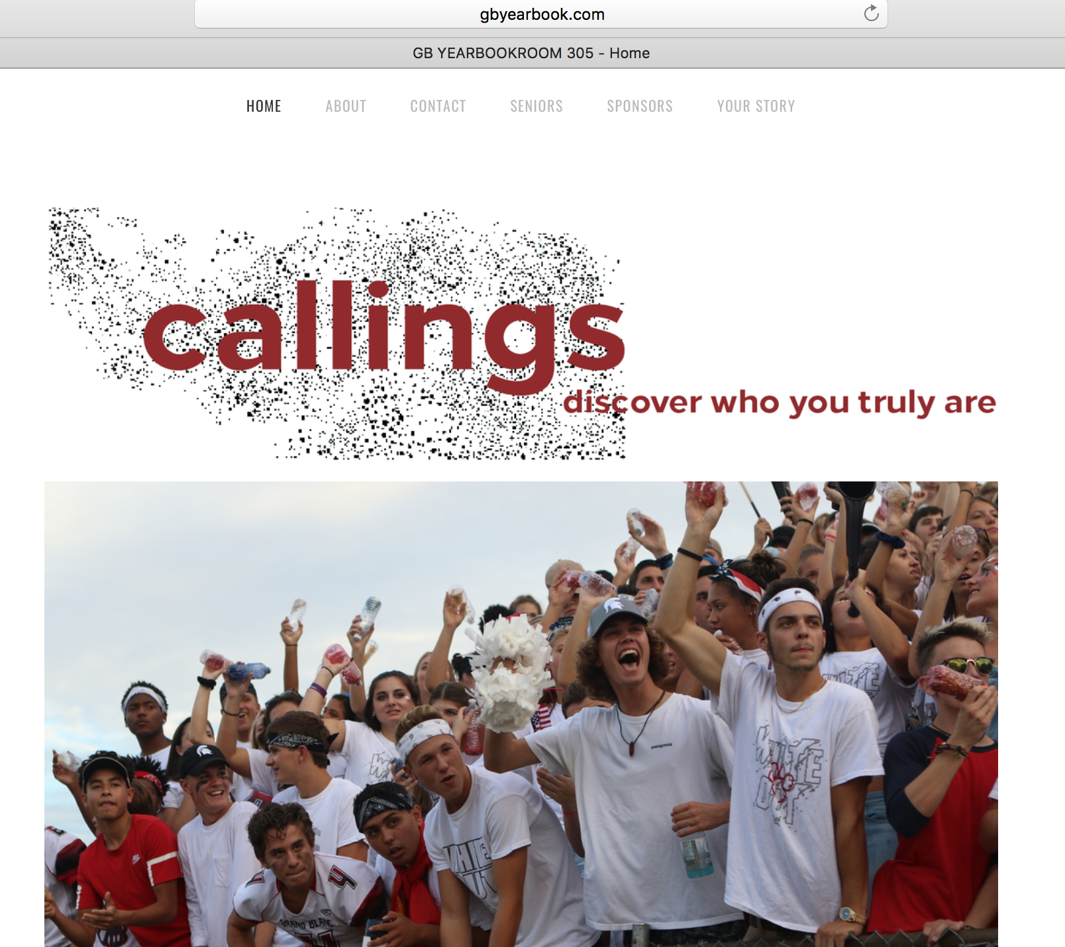
Make the theme (verbal and visual) the banner of the yearbook website.

Slide 36
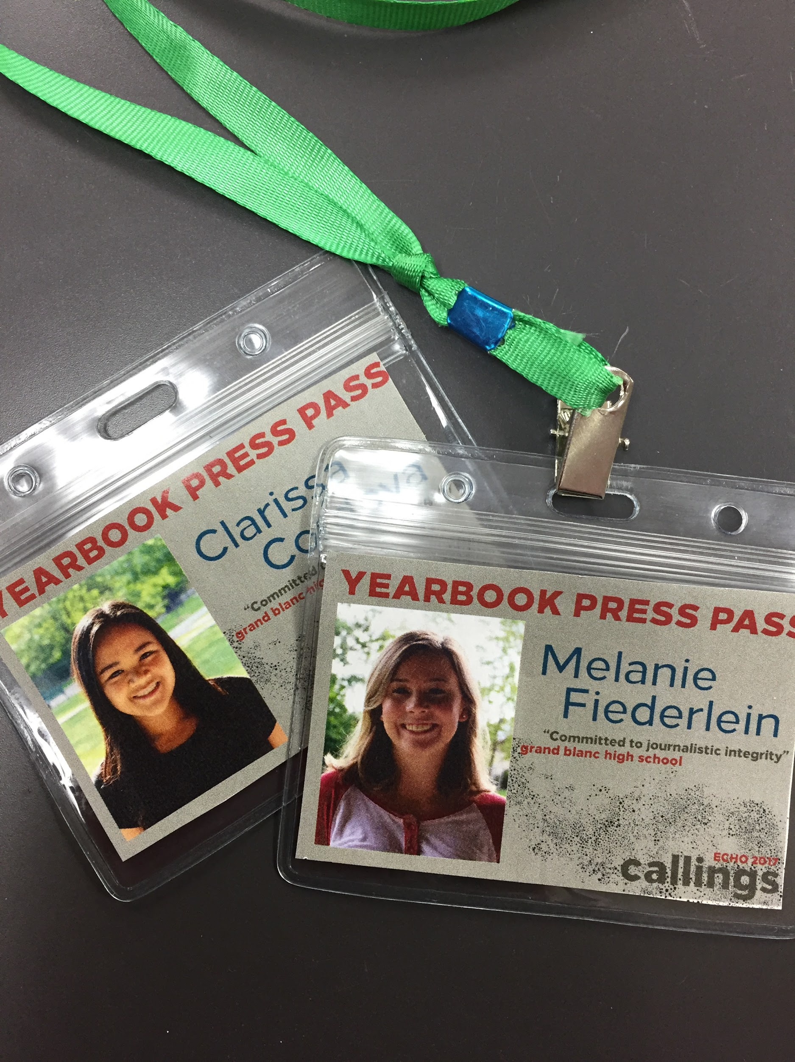
Use the theme (verbal and visual) on press passes

Slide 37
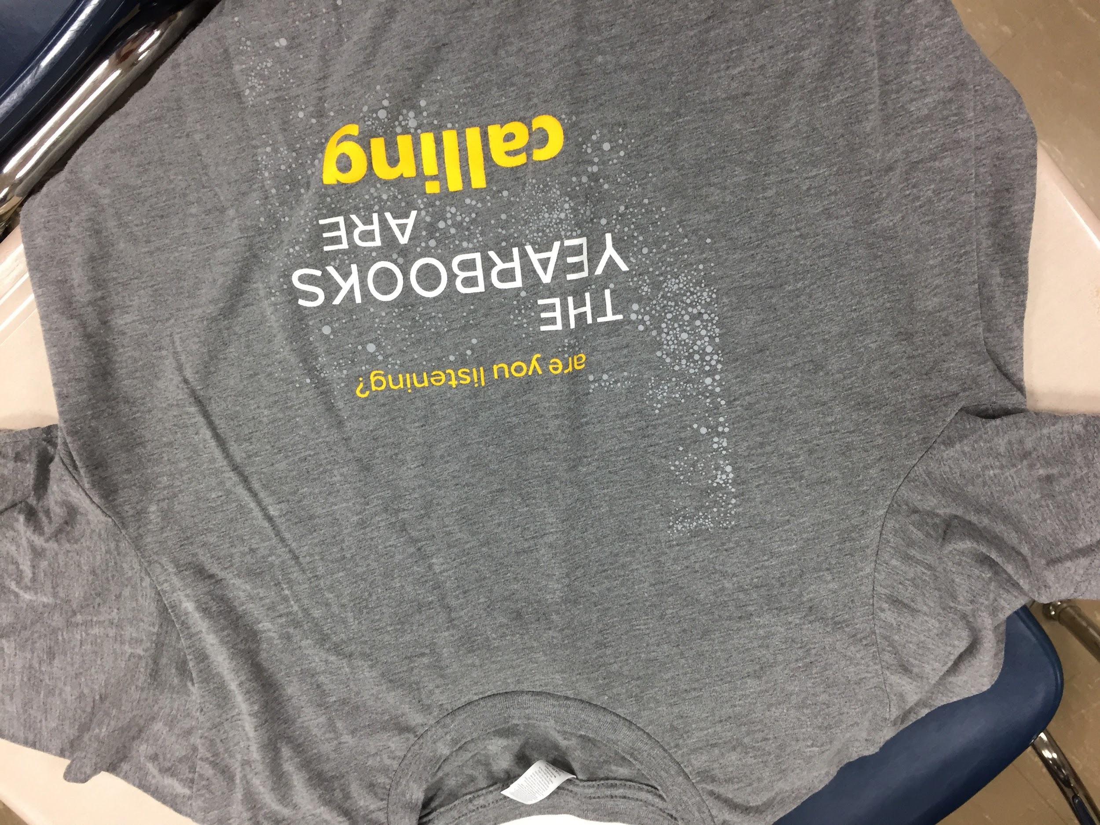
Make the theme (verbal and visual) part of the staff t-shirt design

Slide 38
How can your theme guide coverage in your book?
Personality Profile Challenge
Researching coverage opportunities for students who have passions to showcase or who are involved in special activities that showcase their passions.

Slide 39
Goal: Teach staffers how Brandon Stanton conducts an interview and photo shoot and how he edits and packages his reporting.
Plan: Each staffer conducts a photo shoot and interview and chooses the best photo as well as the best material to turn into a quote story or Q & A. Display work product on posters in the school.

Slide 40
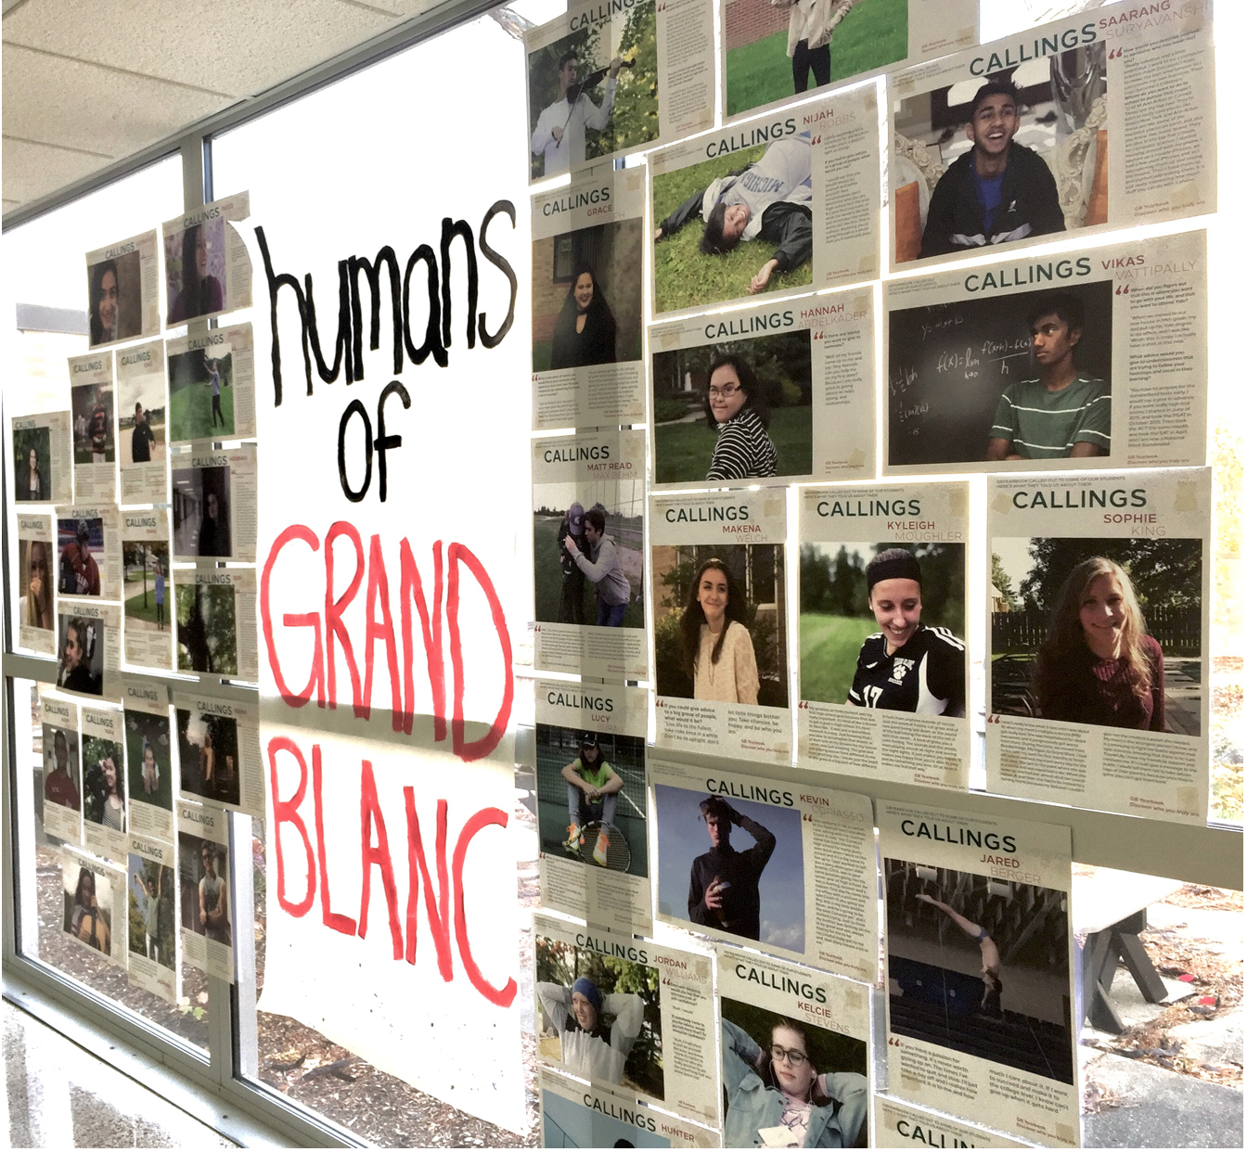

Slide 41
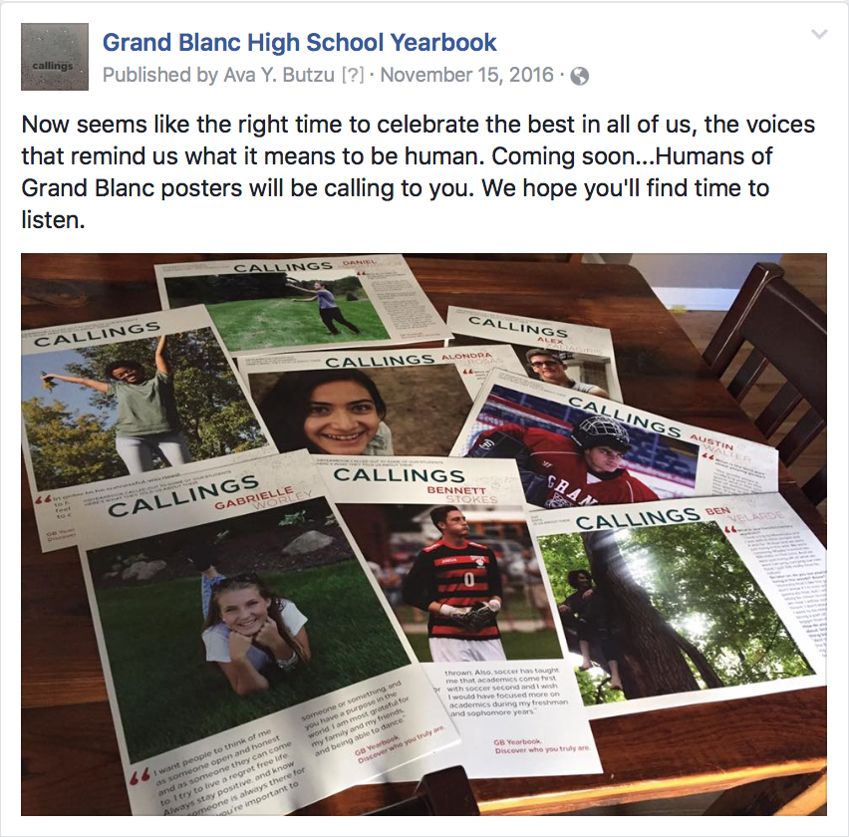

Slide 42
sample

Slide 43
sample

Slide 44
sample

Slide 45
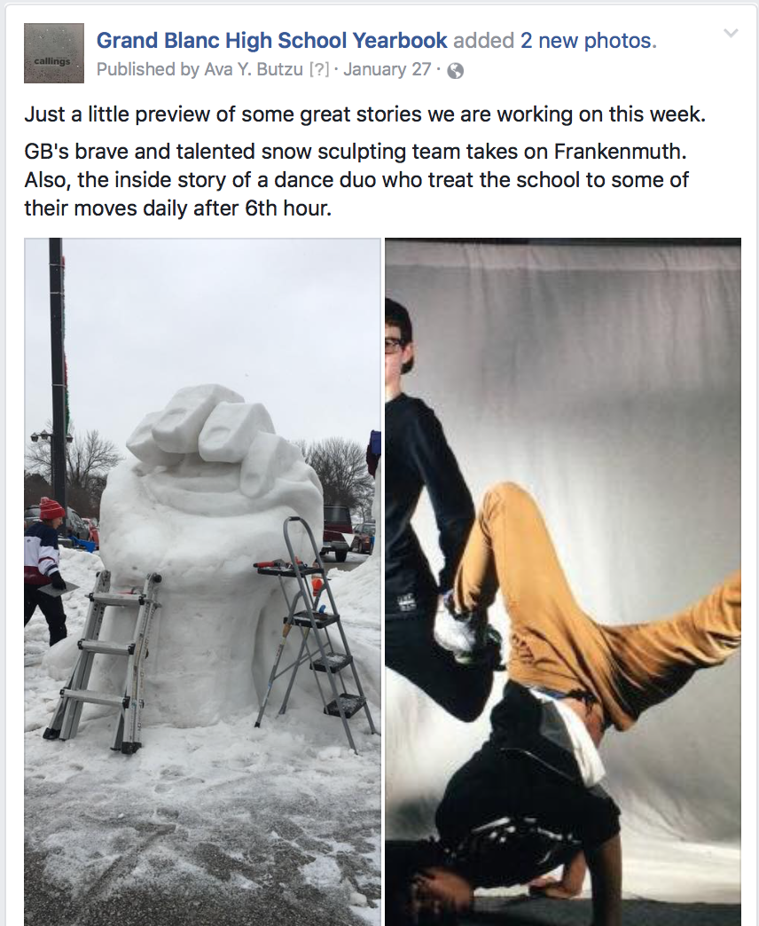
Social media posts of stories staffers are working on that are centered on the theme of “callings.”

Slide 46
How can your theme guide marketing and advertising?
personal letters, hand-delivered
postcards home
theme hashtag
photo frame/selfie backdrop
social media reminders of sales promos

Slide 47
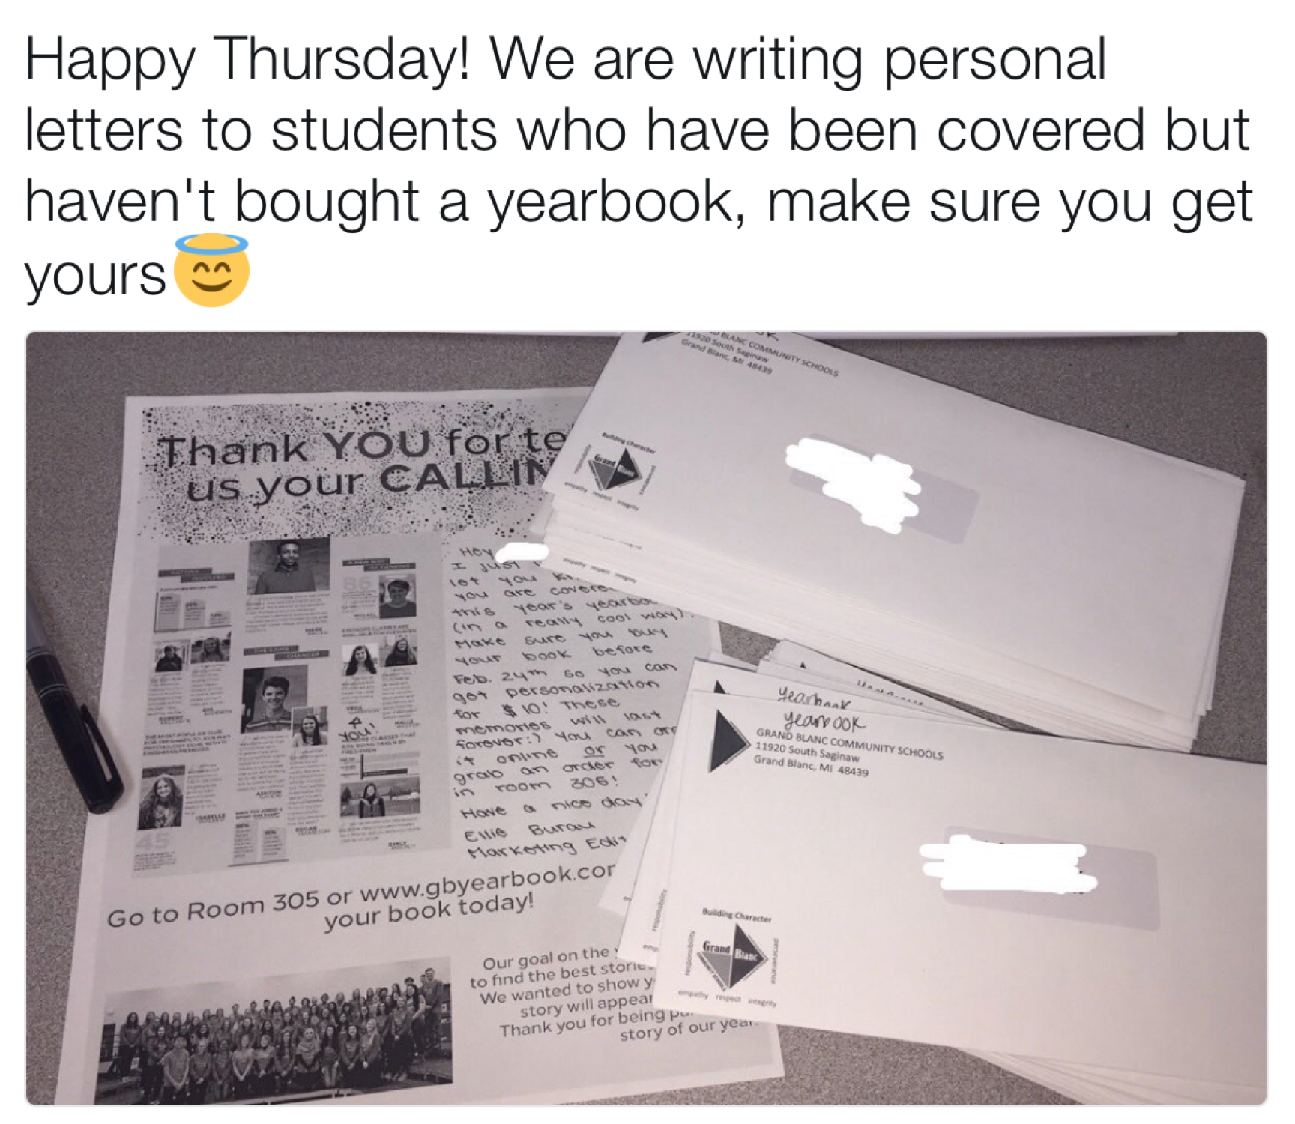

Slide 49
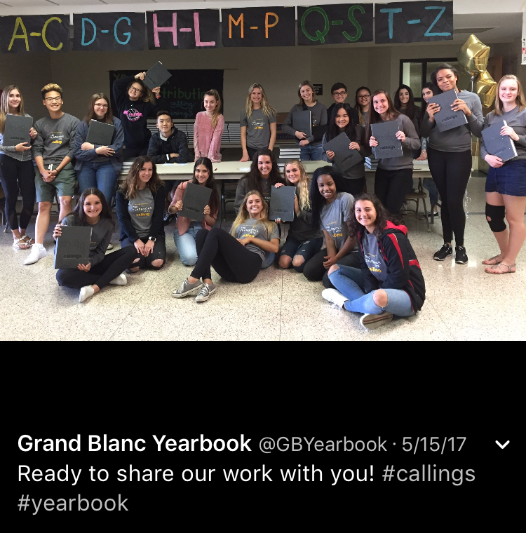
theme hashtags

Slide 50
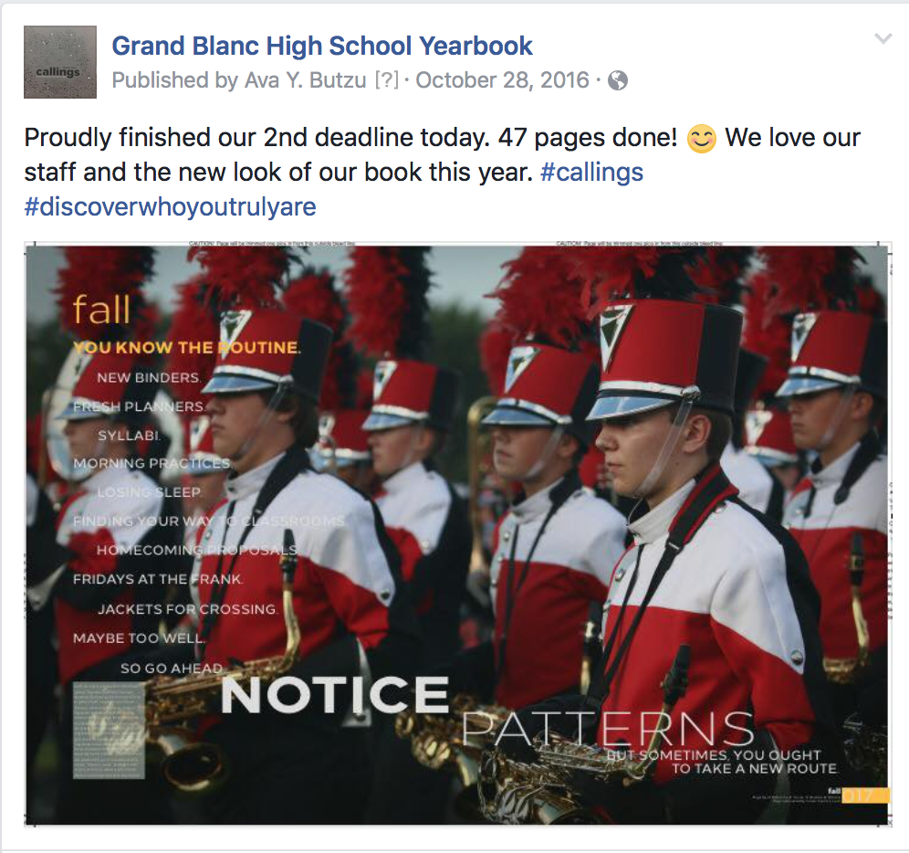
theme hashtags

Slide 51
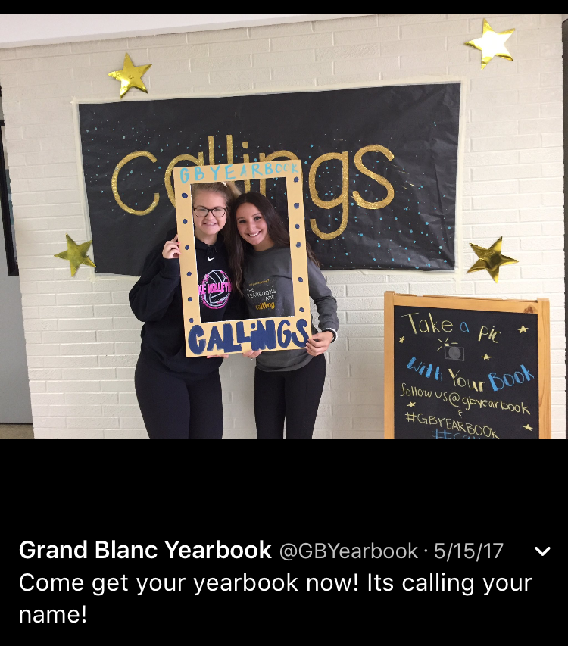
theme selfie frames

Slide 53
Your Turn: Use the samples in this presentation as inspiration to brainstorm specific action plans for each of these questions:
How can you teach your theme to readers?
How can your theme guide coverage?
How can theme guide your marketing?
How can your theme define your staff?

Slide 54
From How to Steal Like an Artist,
by Austin Kleon
“Keep a swipe file...a file to keep track of the stuff you’ve swiped from others…
Newspaper reporters call this a ‘morgue file’ -
I like that name even better. Your morgue file is where you keep the dead things that you’ll later reanimate into your work.”

