Slide 1
Leadership Styles
Approaches to Social Influence
By Travis Feil

Slide 2
What’s this number mean?
23,200,000

Slide 3
What’s this number mean?
23,200,000
It’s the number of hits you’ll get if you Google the phrase “leadership styles”
(as of April 2, 2015)

Slide 4
What’s this number mean?
23,200,000
- It’s the number of hits you’ll get if you Google the phrase “leadership styles”
(as of April 2, 2015)
- It’s the number of opinions you’ll get on this subject if you ask 23,200,000 different people.

Slide 5
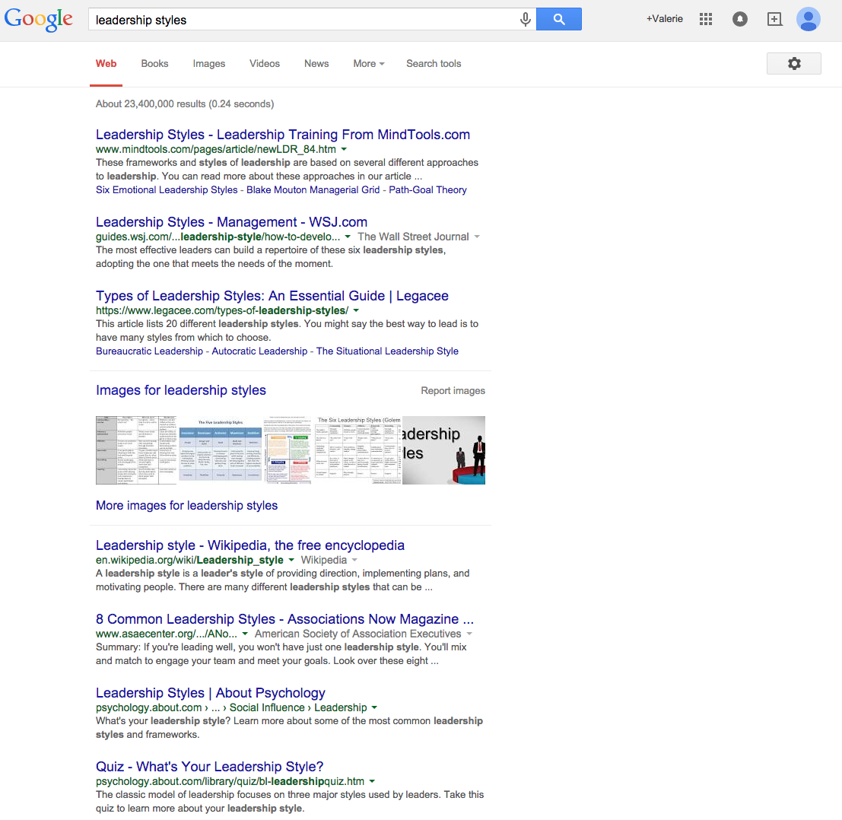

Slide 6
What we won’t do
- Tell you THE BEST way to lead a group
- The simple truth is there are many different approaches and they can all be effective depending on the situation

Slide 7
Deconstruct to Reconstruct
- Think about your favorite classes at school.
Think about the teacher in that class.
Name some traits of that class or teacher that make it both productive and enjoyable

Slide 8
Three Personality Groups of Leaders
Passive:
- Primary concern is being liked by the group
- Strong desire to please others
- Conflict is very uncomfortable and avoided
- The leader isn’t overly worried about meeting his own objectives as long as everything is peaceful

Slide 9
Three Personality Groups of Leaders
Authoritative:
- Primary concern is being in control
- Strong desire to be respected/honored by others
- Conflict is not allowed – “My way or the highway”
- The objectives will be met – end of discussion

Slide 10
Three Personality Groups of Leaders
Assertive:
- Primary concern is cooperative production
- Strong desire to see others succeed in the process
- Conflict is a means of growth
- The objectives are often met using methods the leader didn’t intends – ideas surface when everyone and the leader facilitate the execution of the plan.
- Objectives often change as the group works

Slide 11
Think of it this way…
Passive = Lose-Lose:
- Even though the leader wants to be liked, she often times is not because she is trying to please too many people.
- Nobody is happy because the situation resembles chaos when everyone gets his/her way.
- Objectives don’t get met and the group fails.

Slide 12
Think of it this way…
Authoritative = Win-Lose:
- The leader is not concerned with being liked – he only wants the job done and he’ll do whatever it takes to get it done. He wins.
- Those being led resent that their own ideas and plans are disregarded and they’re not treated with respect. They lose.
- Although objectives are met, the group fails because they are never true participants in the process.

Slide 13
Think of it this way …
Assertive = Win-Win:
- The leader is more concerned with group objectives than how she is perceived. She is motivated by the job being done well. She wins.
- Those being led realize there is a forum for their ideas and know they’ll be listened to if not followed. They win.
- Objectives are met by whatever means are best.
- The leader will insist that the job gets done even if the means to that end are unexpected or unplanned.

Slide 14
Remember Your Teachers …
Passive: Lose-Lose
- Objective is to be liked, so nobody gets in trouble or is held accountable. Whatever learning objective existed in the lesson plan is disregarded because the class wants to do something else. The teacher doesn’t teach, the students don’t learn. People eventually resent the teacher. Everyone loses.

Slide 15
Remember Your Teachers…
Authoritative: Win-Lose
- Objective is determined solely by the teacher, so students have no input in what they learn or how they learn it. The students might pass the test, but the information isn’t internalized. The teacher wins and the students lose.

Slide 16
Remember Your Teachers…
Assertive: Win-Win
- Objective is guided by the teacher according to the needs of the learners. Rabbit trails may be pursued and alternative methods are employed, sometimes as directed by the students. The teacher may have to firmly redirect at times, but everyone wins.

Slide 17
Another Set of Terms
Kurt Lewin – 1939
- Autocratic:
- Leader determines what needs to be done, how it will be done, who will do it, and when it will be finished.
- Works best when the leader is honestly the most knowledgeable about the problem and how to solve it.
- Creativity is minimal since the ideas originate from one person.
- For example: deadline day. The editor may firmly lay out a plan for how all pages will be complete by the 4 p.m. go-to-press time.

Slide 18
Another Set of Terms
Kurt Lewin – 1939
- Participative:
- Leader facilitates the generation of ideas – all participate equally to determine the best route to success.
- Works best when there is time for discussion and when no obvious solution exists.
- Creativity is maximized from a large pool of contributors.
- Failure does occur since not all ideas will work.
- For example: issue planning. The entire staff may generate ideas for covering new topics and how to approach the reporting.

Slide 19
Another Set of Terms
Kurt Lewin – 1939
- Delegative:
- Leader assigns the problem to others who generate the solutions and execute the plan.
- Works best when a member of the group is obviously most qualified to solve the problem in question.
- Creativity is neutralized – out of the hands of the leader
- For example: business management. The editor may assign the planning and execution of the ad campaign to a single business-minded staff member with that skill set.

Slide 20
Review thus far …
Passive: Lose – Lose
Authoritative: Win – Lose
Assertive: Win – Win
Autocratic
Participative
Delegative

Slide 21
And the list goes on …
We could spend a day just exploring these types of theories.
Instead, let’s do some reflection and application based upon the things we’ve discussed so far.
Consider yourself and your own leadership style.
Of the terms lists, which terms seem to describe your own leadersihp style most commonly?
Where could you grow?

Slide 22
Reflection
Fill out the Leadership Style Reflection page in the next few minutes and let’s talk about it.

Slide 23
Perception
An important component of leadership is perception
Perhaps you believe you’re doing a better job than you are.
Perhaps you’re trying really hard, but people aren’t seeing your efforts the same way you are.
It’s a good idea to get feedback from those you’re leading to determine if changes need to be made.
Consider randomly and anonymously surveying your staff about their perceptions of the working environment
Take their opinions with a grain of salt and facilitate discussion about points of contention.

Slide 24
Round Table Discussion
What have you read about being a leader that might make leading easier? It may be a theory, a method, an idea … anything at all.

Slide 25
One-Minute Manager
Because student media is a fast-paced environment, a one-minute-manager approach can be employed for day-to-day management needs

Slide 26
One-Minute Manager
One minute goals:
- Quickly and often, make sure your staff knows what is expected and has the tools necessary to achieve success.
- Use to redirect unproductive behavior that surfaces randomly.
- In 60 seconds, ask what a staff member is going to accomplish during this work session. Listen, affirm, and add objectives as needed.

Slide 27
One-Minute Manager
One minute goals:
- “Caleb – we have 40 minutes of class left. What are the things you’d like to have finished when the bell rings? (Listen) That sounds doable. I’d like to add the caption on page 3 to your list. Amanda is waiting to edit that page. Let’s also plan on you filing your interview notes from yesterday and downloading the pep rally photos before you leave. Thank you for your hard work!”

Slide 28
One-Minute Manager
One minute praise:
- When you see someone doing something right, take 60 seconds to pause and praise them for what they have done right.
- Take a full 60 seconds – that’s a long time, and they’ll feel it is more meaningful.

Slide 29
One-Minute Manager
One minute praise:
- “Rachel – I was looking through your story on the new lunch menu and wanted to tell you I appreciate the perspectives you got in the story. I saw quotes from lunch staff, teachers, students, administrators, and parents and I know that wasn’t easy. Because you made that effort, the story really feels balanced and whole. The facts about the legislation affecting lunch offerings was really well written, too. Very simple and easy to follow information you shared. I know you didn’t necessarily love this assignment, but you did a really good job making it objective and journalistic, and the whole paper is better because of it. Thank you.”

Slide 30
One-Minute Manager
One minute reprimand:
- When a staff member fails, take them in private to directly address the problem
- Keep it under 60 seconds
- Focus only on the performance, not the staff member. Use behavior-centered language.
- Encourage them that they can do better.
- Let it go – don’t hold it over them.

Slide 31
One-Minute Manager
One minute reprimand:
- “Brittney – In the last few class periods, I’ve noticed you haven’t volunteered for any photo assignments. Can you share with me the reason? (Listen). I understand. Balancing work and school is tough for all the staff members with jobs. Here’s the struggle: when the rest of the staff perceives that you’re not willing to take photos, it causes resentment among those who are carrying the extra weight which really erodes the team spirit we’ve tried to create this year. To help keep the staff motivated and cohesive, let’s get you out for some photo assignments that won’t interfere with work. Look at your schedule for the next week and find time to do 3-4 photo assignments, and make sure to consider the in-school opportunities this week. There are lots of classes we need beat coverage for, so that may help you balance it. Next class, let’s agree on 3-4 opportunities.”

Slide 32
No Matter Your Style…
Make your expectations clear. Consider a staff commitment contract.
Create buy-in by seeking input from the group and creating a sense of community.
Choose your words carefully – keep it about the behavior, not the person.
Balance correction with praise.

Slide 33
Review
Passive – Authoritative – Assertive
Autocratic – Participative – Delegative
Reflection on your leadership style
Perception of performance
One-minute management

