Slide 1
Award-Winning High School Broadcast Programs
Multimedia Broadcast

Slide 2
Mustang Morning News
18:19

Slide 3
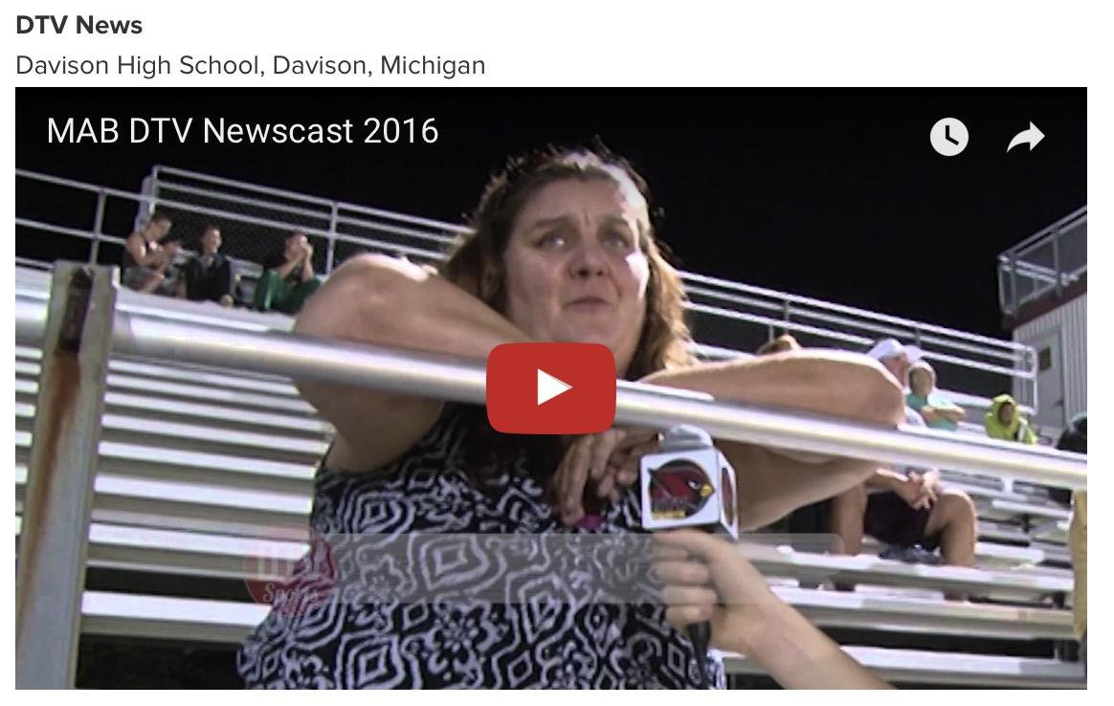
DTV News
18:50

Slide 4
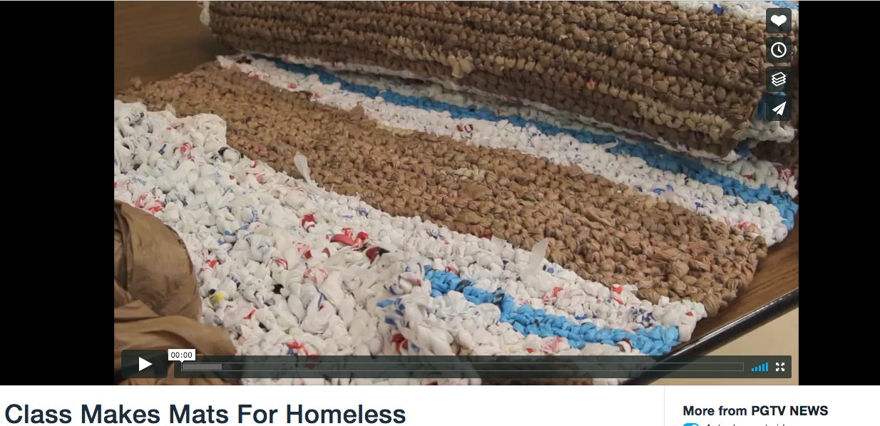
PGTV News
1:22

Slide 5
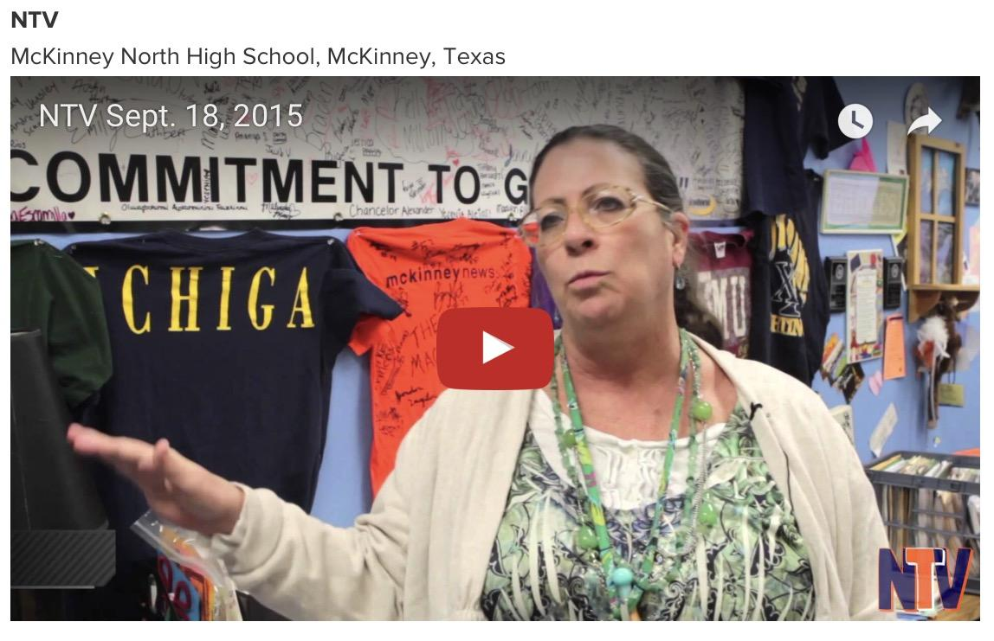
NTV
10:34

Slide 6
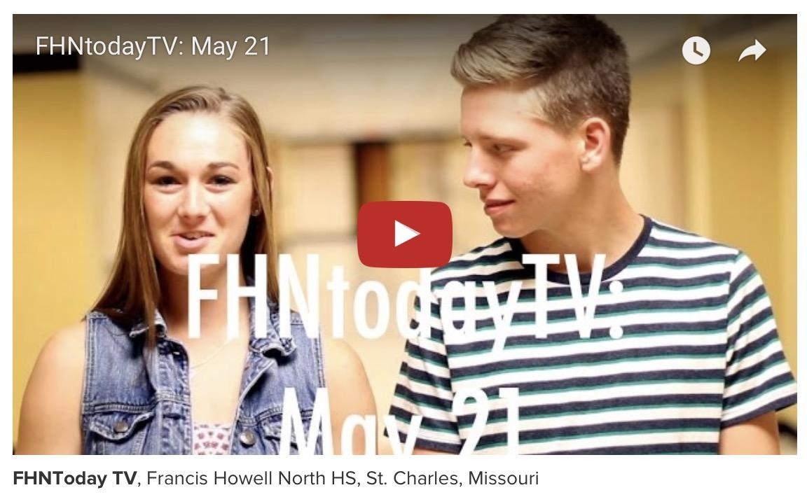
FHNToday TV
11:36

Slide 7
PGTV News
2:16

Slide 8
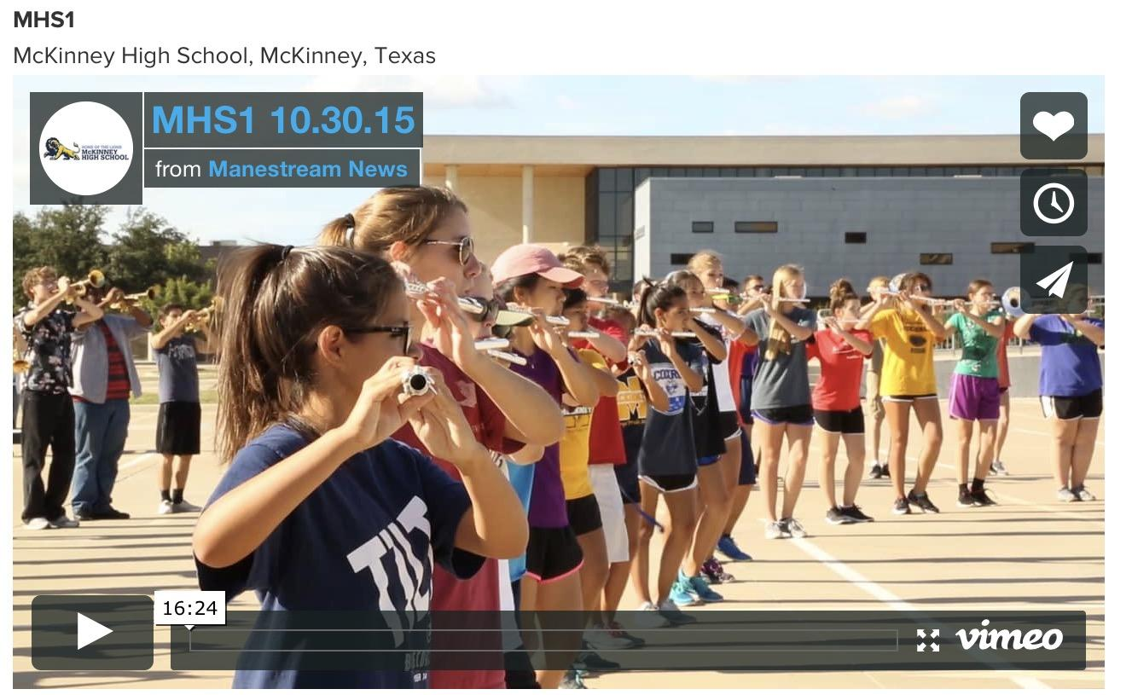
MHS1
16:24

