Slide 1
Script Writing
for Broadcast
Multimedia Broadcast

Slide 2
Why write a script?
By knowing what you are looking for before you begin a production, you will be better organized and better prepared.
Others involved in your productions can give comments or advice on things they would like to see added or removed.

Slide 3
Why write a script?
Timing
Timing is everything in broadcast.
By writing a script you will help yourself meet strict timing parameters that will be set for you.

Slide 4
Two-column script
A two-column script is used when you want to plan out exactly how a video will appear on screen.
Different elements are identified on the left and right side of the screen.
There are a variety of different abbreviations used that you should begin to familiarize yourself with.

Slide 5
Common abbreviations
VO – voice over
A voice is recorded and then edited into the final sequence
NAT Sound – natural sound
The sound that is recorded from the camera
SFX – sound rffects
Sounds other than music or voice overs

Slide 6
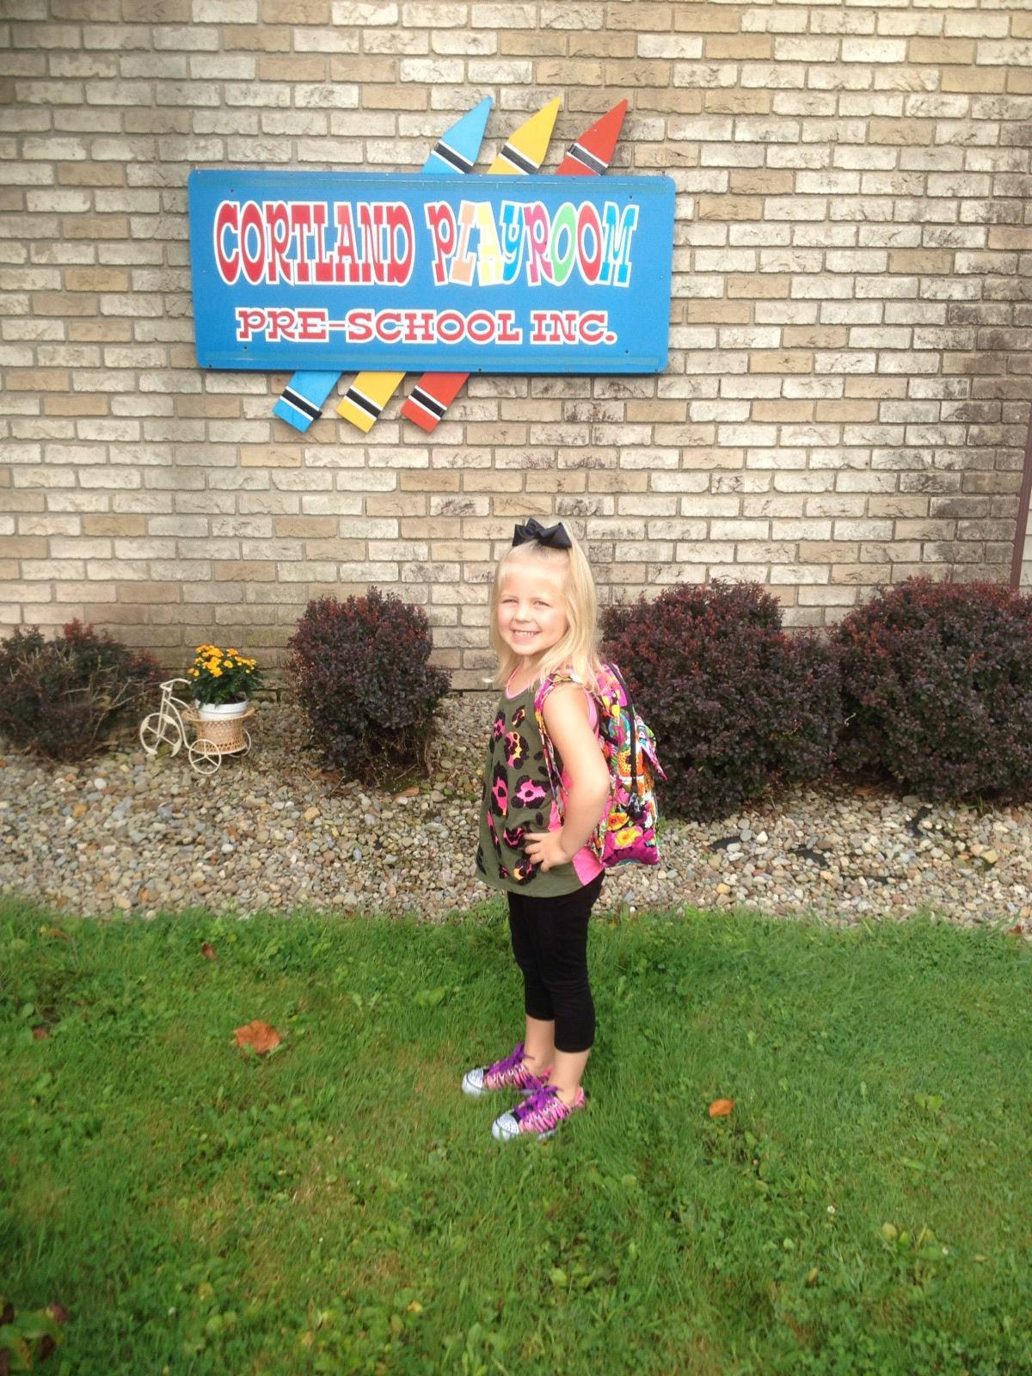
Common abbreviations
WS – wide shot
The camera is shows a wide or establishing shot of the location you are filming
Gabriella Doran

Slide 7
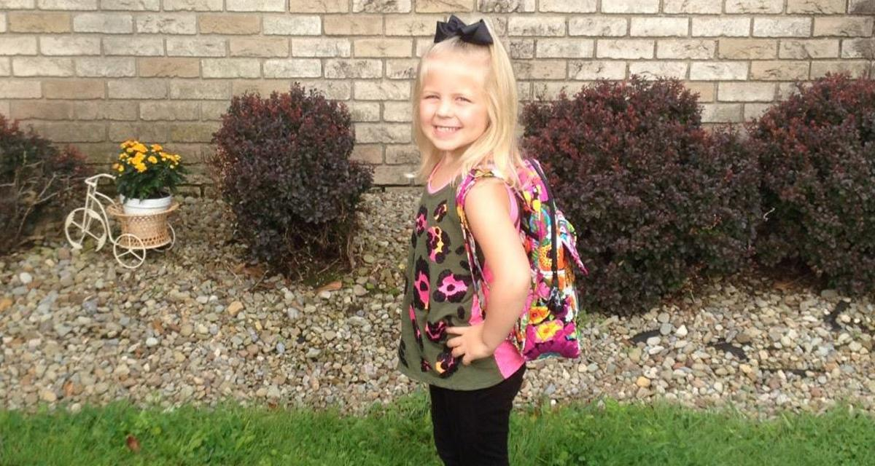
Common abbreviations
MS – medium shot
The camera is either physically moved or zoomed into about the mid-section of the person being filmed
Gabriella Doran

Slide 8
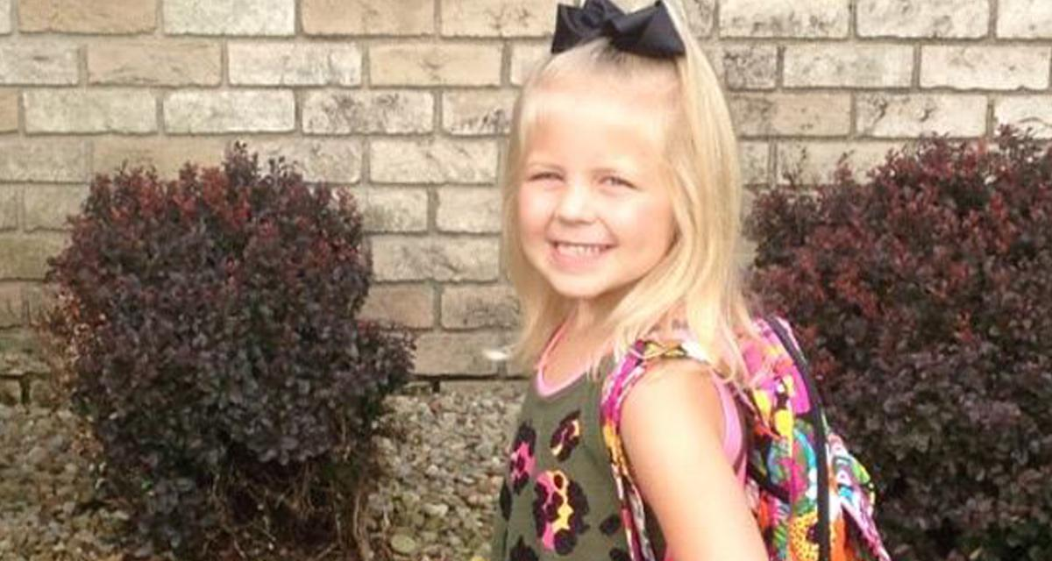
Common abbreviations
CU – close-up
The camera is either physically moved or zoomed into a close shot of a person’s face
Gabriella Doran

Slide 9
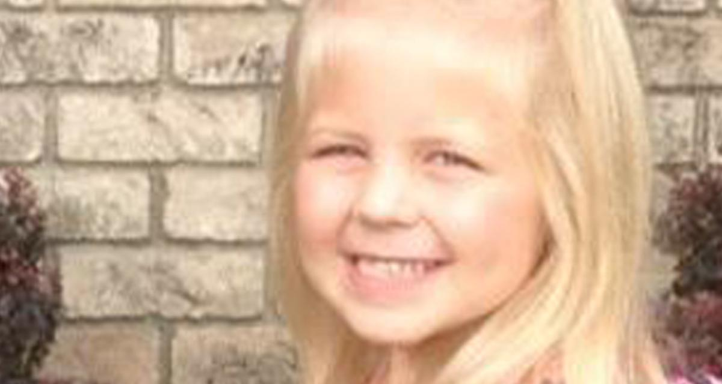
Common abbreviations
ECU – Extreme Close Up
The camera is zoomed into a portion of a person’s face. Usually, it is their eyes or their mouth.
Gabriella Doran

Slide 10
Common abbreviations
LS – long shot
The camera is placed at a distance from the focal point. Often, this shot will demonstrate depth.
Trumbull County Fair
Warren, Ohio

Slide 11
Common abbreviations
OTS – over the shoulder
The camera is placed behind the head and shoulders of one of the subjects to show a conversation between two people.

Slide 12
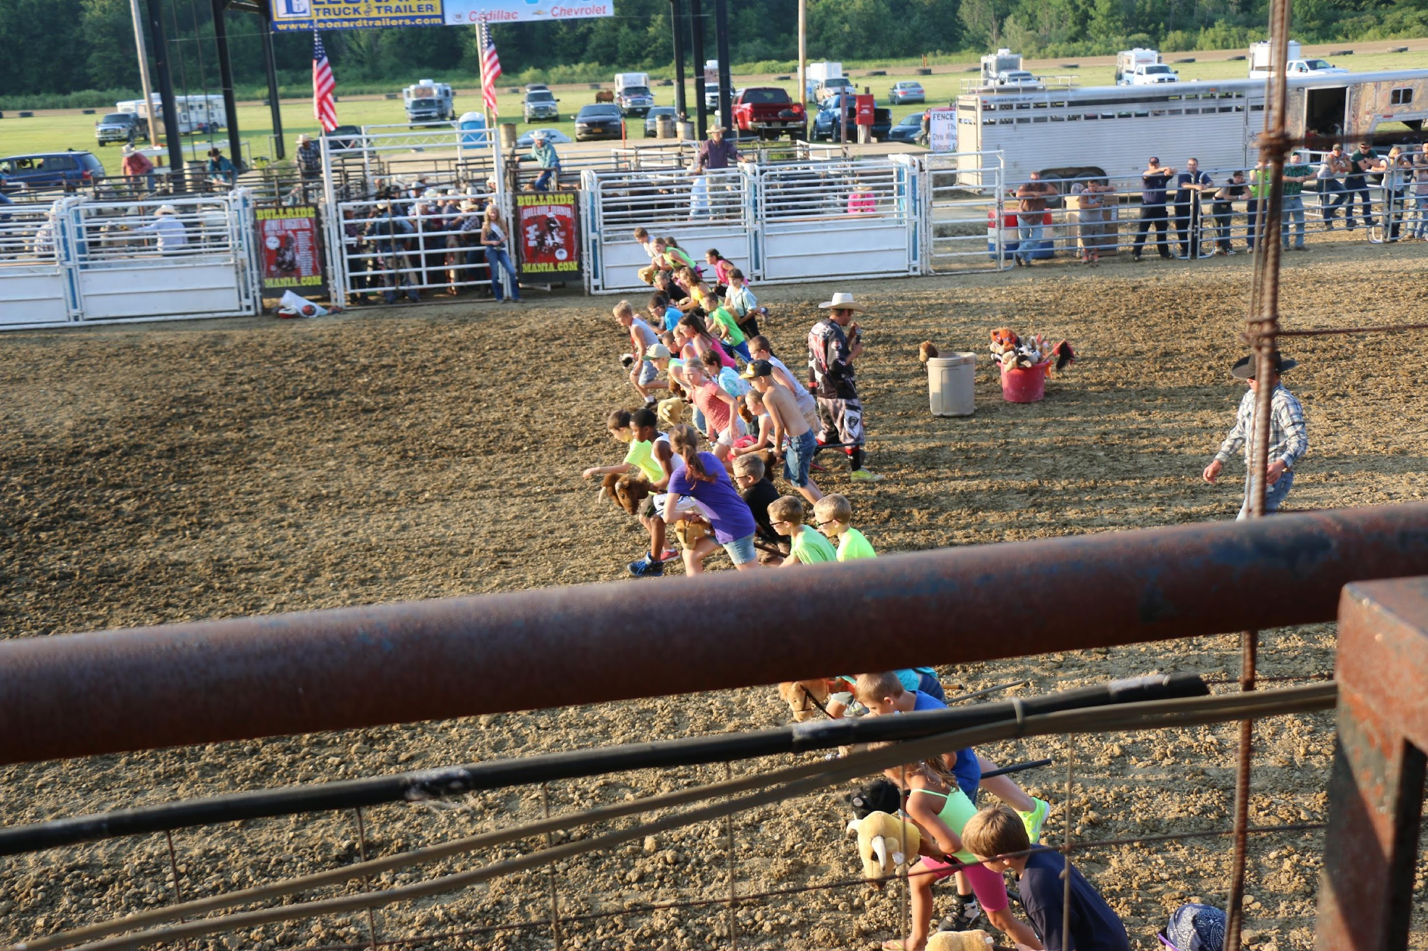
Common abbreviations
POV – point of view
The camera takes the place of the person’s eyes to make viewers feel as if they are experiencing the camera action.
Trumbull County Fair
Warren, Ohio

Slide 13
Common abbreviations
GFX – graphic
This can be labeled to identify full screen, lower third, a picture, bugs or other types of graphics.
CGI – computer generated image
Another way to label a GFX, but you could see this in place of GFX in the industry.

Slide 14
Writing two-column scripts
LEFT SIDE
VIDEO descriptions, abbreviations and special instructions
Graphic formatting and wording
You can also include directions on how you want your on screen talent to act or position themselves
RIGHT SIDE
AUDIO script should be exact and have every word that you want to be included
Music instructions
(Fade up, continue,
fade out)
Sound effects should be on this side as well

Slide 15
Two-column example
WS – Outside of HS
CU – School Sign
LS – School in the distance with lots of traffic in the foreground
NAT Sound – Traffic
VO – Student “Each day that students come to our high school there is an inherited risk in the traffic they have to cross to enter the school.”

Slide 16
Writing two-column scripts
Different than most other media in journalism, script writing for television can be conversational.
It would be difficult watching a show where the talent read a newspaper article or website.

Slide 17
Writing two-column scripts
Conversational script-writing
Find a newspaper, or online article and read it.
Now, explain the article to the class.
You should still include all of the facts and people included in the article, but you want to be much more conversational.

Slide 18
Writing two-column scripts
Practice
Try writing a short two-column script about what is for lunch at school tomorrow.
Compare scripts when finished.

Slide 19
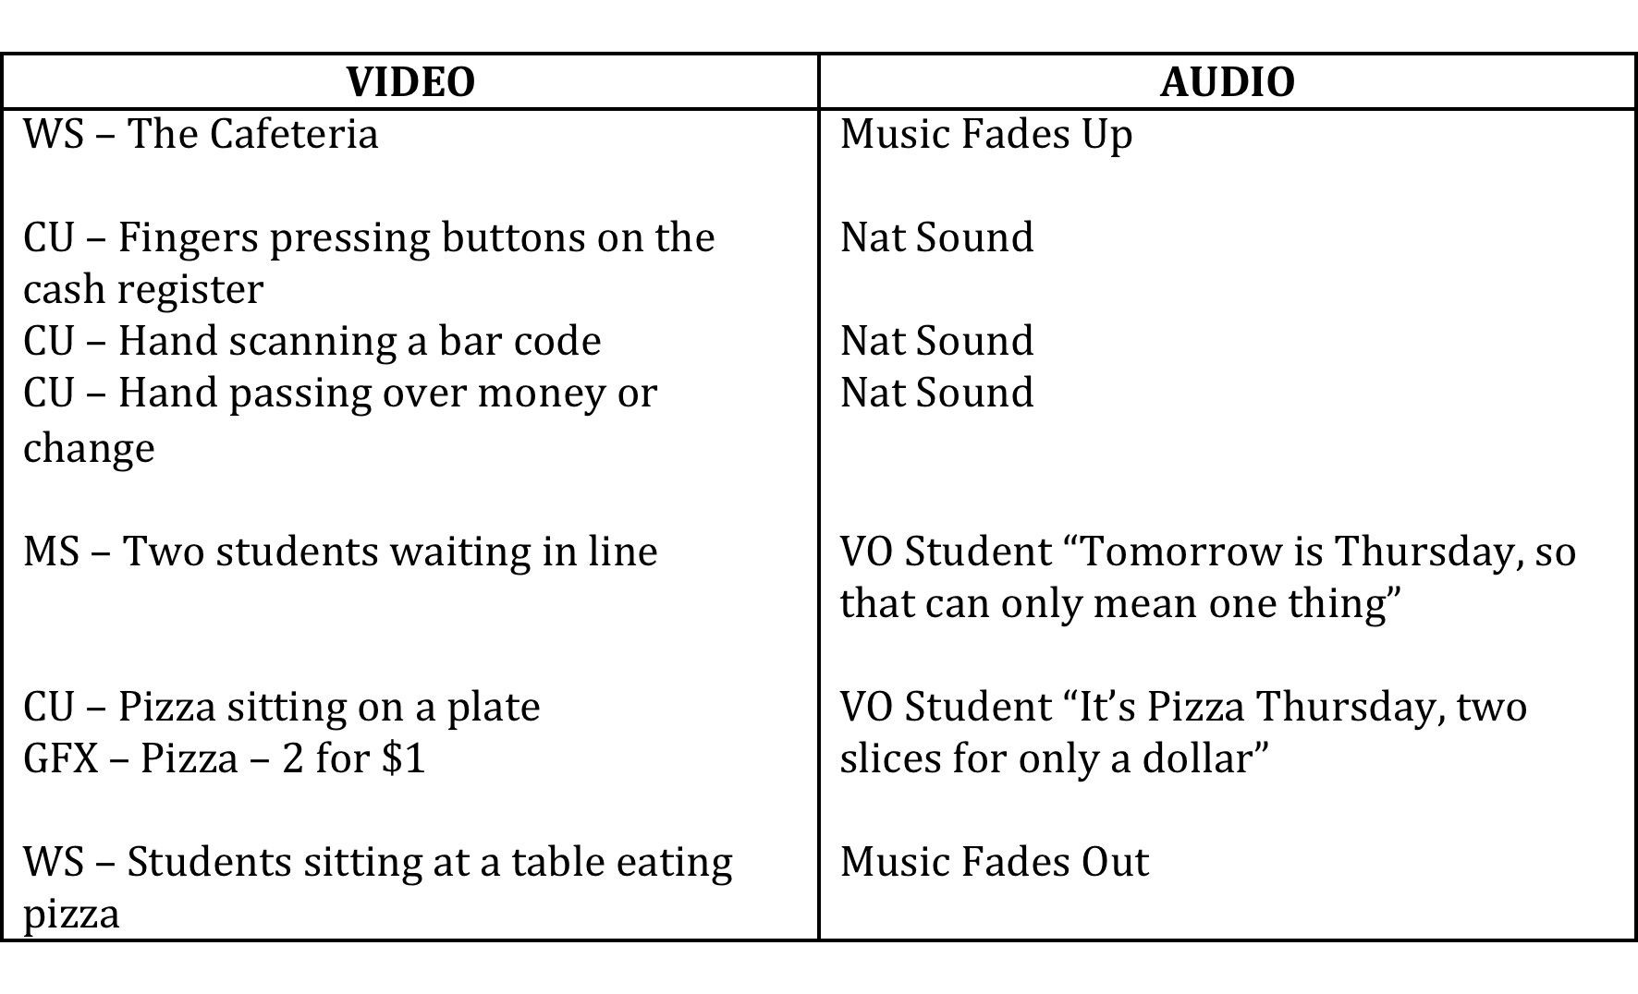

Slide 20
What is narrative storytelling?
In other forms of media, narrative is comparable to a feature story.
It generally has a chronological sequence.
Usually it involves one or combination of the following things:
person or people
place
time
mission, purpose, point of view

Slide 21
Narrative storytelling
As producer you try to make sense of what happened.
You try to put things in the correct order.
You talk to and interview people.
You try to understand why people feel the way they do.
You visit the place things took place.
You make sure you report only things that are TRUE by verifying statements.

Slide 22
Narrative storytelling script writing
When using narrative storytelling or a long-form type story, you do not write a script so much as you write an outline.
A great way to understand how you outline a narrative story is to use classic children's literature.

Slide 23
The Three Little Pigs
Person or people
three little pigs
a big, bad wolf

Slide 24
The Three Little Pigs
The place
A pig farm?
We better verify this if we want to report it.

Slide 25
The Three Little Pigs
Time
one of the three pigs took very little time to build his house of straw
one of the three pigs took some additional time to build his house out of sticks
one of the three pigs took much more time to build his house of bricks

Slide 26
The Three Little Pigs
Mission, purpose, point of view
The wolf
He was hungry.
Wolves eat pigs.
The pigs looked delicious.
He died as result of his efforts.

Slide 27
The Three Little Pigs
Mission, purpose, point of view
The pigs
Each had his own perspective on how much effort they should take to build their houses.
They were terrified when a wolf came for them.
They protected themselves with a pot of boiling water.
They gained new perspective on the quality of their houses.

Slide 28
Narrative storytelling practice
Split into small groups.
Create an outline of another classic children’s type story.
Be prepared to present to the class.

Slide 29
Outlining an interview
Similar to narrative storytelling, you should create an outline before sitting down to interview.
The best thing you can do prior to an interview is understand a basic idea of the story before you sit down to conduct the interview.

Slide 30
Outlining an interview
Many people will try to list every question that they would like to have answered.
Yet, we have discussed that broadcast is conversational.
Is it conversational when everything you are going to ask is already written out?

Slide 31
A better interview
Instead of listing all of your questions, try listing words or phrases that surround the story you are trying to have told
The three pigs relationship
Where did the pigs learn to build?
Lazy, motivated
Survival for the pigs and the wolf’s perspective
What else is missing?

Slide 32
A better interview
As important as listing question/ phrases or keywords is listening.
When you are conducting an interview, often the interviewee will answer questions or phrases that you want answered later.
By having short phrases and keywords, you can simply cross those off the list if you are listening to their responses.

Slide 33
Interview practice
In groups of three, find a story that each person could be interviewed about.
Each member of the group will interview another. First, you should make list of keywords and phrases.
The third member of the group will be a silent observer while each interviews the other.
Note any redundant questions asked, showing they might not be listening.

