Slide 1
Types of Video Shots
Multimedia Broadcast

Slide 2
Review: Types of Video Shots
•Wide shot (WS)
•Medium shot (MS)
•Close-up (CU)
•Extreme close-up (ECU)
•Long shot (LS)
•Over the shoulder (OTS)
•Point of view (POV)

Slide 3
Wide Shot (WS)
Wikimedia Commons image courtesy of Ximonic (Simo Räsänen). License: https://creativecommons.org/licenses/by-sa/3.0/deed.en

Slide 4
Medium Shot (MS)
Wikimedia Commons image courtesy of Irene Scott/AusAID. License: https://creativecommons.org/licenses/by/2.0/deed.en

Slide 5
Close-Up Shot (CU)

Slide 6
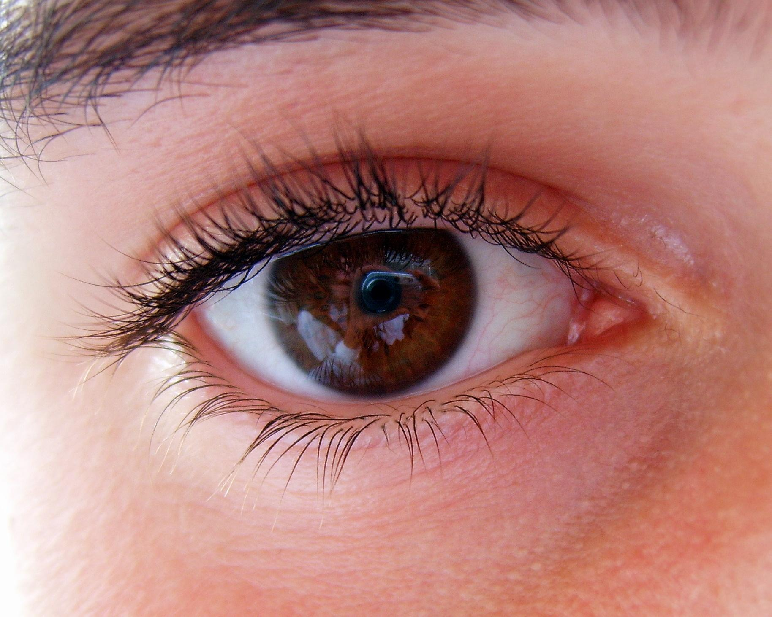
Extreme Close-Up Shot (ECU)
Flickr image courtesy of Dan Foy. License: https://creativecommons.org/licenses/by/2.0/deed.en

Slide 7
Long Shot (LS)
Photo by DAVID ILIFF. License: CC-BY-SA 3.0

Slide 8
Over-the-Shoulder Shot (OTS)

Slide 9
Point-of-View Shot (POV)

