Slide 1
Descriptive Statistics
News Gathering

Slide 2
What are descriptive statistics?
Calculations that allow us to start to analyze our data by describing it in certain ways

Slide 3
Descriptive statistics are measures that show:
central tendency (how close together the numbers/data points are or aren’t)
spread (the range from highest to lowest of the numbers/data points)
variability (how different the numbers/data points are from each other)

Slide 4
Descriptive measures we’ll explore
Mean
Median
Mode
Range
Correlation
Which of these do you recognize?
How would you define them?

Slide 5
Mean
The average.
To find: Add all the numbers and divide by the total numbers in the set.

Slide 6
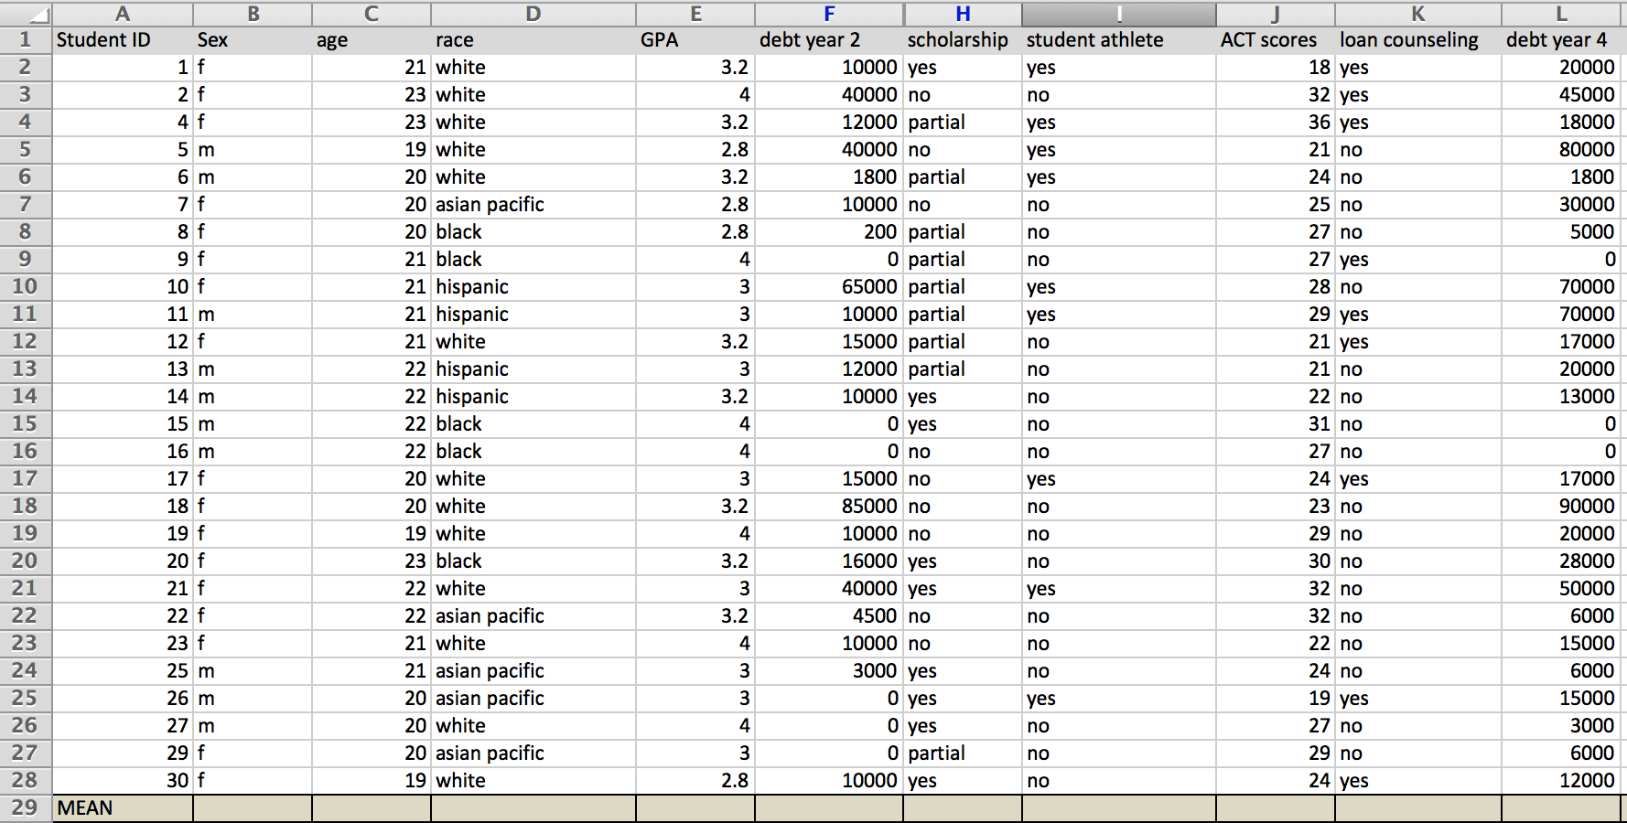
Practice
In your spreadsheet, create an extra row at the bottom with the label “mean.”

Slide 7
Let’s calculate the mean for:
Age
GPA
Debt year 2
ACT scores
Debt year 4

Slide 8
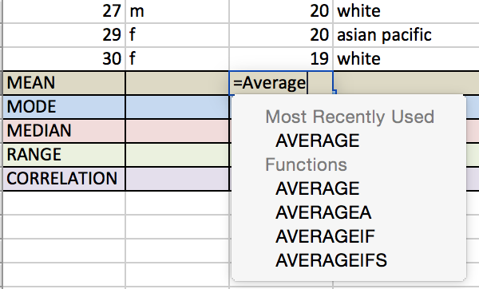
But first, an overview of excel functions
Excel uses commands to calculate. In Excel, the command for “mean” is “Average.”
First, you tell Excel which value you are trying to calculate (i.e. mean, mode, median). Use an equal sign (=) to indicate you are giving a command. You’ll notice as you start typing “Average,” a drop-down menu with command choices appears.
Notes:
Teacher, open the “Sample Spreadsheet: Descriptive Statistics” spreadsheet to show how Excel works. Demonstrate the actions described in the slide.

Slide 9
Then, you tell it which numbers to included in that average calculation. In this case, we are calculating for a whole column (i.e. the mean age).
So, we want Excel to reference and calculate using each cell of the column “age.” We can tell Excel this two ways:
We can type the full range of cells we’d like Excel to reference, using a colon to separate first from last. We would type that command like this, using parenthesis around the column reference:
=Average(C2:C28)
Hit enter
Or, we can use Excel’s “click-and-drag” feature to tell Excel which column and cells to use.
=Average
then hover mouse at the bottom right edge of the top cell of the column (C2) until you see a cross hatch. Then, click and drag all the way down the column until C28. Hit enter.
Notes:
Demonstrate the actions described in the slide. First, show how to type in the formula for average. Then, show the click-and-drag option for Excel. Let them practice a number of times, walking to room to troubleshoot.

Slide 10
You try
Calculate the mean for:
GPA
Debt year 2
ACT scores
Debt year 4
Notes:
Give students 10 minutes to find the answers using an Excel formula in the proper cell. Use the file “Sample Spreadsheet: Descriptive statistics answers” to show answers and troubleshoot after students have a chance to calculate.

Slide 11
Start with the age column
Click inside the cell at the bottom, in the row for “mean”
Type this: =AVERAGE(C2:C28)
OR try the click-and-drag method.

Slide 12
Mode
The value that occurs most frequently in the set.
To find: Order the numbers numerically and count which one shows up the most.

Slide 13
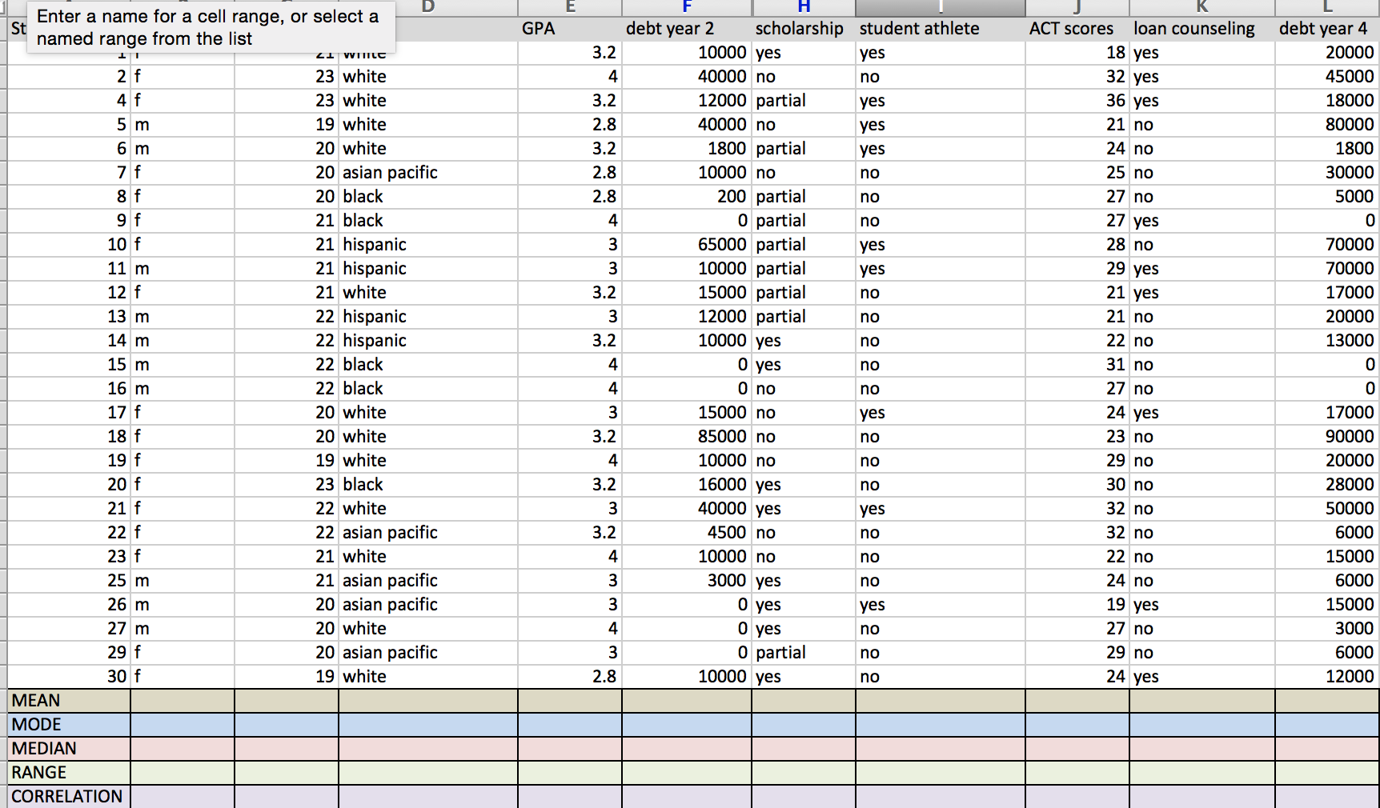
Practice
In your spreadsheet, create an extra row at the bottom with the label “mode.”

Slide 14
Let’s calculate the mode for:
Age
GPA
Debt year 2
ACT scores
Debt year 4
In Excel, the command is MODE. What would we enter into the cell to calculate age?

Slide 15
Calculate for age
=MODE(C2:C28)
or
=MODE
--->then click and drag from C2 down to C28
Troubleshooting: look at the formula bar at the top of the screen if you get the error message: #NAME! The formula should look like the top.

Slide 16
You try
Calculate the mode for:
GPA
Debt year 2
ACT scores
Debt year 4
Notes:
Give students 10 minutes to find the answers using an Excel formula in the proper cell. Use the file “Sample Spreadsheet: Descriptive Statistics Answers” to show answers and troubleshoot after students have a chance to calculate.

Slide 17
Median
The score found at the exact middle of the set.
To find: List all the numbers in numerical order, then find the one exactly in the middle. If the middle exists between two numbers, you would average the two numbers on each side of the middle.

Slide 18
Practice
In your spreadsheet, create an extra row at the bottom with the label “median.”

Slide 19
Let’s calculate the median for:
Age
GPA
Debt year 2
ACT scores
Debt year 4
In Excel, the command is MEDIAN. What would you enter into the cell to calculate median age?

Slide 20
Calculate for age
=MEDIAN(C2:C28)
or
=MEDIAN
--->then click and drag from C2 down to C28
Troubleshooting: look at the formula bar at the top of the screen if you get the error message: #NAME! The formula should look like the top.

Slide 21
You try
Calculate the median for:
GPA
Debt year 2
ACT scores
Debt year 4
Notes:
Give students 10 minutes to find the answers using an Excel formula in the proper cell. Use the file “Sample Spreadsheet: Descriptive Statistics Answers” to show answers and troubleshoot after students have a chance to calculate.

Slide 22
Range
The highest value minus the lowest value.
To find: Subtract the lowest value from the highest value in the set.

Slide 23
Practice
In your spreadsheet, create an extra row at the bottom with the label “range.”

Slide 24
Let’s calculate the range for:
Age
GPA
Debt year 2
ACT scores
Debt year 4
In Excel, you calculate the range by subtracting the lowest number in the column from the highest.

Slide 25
Calculate for age range
Notice that all the ages are the same! So, the range is zero.
Let’s look at the GPA column.
What’s the highest GPA?
4.0
What’s the lowest?
2.8

Slide 26
Calculate for age range
So, command Excel to do the math for you. Type this:
=E3-E5
Hit enter
Or, do this:
Click on the cell where you want the answer to go
Then type “=”
Then click on the cell E3
Then type “-”
Then click on the cell E5
Hit enter.
Range is 1.2
Notes:
Demonstrate this on the Excel spreadsheet. Explain to students that you could use any of the 4.0 cells or any of the 2.8 cells, the result will still be the same. Demonstrate the click method a couple times.

Slide 27
You try
Calculate the range for:
Debt year 2
ACT scores
Debt year 4
Notes:
Give students 10 minutes to find the answers using an Excel formula in the proper cell. Use the file “Sample Spreadsheet: Descriptive Statistics Answers” to show answers and troubleshoot after students have a chance to calculate.

Slide 28
Correlation
Correlation is a single number that describes the degree of relationship between two numerical variables.
To find: Use Excel command CORREL.

Slide 29
Correlation example
Person | Height (in inches) | High School GPA
1 | 60 | 4.0
2 | 68 | 2.5
3 | 59 | 2.7
4 | 62 | 3.1
5 | 71 | 3.8
6 | 75 | 4.0
In this example, we could use a correlation formula to describe the relationship between a person’s height and a person’s GPA. Correlation can tell us how strong a relationship is, and whether it is positively related (both numbers tend to increase together) or negatively related (when one number moves up, the other tends to move down).
Notes:
Teacher note: For advanced students, this website gives more detail on the math behind correlation: http://www.socialresearchmethods.net/kb/statcorr.php

Slide 30
Understanding a correlation result
When you calculate correlation, you should get a result from between -1 to 1. The closer to 1 or -1, the stronger the relationship.
Results closer to -1 suggest that the two sets of numbers tend to move in opposite directions (as one goes up, the other goes down).
Results closer to 1 suggest that the two sets of numbers tend to increase together (as one goes up, so does the other).
Results closer to zero suggest there isn’t a strong correlation — or relationship — between the two numbers.

Slide 31
Practice
In your spreadsheet, create an extra row at the bottom with the label “correlation.”

Slide 32
Let’s calculate the correlation for:
Age
GPA
Debt year 2
ACT scores
Debt year 4
In Excel, the command is CORREL. What would you enter into the cell to calculate median age?

Slide 33
Calculate correlation for age and GPA
=CORREL(C2:C28, E2:E28)
or start typing and choose
=CORREL
--->then click and drag from C2 down to C28, enter a comma, then click and drag from E2 down to E28
Troubleshooting: look at the formula bar at the top of the screen if you get the error message: #NAME! The formula should look like the top.
(Often, people haven’t entered parentheses to close the command)
Notes:
Teacher note: This correlation between age and GPA will result in an error message. Troubleshoot this with students. Why can it not run a correlation? In other words, why can’t it figure out if there is a relationship? Because all the ages are the same. There’s no variation to compare.

Slide 34
You try
Calculate the correlation for:
GPA and Debt year 2
ACT scores and Debt year 4
What else could we try to correlate?
Notes:
Give students 10 minutes to find the answers using an Excel formula in the proper cell. Use the file “Sample Spreadsheet: Descriptive Statistics Answers” to show answers and troubleshoot after students have a chance to calculate.

