Slide 1
Fake AP Tweet
News Literacy

Slide 2
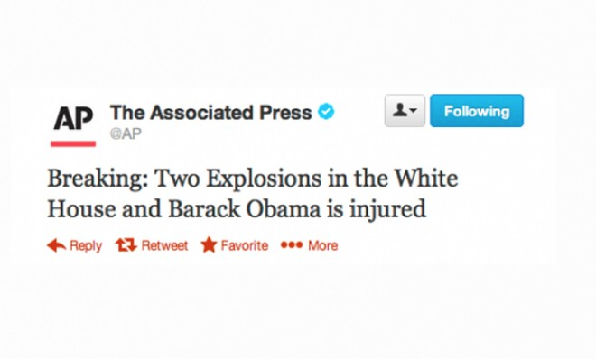

Slide 3
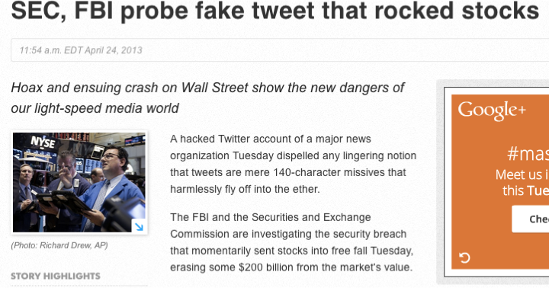
Screenshot form USAtoday.com

Slide 4
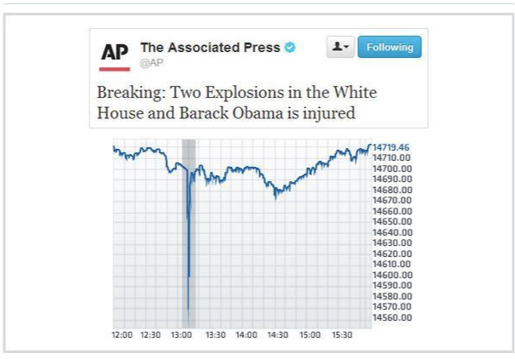
Stock graph: CNBC

