Slide 1
News Covers History
News Literacy

Slide 2
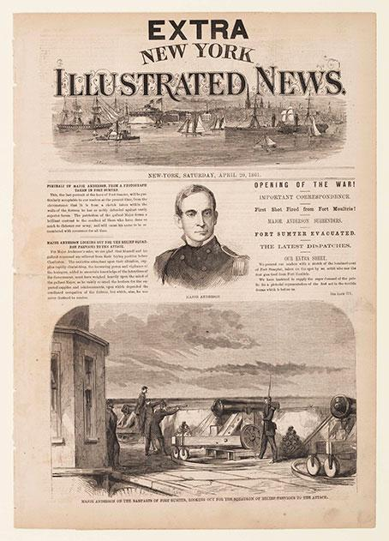
Civil War
The Civil War begins, and a newspaper prints an illustration of a battle at Fort Sumter. War illustrations often took about two weeks to make it to print.
Source: Smithsonian Magazine Collection

Slide 3
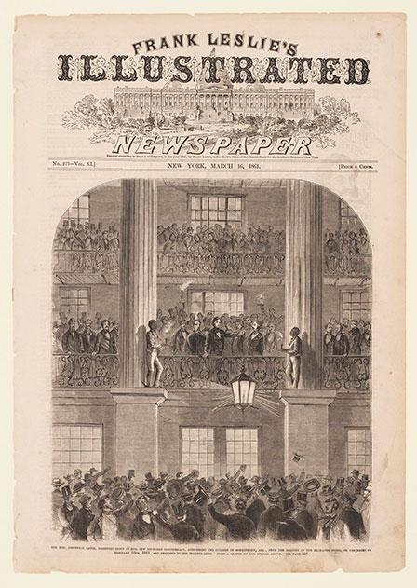
Civil War
An illustration of Jefferson Davis speaking to a crowd before becoming president of the Confederate States.
Source: Smithsonian Magazine Collection

Slide 4
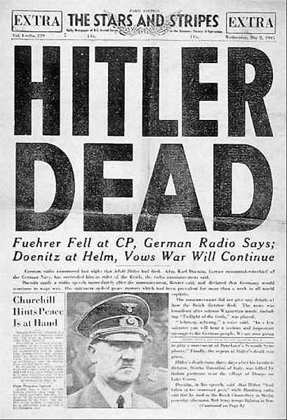
WWII
The Stars & Stripes, a U.S.-government sponsored newspaper, covered Hitler’s death and the closing of World War II.
Source: Creative Commons License, Bundesarchiv, Bild 183-S62600 / CC-BY-SA

Slide 5
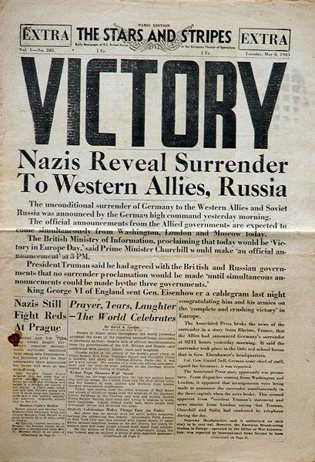
WWII
The Stars & Stripes, a U.S.-government sponsored newspaper, covered Hitler’s death and the closing of World War II.
Source: Creative Commons License, US Army

Slide 6
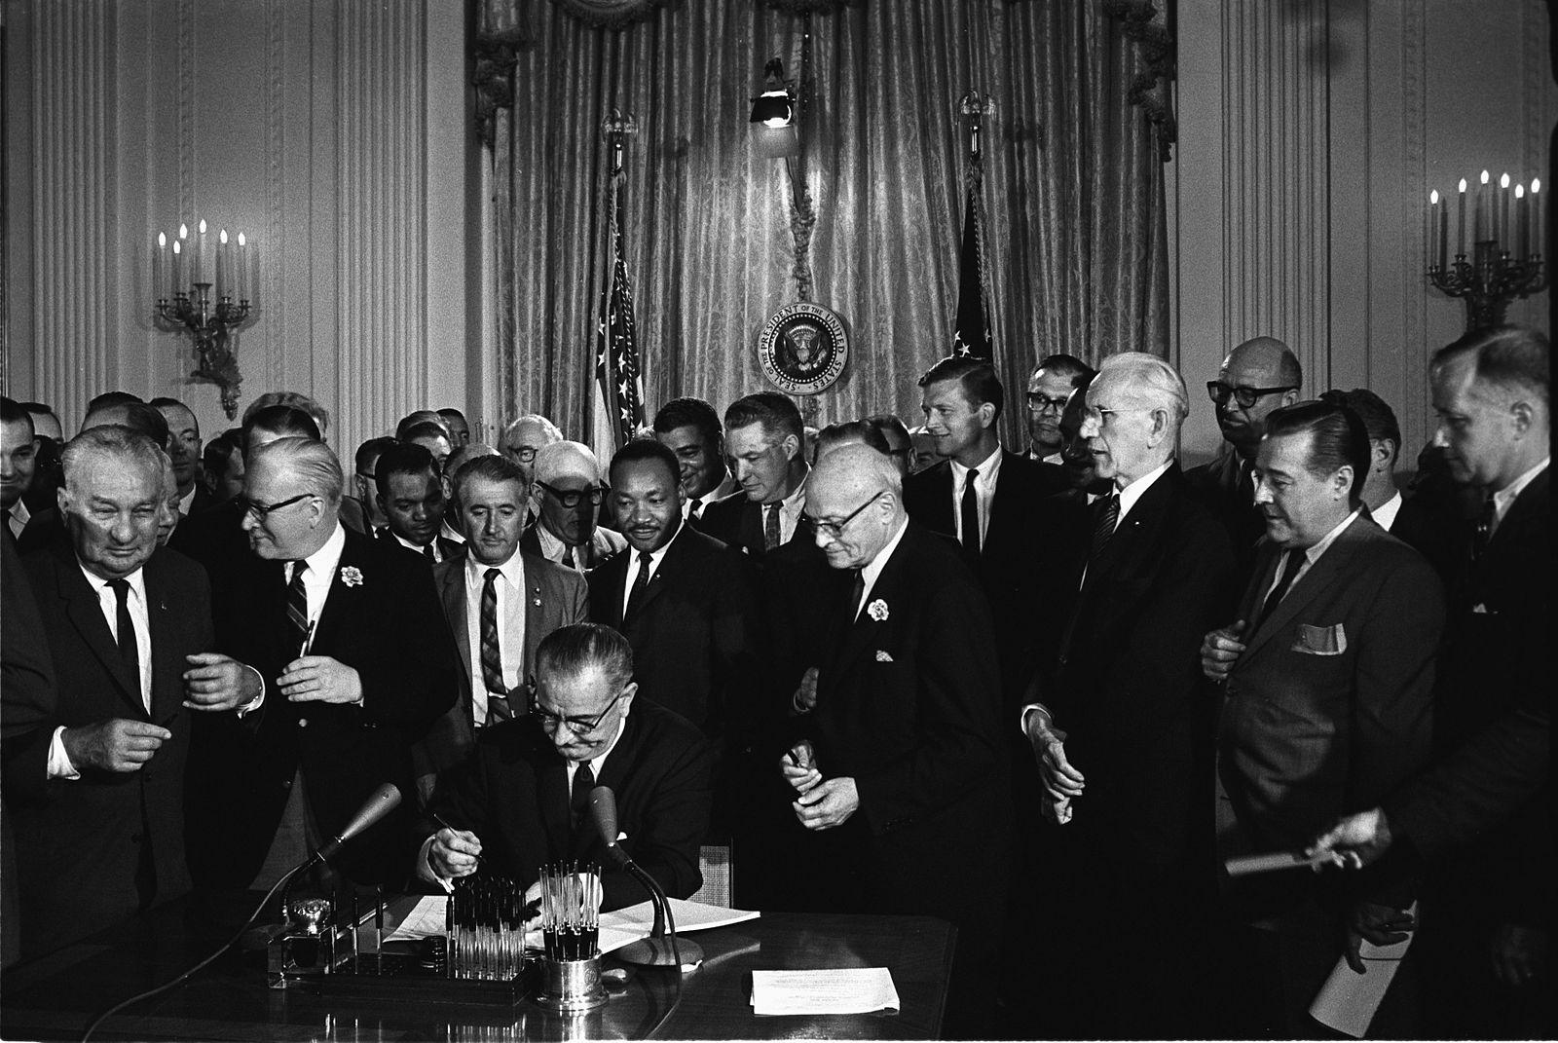
Civil Rights
In 1964, the Senate passed the Civil Rights Bill that outlawed racial discrimination in certain venues.
Source: Cecil Stoughton, White House Press Office

Slide 7
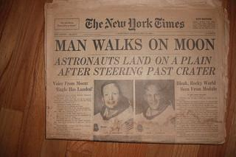
Technology
On July 20, 1969, astronauts walked on the moon for the first time.
Source: Creative Commons attribution license, Ken Mayer

Slide 8
Recent news
Visit Newseum’s Online Front Pages section to see more recent front page coverage of major events.

