Slide 1
30 Questions to Ask Before You Take A Photo
Photojournalism

Slide 2
1) What is my subject?
Notes:
Ask yourself what it is that you are trying to capture - a news event, a sports action shot, a portrait, an emotion. In all the chaos of covering an event or shooting a portrait session, never lose sight of that objective.
Being clear about what your subject is requires some prior thought. Simply shooting a photo of a volleyball match does not narrow things down, ending a photo where your attention is drawn all over the place.

Slide 3
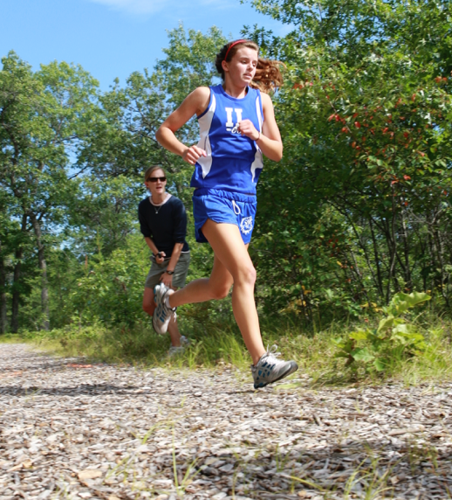
2) How do I best highlight the subject?
Notes:
What kind of composition will best portray what you are trying to say? Hopefully, as the photographer, you already know your subject. Can you convey your knowledge of the subject to your viewer?
By crouching down, the photographer focussed the reader’s eye on the runner, placed her against a dark background and selected an image from the sequence where she was in full sunlight and the coach was in the shade.

Slide 4
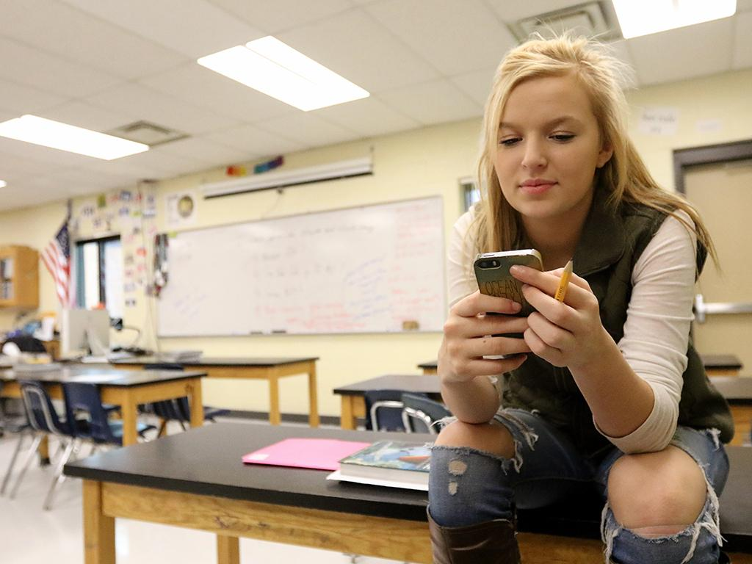
3) Where is the subject in the frame?
Notes:
It isn’t very often that having the subject in the center of the frame will produce the photo with the most impact. Use the rule of thirds and compose the photo that way. Which line or which junction when you overlay that tic-tac-toe board over the viewfinder results in the best composition?

Slide 5
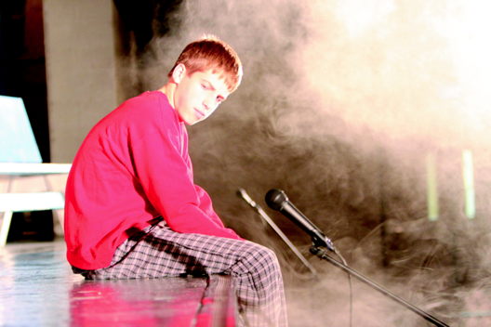
4) Am I close enough to the subject to emphasize it?
Notes:
Most photographs that you want to include in your publication should be close for maximum impact. To do this you either need a long enough lens, or you need to physically get close to the subject. Examine professional media and take note of how close all of the photos of people are.

Slide 6
5) Am I far enough from my subject to allow the viewer to have a sense of time and place in the photograph?
Notes:
While getting close is key to a dramatic photo, an extreme closeup eliminates context.
Have you included enough of the subject’s surroundings to visually place them?

Slide 7
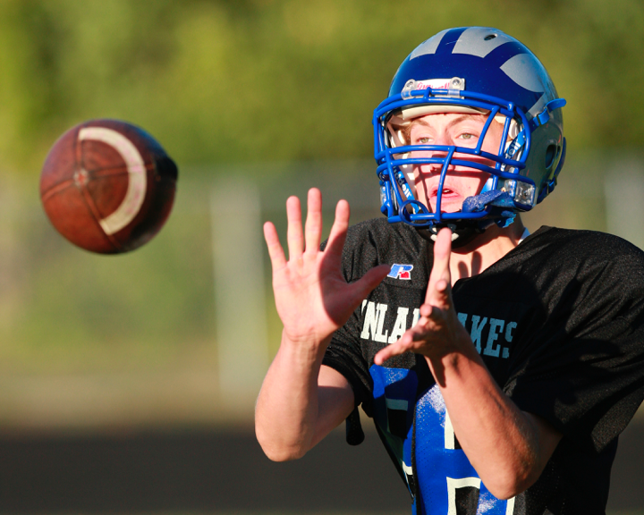
6) Is there something in front of or behind the subject that distracts me?
Notes:
Change positions. Use a narrow depth of field. Do everything in your power to make sure telephone poles are not coming out of the backs of subjects’ heads.
A very narrow depth of field in this photo eliminates what could be a distracting chain link fence in the background.

Slide 8
7) Is there something else in the frame taking my attention away from the subject?
Notes:
Again, this photo is a great example. Where did you eye move when you first saw this photo - the referee’s white shirt, the Gatorade jug, the girl handing out cups of water? So many things are happening in this photo that distract from the volleyball taking place on the court.

Slide 9
8) Is there something else outside the frame that I could incorporate to enhance the image?
Notes:
Is there something just outside the frame that will enhance your image? Recompose: step back, zoom out.

Slide 10
9) Where is the light coming from?
Notes:
The sun produces harsh light in the middle of the day. Can you take the photo early or late in the day for golden hour light? Position the sun behind you to light the subject’s face and create dramatic shadows, or you could use a reflector to bounce the light. Do you need to use artificial light?

Slide 11
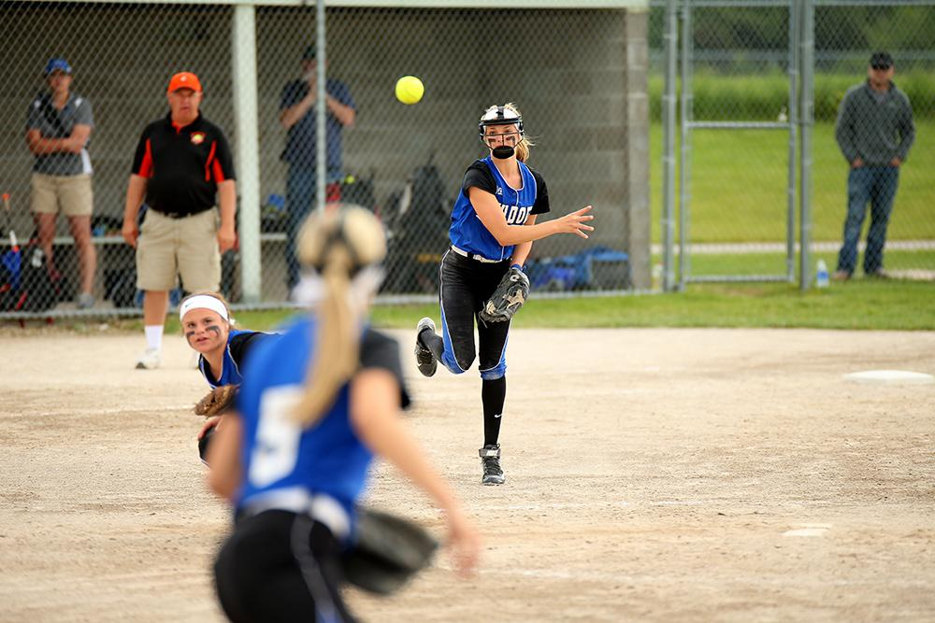
10) How does my eye move through the scene?
Notes:
At first glance, the viewer’s eye sees the whole picture. Then the focus narrows. The eye moves around the image until something grabs the attention. How can you as a photographer plan the image so the viewer’s eye goes where you want?
There are a lot of things happening in this image. Check out the lesson on cropping to see how this image can be improved in steps so that the viewer is looking where we want them.

Slide 12
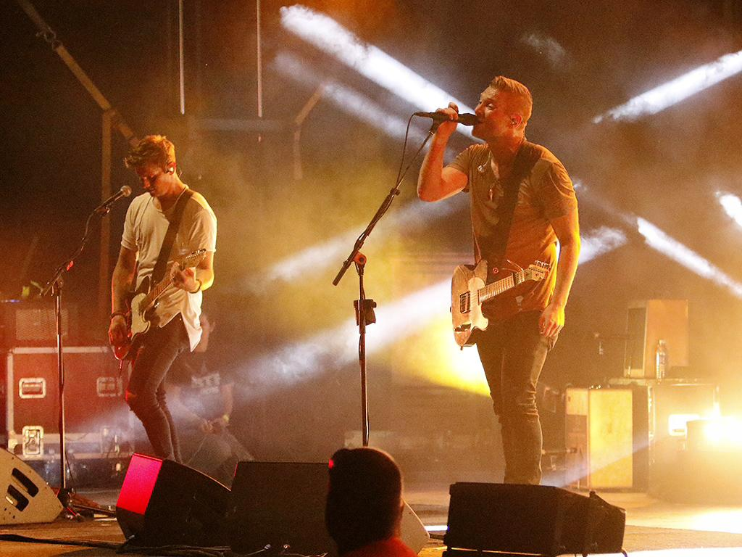
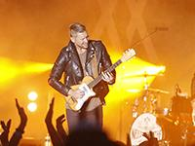
11) Am I standing in the best place to make this photograph?
Notes:
Simply changing perspective can have a huge effect on your image. Use your feet before your zoom.
By changing angles at this concert, the photographer was able to include more than one performer.

Slide 13
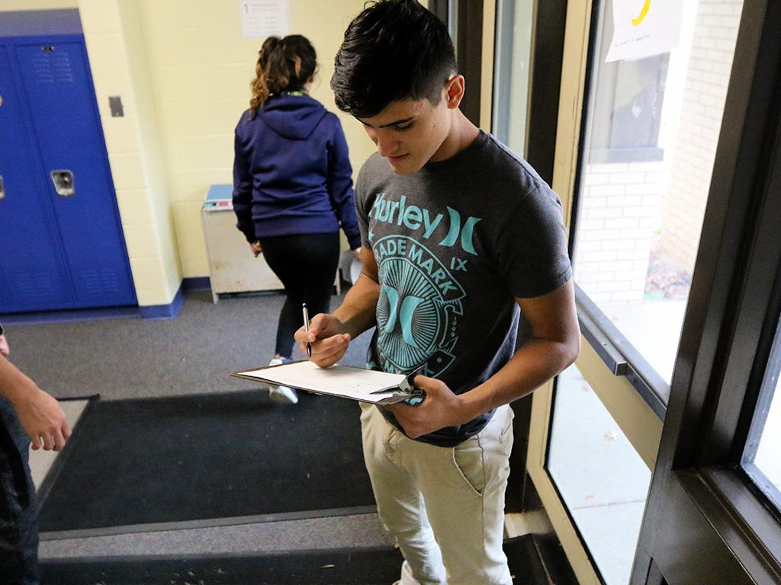
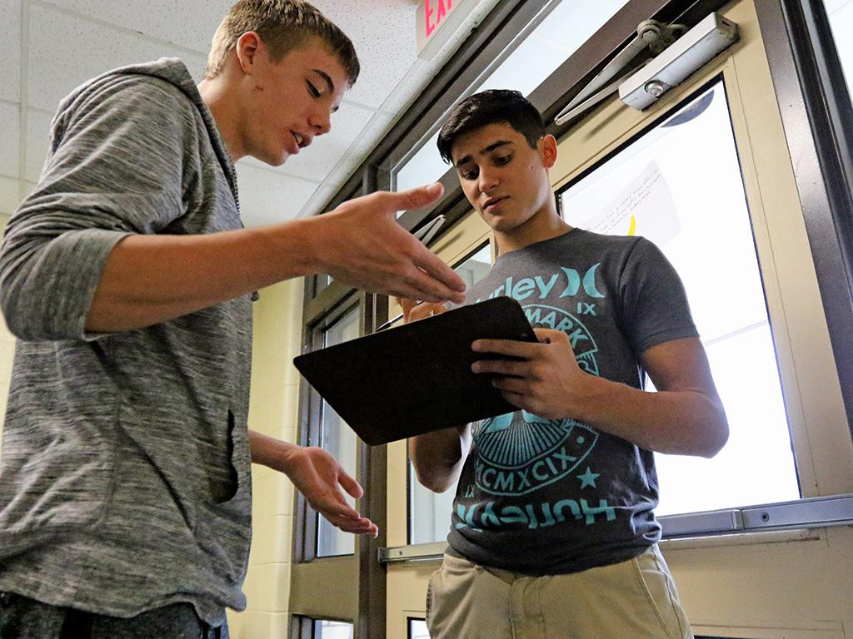
12) Should I be standing straight up and shooting this photograph from eye level, or is there a better perspective?
Notes:
After moving to the proper location, are you shooting from the right angle? We see the world from eye level. Would the image be more interesting or fill the frame better from a lower or higher point of view?

Slide 14
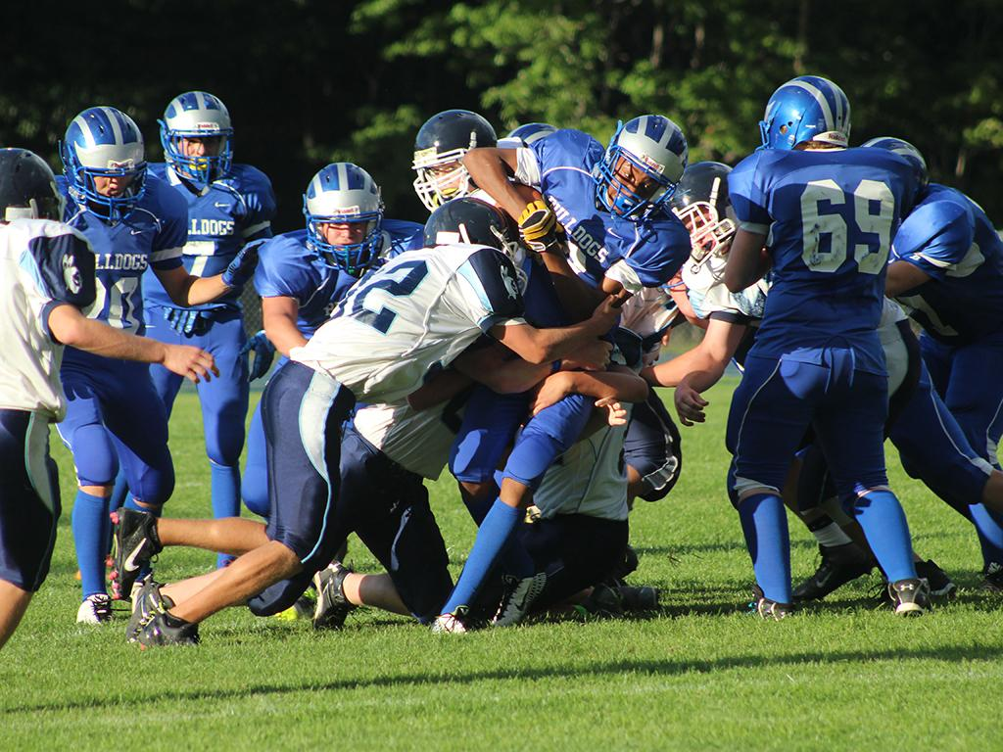
13) Is this the best time of day to make this photograph?
Notes:
This does not apply when you are shooting news, but, as an example, for those artsy shots that accompany a feature article, would waiting until the golden hour for best light make for a better image than when the sun is directly overhead?
Take high school football as an example: the games early in the season start before sunset and have great lighting for most of the game. The light gets progressively worse during these games, but even worse later in the season. The last games happen entirely under the lights, which are notoriously bad.

Slide 15
14) Is this the best moment to make this photograph?
Notes:
Digital imagery allows you to take numerous images without the penalty of having to process more film. If you have the luxury of time, why not wait a little while and see what the subject does?
Maybe the composition or the instant will get even better.

Slide 16
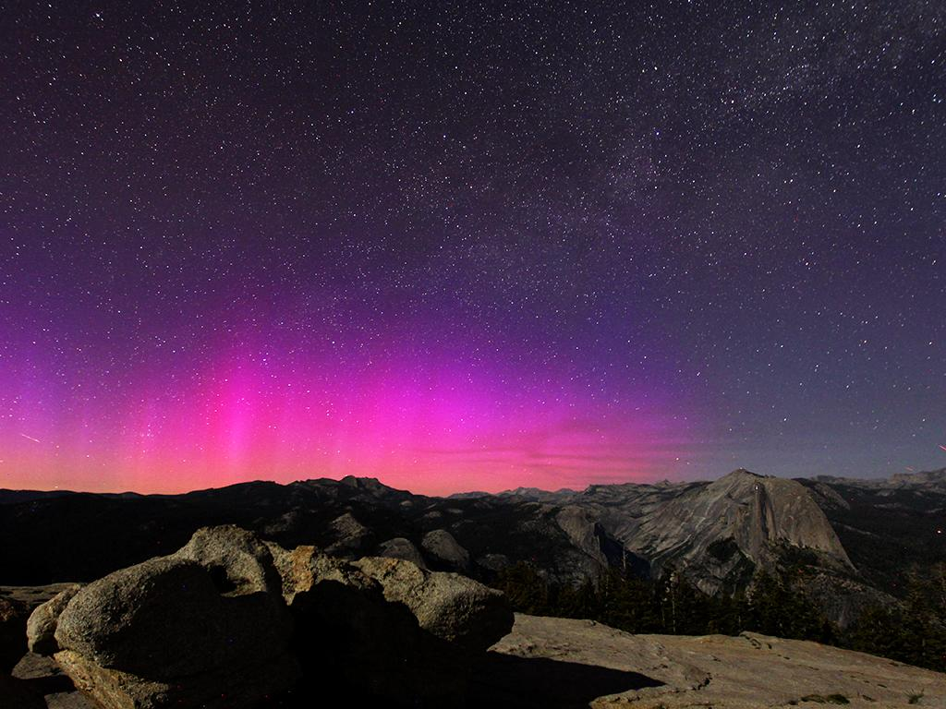
15) Is this the best weather to make this photograph at this particular place?
Notes:
Weather changes. Maybe the best photo of marching band is in the rain. Maybe the story of the championship game is that the softball team was assigned the dugout that was in the sun and the team became dehydrated. Again, if you have the luxury of time, come back when the weather changes.
In this image, the northern lights, which rarely occur in Yosemite National Park, happened to show up in the summer of 2015.

Slide 17
16) Are my lines straight or intentionally angled?
Notes:
Even after years of shooting, some photographers are so engrossed in capturing their subject that the camera is not perfectly horizontal/vertical when the photo is taken. Of course you can fix this by cropping the image. Or perhaps angling the camera is a conscious choice for greater impact.

Slide 18
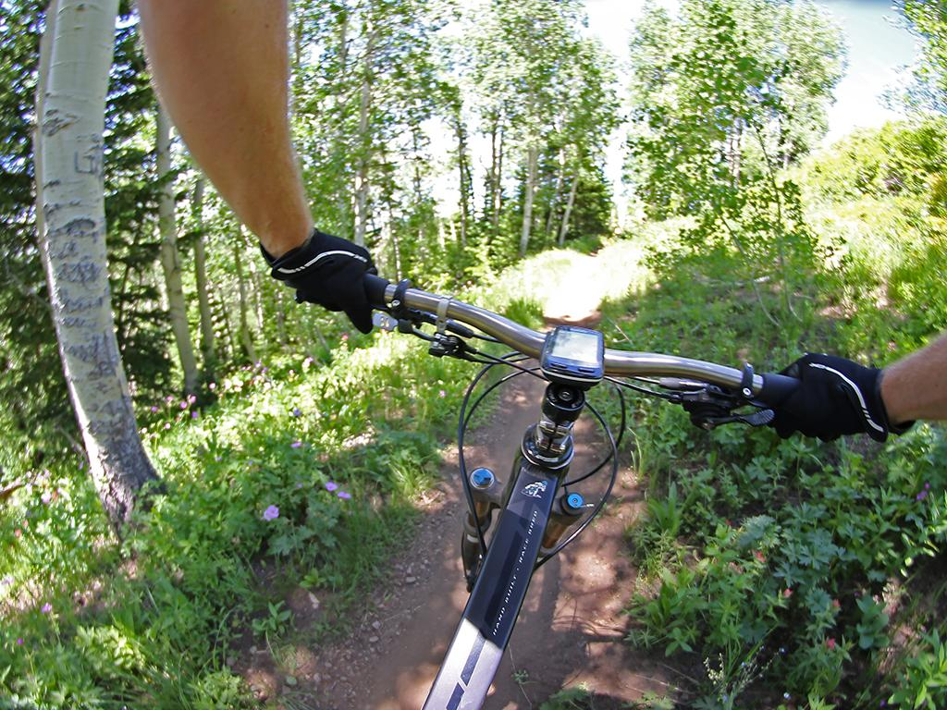
17) Is the camera lens distorting lines or perspective in a way I don’t want them distorted?
Notes:
Similar to keeping vertical and horizontal lines oriented correctly, does the lens you have distort the subject. Is it distracting or can that distortion be beneficial?
The fisheye lens on the camera strapped to the rider’s chest had a fisheye lens on it, distorting the tree on the left edge of the photo.

Slide 19
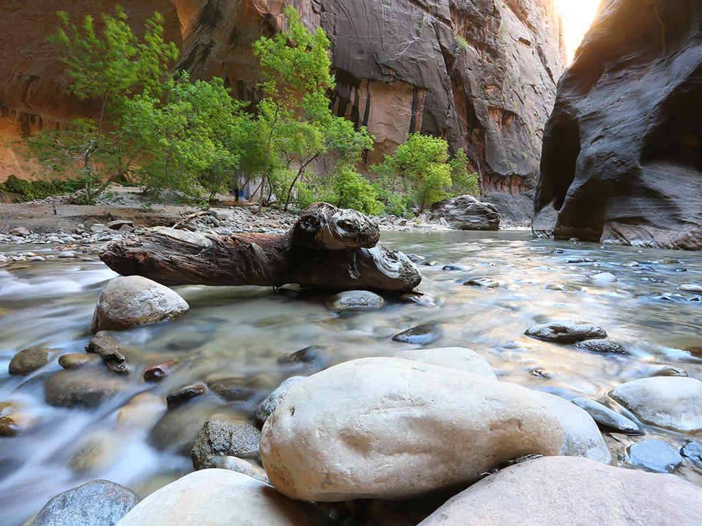
18) Are my camera settings correct for this image?
Use the exposure triangle - ISO, shutter speed and aperture - for best results.
Autofocus mode?
White balance?
Notes:
The exposure triangle - ISO, shutter speed and aperture - are the three main controls you have to make sure the photo you are taking turns out the way you want it. Use a fast shutter speed (1/1000s or above) to stop action. Use a small aperture (a large f-stop number f/8 or larger) for a deep depth of field. Adjust your ISO accordingly.
A slow shutter speed nearly completely blurs out the fellow fellow explorers in the image. You can just make out two people - one just to the right of the v-notch of th etree on the left and the other in the middle of the trees.
The autofocus mode is an important choice. Is the subject moving or stationary?
Make sure your white balance is set properly. For most cameras, auto white balance works, but in difficult lighting situations, you may need to be more specific.

Slide 20
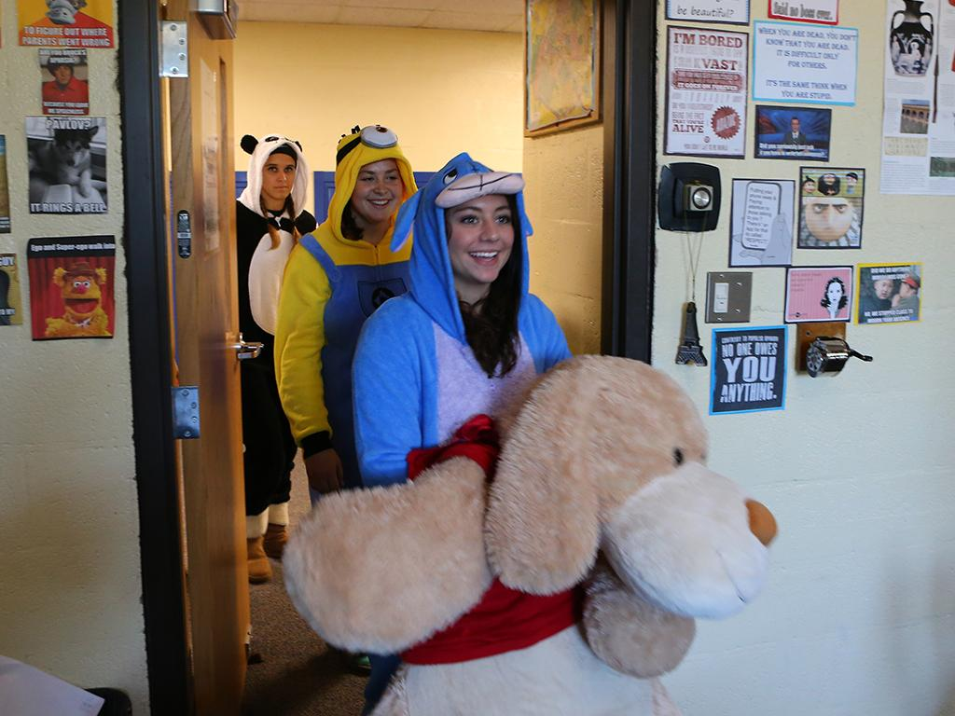
19) Is the camera capable of capturing the dynamic range of the scene?
Notes:
The first digital cameras had low dynamic range - the ability to capture light and shadow in a wide range. The newer the camera, the more likely it is going to be able to capture the light and shadow that we see with our eyes. This can be improved to a large degree in Photoshop, but don’t go crazy, otherwise the image you have created becomes a photo illustration.
This image shows high dynamic range, mimicking how our eye adjusts for variances in shadow and light within the same image.

Slide 21
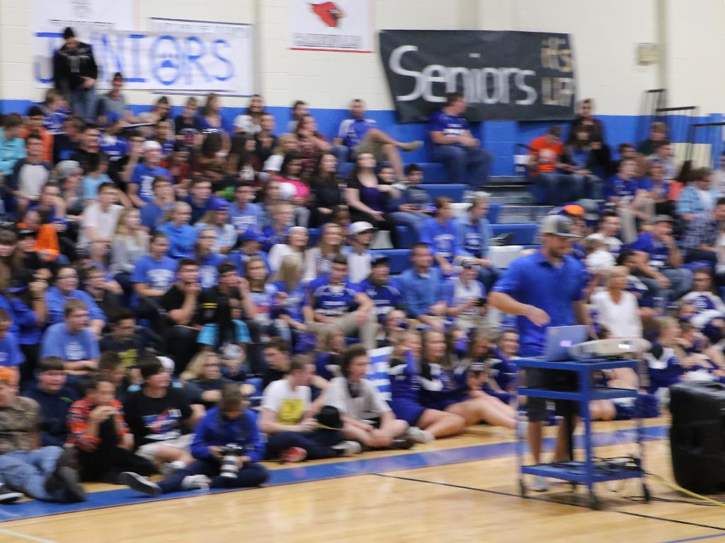
20) Should my camera be stabilized?
Notes:
Sometimes the light level is so low, the possible shutter speed is too low. Learn techniques for steadying your camera, even without a tripod. Brace yourself against a tree. Rest the long lens on a desk.
This image suffers from a slow shutter speed at 1/100 second, which would be too slow to stop action even if the photographer was not in a rush and moving.

Slide 22
Going Deeper
Notes:
Delve into the philosophy behind your photo.

Slide 23
21) What is my concept?
22) What am I trying to say?
Notes:
21) Not every image is going to have a concept behind it, but the true photographer, the artist of light, is going to have a deeper meaning behind it.
22) A picture is worth a thousand words.

Slide 24
23) If this photograph is part of a series, does it fit with the style and emotion of the rest of the series?
Notes:
This comes up a lot when contest judges are looking at a photographic portfolio. Is the style of the image consistent with the rest? A few of the best photos you have ever taken might not be consistent with the subject or style of the majority.

Slide 25
24) Who is this photo for?
Notes:
On assignment, this is probably the most important question a photojournalist needs to answer.
It makes a difference. Websites most often requires a horizontally oriented image, otherwise the images don’t fit the featured image requirements and require the reader to scroll past to get to verbal content. Page designers may require a vertical image for a specific page. For best results, the photojournalist should be shooting a mixture of vertical and horizontal. Also shoot close, medium and far away. Shoot the whole story so the production team has everything they need.
Additionally, who is the audience?

Slide 26
25) If the goal of the image is to make a statement, will this image hit that mark?
26) Will this image create negativity and criticism or positivity and praise?
Notes:
25) What is it you are trying to say? Does the image elicit an emotion? Is it the right emotion?
26) What is it you are trying to say? Does it say it correctly? Does it depict something that is unprotected speech?

Slide 27
27) Will this photograph capture the essential feeling of the moment?
Notes:
What is it you are trying to say? Does the image elicit an emotion? Is it the right emotion?

Slide 28
28) Has this photo been taken before?
29) Am I forcing this photograph?
Notes:
28) Imitation is the greatest form of flattery. Recreating a classic image may be what is needed, but use your imagination. Modify that classic image and make it yours.
29) You may be covering an event and your publication needs the images, but are you in the way? Are you to intimate with the subject? Are you taking us places we don’t need to go?

Slide 29
30) Would I be better served to simply observe the moment or scene before me and not worry about making a photograph?
Notes:
As a photojournalist, it is your job to capture the moment. Most often you are not going to be intruding, but there is a point where a photographer can go too far into a subject’s private life, a place that does not need to be made public.
Think of the images that came out of the bombing at the Boston Marathon. The image from the AP's Charles Krupa that appeared on the front pages of the nation’s newspapers were cropped and did not show the lower legs of the victim (Jeff Bauman Jr.) being rushed away in a wheelchair by the man in the cowboy hat (Carlos Arredondo). The full frame image shows lower legs with no flesh.

