Slide 1
Aspects of Exposure
Photojournalism

Slide 2
Exposure

Slide 3
What is exposure?
Refers to the general term for the amount of light that reaches the lens, as measured by other exposure settings.
Many cameras can manually adjust exposure independently of other settings like shutter speed and aperture.

Slide 4
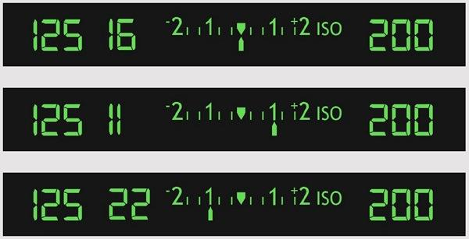
How is exposure measured?
Exposure is measured in stops, generally along a grid. Positive numbers along the grid increase the exposure manually, whereas negative numbers decrease the exposure.

Slide 5
For instance...
An exposure of:
+1
+2
-1
-2
Does this:
2x the exposure
4x the exposure
half the exposure
1/4 the exposure

Slide 6
What does that mean?
If your photos are coming out too dark, increasing the exposure by 1 “stop” may make it look better.
If your photos are too bright or washed out, decreasing exposure may be helpful.

Slide 7
When should I adjust exposure?
Adjust exposure when your entire photograph is either too dark or too light.
Bright sunlight
Dark rooms

Slide 8
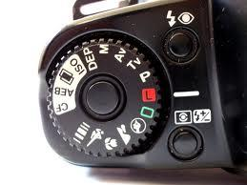
How can I adjust exposure?
Most cameras have a button with a + and - sign. When pushed, this brings up a screen that allows you to toggle to the correct exposure setting.

Slide 9
Potential Problems
Changing any other setting will also change your exposure needs, so it requires constant attention and adjustment.

Slide 10
Shutter Speed

Slide 11
What is shutter speed?
Refers to the speed at which the shutter opens and closes.
This controls the length of time that light is available to the camera as it takes the picture.

Slide 12
How is shutter speed measured?
Shutter speed is measured in fractions of a second.
1- one full second
1/80 (or “80”) - one eightieth of a second
1/100 (or “100”)- one one-hundredth of a second
1/400 (or “400”)- one four-hundredth of a second

Slide 13
For instance...
A picture taken with “1” shutter speed allows light into the camera for a full second.
BUT
A picture taken with “400” shutter speed allows light into the camera for a very tiny amount of time.

Slide 14
What does that mean?
The longer the exposure, the brighter the image.
AND
A fast shutter speed gives you a crisp, clear image. A slow shutter speed starts to blur anything that is moving.

Slide 15
When should I adjust shutter speed?
1) To capture motion.
Freeze motion with a fast shutter speed
Blur motion with a slow shutter speed
2) To adjust light.
NOTE: only do this when nothing in your picture is moving!

Slide 16
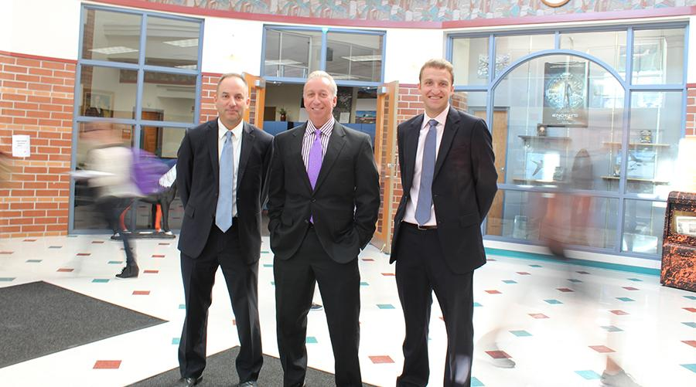
Why should I adjust shutter speed?
It creates some cool effects!
Bushra Ghafoor, R.B. Hayes High School

Slide 17
How can I adjust shutter speed?
Set your camera to Shutter Speed priority.
“Tv” on Canon, Pentax, and Leica
“S” on everything else
From there, adjust using a scroll button on the camera.

Slide 18
Potential Problems
Slow shutter speeds pick up more movement, even a slight shake of your hand.
Use a tripod to fix this problem!

Slide 19
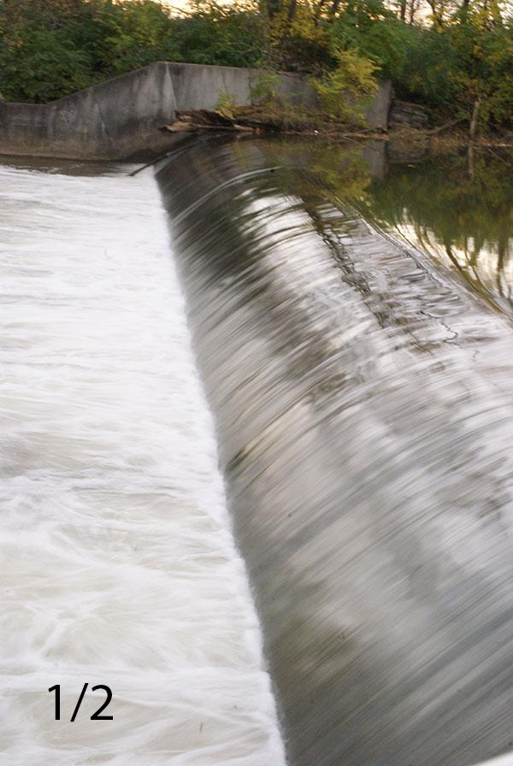
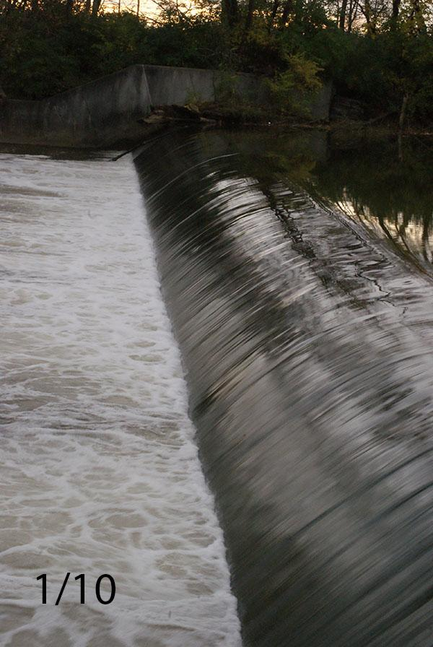
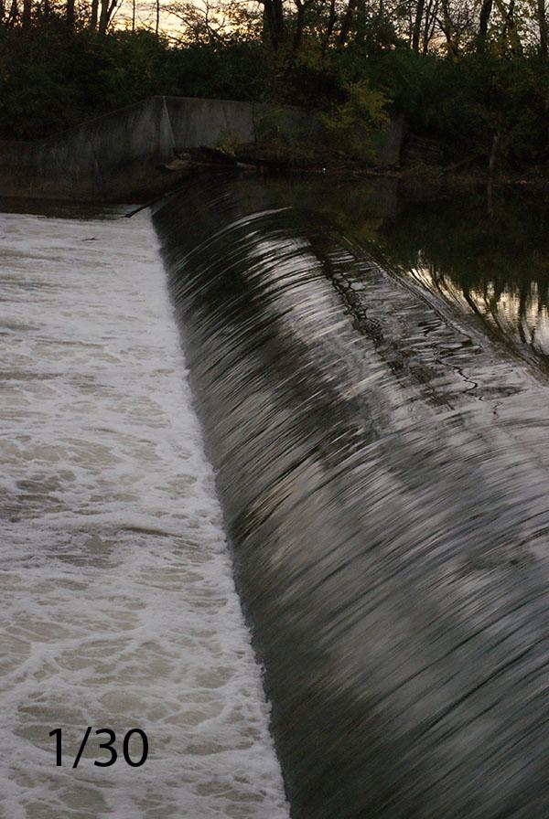
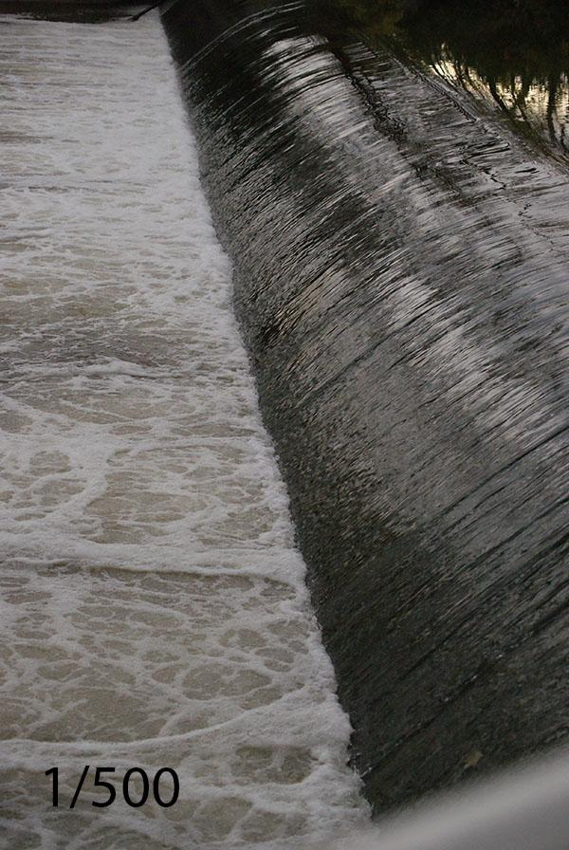
Shutter Speed Examples
Slowest
Notice how the water blends together
Fastest
Notice how you can see individual drops of water

Slide 20
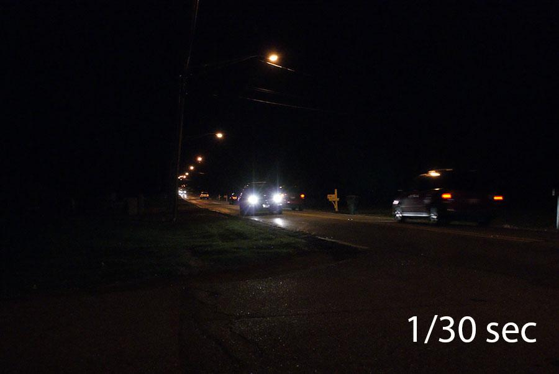
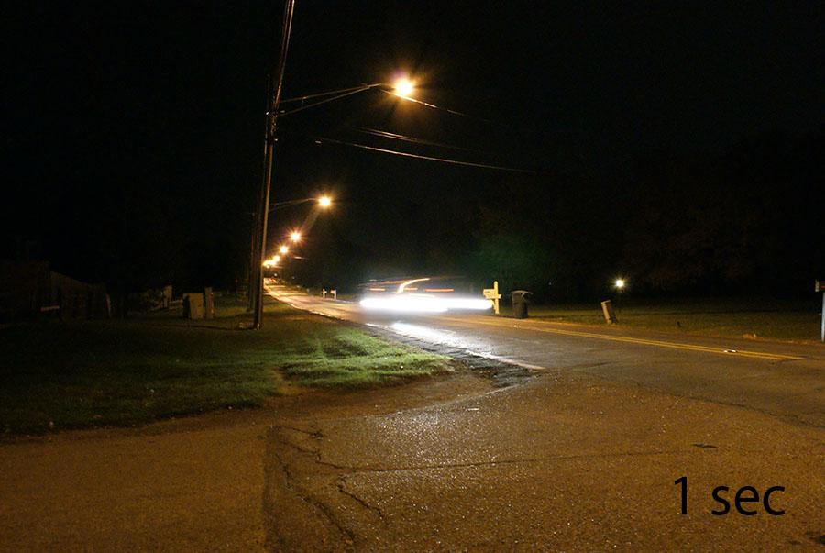
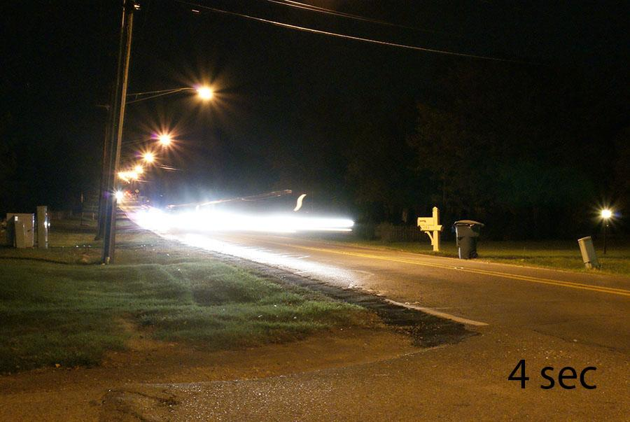
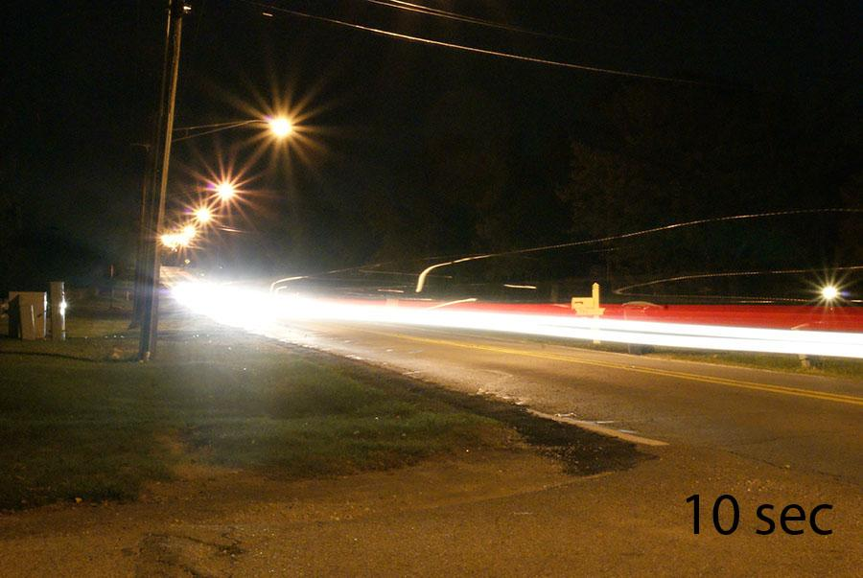
Shutter Speed Examples (at night)
Notice how the faster shutter speed (1/30th of a second) lets in less light, creating a more precise image but a darker one.
The faster shutter speeds are brighter but blur the movement and the light.

Slide 21
ISO

Slide 22
What is ISO?
Refers to a camera’s sensitivity to light.
This controls how much your camera naturally adjusts for a lack of light in situations.
NOTE: On film cameras, ISO referred to the “speed” of the film you bought.

Slide 23
How is ISO measured?
ISO typically comes in one of the following measurements:
100
200
400
800
1600
3200

Slide 24
What does that mean?
The lower the number, the less sensitive the camera’s sensor will be to natural light.
AND
The higher the number, the more sensitive the camera’s sensor will be to natural light.

Slide 25
For instance...
An ISO of 100 or 200 should be used for daylight or bright light situations
WHEREAS
Darker scenes and indoor pictures should use a higher speed.

Slide 26
When should I adjust ISO?
If you are taking pictures in low light situations and your photos are too dark, try bumping up the ISO.
Good for:
-gymnasiums
-concerts & “no flash” performances
-art galleries

Slide 27
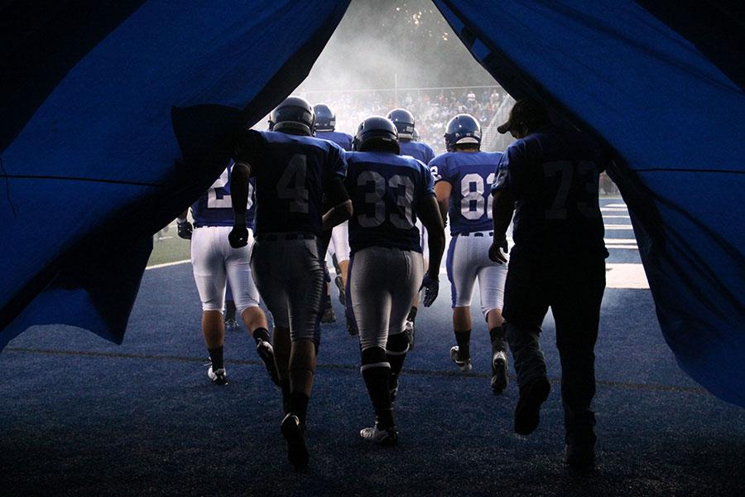
Why should I adjust ISO?
It adjusts for dark situations without using flash!
Bryant High School Publications

Slide 28
How can I adjust ISO?
ISO is located in a different place on each type of camera. On most cameras, ISO can be adjusted in every photo setting (including “auto”).
Check your camera manual to find it.

Slide 29
Potential Problems
As you increase your ISO, your photos will get brighter...BUT they will also get grainier.
It’s a good idea to take the photos using the lowest ISO possible that still gets you a light enough shot.

Slide 30
Aperture

Slide 31
What is aperture?
Refers to the amount of light that enters the eye of the camera.
THINK of aperture like the pupil of your eye: your pupil gets bigger and smaller based on the light that is available, and aperture does that to the camera’s “eye” as well.

Slide 32
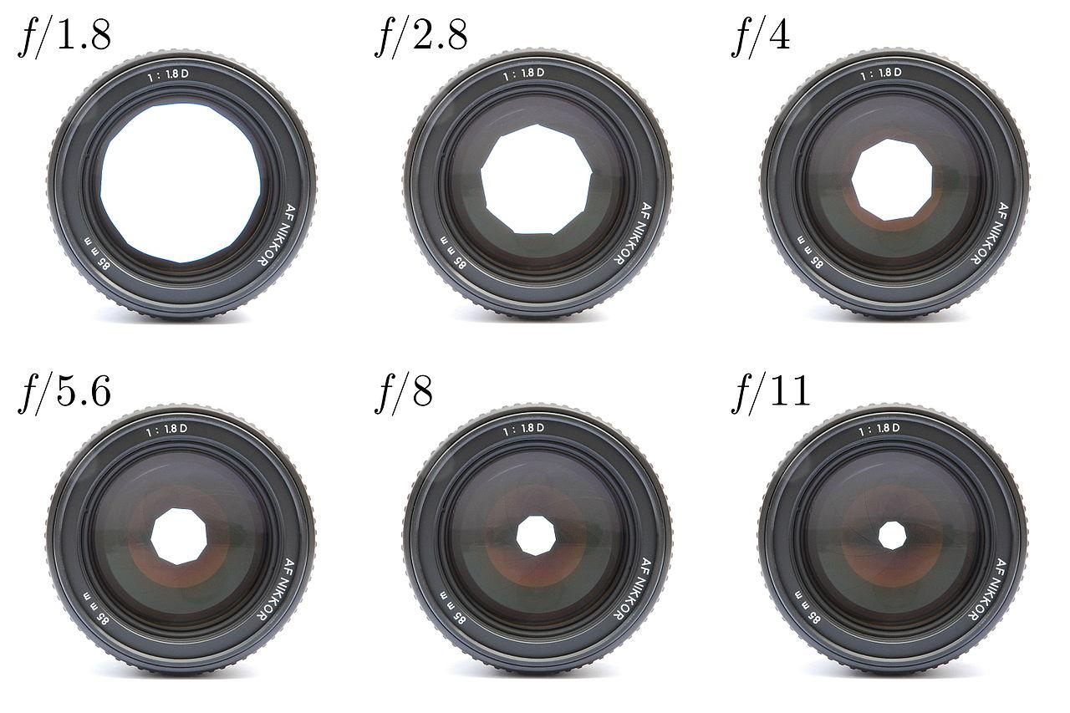
What does that mean?
The larger the “eye,” the more light that the camera will let in.
The smaller the “eye,” the less light the camera will let in.

Slide 33
How is aperture measured?
By the size of the “eye” in the lens, called “f stops”
Here’s where it gets confusing:
The bigger the aperture hole opening,
the more light comes in,
which gives a smaller f-stop number

Slide 34
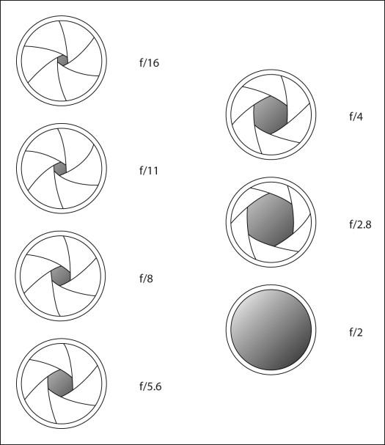
For instance...
Smaller f-stop numbers, like 1.4 and 1.8, actually mean a larger “eye” in the lens and more light.
Bigger f-stop numbers, like 6, mean a smaller “eye” in the lens and less light.

Slide 35
Why should I adjust aperture?
Adjusting aperture controls the depth of field, or how much of the picture is in focus.
A higher f-stop (like 6) will make the entire photo in focus, giving you a wide or deep depth of field
A lower f-stop (like 1.8) will make only part of the photo in focus, giving you a shallower depth of field

Slide 36
When should I adjust aperture?
Adjust aperture when you only want part of the photo to be in focus.
For instance:
busy backgrounds
portraits

Slide 37
How can I adjust aperture?
Set your camera to Aperture priority.
“Av” on Canon
“A” on pretty much everything else
From there, adjust using a scroll button on the camera.

Slide 38
Potential Problems
The lens quality limits how much you can adjust aperture, and lens that allow low f-stops are expensive!
Very high f-stops (8 and up) often require a slower shutter speed, so you may need a tripod to prevent shakiness.

Slide 39
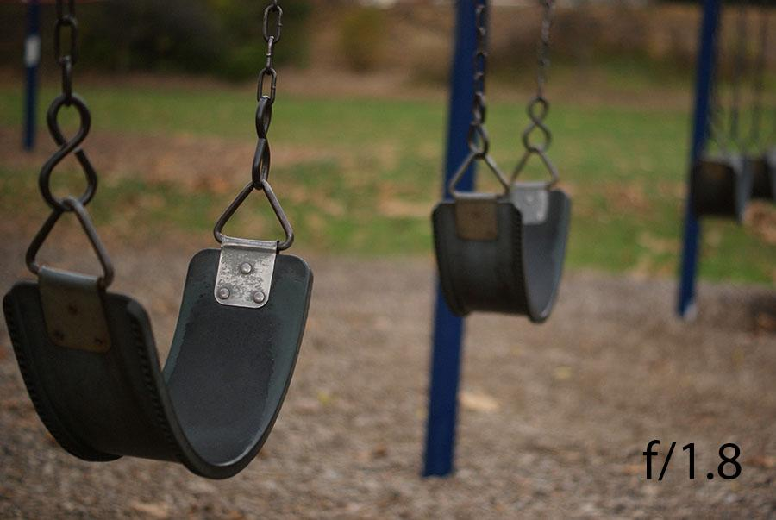
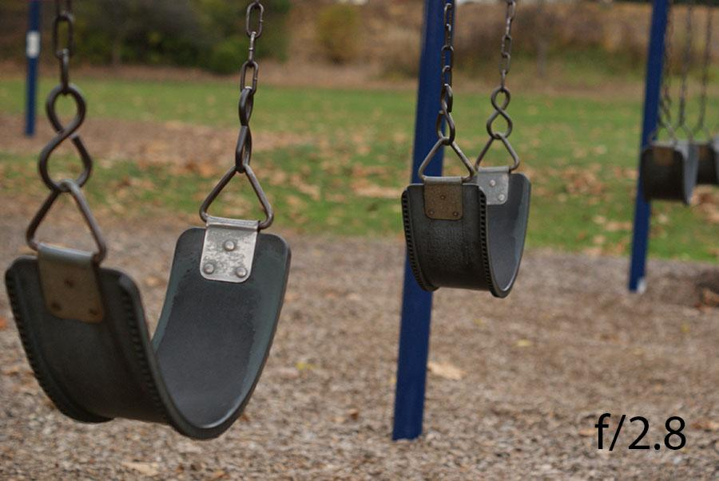
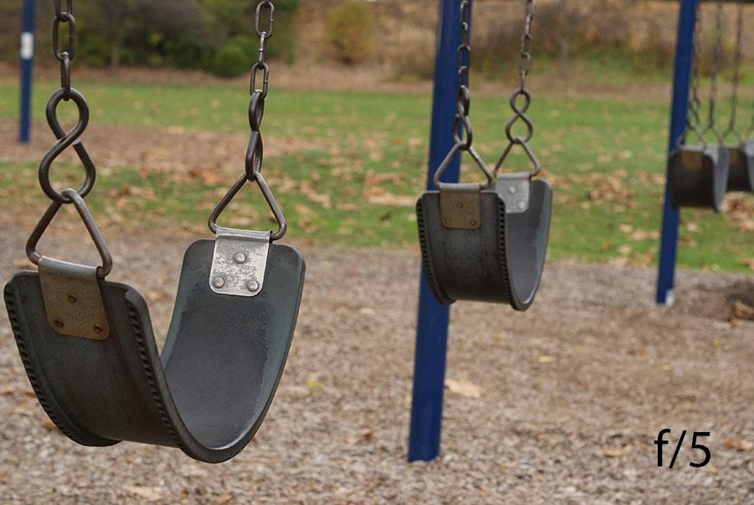
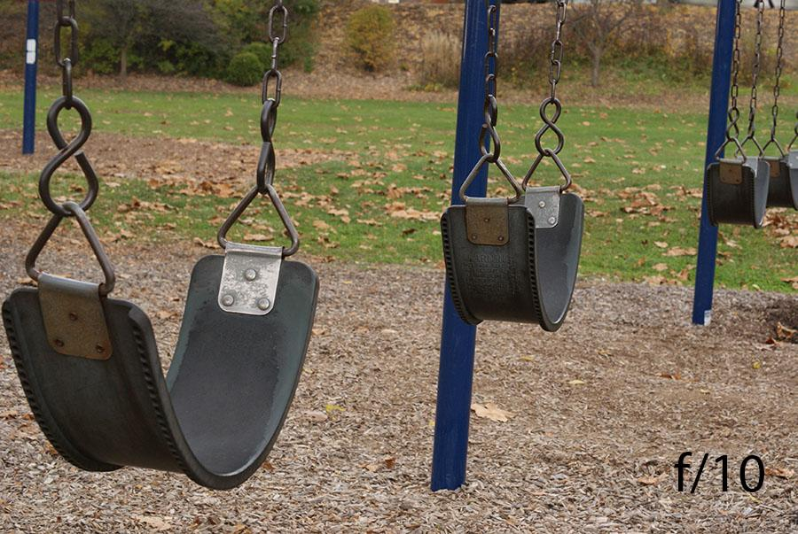
Aperture Examples
Top left: Notice how lower aperture creates a smaller depth of field. The front swing is in focus but the other swings are somewhat blurry.
Bottom right: The higher aperture creates a greater depth of field, meaning that the entire photo is sharp and precise.

Slide 40
White Balance

Slide 41
What is white balance?
Refers to the natural adjustment your camera makes so that things that are white in real life appear white in your photo.
*This can get prevent strange blue or orange tints in your photos.

Slide 42
How is white balance measured?
Specifically, white balance refers to the “temperature” of the photo.
Photos that are 5000 k (degrees) look natural.
Photos less than 5000 k appear blue.
Photos more than 5000 k appear orange.
However, on most cameras you can just set the type of light source.

Slide 43
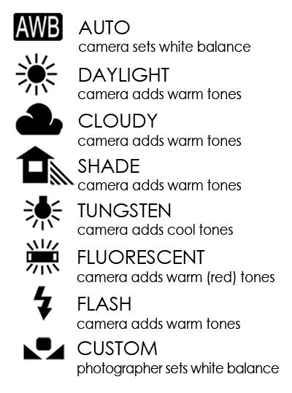
For instance...

Slide 44
What does that mean?
If you are taking photos under fluorescent lights, setting the white balance to fluorescent will naturally add warmer tones to your photos.
This will make your photos appear less “blue”
Similar results will appear for setting the white balance in other lighting situations.

Slide 45
When should I adjust white balance?
Adjust white balance all the time!
Okay, but seriously, it’s always a good idea to pick the type of light source before shooting pictures. Assuming you are staying in one general setting, you should be able to set this once and then forget it for the rest of your photo shoot.

Slide 46
Why should I adjust white balance?
Adjusting the white balance makes your photos appear more natural.
People look healthy and have a “natural glow”
Shadowy hallways appear less orange

Slide 47
How can I adjust white balance?
On most cameras, white balance can be adjusted at any time.
That means that you can adjust white balance no matter what other settings you are using.
*Often under “function” or “menu” in any picture-taking mode.

Slide 48
Potential Problems
The goal of white balance is to make your photos look natural....
BUT
When used incorrectly, white balance can cause photos to look overly bright or washed out.
To prevent this, make sure you always use the correct white balance setting, and check photos often.

Slide 49
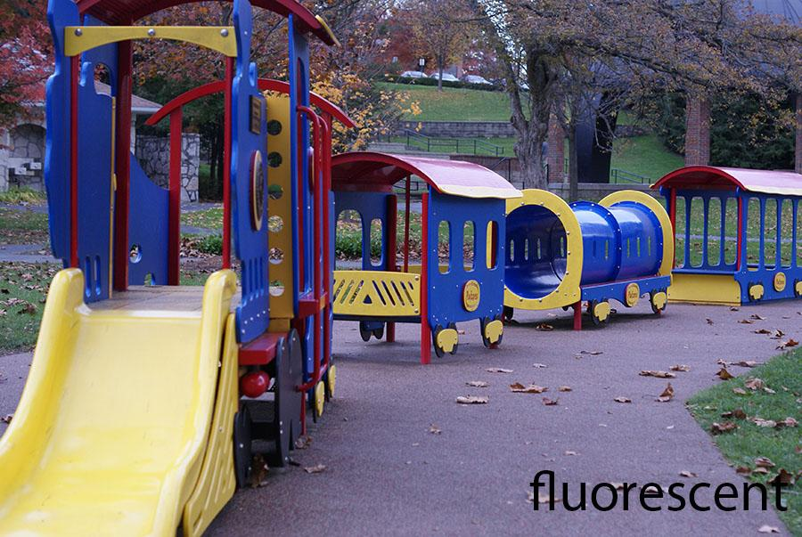
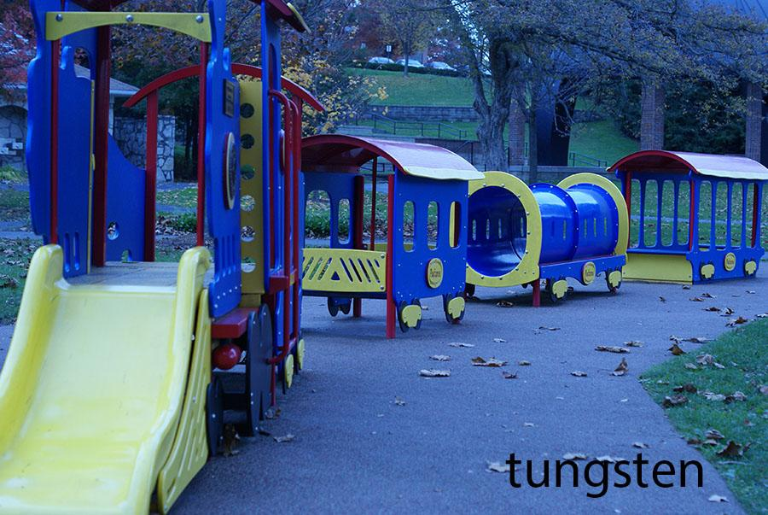
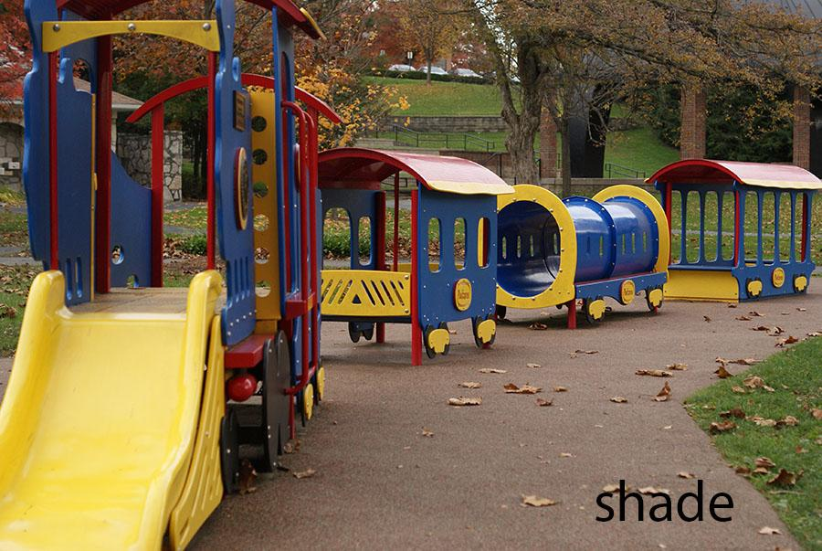
White Balance Examples
Top: These two photos were taken with the wrong white balance setting, making the objects appear unnaturally colored.
Bottom: This photo was taken with the white balance set to “shade” so the camera would automatically adjust for that type of lighting.

Slide 50
Flash

Slide 51
What is flash?
Refers to artificial light that has been added to a photo.
Flash helps to minimize any visual imperfections that occur due to problems with light.

Slide 52
How is flash measured?
Built-in flash is only measured by “on” and “off”...
BUT dedicated flash units can attach to the top of your camera.
These flash units have two different settings:
TTL flash
Manual flash

Slide 53
TTL v. Manual Flash
TTL (Through The Lens): the camera and flash automatically set the power of the flash based on how much light the camera thinks it needs
Manual: the photographer manually sets how powerful of a flash he wants to get the desired effect

Slide 54
Fill Flash
Most dedicated flash units have “fill flash” settings. Fill flash adds just a little light in order to “fill in” the dark sections of the photos.
This can be helpful when photographing people in bright sunlight, because fill flash helps to minimize shadows.

Slide 55
When should I use flash?
Most photographers suggest using flash only when necessary. If you can increase light by adjusting ISO or other settings, that is generally preferred.
Basically, flash should be used intentionally, not just as an easy way to add light to a photo.

Slide 56
Why should I use flash?
Use a standard flash when you want to light up the front side of your subject AND the subject is pretty close to you.
A designated flash (one that attaches to the top of a camera) extends light farther but still only lights up the front of your subject.
A stand-alone remote-controlled flash can add light to a different angle.

Slide 57
Tips for using flash
Bounce a flash: pointing your flash at a wall, a ceiling, or a even piece of posterboard will make the light source less direct and less harsh
In autofocus, your flash will adjust itself to light up whatever is in the middle of the photo. If your subject is off to the side, you need to trick your camera. Start with your subject in the middle, hold down the shutter partway to focus, and then recompose the photo.

Slide 58
Potential Problems
Flash can white out areas of your photo
Flash reflects off glass and other materials
Can create dark backgrounds
Subjects’ eyes can turn red
Can create unexpected shadows

Slide 59
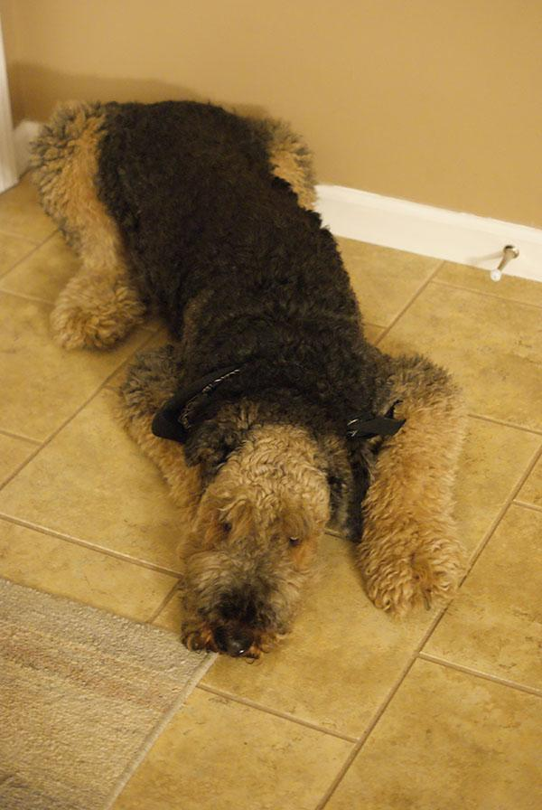
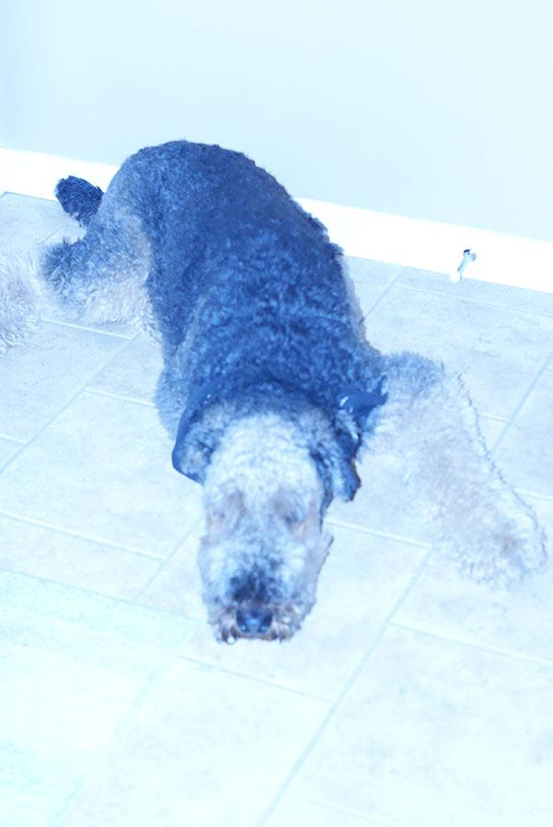
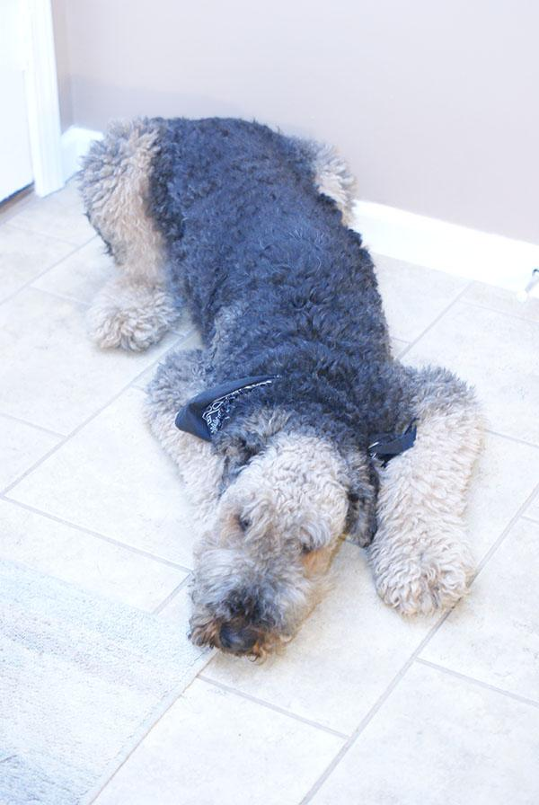
BAD Flash Examples
Left: Even in a dim room, taking a photo without a flash is a better idea than trying to use the flash without knowing how.
Otherwise, your photos will look like the ones on the right.

Slide 60
Metering

Slide 61
What is metering?
Refers to the amount of the viewfinder that the camera analyzes to determine what part you want to be exposed optimally.

Slide 62
For instance...
In the automatic setting, the camera scans the entire viewfinder and tries to guess which part you want the camera to optimize.
BUT
A photographer can choose a specific section of the viewfinder (the center), and the camera will optimize exposure settings based on the light in that part of the picture.

Slide 63
How is metering measured?
There are three settings for most cameras:
Multi-segment: measures the balance of light over the entire scene
Center: averages light of the entire scene but focuses on the center
Spot: measures the spot around the central focus point

Slide 64
When should I adjust metering?
Adjust metering when the center of your photo is much brighter or darker than the rest, like when your subject is standing in a doorway.

Slide 65
How can I adjust metering?
On most cameras, metering settings can be adjust through either the menu or the function buttons.

Slide 66
Potential Problems
Much of the time, a photographer’s subject is not in the center of the photo, so using the Center or Spot metering mode can actually base the camera’s exposure on the wrong area.

