Slide 1
Aspects of Exposure
JEA Photojournalism Curriculum

Slide 2
What is exposure?
Refers to the general term for the amount of light that reaches the lens, as measured by other exposure settings.
Many cameras can manually adjust exposure independently of other settings like shutter speed and aperture.

Slide 3
Shutter Speed

Slide 4
What is shutter speed?
Refers to the speed at which the shutter opens and closes.
This controls the length of time that light is available to the camera as it takes the picture.

Slide 5
How is shutter speed measured?
Shutter speed is measured in fractions of a second.
1- one full second
1/80 (or “80”) - one eightieth of a second
1/100 (or “100”)- one one-hundredth of a second
1/400 (or “400”)- one four-hundredth of a second

Slide 6
For instance...
A picture taken with “1” shutter speed allows light into the camera for a full second.
BUT
A picture taken with “400” shutter speed allows light into the camera for a very tiny amount of time.

Slide 7
What does that mean?
The longer the exposure, the brighter the image.
AND
A fast shutter speed gives you a crisp, clear image. A slow shutter speed starts to blur anything that is moving.

Slide 8
When should I adjust shutter speed?
1) To capture motion.
Freeze motion with a fast shutter speed
Blur motion with a slow shutter speed
2) To adjust light.
NOTE: only do this when nothing in your picture is moving!

Slide 9
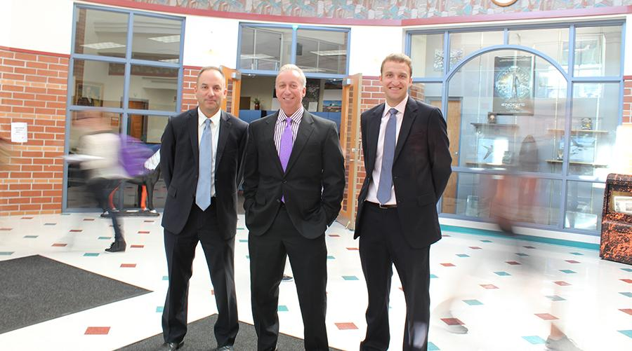
Why should I adjust shutter speed?
It creates some cool effects!
Bushra Ghafoor, R.B. Hayes High School

Slide 10
How can I adjust shutter speed?
Set your camera to Shutter Speed priority.
“Tv” on Canon, Pentax, and Leica
“S” on everything else
From there, adjust using a scroll button on the camera.

Slide 11
Potential Problems
Slow shutter speeds pick up more movement, even a slight shake of your hand.
Use a tripod to fix this problem!

Slide 12
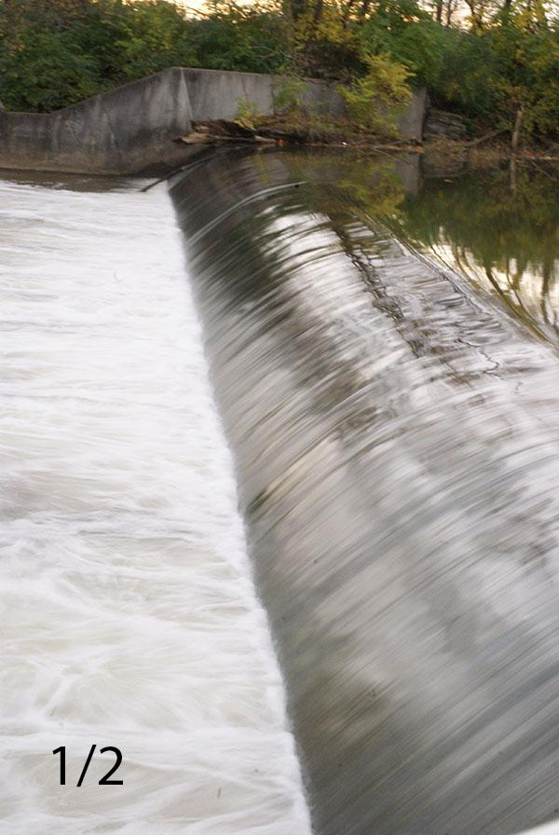
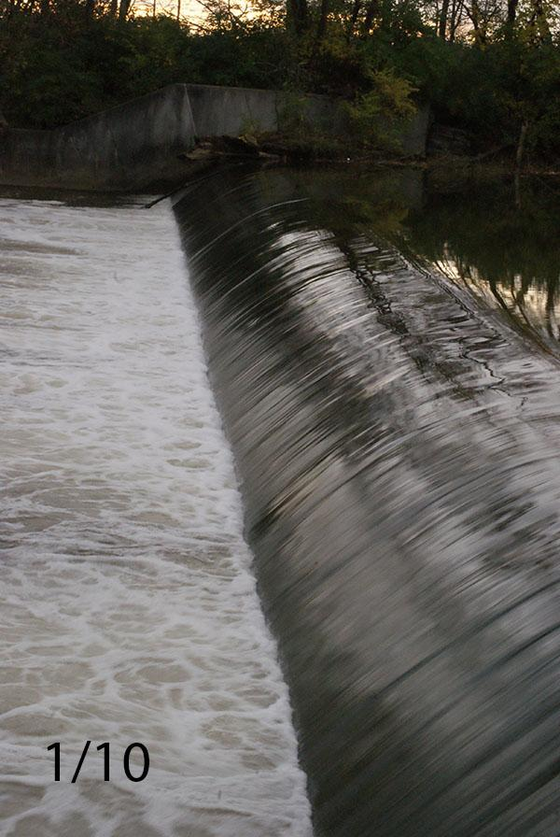
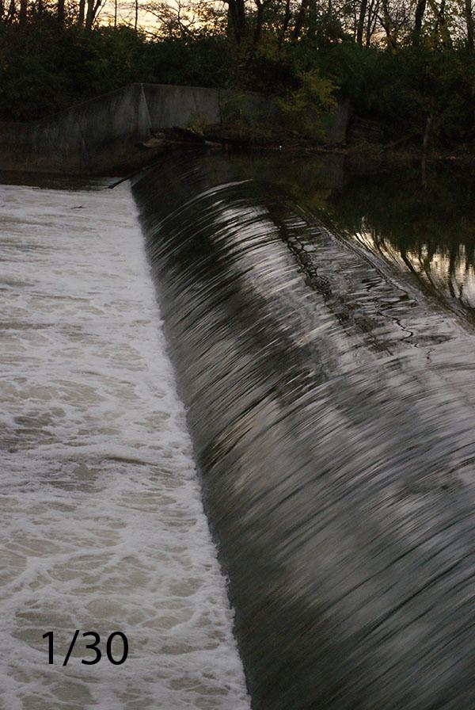
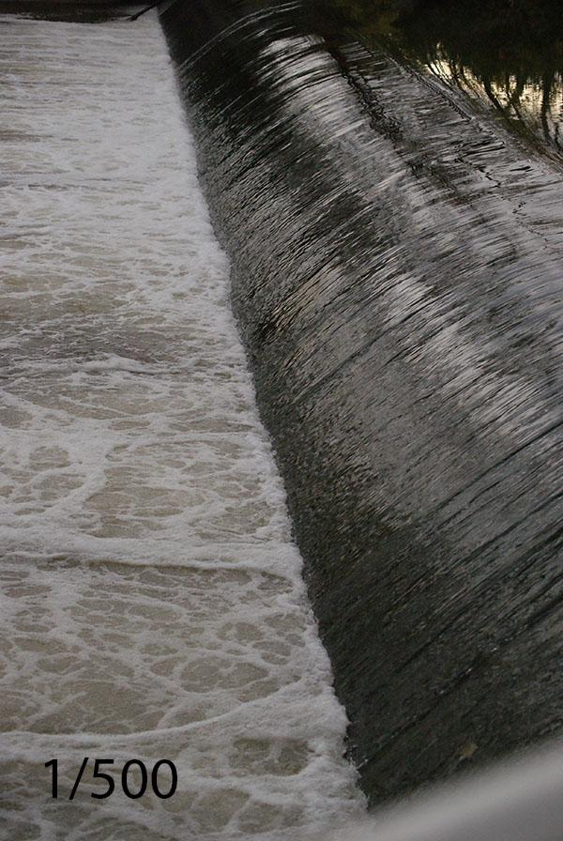
Shutter Speed Examples
Slowest
Notice how the water blends together
Fastest
Notice how you can see individual drops of water

Slide 13
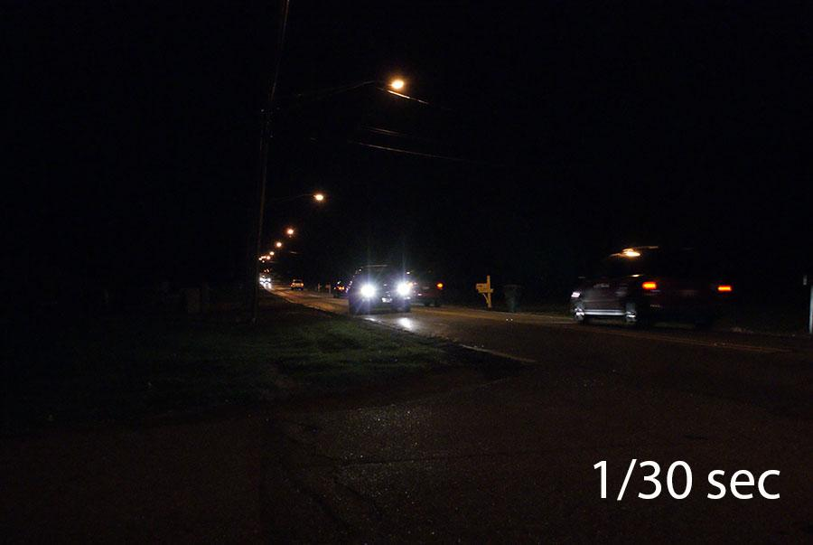
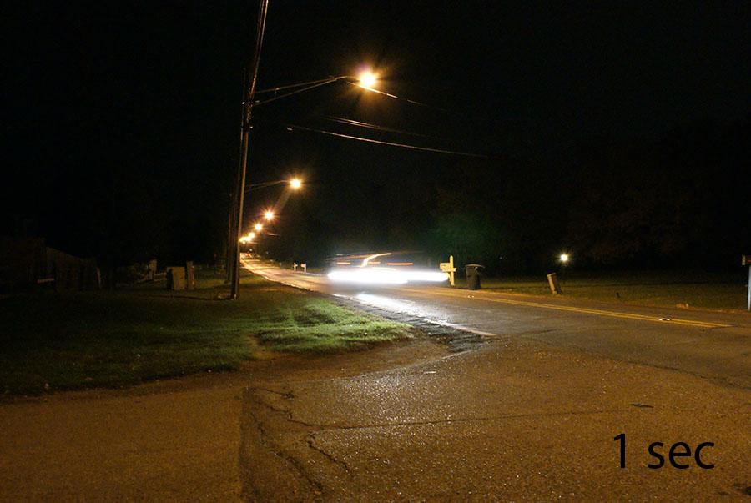
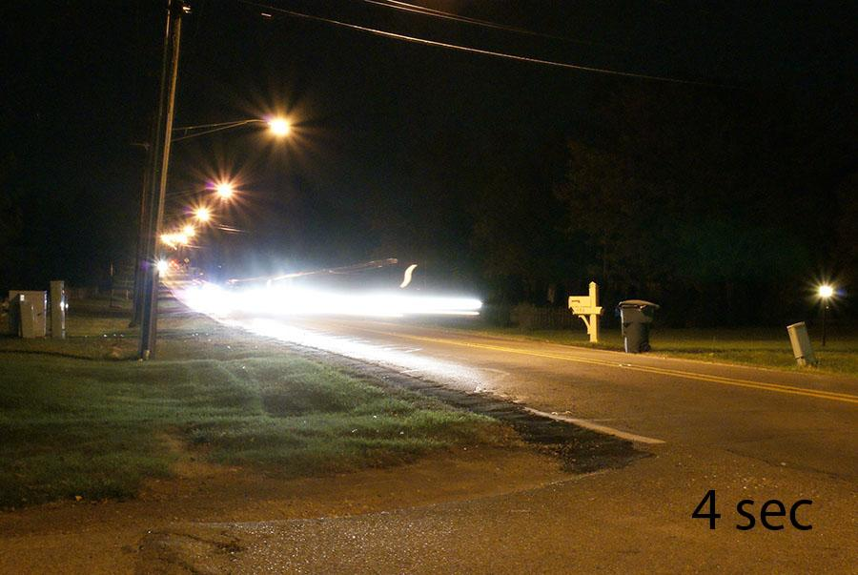
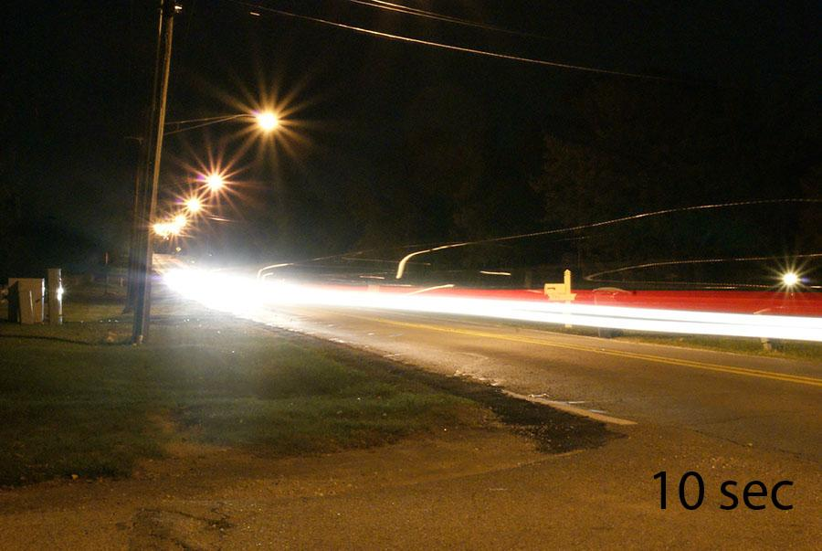
Shutter Speed Examples (at night)
Notice how the faster shutter speed (1/30th of a second) lets in less light, creating a more precise image but a darker one.
The faster shutter speeds are brighter but blur the movement and the light.

Slide 14
ISO

Slide 15
What is ISO?
Refers to a camera’s sensitivity to light.
This controls how much your camera naturally adjusts for a lack of light in situations.
NOTE: On film cameras, ISO referred to the “speed” of the film you bought.

Slide 16
How is ISO measured?
ISO typically comes in one of the following measurements:
100
200
400
800
1600
3200

Slide 17
What does that mean?
The lower the number, the less sensitive the camera’s sensor will be to natural light.
AND
The higher the number, the more sensitive the camera’s sensor will be to natural light.

Slide 18
For instance...
An ISO of 100 or 200 should be used for daylight or bright light situations
WHEREAS
Darker scenes and indoor pictures should use a higher speed.

Slide 19
When should I adjust ISO?
If you are taking pictures in low light situations and your photos are too dark, try bumping up the ISO.
Good for:
-gymnasiums
-concerts & “no flash” performances
-art galleries

Slide 20
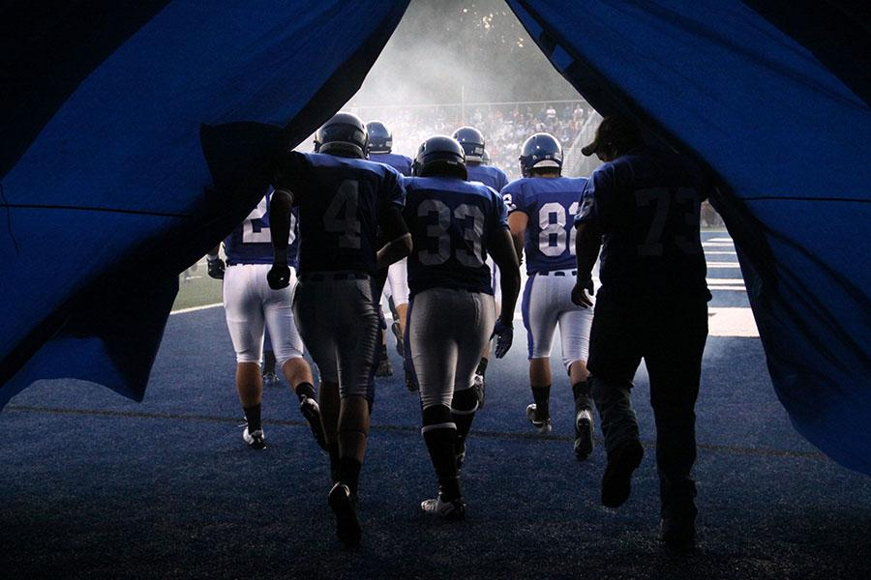
Why should I adjust ISO?
It adjusts for dark situations without using flash!
Bryant High School Publications

Slide 21
How can I adjust ISO?
ISO is located in a different place on each type of camera. On most cameras, ISO can be adjusted in every photo setting (including “auto”).
Check your camera manual to find it.

Slide 22
Potential Problems
As you increase your ISO, your photos will get brighter...BUT they will also get grainier.
It’s a good idea to take the photos using the lowest ISO possible that still gets you a light enough shot.

Slide 23
Aperture

Slide 24
What is aperture?
Refers to the amount of light that enters the eye of the camera.
THINK of aperture like the pupil of your eye: your pupil gets bigger and smaller based on the light that is available, and aperture does that to the camera’s “eye” as well.

Slide 25
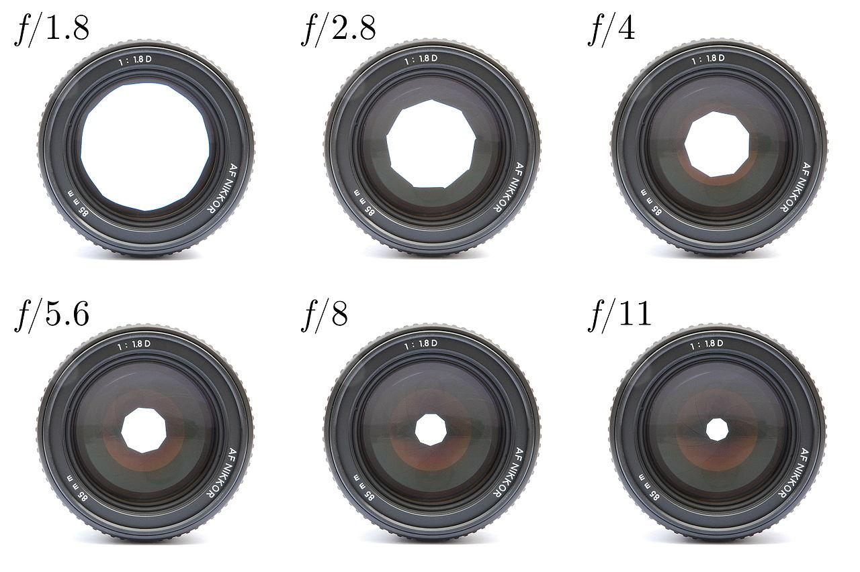
What does that mean?
The larger the “eye,” the more light that the camera will let in.
The smaller the “eye,” the less light the camera will let in.

Slide 26
How is aperture measured?
By the size of the “eye” in the lens, called “f stops”
Here’s where it gets confusing:
The bigger the aperture hole opening,
the more light comes in,
which gives a smaller f-stop number

Slide 27
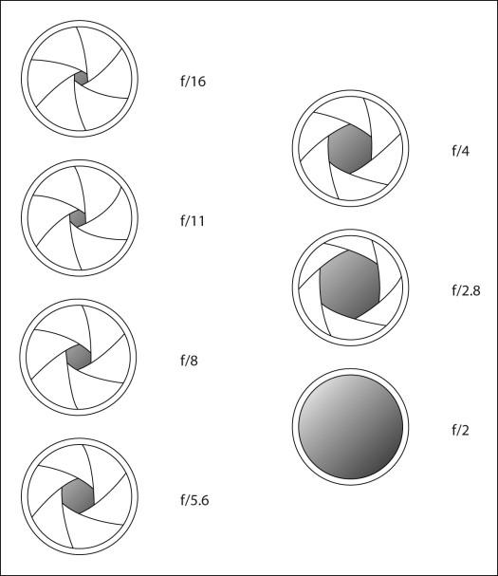
For instance...
Smaller f-stop numbers, like 1.4 and 1.8, actually mean a larger “eye” in the lens and more light.
Bigger f-stop numbers, like 6, mean a smaller “eye” in the lens and less light.

Slide 28
Why should I adjust aperture?
Adjusting aperture controls the depth of field, or how much of the picture is in focus.
A higher f-stop (like 6) will make the entire photo in focus, giving you a wide or deep depth of field
A lower f-stop (like 1.8) will make only part of the photo in focus, giving you a shallower depth of field

Slide 29
When should I adjust aperture?
Adjust aperture when you only want part of the photo to be in focus.
For instance:
busy backgrounds
portraits

Slide 30
How can I adjust aperture?
Set your camera to Aperture priority.
“Av” on Canon
“A” on pretty much everything else
From there, adjust using a scroll button on the camera.

Slide 31
Potential Problems
The lens quality limits how much you can adjust aperture, and lens that allow low f-stops are expensive!
Very high f-stops (8 and up) often require a slower shutter speed, so you may need a tripod to prevent shakiness.

Slide 32
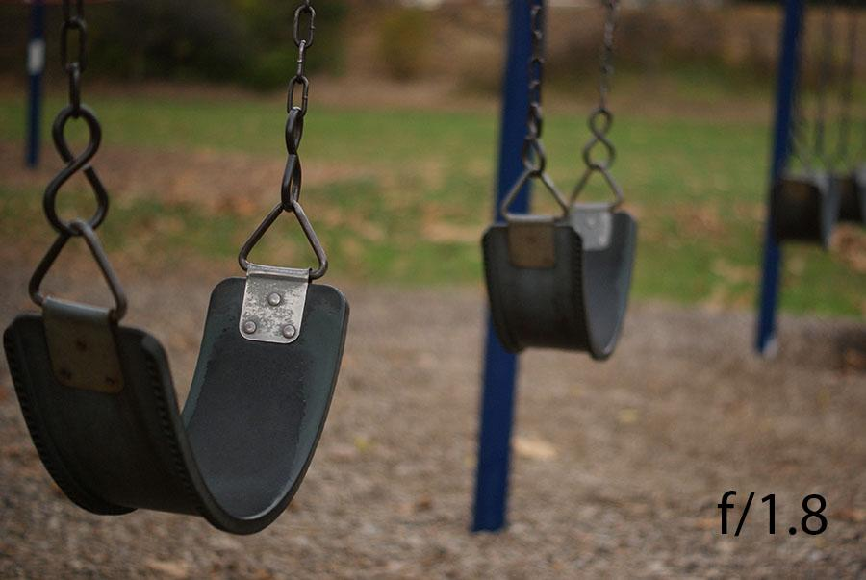
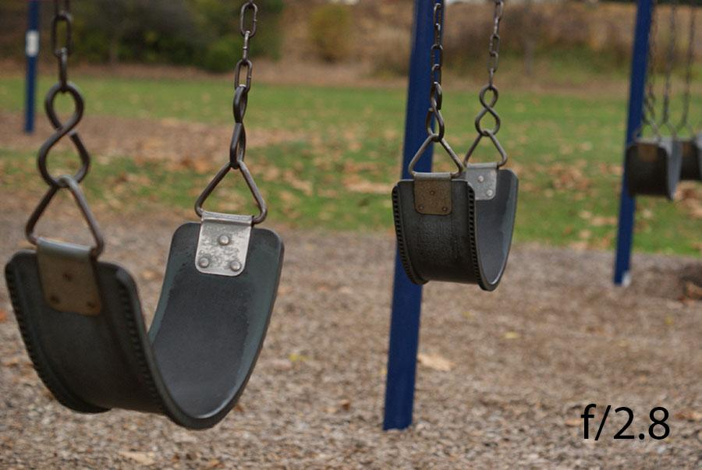
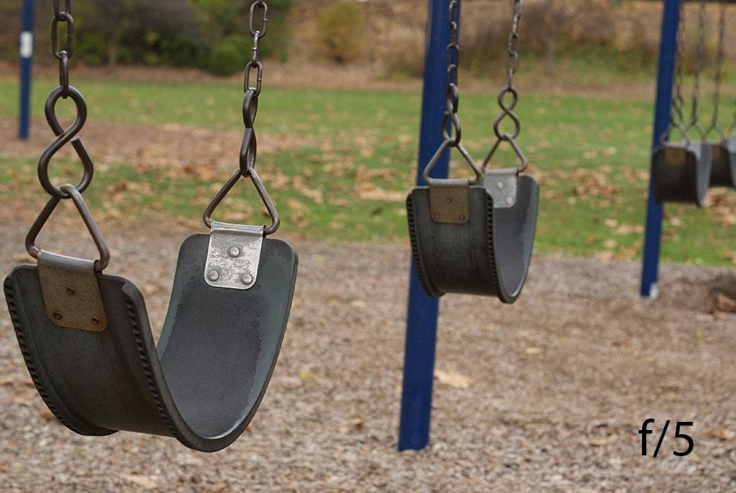
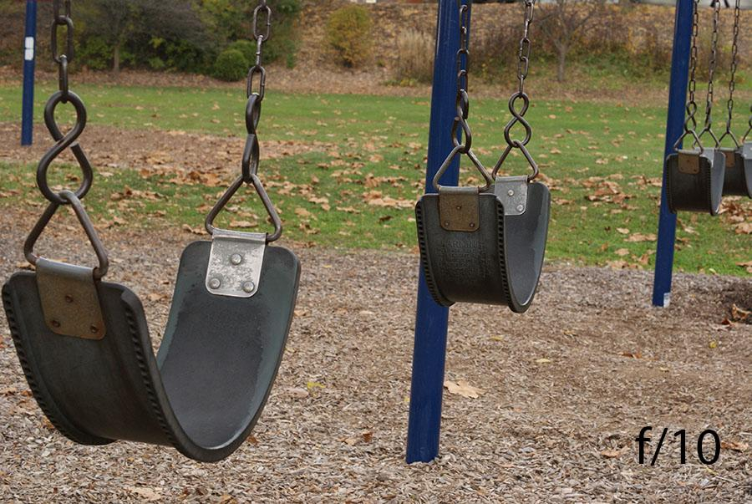
Aperture Examples
Top left: Notice how lower aperture creates a smaller depth of field. The front swing is in focus but the other swings are somewhat blurry.
Bottom right: The higher aperture creates a greater depth of field, meaning that the entire photo is sharp and precise.

