Slide 1
Choosing Photos
for Publication
Photojournalism

Slide 2
Practice scenario
Use the headlines and accompanying photos on the following slides.
Sketch out the front page of your broadsheet-sized student newspaper, The Monthly Gazette.
Choose which stories/photos to include and which to leave out.
You may also choose to crop or adjust photos to help fit your purpose and the stories.

Slide 3
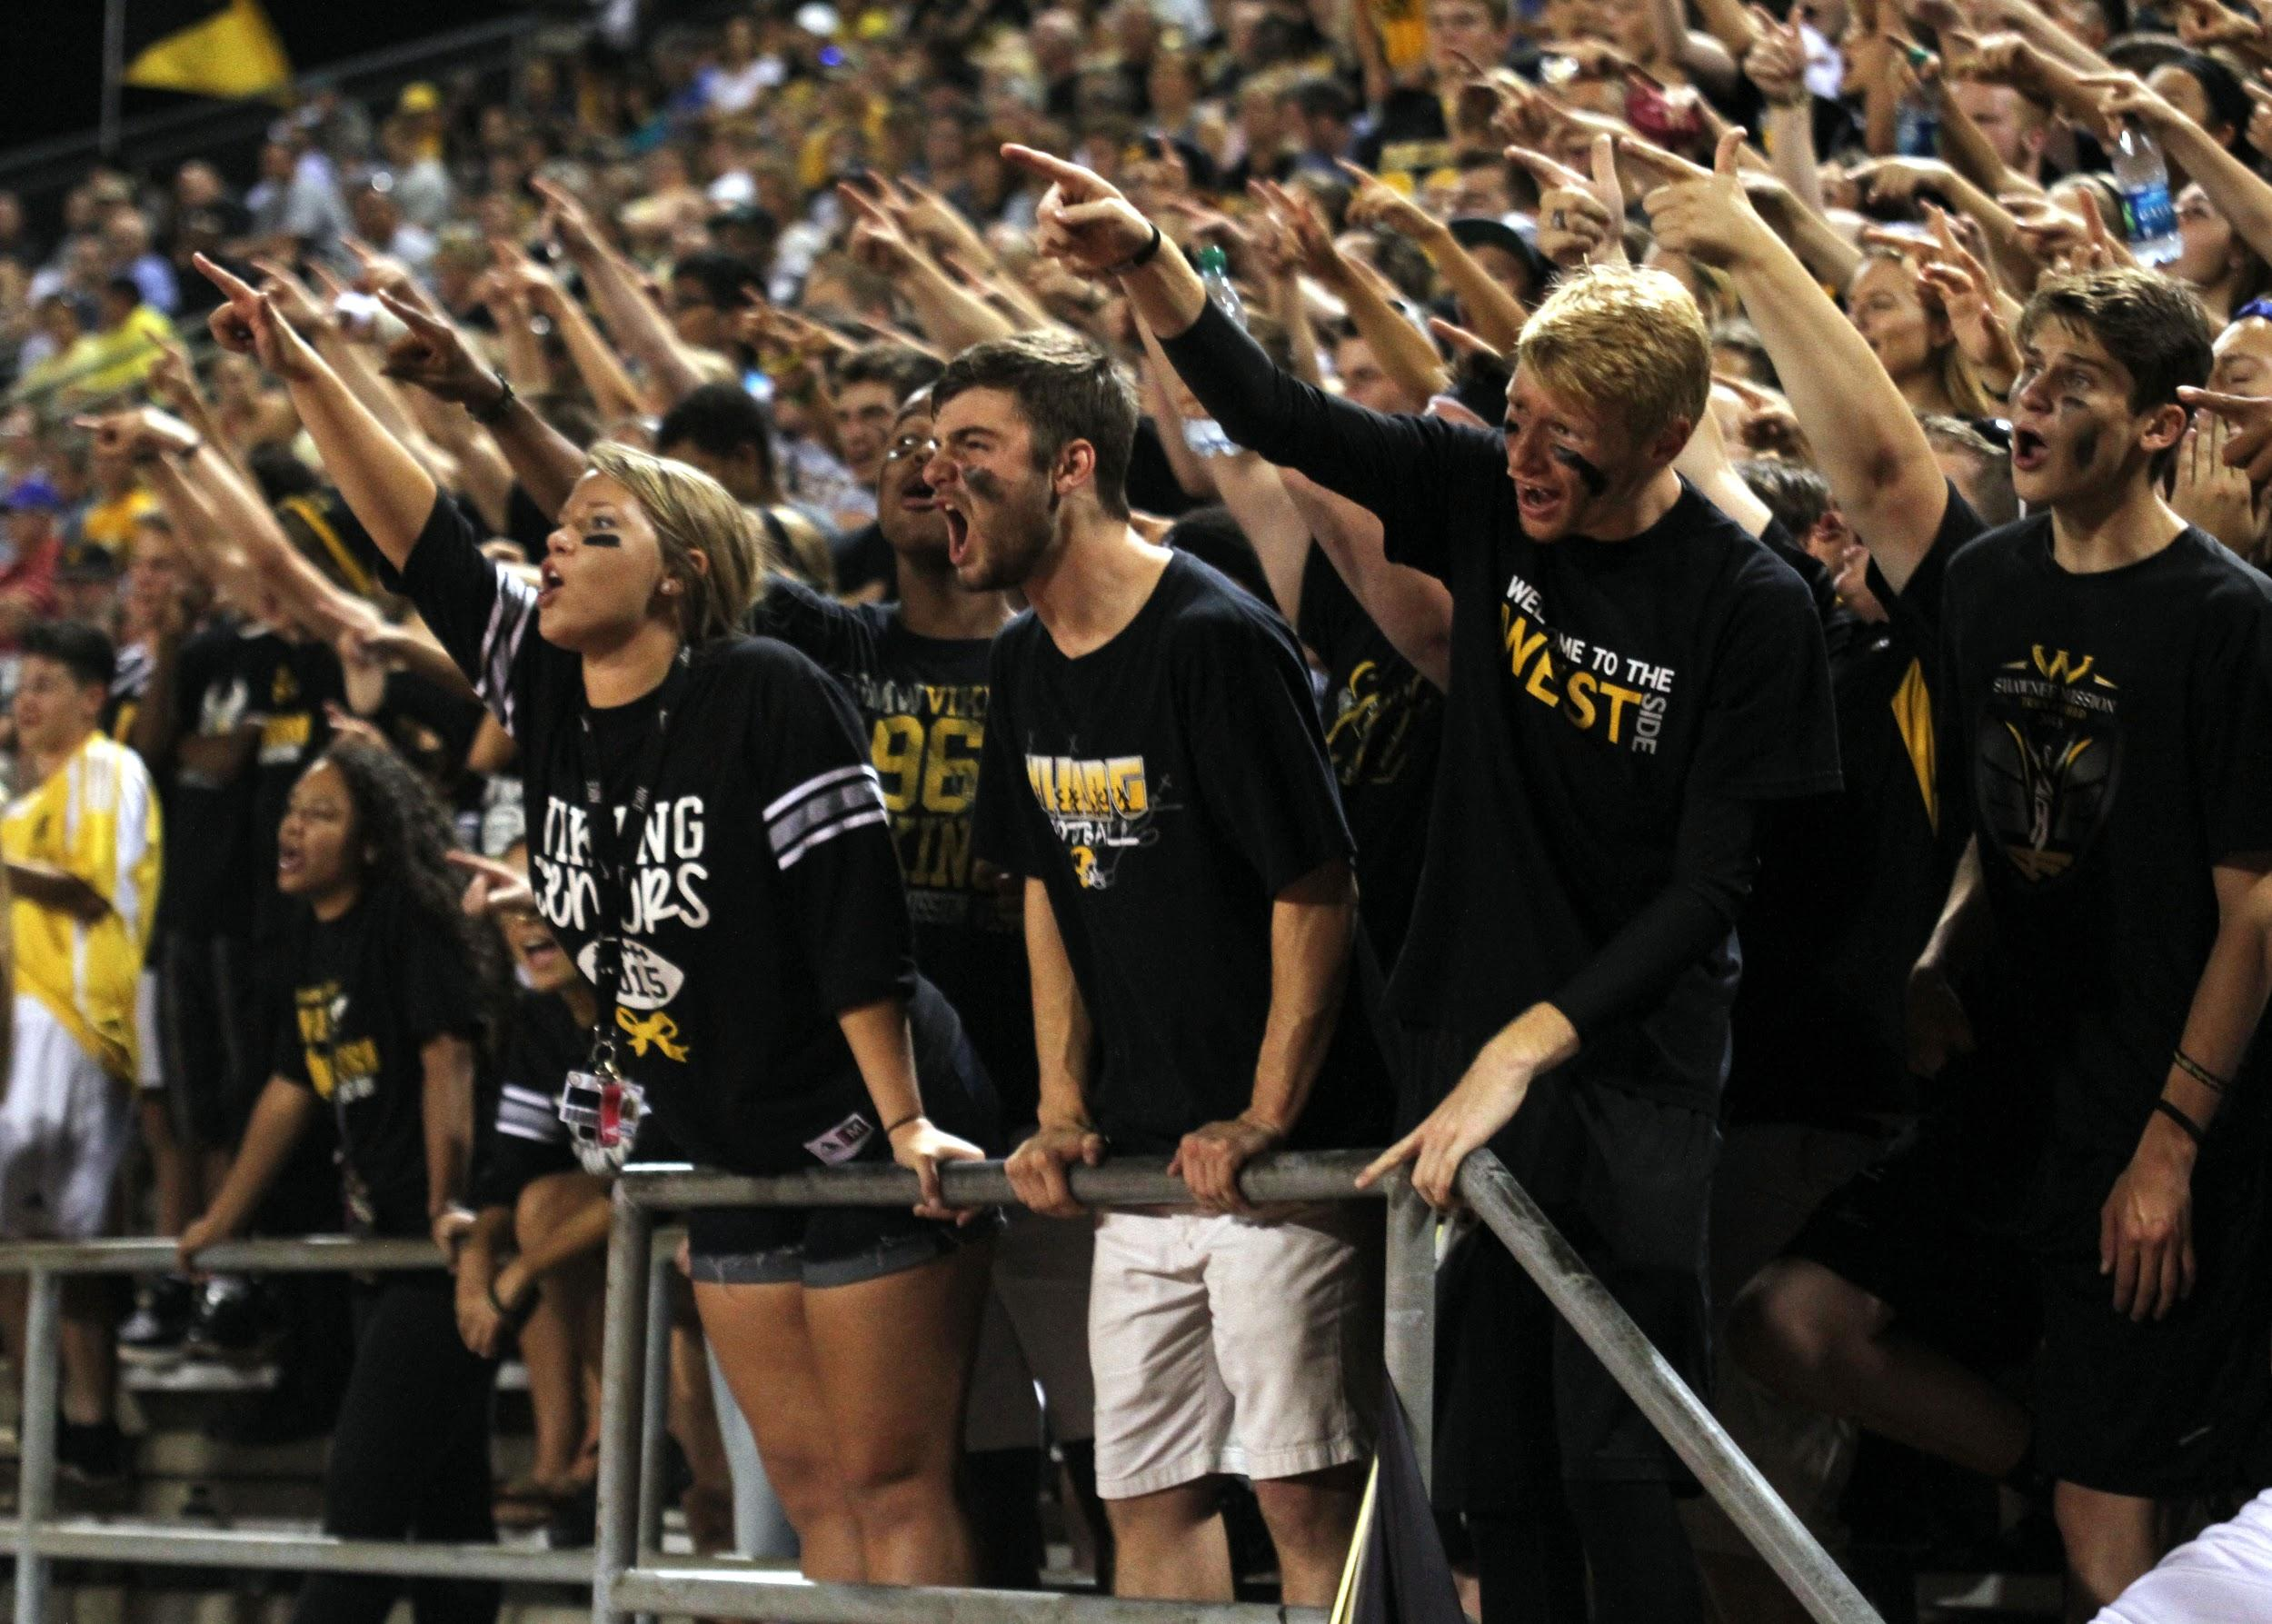
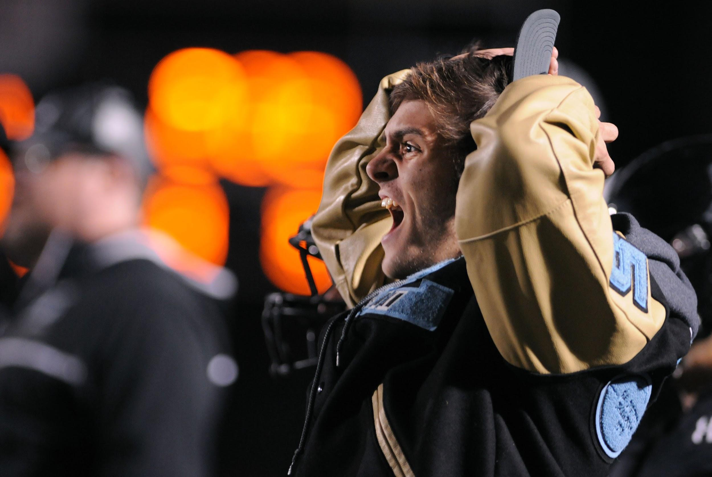
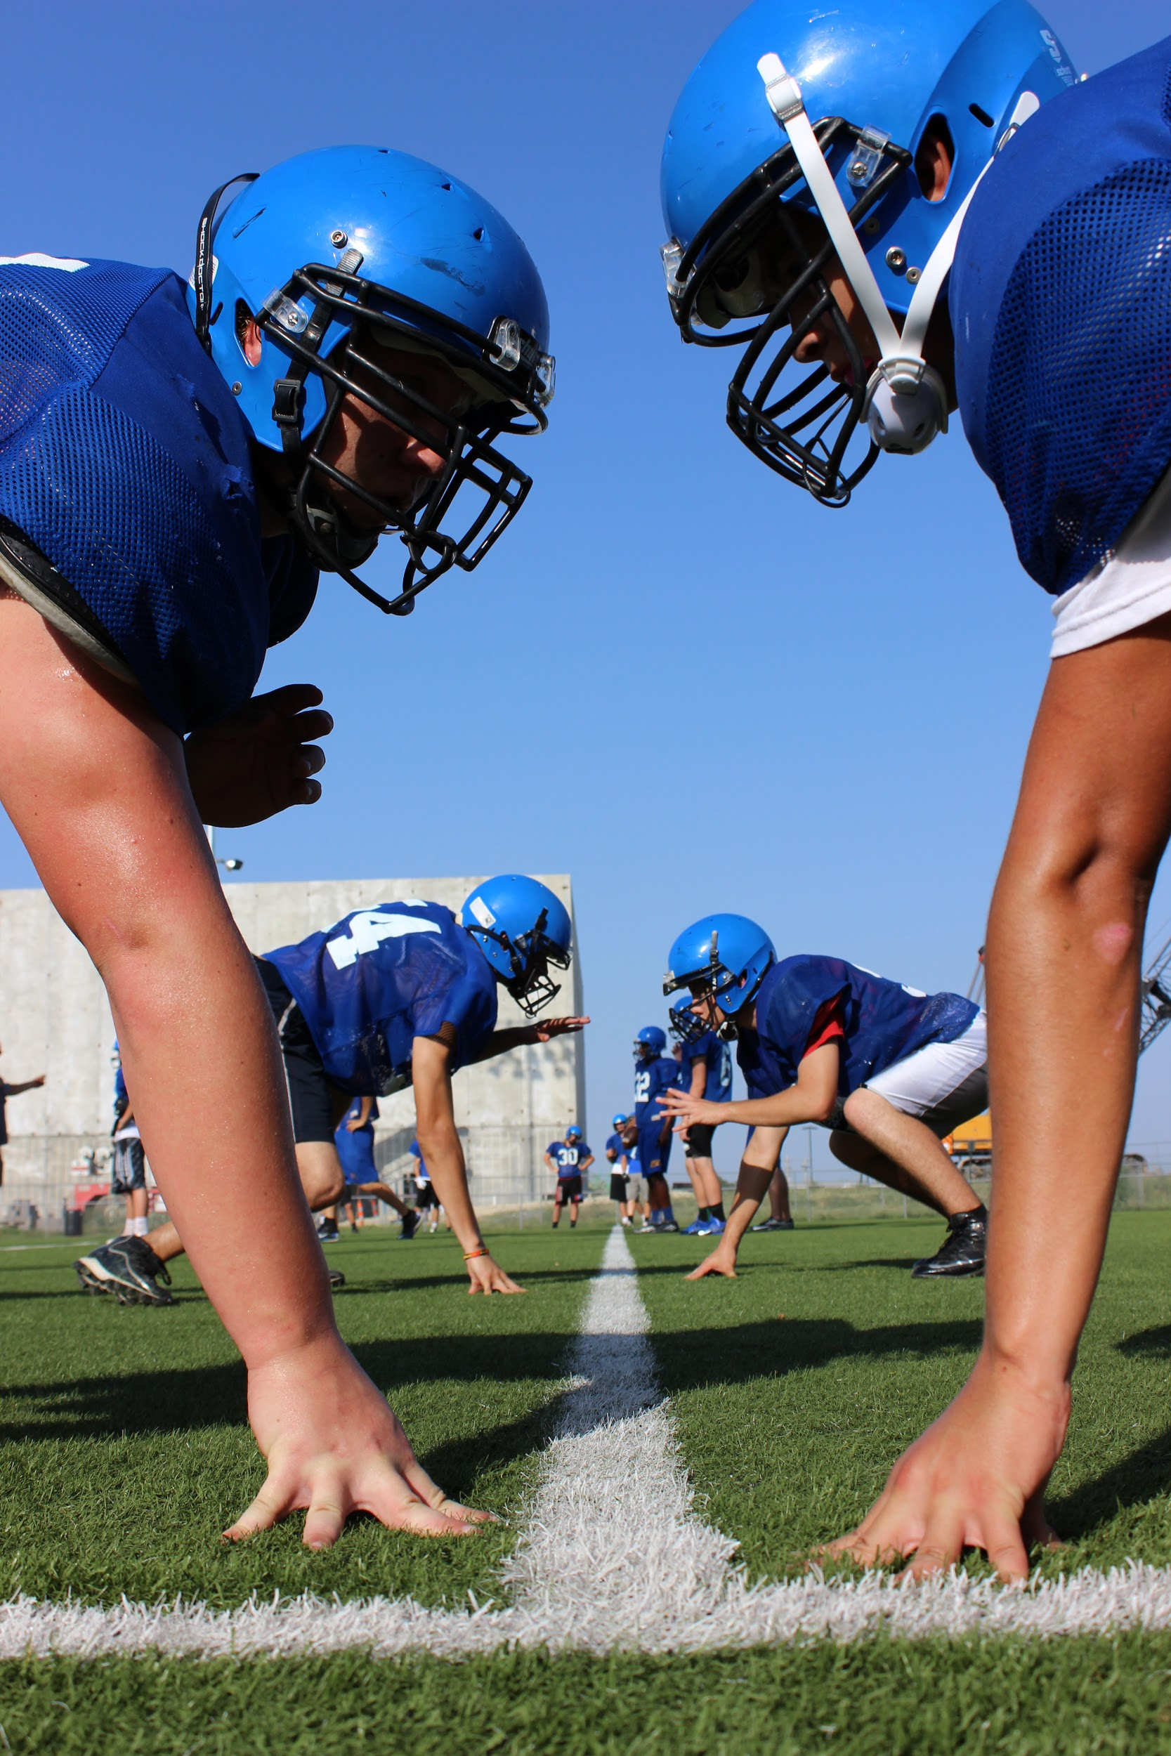
#1: Athletic department begins search for new head football coach after shaky season
Photo credits clockwise from above: Maria Dunn, Shawnee Mission East High School; Shawnee Mission West High School; Malora Lake, Circle High School

Slide 4
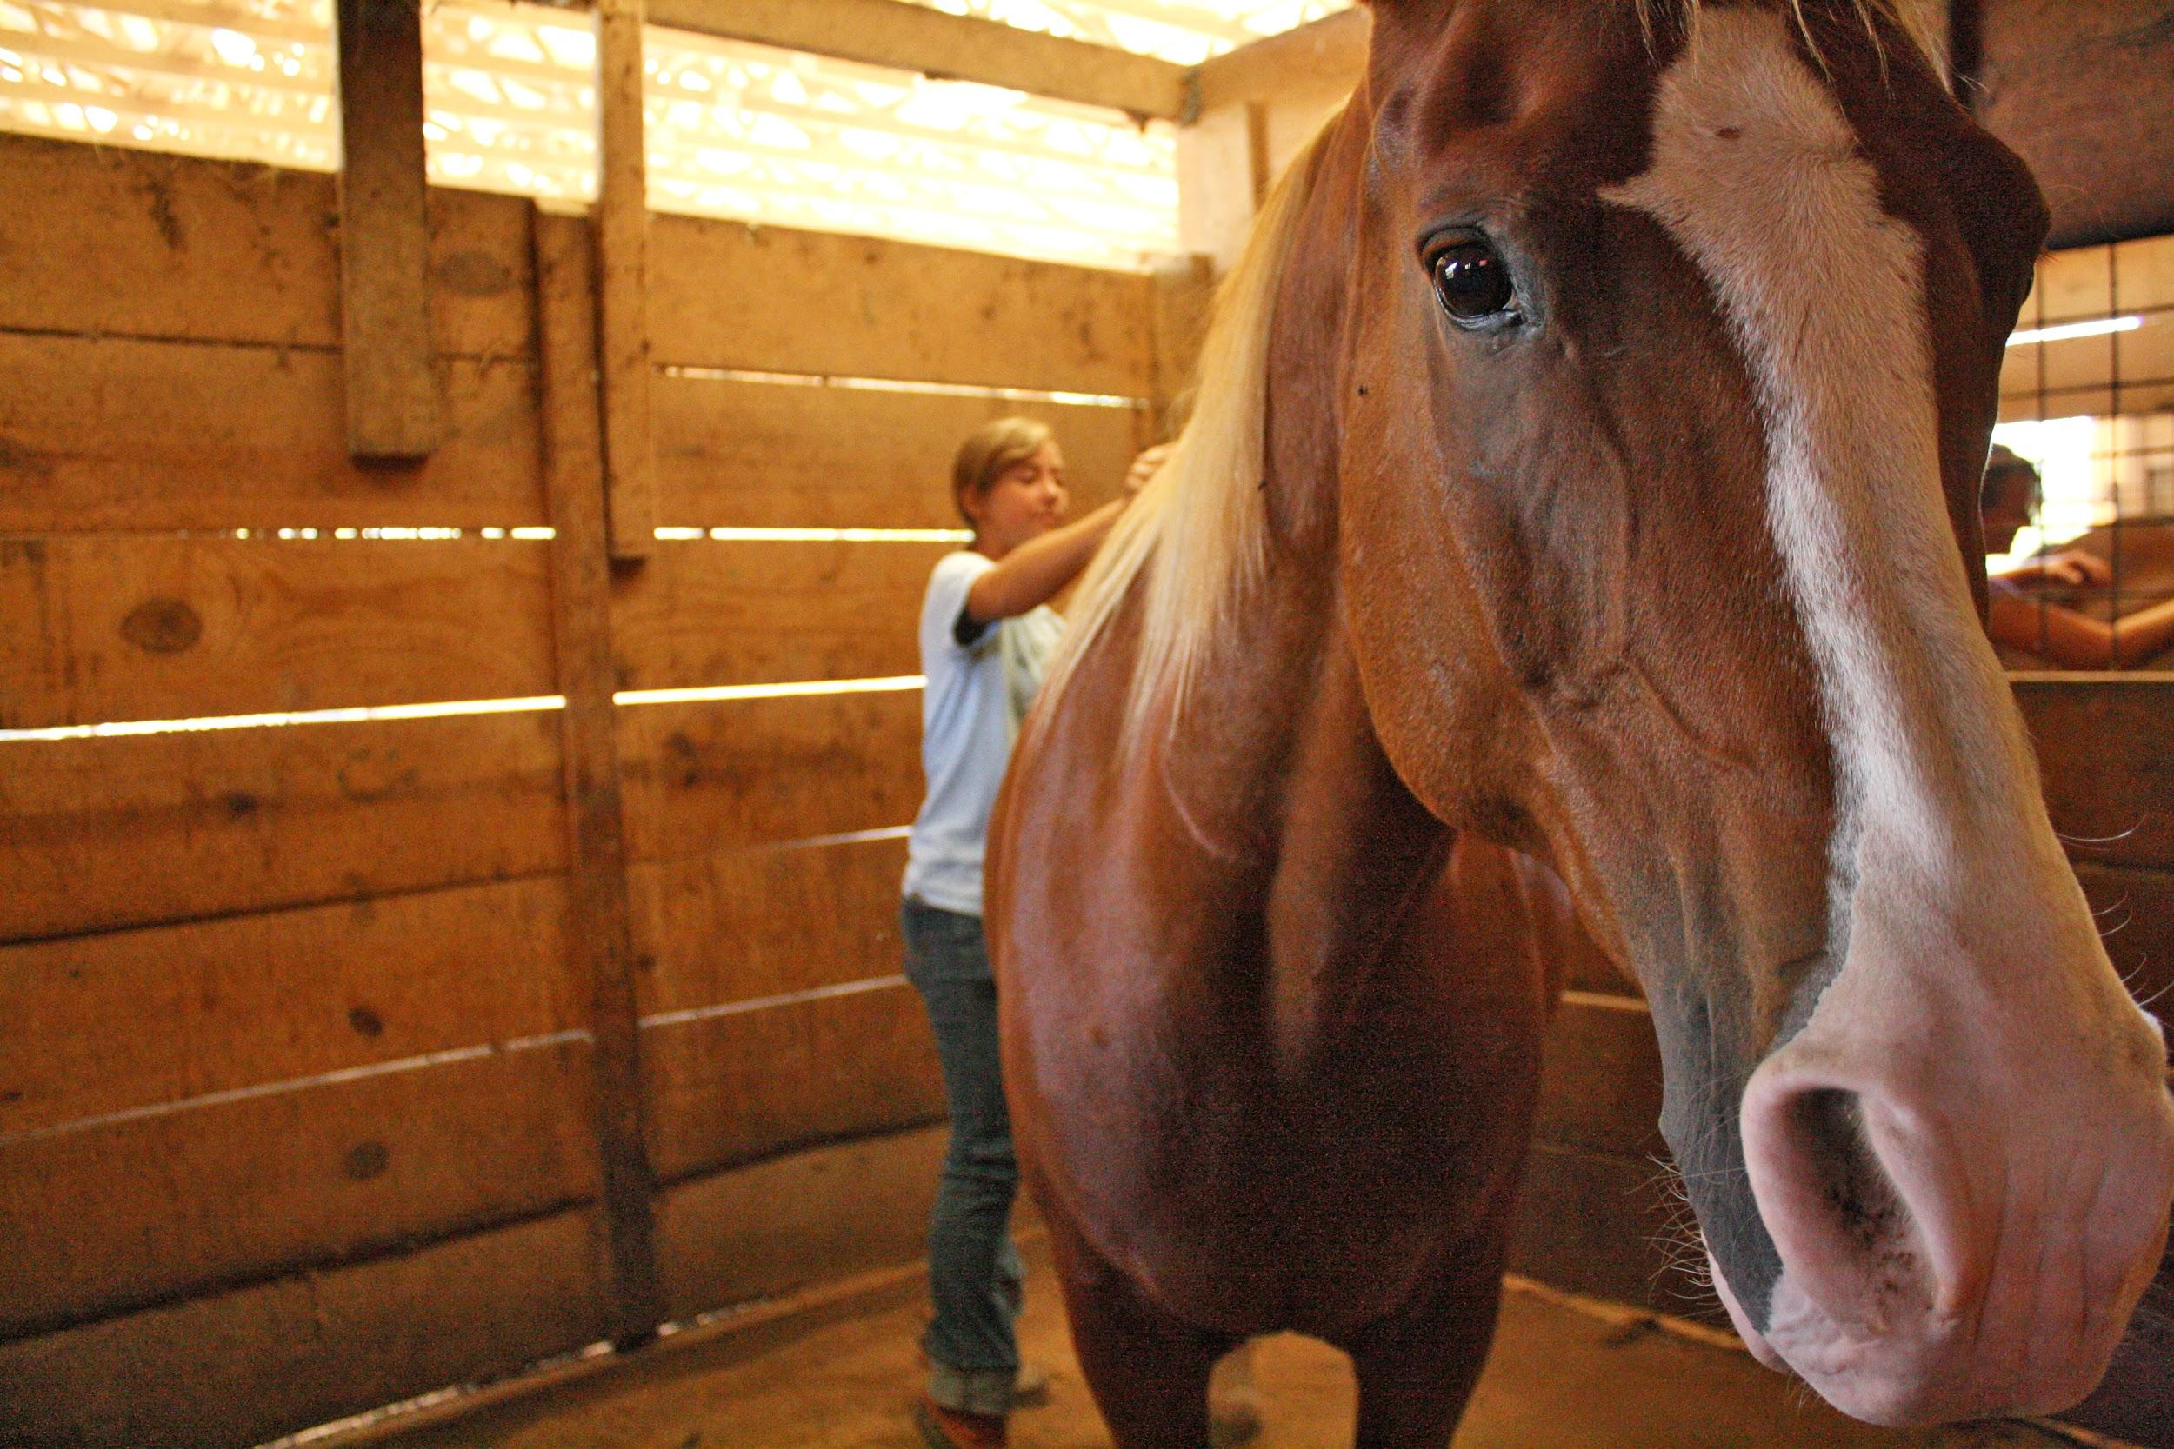
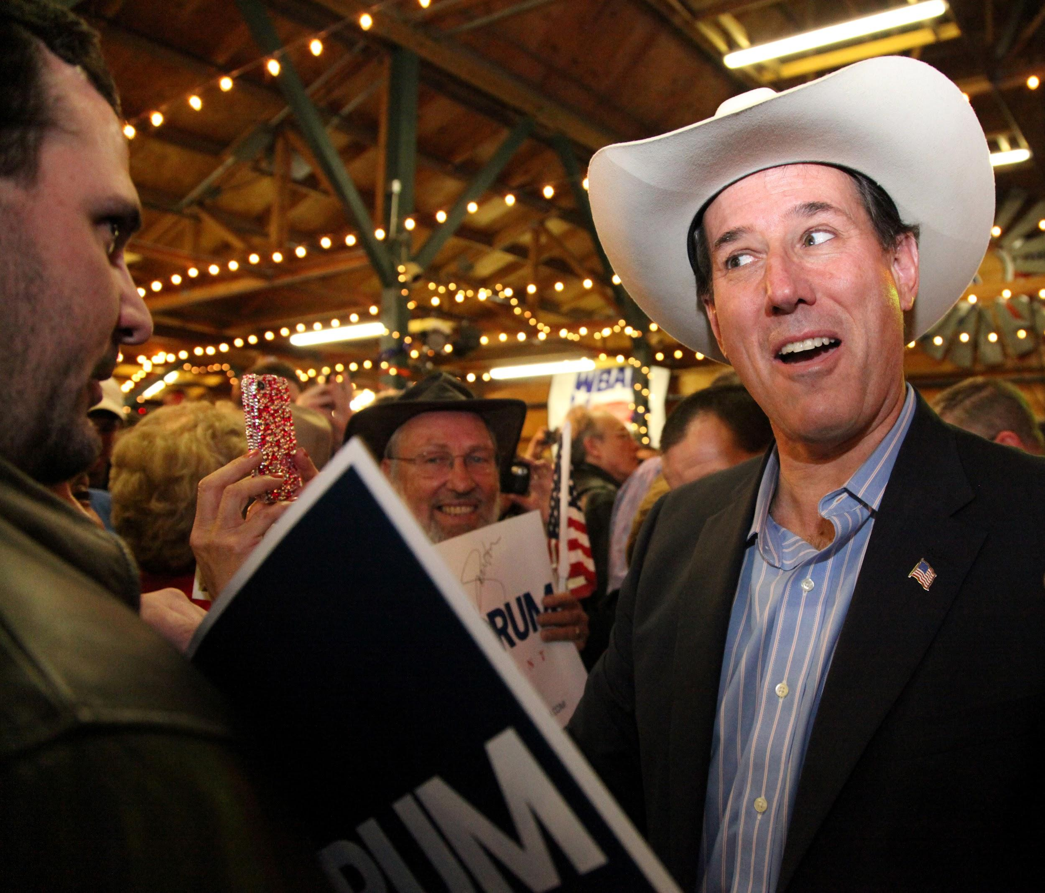
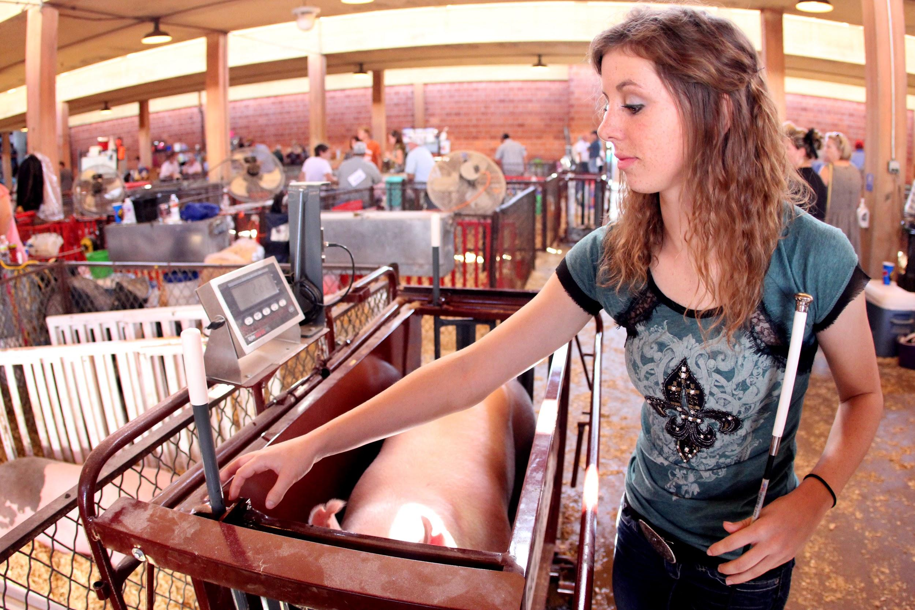
#2: County fair sets records for crowds, contest participation
Photo credits: McKinney High School Publications

Slide 5
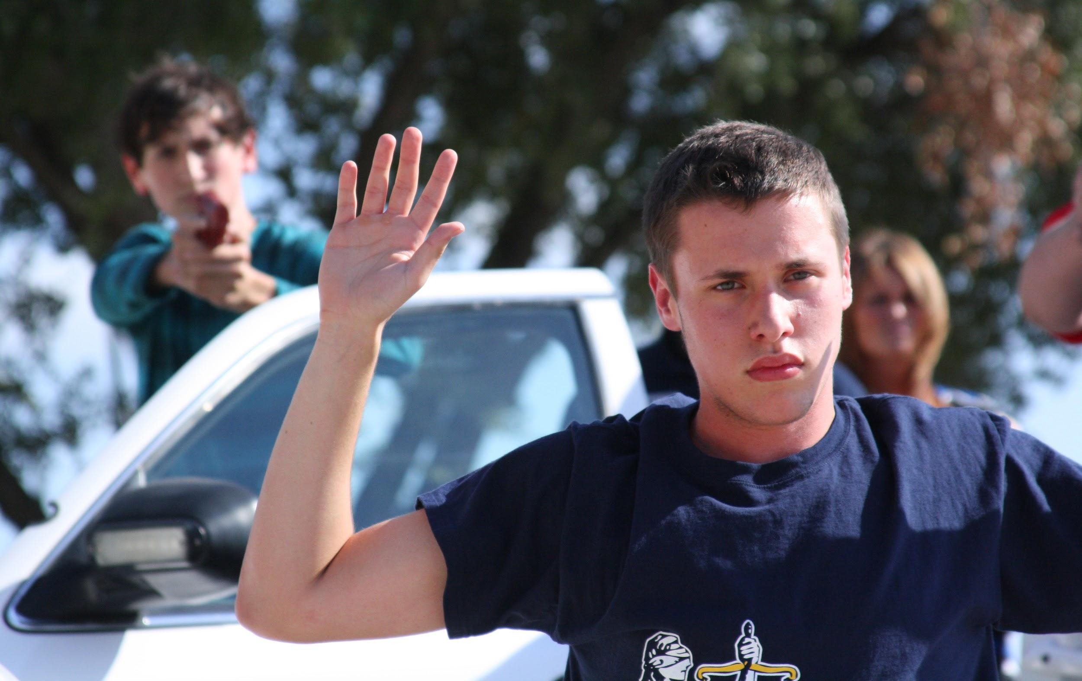
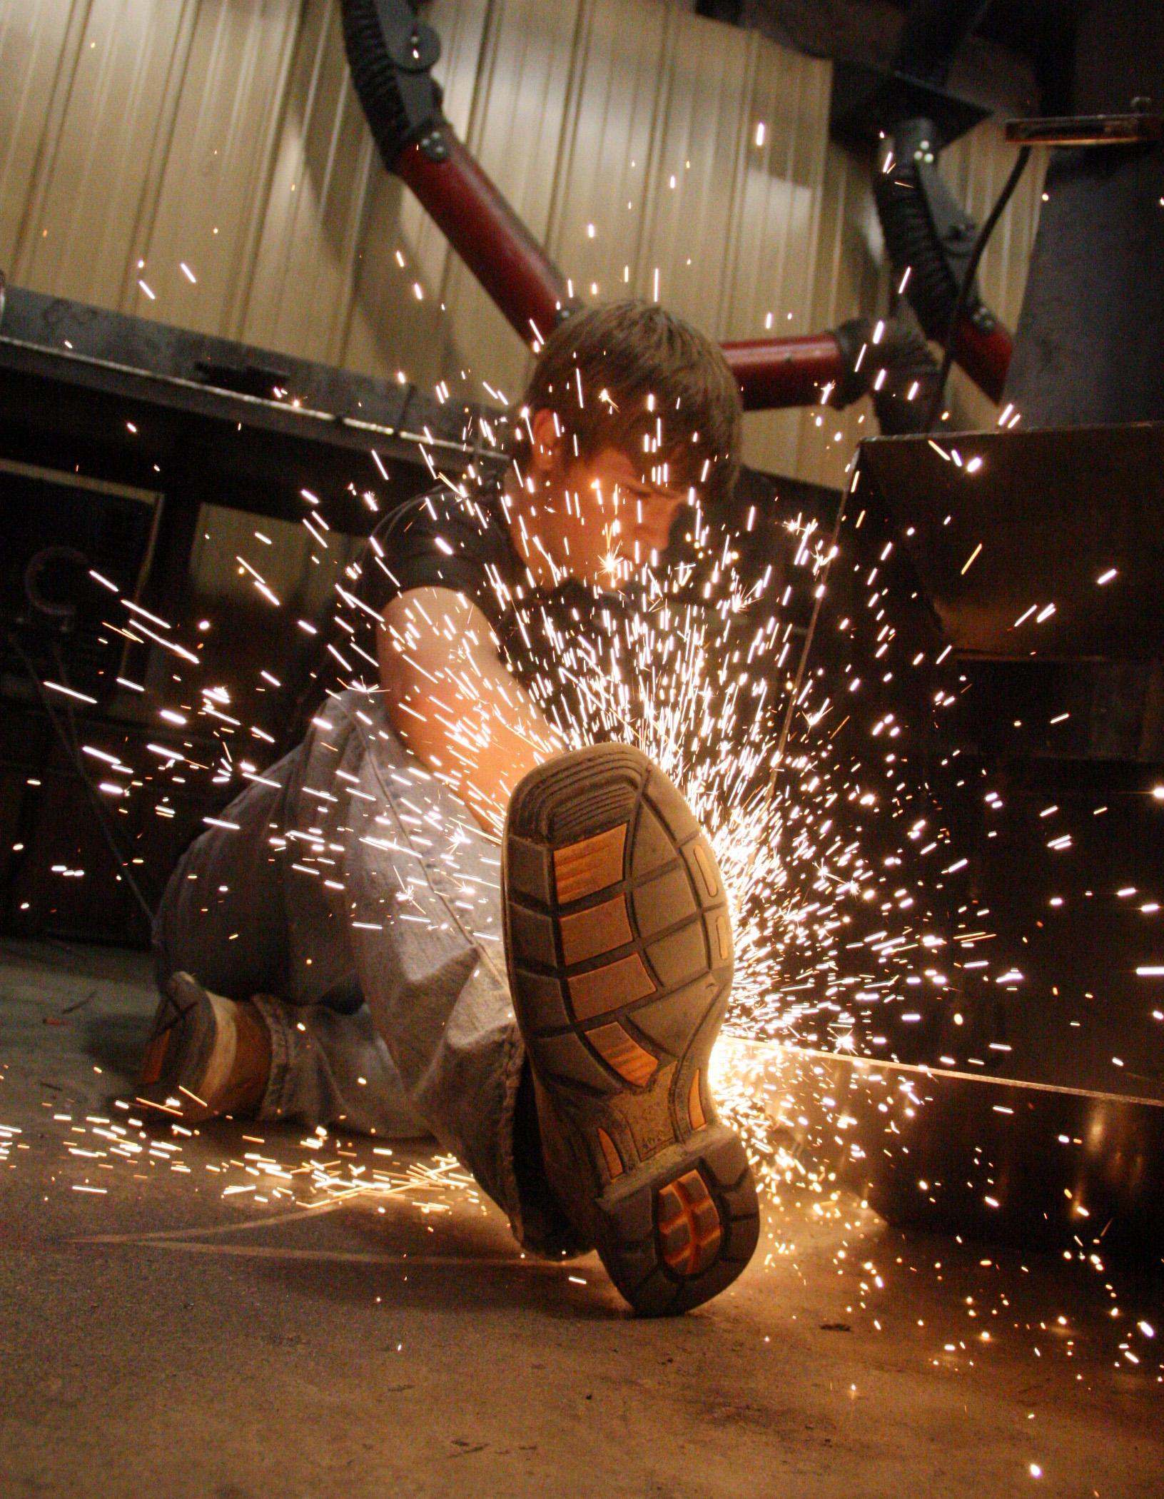
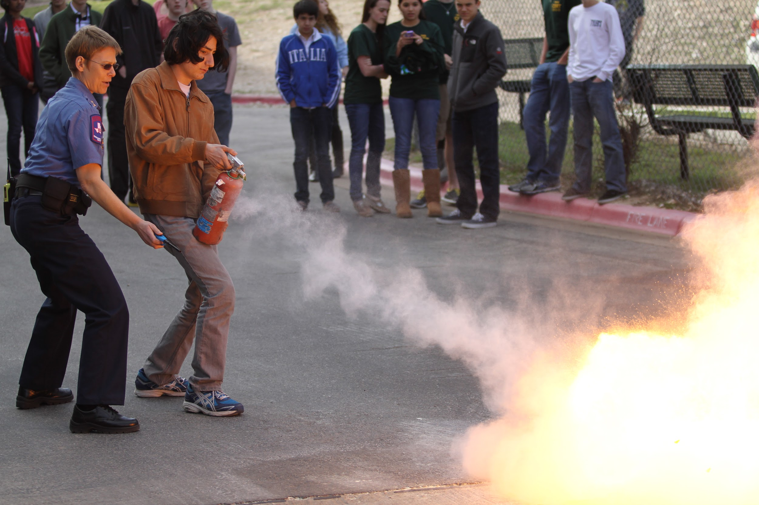
#3: New courses aim to give students a look at career possibilities
Photo credits clockwise from above: Bryant High School Publications; McKinney High School Publications; Sarah Guthrie,
Westlake High School

Slide 6
Your turn! Use the template handout to design your own front page.

Slide 7
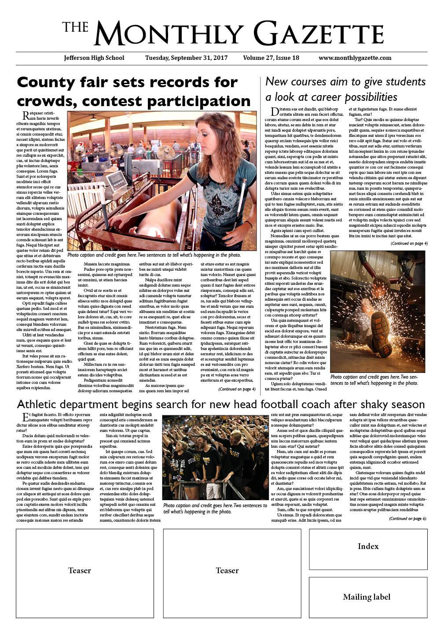
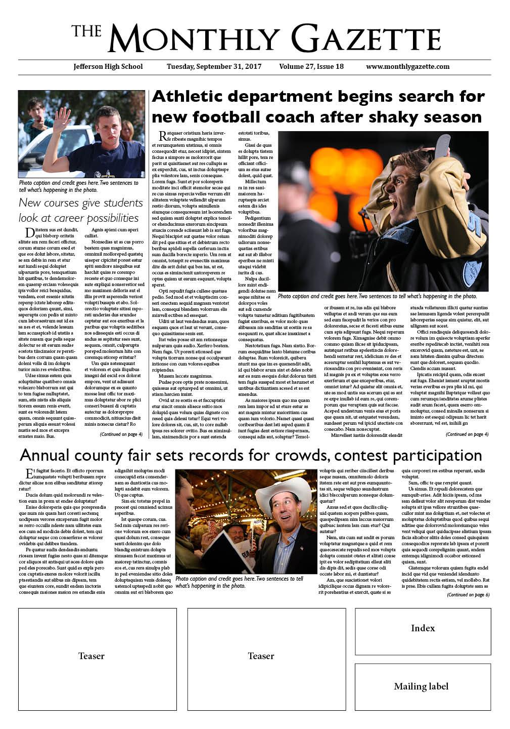
Compare the content of these two papers:
How is the message and focus of these pages different?

Slide 8
Before printing a photo, consider...
*Used with permission from Joe Elbert, Assistant Managing Editor of Photos for The Washington Post
Does the photo communicate quicker, stronger, better or more eloquently than a simple sentence?
Does the photo have visual content or stop short of elevating the story?
Does the photo go beyond the trite or the obvious?
Does the photo have enough impact to move the reader?
Is the photo mindless documentation?
Does the photo communicate effectively? A good photo should move, excite, entertain, inform or help readers understand the story.

