Slide 1
Manipulated Photos
Photojournalism

Slide 2
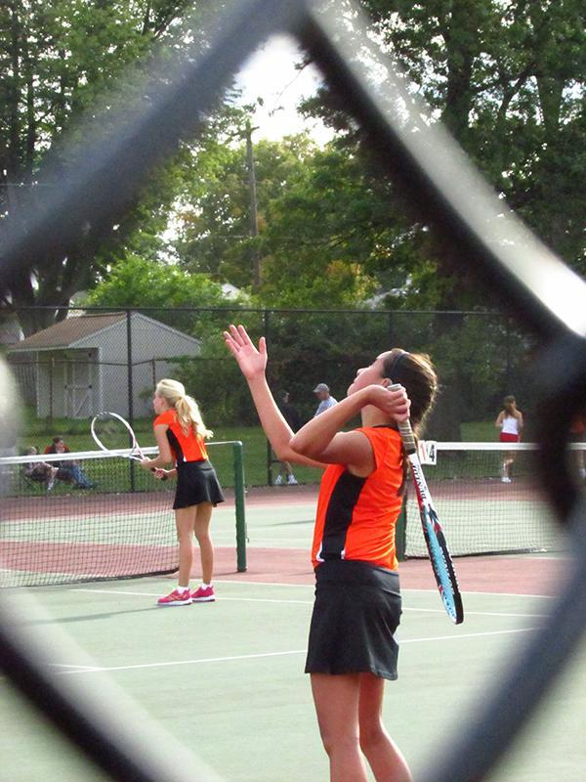
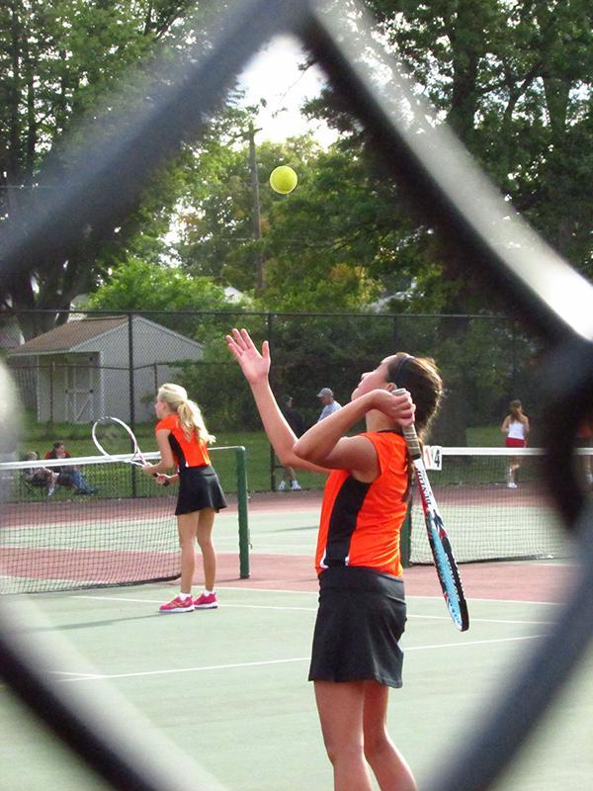
(Monique Martinez - R.B. Hayes High School)

Slide 3
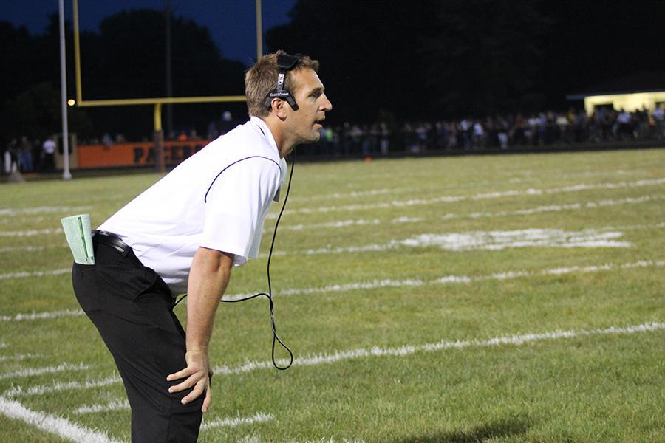
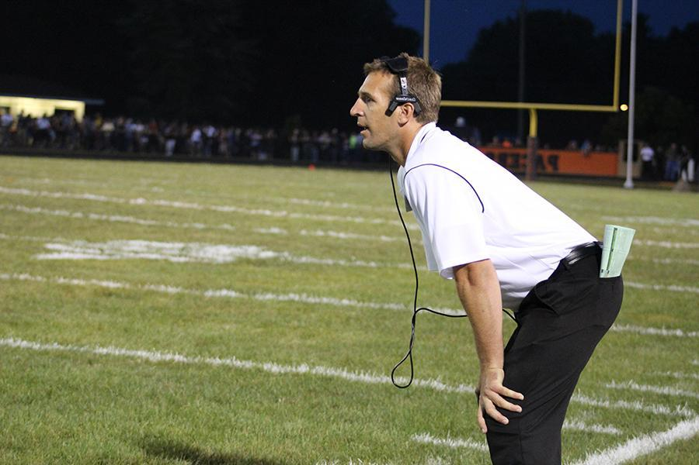
(Bushra Ghafoor - R.B. Hayes High School)

Slide 4
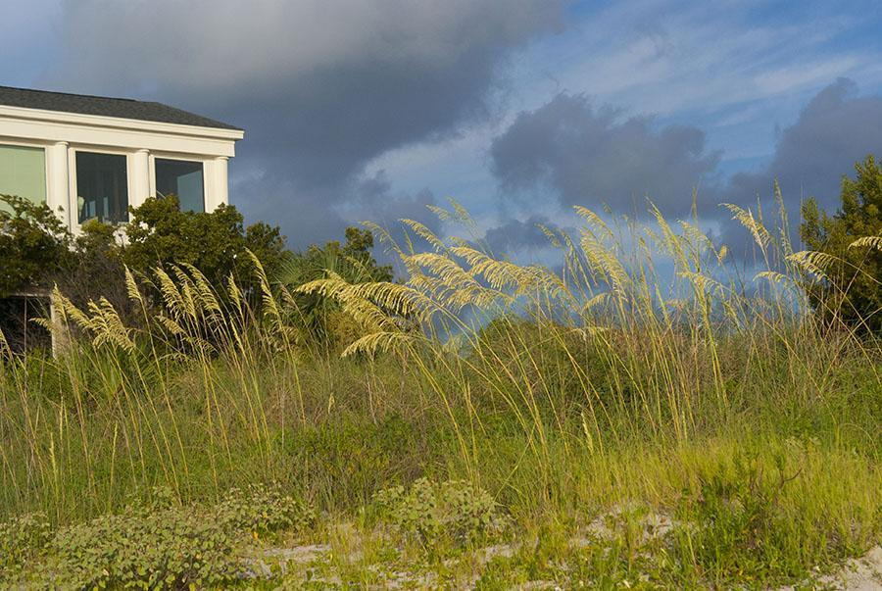
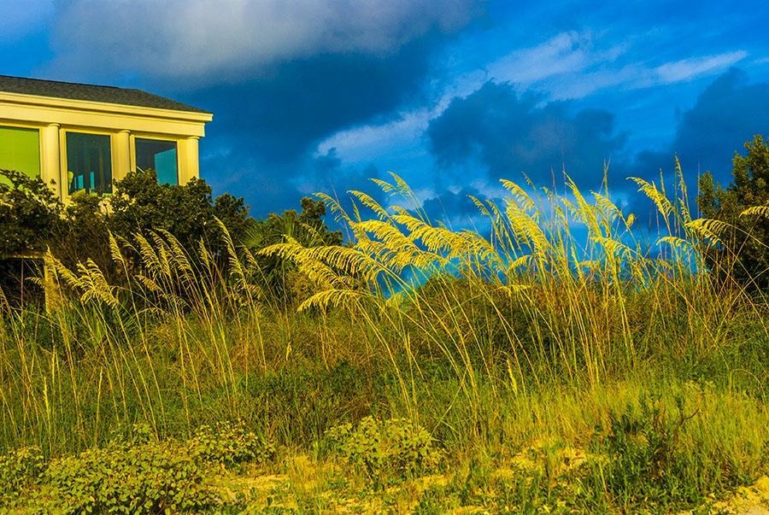
(Julieanne McClain)

Slide 5
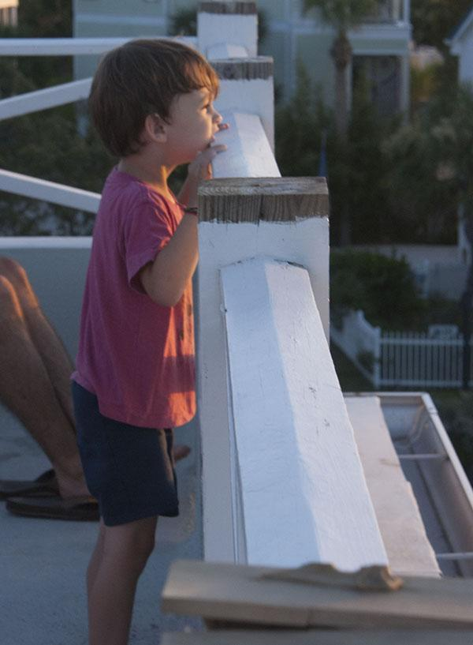
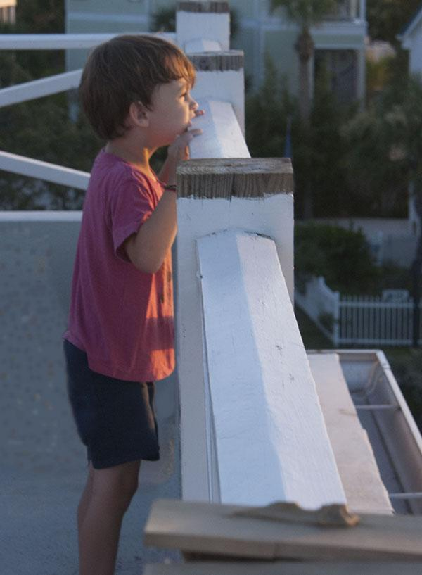
(Julieanne McClain)

Slide 6
National Press Photographer’s Association
“Editing should maintain the integrity of the photographic images' content and context.
Do not manipulate images or add or alter sound in any way that can mislead viewers
or misrepresent subjects.”

Slide 7
Associated Press photo editing policy
“The content of a photograph will NEVER be changed or manipulated in any way. Only the established norms of standard photo printing methods such as burning, dodging, toning and cropping are acceptable.
Retouching is limited to removal of normal scratches and dust spots.
Serious consideration must always be given in correcting color to ensure honest reproduction of the original. Cases of abnormal color or tonality will be clearly stated in the caption. Color adjustment should always be minimal.”

Slide 8
New York Times photo editing policy
“Images in our pages, in the paper or on the Web, that purport to depict reality must be genuine in every way. No people or objects may be added, rearranged, reversed, distorted or removed from a scene (except for the recognized practice of cropping to omit extraneous outer portions).”

Slide 9
USA Today photo editing policy
We do not alter any photograph, electronically or otherwise, to change the content, and we should be very careful about color correcting
or any other potential alteration.
(According to a memo from the 1989
managing editor for photography)

