Slide 1
Sample Sports Photography
Photojournalism

Slide 2
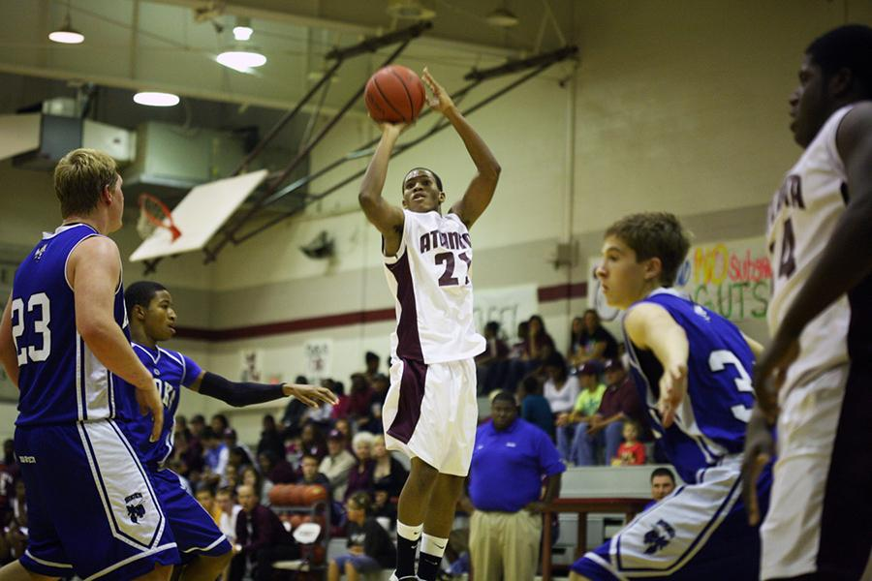
Atlanta ISD Yearbook Staff

Slide 3
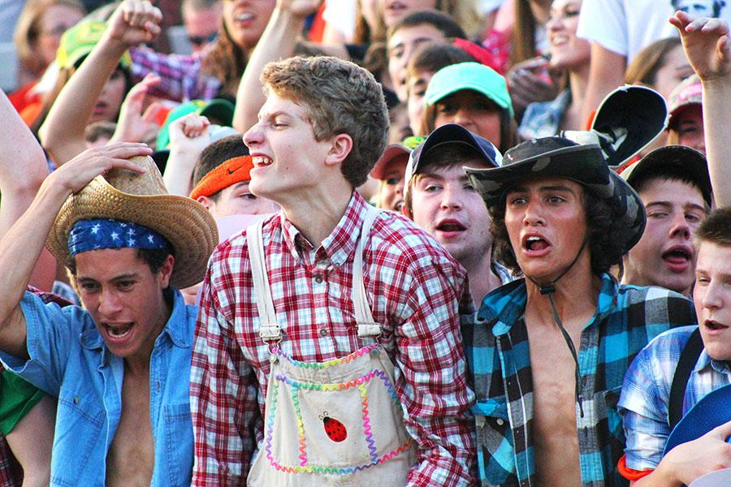
Bushra Ghafoor, R.B. Hayes High School

Slide 4
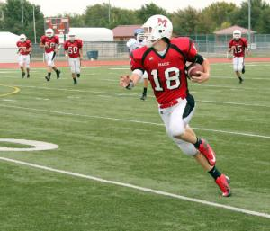
Jet Warren, Maize (Kan.) High School

Slide 5
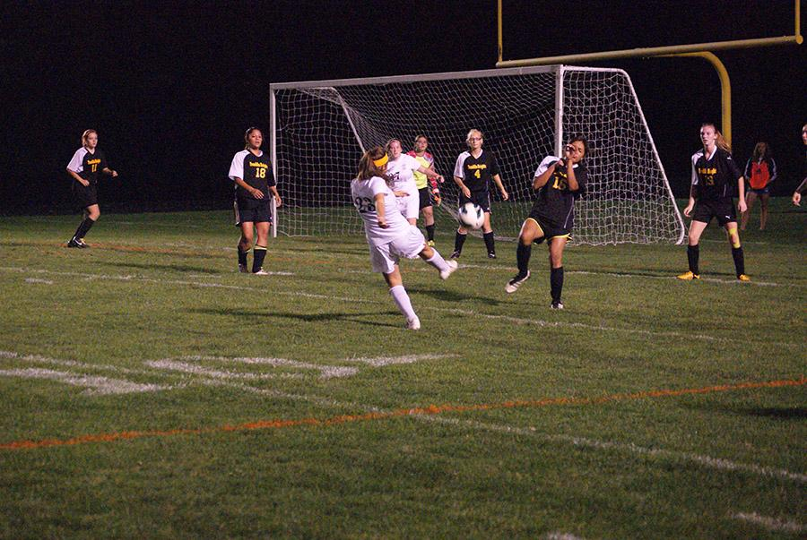
Monique Martinez, R.B. Hayes High School

Slide 6
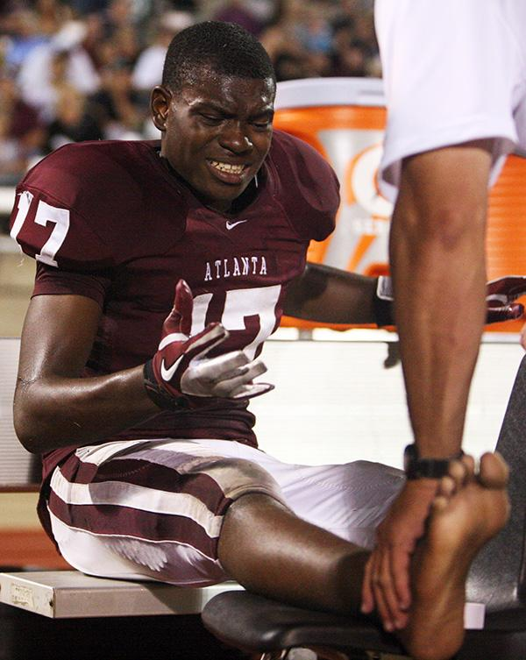
Atlanta ISD Yearbook Staff

Slide 7
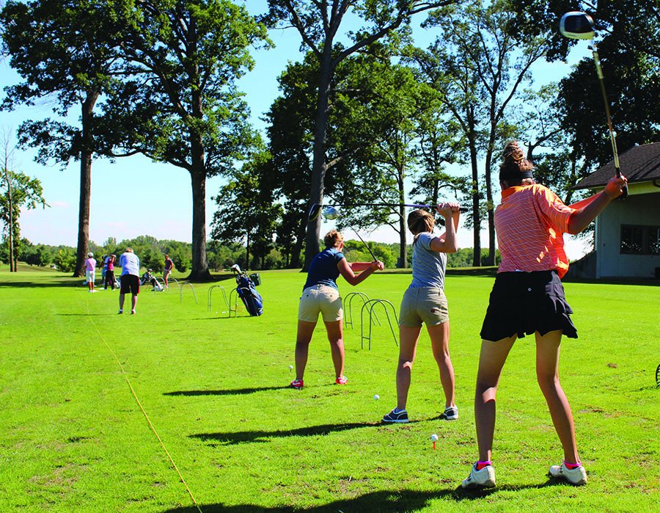
Bushra Ghafoor, R.B. Hayes High School

Slide 8
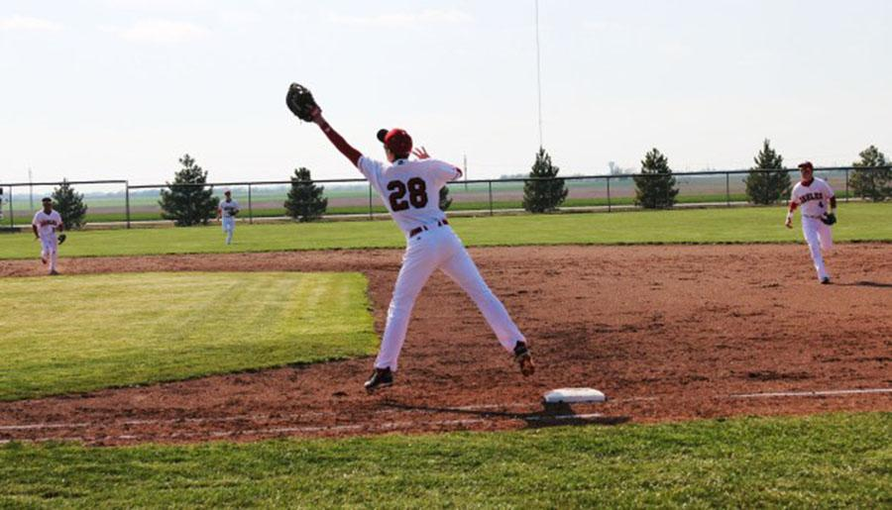
Kylee Betzen, Maize (Kan.) High School

Slide 9
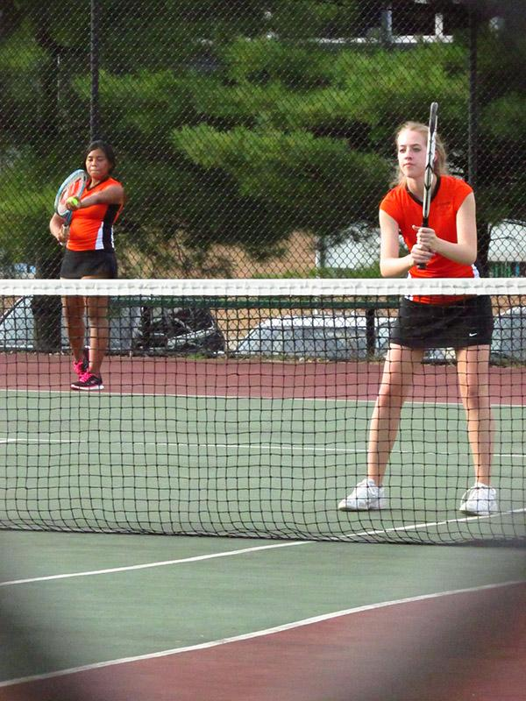
Monique Martinez, R.B. Hayes High School

Slide 10
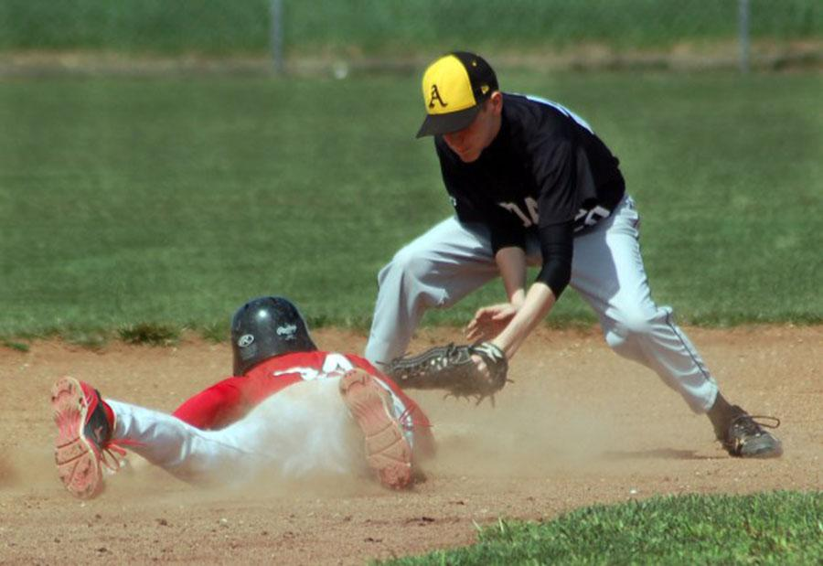
Brittani Casement, Maize (Kan.) High School

Slide 11
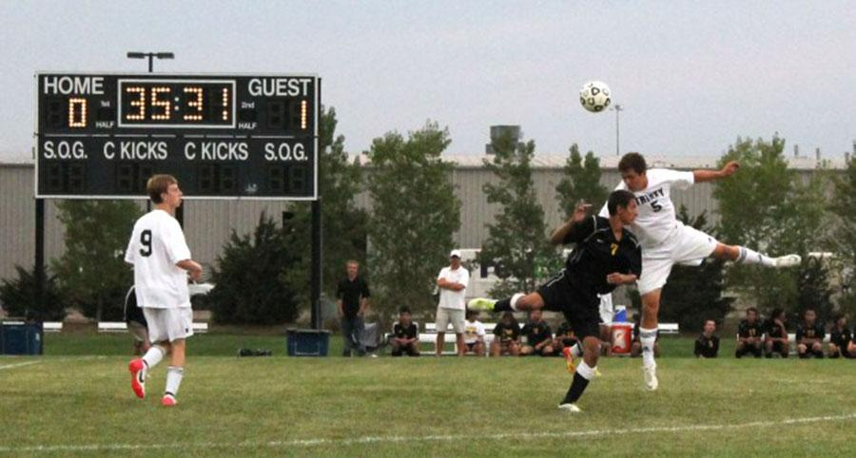
Daisy Marquez, Maize (Kan.) High School

Slide 12
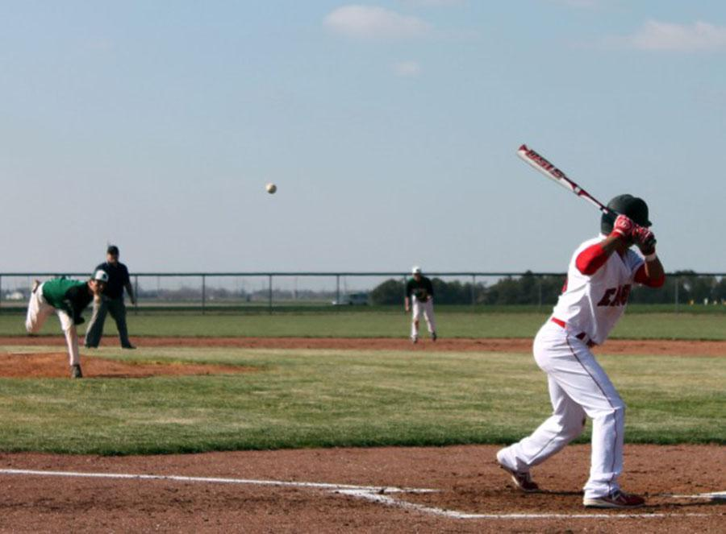
Kayla Crockett, Maize (Kan.) High School

Slide 13
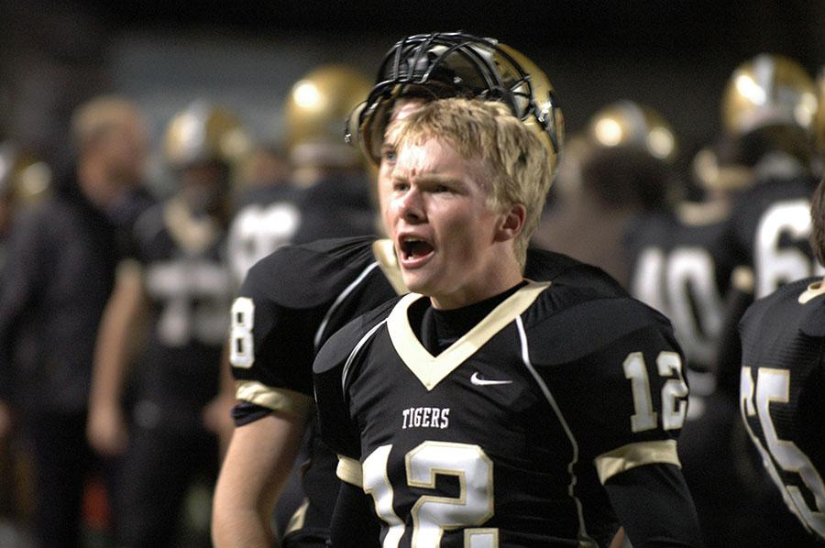
The PIX Yearbook, Little Rock, Arkansas

Slide 14
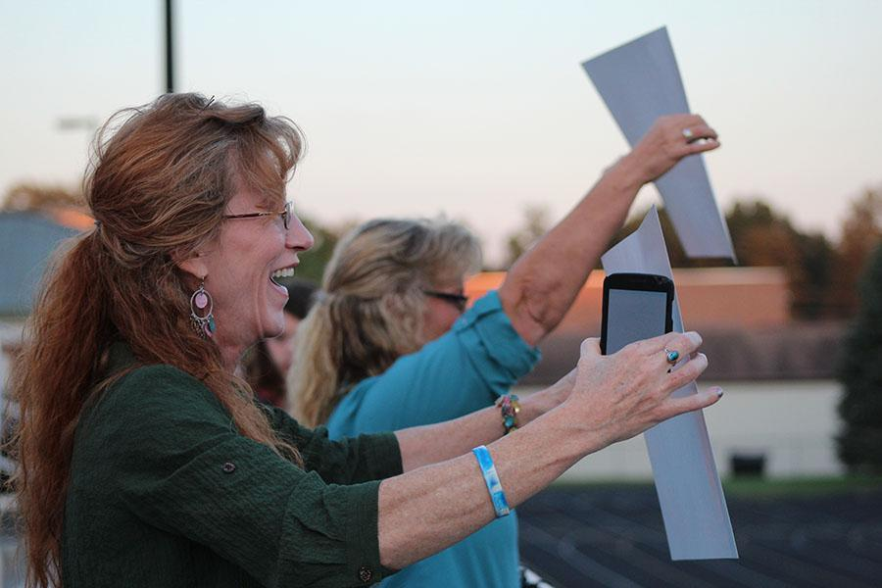
Bushra Ghafoor, R.B. Hayes High School

Slide 15
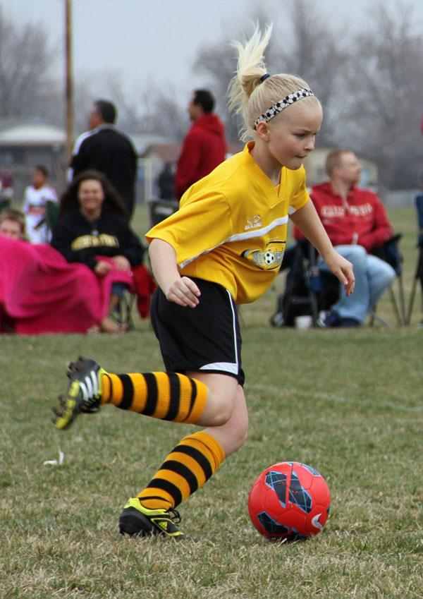
Delanie Pierce, Maize (Kan.) High School

Slide 16
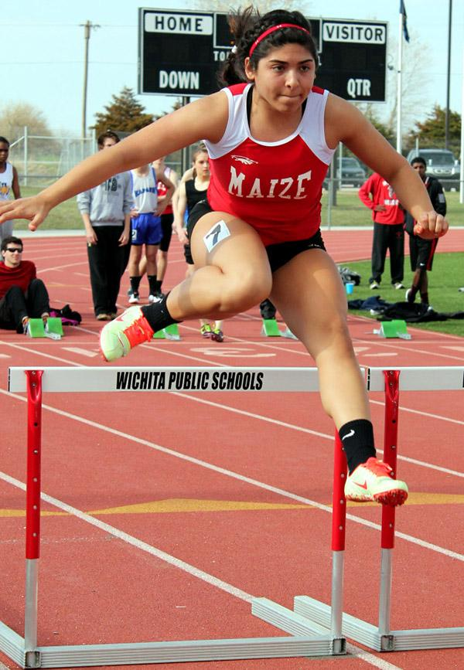
Kaylea Stuart, Maize (Kan.) High School

Slide 17
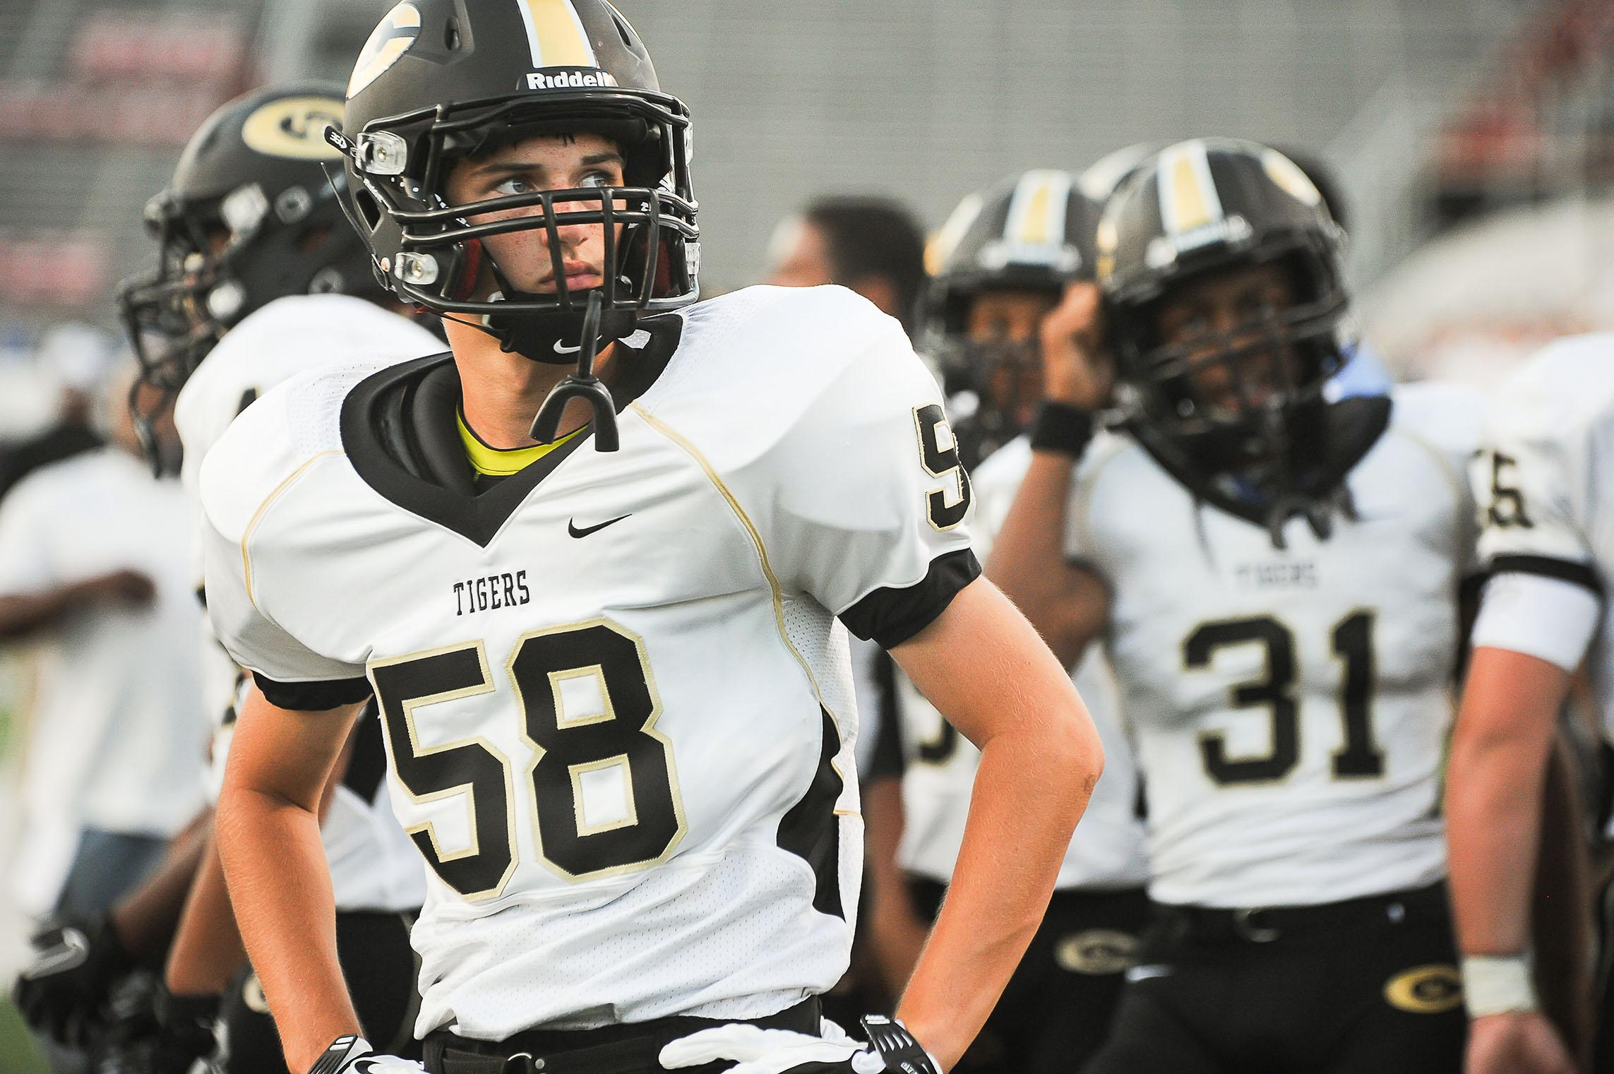
The Pix Yearbook - Little Rock, Arkansas

Slide 18
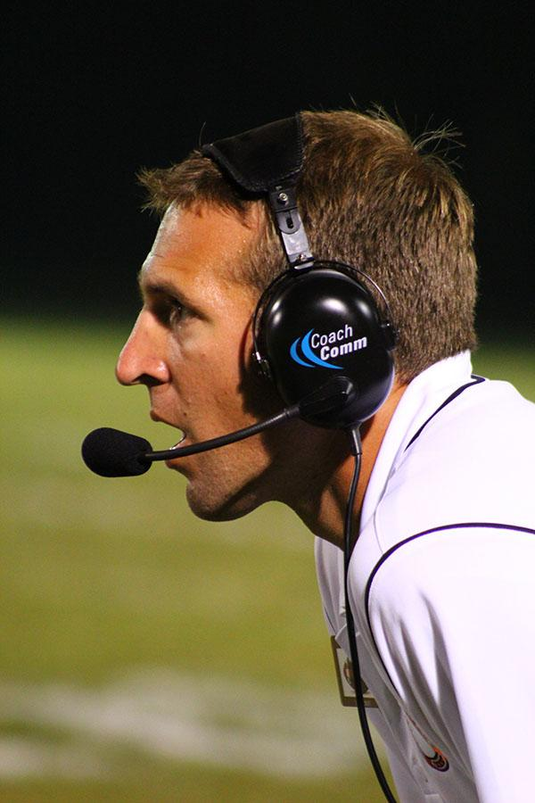
Bushra Ghafoor, R.B. Hayes High School

Slide 19
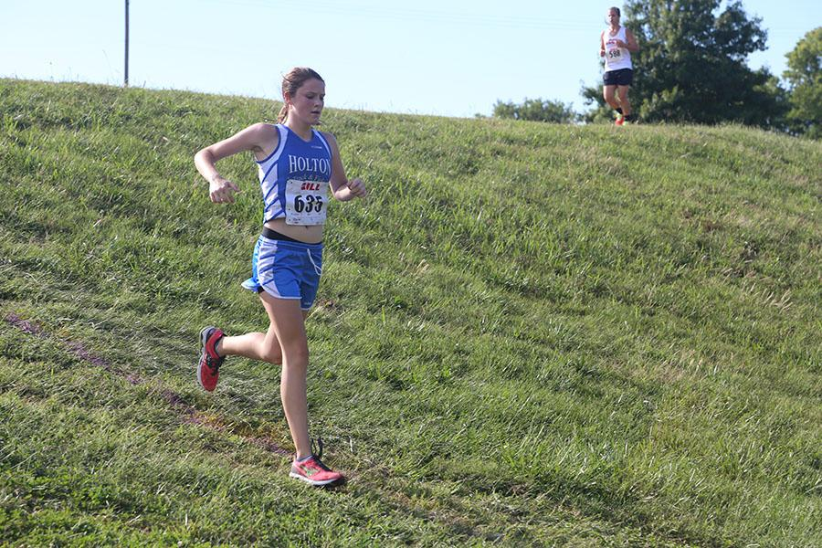
Abby Heitzman, Holton High School

Slide 20
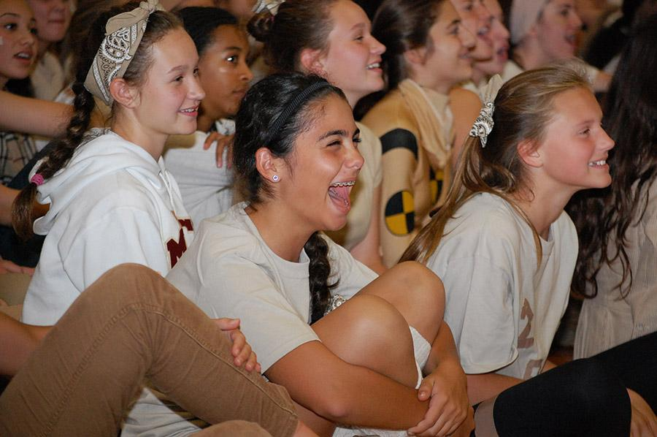
Lore Staff

Slide 21
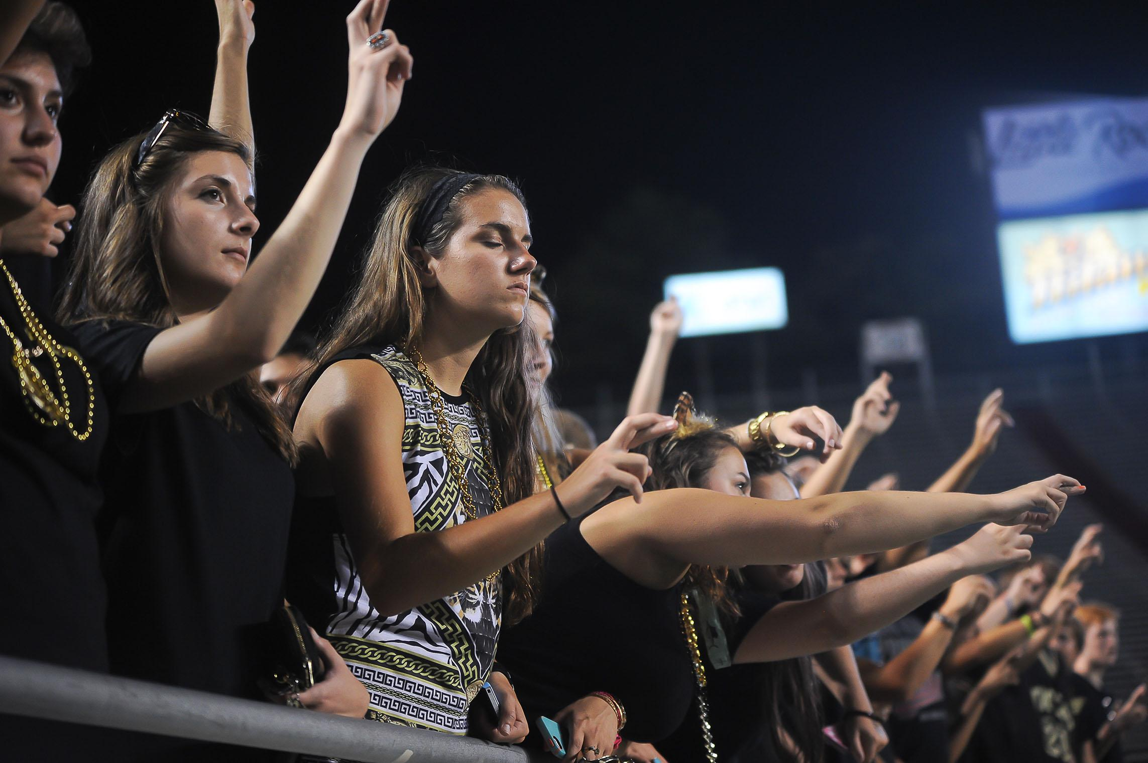
The Pix Yearbook, Little Rock, Arkansas

Slide 22
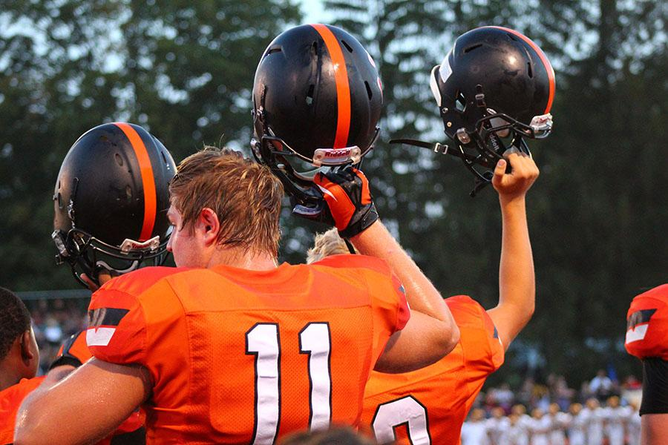
Bushra Ghafoor, R.B. Hayes High School

Slide 23
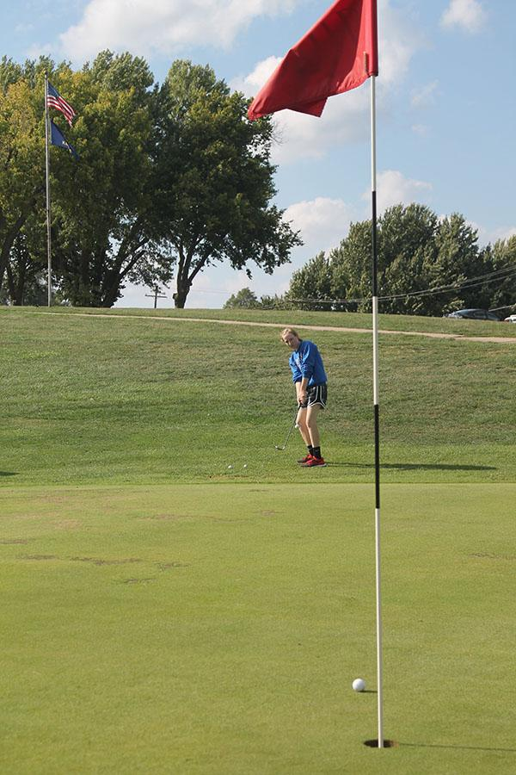
Lyndie Copeland, Holton High School

Slide 24
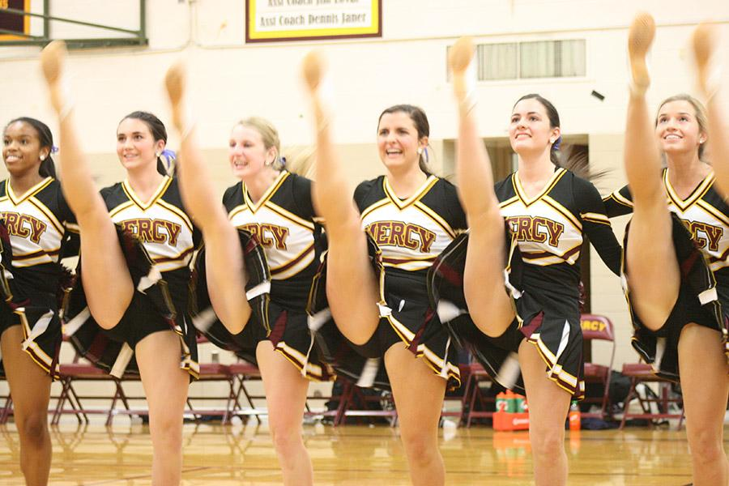
Lore Staff

Slide 25
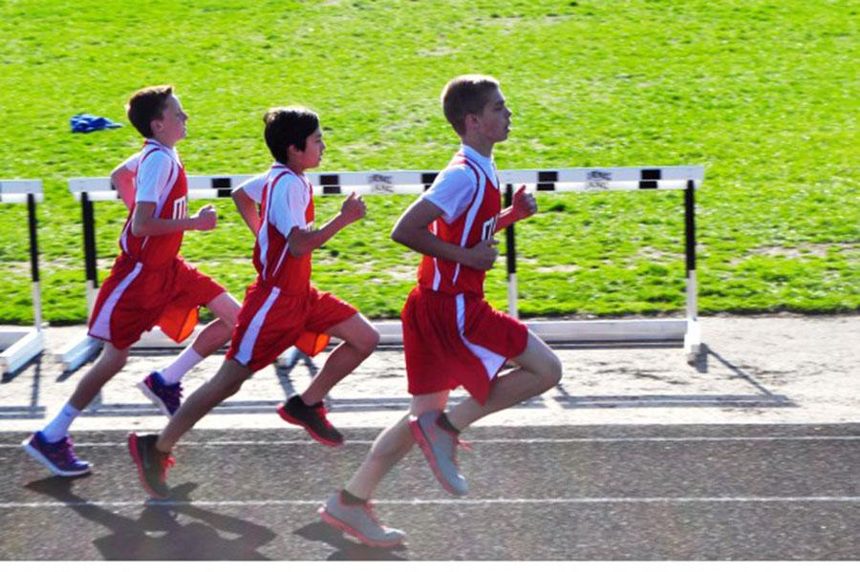
Verity Clark, Maize (Kan.) High School

