Slide 1
Sample Portfolio
Photojournalism

Slide 2
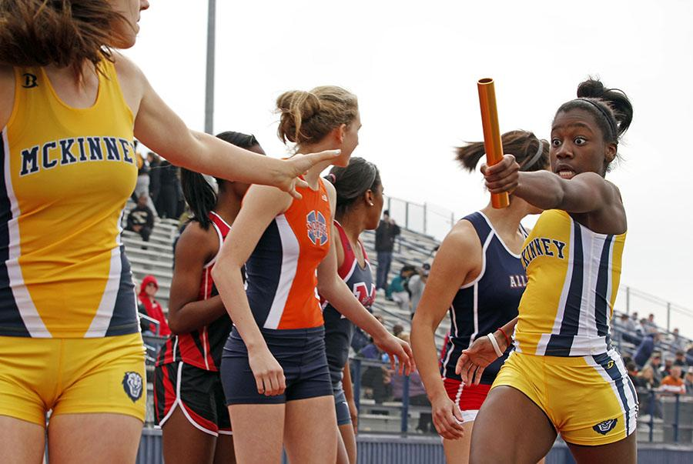
#1: Sports Action
McKinney High School Publications

Slide 3
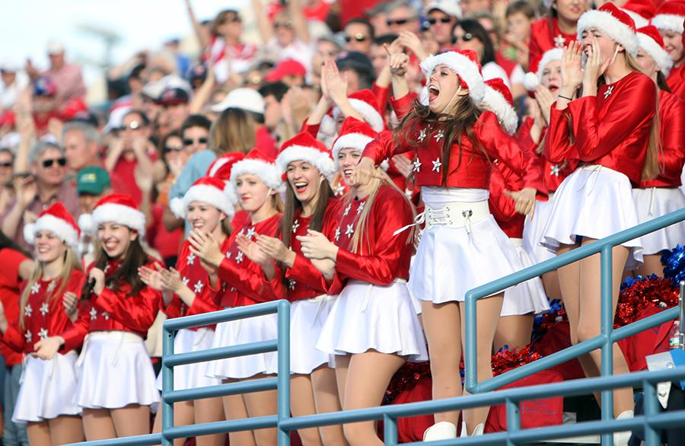
#2: Sports Reaction
Casey Simmons, Westlake High School

Slide 4
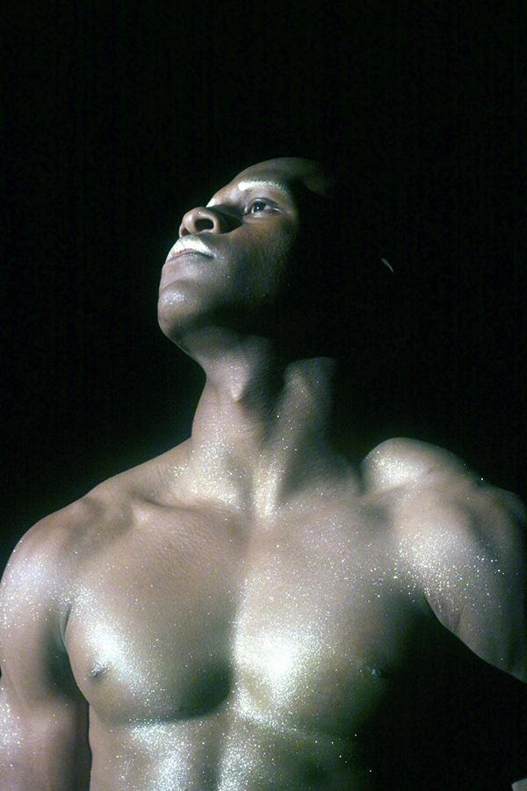
#3: Environmental Portrait
Atlanta ISD Yearbook Staff

Slide 5
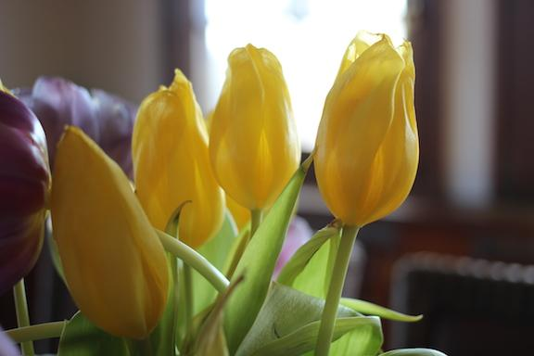
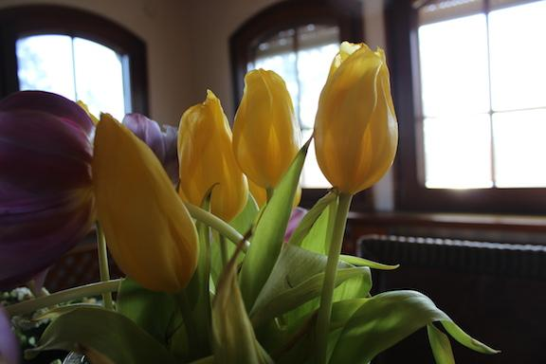
#4/5: Different Lenses
Same subject, same light, same distance away
Canon EF 40mm f/2.8 STM Lens Canon EF-S 18-55mm f/3.5-5.6 IS Lens
Megan Fromm, JEA Professional Support Director

Slide 6
#6: Front Light
Bryant High School Publications

Slide 7
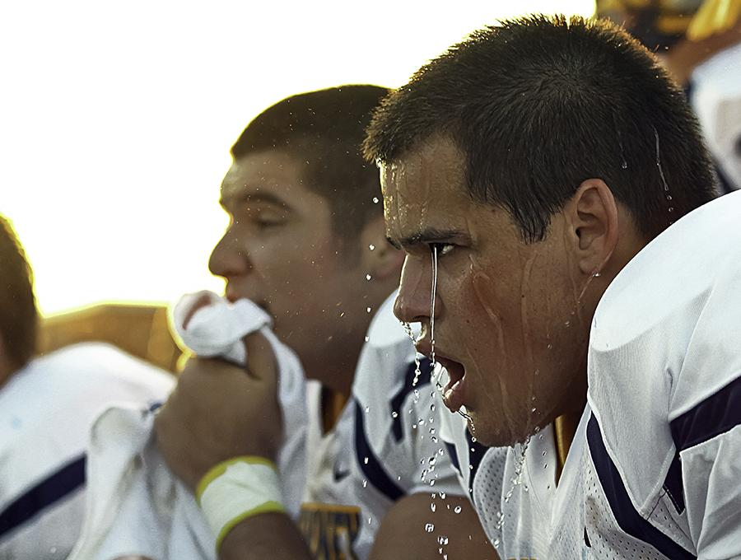
#7: Side Light
McKinney High School Publications

Slide 8
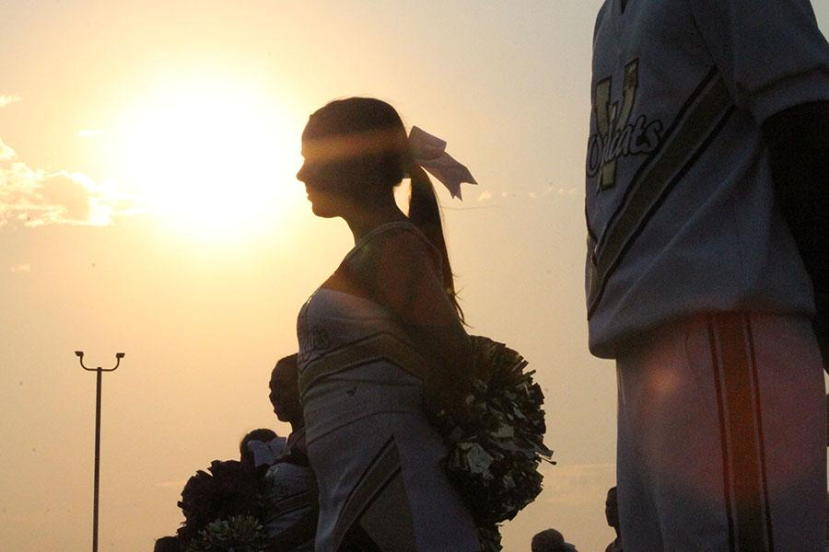
#8: Back Light
Whitney High School Publications

Slide 9
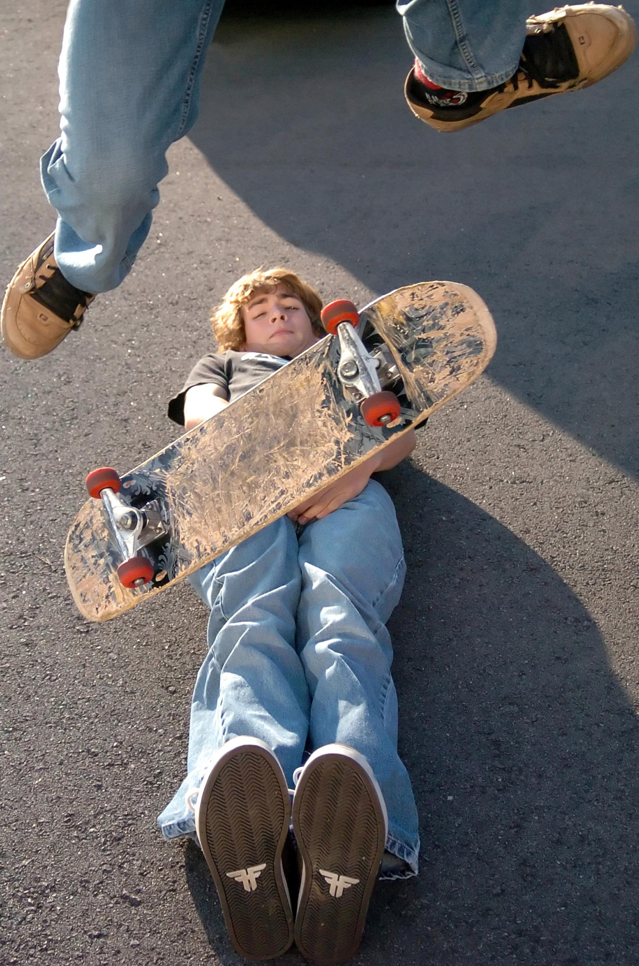
#9: Freezing motion
Bryant High School Publications

Slide 10
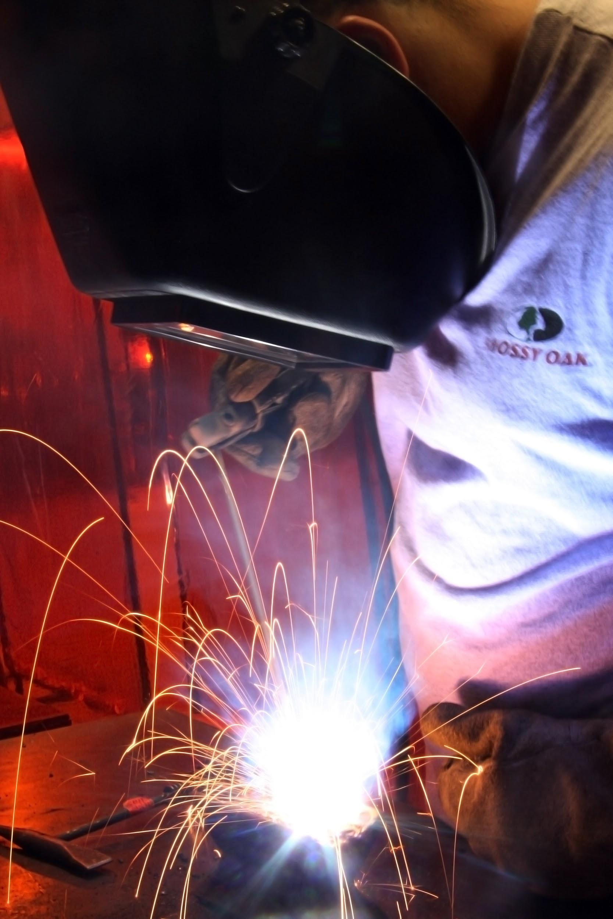
#10: Blurring motion
Bryant High School Publications

