Slide 1
Beat Writer Expectations
Web

Slide 2
Deadline
Articles are due at the assigned deadline time.

Slide 3
Headline
Be catchy and accurate
Include a verb

Slide 4
Featured Photo
HORIZONTAL
Not posed
Related to the story
Scot Scoop News

Slide 5
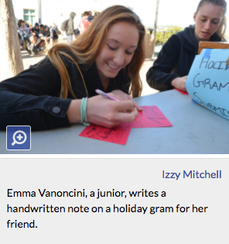
Caption and Sourcing
Name prominent people
Present tense
Source photographer

Slide 6
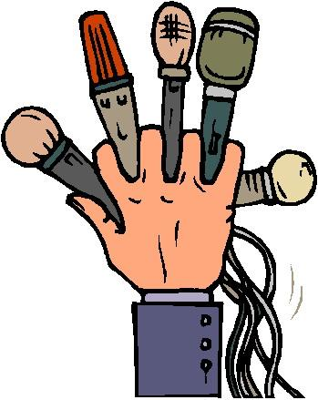
Sources
3 different people
Correct attribution
Unique and relevant angles

Slide 7
Quotations
Properly integrated
Relevant
Non-biased integration (said)

Slide 8
Writing Flow
Engaging angle
Transitions well
Logical order

Slide 9
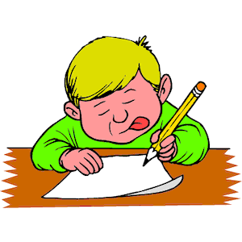
Writing Structure
Engaging lede
Balance of quotes and writing

Slide 10
AP Style
Look up specific rules
Must be perfect here!

Slide 11
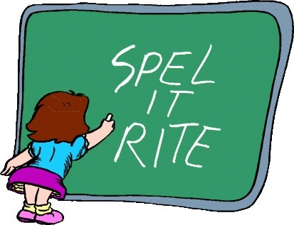
Grammar
Correct spelling
Correct grammar
(quotes too!)

Slide 12
Accuracy
Correct information
Everything attributed correctly
Names spelled correctly

Slide 13
Localized
Related to School Community
Is more than what a reader could get from pro news

Slide 14
Word Count & Hyperlinks
350+ words
At least one hyperlink

Slide 15
Extra Elements to include
Depends on the tools available in your web site...

Slide 16
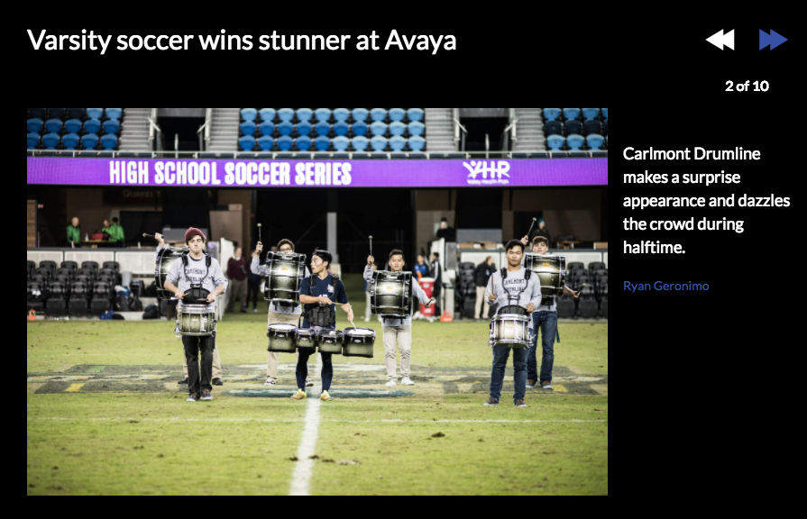
Examples
Pull Quote Photo Gallery

Slide 17
Examples
Infographic Interactive Map
Source: http://scotscoop.com/

