Slide 1
5 Steps
of Revision
Writing Basics

Slide 2
Only two types of writers
Good writers and quitters —
If your writing isn’t good,
you quit before it was.
Notes:
*

Slide 3
The writing process - NOT
Make handwriting neater. Leave out all the scratch-outs.
Use the thesaurus to find bigger words.
Computer spell check and grammar check.
Type it.
Add filler to make it longer.
Notes:
*
All student to talk about what they do to revise their work. Write the answers on the board before revealing this slide. Odds are that the answers will be similar to the ones listed.

Slide 4
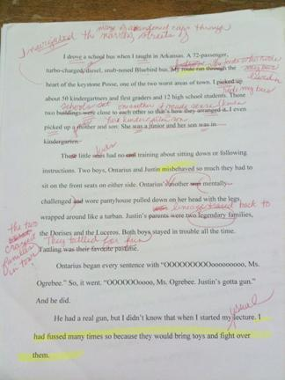
What kind of writer is this?
Notes:
This is a page from an article Lori Oglesbee wrote for C:JET. This is the revision process. Messy, but necessary.
*

Slide 5
This is what revision looks like.

Slide 6
Revision - Step 1
Read the piece aloud.
Mark any place where you stumble, pause in confusion or have to reread.
Listen for repeated words.
Rewrite those sentences.
This step must be repeated each time you make changes.
Notes:
*

Slide 7
Revision - Step 2
Look for summarized or implied dialogue.
Rewrite using the actual exchanges said during the scene.
Notes:
*

Slide 8
For example
I dried my tears, and on Monday morning, trudged into the publications room, picked up an application, filled it out and turned it in. To my surprise, they took me.
“Welcome to yearbook,” said the lady with the glasses that covered half her face and the reassuring voice that let me know others had suffered setbacks and found their home here. “I know you’ll just love it here. Everyone does.”
I slinked into the publications room that Monday, picked up an application from the quiet lady in the classroom brimming with activity. I filled it out and returned it. Hope Carroll took me when I needed it most. I was in.
Notes:
*

Slide 9
For example
Violence in the form of handguns is an ever-present threat in today’s society that penetrate the foundation of our communities by leading our babies, our children, our youths down a path of destruction. Imagine an innocent lad of 5 years of age suddenly boarding a bus brandishing a weapon prepared to play with his new toy and unwittingly commit a heinous crime that will haunt him the rest of his days. It happened one day on bus in Southern Arkansas.
Notes:
*

Slide 10
For example
Every sentence Ontarius uttered began with “OOOOOOOOOooooooooo, Ms. Ogrebee.” So, one day he said. “OOOOOOoooo, Ms. Ogrebee. Justin’s gotta gun.” And he did.
He had a real gun, but I didn’t know that when I started my usual lecture about bringing toys to school and fighting over them.
“JUSTIN. You bring that gun up here right now.” I glared at him in my mirror. “How many times have I told you guys not to bring toys on this bus. Toys are for home, not for school.”
I reached my hand back as Justin slinked up beside me and placed the gun in my hand. I felt the metal and thought is was way too heavy. I brought it around to the front and looked down at a .22-caliber automatic pistol.
Notes:
*

Slide 11
Revision - Step 3
Circle all the -ly words — adverbs.
Select a better verb if the adverb enhances.
Keep the adverb if it contradicts the meaning of the verb.
Notes:
*

Slide 12
For example - enhances
At the end of my junior year, I anxiously applied for an editorial position.
At the end of my junior year, I applied for a couple of editorial positions.
Notes:
*
If you apply for a job, you’re anxious. It’s redundant.

Slide 13
For example - enhances
The teacher’s high heels clicked with each step as she purposely walked to Edward’s desk.
The teacher’s high heels clicked with each step as she headed to Edward’s desk.
Notes:
*
What does purposely walking look like? Writer needs a better verb.

Slide 14
For example - contradicts
She leaned down to his ear and whispered loudly, “If you think you’re funny, think again.”
A whisper is not loud so there’s a contradiction there.
If you need help remembering a contradiction, use this song title: “killing me softly”
Notes:
*

Slide 15
For example - contradicts
The bulls have knocked out his front teeth and broken his arms, ribs, ankles, tailbone, collarbone and kneecap. They’ve given him more concussions and stitches and joy than he can measure.
“I live kind of different,” Stretch says, smiling toothlessly.
Notes:
*

Slide 16
Enhances vs. contradicts
Shrapnel from the explosion completely severed his arm.
Shrapnel from the explosion partially severed his arm.
How do these two sentences differ in meaning?
Notes:
*

Slide 17
Revision - Step 4
Underline all the verb phrases twice.
On a separate sheet of paper list the verbs straight down the page.
Look for weak verbs and rewrite those sentences (ing verbs, verbs with lots of helpers, be verbs).
Notes:
*

Slide 18
For example - bad verbs
The good ol’ boy system was still in tact with administrators at a high school in South Arkansas when I sat down with them one afternoon. The topic of discussion was the lack of qualified bus drivers when I walked into the office after teaching summer school English that August.
Notes:
*

Slide 19
For example - bad verbs
was
sat
was
walked
Notes:
*

Slide 20
For example - better verbs
Administrators rooted in the good ol’ boy system complained they didn’t have enough bus drivers. After federal courts combined two rival school systems in the name of desegregation, the bus superintendent reconfigured routes for this small Arkansas school district creating a need for even more bus drivers.
“Where are we ever gonna git that many drivers,” the bus superintendent said.
Notes:
*

Slide 21
For example - better verbs
“We’re scraping bottom now,” the associate superintendent said.
“I can drive a bus,” I said as I entered the room.
They rebuffed me with laughter and woman-driver comments.
Notes:
*

Slide 22
For example - active verbs
rooted
complained
didn’t have
combined
reconfigured
rebuffed
Notes:
*

Slide 23
Revision - Step 5
Spell check and grammar check.
Check “readability statistics” under preferences. (This will tell you what percentage of your sentences are in passive voice.) Aim for less than five percent passive voice.
The settings button right beside “readability statistics” offers many more options for grammar check.
Notes:
*

Slide 24
Revision - Step 5
To set up more options in Microsoft Word:
Open a document with a misspelled word.
Run spelling and grammar check.
A window should pop up when it finds a misspelled word.
Notes:
*

Slide 25
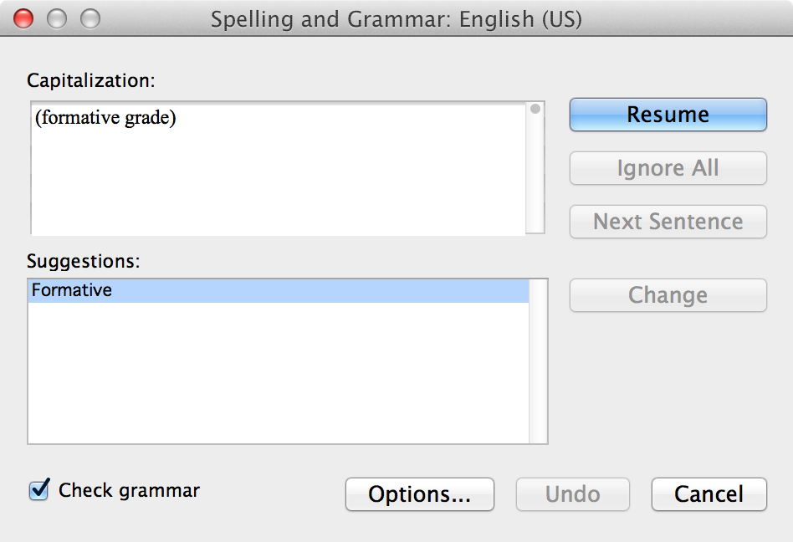
Revision - Step 5
Click “Options”
Notes:
*

Slide 26
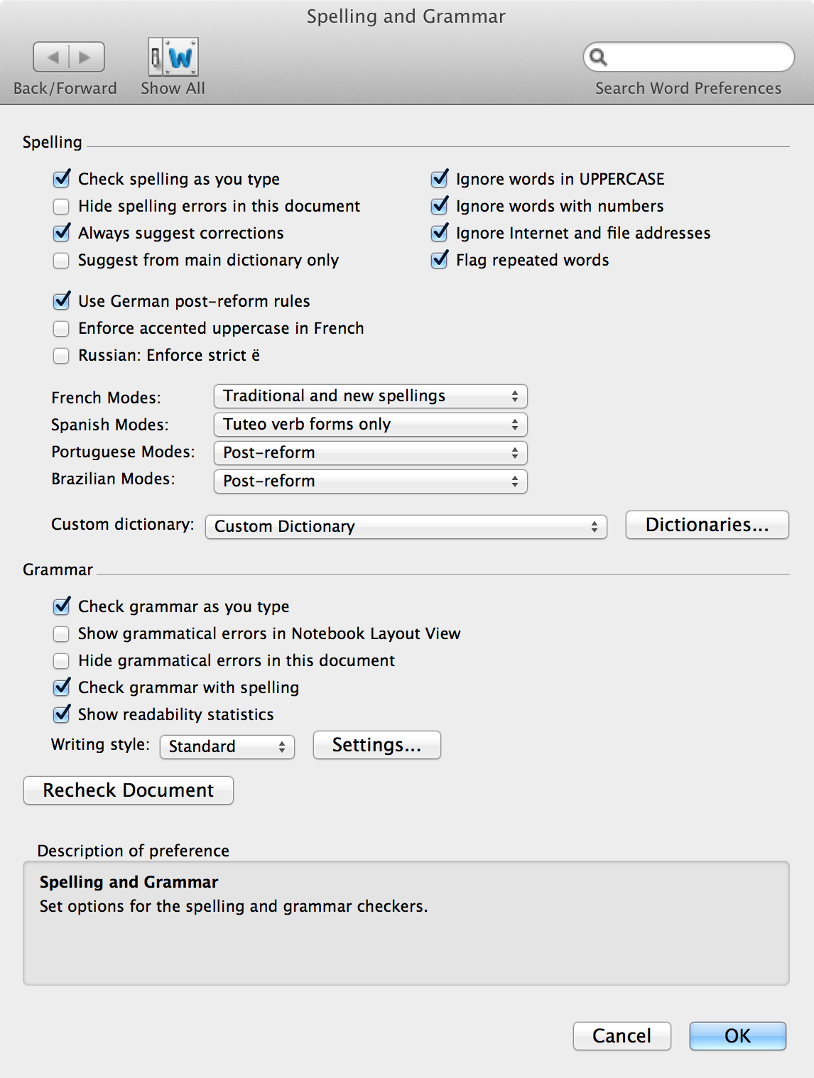
Revision -Step 5
Check “Readability Statistics” and then click on “Settings.”
Notes:
*

Slide 27
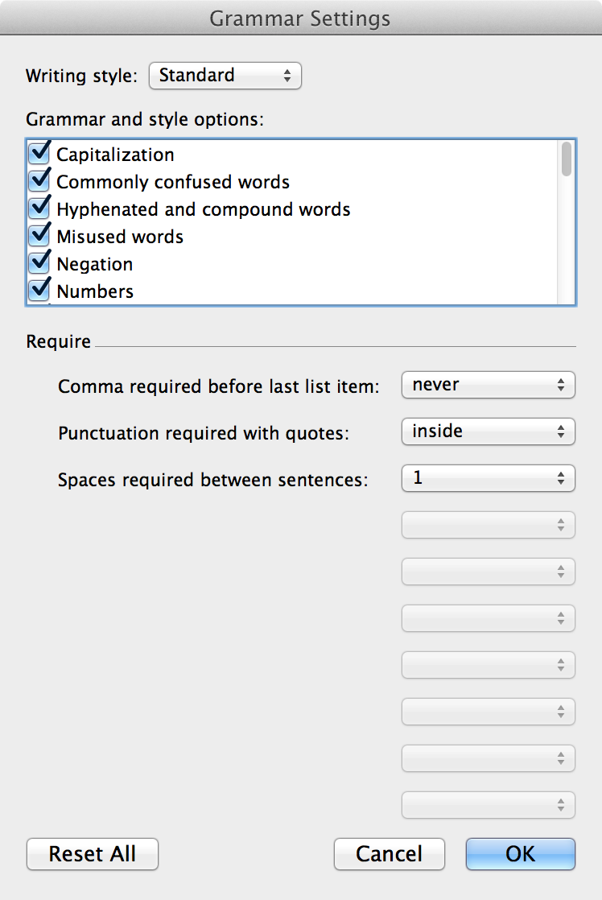
Revision -Step 5
Scroll through list and check appropriate boxes.
Three drop-down windows allow for automatic corrections.
Notes:
*

Slide 28
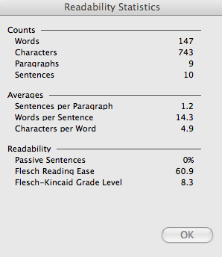
For example
This is for the passage on the bus driving piece.
Notes:
*

Slide 29
Example - unrevised
I love her classroom. It’s uniquely their own. There’s a Marlin on one wall. There’s a giant trout pillow. Well, there’s just fish everywhere in honor of their teacher’s name. There are posters, cartoons, production schedules and most importantly, there’s a place for every type of kid imaginable.

Slide 30
Example - revised
I love her classroom. A marlin covers one wall. There’s a giant trout pillow. Everything honors their teacher’s last name. Posters, cartoons, production schedules clutter the other walls. Every type of kid imaginable finds a home inside these walls.

Slide 31
Final draft
At this point, an edit from another writer is crucial.
Make those noted corrections.
You should now have a great story.
Notes:
*

