Slide 1
Basic
Lead Writing
News Writing

Slide 2
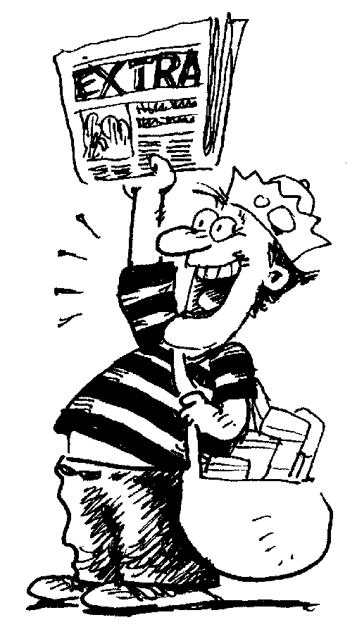
Let’s talk about …
News Writing
By Jeanne Acton, UIL & ILPC Journalism Director
and Vicki McCash Brennan, MA, CJE

Slide 3
News …
… gives readers information that will impact them or interests them in some way.
“News is anything that's interesting, that relates to what's happening in the world, what's happening in areas of the culture that would be of interest to your audience.”
— Kurt Loder, music journalist, former editor of Rolling Stone

Slide 4
What is a lead?
It’s the first sentence of the story, the beginning.
It tells the most important information and the newest information.
It grabs your readers’ attention.
But there’s more …

Slide 5
What must your lead do?
Start a flow of energy for your story
Tell something interesting about the subject of the story
Show the significance of the story
Set pace and tone
Establish your voice
That’s a lot!
Notes:
John McPhee calls the lead “a flashlight that shines into the story.”
Inexperienced writers will try to put all five W’s and H into the lead. That makes an overloaded lead.
Editors call those “suitcase” leads – like an over packed suitcase, it bulges with too much stuff.
Others call it “clothesline” lead because it strings bits of info together one after another … avoid this.

Slide 6
Some great student-written leads …
She peeked around the door leading to the 500 Hall.
“Hey,” she whispered, “is Mrs. Solomon looking?” Five minutes later, the girl with darting eyes would be silently speed walking towards the black gate, trying to leave school during C Lunch. [Hillsborough High School]
Freshman Noah Barboza likes to spend his time lifting at the gym, not lifting textbooks around school. Barboza is constantly struggling with the pain of carrying his books around campus on his way to his eight class periods. [Cypress Bay High School]
At first glance, senior basketball player Myron Dewar might pass through halls unnoticed. His only striking feature is his strange, indifferent gaze that seems to hide his past, his thoughts, his inner turmoil. [Coral Springs High School]

Slide 7
The NEWS or summary lead
Tells the 5W’s and H in 25 words or fewer.
Starts with the MOST IMPORTANT or INTERESTING information first.
Can start with any of the 5W’s or H, but some choices are better than others …
What does your reader need to know most?

Slide 8
Types of news leads
Use these often:
“What” lead – Starts with what happened or what the story is about.
“Why” lead – Begins with the cause of the story, why it happened.
“How” lead – Begins with how the event happened.

Slide 9
Types of news leads
Use this sometimes:
“Who” lead – Starts with a person or group. Use this if “who” the story is about is well known or interesting.
Avoid these:
“When” lead – Begins with time. Almost never the most important factor.
“Where” lead – Begins with a place. Rarely is this the most important factor.

Slide 10
The “who” lead
When the person you’re writing about is the most important reason you’re writing the story, then start with “who.”
President Barack Obama will greet students in the courtyard Thursday after his speech at the Expo Center.
Maybe …
Students will no longer be allowed to leave campus for lunch due to excessive after-lunch tardies, Principal Joe Blow said Tuesday.
Definitely NO!
Principal Joe Blow announced Tuesday that students will no longer be allowed to leave campus for lunch due to excessive tardies.
Notes:
Explain that “who” leads don’t necessarily need to use a name. Describing the person as someone the reader can relate to, or with some unique characteristic can work really well.

Slide 11
The “who” lead
Does not need a name to work. Sometimes identifying the “who” by an occupation or accomplishment will do it – as long as the person is interesting enough to hook your reader.
Yes …
Endurance swimmer Diana Nyad, 64, became the first person to complete a 110-mile swim from Cuba to Florida without a shark cage. It took her 53 hours.
Notes:
Who leads work best when the person is the story and the main reason you are writing it is that this person is a CELEBRITY or has PROMINENCE for your readers.

Slide 12
The “when” lead
Do not start with the time element. It’s almost never the most important factor.
Definitely no!
On Tuesday Principal Joe Blow announced that students will no longer be able to leave campus for lunch.
Maybe, for an anniversary story ...
Fifty years ago, on Nov. 22, 1963, President John F. Kennedy was shot and killed in Dallas. It was a defining moment for the country, one that people older than 55 remember the way most American adults remember Sept. 11.
Notes:
“When” leads can work in anniversary stories, but almost nowhere else. Discourage the use of this lead!

Slide 13
The “where” lead
Don’t start with a place, either. It’s almost never the most important or interesting factor.
Definitely no!
At the school board meeting on Tuesday, Principal Joe Blow announced that he has ended the off-campus lunch policy.
Maybe … but maybe not
In the principal’s office, the senior class dumped 30 pounds of sand to protest the cancellation of the senior trip to Cancun.
And again: Why is this type of lead rarely – almost never – used?
Notes:
Where something happened usually isn’t the most important element of a story. Also, readers of a particular publication know where they are. What happened, to whom and how or why it happened are almost always more interesting. Even in the second example, the place doesn’t necessarily belong first. This works just as well:The senior class dumped 30 pounds of sand in the principal’s office on Tuesday to protest the cancellation of their senior trip to Cancun.

Slide 14
On the topic of “where” …
News writers handle the “where” with a DATELINE,
a city name in all caps before the lead to say where the story originated.
CATANIA, Italy — More than 800 people were believed to have drowned in the weekend sinking of a boat packed with migrants trying to reach Europe, the United Nations refugee agency said Tuesday.
Datelines are not used on local news stories where the place is understood. Similarly, there’s no need for datelines student newspapers, websites and yearbooks to name your school. Readers know where you are.
Notes:
Teachers: Feel free to update the sample lead with something more timely.

Slide 15
The “why” lead
This kind of lead starts a story by explaining WHY something unusual happened. WHY answers: What caused this to happen? Use this often!
Example:
To carry on a tradition that started in the 1970s, four seniors streaked across the football stadium during the homecoming pep rally wearing only paper leis and tennis shoes.

Slide 16
The “how” lead
Similar to the “why” lead, this kind of lead explains how something happened. Use this only when the explanation is short, clear and interesting.
“How” sometimes requires more explanation than you can fit in a lead, but when you can, use the how.
Example:
Through a grassroots effort by young voters, Gilbert Castillo, 18, won the election Tuesday to become the youngest mayor in the city’s history.
Is there a better way to write this lead?
Notes:
If Gilbert is well-known to students, a who lead might be better. Or even this: A flood of young voters carried senior Gilbert Castillo to become the city’s youngest mayor in history.

Slide 17
The “what” lead
Use this most often. This is the most straight-forward. If you can’t write this lead, you don’t know enough to be writing the story.
WHAT tells WHAT HAPPENED. There might be more than one “what” in the story, so figure out which “what” is most interesting to your readers.
Examples:
• The Harry Potter series and Lord of the Rings series won’t be found on school library shelves this fall.
• School libraries will remove the Lord of the Rings and Harry Potter series from shelves this fall.

Slide 18
A great “what” lead …
More than 300 women were shot, stabbed, strangled, beaten, bludgeoned, or burned to death over the past decade by men in South Carolina, dying at a rate of one every 12 days while the state does little to stem the carnage from domestic abuse.
Post and Courier, Charleston, South Carolina. The story “Till Death Do Us Part” won the 2015 Pulitzer Prize for Public Service and was written by Doug Pardue, Glenn Smith, Jennifer Berry Hawes, and Natalie Caula Hauff

Slide 19
Why learn to write the summary lead?
Yes, of course, there are lots of other ways to start a story.
Basic LEADS
Basic news or Summary lead
Anecdotal or narrative (storytelling)
Descriptive
(scene-setting)
Less-used feature LEADS
Metaphor or simile
Word play: puns, alliteration
Action
Contrast, twist of fate
Shocking statement
Freak lead
What information needs to be in your story no matter how you start?
Notes:
No matter what you are writing, you still need the facts: The 5W’s and H. Teachers, please emphasize that every story needs the summary info somewhere, so in some sense, every story needs a summary lead, even if it doesn’t end up being the first paragraph!

Slide 20
It’s your turn
Use the information on the next slide to practice your lead writing skills.
Write six different leads using this information, one beginning with each of the 5W’s and H.
After you have written all six leads, circle the one you think is strongest.
Notes:
This is an in-class practice activity.

Slide 21
Write the lead (well, six leads!)
•A baby macaw parrot was stolen from the Baby Exotic Birds store in Lakewood.
•Jill O’Connor, 35, faces felony charges for stealing the bird, worth $2,000.
•O’Connor was employed at Baby Exotic Birds.
•She traded the bird for a 2000 Mercury Cougar.
•She bragged to the car owners that she’d smuggled the bird out of the store by nesting it in her brassiere.
•The car owners were friends with the owners of the bird store. They reported the theft.
•O’Connor was booked into the county jail.
Notes:
Students should use this information to write six different leads, one focused on each of the 5W’s + H. Then they should decide which is strongest and circle it on their paper. Share, discuss, and/or collect.

Slide 22
While we’re on this topic … Three leads to avoid
1. Question Leads Usually, question leads are just weak and uninteresting. Get to the point with a summary lead instead.
Have you ever wondered … (No. Next…)
2. Quote Leads
Quotes need context. The reader needs to know who’s speaking. Seldom is a quote so compelling and well-said that it can set the tone and focus for the whole story.
Just don’t write these leads.
Notes:
Have you ever wondered about … is a close cousin to the “Imagine if” lead, which is also a terrible lead.

Slide 23
While we’re on this topic … Three leads to avoid
3. Topic Leads
It is not enough to just state the topic of your story. These are some of the worst leads ever:
On April 25 at the Shockley Community Center, prom was held.
The school board met Tuesday to discuss problems with school lunch.
The Bulldogs played the Hurricanes Friday in a crucial conference game.
With Thanksgiving coming, people are thinking about food.
Just don’t write these leads.
Notes:
The problem with topic leads is that they say nothing and don’t really tell you what the story itself is about. The point of a news story – or any story, really – is to tell the readers what happened.

Slide 24
Every story needs a summary
Regardless of what you are writing about, the 5W’s and H belong in the story.
If you get in the habit of writing a summary lead for EVERY STORY, you will always have the basics covered – even if you end up with a different kind of lead.
A bonus: Your feature leads will have a better focus, because they have to lead into your summary!
Notes:
Lesson on types of leads ends here. The next part could be continued before or after students write practice leads. (See “Lead Writing Exercises” slideshow for practice exercises that can be used as bell ringers.)

Slide 25
How to write effective news leads
Now you know you can start your leads in different ways,
but how do you find the BEST lead for your story?
Use this four-step process.
Notes:
Lesson on types of leads ends here. The next part could be continued before or after students write practice leads. (See “Lead Writing Exercises” slideshow for practice exercises that can be used as bell ringers.)

Slide 26
How to write an effective news lead*
Collect all your facts. REPORTING is key.
Who: What person or group is this story about? There might be more than one. List them all.
What: What happened? What is the issue, problem or conflict? Explain it.
When: Day, date, time
Where: Be as specific as possible
Why: Why did this happen? Provide context.
How: How did it happen? Provide details.
*Adapted from Inside Reporting by Tim Harrower
Notes:
Remind students again that when and where are often the least important. Those details need to be there, but students shouldn’t start the story with those elements.

Slide 27
How to write an effective news lead*
2. Sum it up, boil it down.
If you had just 10 seconds to tell the story, what would you say? How would you tell it to your best friend? How would you tweet it? If telling your mom, would you tell it differently?
Tell the story out loud to yourself or a friend.
*Adapted from Inside Reporting by Tim Harrower

Slide 28
How to write an effective news lead*
3. Prioritize the 5Ws.
Which of the 5W’s or H is most compelling, most interesting?
Write a draft of your lead focusing on that fact, usually the what, why or how.
Use the “who” only if the person is someone interesting or prominent.
Avoid starting with “when” or “where.”
*Adapted from Inside Reporting by Tim Harrower

Slide 29
How to write an effective news lead*
4. Rethink, rewrite, revise.
Here’s where you stop thinking that your first draft is good enough. It is not.
Ask yourself:
Is this clearly written so everyone can understand it?
Is it in the active voice? (Who did what to whom?)
Are there extra words you don’t need?
Will this grab the readers and make them want to keep reading?
*Adapted from Inside Reporting by Tim Harrower

Slide 30
Create a concept map
Using your notes from this presentation and any other resources available in the classroom, create a concept map showing how to write a basic news lead, also called a summary lead or a direct lead.
Your map should:
define “lead” (the center of the map)
name each of the 5W’s and H, and when they should be used to start a story (five prongs)
describe the four-step process of how to write a summary lead (a sub category with four prongs)
Notes:
This is a textbook reading strategy … If you also have textbooks in the classroom, ask students to read or refer to the chapters about basic news leads for reinforcement.

