Slide 1
Alternative
Story Forms
Design

Slide 2
by definition
Alternative story forms break down information by category rather than presenting it in inverted pyramid format.
Use smaller chunks of information combined with visuals for a reader-friendly approach.
Infographics (addressed in the previous lesson) are one type of alternative story form. Many other types exist, as you’ll see today.

Slide 3
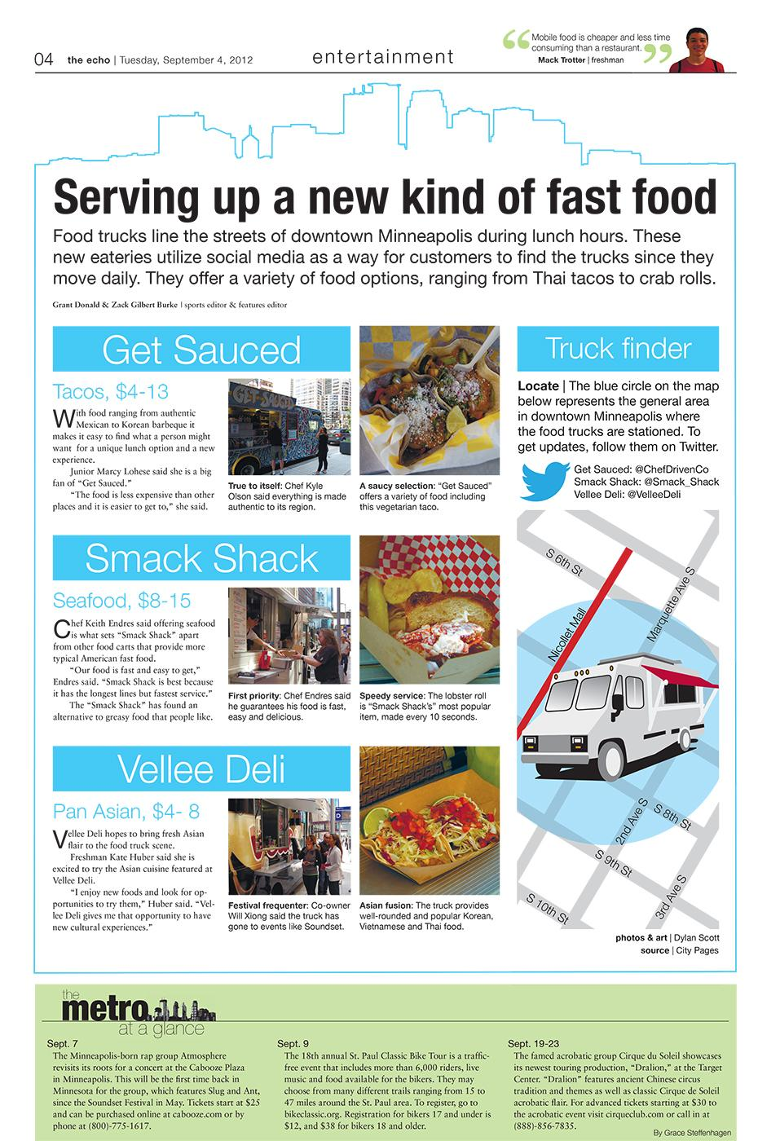
also known as
alts
sidebars
quick-reads
non-narratives
charticles
The Echo; St. Louis Park (Minn.) High School

Slide 4
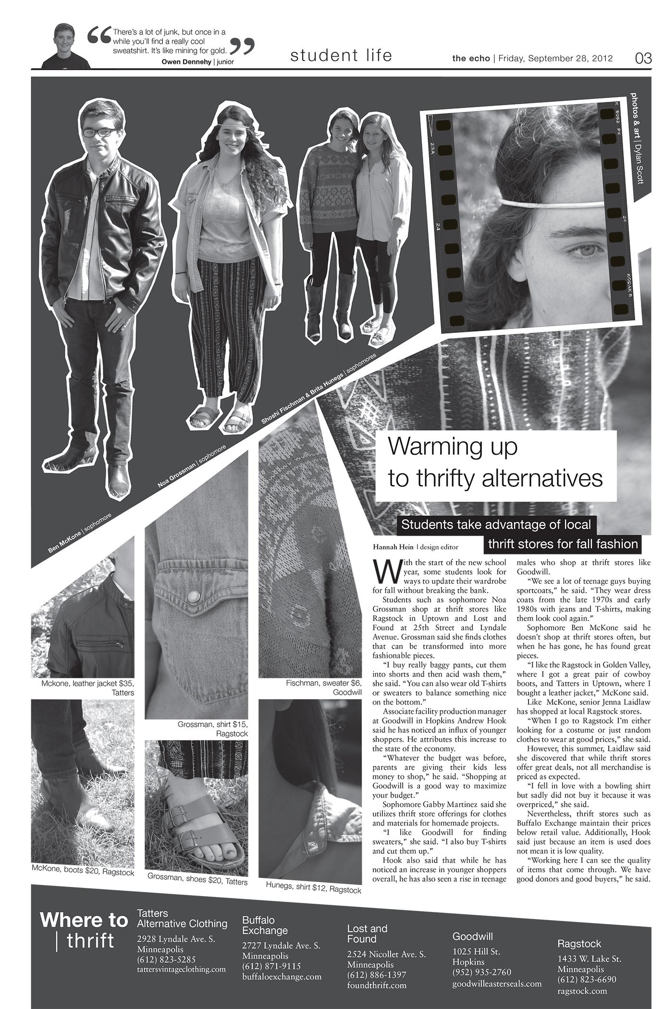
list
a series of names, items, events or components that add context
(In this example, the list provides a set of thrift stores in the area and the location of each.)
The Echo; St. Louis Park (Minn.) High School

Slide 5
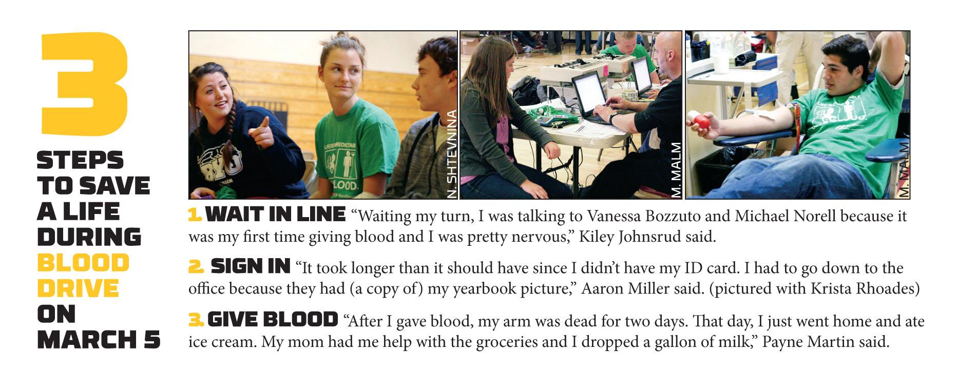
step-by-step
Whitney High Student Media; Rocklin, Calif.

Slide 6
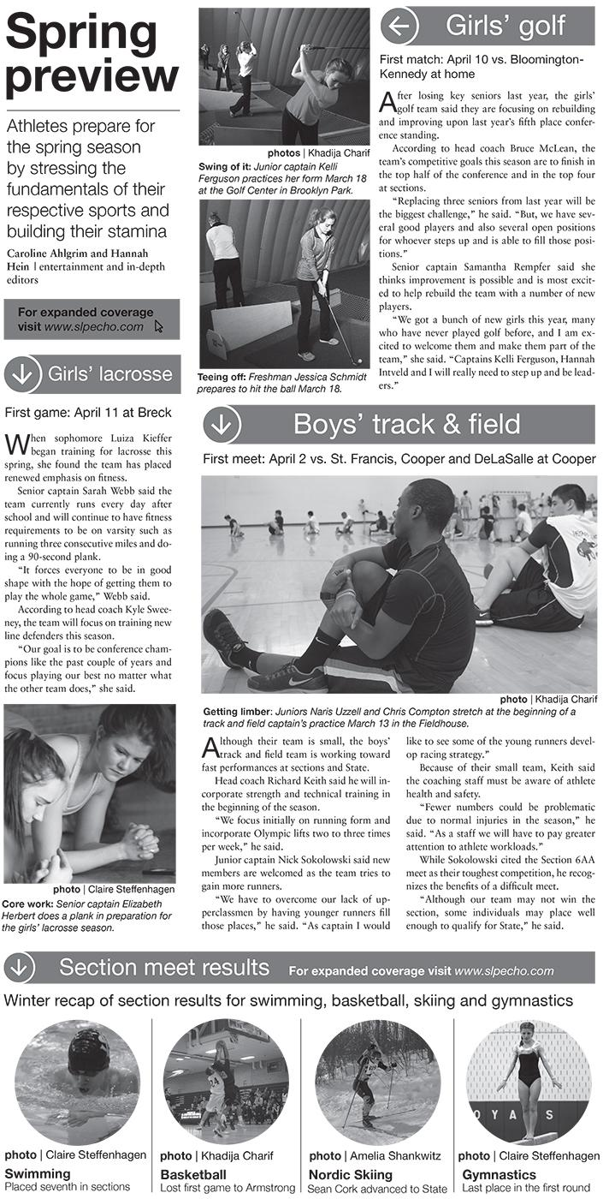
briefs
short news stories add reader appeal by offering quick updates
(On this page, the repeating mini-headline style separates each topic and creates visual unity among the four sports briefs presented.)
The Echo; St. Louis Park (Minn.) High School

Slide 7
quote collection
multiple responses to a common topic or question as a way to present a variety of perspectives
Whitney High Student Media; Rocklin, Calif.

Slide 8
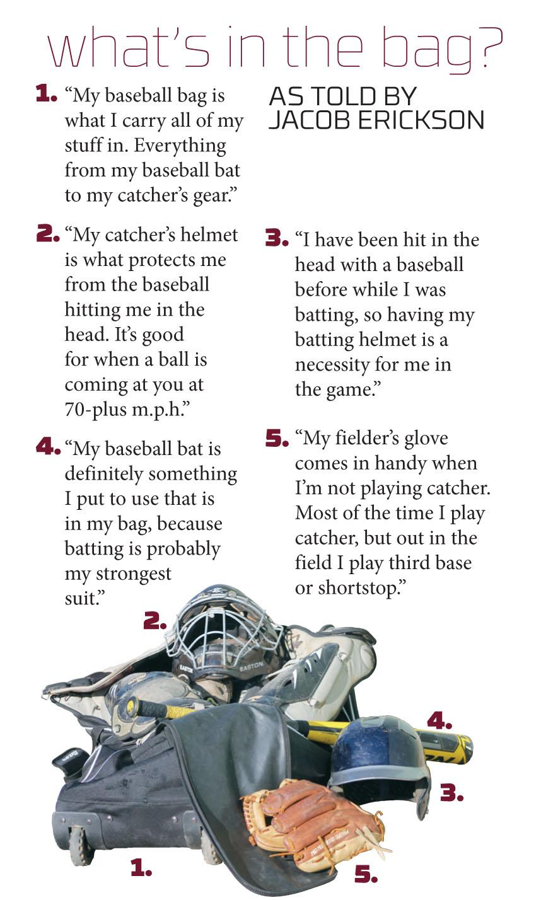
diagram
breaking down parts of a whole or providing background about how something works
Whitney High Student Media; Rocklin, Calif.

Slide 9
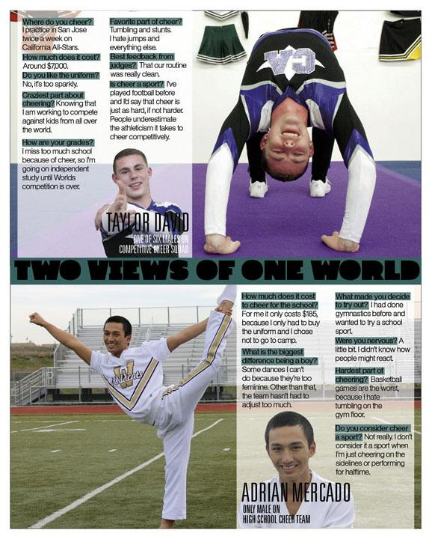
Q-and-A
a way to capture word-for-word dialogue based on questions and answers from an interview subject
Whitney High Student Media; Rocklin, Calif.

Slide 10
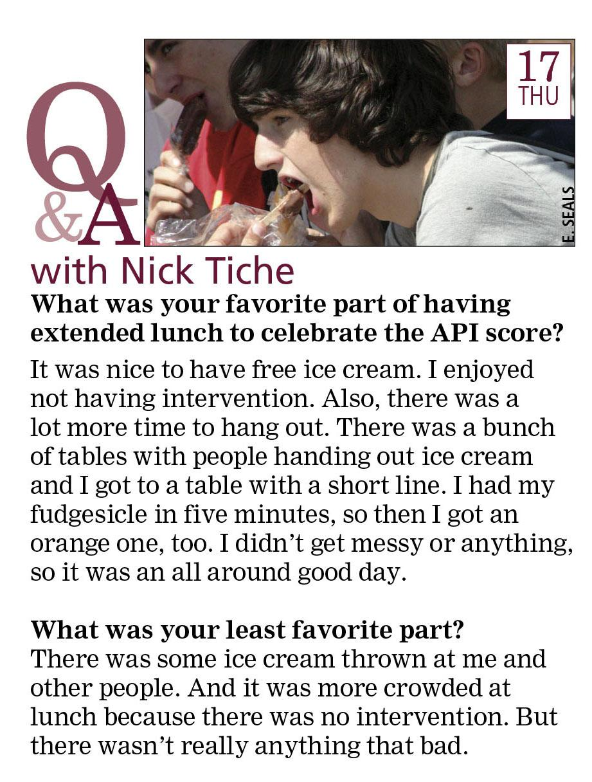
Whitney High Student Media; Rocklin, Calif.

Slide 11
Q-and-A
contrasting type separates the question from its answer
Whitney High Student Media; Rocklin, Calif.

Slide 12
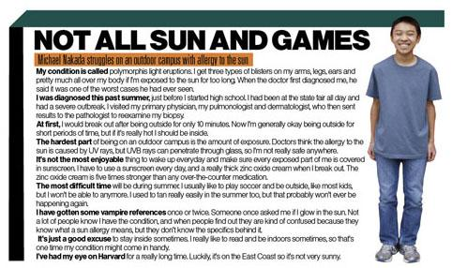
finish the sentence
a form of quick-read in which the source completes phrases provided
by the interviewer
Whitney High Student Media; Rocklin, Calif.

Slide 13
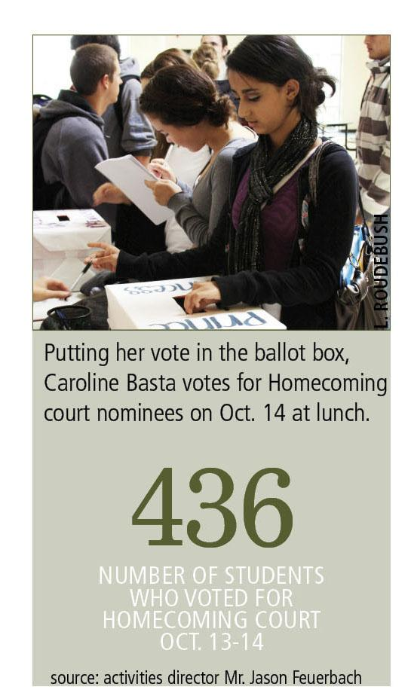
fast fact

Slide 14
timeline
a chronological listing of events to highlight significant happenings
Whitney High Student Media; Rocklin, Calif.

Slide 15
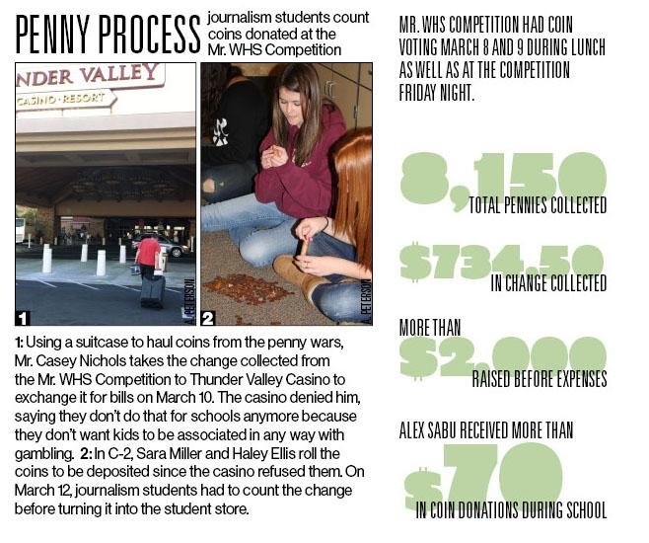
by the numbers
Whitney High Student Media; Rocklin, Calif.

Slide 16
quote collection
“in a word” answers to a prompt or question
Whitney High Student Media; Rocklin, Calif.

Slide 17
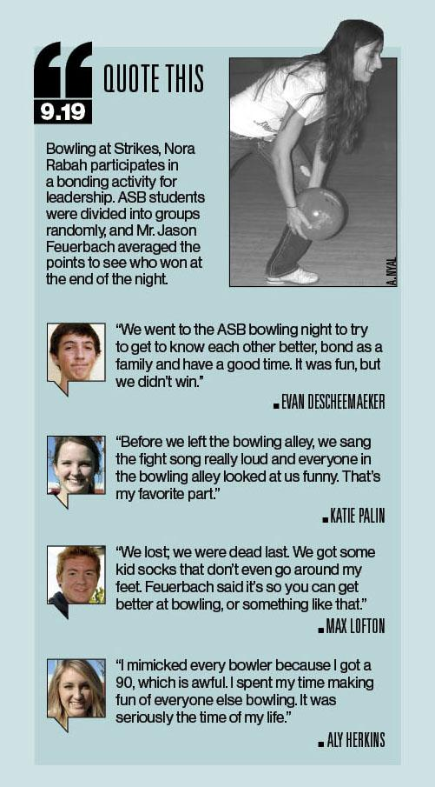
quote collection
with mug shots
Whitney High Student Media; Rocklin, Calif.

Slide 18
quote collection with action shots
Whitney High Student Media; Rocklin, Calif.

Slide 19
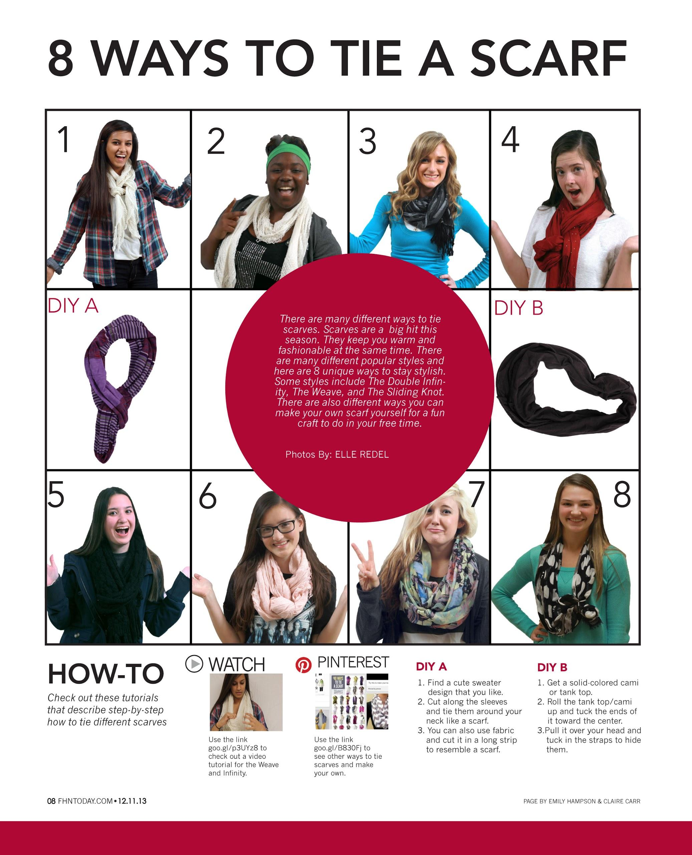
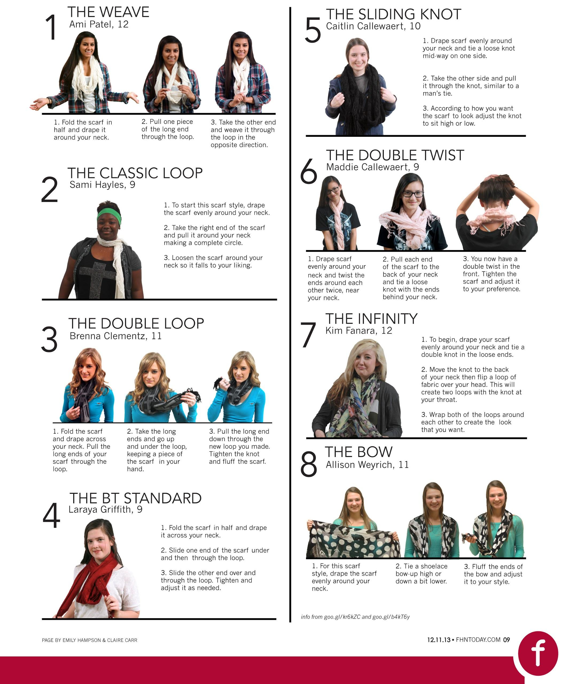
how-to
The North Star; Francis Howell North H.S.; Saint Charles, Mo.

Slide 20
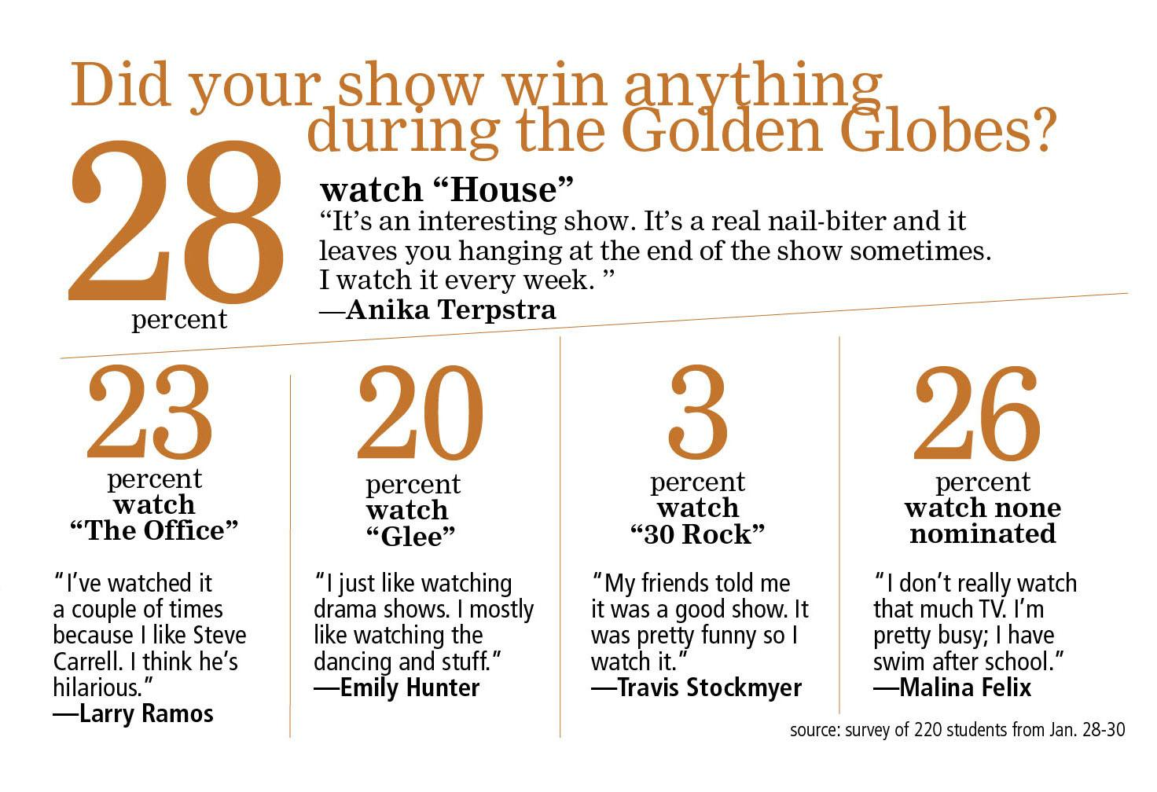
public opinion poll
Whitney High Student Media; Rocklin, Calif.

Slide 21
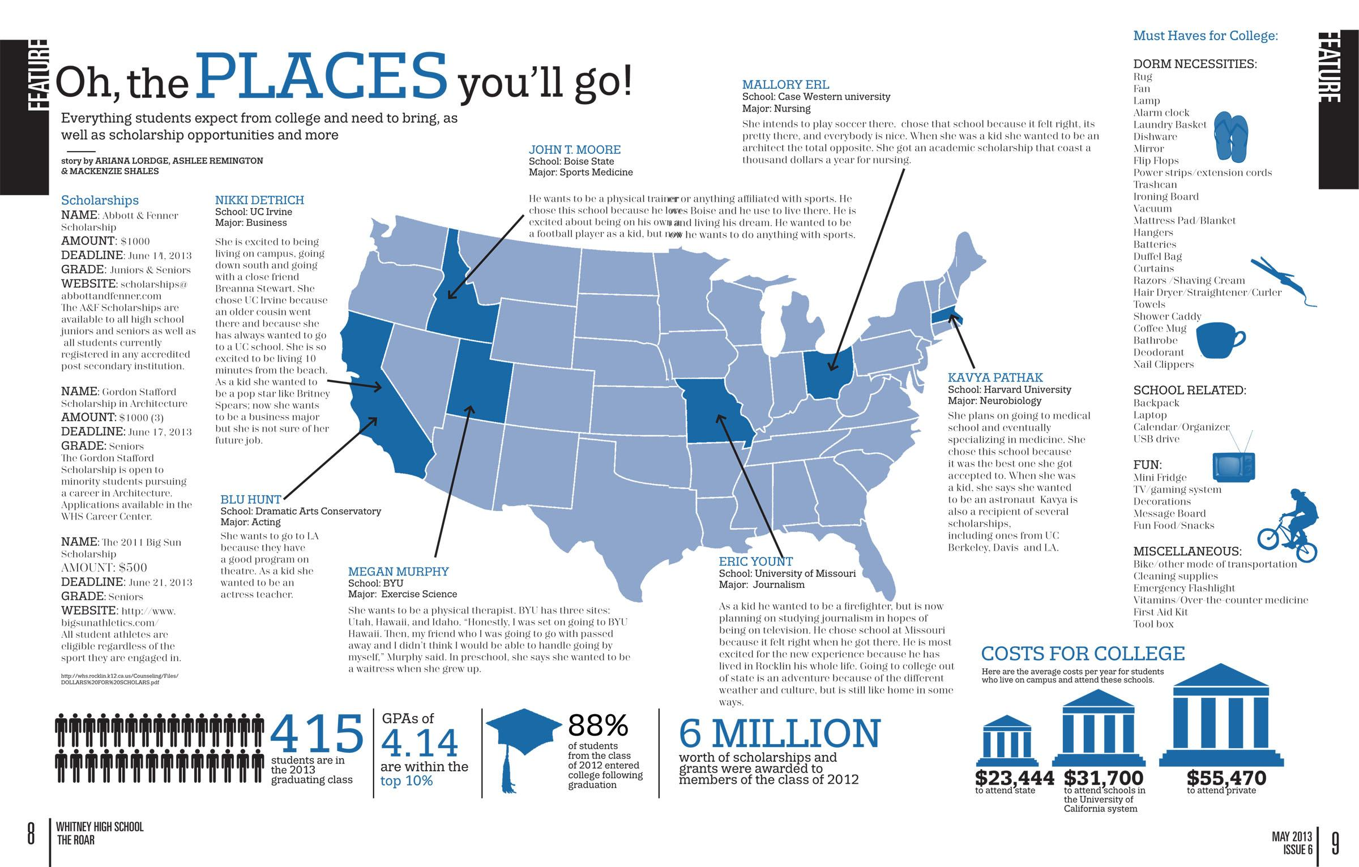
Whitney High Student Media; Rocklin, Calif.

Slide 22
best uses
to cover recurring events such as the annual blood drive (After all, is the story really all that different from year to year?)
to break down complex material in detail for readers to understand more easily (For example, a step-by-step guide to completing the FAFSA would benefit readers.)
to update an ongoing story (A school undergoing construction or renovations will likely have regular coverage on the topic.)

Slide 23
Let’s try some together...
Consider the most recent play/musical. Let’s brainstorm at least five alternative story form ideas for a yearbook spread.
The basketball team won its latest playoff game and advances now to the state championship, a topic that will receive a whole page in the next newspaper issue. Suggest two alternative story forms to run beside the inverted pyramid game story.

