Slide 1
Principles of
DESIGN
Middle School / Junior High Version

Slide 2
PRINCIPLES TO KNOW
Composition
Component
Concept
Placement
Harmony
Balance
Proportion
Scale
Proximity
Unity
Rhythm
Division
Grouping
Emphasis
Contrast
Direction
Value
Alignment
Flow
Spatial Relationships

Slide 3
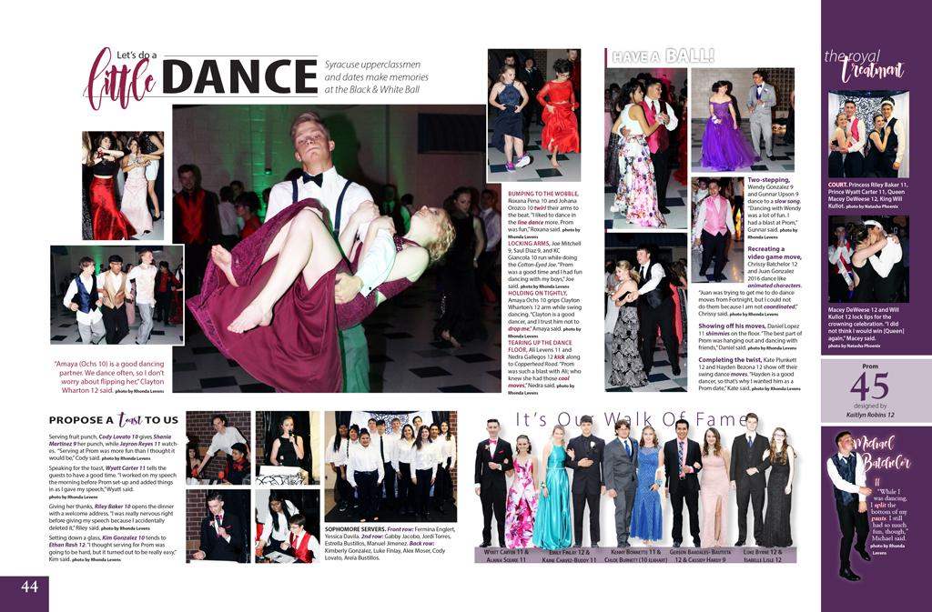
Day One - Quickwrite
What do you notice about this spread? Look closely? How are things placed and designed?

Slide 4
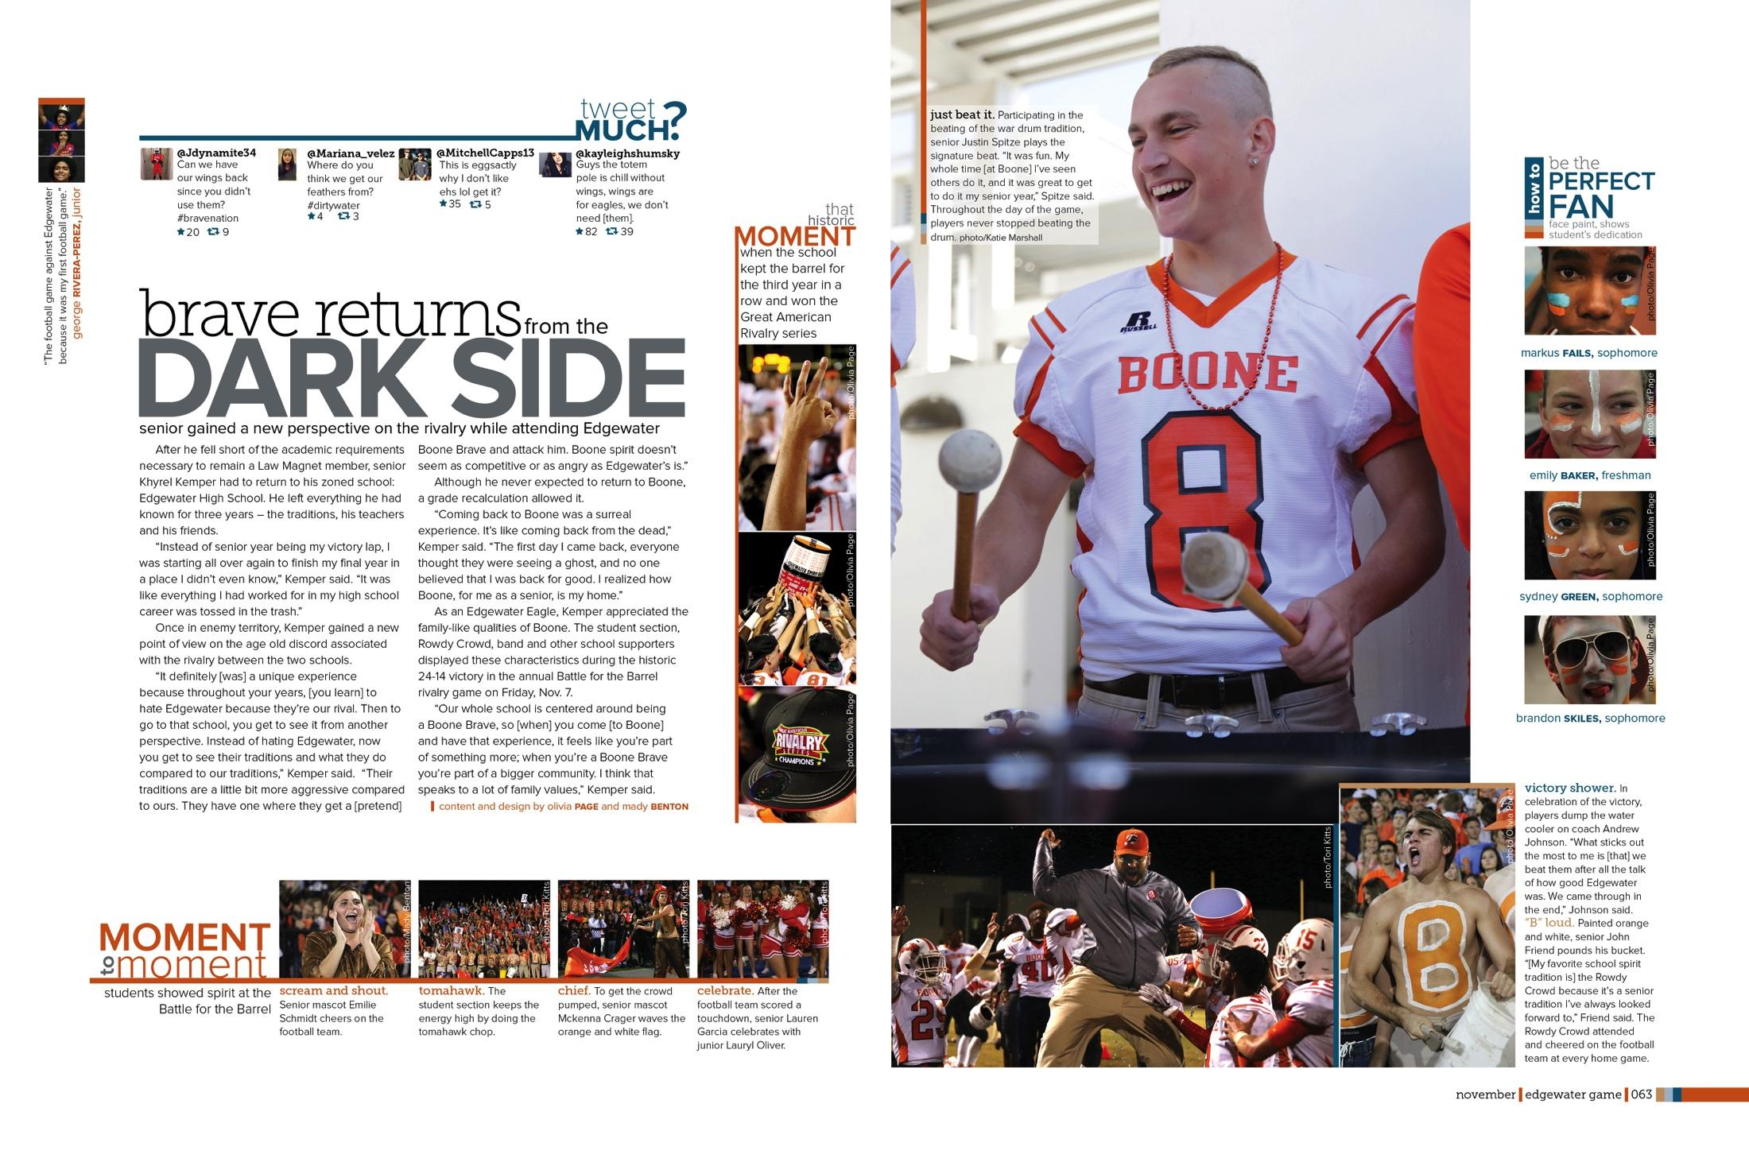
COMPOSITION
The way in which components of a design are visually combined and arranged to create a final product.

Slide 5
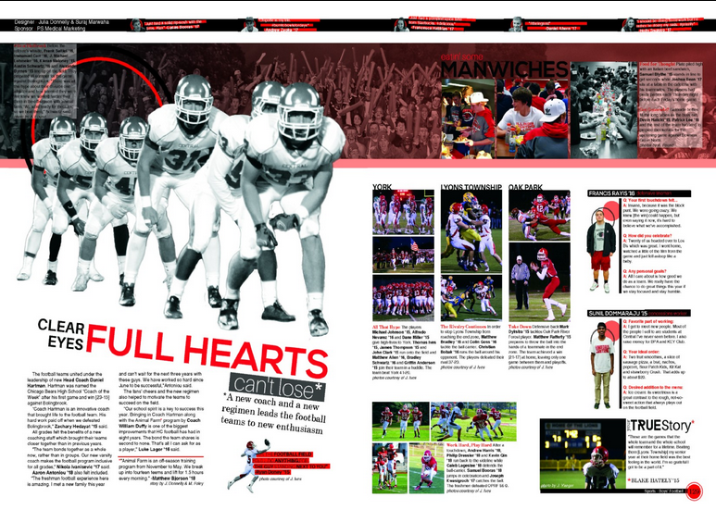
COMPONENT
Each of the elements placed within a composition: headline, subheadline, captions, copy, byline, photos, typography, banners, images, links, etc.

Slide 6
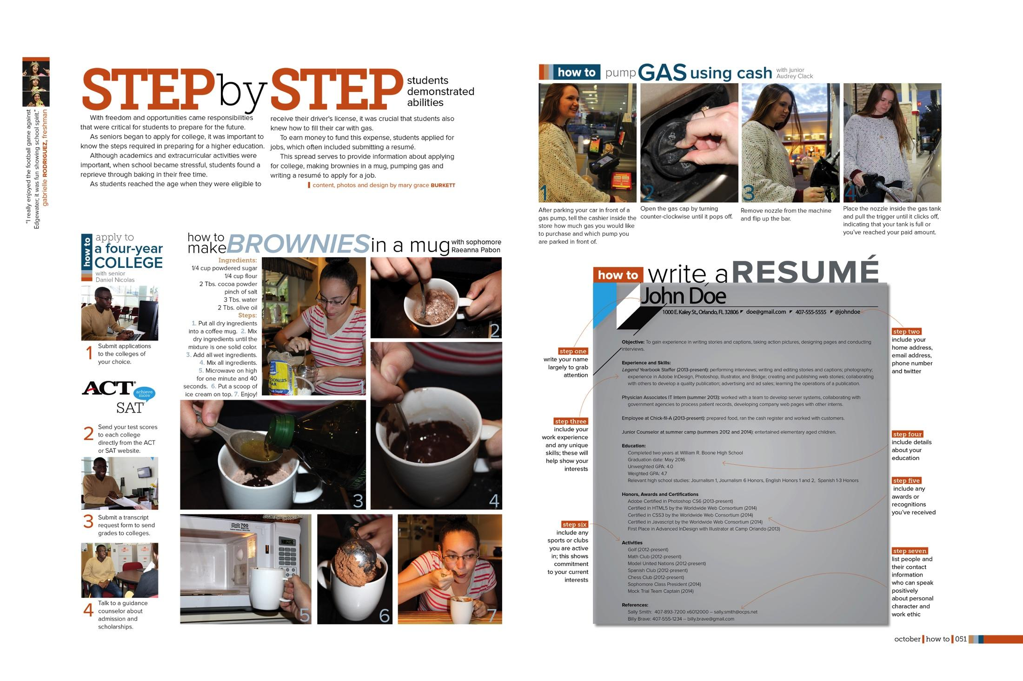
CONCEPT
Abstract elements of theme, connotation, message and style.

Slide 7
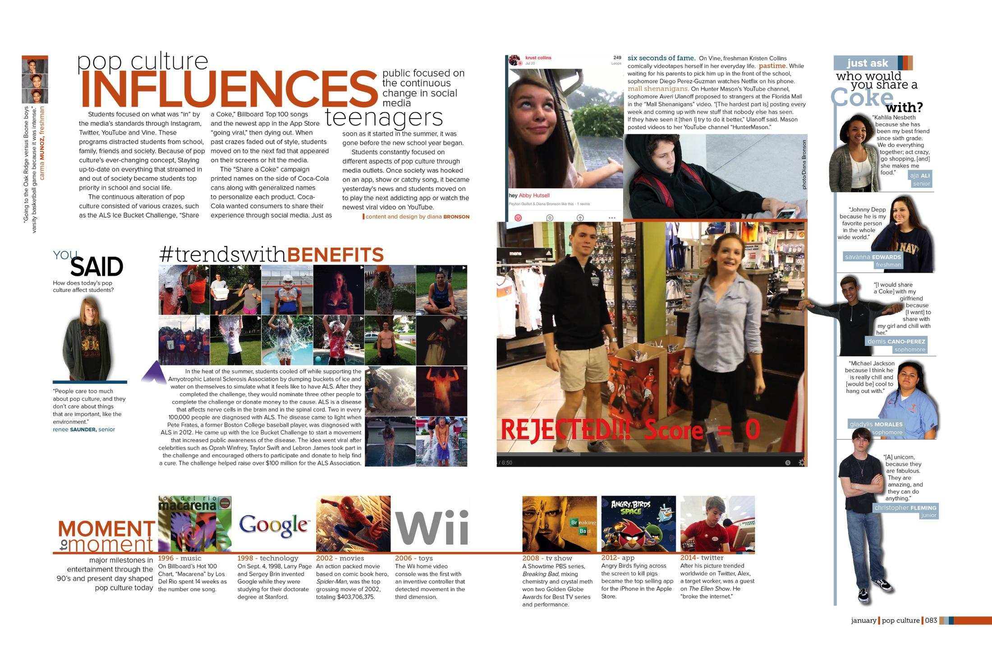
PLACEMENT
The position of items on a spread. Placement of elements within a page/spread determines the spatial relationship between elements and determines their relevance and significance.

Slide 8
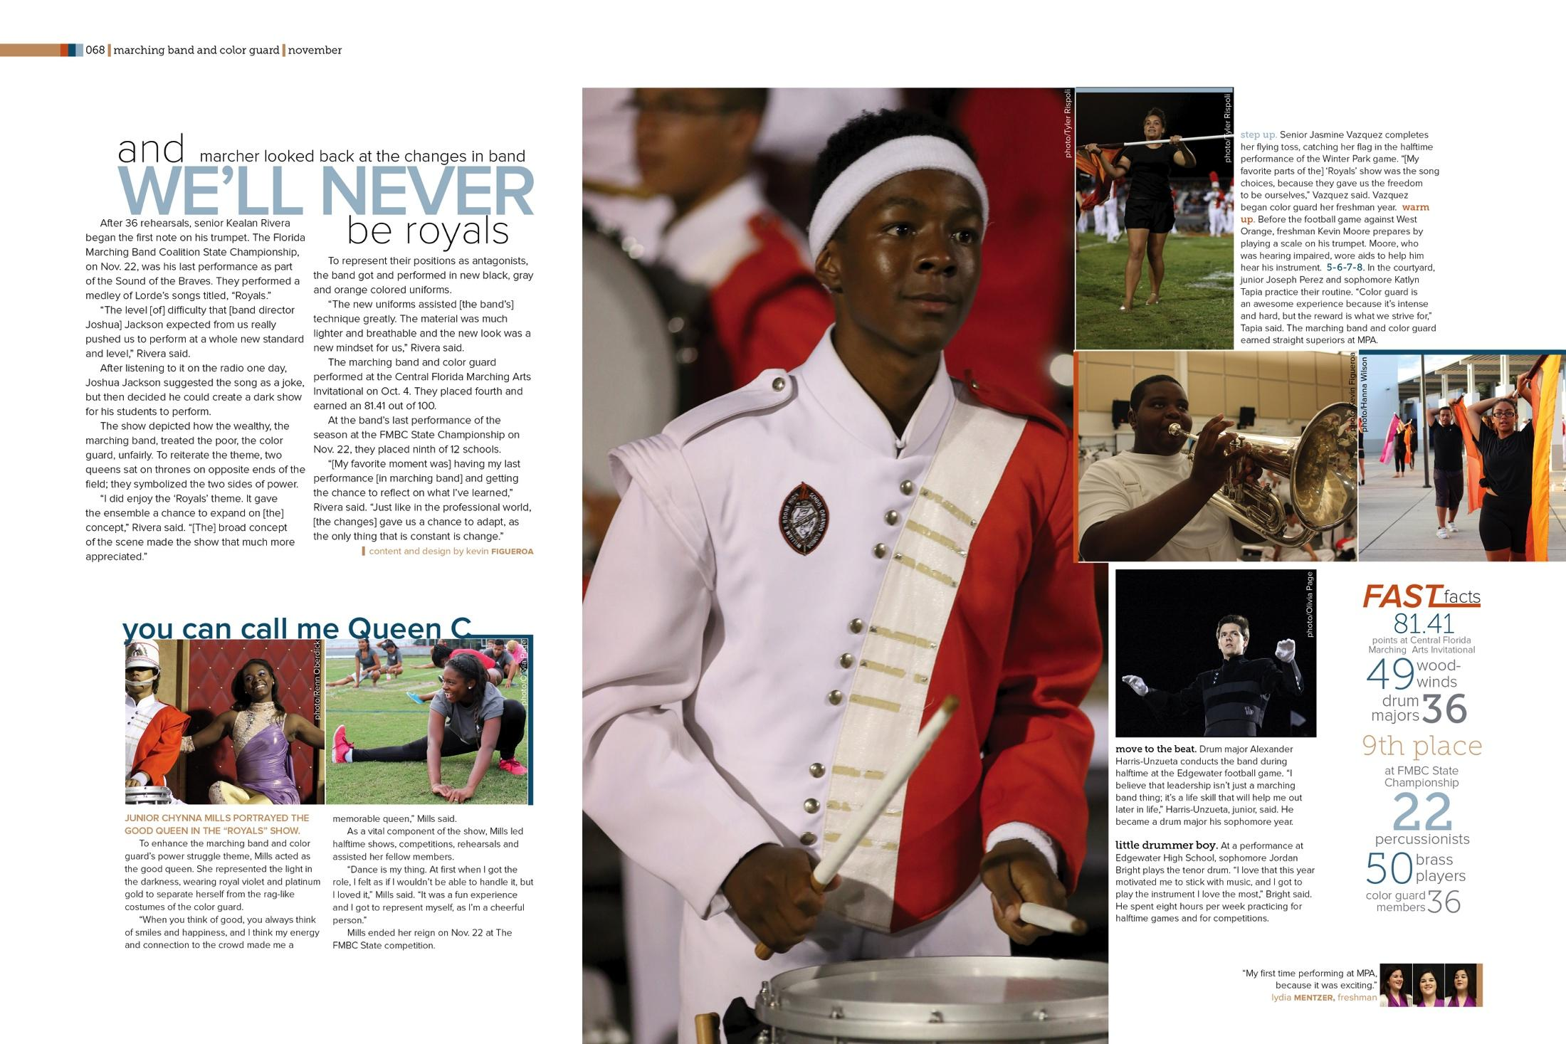
HARMONY
Visual harmony means agreement between elements, and is a key component to developing the theme and visual appearance in a composition.

Slide 9
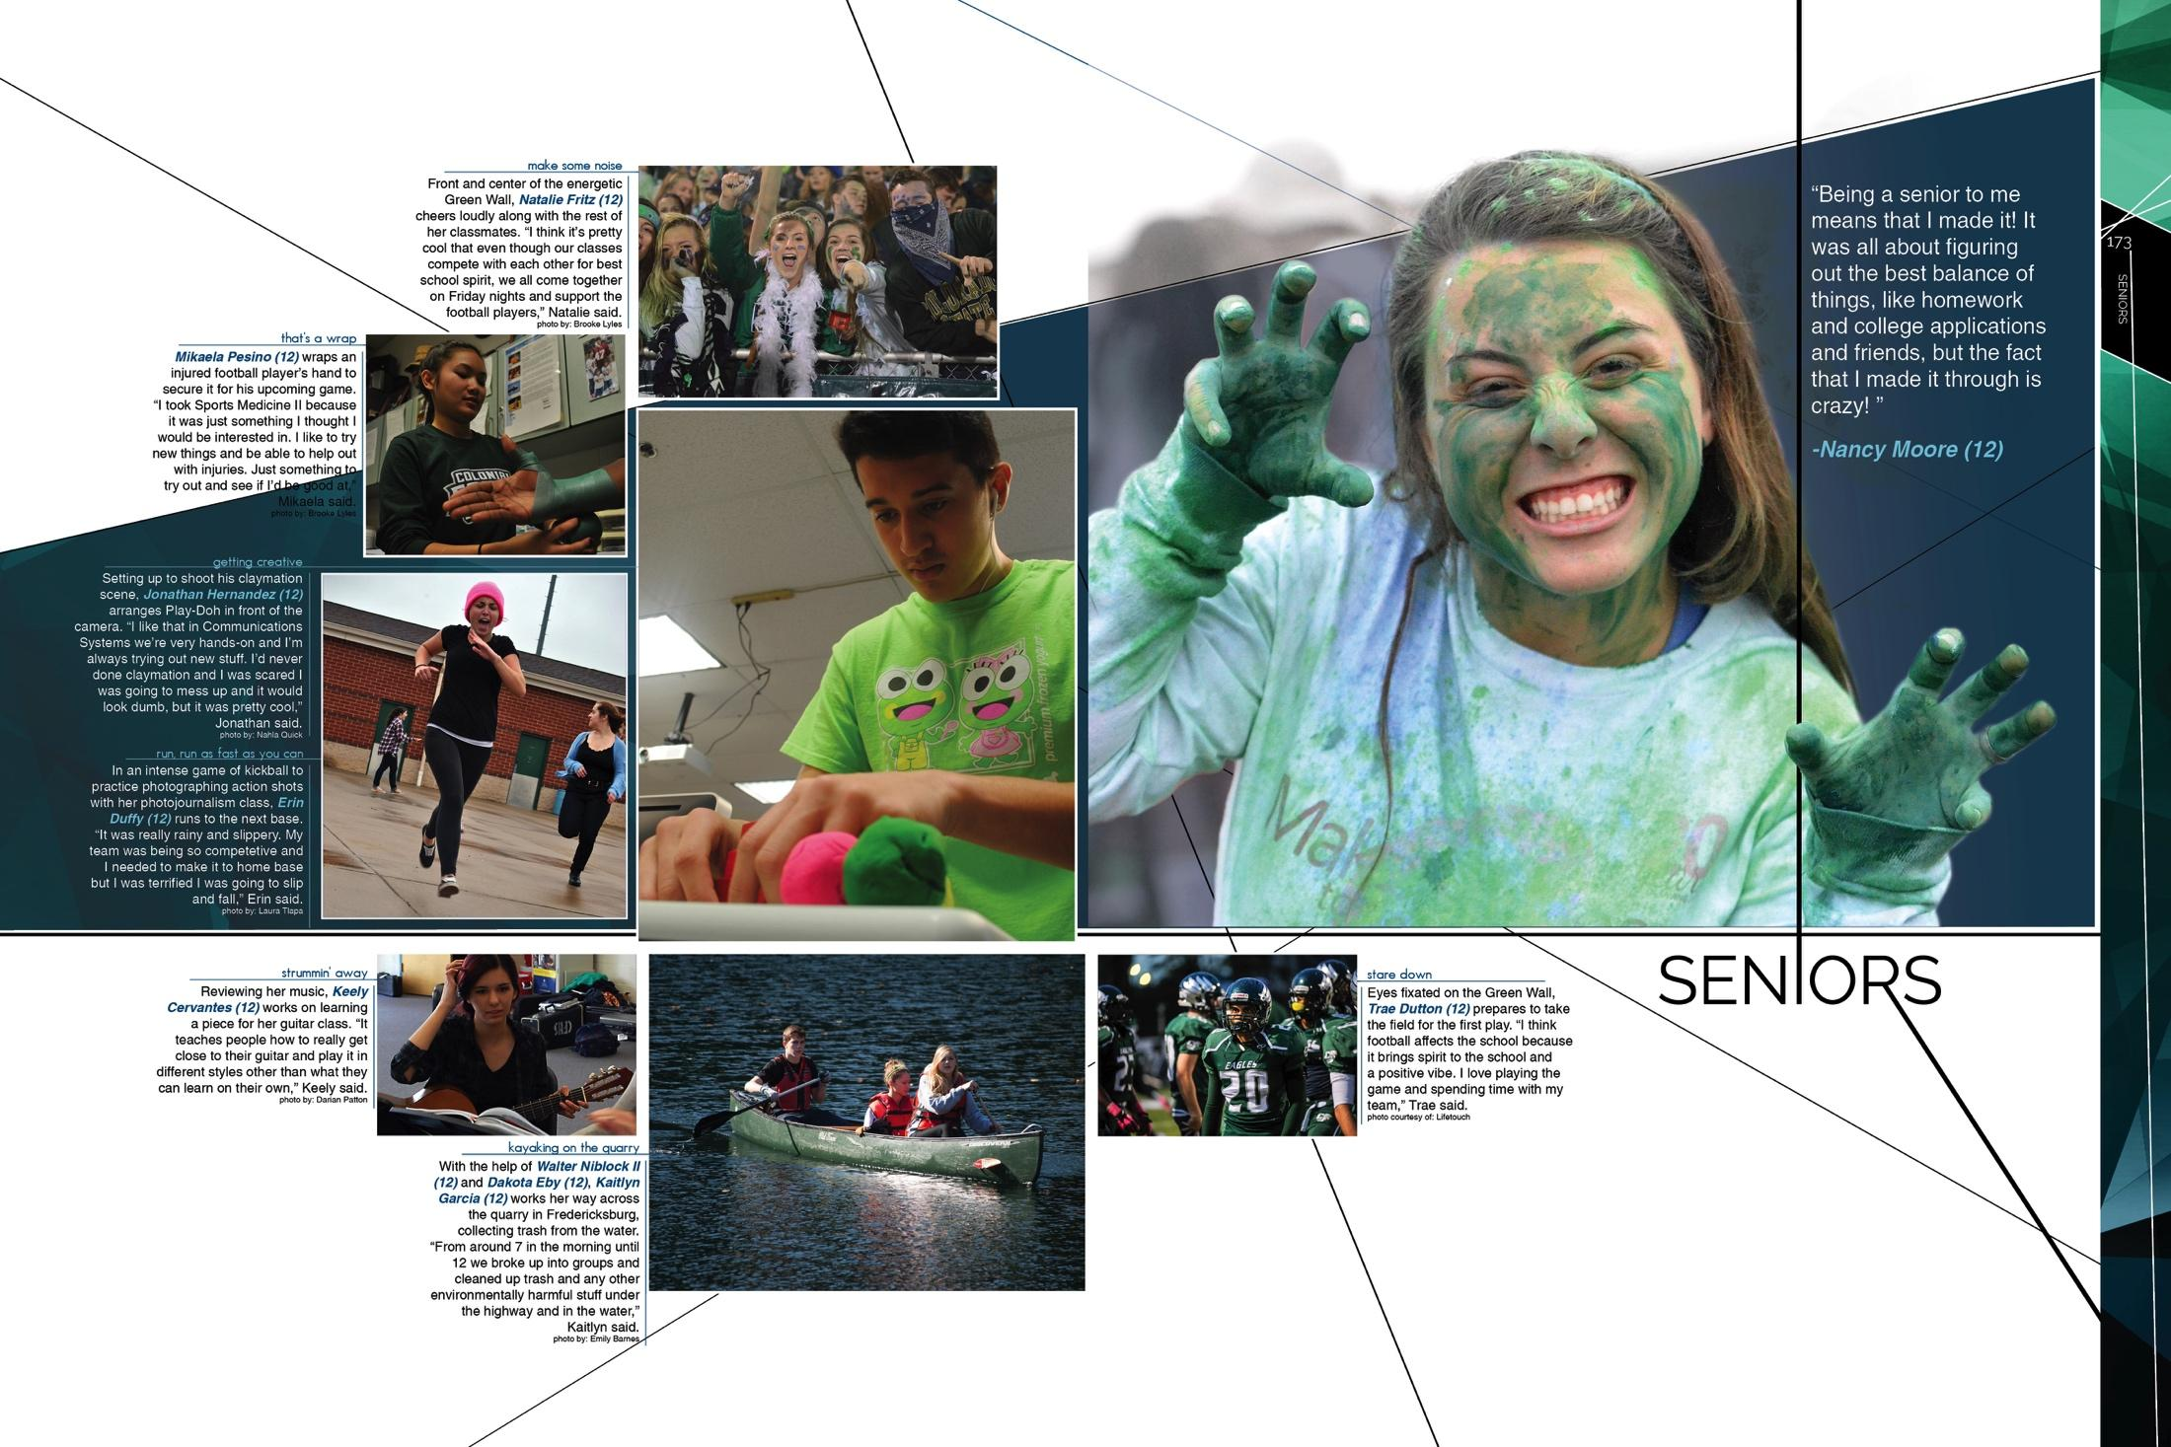
BALANCE
The distribution of the components of a composition giving it a stable feel or appearance. Balance may be symmetrical, asymmetrical, or radial.

Slide 10
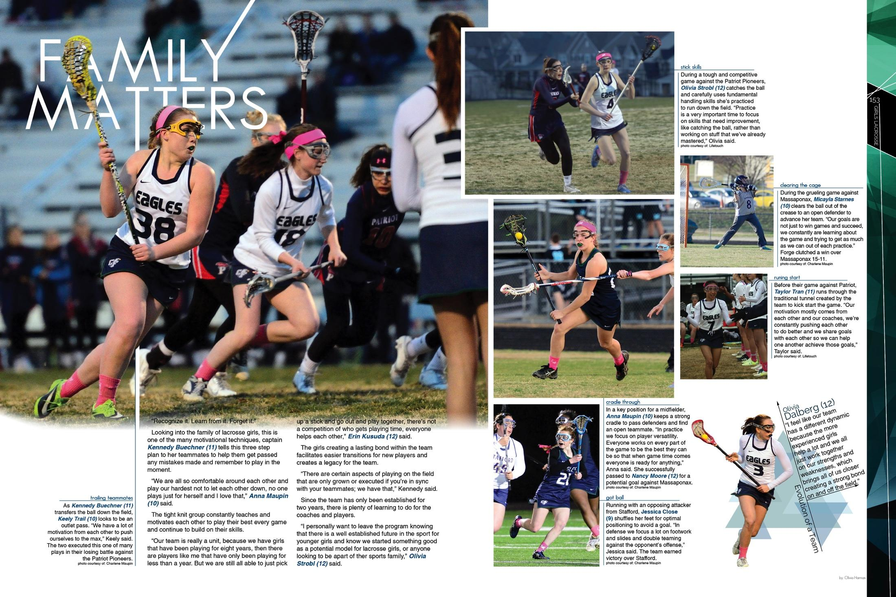
PROPORTION
The relative size and scale of components of a composition that create a feeling of unity; the relative size of all the components to the whole composition.

Slide 11
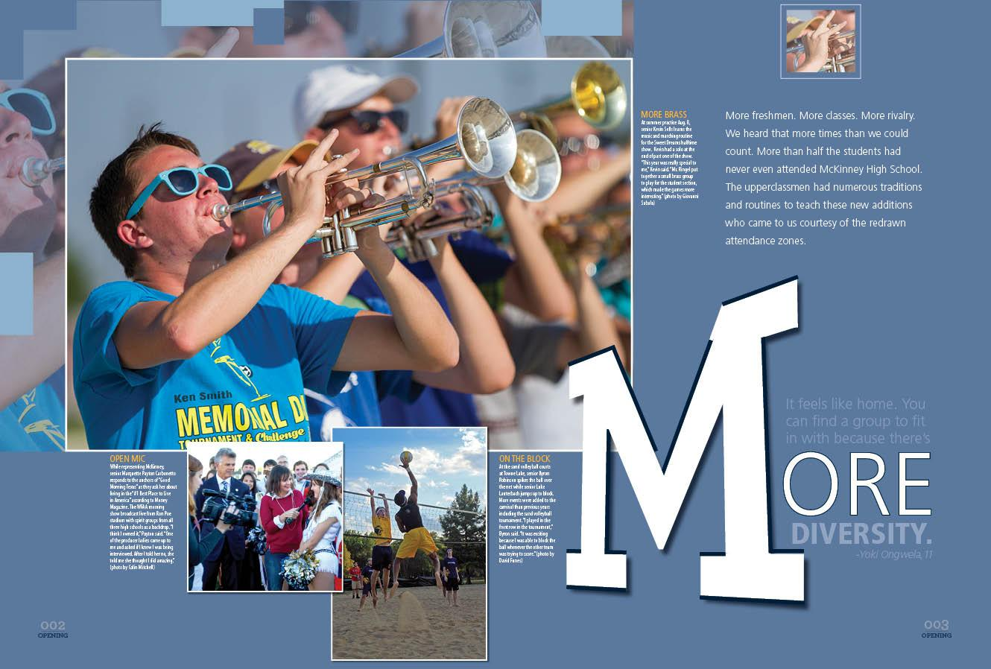
SCALE
The relative size of one component to another.

Slide 12
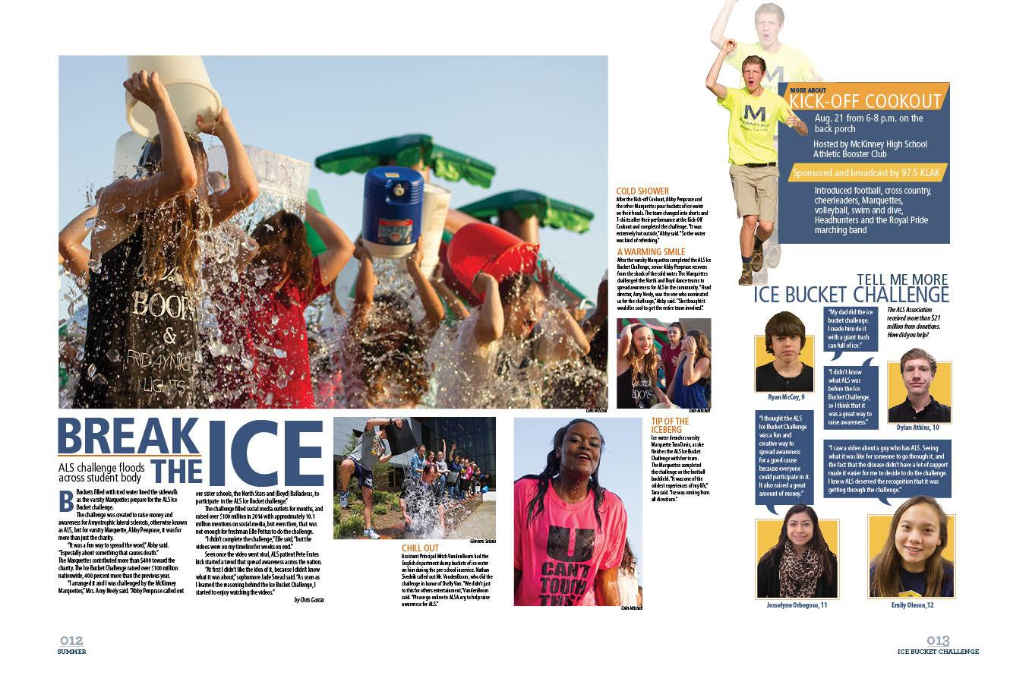
PROXIMITY
The grouping of objects based on their closeness to one another.

Slide 13
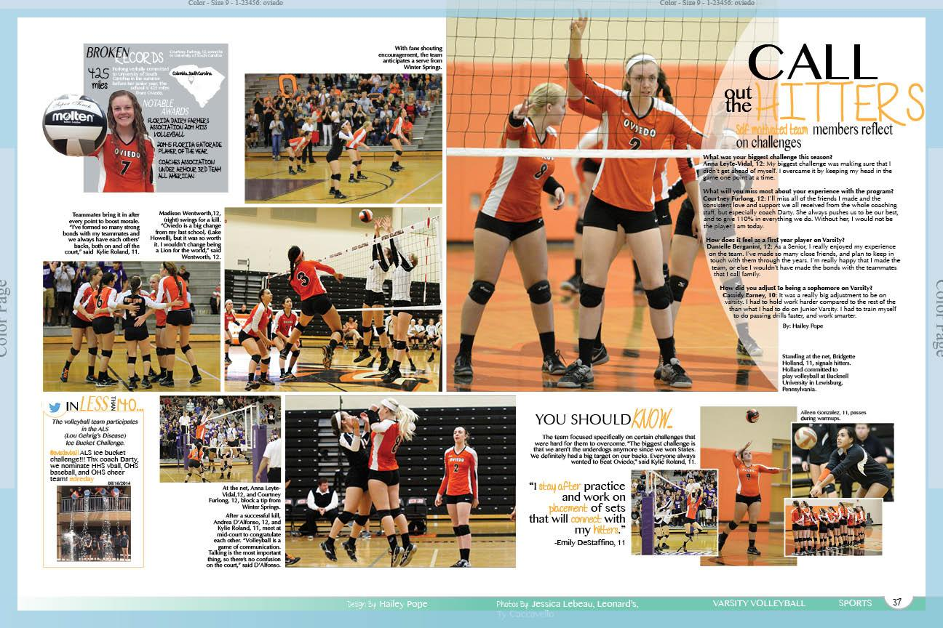
UNITY
The feeling of harmony between components of a composition, creating a sense of completeness.

Slide 14
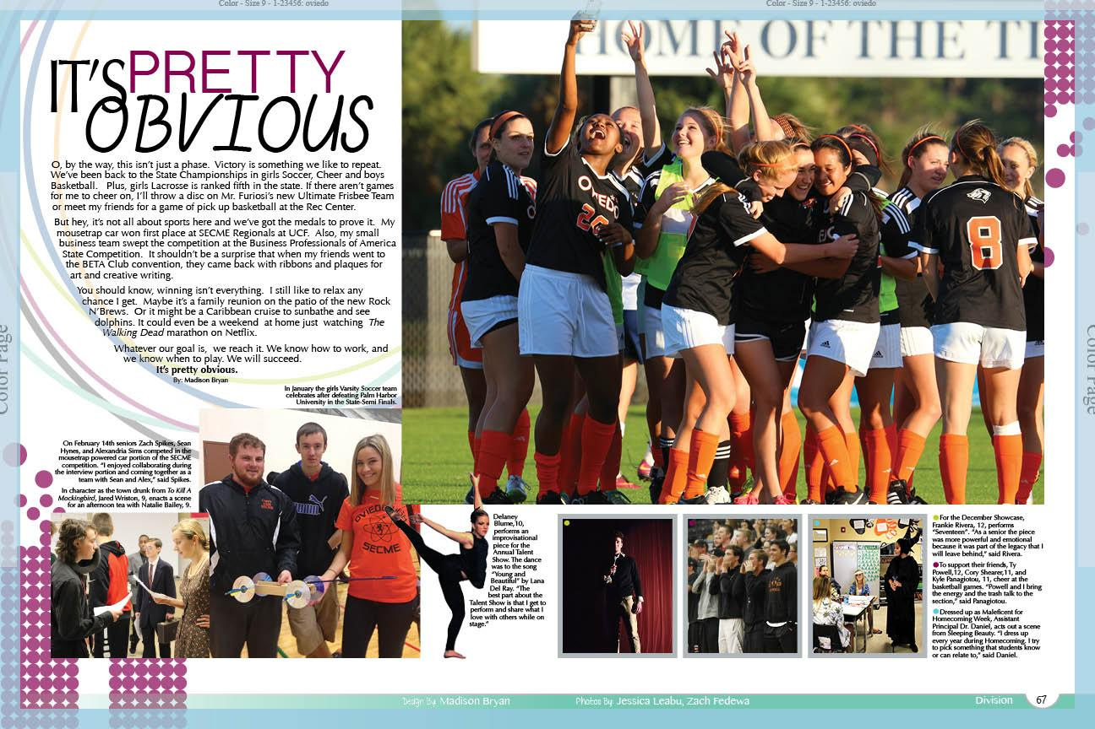
RHYTHM
The repetition or alternation of components within a composition.

Slide 15
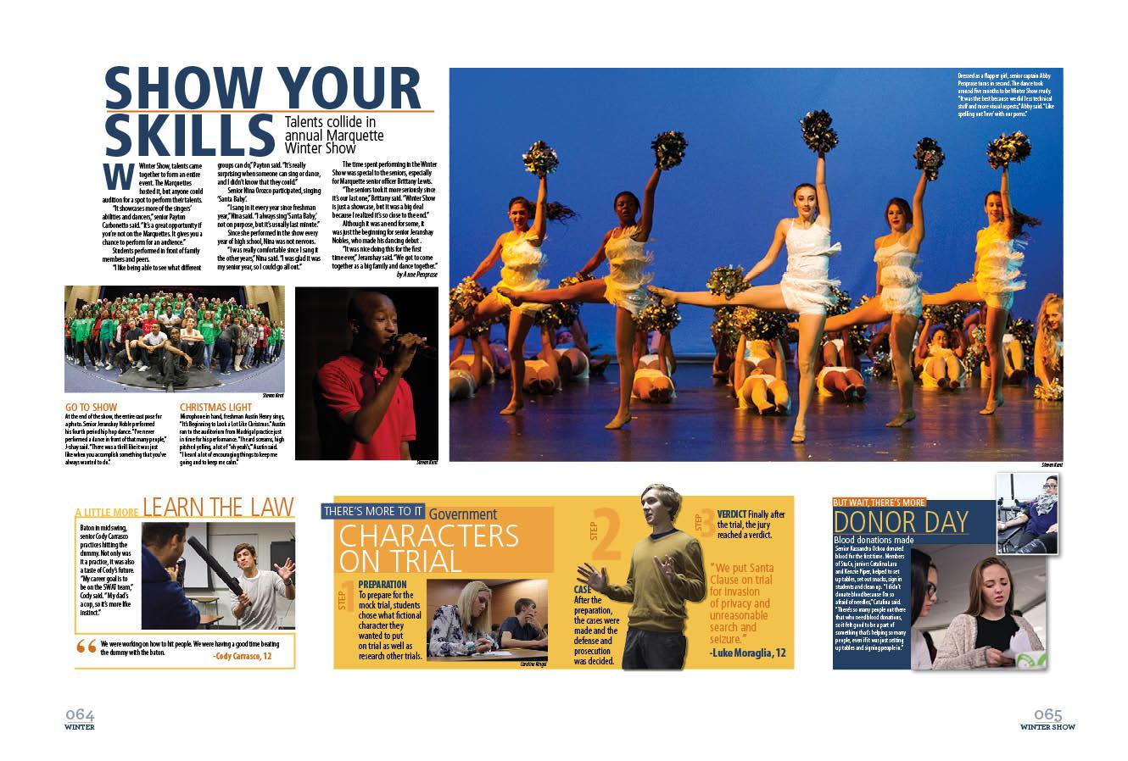
DIVISION
The use of white or negative space to separate or distinguish components in a composition.

Slide 16
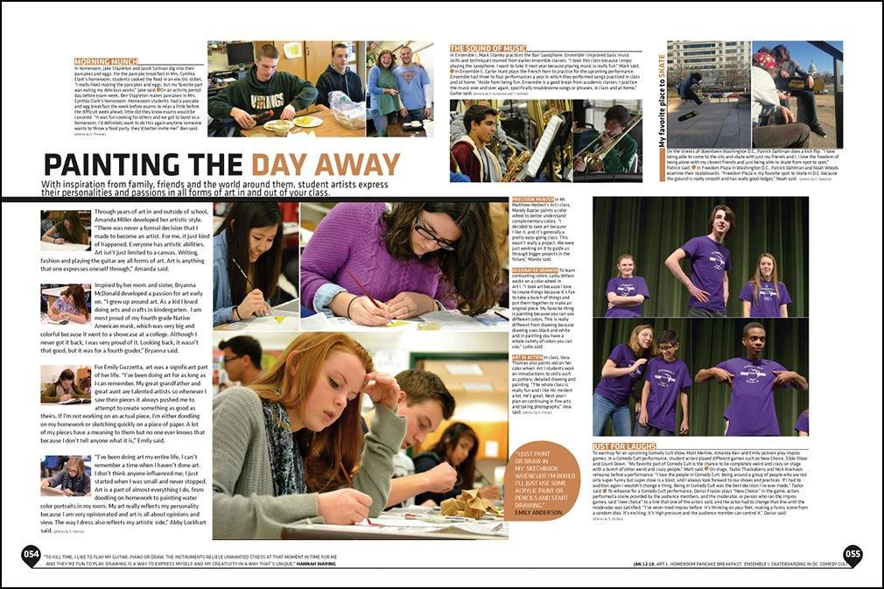
GROUPING
Elements that are unified as a whole based on proximity, similarity, continuation or alignment.

Slide 17
EMPHASIS
A component that stands out in a composition and draws a viewer’s attention.

Slide 18
CONTRAST
Differences in color, size, shape, location or relationship that compares/creates differences in a composition.

Slide 19
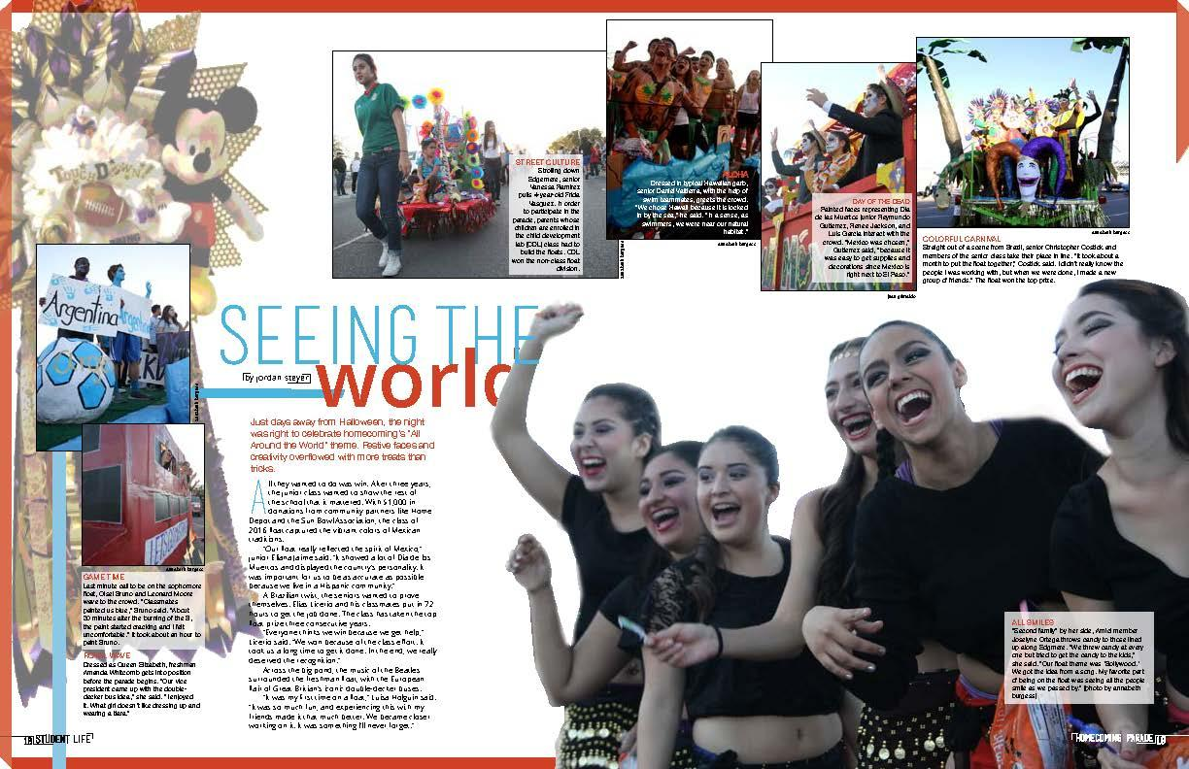
DIRECTION
The management of the movement of components within a composition.

Slide 20
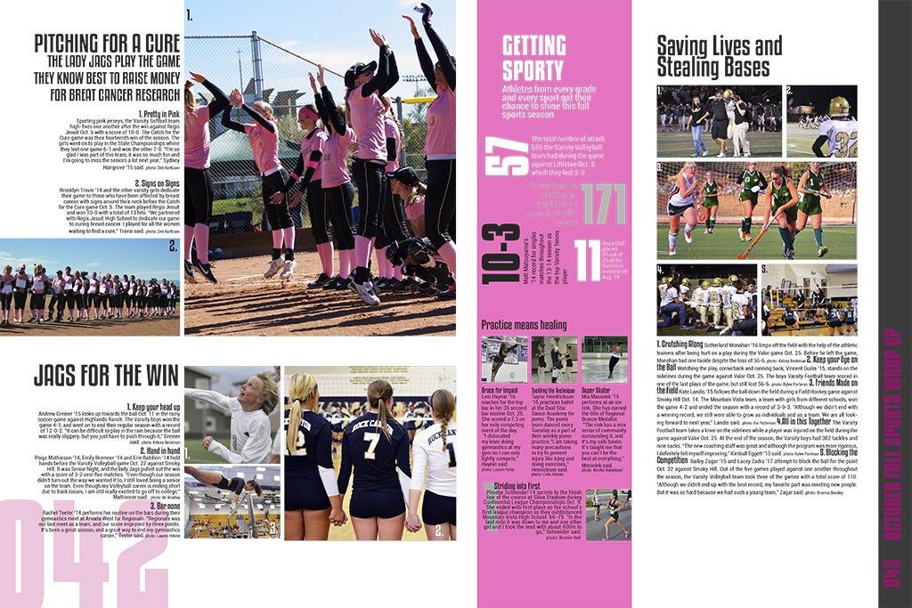
VALUE
The measure of lightness and darkness in composition.

Slide 21
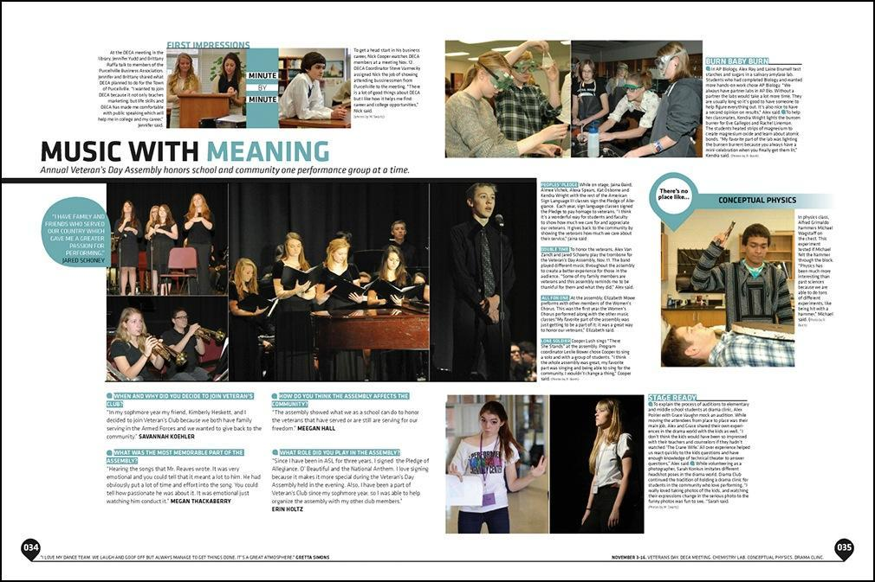
ALIGNMENT
The lining up of components with each other based on the edges or guides within a composition.

Slide 22
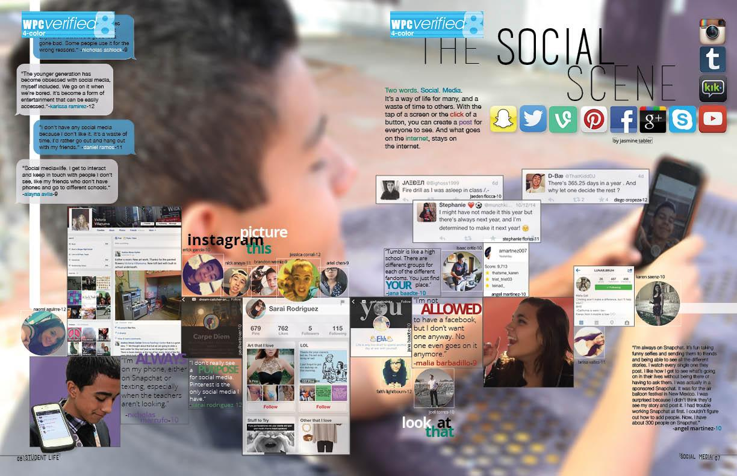
FLOW
Guides a viewer through a composition by the placement of components.

Slide 23
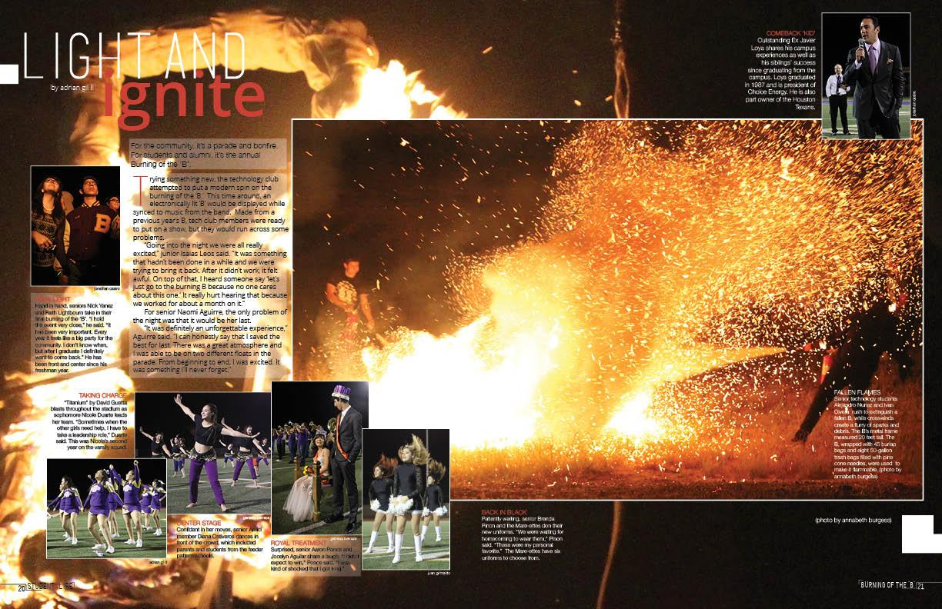
SPATIAL RELATIONSHIPS
The relationship of all components within a composition and their position within space.

Slide 24
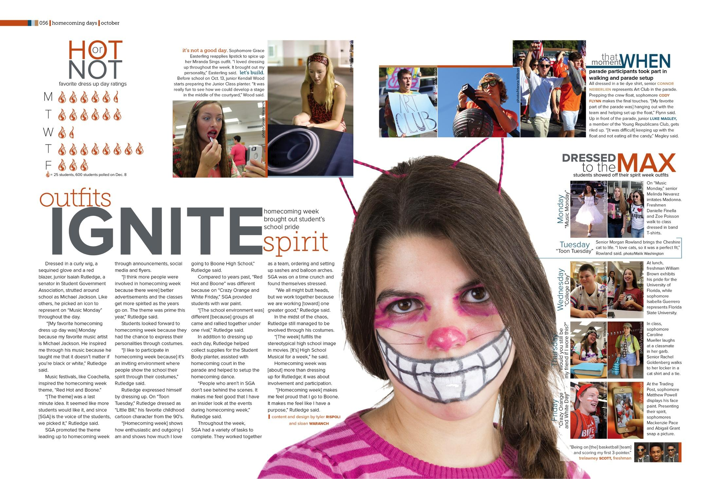
How many principles can you find?
Look at this layout and make a list of all the principles of design you think it uses.

Slide 25
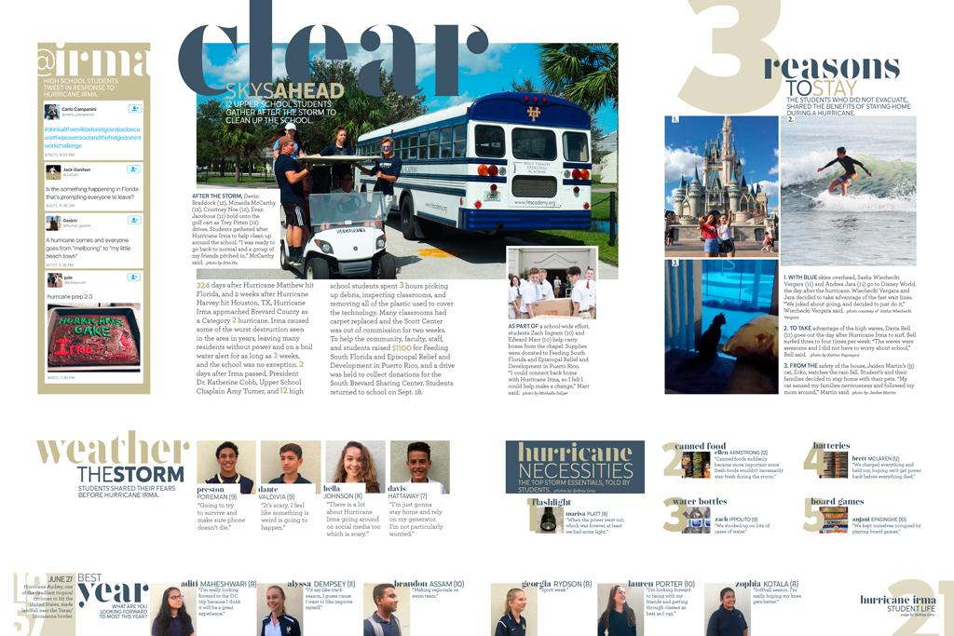
Day Two- Quickwrite
What are two elements you see from the terms we learned about yesterday?

