Slide 1
Distribution
Entrepreneurship
Attribution: Adviser Sarah Nichols of Whitney High School contributed photos to this slideshow

Slide 2
Distribution: Whitney High School
For each of the following examples, consider …
How does this help promote the yearbook?
What do you like and dislike about this?
How effective would it be in your own context?

Slide 3
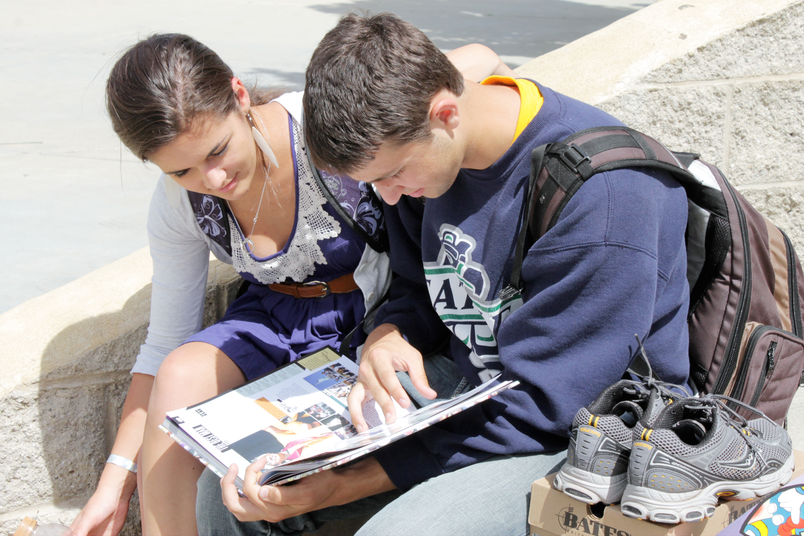
Distribution events allow buyers to experience the yearbook together

Slide 4
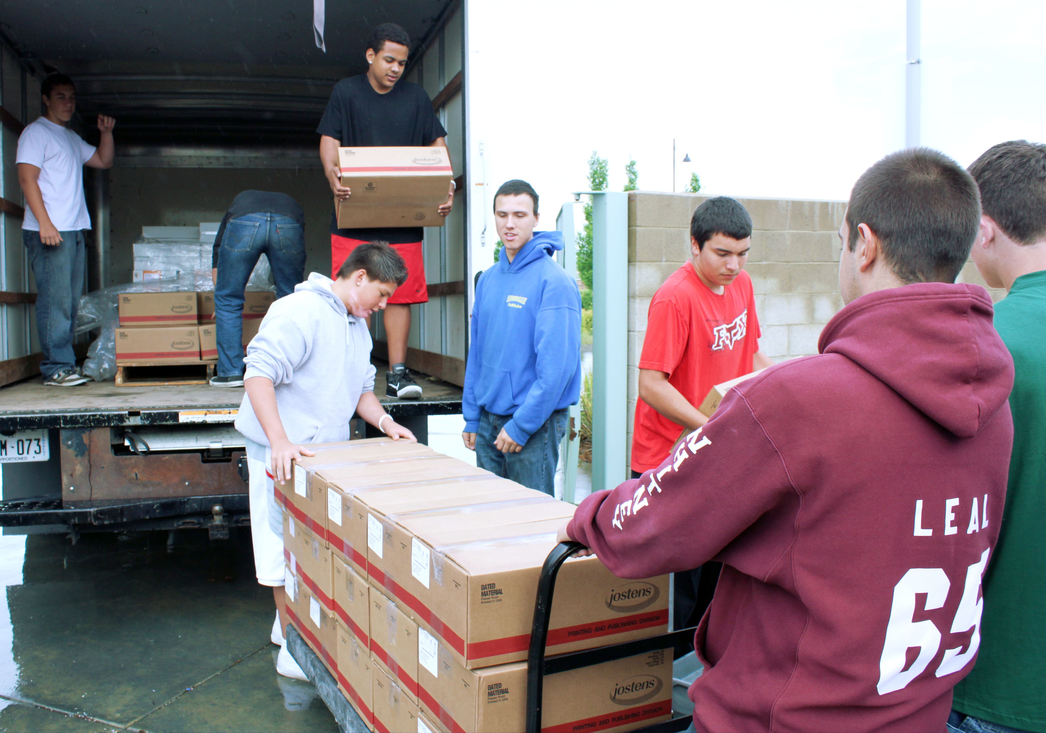
Involve staff members in all aspects of the distribution event

Slide 5
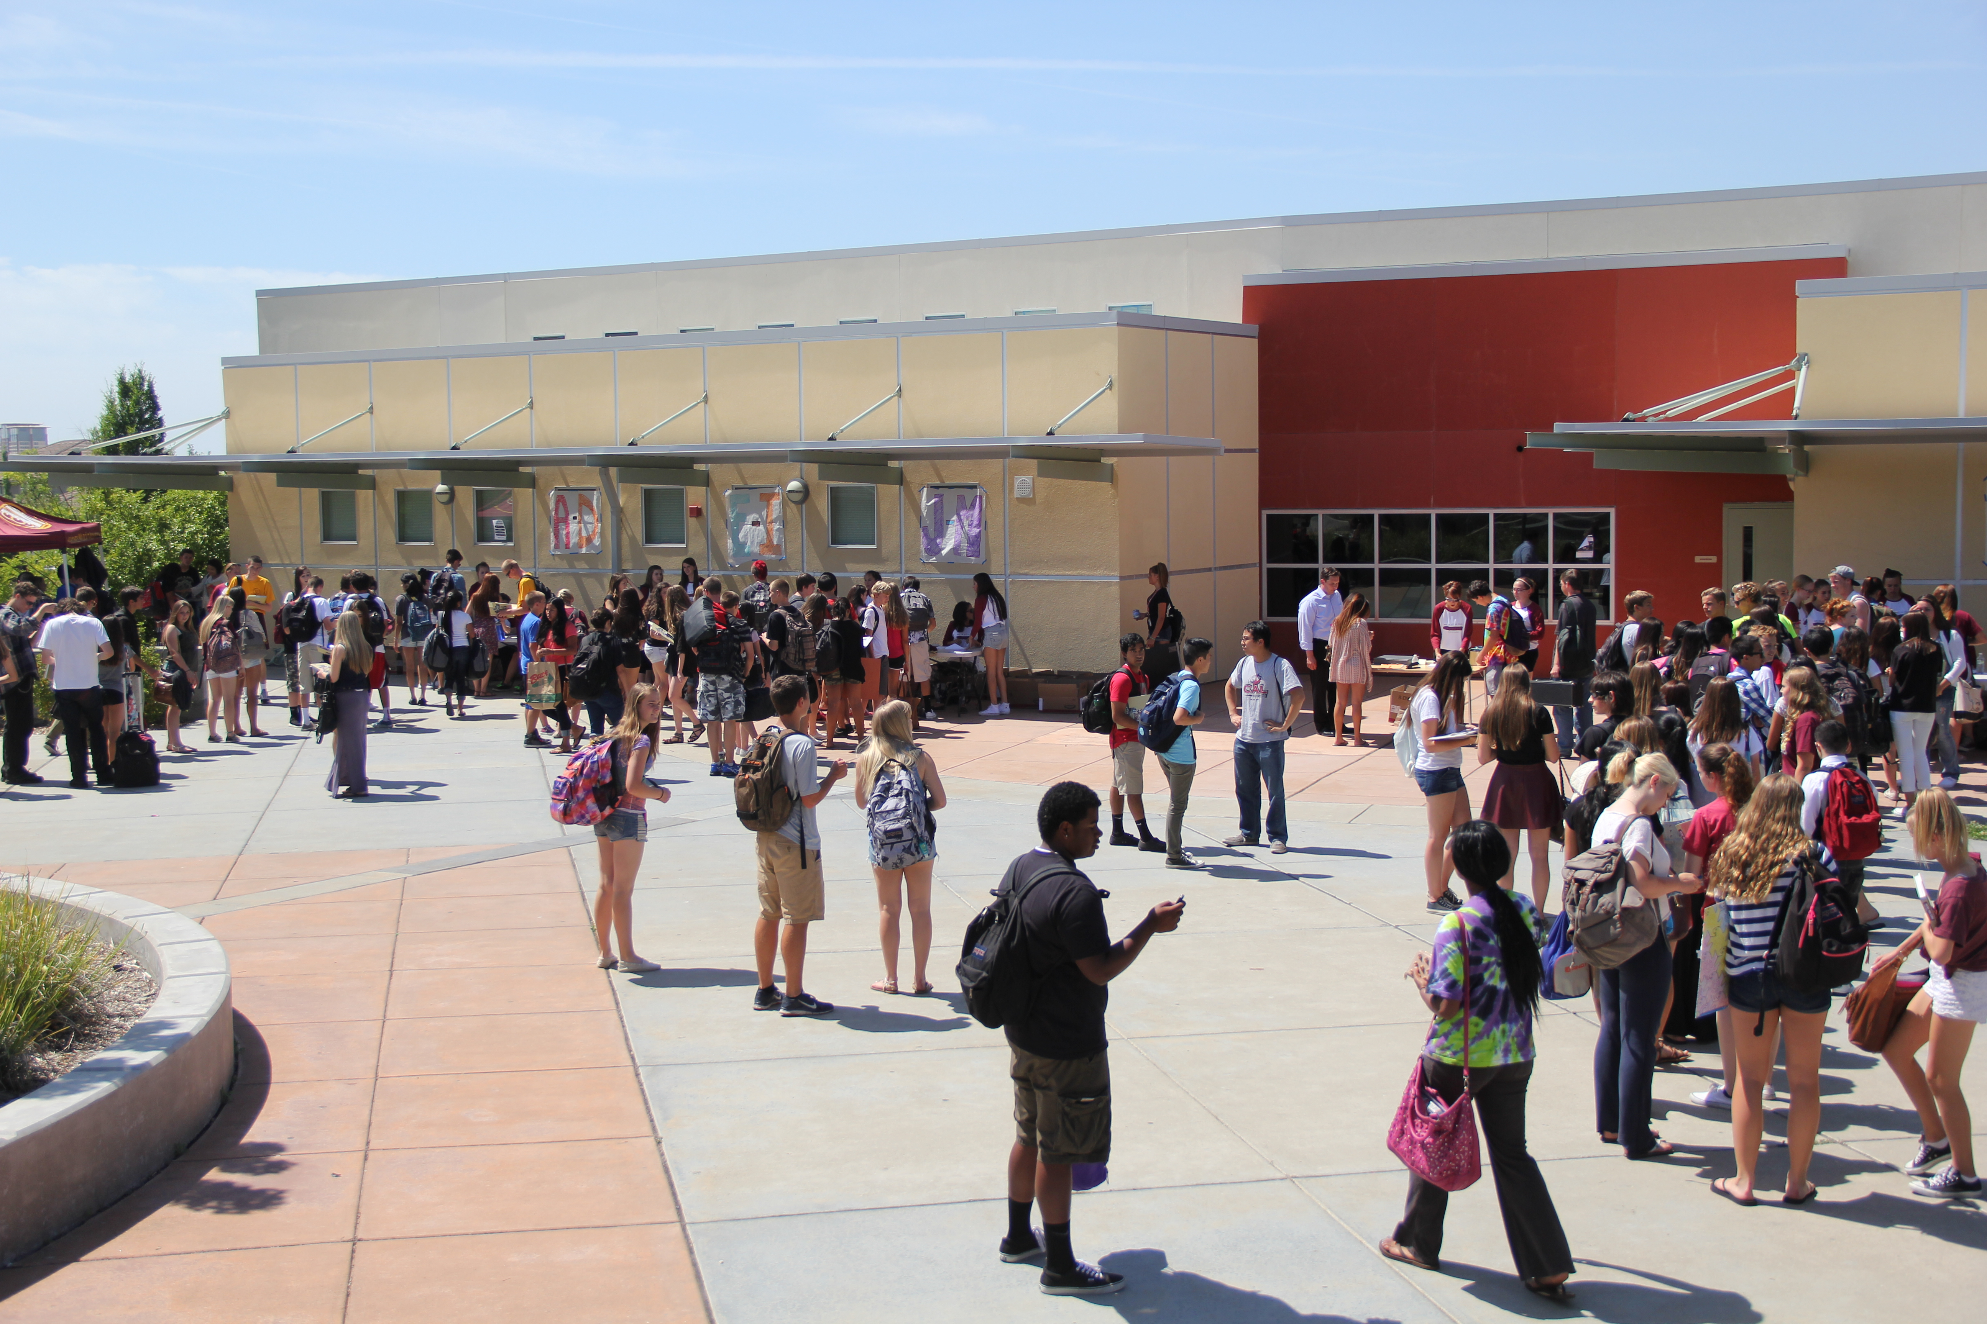
Hold the event at a time when many students will be able to attend

Slide 6
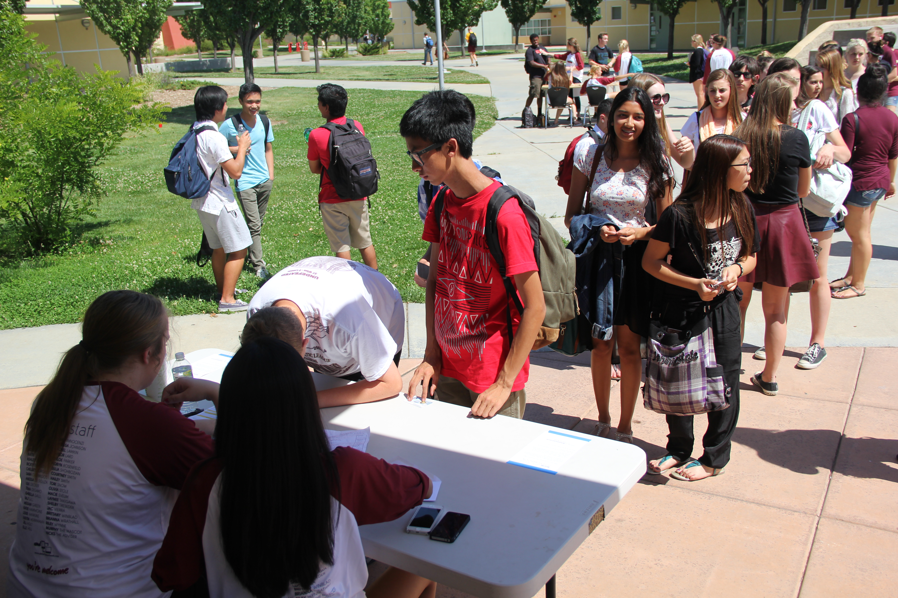
Create orderly lines so buyers know where to go, especially at big schools

Slide 7
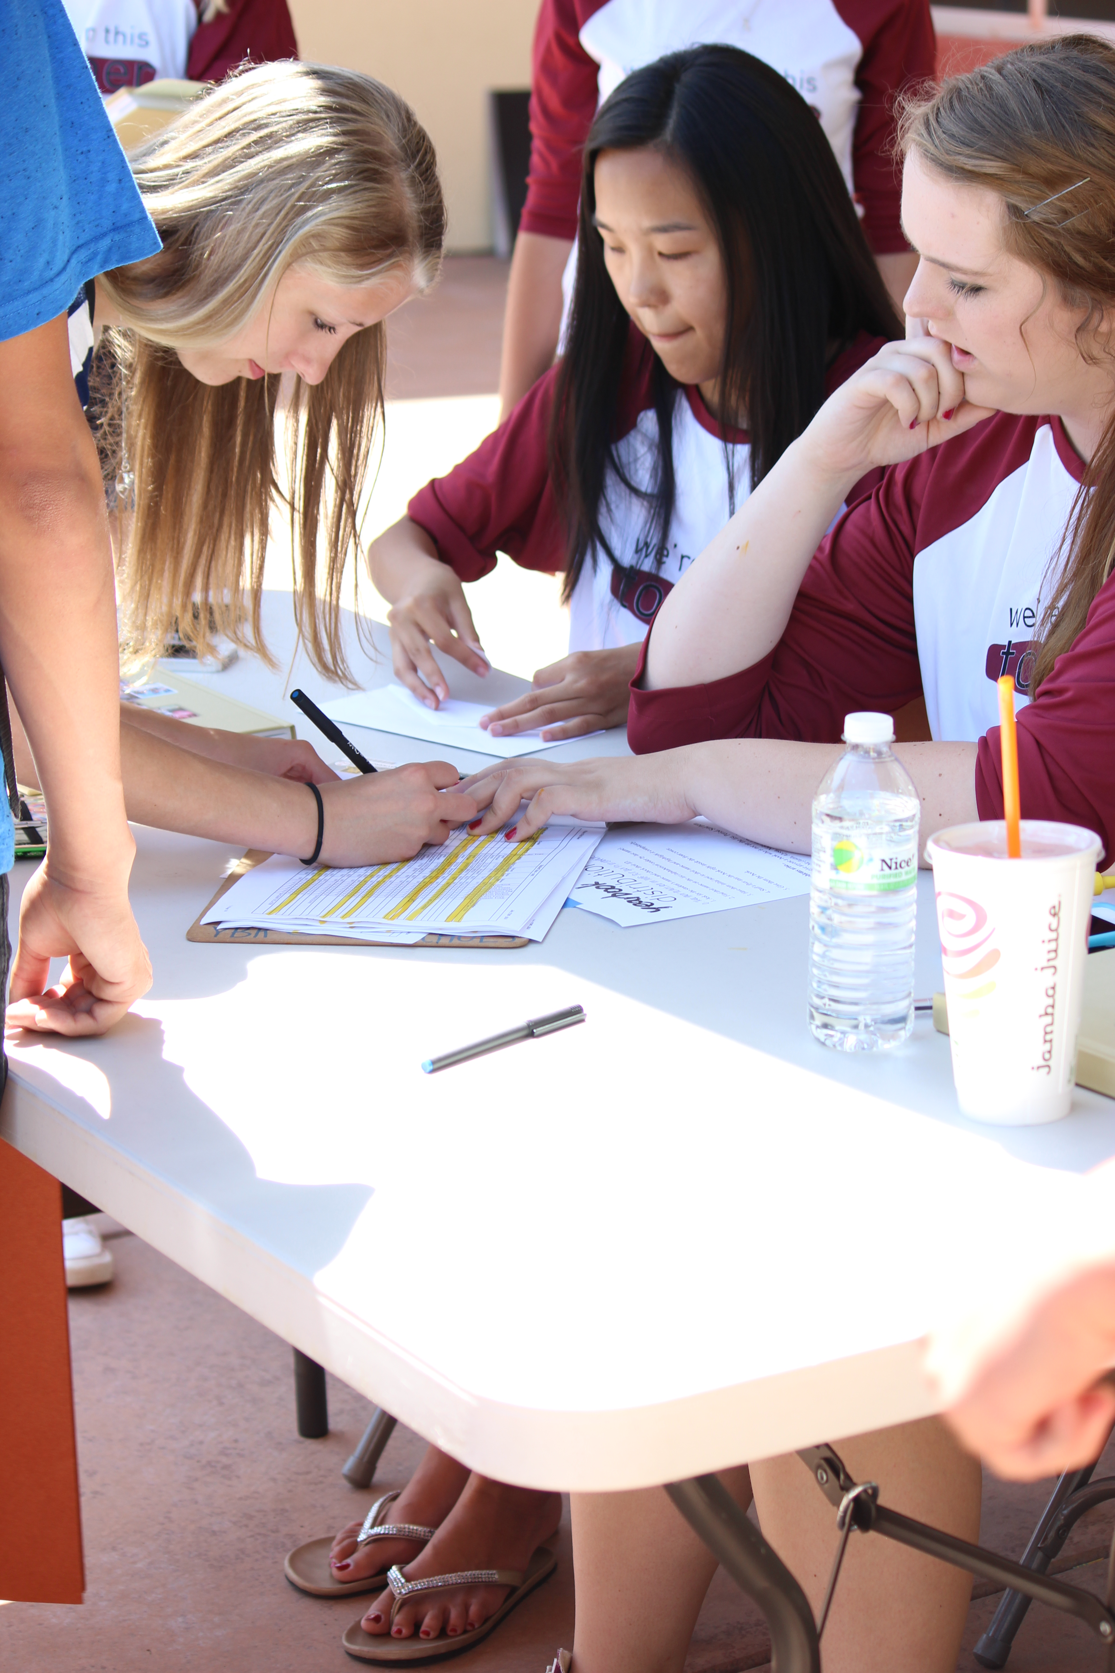
Alphabetize books and check names off of a list to make it easier to keep track of buyers

Slide 8
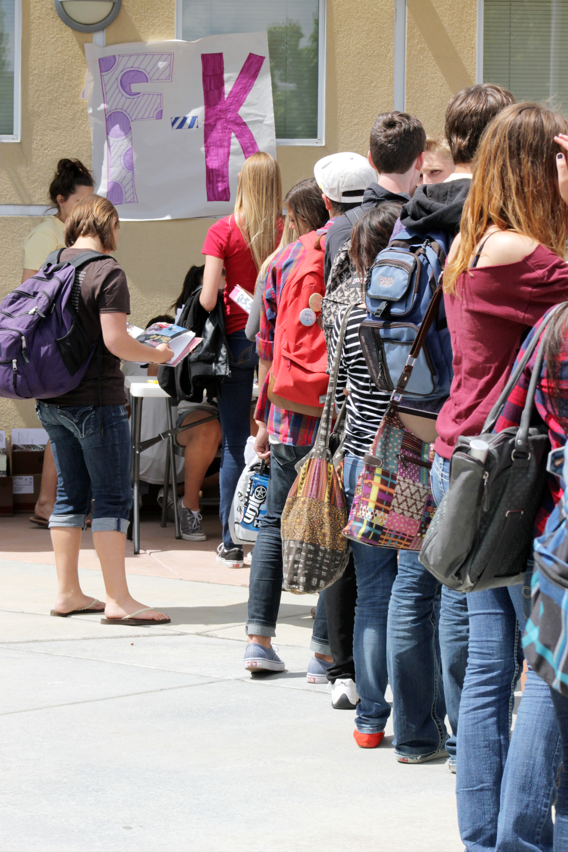
Distribution events allow buyers to experience the yearbook together

Slide 9
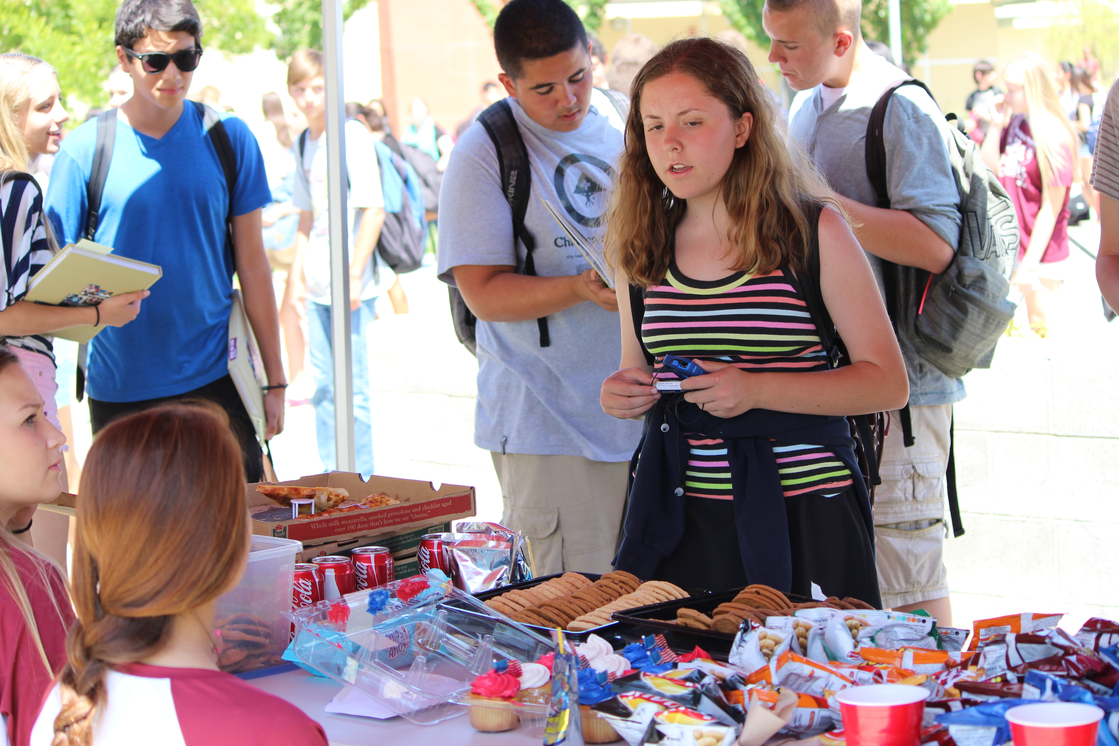
Offer food and make the event a party!

Slide 10
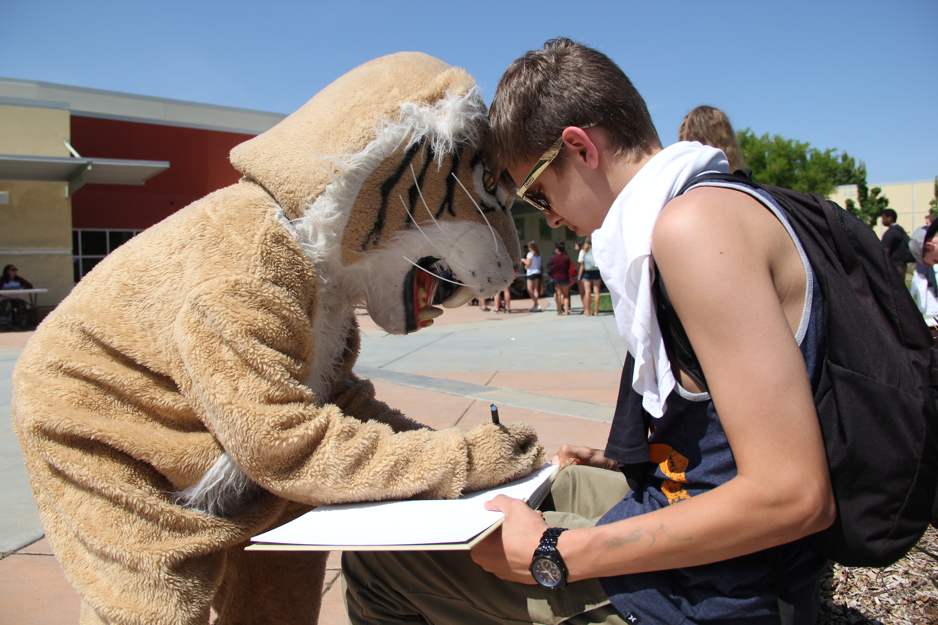
Make sure your school mascot is there to sign yearbooks

Slide 11
Have staff members on hand to survey buyers on their impressions

Slide 12
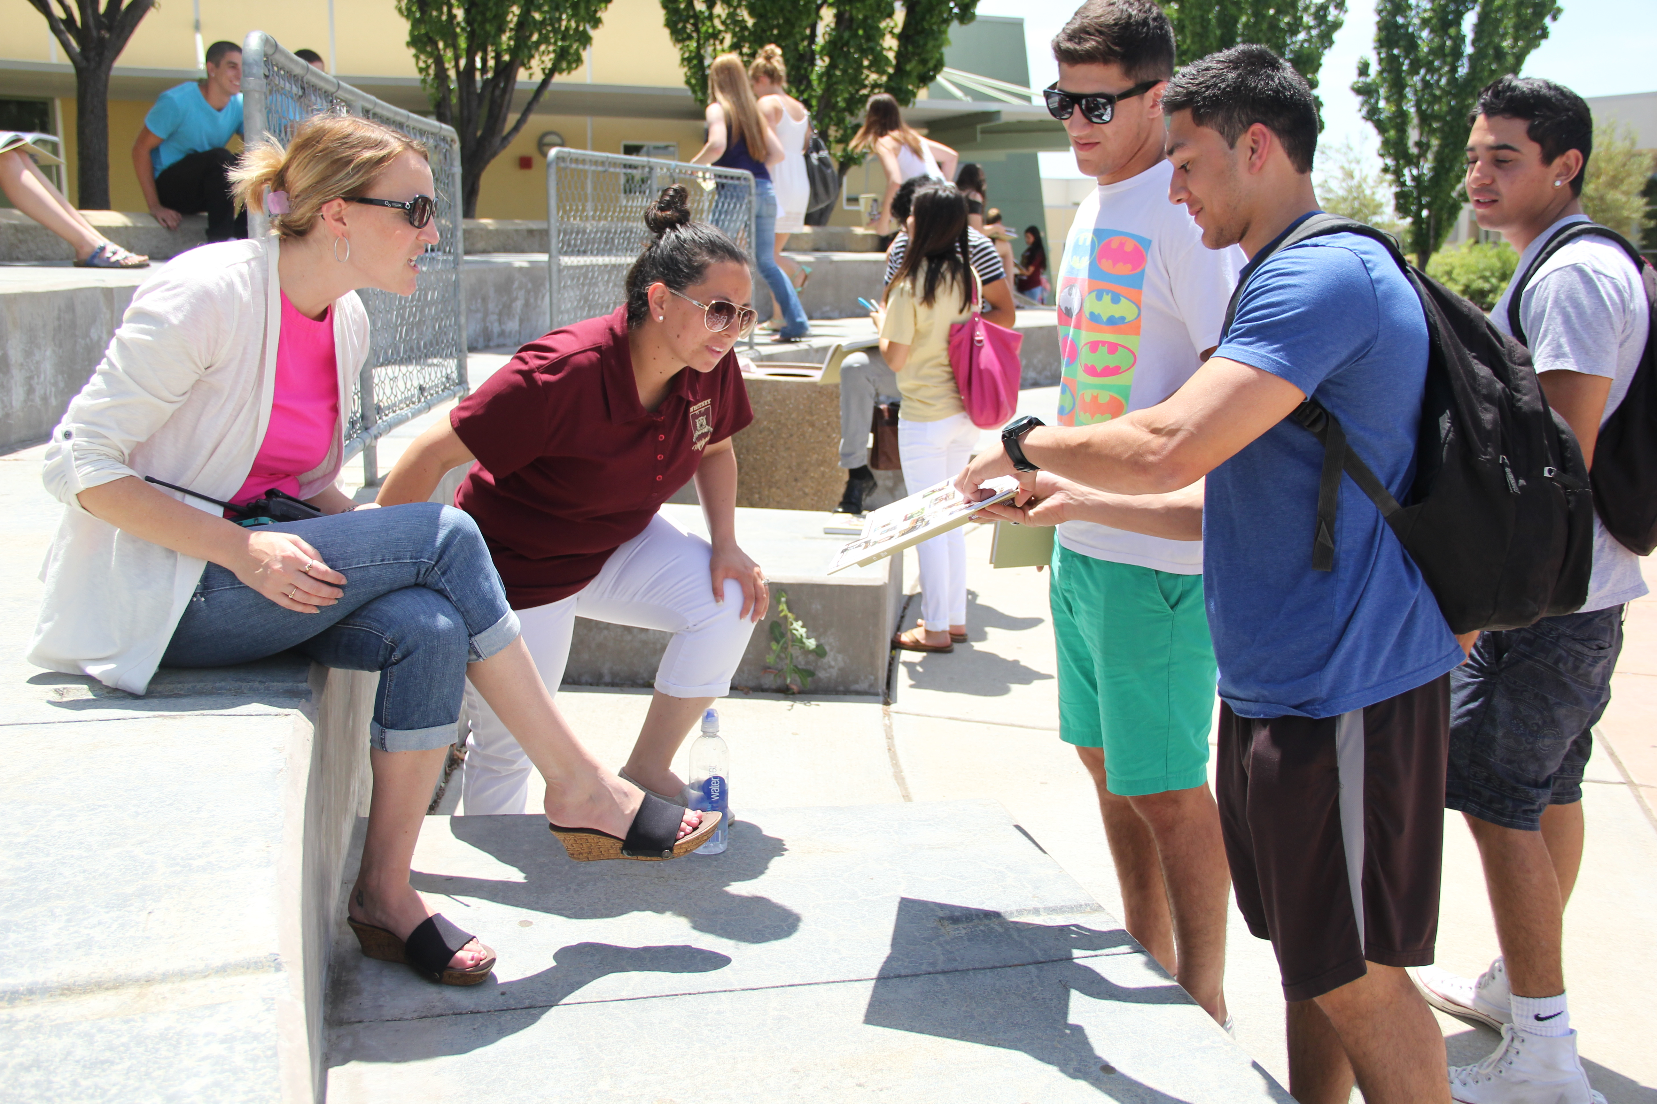
Distribution events allow buyers to experience the yearbook together

Slide 13
Brainstorming
Consider the following aspects of the distribution process. What are some important factors that staffs need to consider? How does each represent an opportunity to create a positive publications image? What kinds of problems can occur?

Slide 14
Planning
Important Factors
Allow sufficient time
Consider both buyers and non-buyers/those who interact with your publication and those who don’t
Work with administration to determine when, where and how
For yearbook/new publication launch
Set a budget to determine event perks and branding strategy
Food? Signing party? Pens? Ice cream? Popcorn?
Staff tshirts? Flyers? Advertising?

Slide 15
Planning
Opportunity
Plan a coherent branding strategy
Staff tshirts? Fliers?
Present yourselves as entrepreneurs
Use your distribution method as a sales tactic
Preview the perks
Distribute fliers/email home
Use social media

Slide 16
Planning
Problems
Lack of direction — need a leader!
Insufficient time
Budget
Administration may push back

Slide 17
Distribution Event
Important Factors
Consider both buyers and non-buyers/those who interact and those who don’t
Sell those extra books!
Demonstrate how the new publication will add to their lives
Determine when, where and how
At school? During school? After school?
May/June? Summer? Fall?
Classroom? Gym? Cafeteria?
Consider perks for yearbook/new publication reveal
Food? Signing party? Pens? Ice cream? Popcorn?

Slide 18
Distribution Event
Opportunity
Make direct connections with the audience
Allow audience to make connections with each other
Build a readership for a new publication
Get direct feedback instead of relying on surveys
Sell extra books

Slide 19
Distribution Event
Problems
Lack of planning
Lack of audience buy-in
Not everyone will be able to come
Hard to avoid disrupting the school day
People will complain

Slide 20
Opportunities for Critique/Feedback
Important Factors
Consider both buyers and non-buyers/those who interact and those who don’t
Finding out why people don’t read/interact is just as important as finding out what the actual readers like
Determine when, where, and how
At school? During school? After school? Online? Focus groups?
Immediately upon receipt of publication? Later?
Social media? Email? Letters to the Editor?
Create a consistent story and train your staff
Not everyone should respond; have a system

Slide 21
Opportunities for Critique/Feedback
Opportunity
Keep readers and reach new readers
Demonstrate responsibility and professionalism
Reinforce the idea of the publication as a public forum for student expression

Slide 22
Opportunities for Critique/Feedback
Problems
People will still complain
It is easy to be discouraged
Readers may not use your system
Readers may not understand your system
It is impossible to reach everyone … but still try

Slide 23
Making Corrections
Important Factors
Acknowledge your error, apologize and include a correction
Designate an area of your publication for this
Newspaper: Near staff box or in the opinion section
Online: Make corrections in the article and acknowledge at the bottom
Yearbook: Could be run in newspaper or online
Have a process and make readers aware of it each time a publication is distributed
Check comments on articles and social media

Slide 24
Making Corrections
Opportunity
Demonstrate responsibility and professionalism
Reinforce the idea of the publication as a public forum for student expression
Appease unhappy readers

Slide 25
Making Corrections
Problems
People will still complain
It is easy to be discouraged
Readers may not use your system
Check comments on articles and social media
Readers may not understand what a public forum for student expression means
Administration or other adults may try to increase censorship

Slide 26
Responding to Criticism
Important Factors
Be polite and brief
Try to take the conversation offline and in person, in the case of social media comments
Resolve the problem without ceding control to the reader
Stick together as a staff, but also acknowledge your mistakes, errors or lapses in judgement

Slide 27
Responding to Criticism
Opportunity
Demonstrate responsibility and professionalism
Reinforce the idea of the publication as a public forum for student expression
Appease unhappy readers

Slide 28
Responding to Criticism
Problems
People will still complain
It is easy to be discouraged
Readers may not use your system
Check comments on articles and social media
Readers may not understand what a public forum for student expression means
Administration or other adults may try to increase censorship

Slide 29
Limiting Disruption
Important Factors
Work with your administration, not against them
They ARE allowed to define the time, place and manner of your distribution, in most cases
Find common ground — You don’t want to keep kids from learning either
Determine what you value — Audience feedback? Efficiency? Conversation?
Aim for non-disruptive times
Beginning or end of the day, lunch time, activity period, etc.

Slide 30
Limiting Disruption
Opportunity
Demonstrate responsibility and professionalism
Reinforce the idea of student control over a publication
Demonstrate a willingness to respect the educational environment of a school

Slide 31
Limiting Disruption
Problems
Administration or other adults may be unwilling to compromise
Teachers may not buy-in to your system
You will probably not get to do everything you want

Slide 32
Reflection
In your opinion, which of these aspects provides the greatest challenge for a staff?
In your opinion, which of these aspects provides the best opportunity to create a positive publications image?

