Slide 1
Publication Branding
Entrepreneurship
Attribution: Adviser Ava Butzu of Grand Blanc High School (Mich.), adviser Sarah Nichols of Whitney High School (Calif.), and adviser Mary Van of Century High School (N.D.) contributed to this slideshow

Slide 2
Warm Up
1. Think of an actor or reality television star who has largely lost credibility with the public. What did that person do to build their following? What kinds of actions destroyed their relationship with their audience?
2. If your non-journalism classmates were to describe (1) your staff and (2) your publication in 3-5 sentences, what do you think they would say?”

Slide 3
Discussion
To what extent is a positive view of a publication and publication staff necessary to a publication’s success?
How does social media play a role in establishing a publication’s “brand”, the face they portray to their audience?
What other interactions do we have with our audience that form our “brand”?

Slide 4
Debrief
3. Based on our initial discussion, why is publication branding important?

Slide 5
Branding
A strategic plan to put forward a specific image to an audience and/or to interact with an audience in order to facilitate a positive audience outlook, thereby increasing the favor of the brand in their eyes
Publications, like individuals, need a brand management strategy to …
Maintain a positive image with the audience, including credibility and responsibility
Encourage the audience to interact with the publication
Drive sales of physical products (yearbooks, newspapers) as well as traffic to electronic products (website, social media)
Our audience is social, therefore we need to participate in their social culture

Slide 6
Publication Branding
 | Before | Now
Production | Producing a publication behind closed doors, revealing it when the staff was ready | Maintaining a constant , professional, positive presence among our student body, including previews of content
Sales | Conducted on a weekly basis; one-size-fits all strategy | Use a “blitz” strategy, targeting students at key moments during the year with materials that relate to their interests and experiences and that are personalized and interesting
Content | Staff decides all of the content on their own | Go to where students are and ask for content and ideas; involve them in the process so they feel some sense of ownership, that the publication is theirs also

Slide 7
Publication Branding
For each of the following examples, record …
How does this help support a publication’s brand?
What do you like and dislike about this?
How effective would it be in your own context?

Slide 8
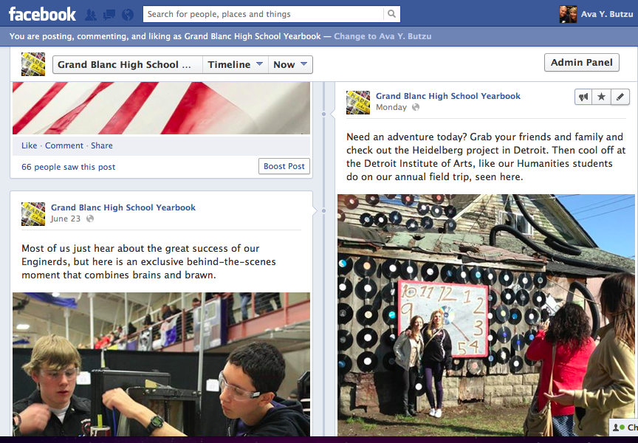
Be involved in the lives of ALL students, championing their successes and interesting experiences instead of sticking with “traditional” coverage

Slide 9
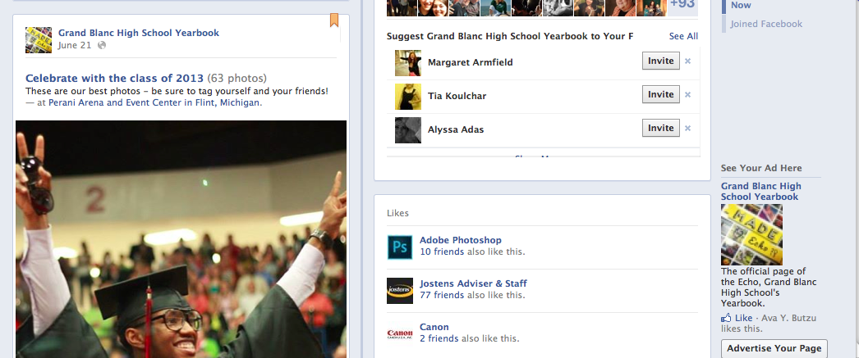
Encourage the audience to interact with the publication by posting their own content; become a vehicle for user-generated content instead of fighting it

Slide 10
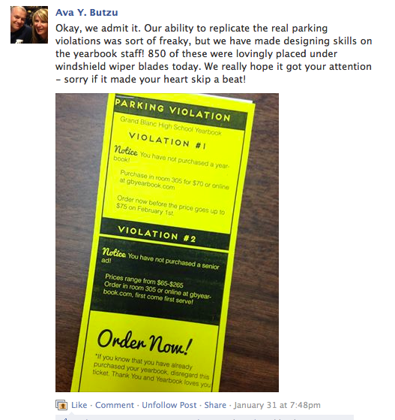
Use unique sales tactics that will speak to your audience and relate to their everyday experiences … even parking tickets!

Slide 11
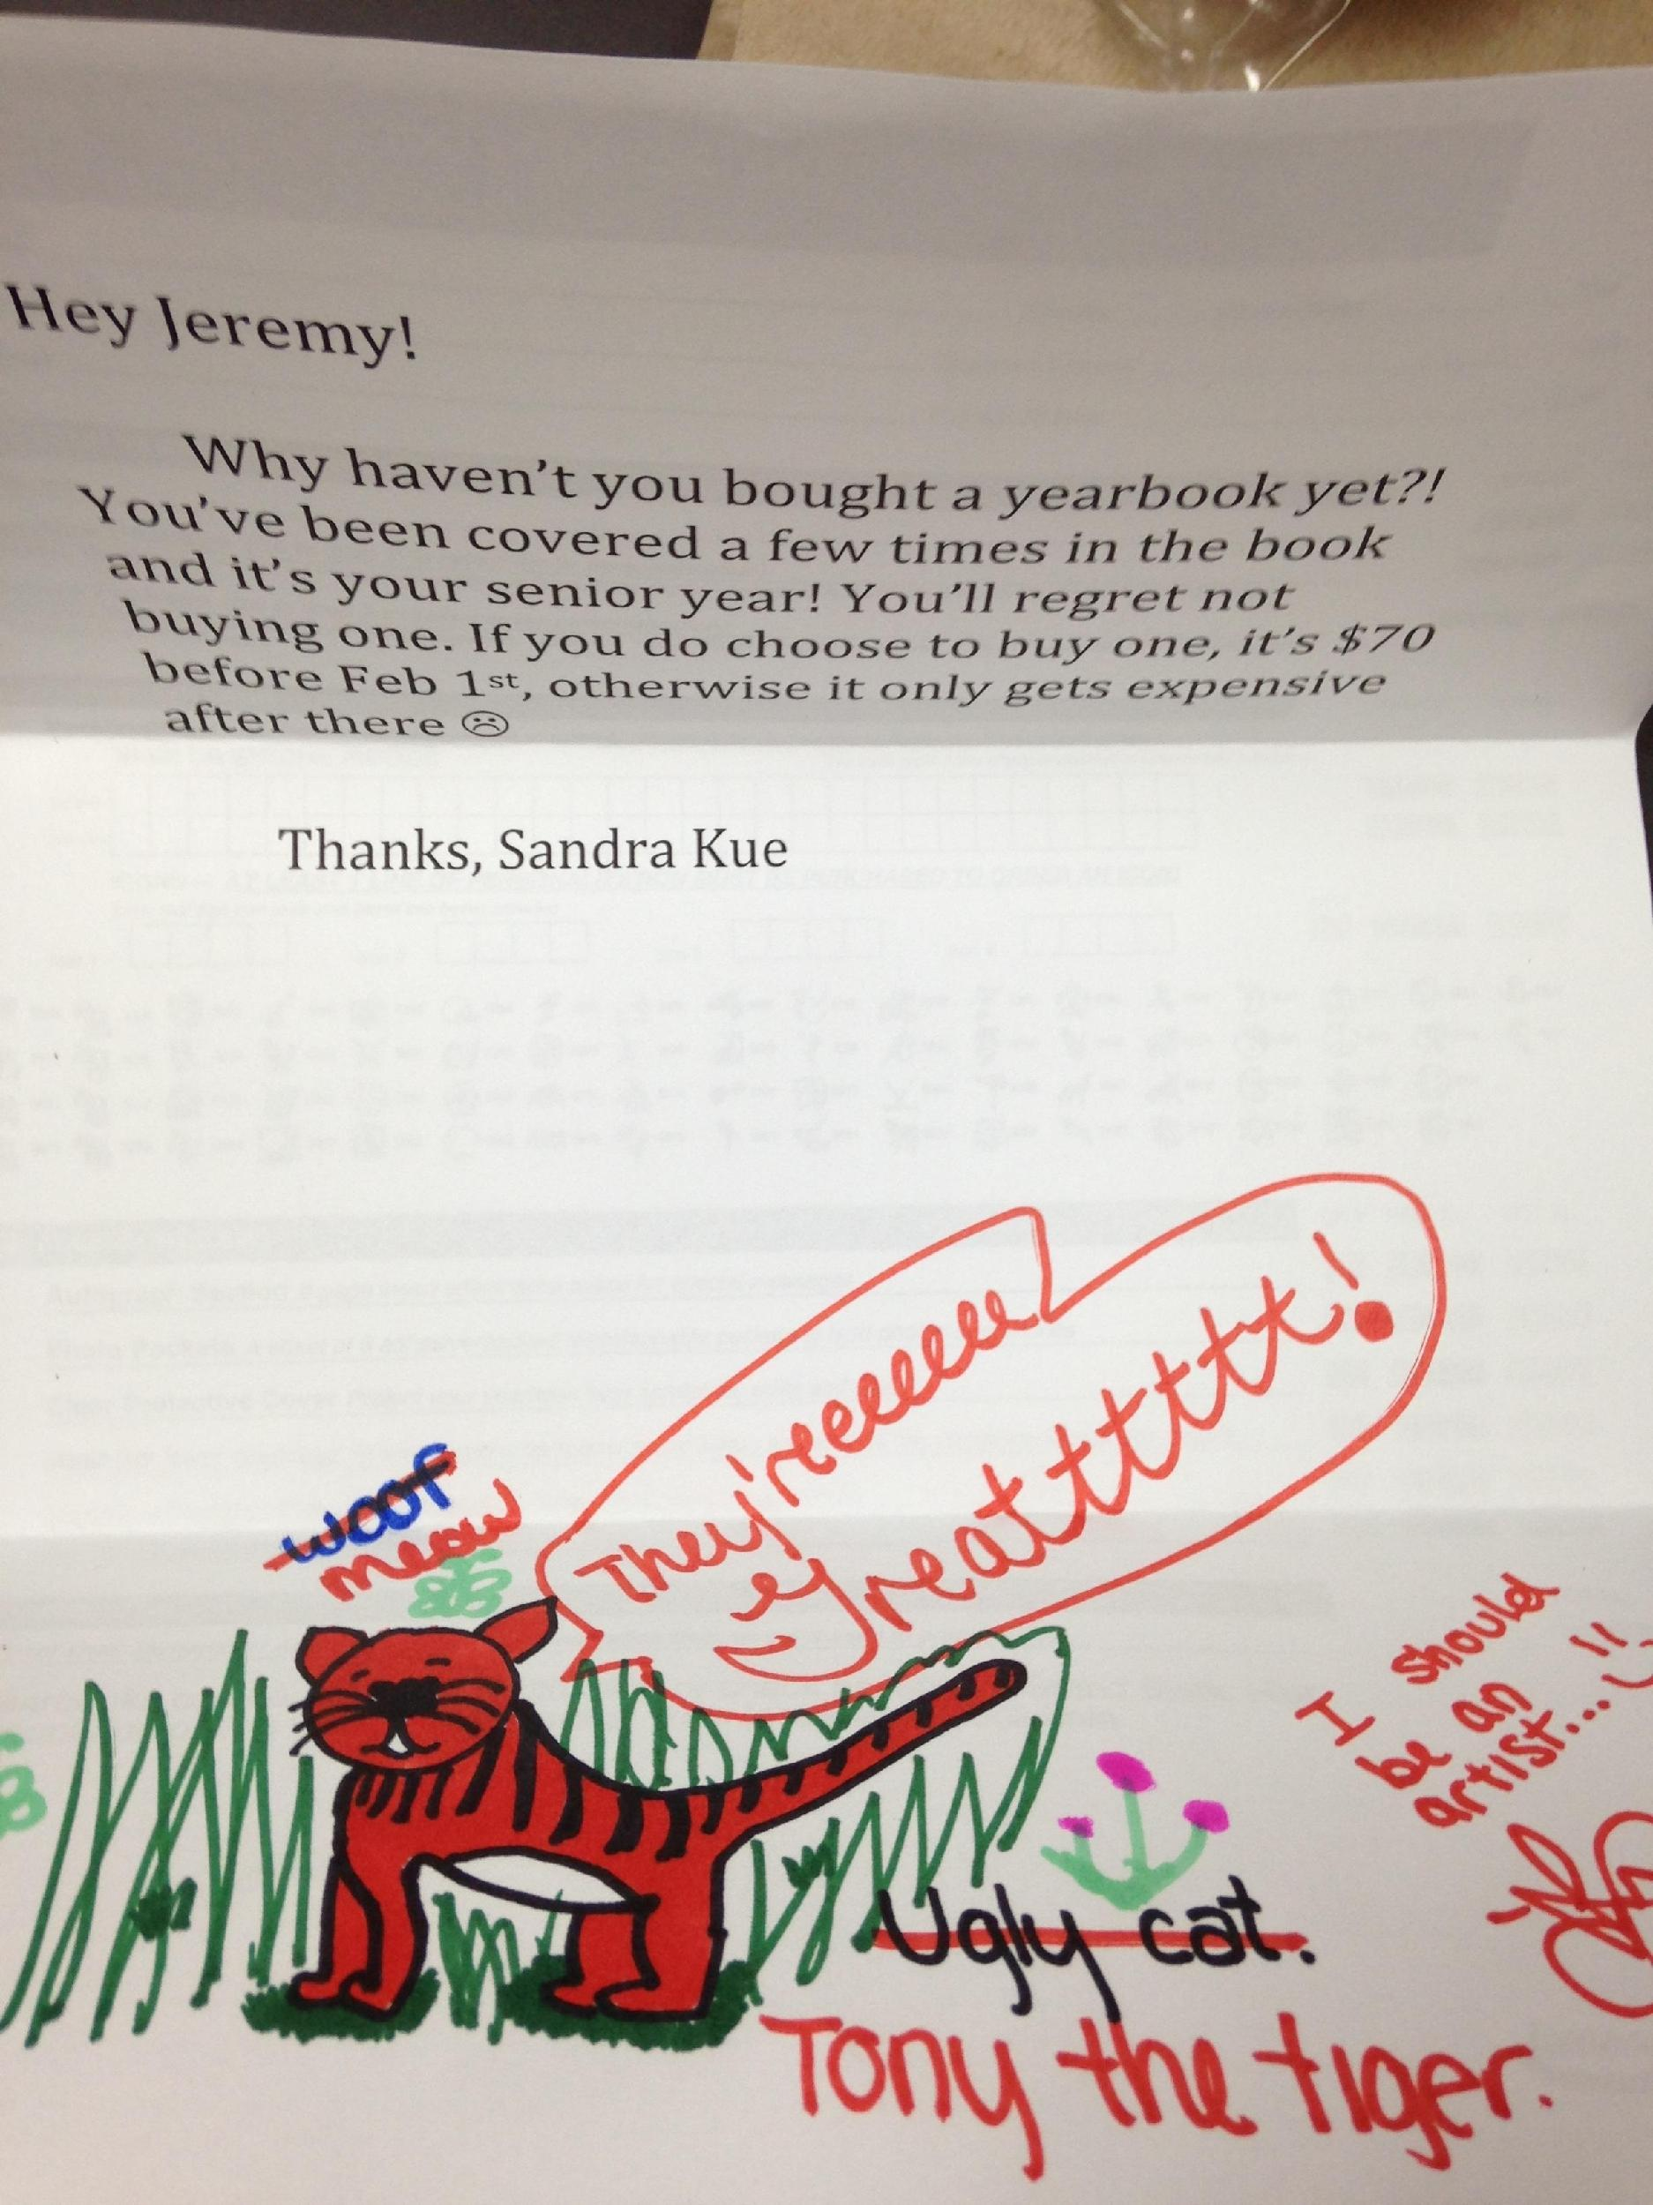
Use direct, personal marketing to individuals, making the sales process personal instead of business

Slide 12
Take screen shots of modules in the yearbook or post photos used in a story on social media to show students how they are featured
Notes:
Staff members shared modules and tagged students to increase interest.

Slide 13
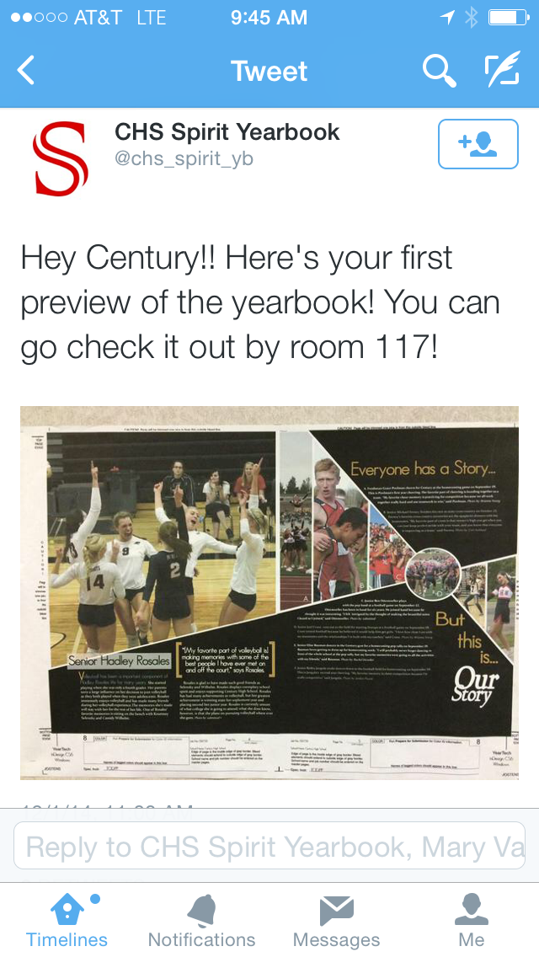
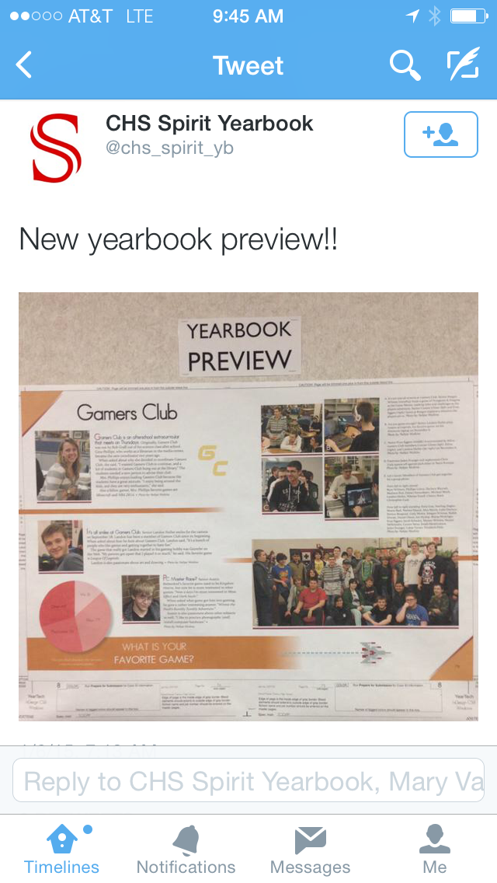
Take screen shots of modules in the yearbook or post photos used in a story on social media to show students how they are featured

Slide 14
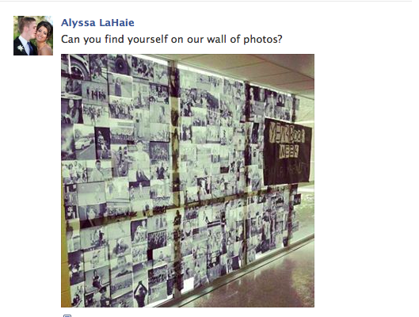
Print off photos used in the yearbook and make a giant wall; encourage members of your publications staff to be involved in marketing from their own social media accounts
Notes:
the staff didn’t solely rely on marketing materials from their kit. they printed out photos that were being used in the book and created this wall of content by using the windows. notice that they include their theme phrase ‘are you wired’ on the promotional materials

Slide 15
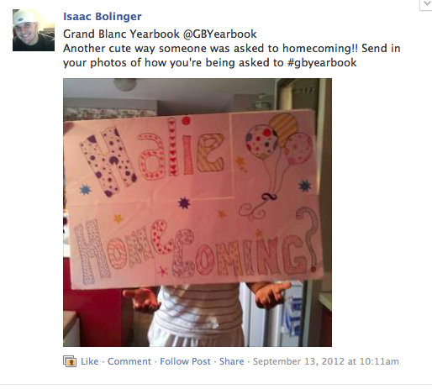
Ask students to submit their own content to the publication

Slide 16
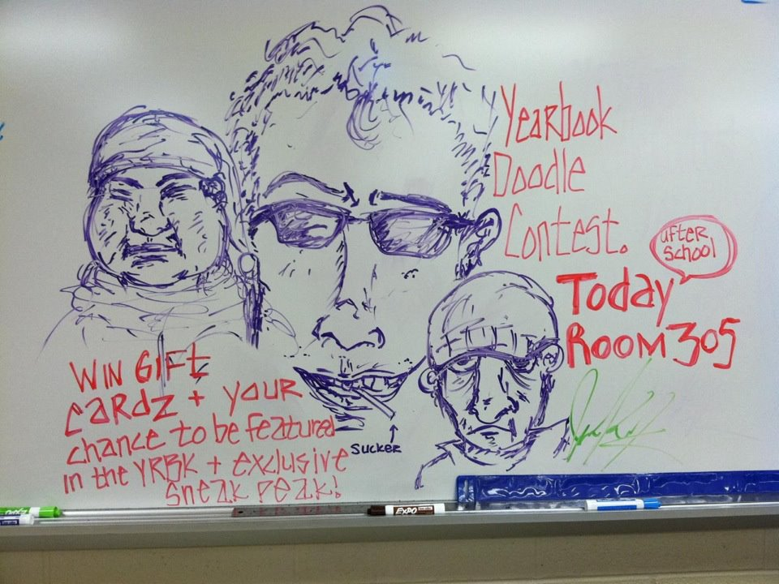
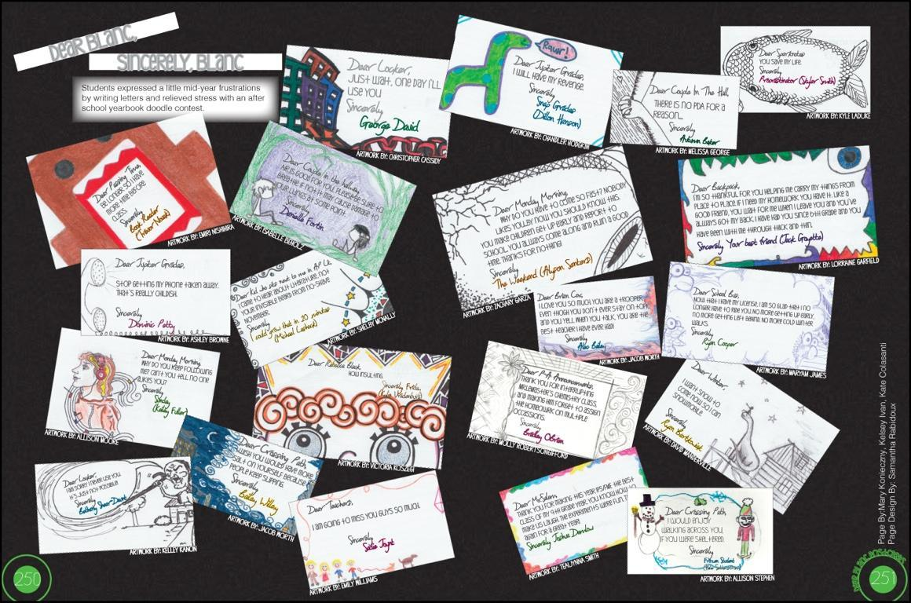
Create a contest that can serve as both a way to engage your audience and a way to gather content for your publication (featured: a spread in the yearbook made up of the students’ doodles)
Notes:
The staff created a fun contest that was included as a content spread in the book

Slide 17
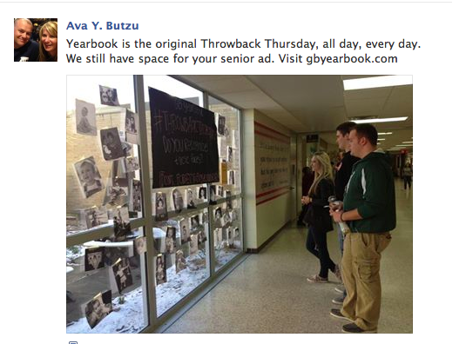
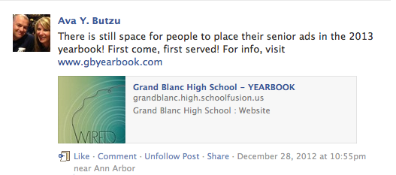
Use current trends in social media (Throwback Thursday, selfies, “Keep calm and …”, “I don’t always … but when I do I …”) to market the publication, as well as increase ad sales

