Slide 1
“We’re Really Diverse!”
adwhitten@fcps.edu
Anthony Whitten, CJE Westfield HS
The Guardian Yearbook The Watchdog Newspaper

Slide 2
Why Are You on Yearbook?
Your personal reason may be different from what your purpose is
Purpose: Tell the accurate story of the year, represent all types of people, not just our friends

Slide 3
Coverage
We’ve developed a number of ways to demonstrate diversity of our schools in our publications

Slide 4
Club Pictures
“Decahmian” Del Campo HS Carmichael, Calif.
Notes:
Our organizations sections should give some coverage to every group at your school. In this book you see diversity in the clubs that get a picture.

Slide 5
Personal Profiles
“Decahmian” Del Campo HS Carmichael, Calif.
Notes:
We have covered students with special profiles, this profile highlights a student’s family trip to India.

Slide 6
Personal Profiles
“Wingspan” Enochs HS Modesto, Calif.
Notes:
We cover religious differences.

Slide 7
Personal Profiles
“Titanium” Antelope HS Antelope, Calif.

Slide 8
Cultural Coverage (Individuals)
“Summitt” Smoky Hill HS Aurora, Colo.
Notes:
Quinceañera coverage for birthdays

Slide 9
Cultural Coverage (Individuals)
“Wingspan” Enochs HS Modesto, Calif.
Notes:
Exchange students coverage

Slide 10
Cultural Coverage (Events)
“Titanium” Antelope HS Antelope, Calif.
Notes:
Spread about “Challenge Day”

Slide 11
Diversity in Polls
“The Watchdog” Westfield HS Chantilly, Va.
Notes:
At my school it’s a standing rule that all polls must reflect the student population. The poll on the right is especially significant because we covered a student who came out as a lesbian in Seventeen magazine. I was super proud that my kids kept with our poll rule and found 6 other out gay and lesbian student willing to speak on the topic.

Slide 12
Missed Opportunity
“The Clan” McLean HS McLean, Va.
Notes:
When you cover holidays are you only covering Christmas?

Slide 13
Missed Opportunity
“The Clan” McLean HS McLean, Va.
Notes:
Are you covering more than one cultural traditions?

Slide 14
Diversity Matters
Great, you're really diverse, and you show the different people in your school
You’ve created a spot for everyone

Slide 15
Here’s the Concern
Our coverage stops there
There’s more to including diversity in your publications
We’re looking to tell stories that show universal, relatable truths about what it means to be human
Instead of creating a separate part for Diversity, we want to integrate the coverage into the whole

Slide 16
It’s All About Integration
“Titanium” Antelope HS Antelope, Calif.
Notes:
The girl on the wrestling team story gets told on the wrestling spread as the dominate story.

Slide 17
It’s All About Integration
“Summitt” Smoky Hill HS Aurora, Colo.
Notes:
Halloween which focuses on a student’s Halloween as a parent.

Slide 18
Next Steps
For better coverage
Notes:
The following strategies can help you cover stories year to year but tell them in a different way.

Slide 19
Step 1 Study the Statistics
Investigate the numbers
What are the demographics at your school?
How have they changed in recent years?

Slide 20
Investigate the numbers
Westfield High School Chantilly, Va.
 | 2000 - 2001 | 2005 - 2006 | 2011 - 2012 | 2013-2014
Population | 1603 | 3212 | 2805 | 2750
Gender | 50.8% male 49.2% female | 50.4% male 49.6% female | 52.7% male 47.3% female | 52.6% male 47.4% female
Race | 70% White 12.5% Asian 9% Black 7% Hispanic 1.7% Multi-racial | 63% White 16% Asian 9% Hispanic 8% Black 3% Multi-racial | 49% White 20% Asian 16% Hispanic 10% Black 4.5% Multi-racial | 44.8% White 21.1% Asian 18% Hispanic 11.6% Black 4.2% Multi-racial
Wealth |  | 9.37% Free/Reduced lunch | 21% Free/Reduced lunch | 22% Free/Reduced lunch
Notes:
These are the demographic trends of my high school since its founding in 2000. It’s important to understand that our school has changed dramatically in the last 14 years. A school that started 70% white and less than 1% free and reduced lunch is currently less than 50% white and has a free and reduced lunch population of 22%. This has a HUGE impact on our coverage choices, our sales and our marketing techniques.

Slide 21
What Do We Learn
Numbers give us:
Trends
wealth
(impact on sales?)
ethnic diversity
gender
special education
Where to go for data
School or county websites
State website
Notes:
All of your demographic information is public information.

Slide 22
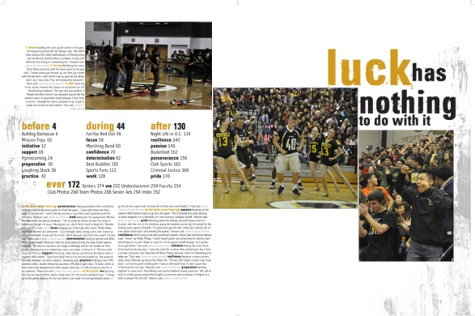
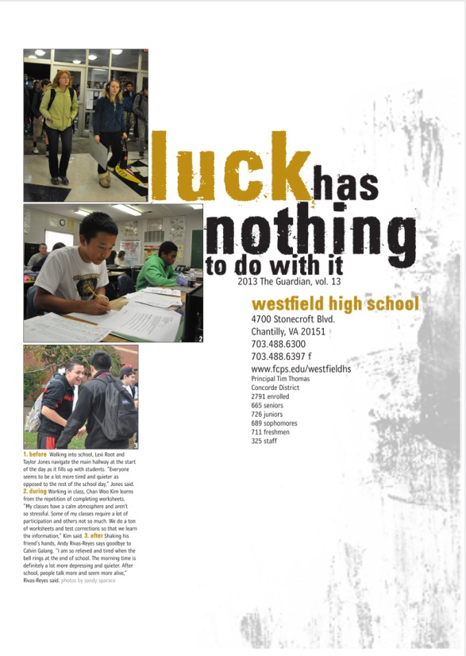
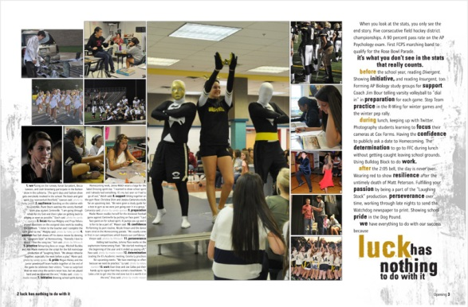
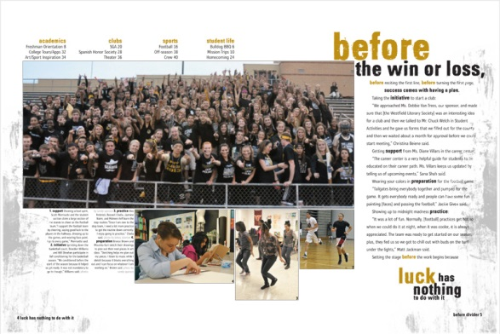
What Does That Look Like For Us
Notes:
Because of the demographics at our school, diversity plays a big part in all of our coverage. For our 2013 yearbook, you can see that diversity in the cover through all of the theme pages.

Slide 23
There’s More to the Story
Numbers do not give us:
Religion
Sexual orientation
Family dynamics
Educational experience
Notes:
It’s hard getting everything right at once. We struggle with covering students who are not a part of the AP or Honors experience. We also have just started telling the stories of kids from split and blended homes.

Slide 24
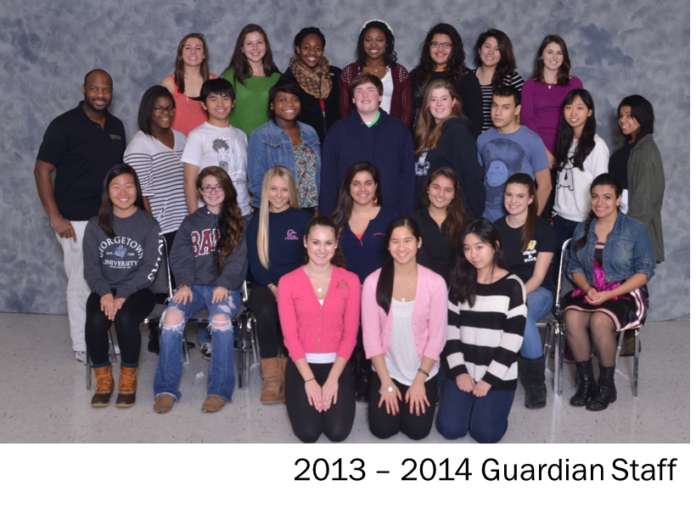
Step 2 Reflect on your staff
Does your staff look like your school?
Yes: Great!
No: WORK HARDER!
It’s about creating a balance. Creating a circle of people with different experiences and backgrounds.
Notes:
Over the last five years, I’ve worked really hard at making my yearbook staff more diverse. I’ve taught kids who have lived in the trailer park community and those who have lived without health insurance. Having those students on staff has definitely changed the way we’ve thought about issues or spreads.

Slide 25
Step 3 Have Honest Conversations
What does that mean?
1St Being explicit with your staff with areas of weakness.
2nd Being honest with those individuals or groups you’ve not done a great job at covering.
When at first you don’t succeed
Try, Try, Try again
Sometimes groups you’ve not covered aren’t trusting. It’s important to not give up, but reaffirm and show respect/trust.

Slide 26
Find the People
Engage in social media
Twitter
FB
Crowd source
Survey (Google Docs)
You’re always on. Look for the story. Ask yourself, “What’s the story here?”
Notes:
One of the big rules on my staff is that “Anything can be a story.” Any time I am sitting a teacher workroom I am always keeping my ears open for a potential story idea. A couple of weeks ago, I listened as a teacher complained that a student was always late to class and failing because the student didn’t have a first or second period class. Turns out that student was a competitive figure skater and took two online classes so that she could practice in the mornings. We happened to be searching for personal profile stories and that information happened to fill a need.

Slide 27
Find the People
Talk to the adults
Seek out English teachers, counselors
They usually know students with compelling stories that should be told

Slide 28
Find the People
Observe
Look around the cafeteria
You can see how people group themselves
Notes:
What are the patterns? What do your observations tell you about your readers and community?

Slide 29
Engage the People
Be brave
Show up
Have conversations with people you don’t know
Cafeteria
Library
Kiss ‘N Ride
Saturday School
School Events
Club Meetings
Listen
Ask questions
Notes:
No “butt journalism” Talking to people is one of the most important parts of what we do.

Slide 30
Engage the People
Invite
Bring representatives of the different groups of your school community into your publication lab
Feed them lunch, snacks
Interview them, have a real conversation

Slide 31
Engage the People
Use writing prompts to engage your school and allow students to submit their own stories
After you have read them, invite people to tell you more
Notes:
In 2012 we did a Twitter inspired theme concept in our yearbook. We worked through English classes with a writing prompt. This helped us get content for the cover but also helped us identify other areas of coverage in the book.

Slide 32
Example
“The Pilot” Redondo Union HS Redondo Beach, Calif.
Notes:
When you engage people you can find the links. Here’s a story about two kids who both lost a parent.

Slide 33
Example
“The Watchdog” Westfield HS Chantilly, Va.
Notes:
The doubletruck topic was all about body image. This story originated because my newspaper editors made note of a student’s posts on Instagram. She had undergone a breast reduction for health reasons and began taking a daily picture of herself. The smaller mod on the bottom is about a student who lost 80 pounds doing MMA and changed his life.

Slide 34
Example
“Summitt” Smoky Hill HS Aurora, Colo.

Slide 35
Example
“The Watchdog” Westfield HS Chantilly, Va.
Notes:
Here’s a doubletruck we did on a transgendered student and bullying. This was a topic that was specifically linked to this student because members of the student body were particularly harsh, especially on the Internet. This is an example of how our coverage really had an impact at our school. After this story the bullying virtually stopped overnight, students became advocates both in person and online.

Slide 36
Example
“Aquila” Freedom HS South Riding, Va.
Notes:
Story about grass-roots student organizer and others who took inspiration from the work.

Slide 37
Example
“The Pilot” Redondo Union HS Redondo Beach, Calif.
Notes:
Story gained from student activism in International politics.

Slide 38
Step 4 Hold Yourself Accountable
Be critical of your own work
Golden Rule: You want to be in the yearbook, right? You want your friends to be in the book, too, right? Is this how you want to be portrayed?

Slide 39
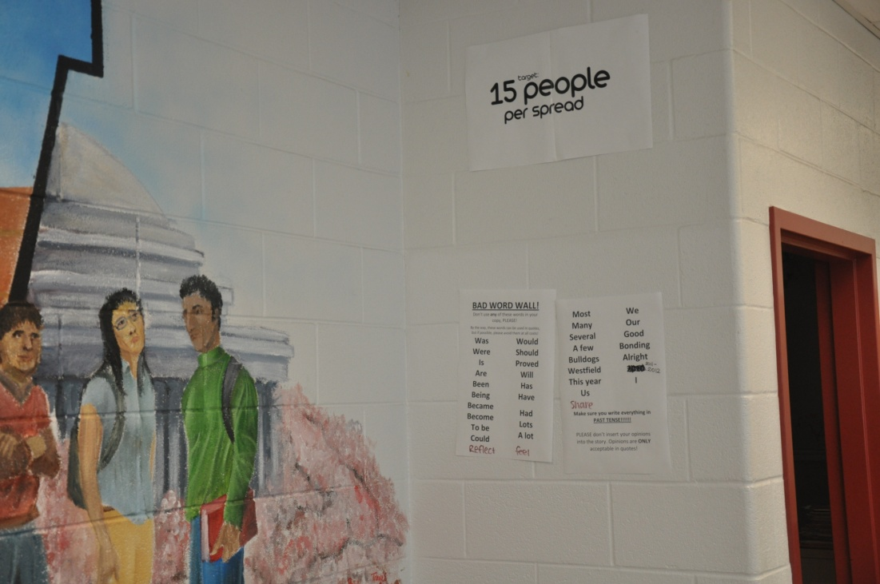
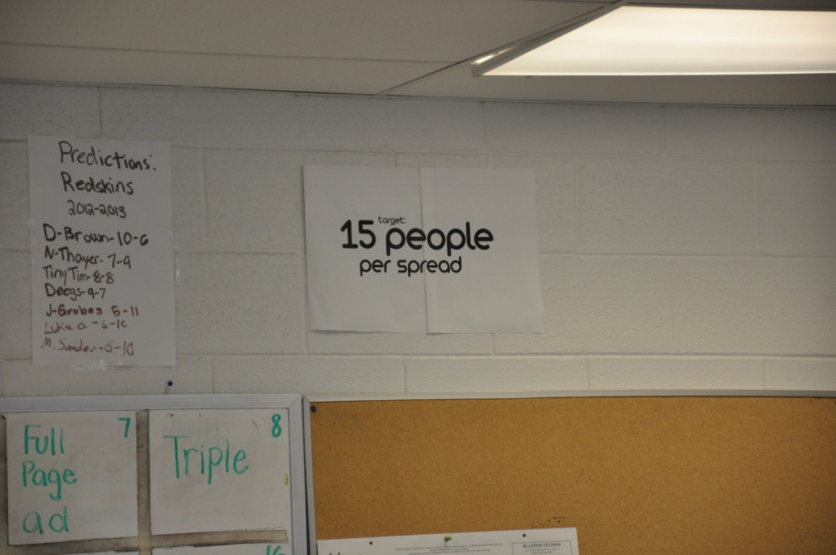
Accountability
Do the math
Set a goal for coverage
Numbers of pages minus baby ads divided by the number of students at your school

Slide 40
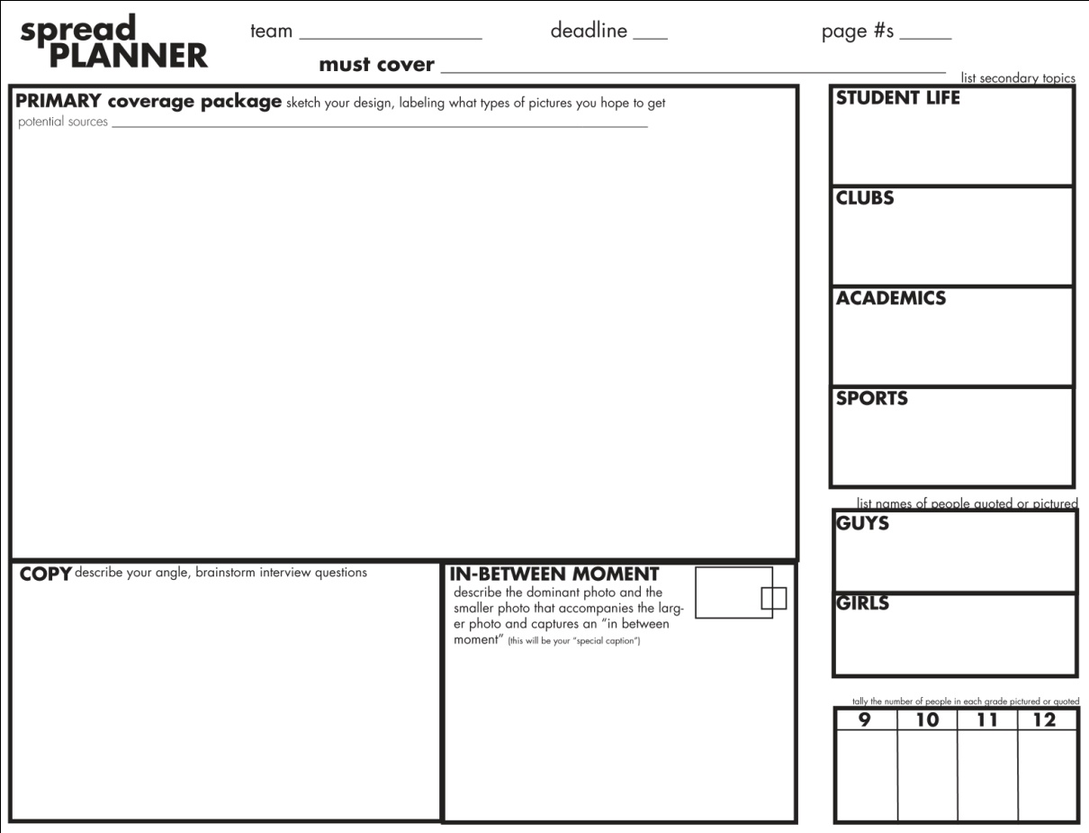
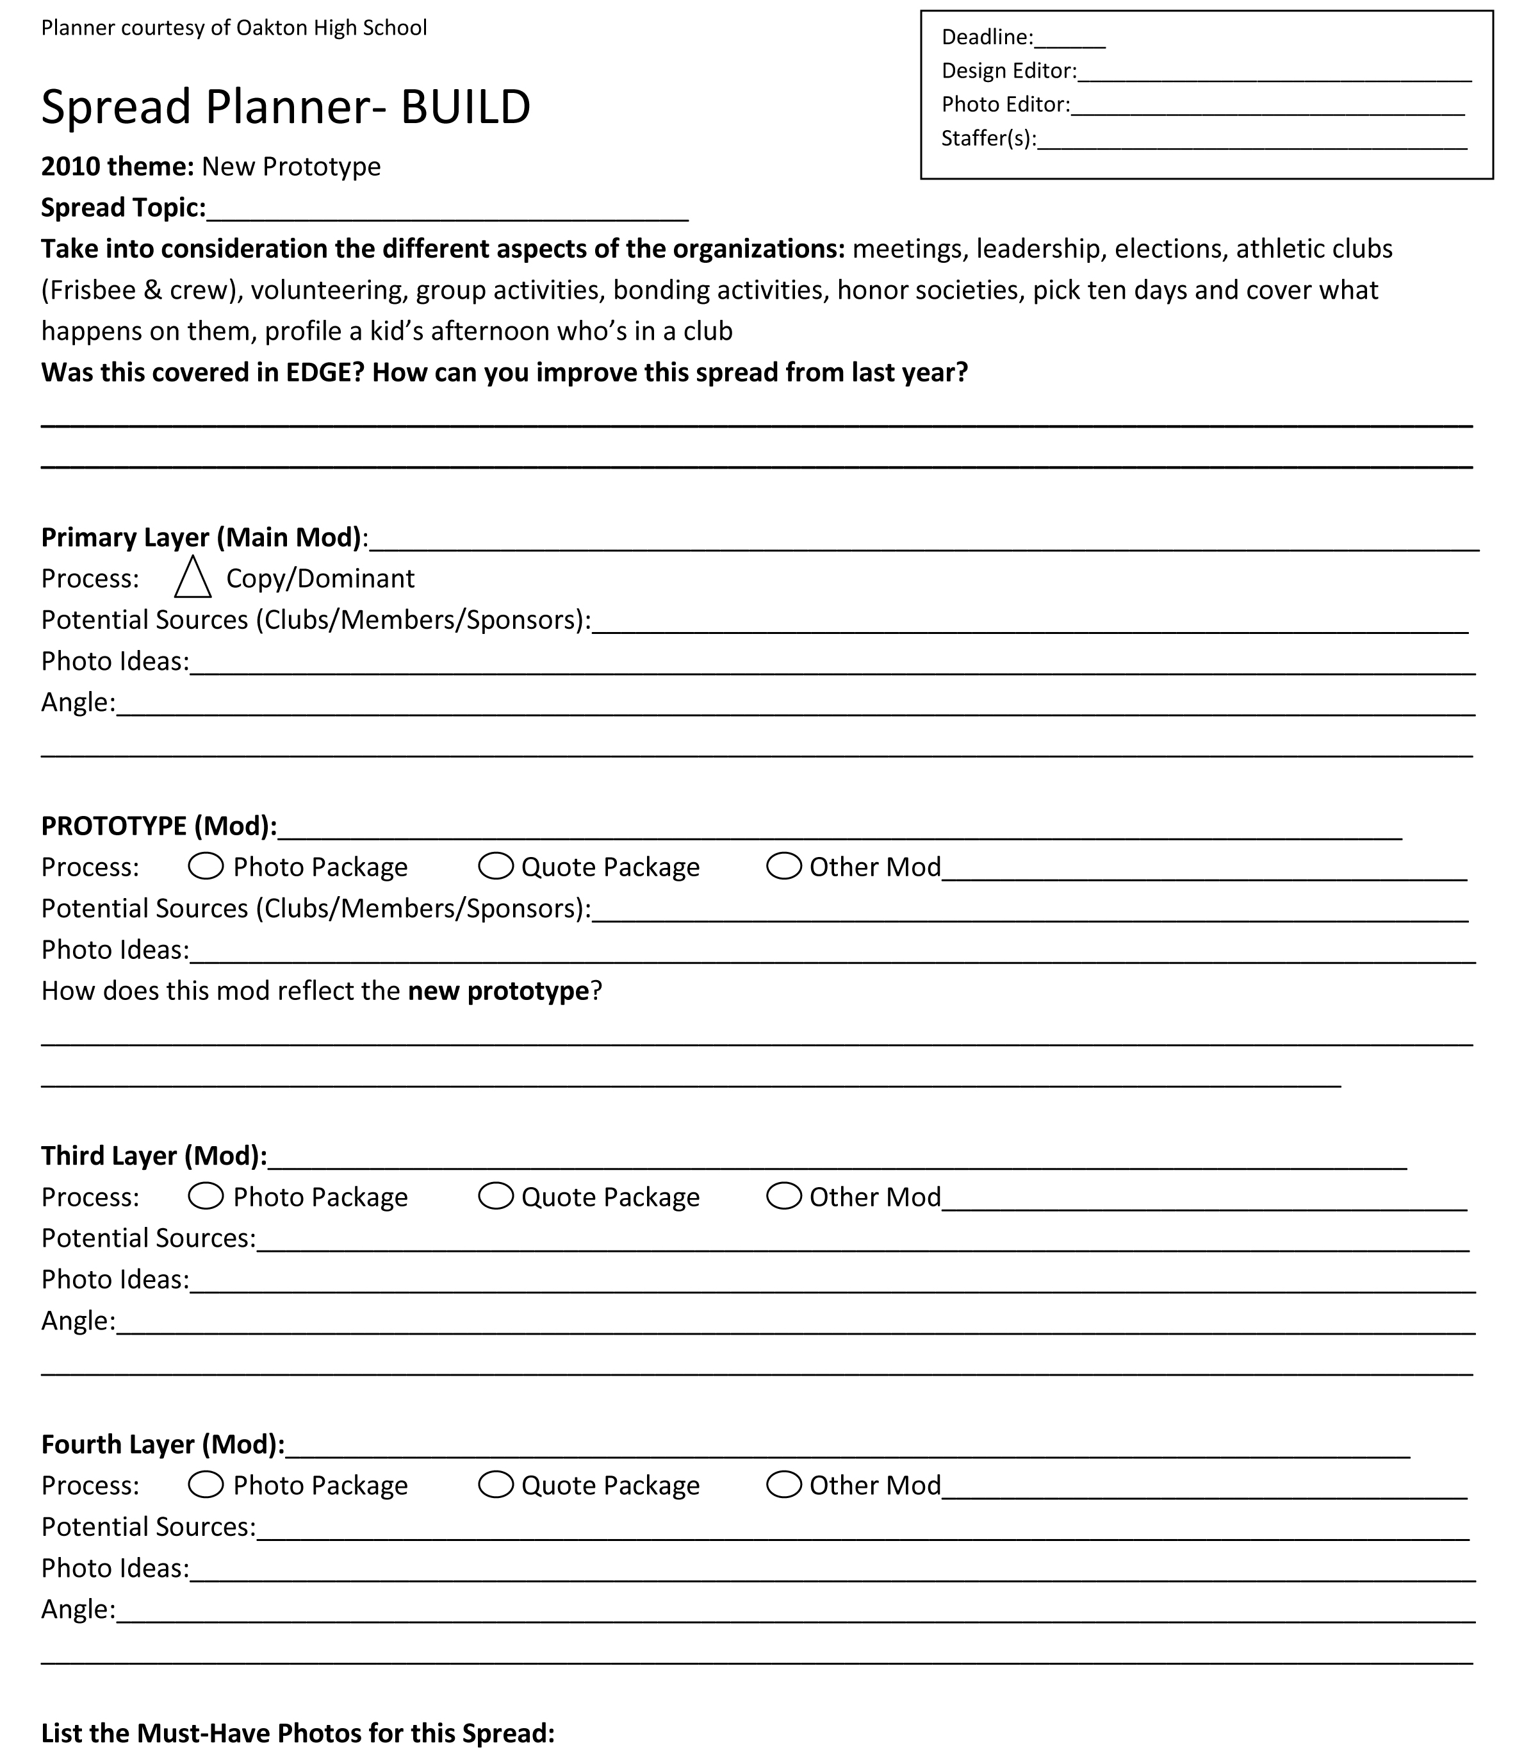
Accountability
Use a spread planner to plan and to think ahead
Templates located at www.novayearbooks.com
Notes:
My yearbook rep has a number of these resources online on her website www.novayearbooks.com

Slide 41
Accountability
Look for new and interesting stories
Notes:
This is an example from McLean HS. This a whiteboard they keep in their lab for story ideas.

Slide 42
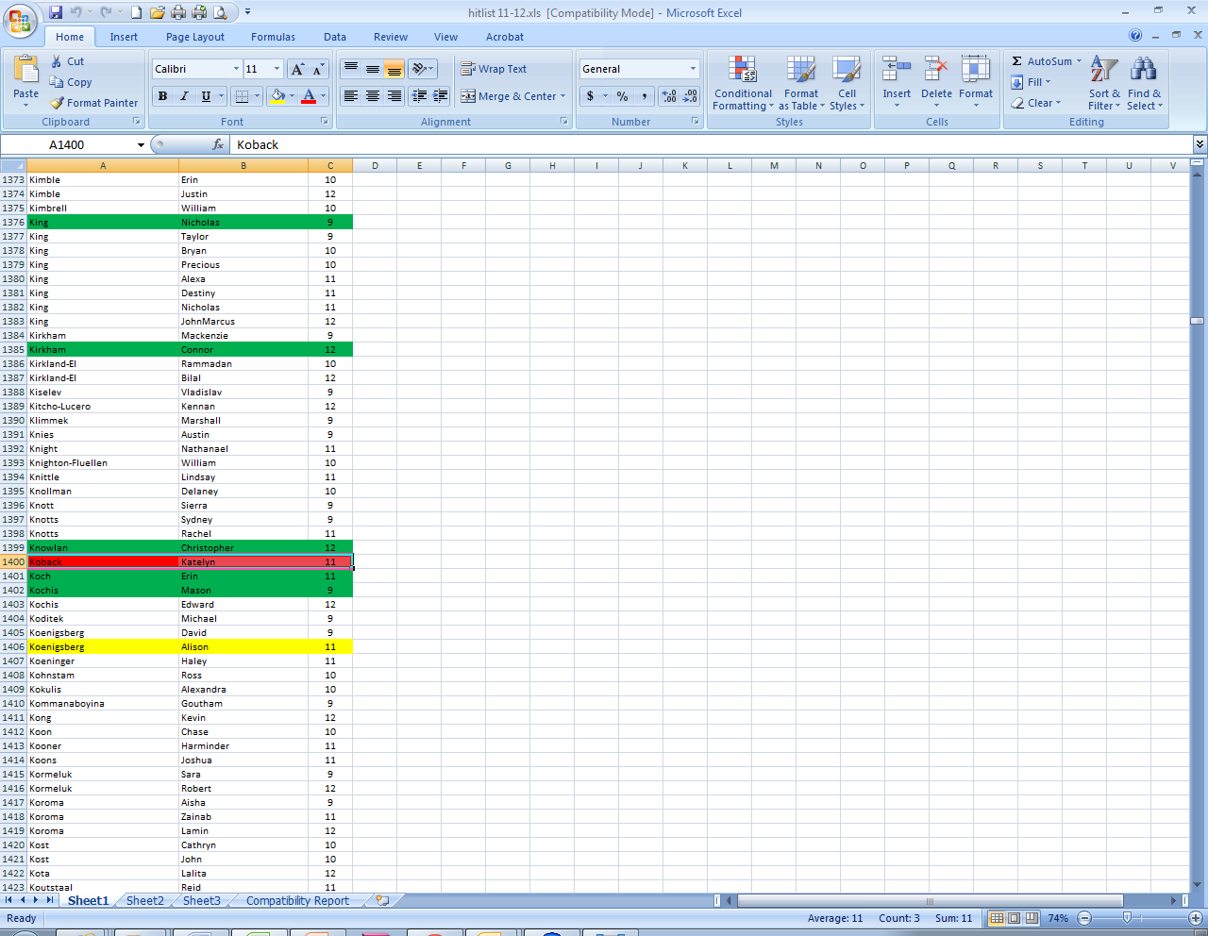
Accountability
Run your index to track your coverage after every deadline
Notes:
Green: 1 citation
Yellow: 2 citations
Red: 3 citations (person should not be used)
This is also something that can work for newspaper. You’d be surprised if you ran an index on your newspaper issues.

Slide 43
Accountability
Critique your work:
What is the alternative story?
Did I cover it?
Have I talked to someone who is different from me?

Slide 44
Alternative Stories
“Decahmian” Del Campo HS Carmichael, Calif.
Notes:
Story about openly gay kid who left school, but decided to come back and graduation with his class.

Slide 45
Alternative Stories
“Journey” Heritage HS Leesburg, Va.
Notes:
Student loses her mom and goes to live with her aunt and cousins.

Slide 46
Alternative Stories
“Titanium” Antelope HS Antelope, Calif.
Notes:
Car spread, but a story about a kid who builds his car from scratch.

Slide 47
Accountability
Revise your student life, people, academics and organizations coverage
Are you telling all of the possible stories?
Does your coverage reflect other people's experiences?

Slide 48
AVID in Club Pictures
“Decahmian” Del Campo HS Carmichael, Calif.
Notes:
When clubs are important to your school, we should see different pieces of coverage across your book. There are four AVID groups at this school.

Slide 49
AVID in People
“Decahmian” Del Campo HS Carmichael, Calif.
Notes:
So we see AVID in the people section.

Slide 50
AVID in Academics
“Decahmian” Del Campo HS Carmichael, Calif.
Notes:
And we see AVID in the academics section. Note that the coverage is all different.

Slide 51
I-Night
“Techniques” TJHSST Alexandria, Va.
Notes:
International Night is huge at TJ. The following spreads show how many times the topic appears in the book.

Slide 52
I-Night
“Techniques” TJHSST Alexandria, Va.

Slide 53
I-Night
“Techniques” TJHSST Alexandria, Va.

Slide 54
I-Night
“Techniques” TJHSST Alexandria, Va.

Slide 55
Final Thoughts
It’s our job to tell an accurate story of the year
When we make yearbooks where everyone looks the same or it has the same stories every year, we’re lying
Your Action Plan
Study the statistics
Reflect on your staff
Have honest conversations
Hold yourself accountable

Slide 56
“We’re Really Diverse!”
adwhitten@fcps.edu
Anthony Whitten, CJE Westfield HS
The Guardian Yearbook The Watchdog Newspaper

