Slide 1
Audio
Multimedia Broadcast

Slide 2
Understanding audio

Slide 3
Audio Terms
Analog Audio
Sound Waves that are recorded directly onto a medium such as a tape.
Digital Audio
Sound Waves are sampled and stored a computer or other device.
Channels
Audio is usually separated into separate channels. For Multimedia and Broadcast, usually audio is restricted to a left and right channel if the device is in Stereo. If the device is in mono, then you will only have one channel
Mono
Audio singles are mixed together to create one source
Stereo
Signals are separated into left and right channels

Slide 4
Audio Terms
Audio Pickup Patterns
Omnidirectional
Omni or all, sound is picked up from all directions
Unidirectional
Uni or one, sound comes from the one direction it is pointed at
Bidirectional
Bi or two, sound comes from two different or opposite directions
Cardioid
Or heart shaped, sound is very close to unidirectional with some pickup to the sides. Usually most hand-held microphones have this pattern

Slide 5
Pickup Pattern Practice
Create a sketch of what you think a pickup pattern would look like on a paper for each of the following microphones
Omnidirectional
Unidirectional
Bidirectional
Cardioid
Compare your sketch with a partner.

Slide 6
Audio Terms
Ambient Audio
The sound that exists in the room without creating any additional sounds.
Sound Effects
Artificial sounds that did not exist in the original recording
Music
Used to create dramatic moods or fill voids in sound

Slide 7
Microphone Types & Placement

Slide 8
Lavaliere Microphone
Typically used in situations that allow for the talent to sit down and be interviewed
These microphones can be both wired and wireless.
If they are wireless, they normally have to have programmed to specific frequencies
Wireless systems have a transmitter pack with a wired microphone and a receiver with 1 or 2 antennas

Slide 9
Lavaliere Microphone Placement
Place the corded part of the transmitter on the outside of your talent’s shirt by using a microphone clip
Try to avoid placing the clip so that is causes the microphone to rub against the talent’s shirt.
Also, ask your talent to run the corded portion under his/her shirt so it looks more professionally done

Slide 10
Boom Microphone
Also called a Shotgun Microphone
A directional microphone that typically is used in situations where your subject will be moving or if there are more subjects than you have microphones.

Slide 11
Boom Microphone Placement
On top of a small camera or a DSLR photography camera
Typically these use a ¼” jack.
Some will still use a XLR cord
Mount a shotgun microphone onto a boom pole that needs to be pointed at the person speaking.

Slide 12
Hand-Held Microphone
Sometimes called a stick or hand mic
Many have an off/on switch
Can be wired or wireless
If wireless, the microphone will be attached to a transmitter that sends a signal to a receiver attached to your camera

Slide 13
Hand-Held Microphone Placement
The best way to measure where you place a hand-held microphone is to use your fist.
Place your fist against the bottom of your chin, then place the microphone against the bottom of your fist.
Try to estimate the same distance if you are interviewing someone while using it
Don’t forget to point it at their mouth when they are talking

Slide 14
Audio accessories

Slide 15
Common Audio Accessories
XLR Cables
RCA Cables
1/4” cable
1/4” to XLR Adapter
Sound Mixer

Slide 16
Microphone Practice
In small groups, do a field test for each of the microphones that you have in your class.
Try testing each of the microphones in different settings
Inside a small room with and without other people
Inside a large room with and without other people
Outside near people and away from people

Slide 17
Audio Software

Slide 18
What to look for
There are a variety of audio editing software packages available for free and for a cost.
When choosing, consider these features:
The ability to record audio through a port on your computer
The ability to trim the beginning, middle and end of your recording
The ability to change the volume of tracks
The ability to mix multiple sources into a master track
The ability to apply filters or effects to alter original tracks
The ability to save the finished edit in various formats

Slide 19
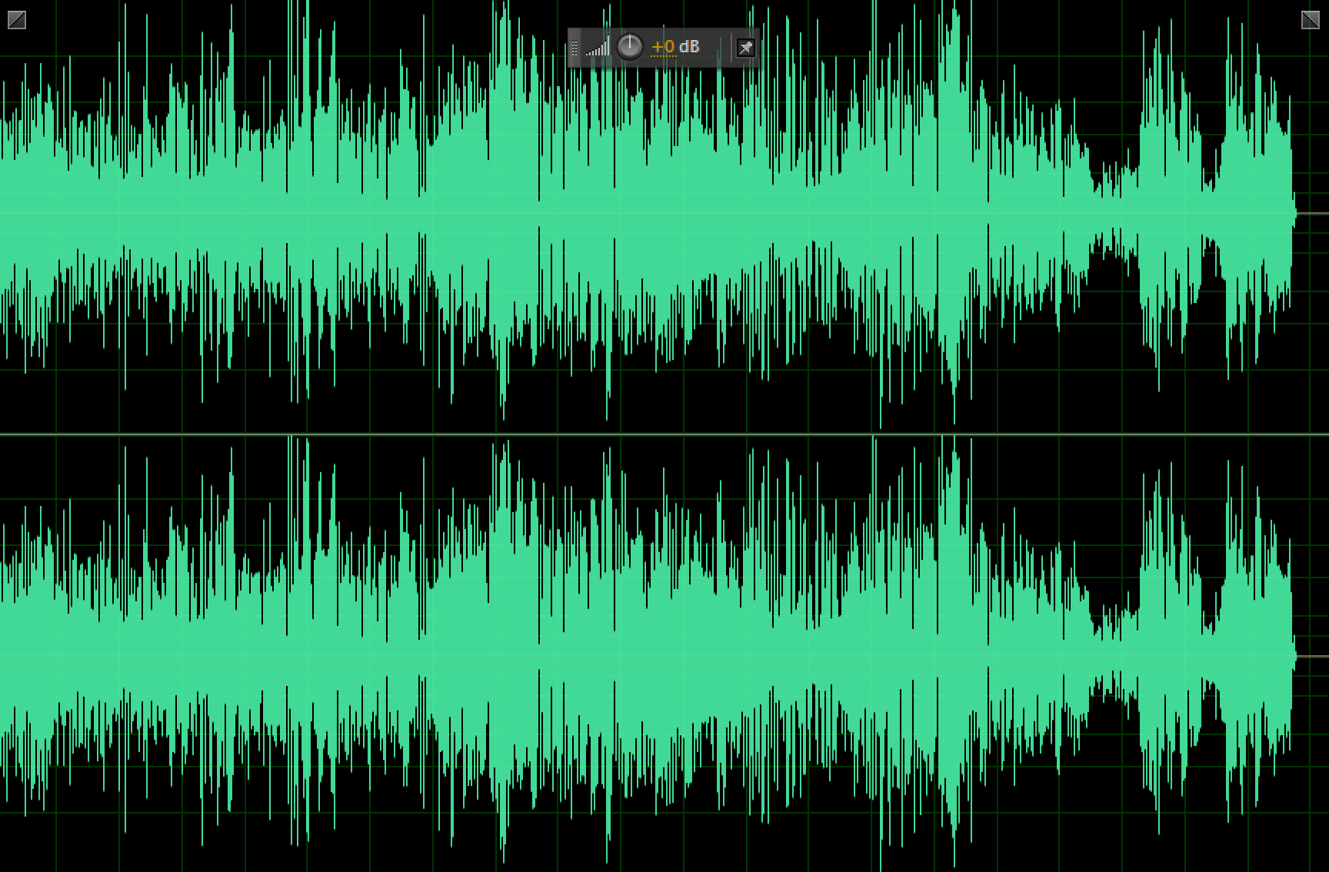
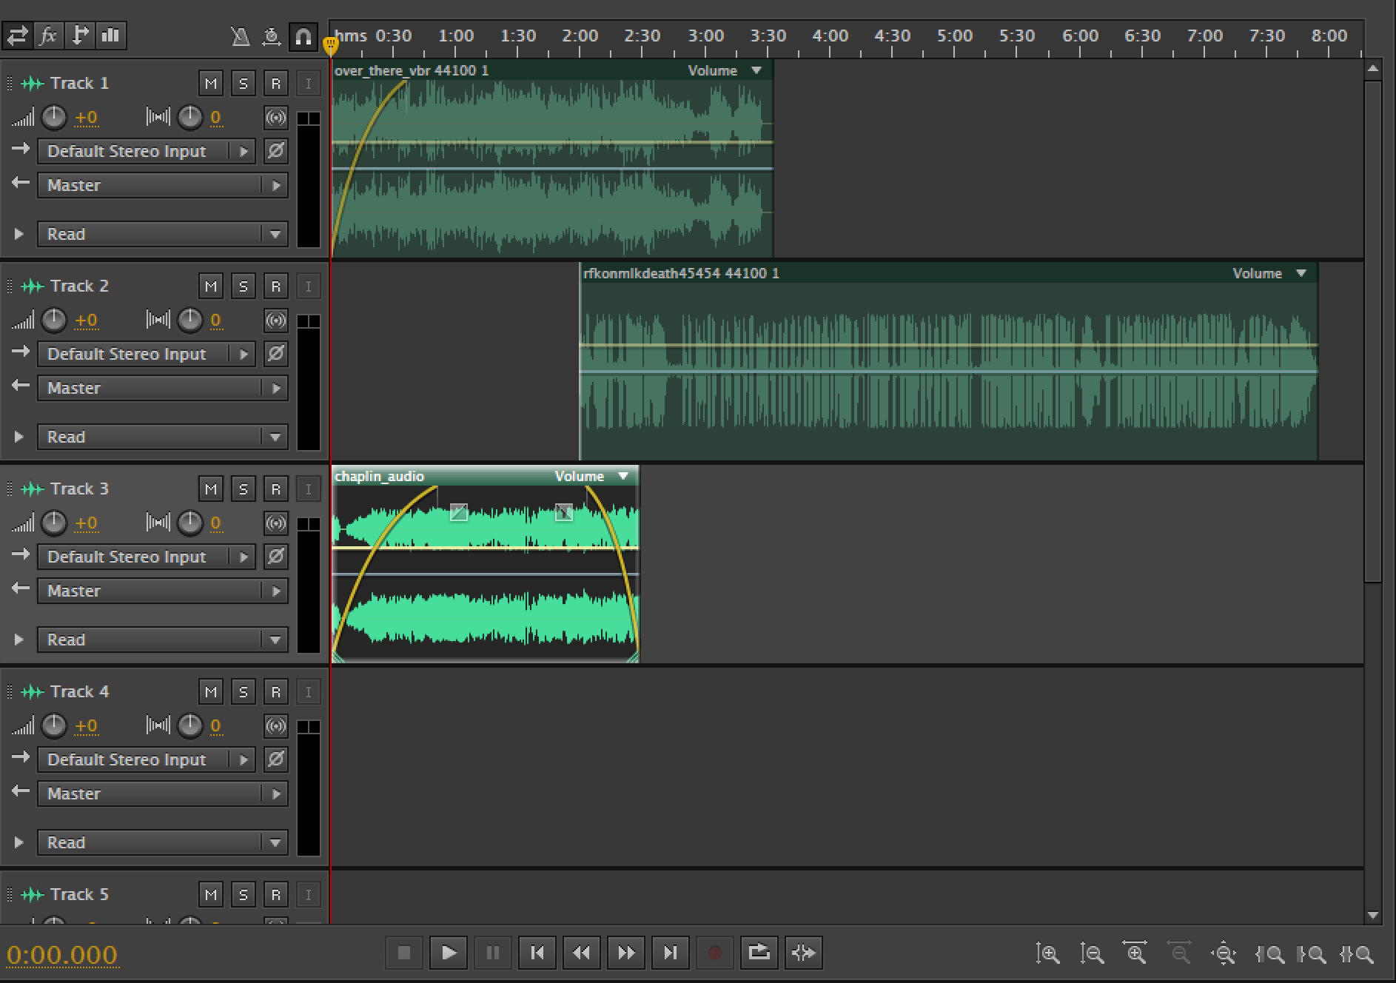
Audio Editor
Single-Track of Audio
Multi-Track Editing

Slide 20
Audio in Journalism Projects
Conduct an audio interview
Create an audio feature completely of others words
Create an audio talk show or podcast
Create an complete audio story

Slide 21
Advanced Audio
Moving beyond basic knowledge

Slide 22
Advanced Audio
How do we hear sounds and why do they sound different?
Frequency
Amplitude

Slide 23
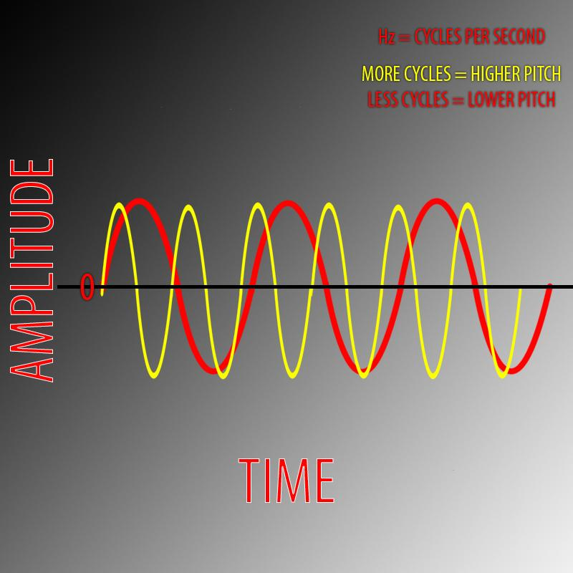
Advanced Audio
Frequency
Sound travels through air
It changes from changes in air pressure
It travels as sound waves
When sound waves hit your ear drum, they become sound

Slide 24
Advanced Audio
Amplitude
Easiest to think of as the loudness of the sound
The higher it is, the more air it pushes around
Measured in decibels

Slide 25
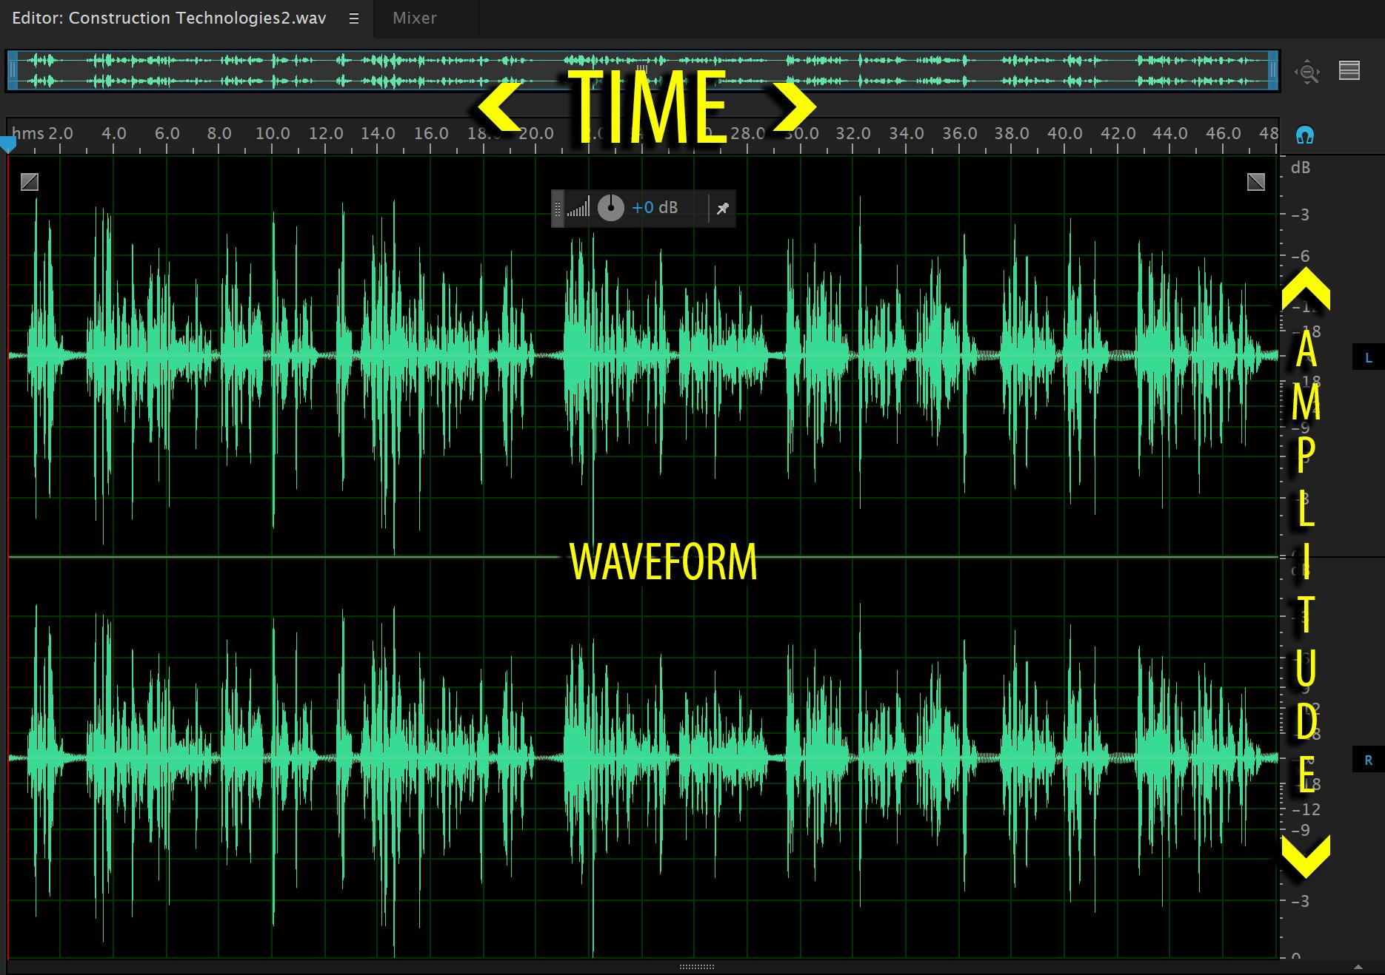
Advanced Audio
Frequency & Amplitude
You now have your pitch and loudness

Slide 26
Advanced Audio
Human Hearing
Low 20Hz
High 20kHz
Advanced Audio Hands On
Using your audio editor, record a simple voice over and experiment with raising or lowering the volume at different levels of amplitude or db (decibels)
Watch the Audio Hands on Example for short tips

Slide 27
