Slide 1
Big Data
on the Web
News Gathering

Slide 2
What is big data?
“Big data” refers to large, often public data sets that contain massive amounts of information.
Big data sets are often raw data, meaning the individual data points have not been summarized into an overview of that data.

Slide 3
Why use big data?
These data sets can be used to shed light on an issue, show government accountability or identify a trend.

Slide 4
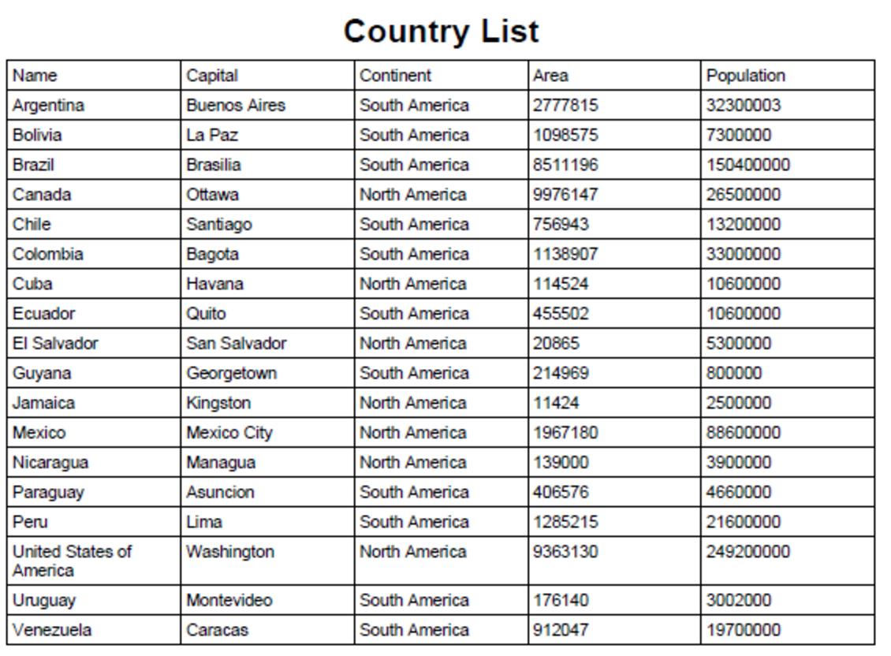
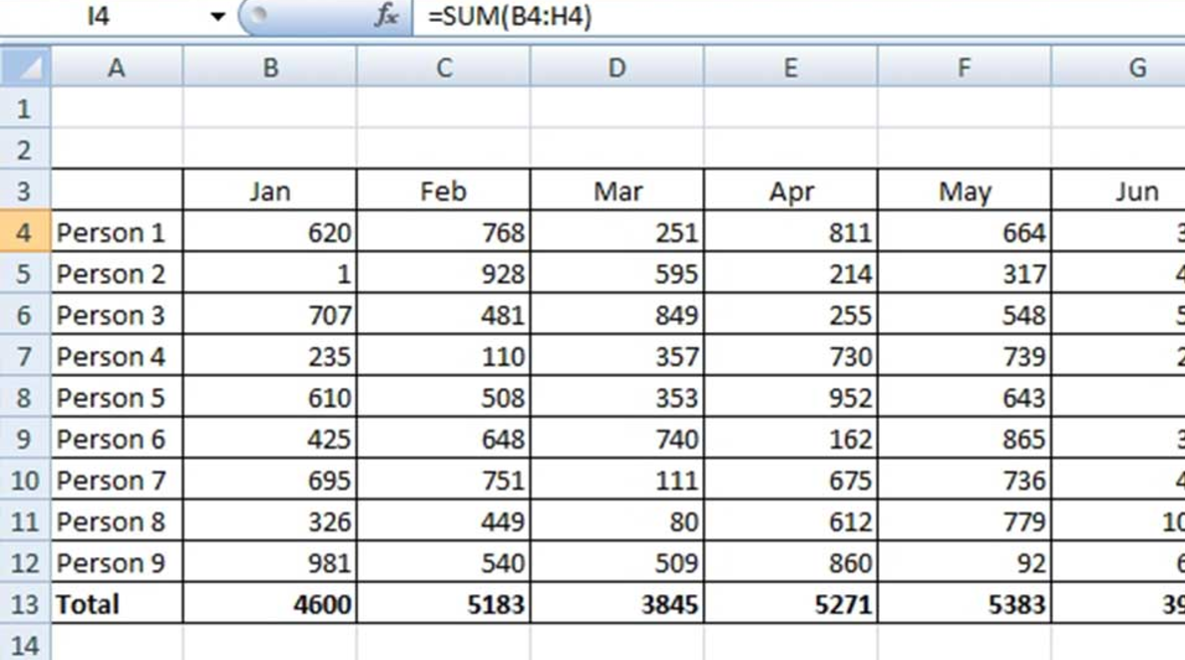
What does big data look like?
Typically, these data sets come in formats like Excel spreadsheets. Sometimes, however, they are buried in pdfs.
Notes:
The example on the left is what data in a spreadsheet might look like. On the right, this is data that we might see in the form of a Word document table or PDF table.

Slide 5
What kinds of data exist?
Property records
Census records
Animal control records
Test scores
Arrest records
Auto accident records
Budgets
Criminal/court records
… and more!

Slide 6
Methods of accessing data
Request database (using an open records request or FOIA if necessary)
Download spreadsheets directly from websites
“Scrape” data from the web or from a PDF file by using a web tool to help you

Slide 7
Tips for finding big data on the web
Use advanced Google searches
“filetype:csv” or “filetype:xls” will look for only spreadsheets
“domain like .edu or .gov” will look for public sites that are governmental or educational

Slide 8
You try
Search Google with this command:
high school graduation rate Colorado filetype:xls
(or try searching with your home state)
What files do you find? Are they spreadsheets? How much information do they provide?

Slide 9
Brainstorm an idea
Now that you’ve found an example of big data, let’s get more specific.
What else could we search for using Google to help us find information about our state?
Notes:
Teacher note: college funding, school funding, prison populations, tax data are great places to start here. Think statewide, and don’t worry yet about whether these topics would translate directly into story ideas for student media.

Slide 10
Learn more about what records are public
Sometimes, finding big data is easier when we know what type of information the state actually collects.
Let’s browse our state open government guide to see what kind of data we could look for.
Notes:
Teacher note: the link will allow you to choose your state. Spend a few minutes clicking through the different types of records to see what data is collected. Usually the section titled “Records categories — open or closed” is a great starting point.

Slide 11
You try
Using the “Open Records Resources” sheet, explore this open government guide and start to look for places that “big data” might exist.
Notes:
Teacher note: Distribute a hard copy of the “Open Resources Worksheet” or provide a digital copy for students to type answers directly into. This exercise will take about 20-30 minutes to complete.

Slide 12
When data isn’t in a table
Sometimes, data doesn’t come in a nice spreadsheet.
AFL-CIO legislative scorecard
How would we get this data out of the pdf?
Notes:
Teacher note: Click on the link to open the scorecard, and explain that this is one advocacy group’s way to track how politicians in Colorado vote for or against their group’s positions. Scroll down to the table on Page 3.

Slide 13
“Scraping” data
Scraping is a method of taking data from documents or websites when that information is not already in spreadsheet form.
Web tools helps us scrape.

Slide 14
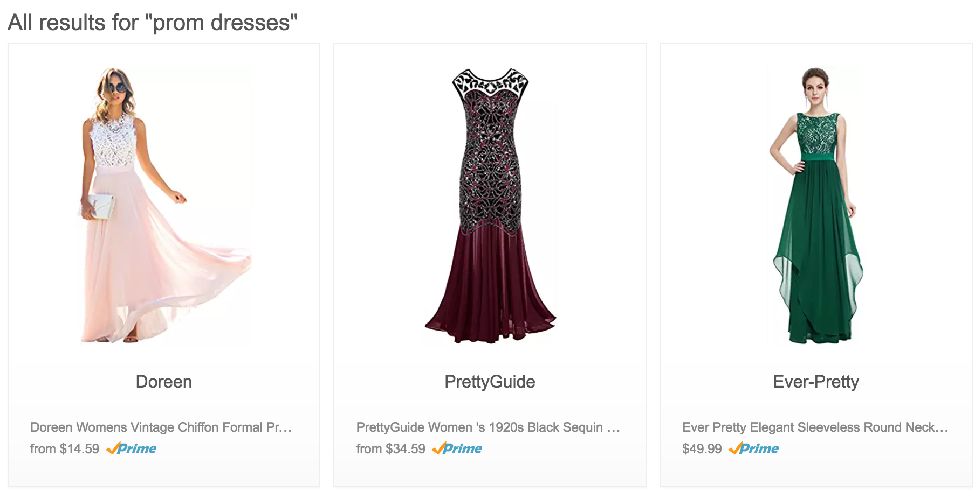
Another example of data to scrape
Let’s say you’re doing a story on the cost of prom dresses. Where could you get data?
Notes:
The image links to an Amazon page search for prom dresses. Open the link, and take a look at some of the information provided for the prom dress products. Ask students: What information, or data, on this page might be useful if you wanted to do a story on prom dresses? After discussing, then ask, how easy would it be to get all this information in a spreadsheet? (Answer: Not easy; that’s why we use a web tool to “scrape” this information into a spreadsheet for us.).

Slide 15
Common scraping tools
PDFs: Tabula
Web: import.io
Notes:
We will learn how to scrape data using two different tools. Remember that scraping data simply means we are taking data from a website or document and putting it into a spreadsheet format. Now, let’s explore these tools ...

Slide 16
You try: Tabula
Using the AFL-CIO scorecard we just looked at, use Tabula to “scrape” the table on pages 3-4-5.
Take notes on HOW this process works. You will create a “how to” at the end of this lesson.
Notes:
Teacher: Provide the link to the scorecard or provide a PDF for students to use. Ask them to play around with it and explore how Tabula works.

Slide 17
You try: Import.io
Now go to import.io and practice scraping a web page.
Take notes on HOW this process works. You will create a “how to” at the end of this lesson.

