Slide 1
Using Social Media
to Cultivate Coverage
News Gathering

Slide 2
Staff Social Media Use
Vision
Purpose
Intent
Notes:
With our own use of social media through our staff’s chosen platforms, do we have purpose, intent, vision? Are we consistent? Does our audience know what to expect from us?

Slide 3
Visual Verbal
Our vision for social media helps us build our voice as a staff.
Be consistent
Build community with audience
Notes:
Use the VISION on our chosen platform to become our voice. Be consistent with it.
Every day.
What is our VOICE? Have we thought through what we are trying to say through our platform? Just like in long form writing, consistent voice through our platforms will help us build rapport with our audience.

Slide 4
Audience
We need to be where they are
Learn who target audience is
From our audience will learn:
likes, dislikes
values
beliefs
behaviors
relationships
environment
Notes:
Audience is the core of all journalism programs. We have stories to tell. We need someone to tell them to. Social media platforms allow us to be where are target audience is.
Approach social media – consider behaviors, relationships, attitudes, values and the environment.

Slide 5
Social Experiment
build VOICE
build FOLLOWING
build EXPERIENCES
build COMMUNITY
Notes:
It’s the portal that connects us to our audience. Benefits we will see by reaching out to large percentage of our population by being visible daily, by building and providing a place to engage and share. Develop a plan of action – to create content, or cultivate content, focus on the individuals when it comes to storytelling, engage your audience and share the experience. The relationship evolves from this.

Slide 6
Action Plan
Create content to share
Photos
Stories
Personalities
Cultivate & generate new ideas
Using the audience's photos, stories, personalities how can it influence our story gathering process, how can our audience help us develop new story ideas
Notes:
Develop a plan of action – to create content, or cultivate content, focus on the individuals when it comes to storytelling, engage your audience and share the experience. The relationship evolves from this.

Slide 7
Build Voice
Journalism is journalism so the reporting goal is the same
Inform
Educate
Entertain
In return for consistent reporting on social media, we will build a following that will inspire new ideas for coverage our audience needs or wants

Slide 8
Build Voice
Use what you have
Reporting & interviewing skills
Photography & video skills
Sharing news, information & other content
Know your limits
Focus on one platform
Don’t overwhelm or stretch thin
Get traction & then expand
Share the type of content your staff does well
Notes:
Know what you have and use it to your advantage. In time you will have more. More content, more experience, more knowledge of what works, what doesn’t, what might.
Know your limits and restrictions. Don’t over do it. Don’t set the unobtainable goal and become overwhelm. Focus on one or two platforms until you get traction. Figure out what is working for you then branch out.

Slide 9
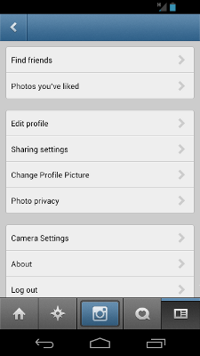
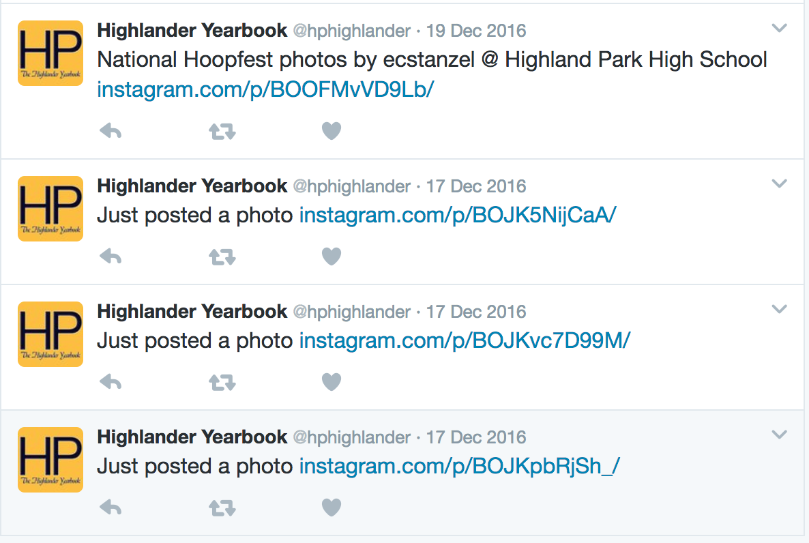
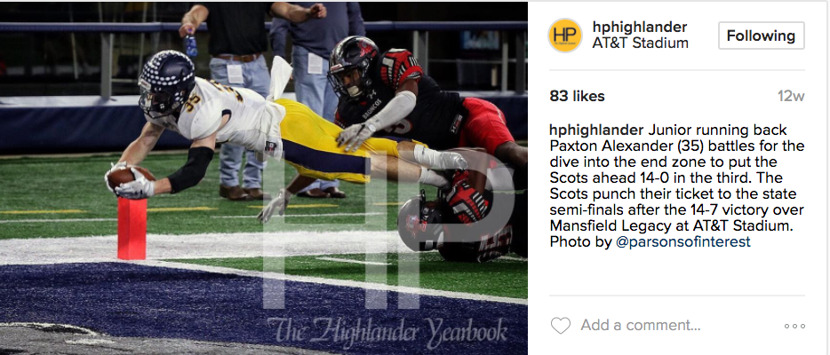
Example: Consider starting with Instagram.
Turn on sharing options to cross-post to Twitter
Notes:
Permission to use social media screenshots from Highland Park HS, Dallas, TX
adviser Margie Raper

Slide 10
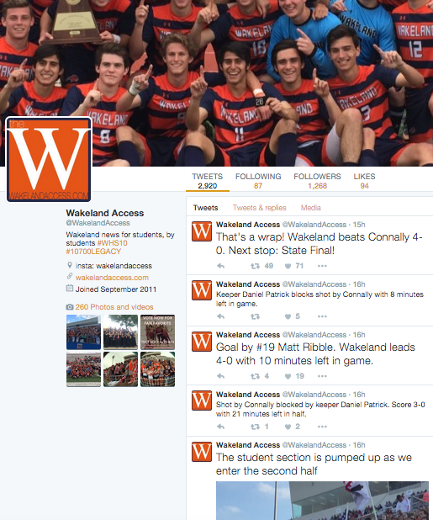
Build Following
@wakelandaccess Wakeland HS, Frisco, TX
Notes:
Live tweeting sporting events is an easy way to gain followers.
Used with permission of Wakeland Access, Wakeland High School, Frisco, TX
Adviser at the time of screenshot, Margie Raper

Slide 11
Tips for Live Tweeting
Announce ahead of time live tweeting
Promote own hashtag or established hashtag
Have staffers use personal accounts to help spread the word
4 to 6 tweets per hour. Don’t overwhelm audience; unless it is competition that is fast paced, quickly changing scores
Tag people mentioned using their usernames to expand audience reach

Slide 12
Tips for Live Tweeting
Include images when you can
Be a witness. Be descriptive. Use details.
Tweet visually. Think sensory details.
Remember you are still a reporter, not a fan.

Slide 13
Build Voice
Use what you have, where you are
Create strategy for content creation
Create strategy for content curation
Have audience-value content
Avoid posting promotional-only content
Re-think when engagement is stagnant or dropping
Notes:
Know what you have and use it to your advantage. In time you will have more. More content, more experience, more knowledge of what works, what doesn’t, what might.
Know your limits and restrictions. Don’t over do it. Don’t set the unobtainable goal and become overwhelm. Focus on one or two platforms until you get traction. Figure out what is working for you then branch out.

Slide 14
Create Policy
Staff Policy
Core values
Goals
Procedures
jeadigitalmedia.org for examples
tips
policy development
list of accounts from other schools
Notes:
Accuracy, Efficiency, Immediacy-timeliness, Respect, Responsible, Creation, Curation, Promotion,
Teach them how to be responsible journalists – just like we do now.
Lots of examples and articles available online.

Slide 15
Build Following
Be consistent
Be a witness
Be helpful
Be you
Be disciplined
Set goals
Stick to the goals
Notes:
Once you have set goals and established a policy. Start with building your following.
Be the resource your audience turns to. Have fun with it. Develop voice

Slide 16
Build Experiences
Focus on engagement with individuals
share, respond, interact
give credit, tag
event coverage
tweet ups
hashtags
takeovers
Notes:
Use coverage and digital tools to make it an experience

Slide 17
Build Experiences
Digital tools can enhance the coverage experience
Equipment-digital cameras, selfie sticks, mobile lenses
Establish posting workflow
DSLR to mobile sharing
Watermark images
Post-production edits before posting
Word art apps to make visuals out of text
Notes:
Use coverage and digital tools to make it an experience

Slide 18
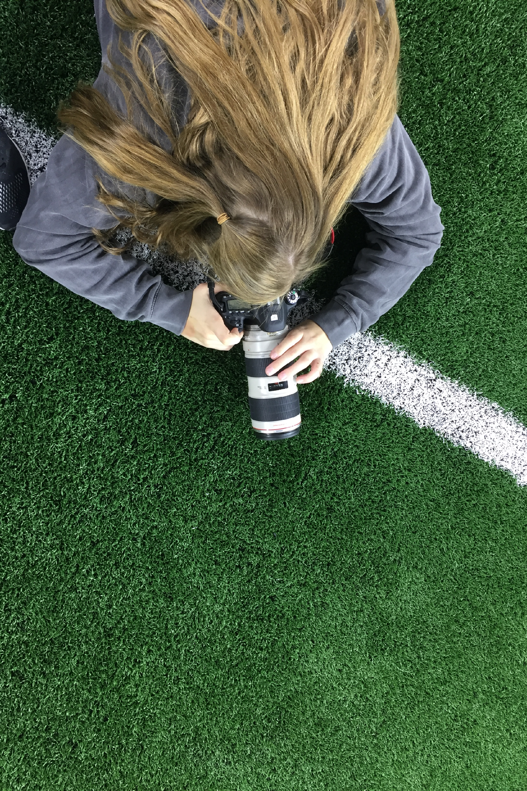
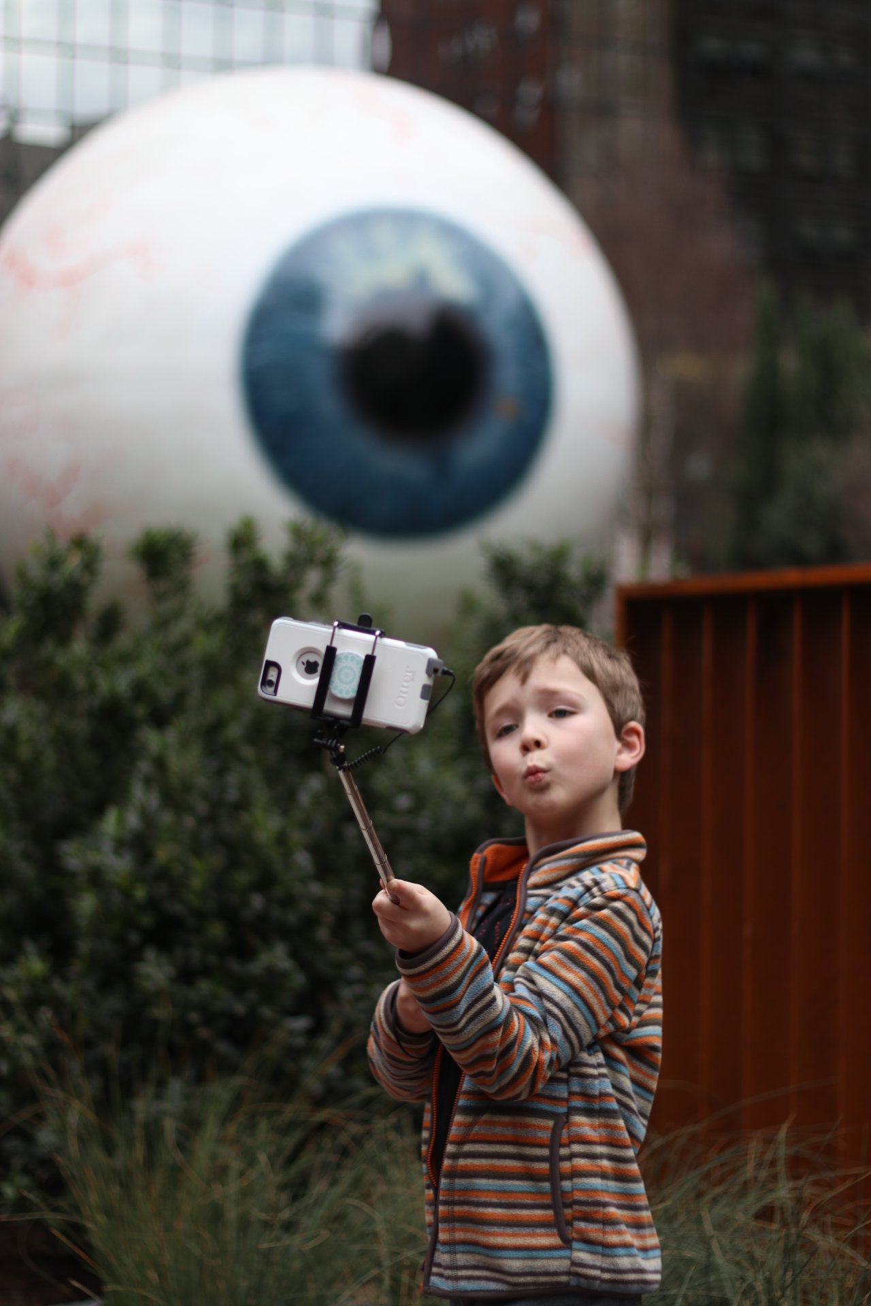

Slide 19
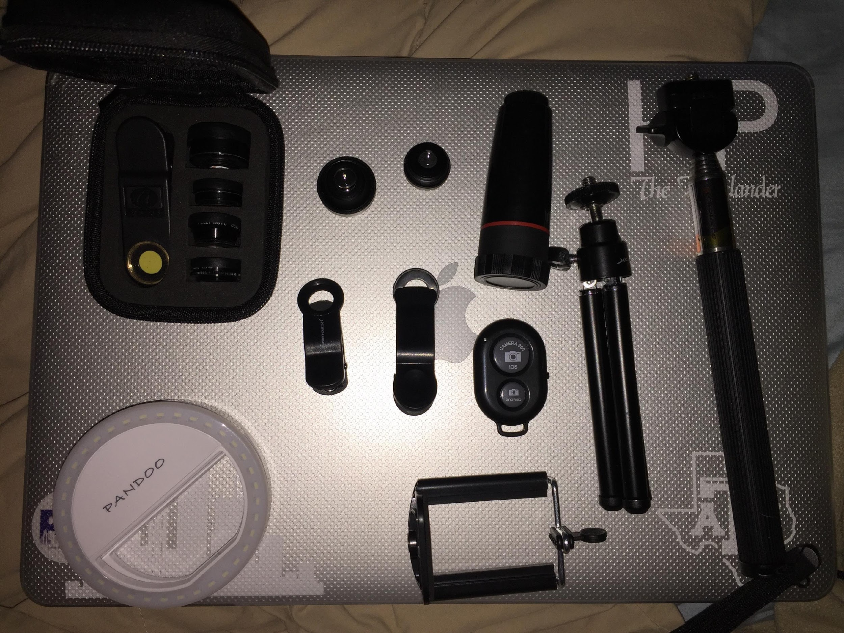
Notes:
Mobile photography tools can be found for very cheap on Amazon

Slide 20
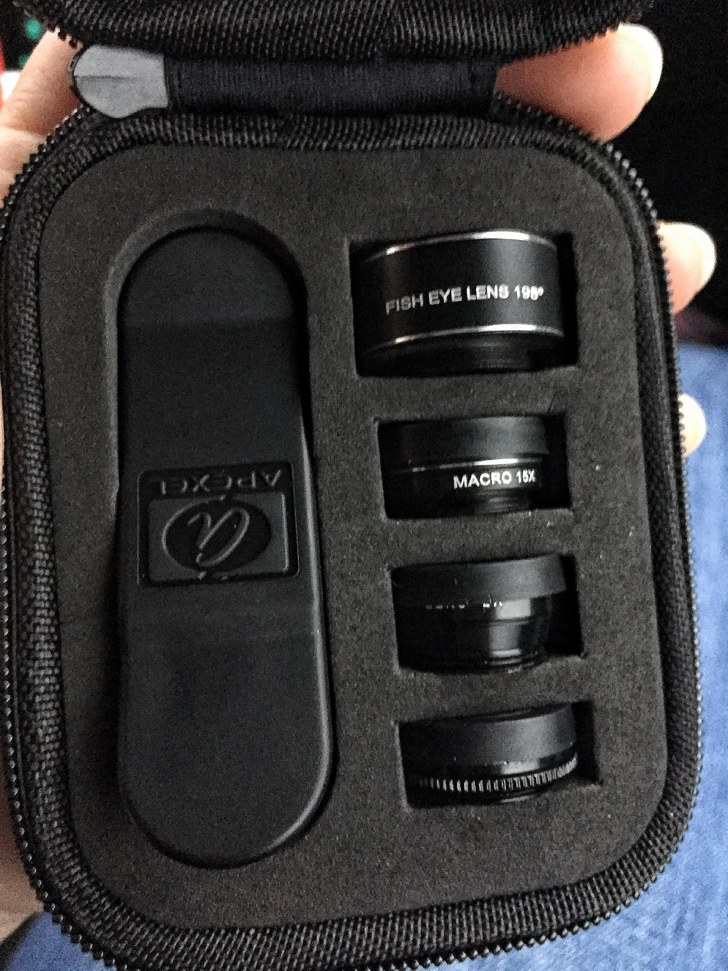
Notes:
Mobile photography tools can be found for very cheap on Amazon

Slide 21
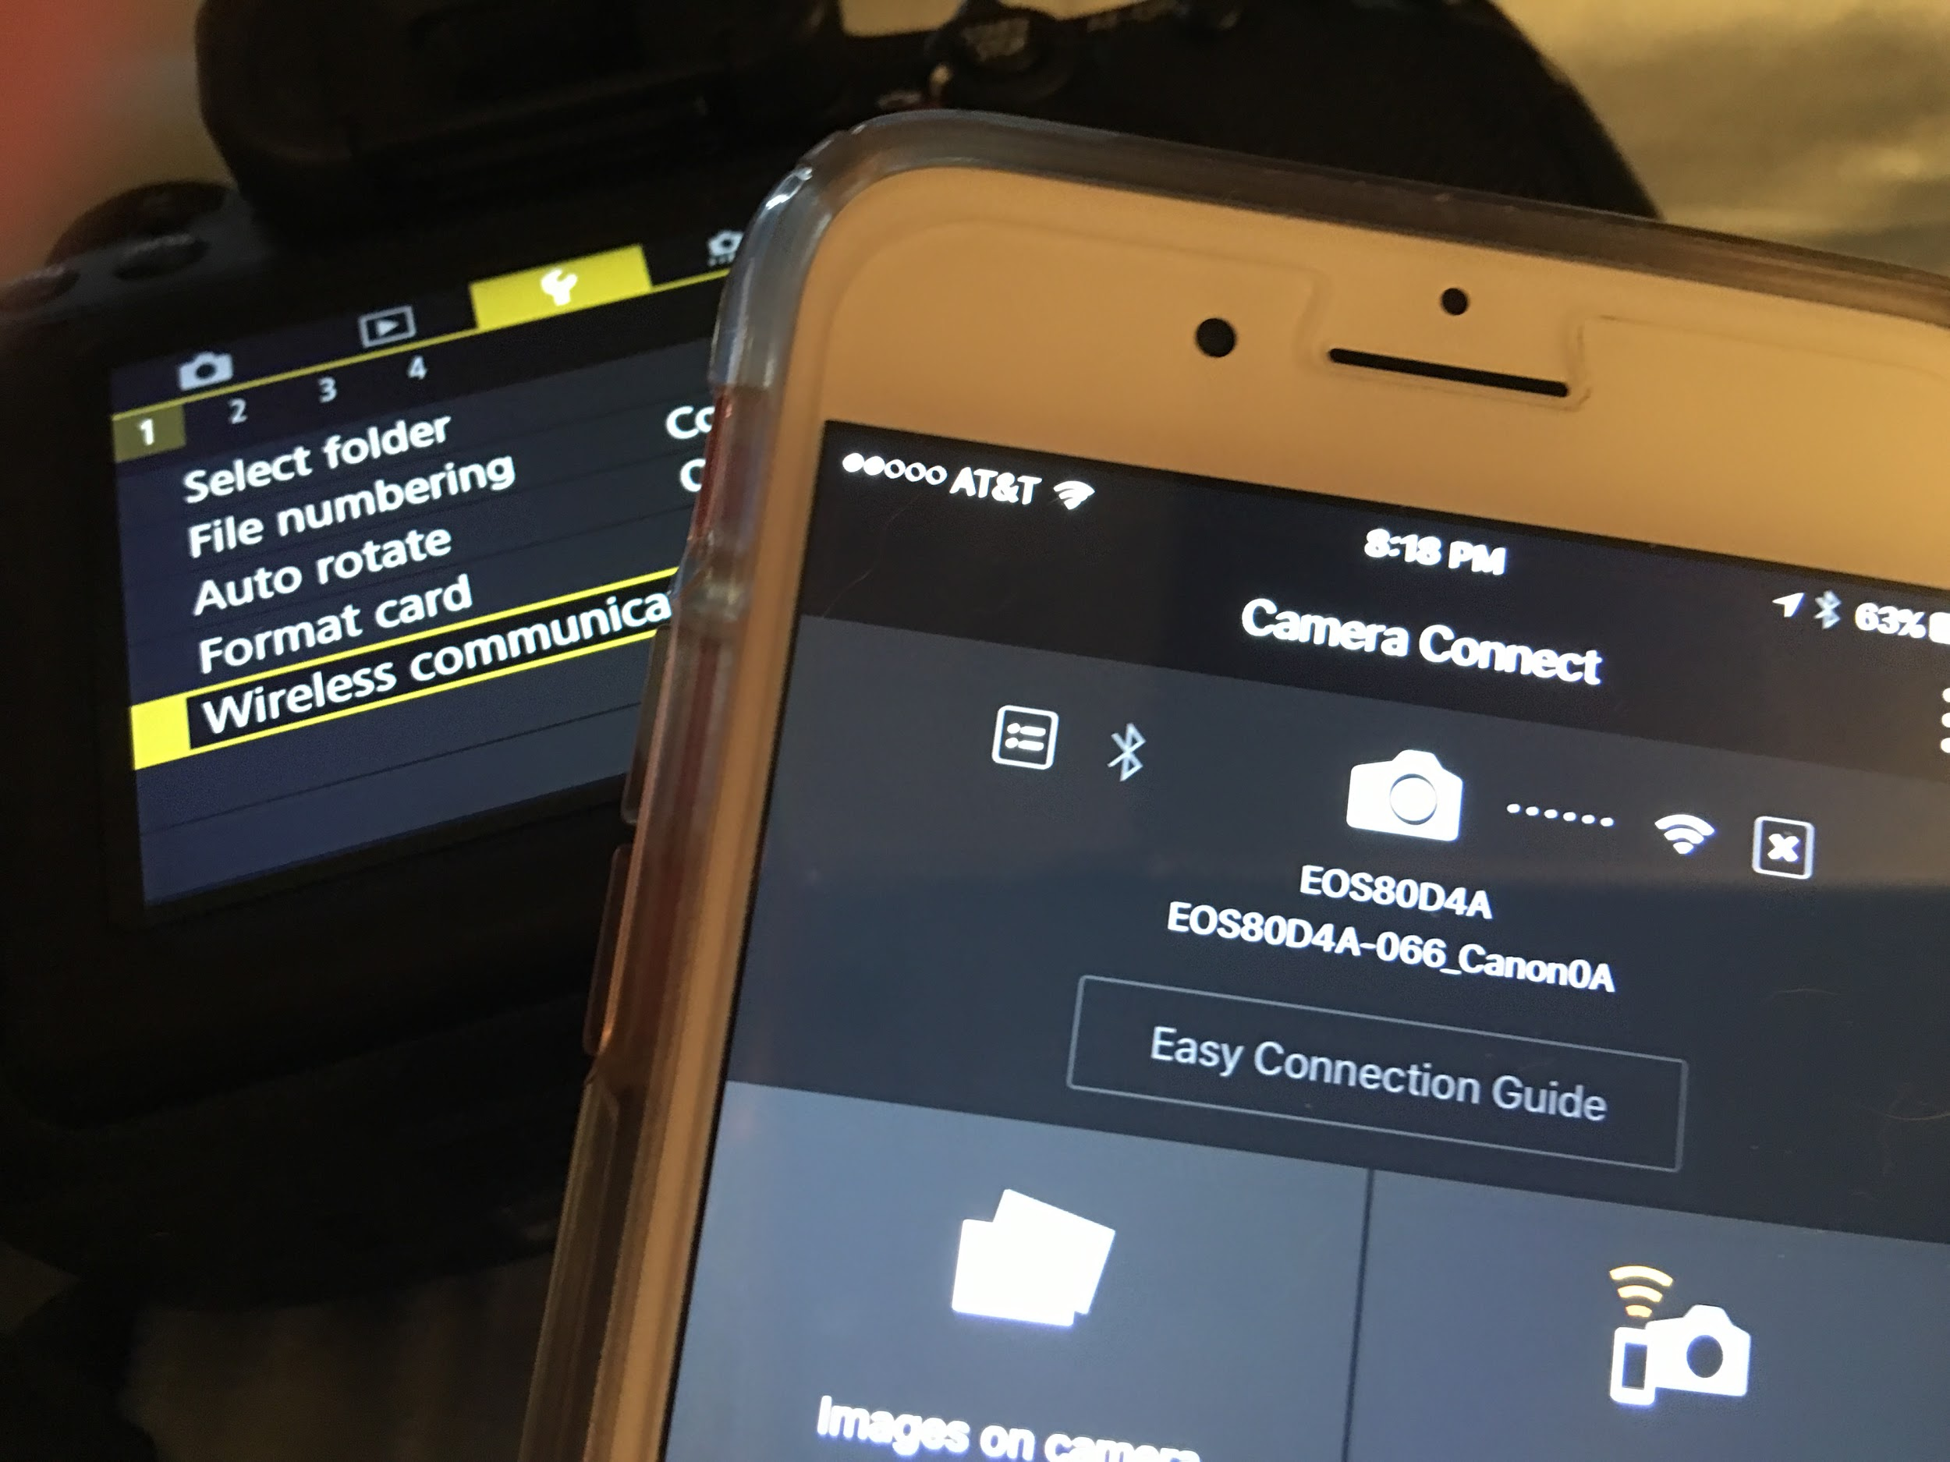
Notes:
Wifi sharing from DSLR to mobile app

Slide 22
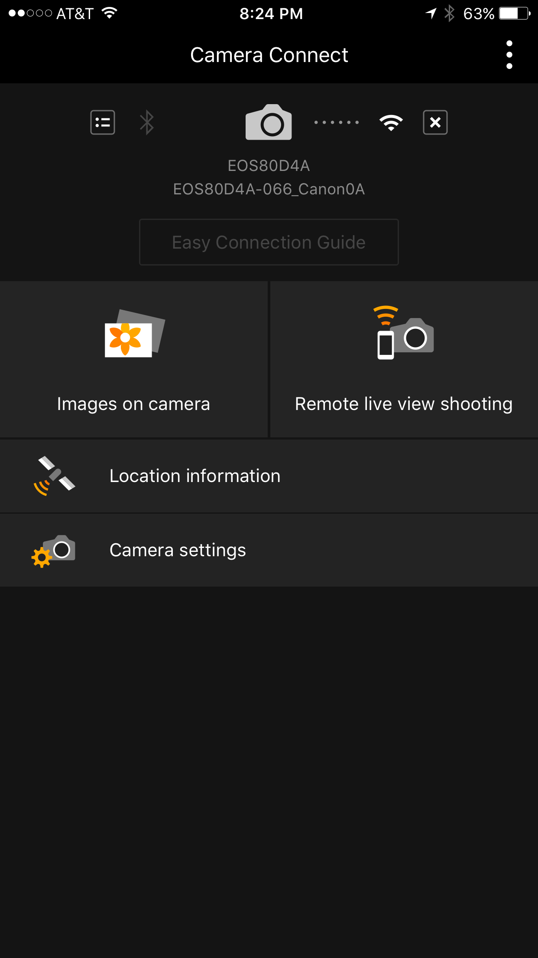
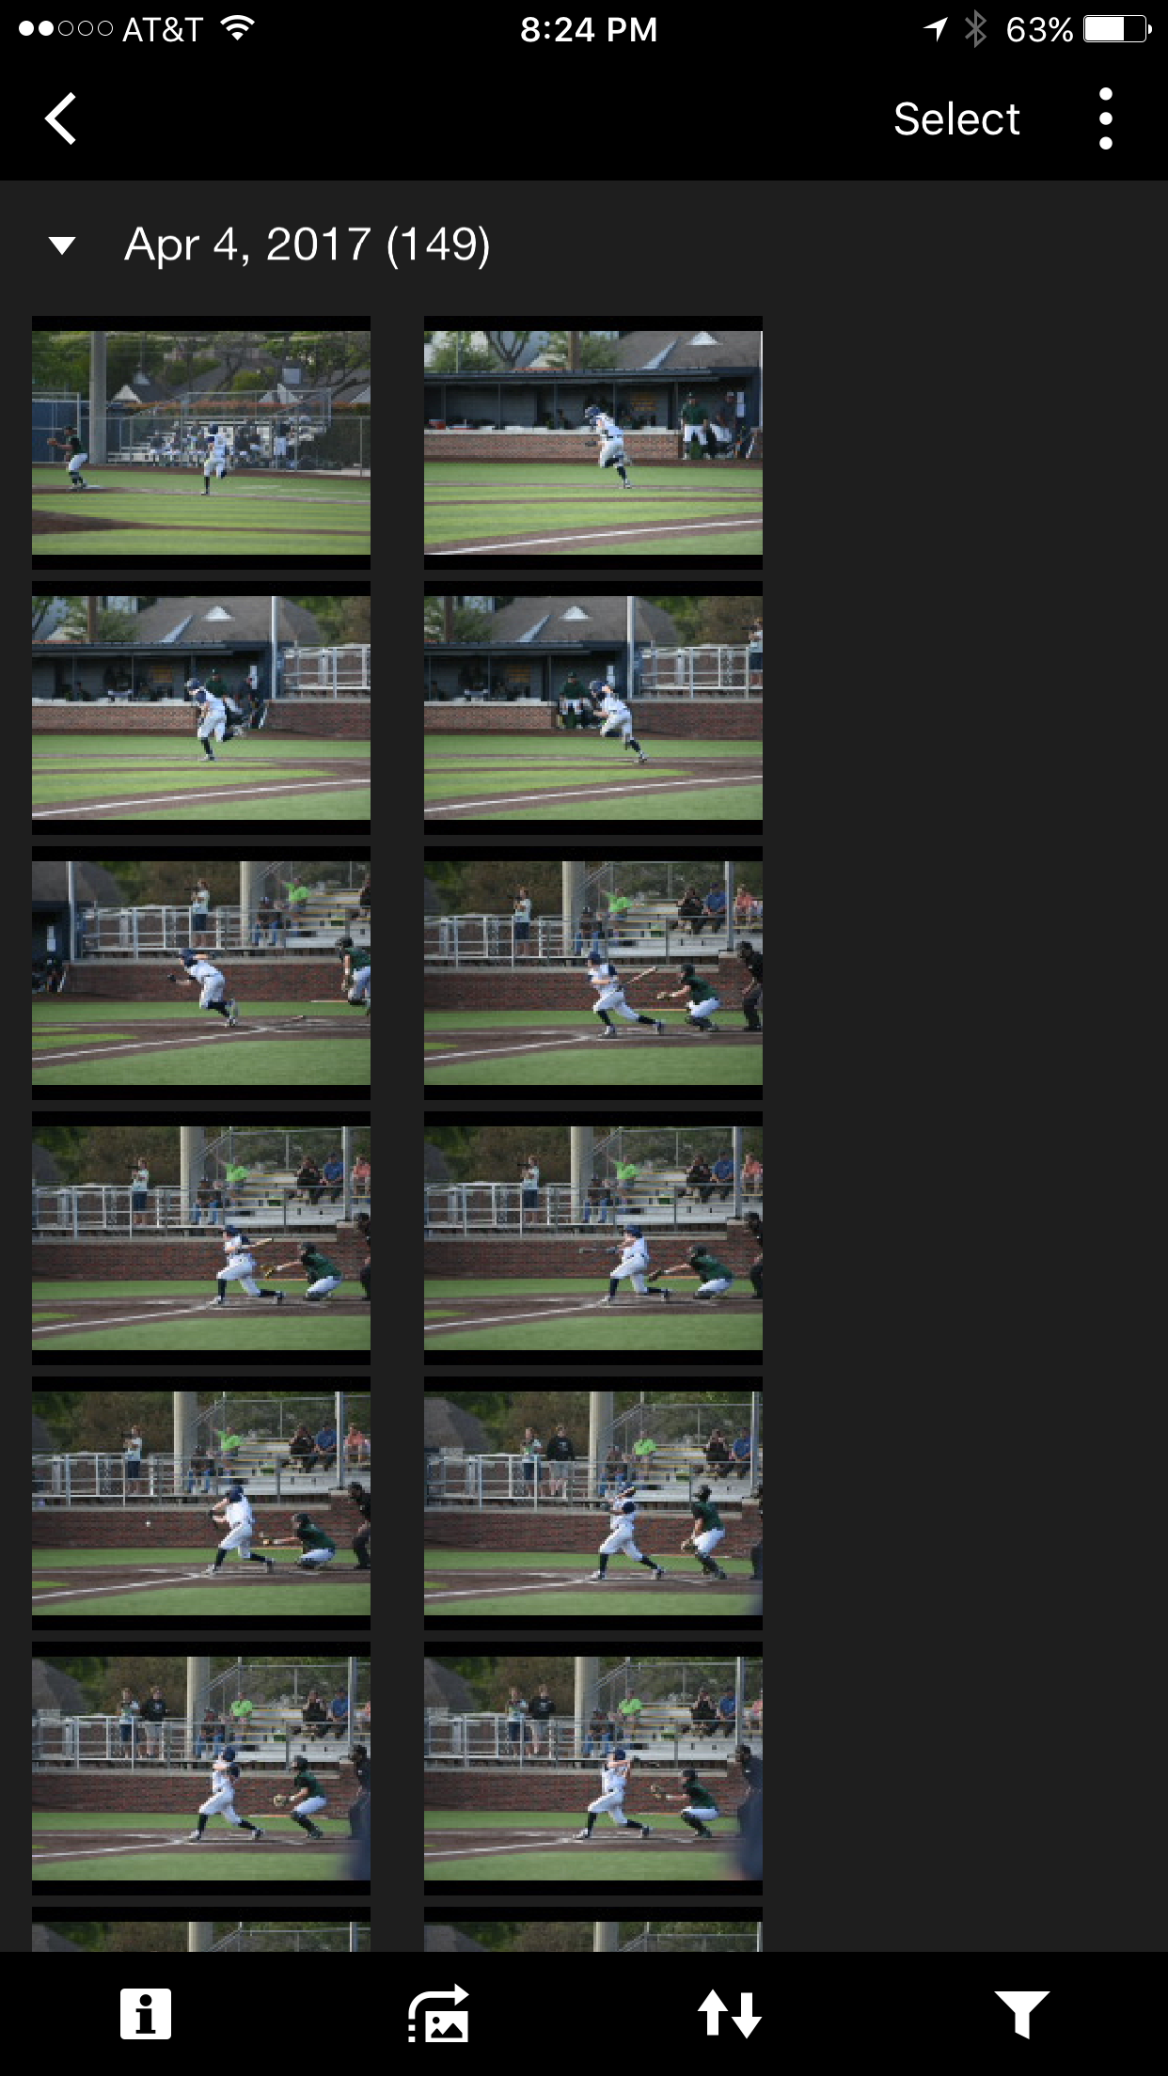
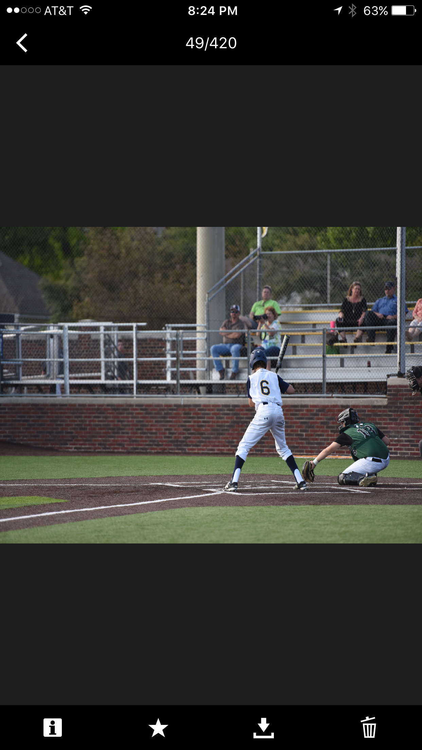
Notes:
Wifi sharing from DSLR to mobile app allows for high quality images to be posted immediately during an event, close to live, immediate coverage

Slide 23
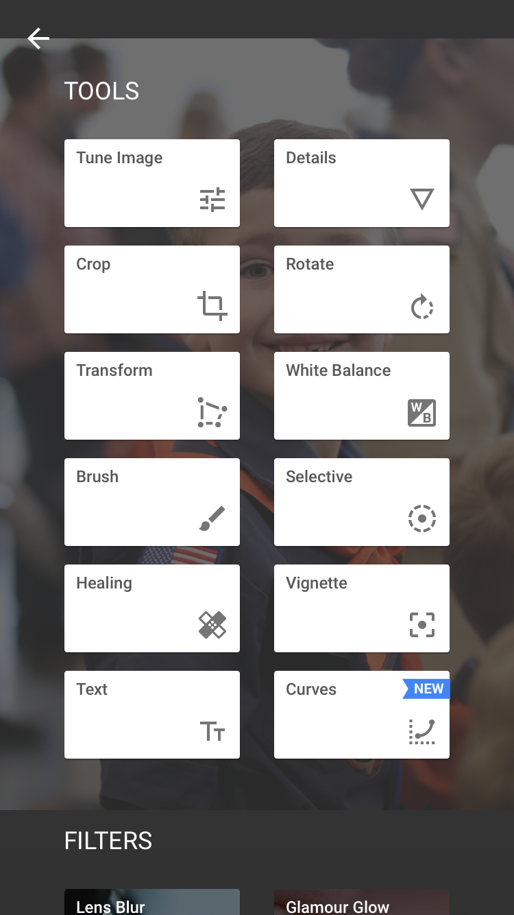
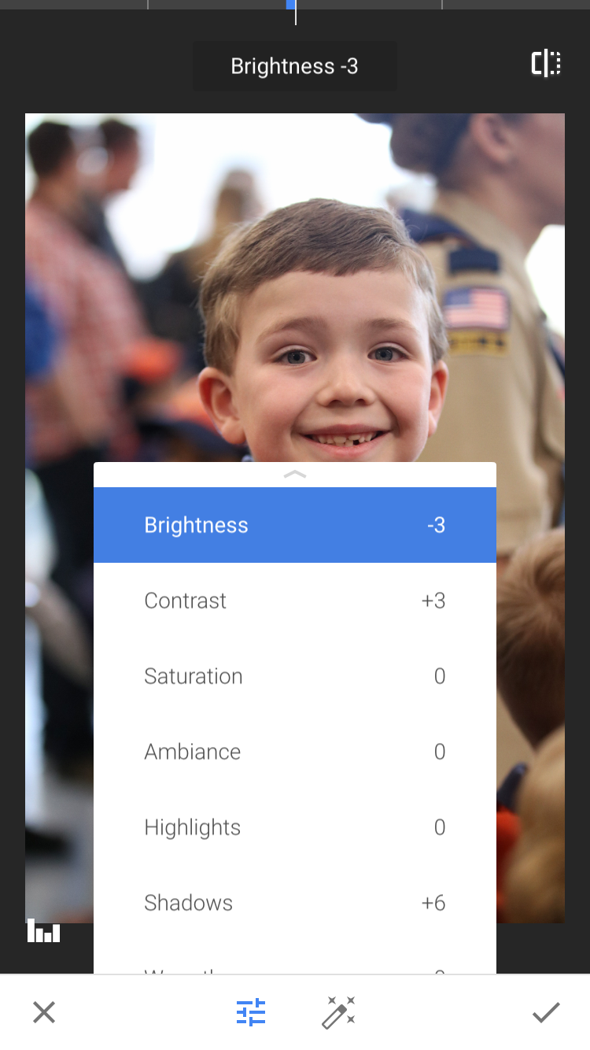
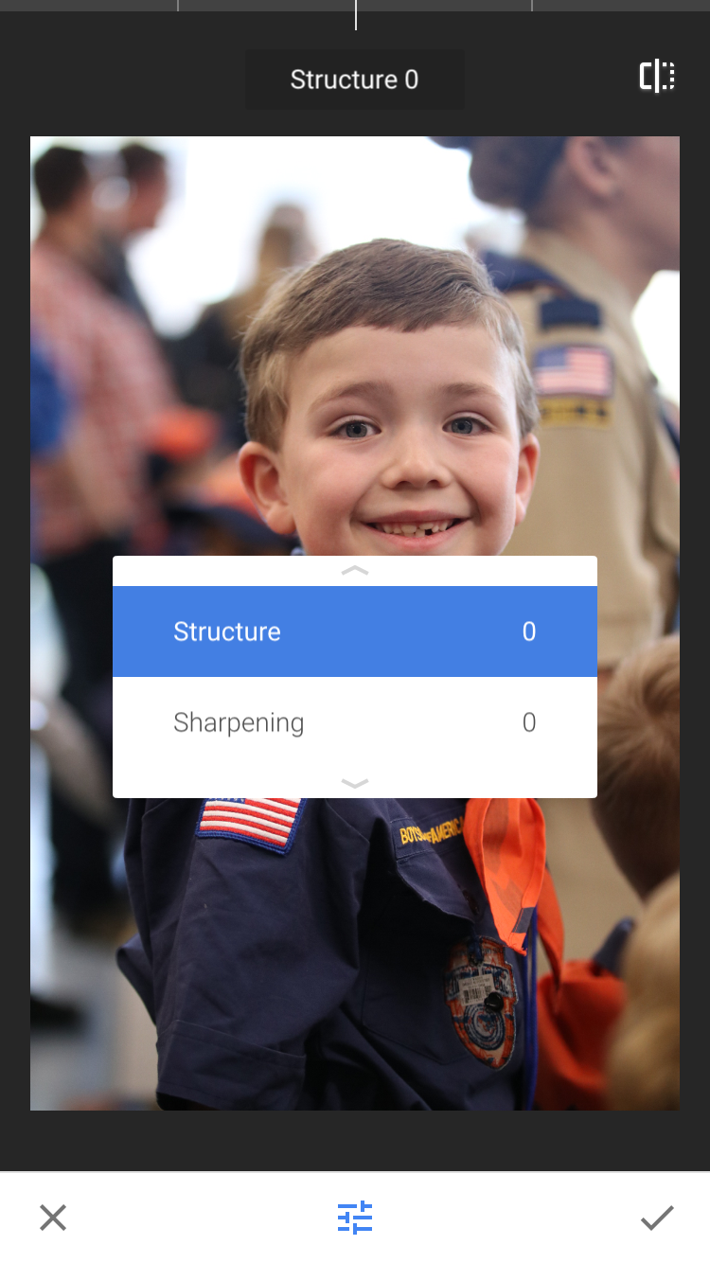
Notes:
Post-production editing of images through apps like SNAPSeed, BIG LENS, PS EXPRESS, VSCOCAM

Slide 24
Notes:
Graphic production with Worddream, retype, Canva
images from Margie Raper, used with permission

Slide 25
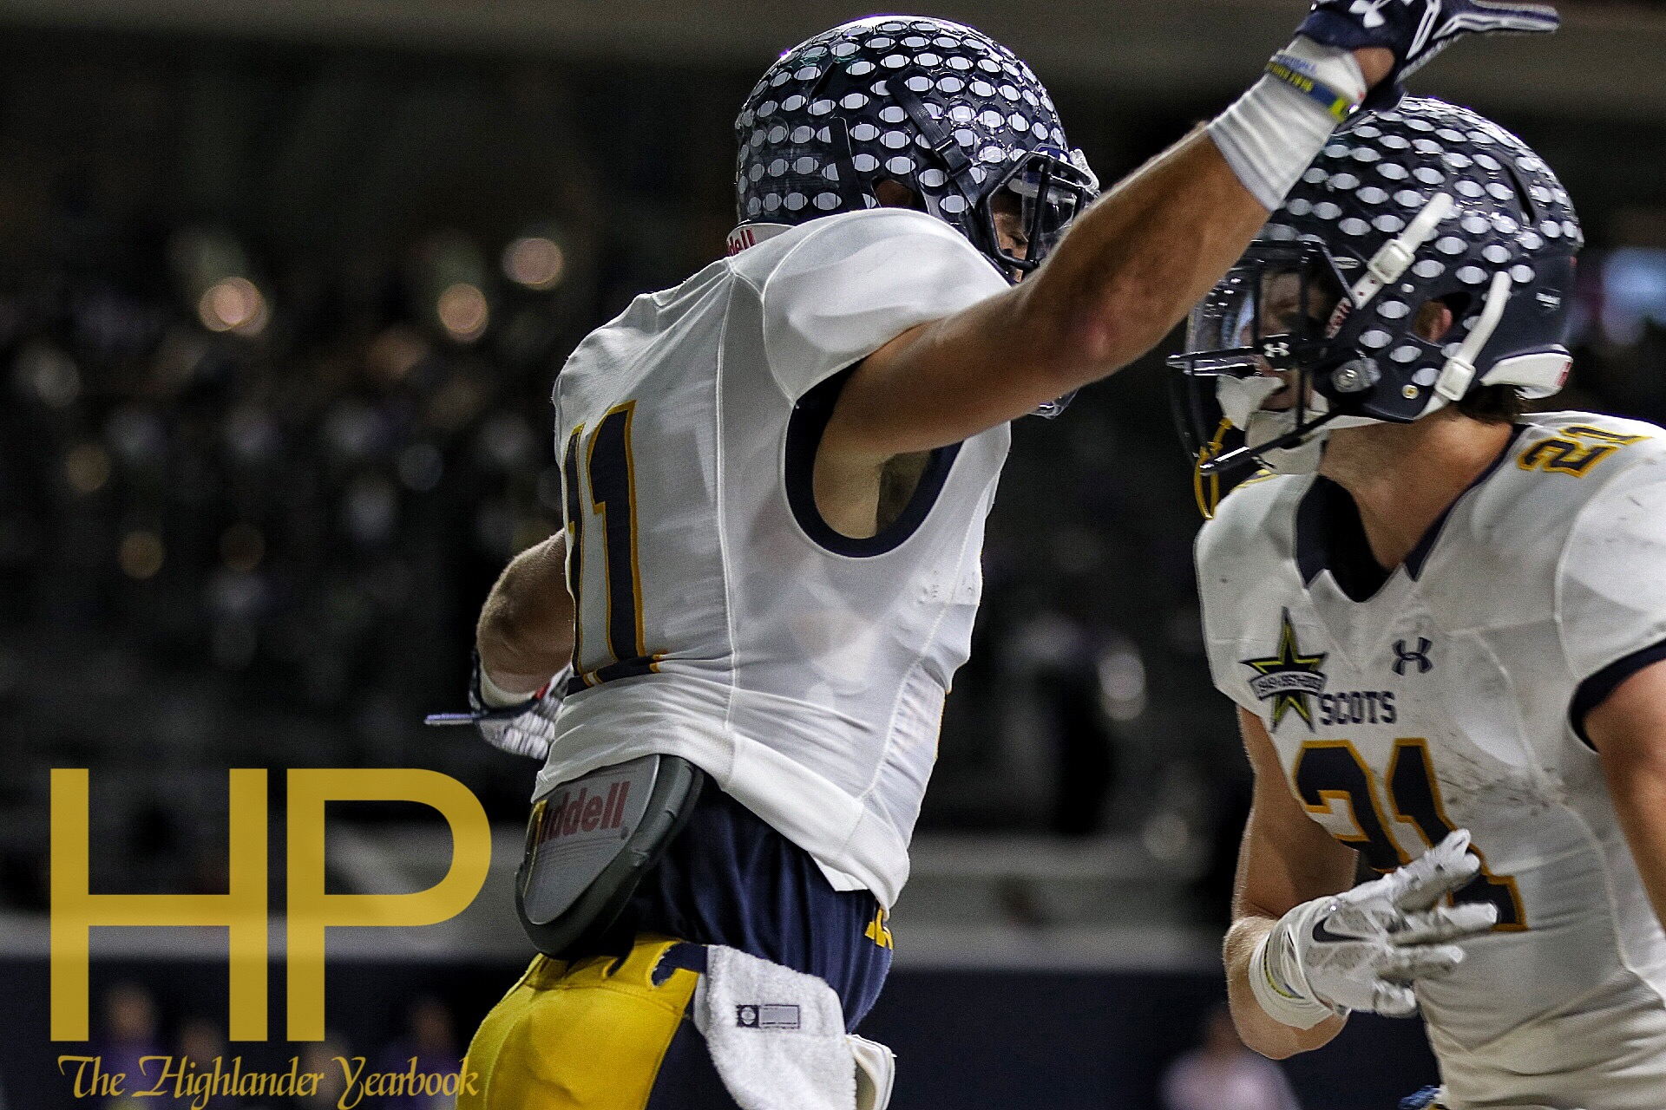
Notes:
Protect images with watermarking apps

Slide 26
Build Community
Use social media trends
#WCW
#MCM
#TBT
Piggy back on major events
Notes:
Use coverage and digital tools to make it an experience

Slide 27
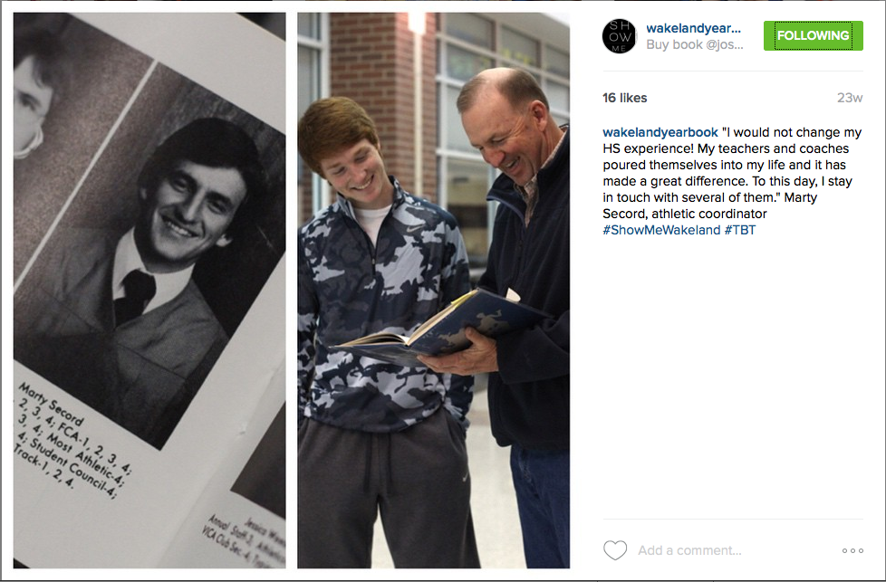
Notes:
Throwback Thursday event by Wakeland Prowler yearbook, adviser Margie Raper

Slide 28
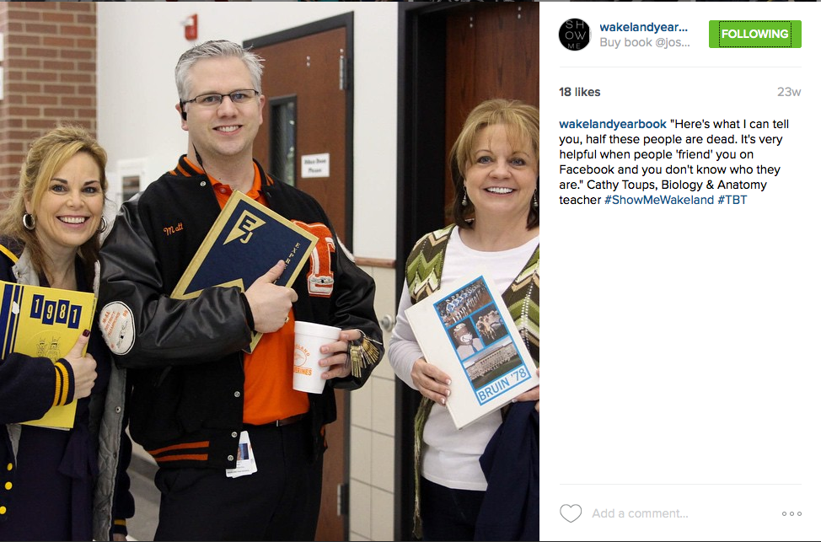
Notes:
Throwback Thursday event by Wakeland Prowler yearbook, adviser Margie Raper

Slide 29
Build Community
Sharing
Coverage
Trust
Creditability
Reliability
Notes:
You see it in the form of retweets, shares, likes, favorites, screenshots, profile pictures, etc
Day in and day out, feel the content, audience wants three types of content
Informational, inspirational, entertaining. Make a goal to fill all three content types

Slide 30
Build Community
Give your audience variety
Emphasize content they want
Never trade quality for quantity
Have fun with audience
They will respond will you need them
They will bring you ideas...both directly and indirectly
Notes:
You see it in the form of retweets, shares, likes, favorites, screenshots, profile pictures, etc
Day in and day out, feel the content, audience wants three types of content
Informational, inspirational, entertaining. Make a goal to fill all three content types

Slide 31
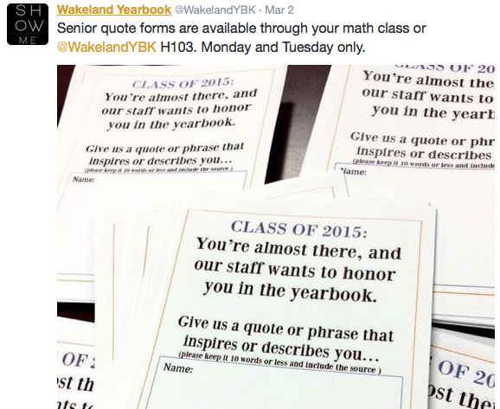
Notes:
Adding a photo to the post can help it visually. We needed them to come to us. Out of 500 seniors we only go about 60 senior quotes from the math classes. We got nearly 300 after we promoted on Twitter.
Wakeland Prowler yearbook, adviser Margie Raper

Slide 32
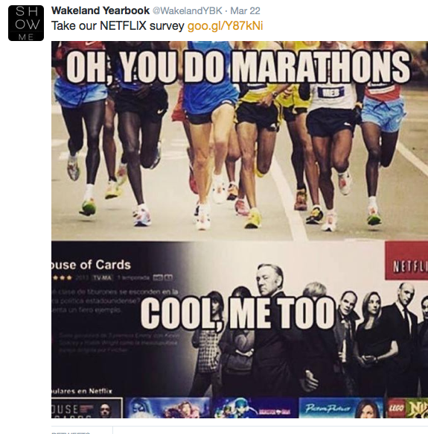
Notes:
Wakeland Prowler yearbook, adviser Margie Raper

Slide 33
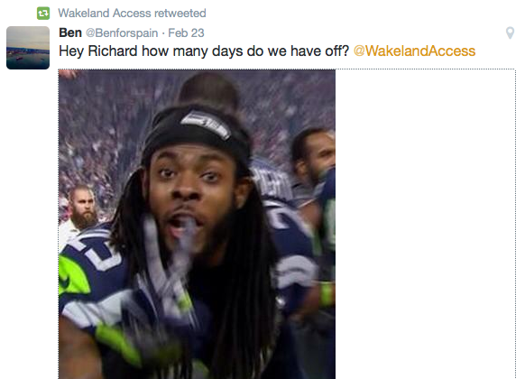
Notes:
We gathered coverage ideas when we had snow days via social media. We loved they tagged us. Had fun with us.
Wakeland Prowler yearbook, adviser Margie Raper

Slide 34
Coverage
Give your audience variety
Emphasize content they want
Never trade quality for quantity
Have fun with audience
They will respond will you need them
They will bring you ideas...both directly and indirectly
Notes:
You see it in the form of retweets, shares, likes, favorites, screenshots, profile pictures, etc
Day in and day out, feel the content, audience wants three types of content
Informational, inspirational, entertaining. Make a goal to fill all three content types

Slide 35
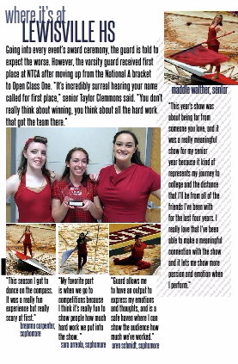
Notes:
The three color guard member photo was taken from social media as well as the DECA group photos. Both became content in the yearbook.
Wakeland Prowler yearbook, adviser Margie Raper

Slide 36
Notes:
Wakeland Prowler yearbook, adviser Margie Raper

