Slide 1
7 Steps
to Fact Checking
News Literacy
Notes:
This slideshow is adapted with permission for educational use from Jane Elizabeth of the American Press Institute and Sean Gorman of the Virigina Times Dispatch and Politifact. We are going to explore 7 steps that professional fact-checkers use when they decide to fact-check a story, especially those facts that relate to political activity.

Slide 2
Fact checking is a process of accountability
It is not mere “copyediting”
It is not simplistic
It is used for any and all purposes, regardless of the subjects involved or angle of the story
Notes:
In other words, we don’t fact check some stories and not others, and we do this as a separate process outside of just looking typos or spelling errors. This is the way we show our readers that we are interested in getting everything right, not just the stories that have the most at stake.

Slide 3
7 steps from the pros
Choose the right fact
Prepare yourself
Decide on a ratings system (or not!)
Use the tools
Do some social media prep work
Be transparent and make corrections
Pay attention to the aftermath
Notes:
These steps were created by professional fact-checkers Jane Elizabeth and Sean Gorman. We will explore each of them in turn.

Slide 4
Choose the right fact
Not every “fact” is truth, nor can it be verified using this method. The pros will ask:
Can it actually be proven? Or not?
Is it a factual statement and not an opinion or prediction?
Is it interesting? Does it make you wonder, is this true?
Has it been getting a lot of buzz? Commentary? Repetition?
Was it an expensive ad or major production?

Slide 5
Examples:
Clinton said she will create two million new jobs in her first term as president.
Obama said there is less crime in his former Chicago neighborhood than in other areas of the city.
Notes:
Use the questions in the previous slide to discuss these examples. Which of these “Facts” can be proved? (Not the first one--that’s a future claim, which we have no way of proving, therefore, we wouldn’t bother fact-checking it). Why would students be correct to fact check the second one?

Slide 6
Prepare yourself
The pros will do the following to make fact-checking efficient and transparent:
Create a “database of databases”
This means keeping track of facts that you’ve already verified and information or data/numbers commonly used
Use Google docs
Make it a collaborative effort with your peers
Learn to use Soundcloud for radio ads
You need some storage system for audio or visual content that you want to verify
Notes:
At a school newspaper, this might mean keeping a Google drive folder with common facts about your school---calendars, enrollment information, teacher salaries, emergency evacuation plans, etc. That way, you have your own database and don’t have to rely on the school secretary to track down info. Using a google doc for fact-checking allows everyone to participate, not just editors. If you cover speeches or other events, use a cloud to store that audio or keep a copy of an ad so that you can reference it later in case it gets pulled from the airwaves.

Slide 7
Decide on a ratings system
If you are going to regularly check and correct facts in the local media related to your school/community, you might consider using a ‘rating’ system to draw your readers in.
Notes:
This part won’t apply to many school publications, but let’s say that in the lead up to the school board election, your staff decides to run a fact-check feature on the candidates. You might decide to use a thumbs up/thumbs down image to represent true/false statements. Or, you might use a “truth-o-meter” image to show how factual a statement was.

Slide 8
Use the tools
The pros use these tools to help:
Google Translate
TinEye
Skeptive.com
Snopes
Spokeo
WolframAlpha
Google Maps, Google Earth
Keep up: Verification Junkie Tumblr, Craig Silverman, API newsletter/site.
Notes:
You could explore each of these websites as a class, or assign each website to a group of 2-3 students to explore and present on.

Slide 9
Do some social media prep work
Remind your readers to follow you on social media for quick fact-checking or corrections. Don’t wait until your next print edition to get the information out there.
Tips from the pros:
Make hashtag decision and promote.
Have your links ready.
Check social media for bad facts.
Notes:
Do you want to create a specific hashtag for your readers so they know when you’re correcting information or providing a fact check? Provide internal short links to supporting sites in your tweet. And, don’t forget to fact check the social media about your community/school just like you would anything else!

Slide 10
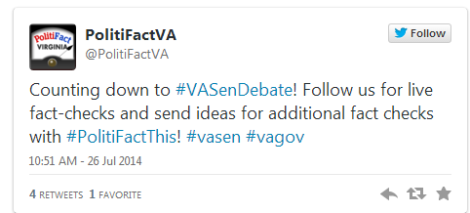
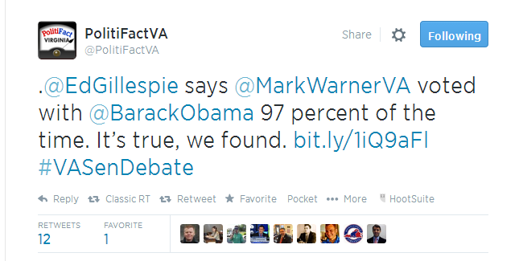
Notes:
This is a screen shot provided by Politfact of the tweet they send out advertising their fact-checking process and trying to encourage readers to help. Here is also an example tweet of the results of one of their fact-checked items.

Slide 11
Be transparent and make corrections
The pros say:
Tell your readers how you do what you do
Make corrections obvious
Notes:
You might consider at the start of the school year running an “explainer” piece on how information gets fact checked and published in your school publication. That way, readers can see that you are trying to do the right thing and they are aware of the process. This behind-the-scenes can sometimes generate goodwill in the event that you do accidentally publish something false.

Slide 12
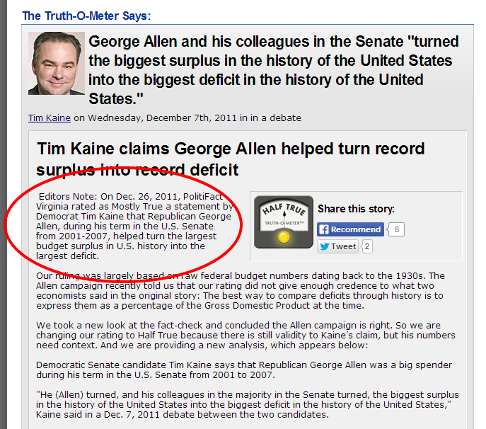
Notes:
Sometimes, even the fact-checkers get it wrong. Here’s an update from Politifact’s Truth-o-meter that actually corrects one of the facts they were checking and trying to authenticate.

Slide 13
Pay attention to the aftermath
The pros say:
Be prepared for some fallout.
Read comments and take criticisms seriously.
Be quick to correct or clarify.
Follow up: Is your fact-check getting out there? Or are people still repeating false information.
Notes:
People in your community, especially politicians, might not appreciate having their facts checked by student journalists. But, you likely have the time and resources to do a better job than even the local media might be able to. So, don’t be afraid to dig deep and then publicize what you’re doing so that it helps the most people.

Slide 14
What facts should you be checking?
Know what’s going on in the community, and what facts are most relevant or impactful for your student readers.
Understand the greater connections between facts and what happens at your school or in your neighborhoods.
Be better than your local media!
Notes:
Students often think that this kind of political fact checking is not relevant or should be left to the pros, when in reality, it’s often the local politics that will have the biggest impact on your school. Find out what the connections are and what facts your readers should care about, and then spend some time caring for them even if they don’t seem to. That’s your job!

