Slide 1
Images to Remember
News Literacy

Slide 2
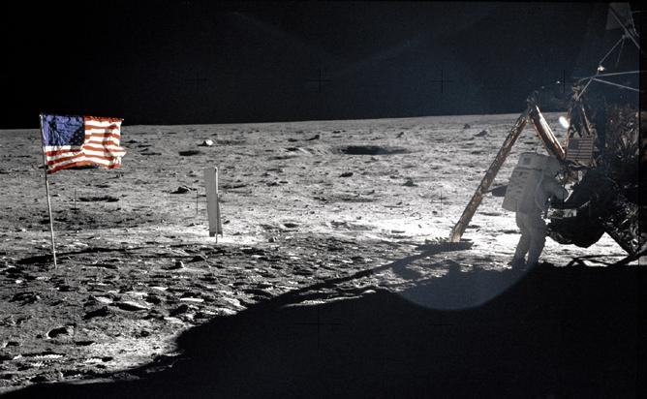
Administration pulls lunar mission funding

Slide 3
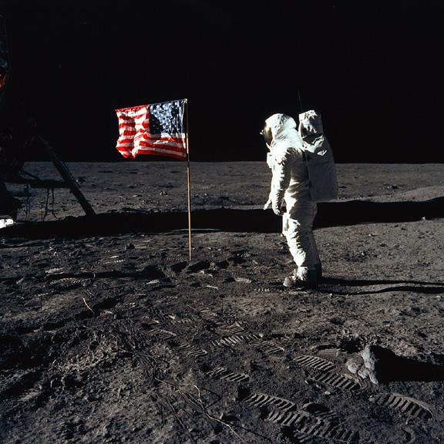
US lags behind in new moon race

Slide 4
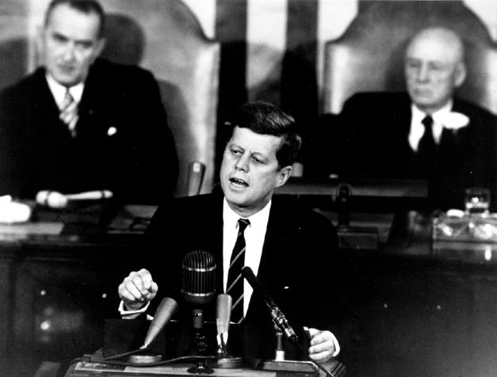
Congress divided on presidential mandate

