Slide 1
Alternative
Story Forms
News Writing
Notes:
*

Slide 2
Alternative? Huh?
Stories don’t have to be all text.
Draw in readers with other elements.
Pages need eye-catching elements.
Blurbs, quote blocks, photo captions, polls, maps, text boxes and similar elements entice readers to read your story.
Sometimes, stories are best told with only photos or graphics.
Notes:
*

Slide 3
You’re cutting my story?
No. But maybe!
Ask yourself: Is there a better way to present this information?
Keep your readers! Readers retain 30 percent more information with non-narrative information presentation (Poynter Eye Track 3 Study, 2007)
What follows are some basic story alternatives or supplements for news stories.
Notes:
*
Example: If a story has a lot of numbers…can we turn it into a chart?
Note: Reporters, even on charts, get bylines.

Slide 4
Charticle or list
Good for comparisons/parallel construction
must have matching info
Be selective
What is left out can be as important a choice as what is left in
Notes:
*

Slide 5
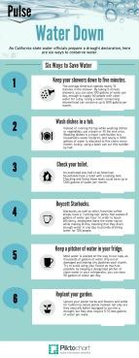
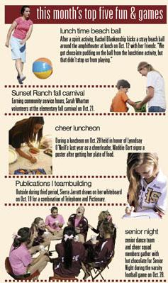
El Estoque Monta Vista H.S.;
Cupertino, Calif.
Details Whitney H.S.;
Rocklin, Calif.
Eagle Eye Mountain Vista H.S.;
Highlands Ranch, Colo.

Slide 6
Timeline
multiple plot points
long period of time (years)
short period of time (minutes/seconds)
bits of info presented in time
key events are annotated in chronological order along a line
Notes:
*

Slide 7
North Star Francis Howell North H.S.;
Saint Charles, Mo.
Notes:
*

Slide 8
Tonitrus Rocklin H.S.;
Rocklin, Calif.

Slide 9
Info box, fast facts box
List the 5W’s and H in bulleted list for a quick look at what happened.
Add info to stories.
Tell how to get there, where to find it
Tell more information about the subject of your story (profiles, issues)
Highlight additional resources
Provide scores or schedules
Add related trivia or statistics
Notes:
*

Slide 10
How to or step-by-step guide
step-by-step
bulleted/numbered list
example: how to choose the right college (key fields with short blurbs)
put steps in a logical or chronological order for readers (do this first, then this, then this, then this next …)

Slide 11
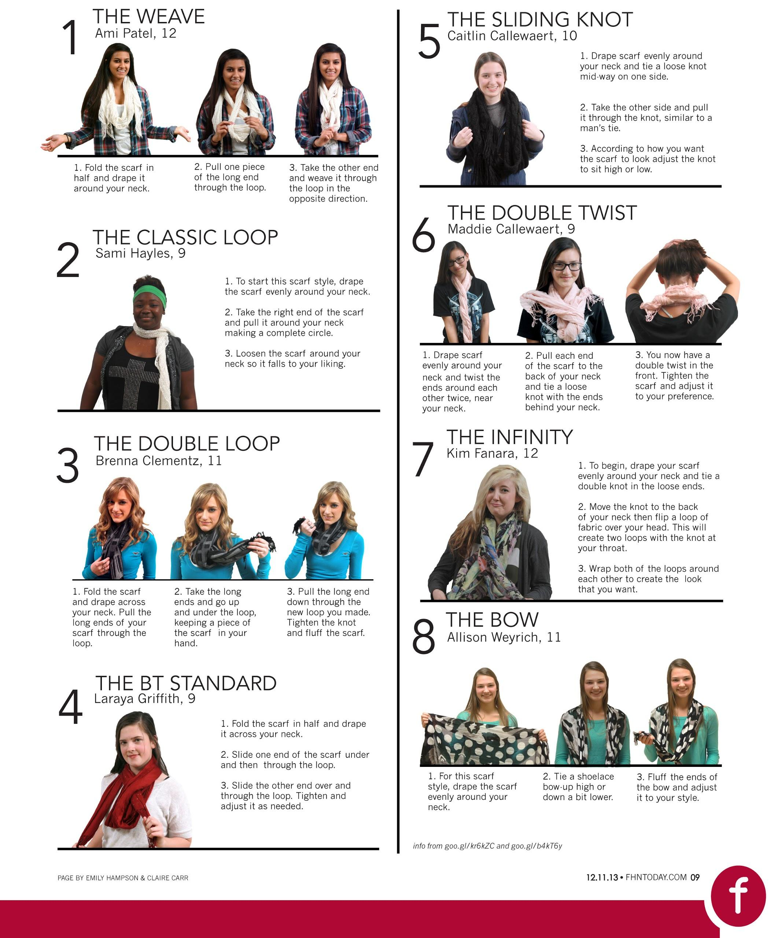
North Star Francis Howell North H.S.;
Saint Charles, Mo.

Slide 12
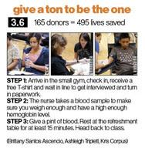

Slide 13
Map
eye scans looking for interesting info
can be a little tricky to reproduce, so think through how you are going to create the map before you do it
works better if it’s not a “normal” map
perspective
color
illustrations
Notes:
*
Examples: A map of where the best wi-fi or cell phone reception is in the school.
A map of nearby restaurants with logos
A map of the school’s security camera zones

Slide 14
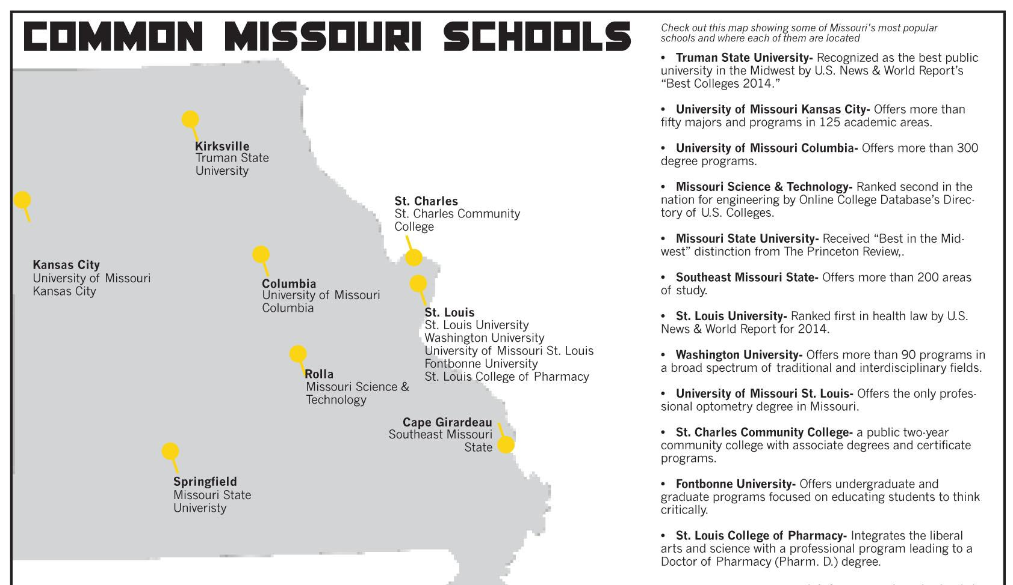
North Star Francis Howell North H.S.;
Saint Charles, Mo.

Slide 15
Quote collection
several people are quoted on the same topic
ask the same question of everyone, and make sure it is an open-ended question (one that takes a sentence to answer)
another option is to sample one significant person’s opinion on several topics

Slide 16
Details Whitney H.S.;
Rocklin, Calif.

Slide 17
Annotated photo or diagram
provide information about what’s in a photograph
example: cost of a prom outfit with photo of a male and female student wearing appropriate attire; price of each aspect from head to toe (hair, makeup, dress, shoes, flowers, tux or suit/tie, jewelry, etc.)

Slide 18
Assignment A
Choose one alternative story form other than a poll that goes with a story that you are currently working on. (charticle, timeline, map, fast facts box, how-to box, quote collection, annotated diagram)
Create it to go with your story.

Slide 19
Whatever it takes
Don’t let your story be limited because it won’t fit within a prescribed format.
Mix and match to present information in the friendliest way for your readers.
Notes:
*

Slide 20
Polling: an excellent news tool
get the reader involved
could refer to a web poll
getting to know readers is important to maintain and improve readership
fun to make, fun to take, fun to read
but ... you have to do it right
not all polls are equal
Notes:
*

Slide 21
Polls: four elements
the sample
the questionnaire
the interviewers
the findings
*Source: How to Conduct a High School Poll, adapted from guidelines developed by Dr. George H. Gallup
Notes:
*

Slide 22
Polls: the sample
A representative sample includes each major group in proportion to its size and number in the overall population.
Male/female. Grade level. Race/ethnic breakdown. Honor student/regular ed.
Choose your sample groups based on what you want to know in your poll.
Notes:
*

Slide 23
A warning about online polling
If you are doing an online poll, your sample will be self-chosen and therefore unscientific. This is OK for reader interaction, but you cannot draw any factual conclusion from a web poll.
(You might, however, be able to spot a trend or find a source to help illuminate a point in your story.)

Slide 24
Polls: the sample procedure
select students alphabetically (every fifth name on the list of all students)
every student with English in third period (with permission of teachers/principal)
a selection of homerooms (or equivalent) from each grade level
a selection of classrooms in one period in which teachers have given you permission to poll (might require follow-up)
Notes:
*
The last option is the one that many newspaper and yearbook advisers end up using, because cooperation from other teachers is essential, and you can’t always be interrupting English classes (which is usually the only subject that all students take all four years). But if you do this, you need to check your sample carefully after the first round of polling. You may need a second or third day of polling to balance your sample across grade-levels and/or student type.

Slide 25
Polls: the sample size
In smaller schools, maybe you can survey everyone, or almost everyone.
In larger schools, the sample size will affect the accuracy. Aim for about 10 percent of the total. If your sample reflects the population of the school, you’ll have a reasonable result. The more people surveyed, the more accurate the results.
Notes:
*

Slide 26
Polls: the questionnaire
Questions should be interesting and related to the topic of your news story.
close-ended (easy to ask, but not much info): Should a salad bar be added in the cafeteria?
open-ended (more variety in answers): What improvement would you like to see in theschool cafeteria?
intensity scale: If there were a salad bar in the cafeteria, I would eat it at least once a week. (Strongly agree, Agree, No Opinion, Disagree, Strongly Disagree)
Notes:
*

Slide 27
Polls: the questionnaire
Ask clear, concrete questions that have measurable answers.
NOT: Have you ever used drugs?
INSTEAD: In the past week, have you smoked or eaten marijuana? If yes, how many times?
Be as specific as possible as to what you are asking, or else you will get false results.
Notes:
*

Slide 28
Polls: the questionnaire
Include questions regarding the background characteristics of your respondents so you can check whether your sample is representative (gender and grade level, at least).
Pre-test your questionnaire with at least a dozen students who will not be included in the sample. This pre-test will reveal questions that are difficult to understand or are biased.
Ask your pre-testers for feedback on how the question is asked.
Notes:
*

Slide 29
Polls: the interviews
Ask questions as written or have respondents write their answers on paper.
Explain that “cute” or “clever” answers will be discarded, not counted.
If conducting the poll as an interview, do it in a place where others are not listening, as that may affect answers.

Slide 30
Polls: processing, analyzing
Separate forms by grade and count by gender in each grade level.
Divide again by any other background data you have collected (such as ethnicity, honors program enrollment or where students live).
Make sure your reporting on the data is fully supported.

Slide 31
Polls: the final report
Always include the sample size, the exact wording of each question and the survey methodology (how and when you collected the information).
Be careful not to make a conclusion that is not supported by your data.

Slide 32
Assignment B
Working in teams of three, create and conduct a poll according to the steps outlined in this presentation.
Using Excel or another program, create a chart of your findings.
Write a news story reporting your findings.

