Slide 1
Peer Reviews
With Cheese and Bacon
Opinion Writing

Slide 2
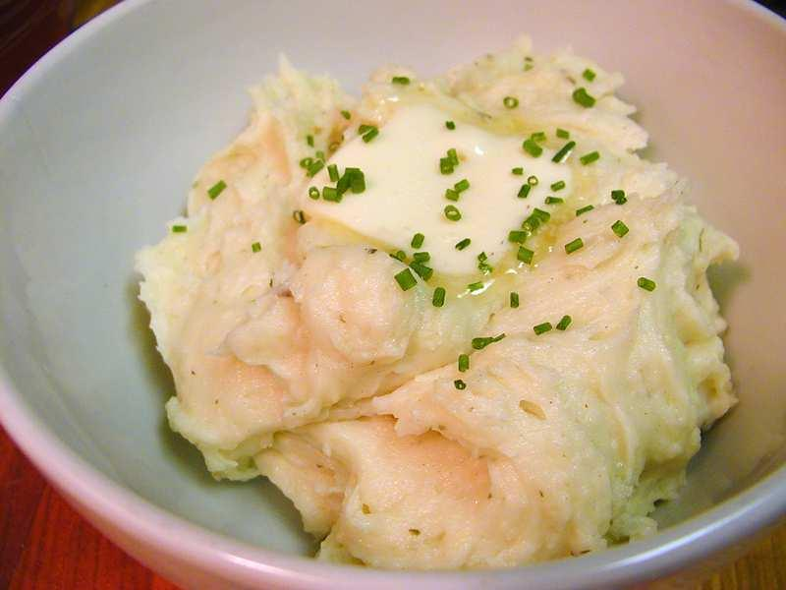
Mashed potatoes are a big deal
At least at my house. They are "good."

Slide 3
Writing can be "good," too.
Students often say, "Three people read my paper, and they didn't say to change anything because it was already good."

Slide 4
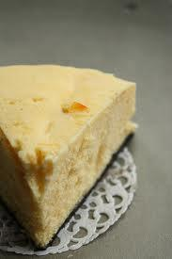
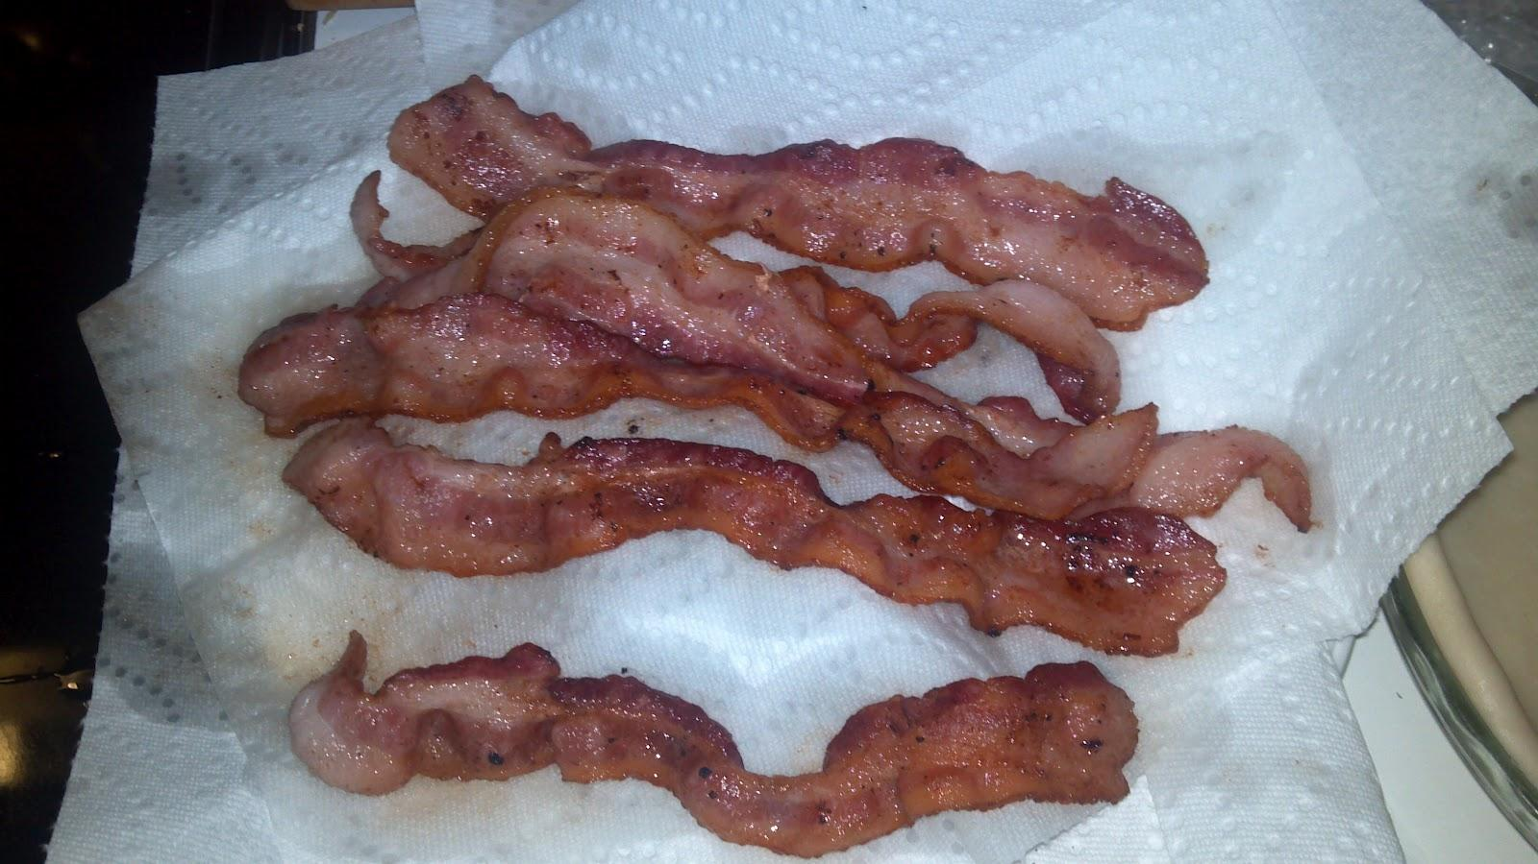
But can good be better?
Imagine: Mashed potatoes...
With cheese...
and bacon.

Slide 5
Writing can be better, too.
Even if your friend's story is good, think about how they can add cheese and bacon.
(Or hot fudge and caramel, if you like ice cream better.)
What would make the writing even better?

Slide 6
STAR
STAR is a good place to start. It stands for:
• substitute
• take out
• add
• rearrange

Slide 7
Substitute
Something in the paper is good, but it could be even better if you
• "used this word instead of that word because..."
• "put information that proves your point even better than what you have..."

Slide 8
Take out
Get rid of parts of your story that don't fit.
• "I like this part, but it doesn't fit the rest of your piece."
• "Your story is mostly serious, so this joke doesn't seem to fit."

Slide 9
Add
One of the most important parts — is there good stuff the writer left out?
• "I don't know much about your topic, so it would help to explain it more."
• "You could describe your brother more so I get a better idea of what he's like."
• "I like this part and I want even more information about it."

Slide 10
Add, continued
• "You describe what happened, but you don't show how you feel — maybe tell me more about that."
• "You have a good opinion, but you need more facts to back it up and show why you are right."

Slide 11
Rearrange
Sometimes the parts of a story aren't in the best order. Is there a way to rearrange them to make more sense?
"I think you need to put this part later, so it fits with your conclusion."

Slide 12
Peer reviewing isn't mean
You aren't telling your friend what is wrong with his/her paper...
(Okay, sometimes you are.)
You are telling the writer how to make a story even better.

Slide 13
So once a piece of writing is “good”
Help your friend find ways to “add cheese
and bacon.”

