Slide 1
The Opinion Section
Opinion Writing

Slide 2
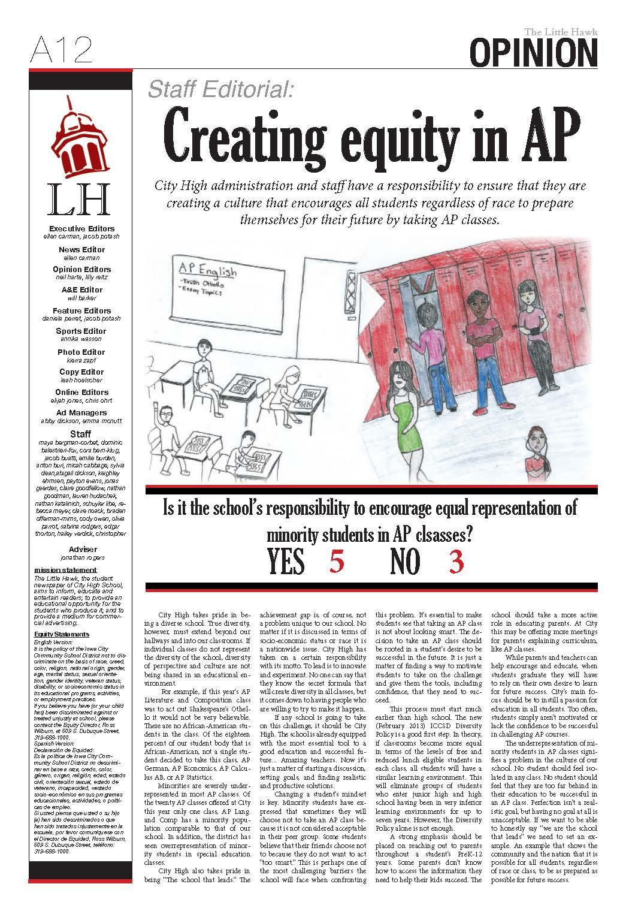
Little Hawk Editorial Page
City High School
Iowa City, Iowa
November 2013

Slide 3
The opinion section
While opinion writing can appear in many forms in magazines and news websites, newspaper opinion pages have several features that pop up often.

Slide 4
Two types of pages
Newspapers often have two types of opinion pages.
Editorial page: Has opinion stories with paper’s official opinion.
Op/Ed: Opposite the Editorial page is a page with columns, which are stories that reflect the writer’s personal opinion.

Slide 5
Editorial page features
Editorials: These stories are often unsigned, because they represent a collective viewpoint rather than an individual one.
Letters to the editor: Letters from people in the community about their opinions.

Slide 6
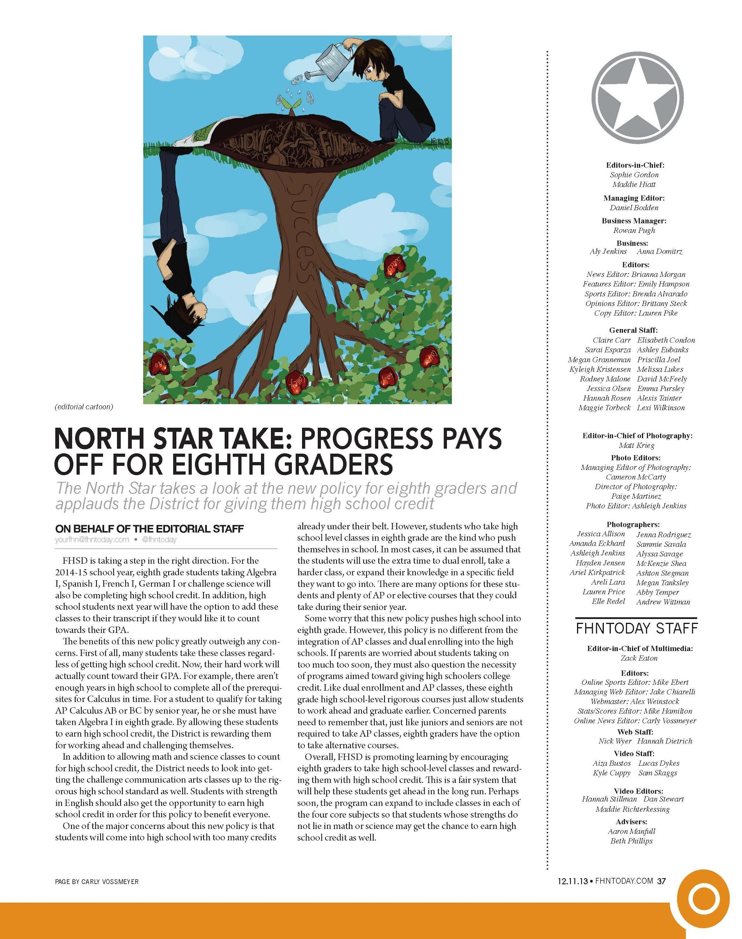
North Star Editorial Page
Francis Howell North High School
St. Charles, Mo.
December 2013

Slide 7
The editorial is unsigned because it represents the opinion of the newspaper staff, not just one student.

Slide 8
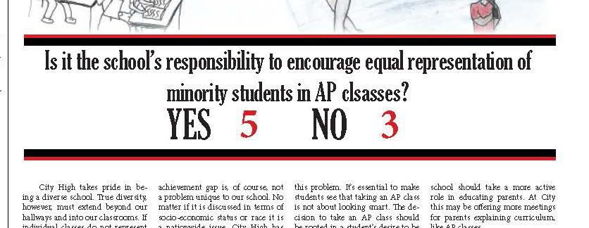
Often newspaper staffs or editorial boards will votes on the editorial and publish the results.
Little Hawk, City High School
Iowa City, Iowa
November 2013

Slide 9
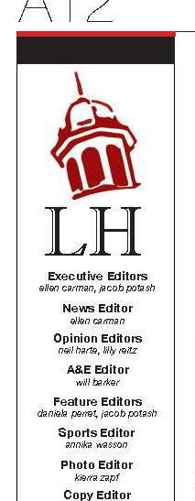
Editorial pages often contain the masthead, sometimes also referred to as the staff box, which includes a list of staff members and their positions.
The masthead also may include a brief overview of staff policies, logos for the staff, associations the newspaper is a member of (such as Quill and Scroll or the National Scholastic Press Association.)

Slide 10
Op-Ed page
Columns: Stories by specific writers, showing their opinion.
Columns are signed, and often include a mugshot (small portrait photo) of the writer.

Slide 11
Granite Bay Gazette
Granite Bay High School
Granite Bay, Calif.

Slide 12
Both pages
Ad-free: Most papers refrain from running advertisements on opinion pages so there’s no suggestion the advertisers influence opinions or endorse them.

Slide 13
Both pages
Political cartoons: Usually single-panel cartoons that use symbolism and exaggeration to make a point appear on these pages.

Slide 14
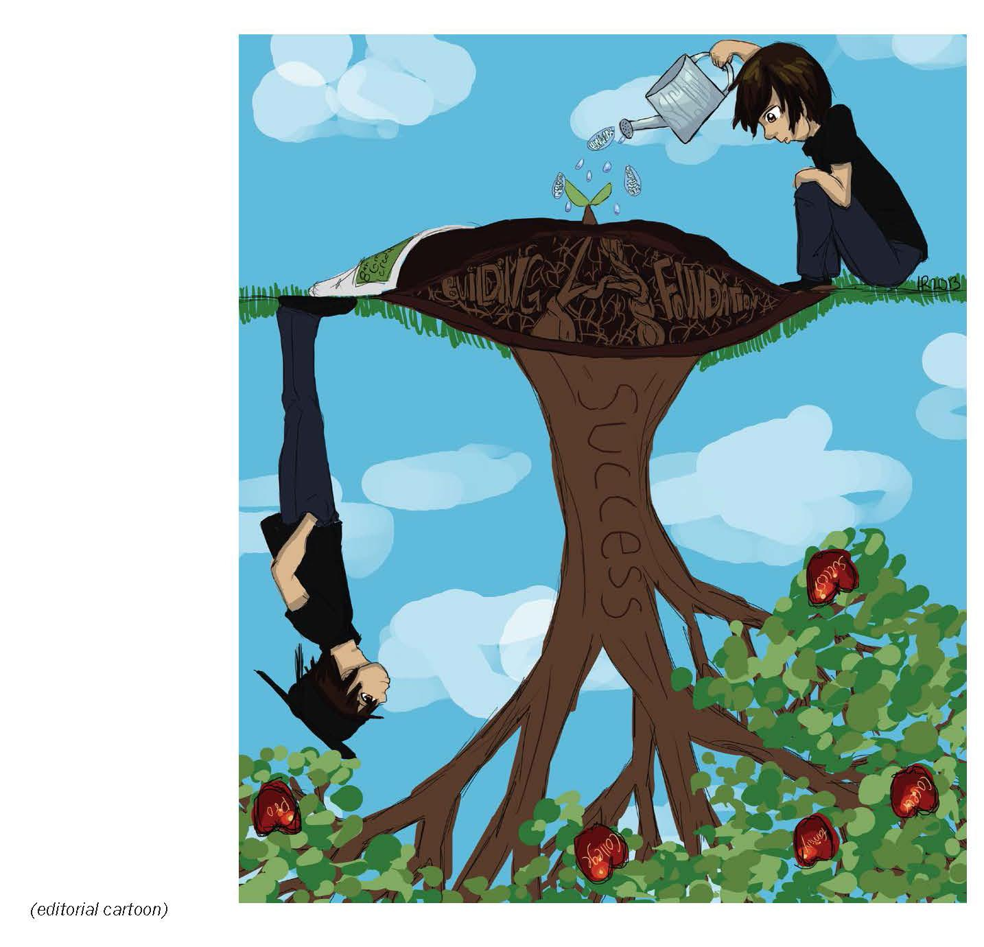
An editorial cartoon illustrates the staff opinion.

Slide 15
Both pages
Editorial briefs: Lists of things the paper sees as good or bad in the community.
(See next slide, Granite Bay Gazette)

Slide 17
Both pages
Sidebars, graphics, illustrations: Designers can use many visual devices to lead readers onto the page and better explain the stories.

Slide 18
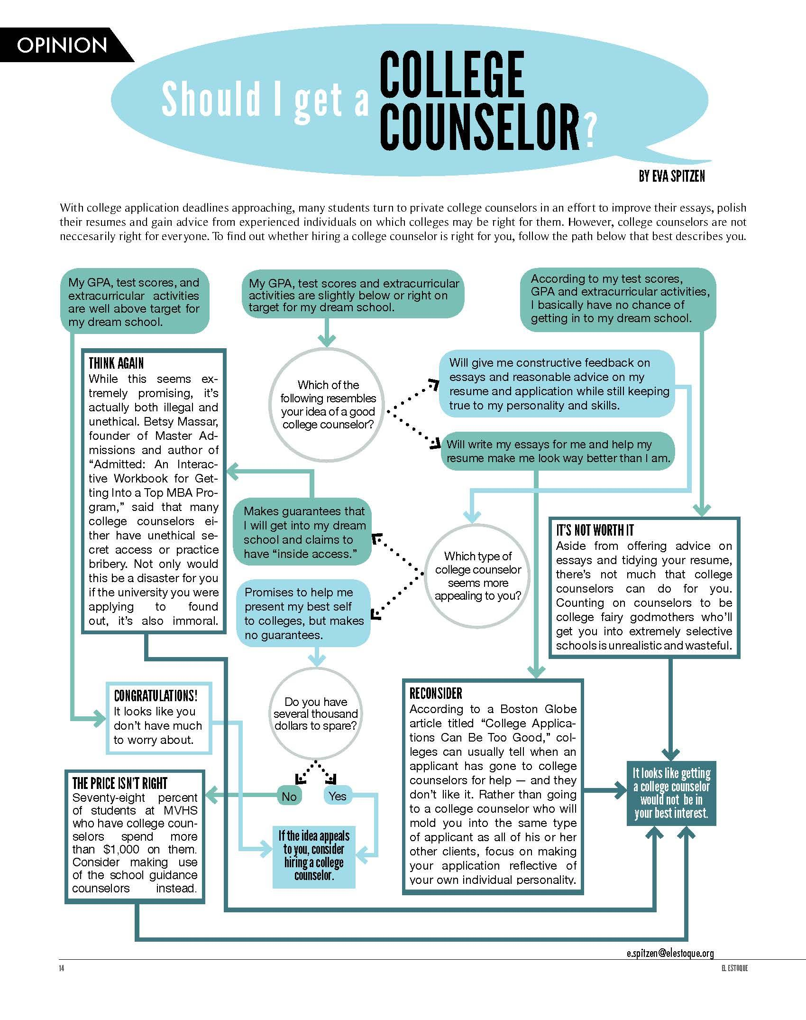
El Estoque
Monta Vista High School
Cupertino, Calif.

