Slide 1
Cropping for Impact
Photojournalism

Slide 2
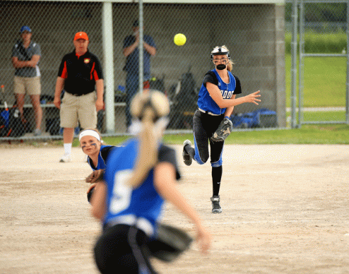
Consider this photo
Notes:
There is a lot going on in this photo, but what story are you trying to tell?

Slide 3
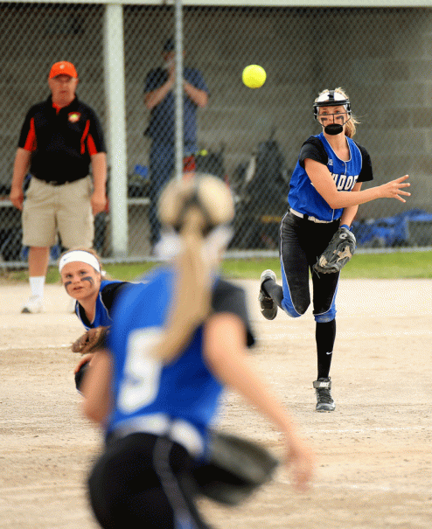
Cropping from the outside in
Notes:
If we take the original image and crop away the sides, we eliminate the “wasted space” where nothing is happening. This is a perfectly cropped photo this way, but are we creating the biggest impact or telling the story we want to tell by leaving everything in the image the way we have?
This is the method that a lot of people would use to crop this photo.

Slide 4
Consider cropping from the inside out
Photos with
the highest impact
feature the subject
big and bold.

Slide 5
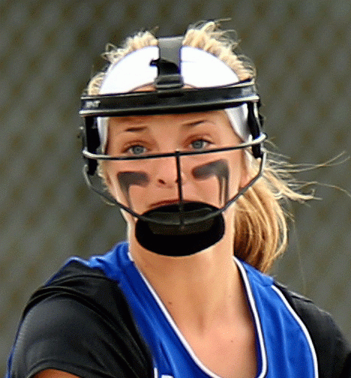
Start with the main subject’s head
Notes:
Already, we have reduced this image to its essence: a softball player with an intense look in her eye.

Slide 6
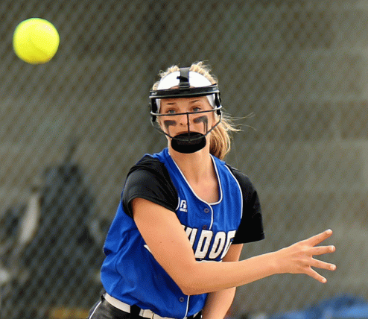
Work your way out from there
Notes:
Gradually add more to the cropped image. Now we have the ball and her arm in the photo. This is begins to tell the complete story. We have a third baseman throwing to first.

Slide 7
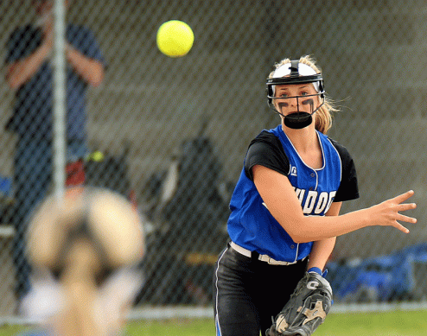
Keep adding more to your crop
Notes:
By expanding our crop just a tiny bit, we now include the head of the first baseman, framing the thrower and giving us a definite context for what is going on in the photo. It’s a shame that the guy in the dugout chose that moment to blow his nose. Is that too distracting? Maybe not, since the wide aperture used in the photo narrows the depth of field enough to blur him significantly.

Slide 8
And one step further out
Notes:
Now we are back to our first outside-in crop. We now have the opposing coach in the photo. We also have our all-state pitcher crouching down so the throw is clear. But there is no way to crop farther out than the second image with the ball and arm that does not include the nose-blower.

Slide 9
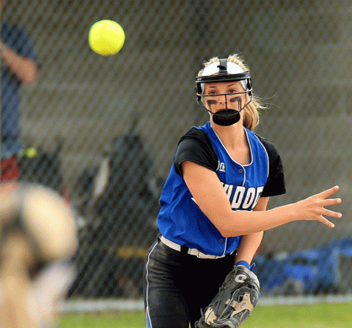
A final decision
Notes:
So the final decision is up to you. By adjusting the left-hand edge of the third crop, we eliminate the pole in front of the dugout, as well as the complete nose-blowing. We have included a portion of the head of the first baseman, so there is more context and some framing. The viewer’s eye is drawn to the intense look on the third baseman’s face, and we have included the ball in the image.

Slide 10
Your turn
Using the image on the following slide, crop from the outside edges and simply eliminate any dead space.
Next, crop from the inside out. Start with just the head of the main subject. Work your way out until you reach a point where adding the next iteration adds no more important information to the image.

Slide 11
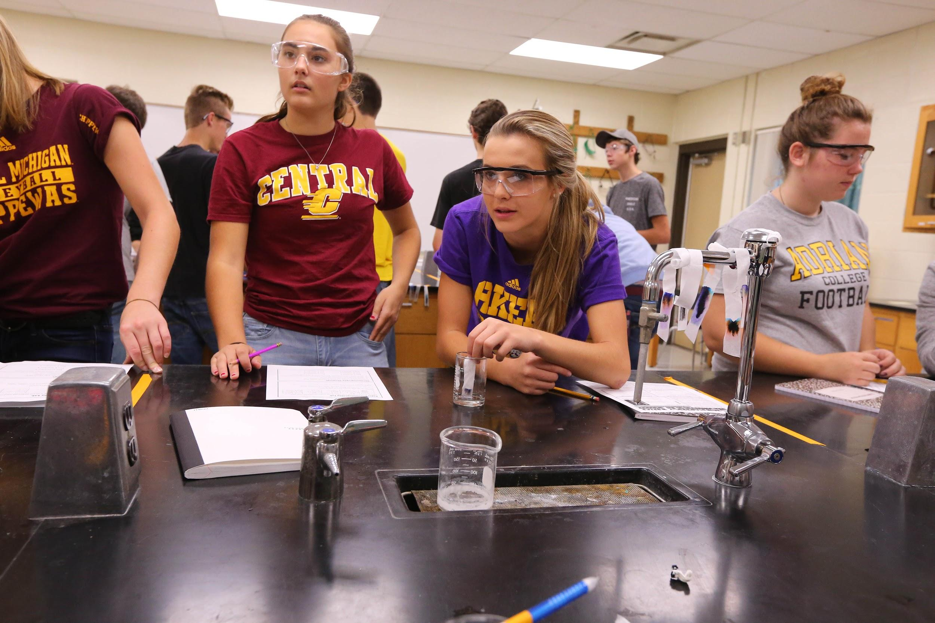

Slide 12
