Slide 1
Photo Editing Basics
Photojournalism

Slide 2
IMPORTANT!
ALWAYS make a copy before editing. Never work on your original.

Slide 3
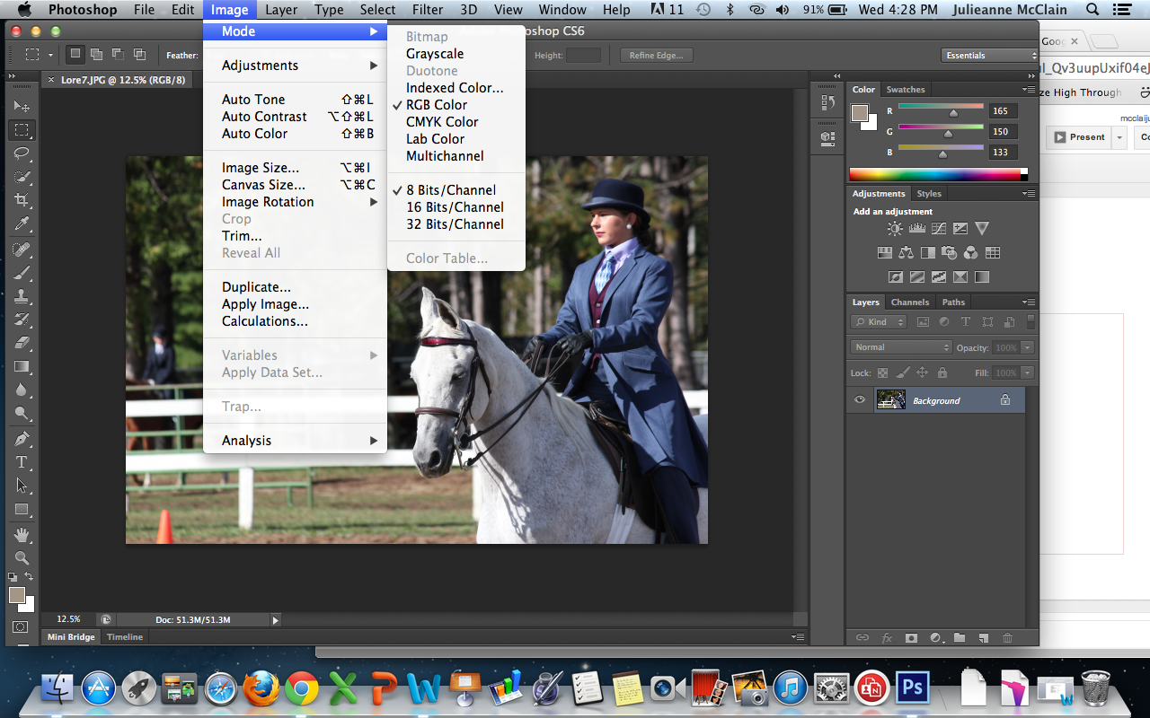
Mode adjustment
Grayscale = no color
RGB = specifies Red/Green/Blue
CMYK = specifies Cyan/Magenta/
Yellow/Black
Which do you need?
Printing in color:
you need CMYK.
Printing in black
and white:
use grayscale.
Saving for the Web: you need RGB.

Slide 4
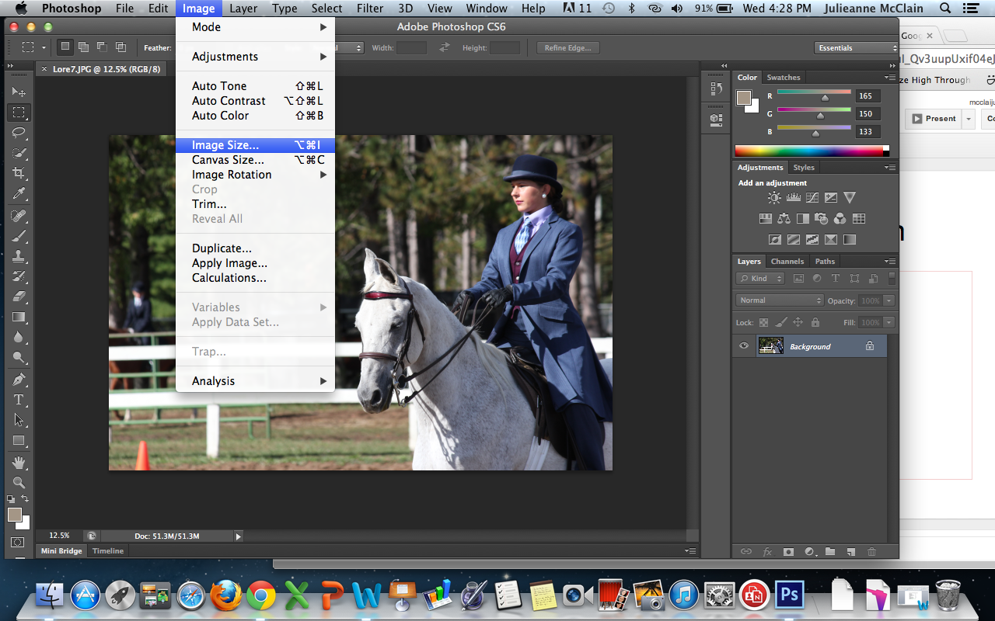
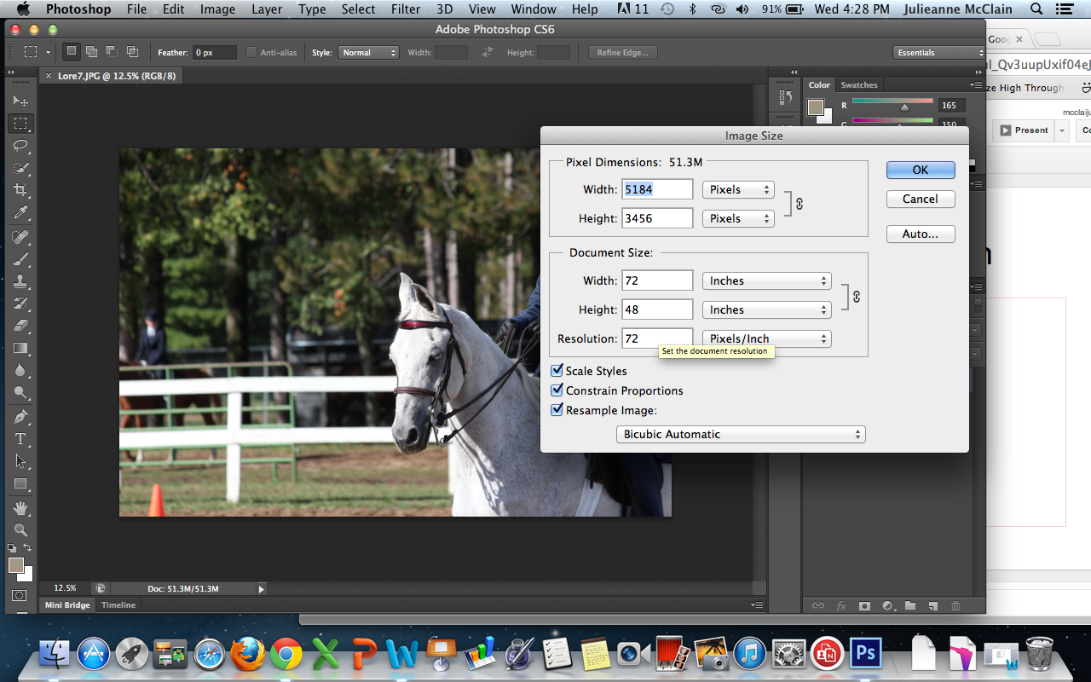
Adjusting Resolution
“Image Size:” Lots of helpful stuff
Change the size of the photo by specifying number of pixels.
Change the size of the document by specifying height or width.
Change the resolution of a photo.
Use 72 for web, but higher (200-300) for print.

Slide 5
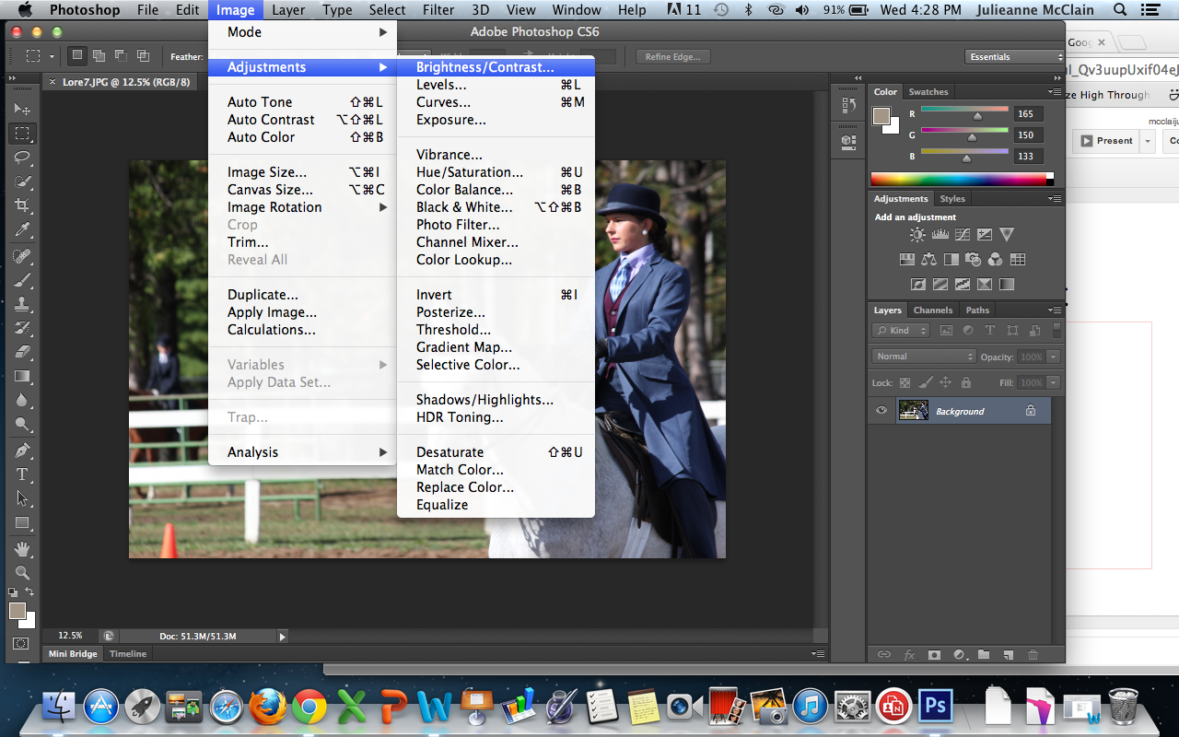
Color adjustment: Brightness/Contrast
The brightness and contrast settings adjust an entire photo.
BUT
A photo is complex, so adjusting the entire thing almost never works.
Levels and curves are much better options

Slide 6
Levels & Curves

Slide 7
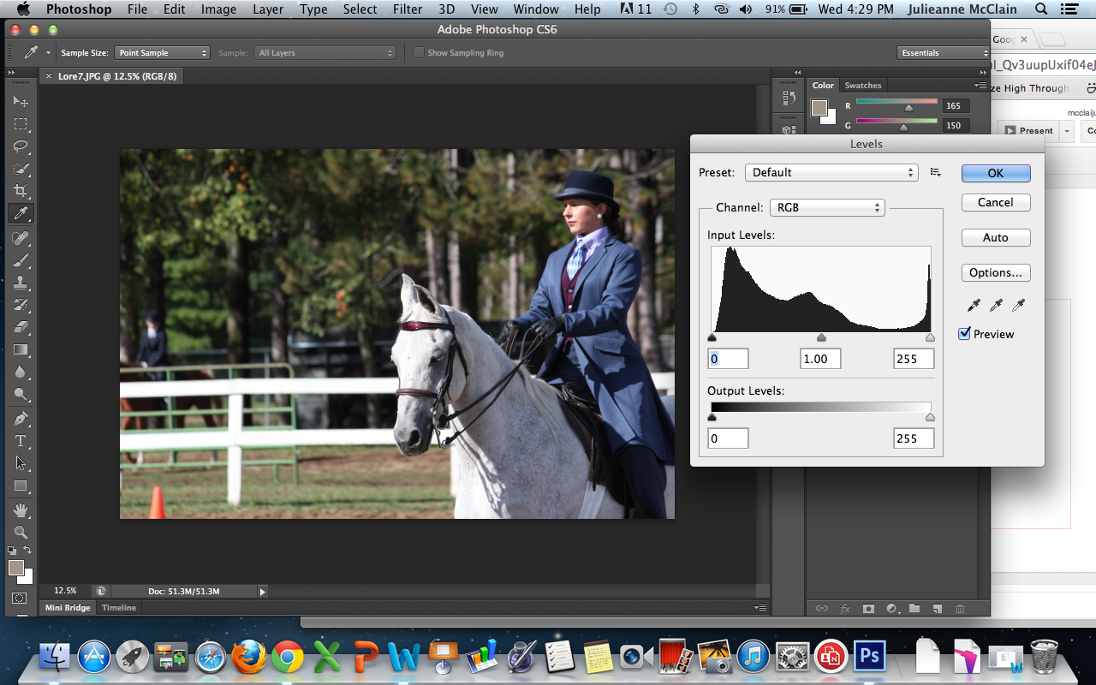
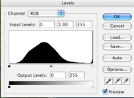
Color adjustment: Levels
Adjust by moving the triangles:
Black - adjusts blacks
White - adjust whites
Gray - adjust midtones
A correctly exposed photo will have peaks above both the white and black triangles
If your Levels box looks like this, try sliding both the black and white triangles to the beginning of the “mountain.”

Slide 8
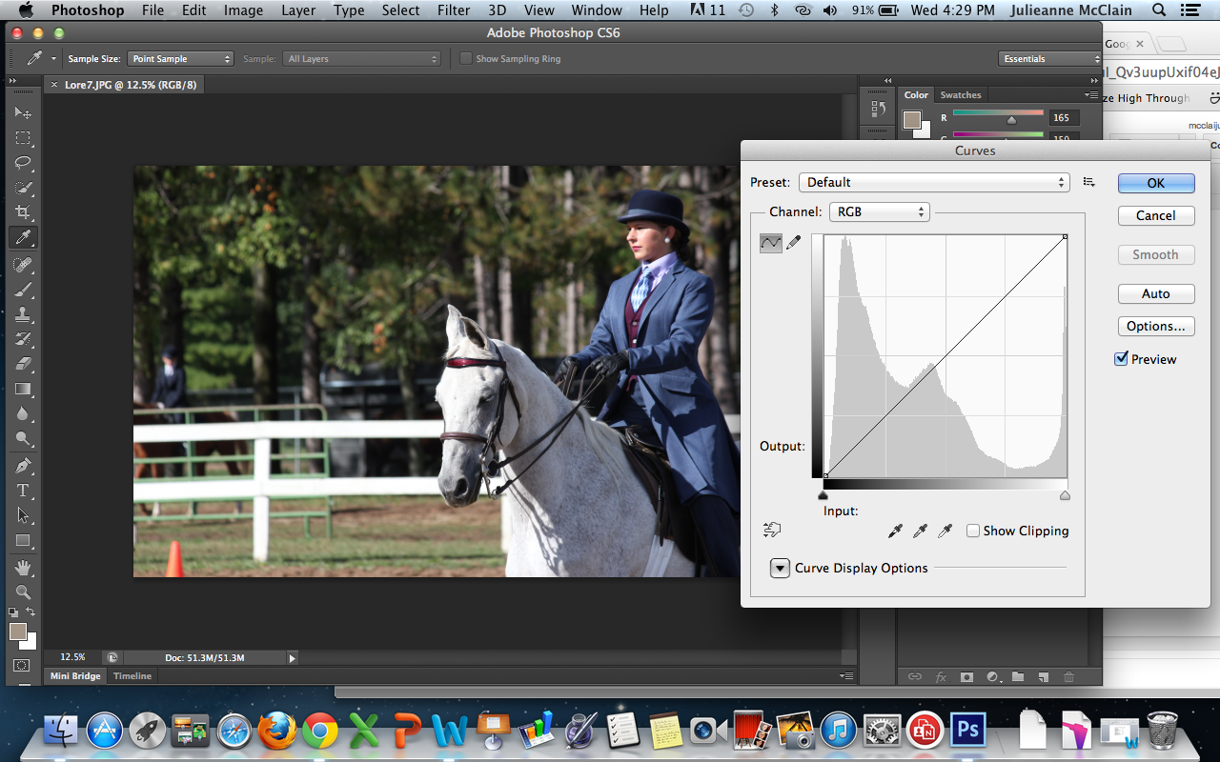
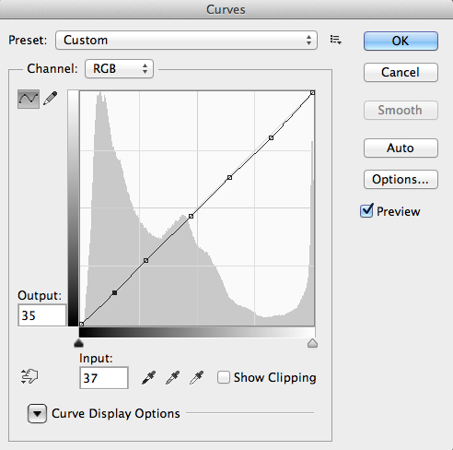
Color adjustment: Curves
Curves gives an even more fine-tuned approach to color adjustment.
Open up the Curves dialog box. Click on the line to add several additional points, and then drag them to adjust color levels.

Slide 9
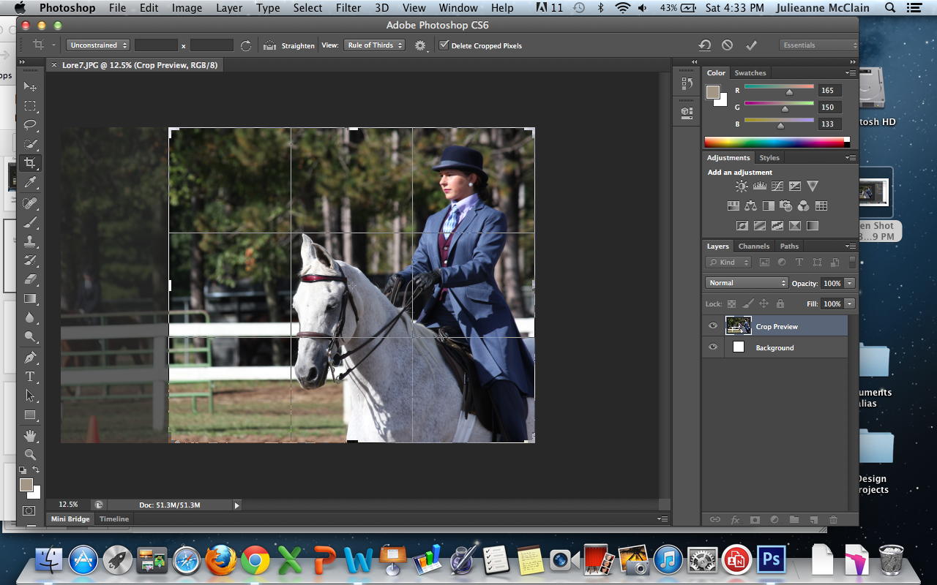
Cropping
Cropping a photo means removing the exterior edge(s) of a photo. This can help to improve framing or accentuate the photo’s subject.
This is the Crop symbol
When the Crop tool is selected, click and drag to decide what area of the photo you want to keep.

Slide 10
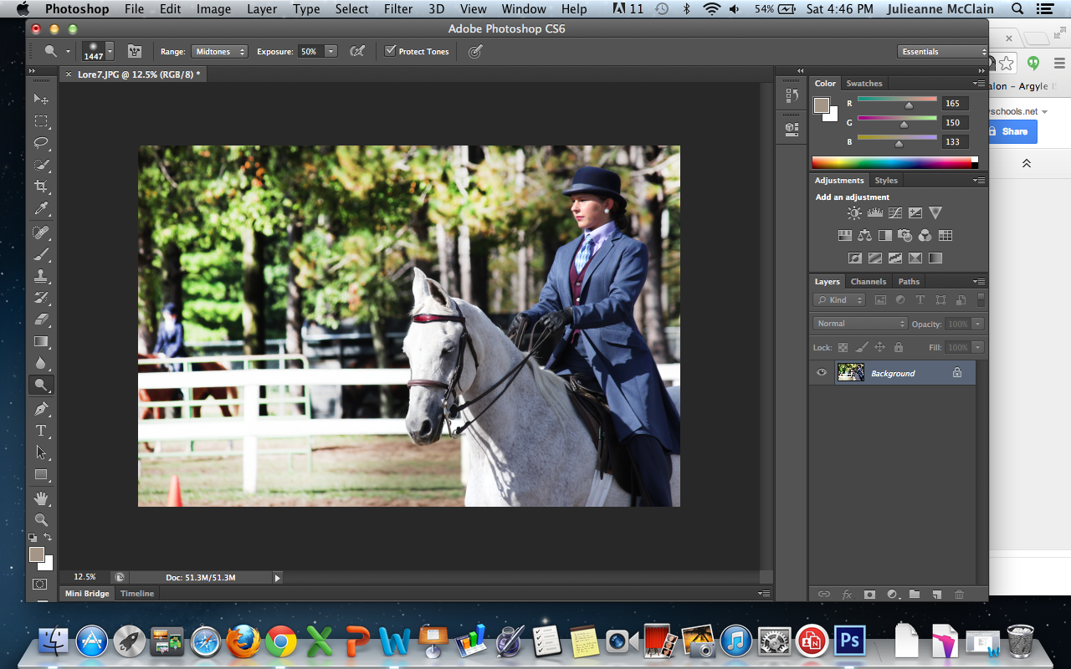
Dodging
Refers to the process of making an area of the photo lighter.
This is the Dodge symbol
When the Dodge tool is selected, you can change the size of your brush and click or drag to lighten specific areas.
In this photo, the trees have been lightened.

Slide 11
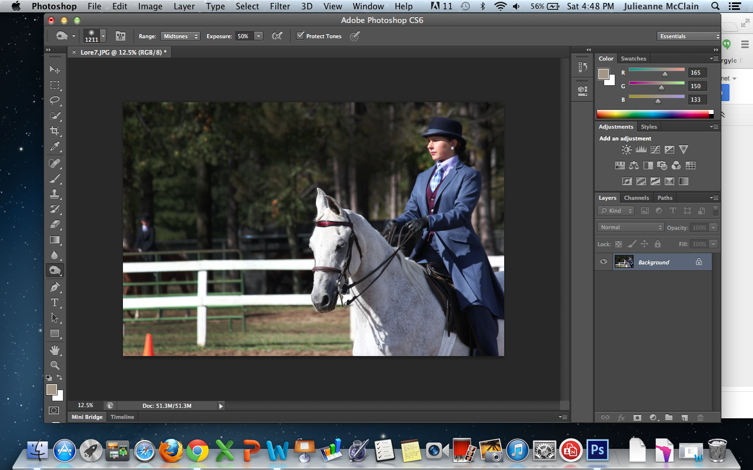
Burning
Refers to the process of making an area of the photo darker.
This is the Burn symbol
When the Burn tool is selected, you can change the size of your brush and click or drag to lighten specific areas.
In this photo, the trees have been darkened.
WARNING: Both dodging and burning can be used excessively and are difficult to do well. Only use when necessary.

Slide 12
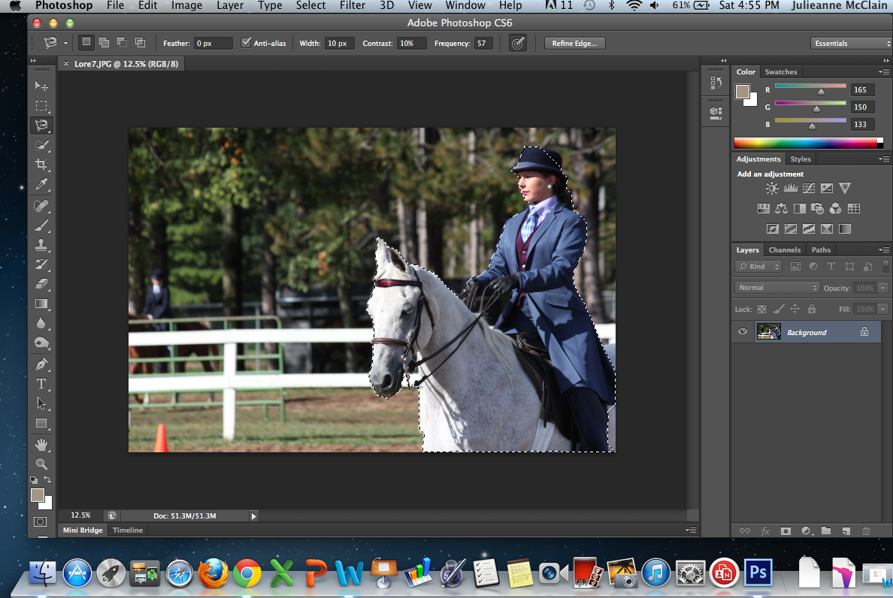
Cutouts
A cutout refers to an image where the background has been deleted or cut away.
WARNING: Cutouts require time, energy, and a little bit of perfectionism. When done haphazardly, they can cut off parts of your subject (like the example below).
Cutouts are multi-step processes that generally involve selecting an object using either a Lasso or a Pen Tool, then copying that subject onto a transparent background.
Lots of tutorials are online.

Slide 13
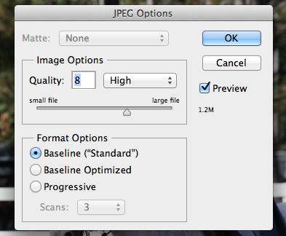
Saving for Print
A .psd file format will retain a photo’s layers (any text or images you add on top of the original photo). That way you can still go back and adjust.
A .jpeg will flatten the layers of a photo so they are no longer adjustable.
When saving as a .jpeg, you can choose what quality (high is usually fine)
This will also tell you the size of the photo.

Slide 14
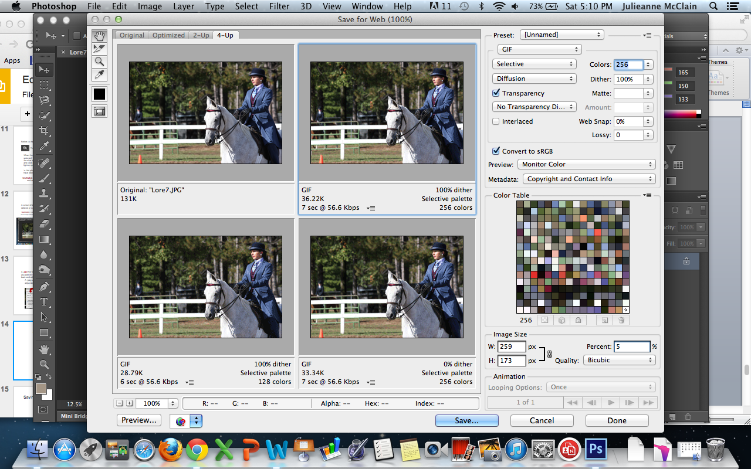
Saving for the Web
A .gif file format is usually preferable for Web.
Choose File > Save For Web, then click the “4Up” tab to see options.
From here, select which option you want based on file size and loading time.

Slide 15
Saving for the Web - SEO Tags
Adding an SEO (Search Engine Optimization) Tag to your photo is a good way to ensure several things:
1) If your photo doesn’t load, the viewer still knows what is supposed to be there.
2) Search engines like Google can find your photo when people search for it.
SEO Tags are often entered as you upload photos (Your web host may just call it “ALT TEXT”). It may be tempting not to type anything, but don’t skip this step!

Slide 16
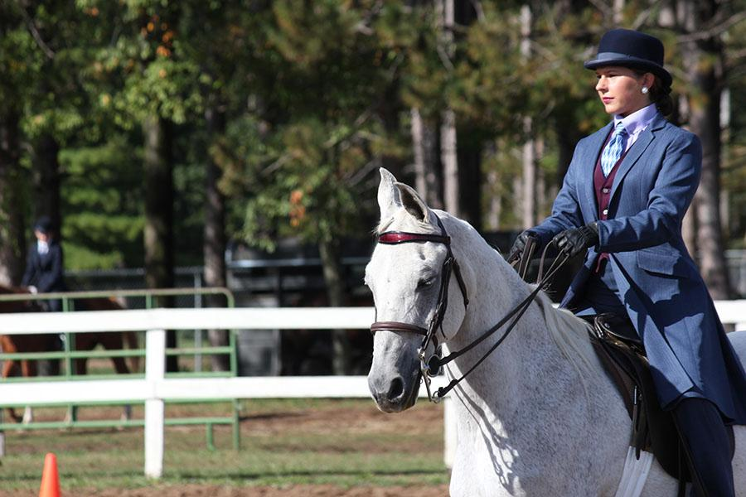
Lore Staff

