Slide 1
Photography
in Motion
Photojournalism

Slide 2
Why motion?
Photography is about capturing one moment.
BUT
Life, and its subjects, are
constantly in motion.

Slide 3
Why motion?
One obvious reason to capture motion:
to show movement
but also, journalists capture motion ...
to eliminate visual distractions
to communicate mood

Slide 4
How to show motion
Depending on the effect you want to create, you may choose several options:
blur the background, freeze the foreground
blur the foreground, freeze the background
blur the entire image
freeze the entire image

Slide 5
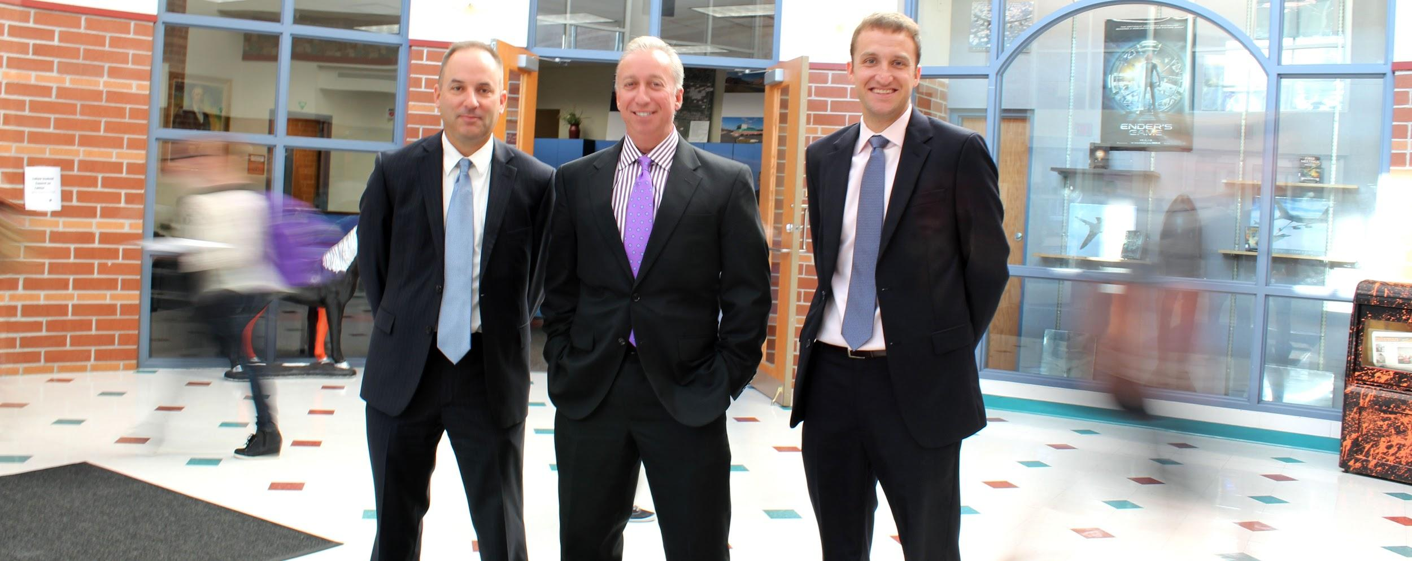
Consider the image below.
The Talisman; Rutherford B. Hayes High School

Slide 6
Why did the photographer choose to take a photo with this effect?
What mood is communicated?
What message is communicated?
How does the motion contribute to the mood/message?

Slide 7
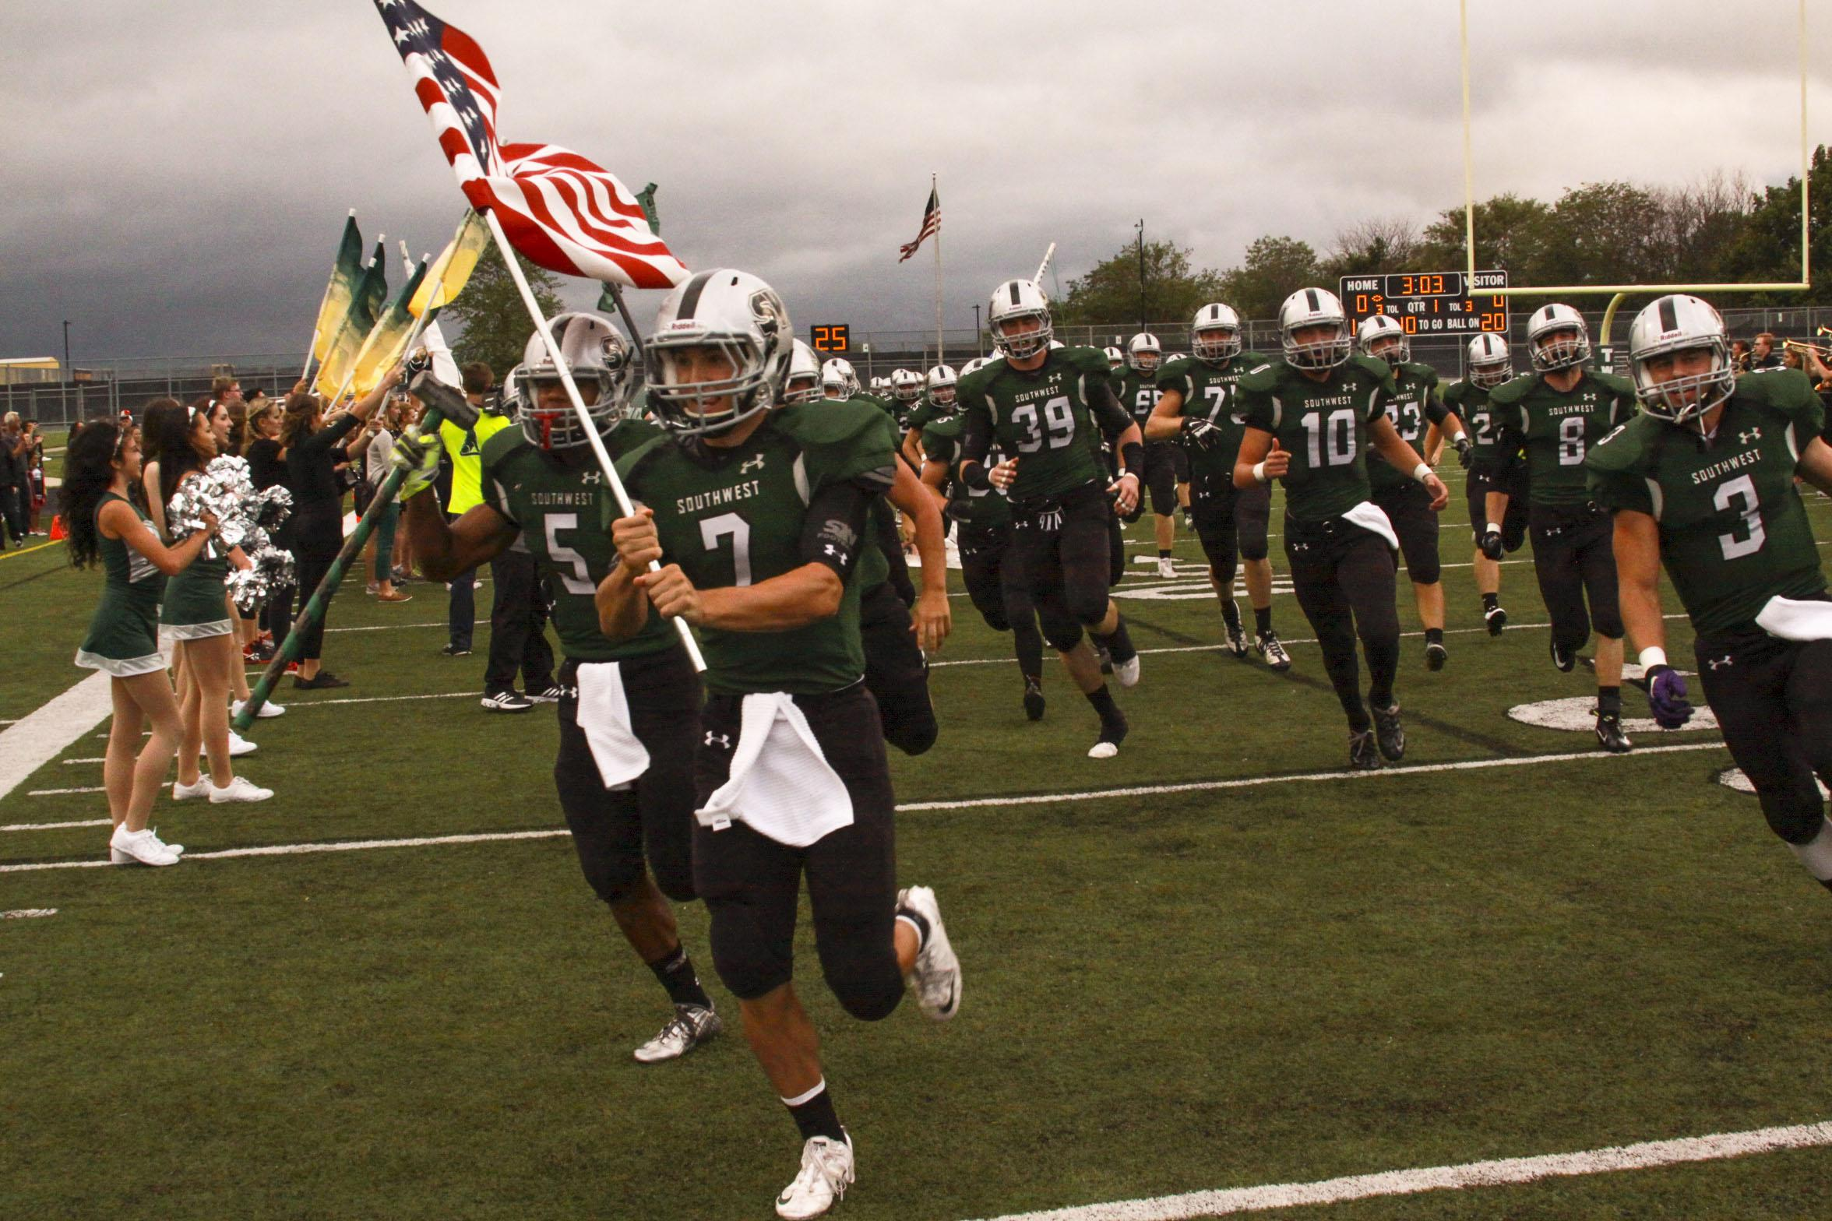
How to capture motion
Use a high shutter speed to freeze an entire image:
Blue Valley Southwest High School

Slide 8
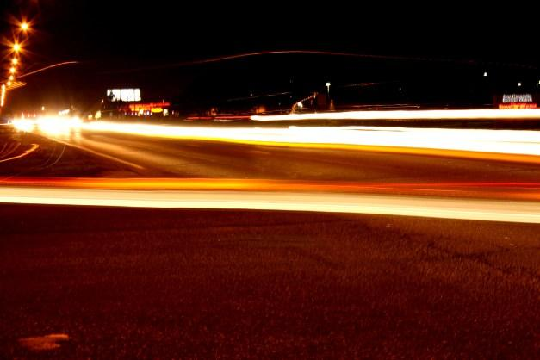
How to capture motion
Use a slow shutter speed (& a tripod) to blur everything moving in an image:
Maize High School

Slide 9
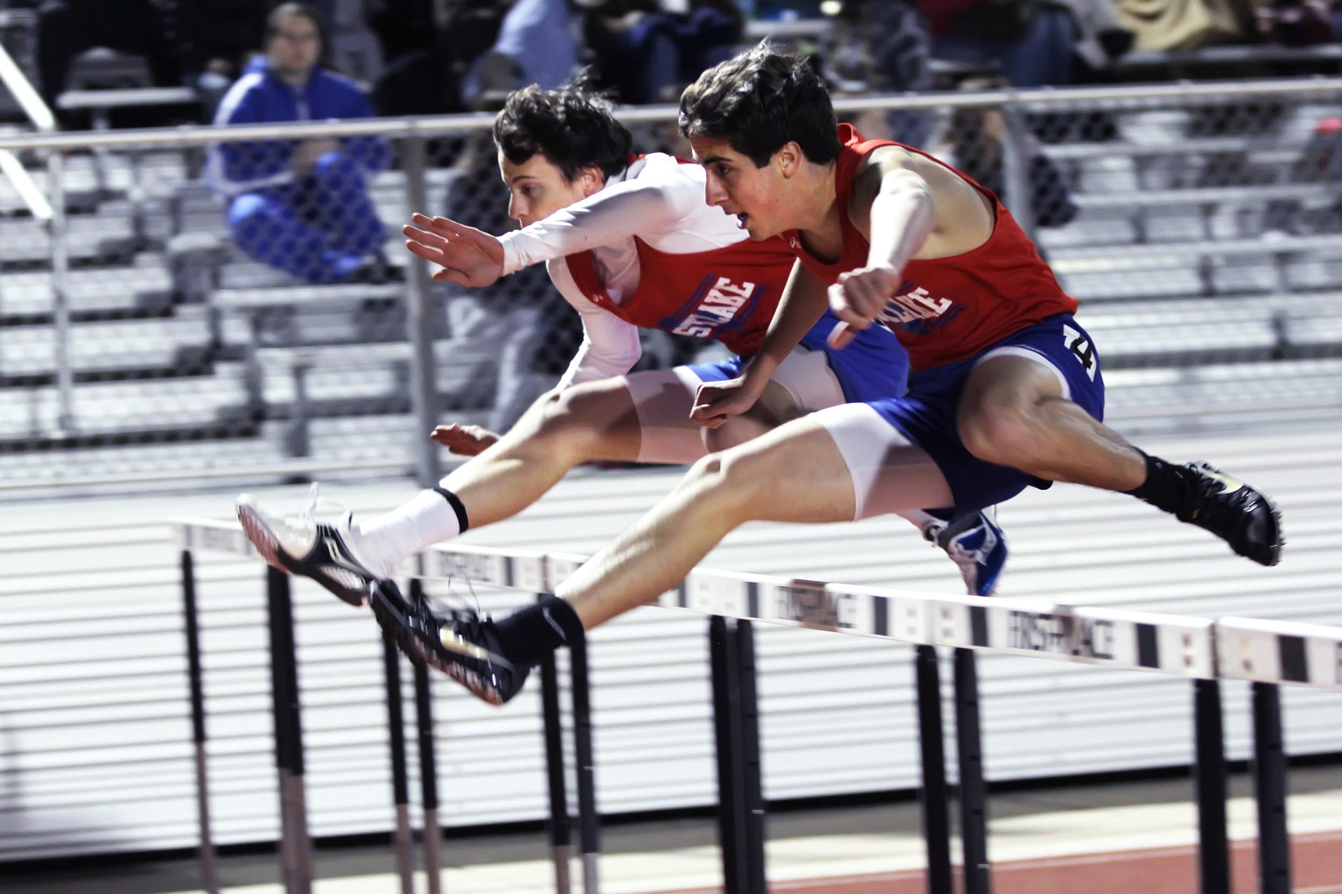
How to capture motion
Use a panning technique to freeze movement while blurring still (non-moving) parts of the image:
Casey Simmons; Westlake High School

Slide 10
Understanding panning
Panning is technique in which a photographer moves the camera parallel to a moving subject
Steps for panning:
Select a slower shutter speed.
Position your body facing the end position of the moving subject.
Twist your torso to point camera at approaching subject.
Follow subject with camera prior to pushing shutter (in order to better feel the movement).
Press shutter trigger and “untwist” body, keeping your camera pointed at the subject.

Slide 11
Freezing, blurring, panning
No matter what, dealing with motion
in photography takes practice.
Experiment. Be patient.

