Slide 1
Making Selections in Photoshop
Photojournalism

Slide 2
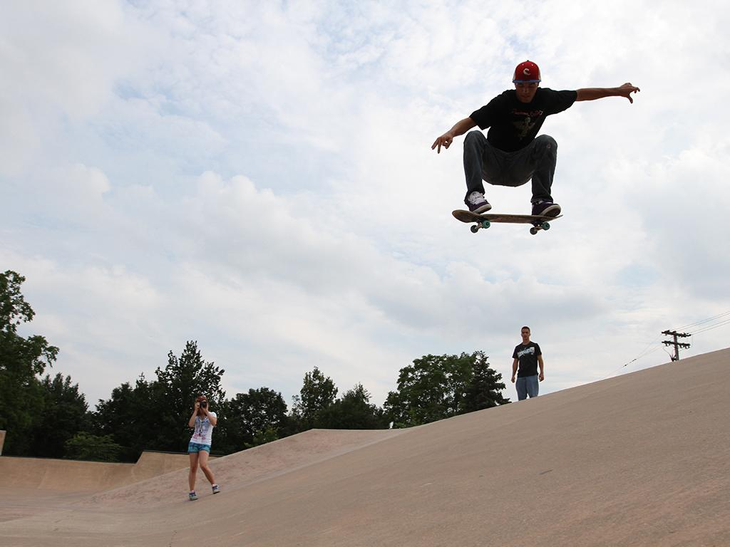
Choosing a sample image
Choose an image to practice with that has high contrast between the subject and the background.

Slide 3
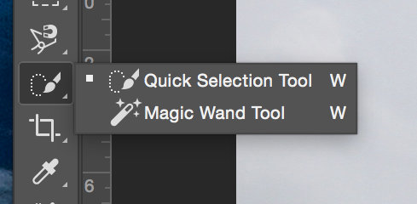
Magic Wand tool
A very quick way to make a selection is the Quick Selection Tool or the Magic Wand Tool. Both of these use contrast detection to find the edge.
HINT: change the size of a tool using the square bracket keys located above the Return key on the keyboard.
HINT 2: Hold down the Option key on the keyboard to change from adding to subtracting from a selection.

Slide 4
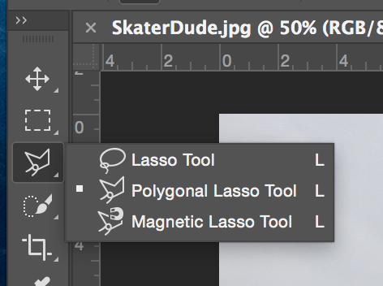
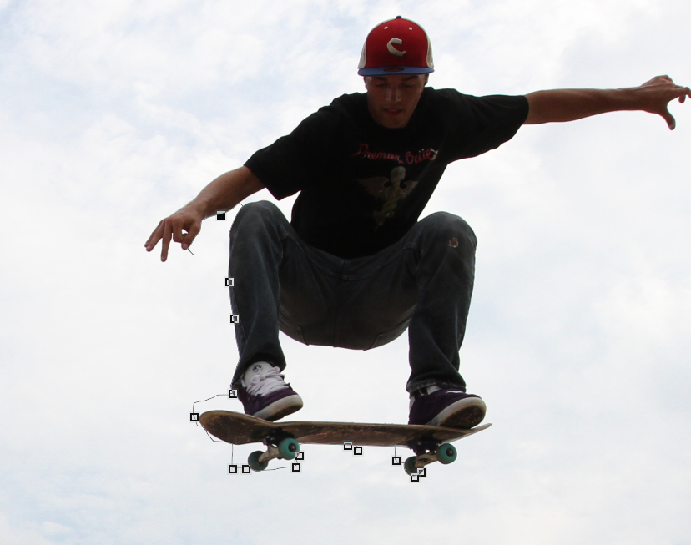
Magnetic lasso tool
Photoshop automatically detects the difference in contrast as you guide your mouse near the edge of the subject.

Slide 5
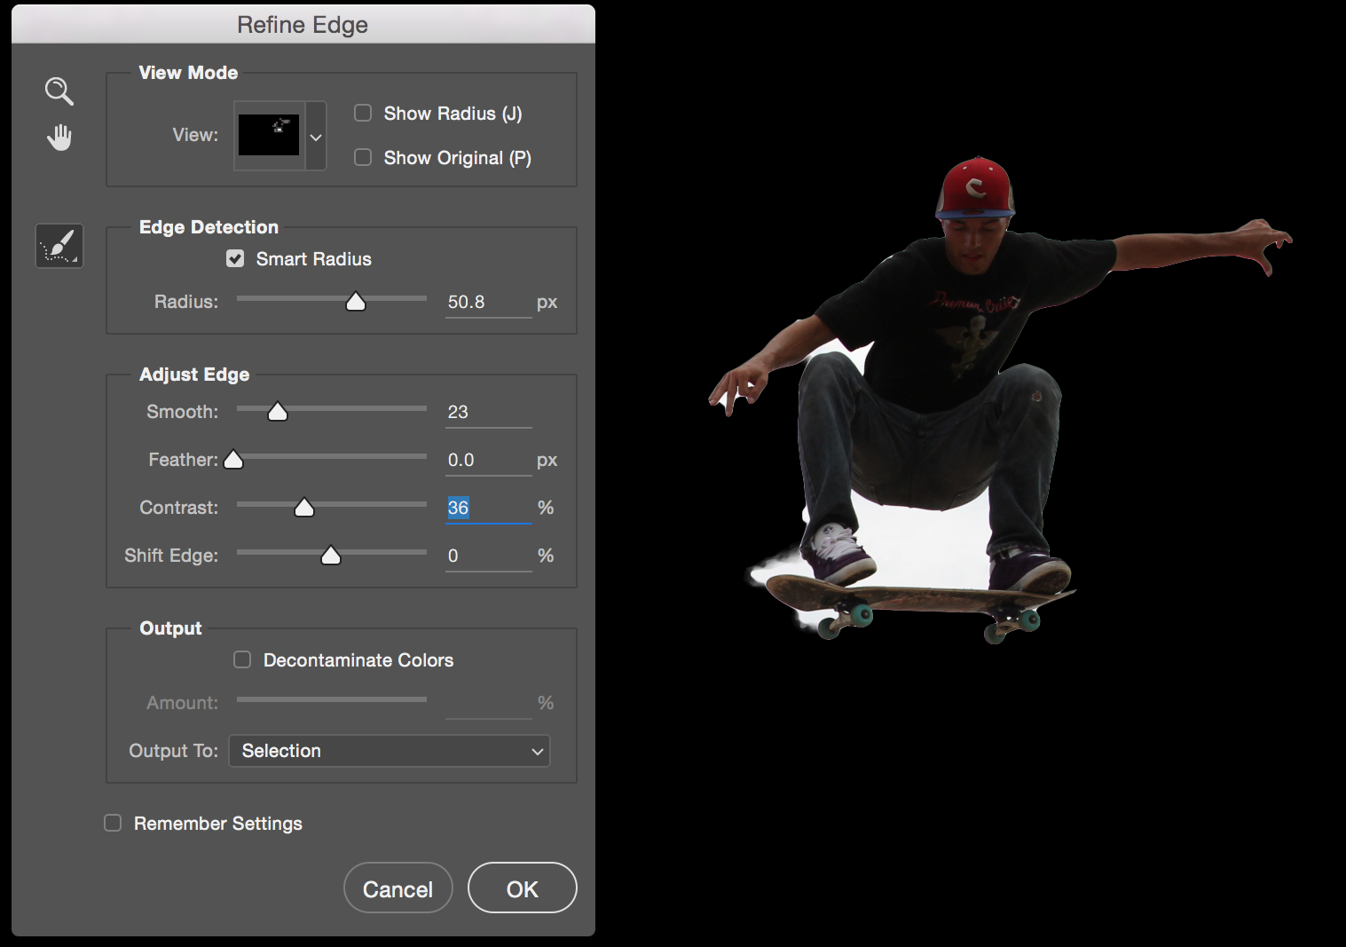
Refine edges
You can modify your selection using the power of Photoshop under Select>Refine Edge

Slide 6
Quick Mask Mode
Sometimes, despite how powerful it is, Photoshop just does not get it right. You can make selections “by hand” using Quick Mask mode.

Slide 7
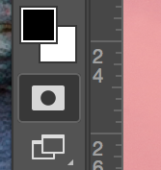
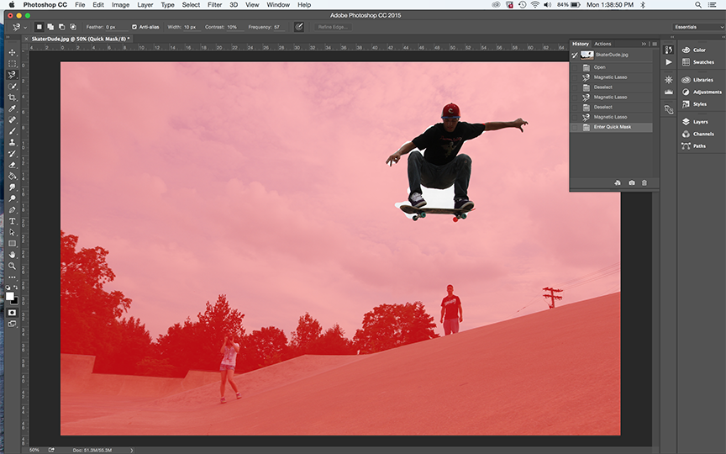
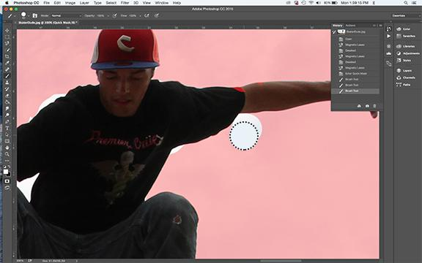
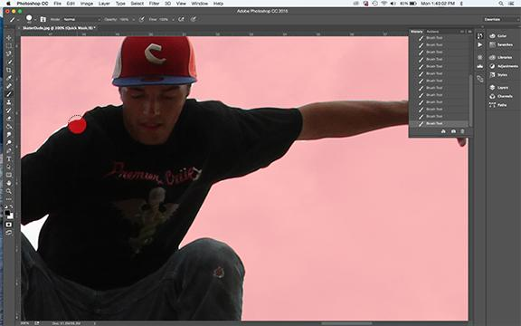
Quick Mask Mode
The selected area appears normal. Unselected areas appear red
Use the brush tool to paint over areas to keep or not
Alternate between black (remove) and white (keep) using the X keyboard shortcut
Notes:
Toggle in and out of Quick Mask mode using the Q keyboard shortcut or by clicking on the icon below foreground/background colors in the bottom left under the tools.

Slide 8
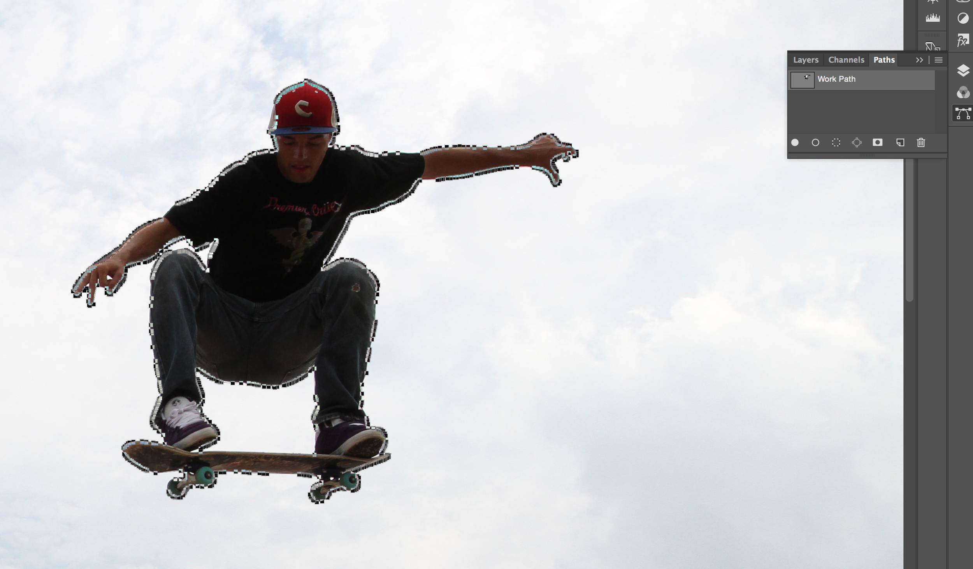
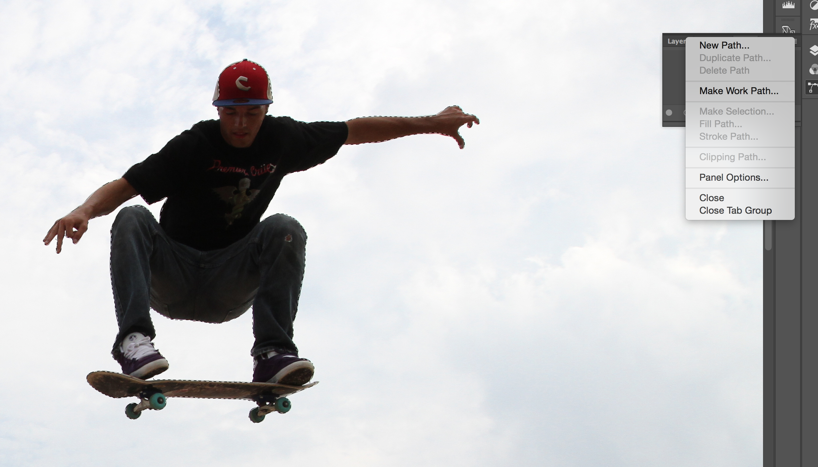
Save Path
At this point, you have worked so hard to make a great selection, it might be an excellent idea to save this selection as a Path. You can come back to editing this selection later by making a chosen Path a selection using the flyout menu in the upper right corner of the Path palette.
Notes:
Going from a Selection to a Make a Work Path… is the only option at that point. After the Work Path is saved, then Save Path is available. The image of the Make Work Path icon is included above.

Slide 9
Save Path
To fully save the Path, make your selection a Working Path first by choosing Make Work Path..., then Save Path. Saving the image at this point will also save the included path.

Slide 10
Your Turn
The assignment is to turn in FIVE images, four demonstrating each of the selection methods and a FIFTH which may combine the use of some or all of these to create the best possible selection with that selection saved as a Path.

