Slide 1
Social Media & Photography
Photojournalism

Slide 2
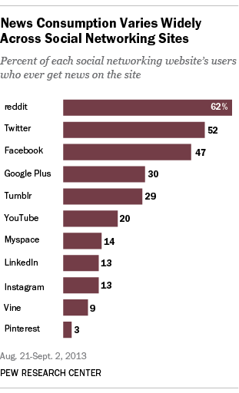
Why social media?
A 2013 study found that social media users represent 1 in 4 people
on the globe, roughly 1.73 billion people.
Discuss: Why do you think social media is so popular today?
(November 14, 2013; Pew Research Center)

Slide 3
Social media is visual
Discuss with a partner:
When you first log on to a social media account, what do you look for?
How do photos fit into that?
True or false? Social media’s popularity is dependent on visual content.

Slide 4
Copyright concerns
Just because someone else posts it,
doesn’t make it copyright free.
Journalists must still be aware of copyright law.
For example,
Pinterest’s policy:
That means you are legally liable, not them.
“Your Content. Pinterest allows you to post content, including photos, comments and other materials. Anything that you post or otherwise make available on our Products is referred to as “User Content.” You retain all rights in, and are solely responsible for, the User Content you post to Pinterest.”

Slide 5
Smartphones and photography
The ability to take photos and upload digital content on the go has dramatically changed the face of journalism.
Smartphones are now used to:
• update social media accounts
• take photos and upload instantly
• access mobile versions of websites

Slide 6
Case study: Chicago Sun Times
In May 2013, the Chicago Sun Times laid off its entire photography staff. In its place, they gave iPhones to all its reporters and trained them in using the phones to take pictures effectively.
The newspaper received criticism from across the country from people saying the decision would destroy the quality of images published.

Slide 7
Case Study: Chicago Sun Times
Compare these two newspapers front pages from June 26, 2013
(Huffington Post, June 27, 2013)

Slide 8
A note about resolution/image size
Image quality (resolution, size) varies by phone.
A photo taken with a flip phone is a different resolution than one from an iPhone or an Android.
This limits how large a photo can appear in print.
Never adjust a photo larger than its maximum resolution and size.

Slide 9
Discuss:
What do you already know about different social media outlets?
Which do you like and use?
What challenges do you think journalists face when using social media?
Notes:
Teachers: depending on the time you have available in class, you can ask students to take a few minutes to research current usage statistics for their own favorite social media sites. You could also ask them to respond to the statistics they find - for instance, if they find that Facebook has the most total users, they can respond to whether or not they think it is still popular in their area/demographic.

Slide 10
App overview: Facebook
What is it?
An online personal profile that allows users to find friends, follow activity of other users (individuals, organizations, groups) and post content.
How do photos fit in?
Users can upload photos, post links to outside photos, and “tag” photos to attach them to others’ accounts.
Specific concerns:
Many users quit due to privacy concerns.

Slide 11
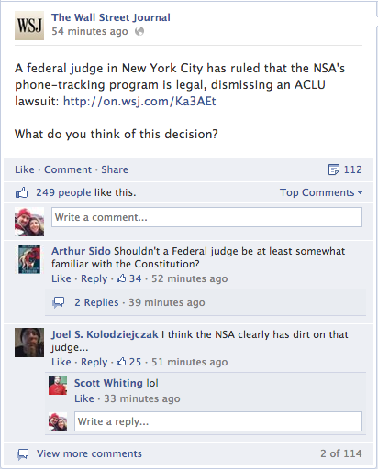
App overview: Facebook

Slide 12
App overview: Facebook
Benefits:
Largest audience (1.28 billion monthly active users)*
Appeals to all ages and demographics
Disadvantages:
Increasingly unpopular with teens
It’s “old” for social media (10 years!), so it’s probably on its way out
*2014 Statistic according to Media Bistro

Slide 13
App overview: Snapchat
What is it?
A photo sharing app that allows users to send photos with short captions and/or drawings to their followers; the receiver can view for up to 10 seconds; Publications post “stories” to followers, which are a series of photos
How do photos fit in?
Snaps are based on photos.
Specific concerns:
There is an expectation that content is deleted, but the Conditions of Use stipulate that Snapchat keeps a copy.

Slide 14
App overview: Snapchat
Notes:
New “Discover” feature allows news outlets to produce daily stories for users. For example, CNN posts popular snaps from the week, and the Food Network posts daily recipe ideas and interviews with chefs. This is a great way to get ideas for how to put together a Story to send to followers.

Slide 15
App overview: Snapchat
Benefits:
Increasingly popular with journalists and teenagers
Allows for a quick overview, like TV (new Discover feature)
Disadvantages:
Length limitations
Concerns about privacy

Slide 16
App overview: Twitter
What is it?
A “microblogging” site; users can post/repost content and links of <140 characters, follow others, etc.
How do photos fit in?
Photos appear in users’ feeds automatically.
Specific concerns:
Twitter shares users’ info with third parties; public messages are visible to anyone, but users can “protect” their tweets so that only approved followers see them.

Slide 17
App overview: Twitter

Slide 18
App overview: Twitter
Benefits:
Incredibly popular with journalists and teenagers
Hashtags (#) allow users to search for specific content
Disadvantages:
Can be difficult for users to find specific content
Easily links to other social media tools, sites, etc.

Slide 19
App overview: Instagram
What is it?
An online photo-sharing site that allows users to take photos and apply filters to create unique effects, with captions that can include hashtags.
How do photos fit in?
The feed is entirely photo-oriented.
Specific concerns:
Some concerns exist about whether Instagram sells users’ content and photos to third parties.

Slide 20
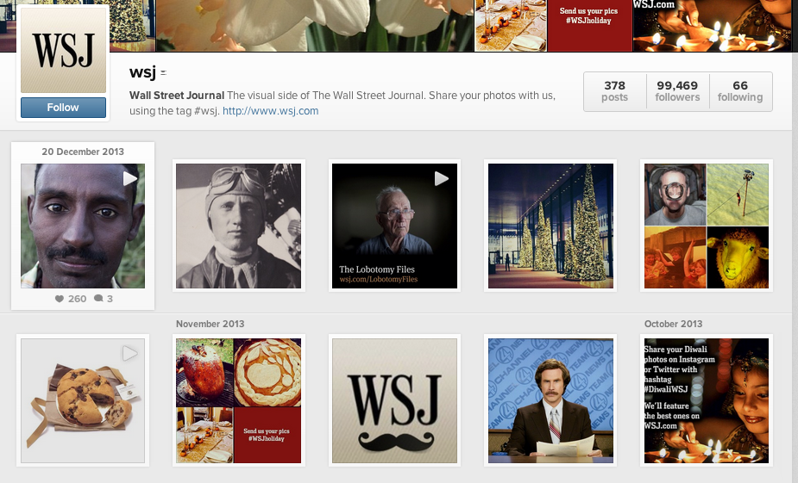
App overview: Instagram

Slide 21
App overview: Instagram
Benefits:
Connects easily to other social media
Creates instant emotional (and visual) connection
Can “tease” content that you’re covering in other media
Disadvantages:
Uses hashtags but not links, so it doesn’t easily drive traffic to a site or story like other tools do

Slide 22
App overview: Vine
What is it?
An online video-sharing site that allow users to create 6-second videos and share them with others
How do photos fit in?
They don’t, really. Video is king here.
Specific concerns:
It’s fairly new (January 2013), so there are still questions about how it will continue to develop.

Slide 23
App overview: Vine
Benefits:
6 seconds = enough time to get across a point
Video creates instant emotional connection
Disadvantages:
In its early stages, Vine videos had to be uploaded to other accounts.
6 seconds = not much time

Slide 24
App overview: Pinterest
What is it?
Users can organize photos into categories; each photo can link to outside content.
How do photos fit in?
Upload unique photos OR “pin” others’ work.
Photos are the only items that can be “pinned.”
Specific concerns:
Some questions exist about whether pins violate copyright law.

Slide 25
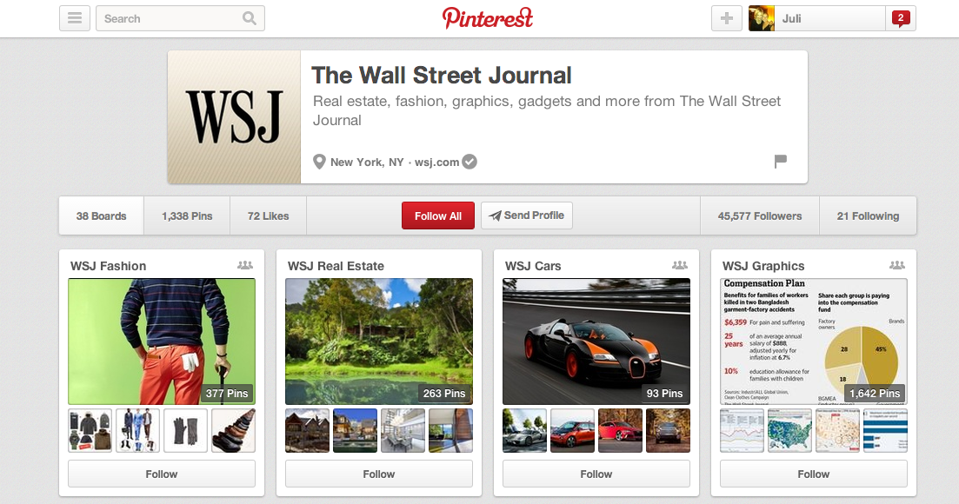
App overview: Pinterest

Slide 26
App overview: Pinterest
Benefits:
Very visual
Can follow and be followed
Can pin original or repin others’ posts
Disadvantages:
No photo, no pin (difficult to post non-visual content)
May violate copyright, especially if no credits are included

Slide 27
App overview: Reddit
What is it?
A news and entertainment site with entirely user-generated content; can also link to other sites.
How do photos fit in?
Users post/link to photos that match their content.
Specific concerns:
Many critics say that Reddit lacks legitimate and responsible news content.

Slide 28
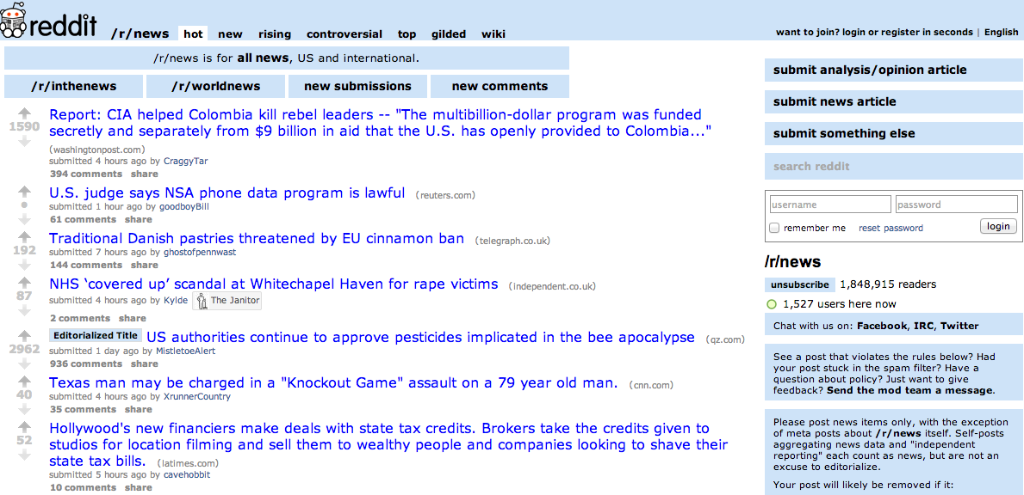
App overview: Reddit

Slide 29
App overview: Reddit
Benefits:
Fast & up-to-date, because anyone can post content
Searchable and sortable
Disadvantages:
Often unreliable and unprofessional because anyone can post content
Difficult to search for high quality instead of junk

Slide 30
App overview: tumblr
What is it?
A short-form blogging site; allows users to post unique content and link to or follow others’ pages
How do photos fit in?
Users post/link to photos that match their content.
Specific concerns:
A relatively large amount of the content is adult-oriented.

Slide 31
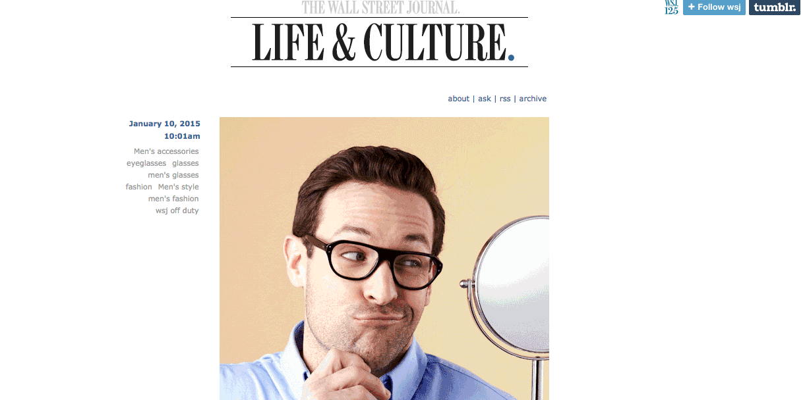
App overview: tumblr

Slide 32
App overview: tumblr
Benefits:
All the benefits of Twitter, without the 140-character limit
Large photos make sites extremely visual
Disadvantages:
Fewer users but growing in popularity (152 million blogs in November 2013)

Slide 33
Social media + photography + YOU
In what ways can student media programs effectively use these social media tools?

