Slide 1
Introduction to alternative copy tools
for the Web
Web

Slide 2
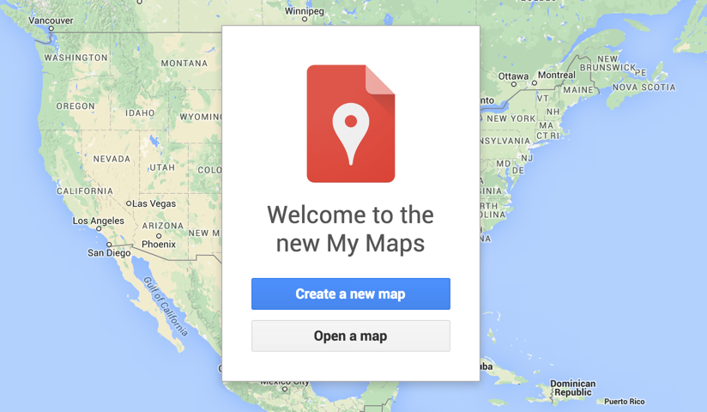
Google Maps (using My Maps)
Notes:
Google Maps — My Maps: https://www.google.com/maps/d/

Slide 3
Journalists at Mountain Vista High School in Highlands Ranch, Colorado created this interactive map to plot the college destinations of their
graduating seniors.

Slide 4
Google Maps
For stories or packages with a geographic focus.
Ideas: food reviews plotted on a map, student travel locations with quote-reel style blurbs, tourist in your own city feature, comparative reviews (e.g. bowling alleys, froyo places), show where news events occurred.

Slide 5
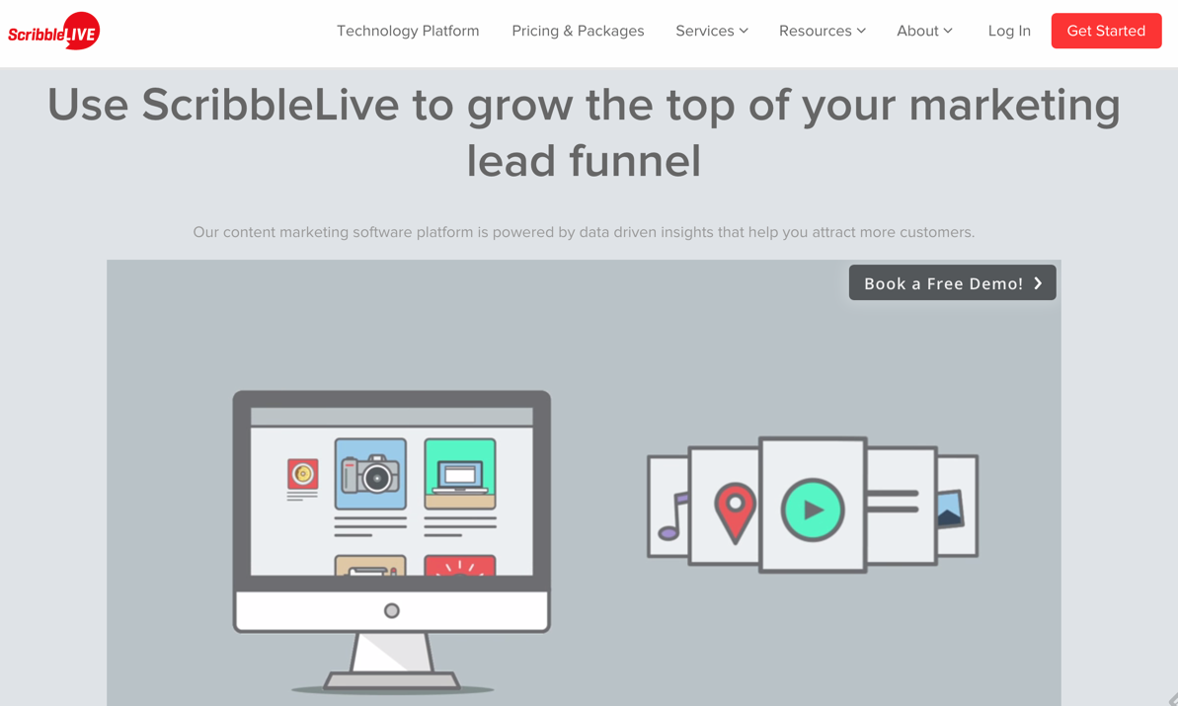
ScribbleLive/CoverItLive (blogging)
Notes:
Scribble Live: http://www.scribblelive.com/
Cover It Live: http://www.coveritlive.com/

Slide 6
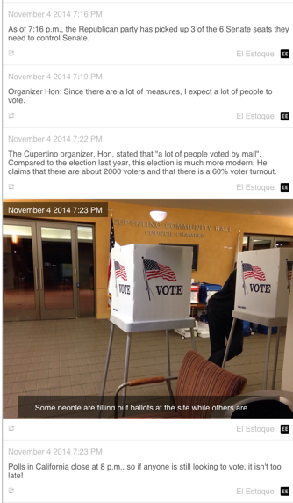
ScribbleLive/CoverItLive (blogging)
Journalists at Monta Vista High School in Cupertino, California used ScribbleLive to report from multiple locations on election night.

Slide 7
ScribbleLive (live blogging)
Best when working from a mobile device and trying to cover an event live.
Ideas: game coverage, election night coverage, interactive chat with a featured guest, Q&A session with an expert, live coverage of an awards night, season premiere or finale viewing party.

Slide 8
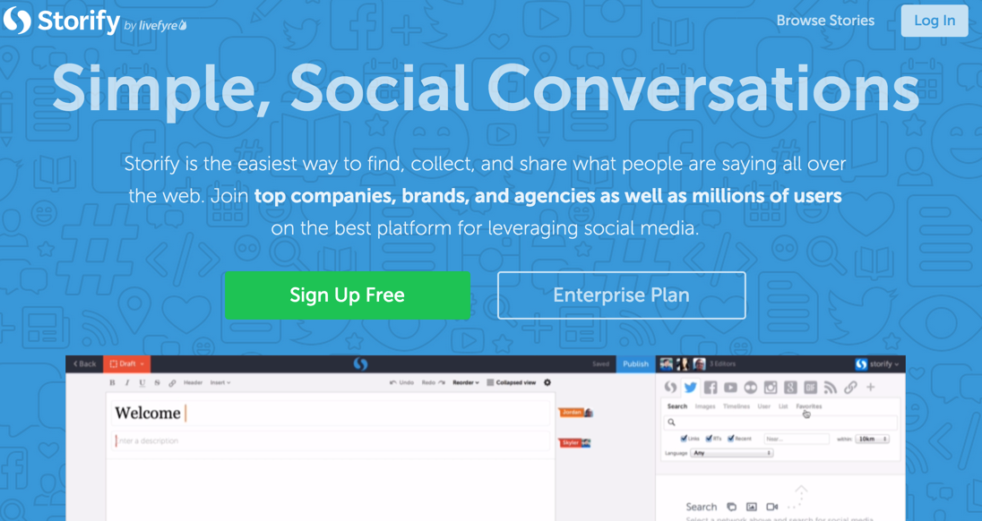
Storify (curation)
Notes:
Storify: https://storify.com/

Slide 9
Journalists at Whitney High School in Rocklin, California used Storify to cover a Sadie Hawkins event on campus, integrating Tweets, Instagram photos, and their own storytelling.

Slide 10
Storify (curation)
Best for stories that are important to your readers but that you may not have definitive or timely access to.
Crowdsource around a shared hashtag at an event and publish a collection of posts.
Ideas: have readers share perspectives on big events (open mic night, rallies, first day of school), follow breaking news in the community through official Twitter posts, have a team of reporters cover an event.

Slide 11
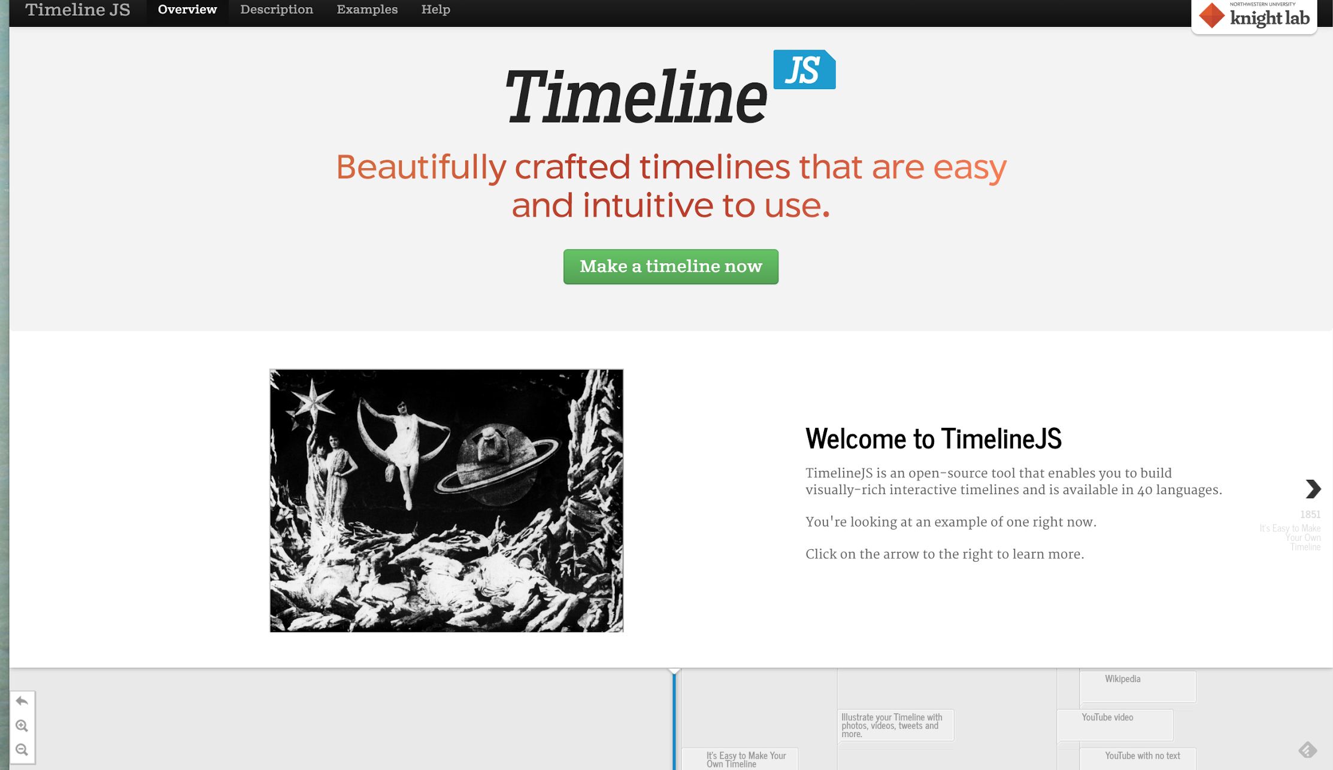
TimelineJS (interactive timeline)
Notes:
TimelineJS: http://timeline.knightlab.com/

Slide 12
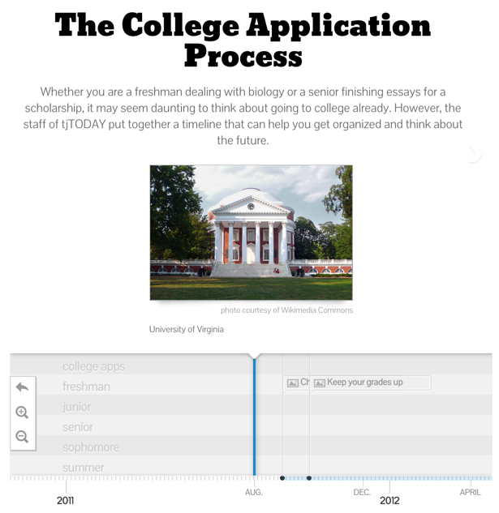
TimelineJS (interactive timeline)
Journalists at Thomas Jefferson High School in Alexandria, Virginia used TimelineJS to offer readers an informative timeline of events relevant to the college application process.

Slide 13
TimelineJS (interactive timeline)
Works best with chronological coverage, but great for historical pieces, too.
Ideas: game coverage, anniversary stories, construction coverage, year-long coverage.

Slide 14
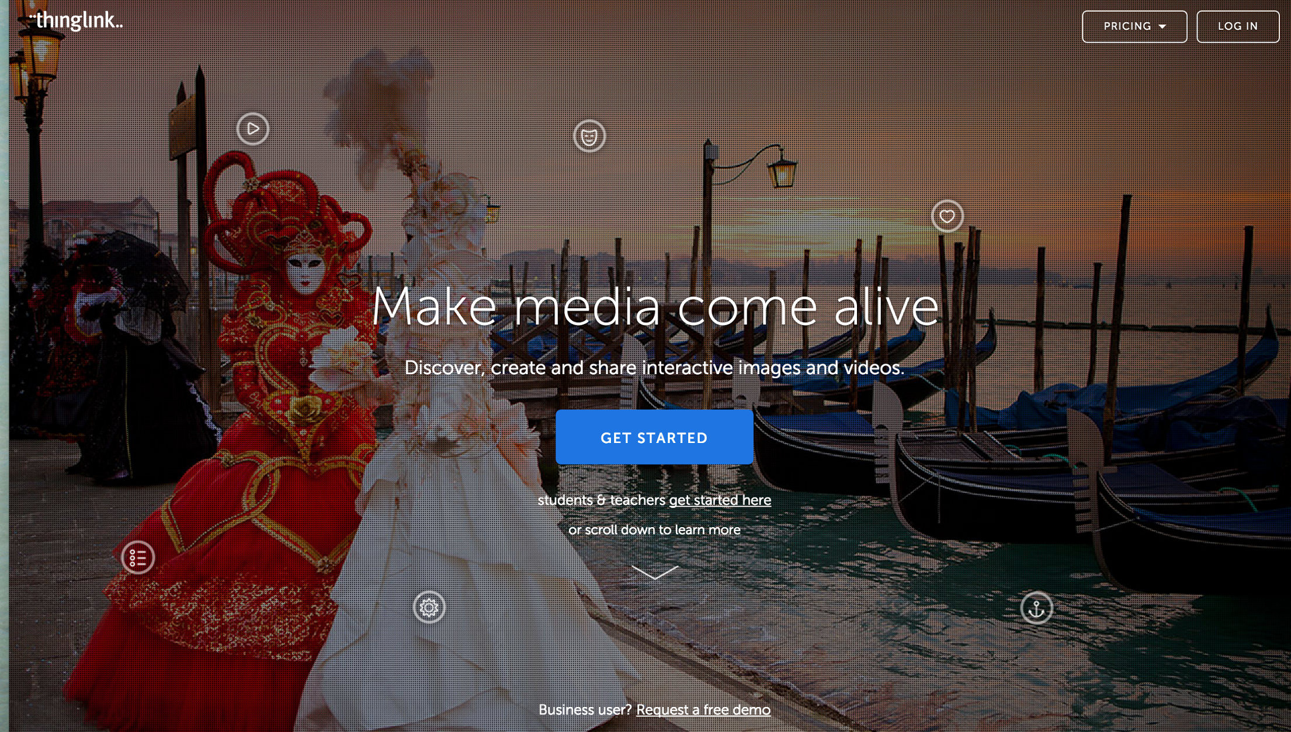
ThingLink (interactive image)
Notes:
ThingLink: https://www.thinglink.com/

Slide 15
ThingLink (interactive image)
Journalists at Francis Howell North High School in St. Charles, Missouri
used Thinglink in a feature on a local business.

Slide 16
ThingLink (interactive image)
For going beyond the simple image at the top of a story.
Ideas: food reviews with criticism overlaid on images, season preview team photo with info about each player, room features (or any environmental photo, really) with mini-stories highlighted.

Slide 17
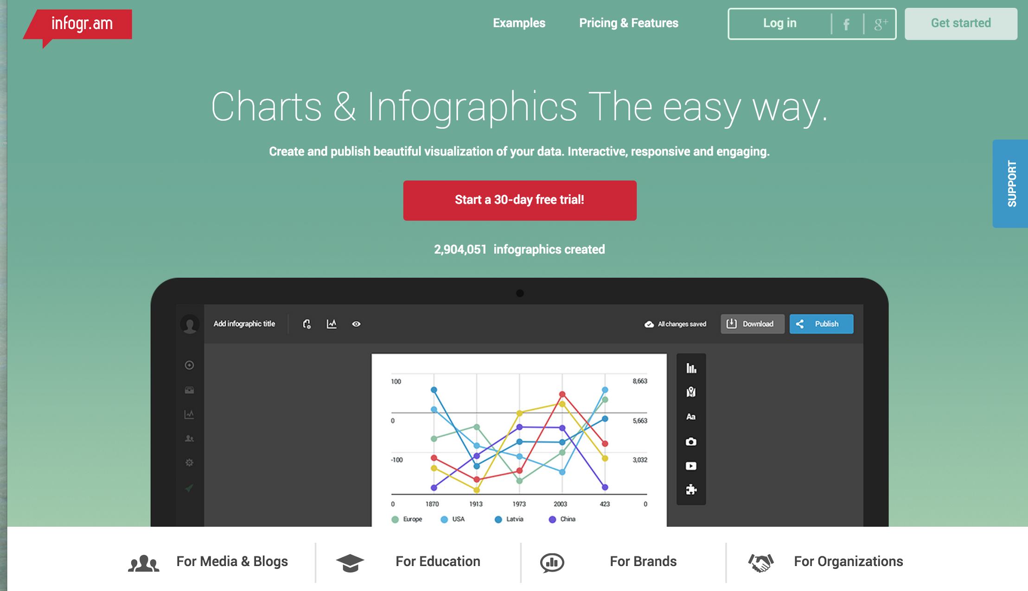
Infogram/Piktochart (infographic)
Notes:
Infogram: https://infogr.am/
Piktochart: http://piktochart.com/

Slide 18
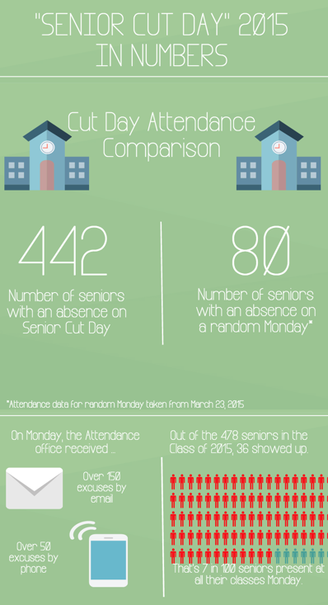
Infogram/
Piktochart
(infographic)
Journalists at Palo Alto High School in Palo Alto, California used Piktochart to show data around senior cut day.

Slide 19
Infogram (infographic)
Integrate into stories that use numbers, data.
Can also stand alone without a story.
Ideas: budget coverage, meetings coverage, localization of national news (e.g. national research vs. school survey data).

Slide 20
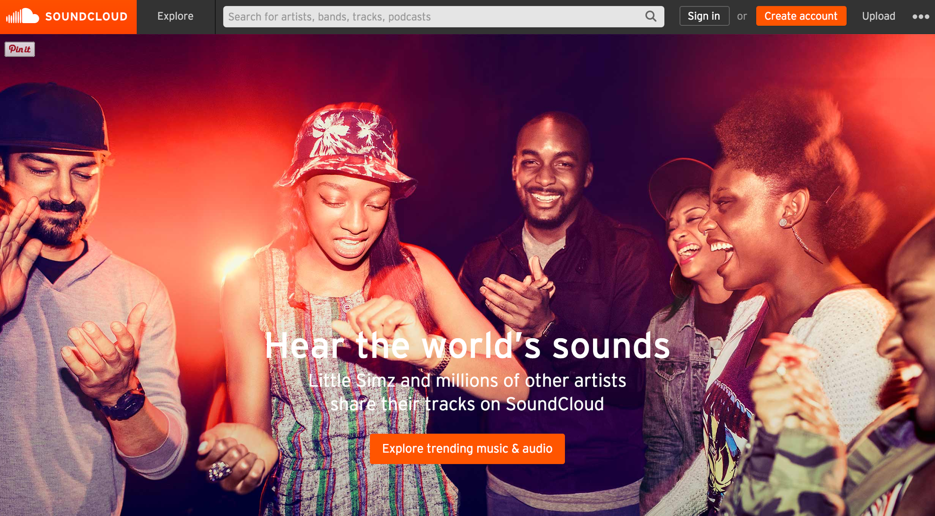
SoundCloud/SoundCiteJS
Notes:
SoundCloud: https://soundcloud.com/
SoundCiteJS: https://soundcite.knightlab.com/

Slide 21
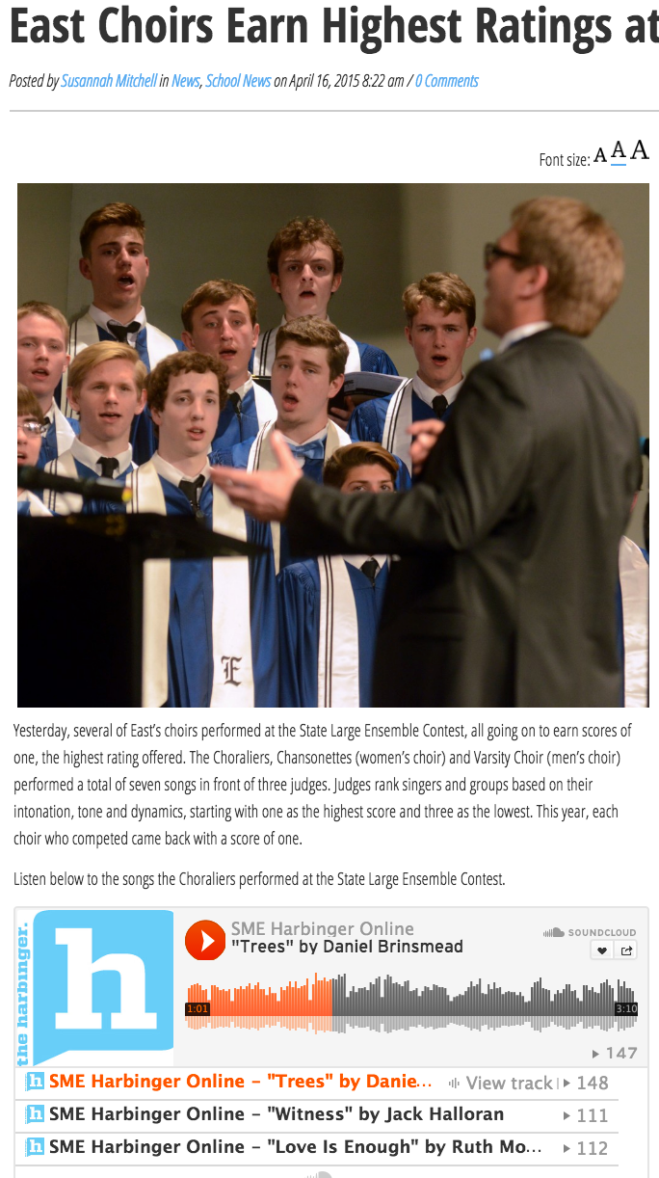
SoundCloud/
SoundCiteJS
Journalists at Shawnee Mission East High School in Prairie Village, Kansas used Soundcloud in a brief about the school’s choir program, allowing readers to listen to full songs performed by the group.

Slide 22
SoundCloud/SoundCiteJS
Integrate audio into stories where sound is a prominent element.
Complete sound stories or audio clips.
Ideas: integrate clips into music reviews, collect audio pull quotes in their own voices, Integrate “full audio” into stories about major events with speeches, collect experiential sound and build it into the story at appropriate moments.

Slide 23
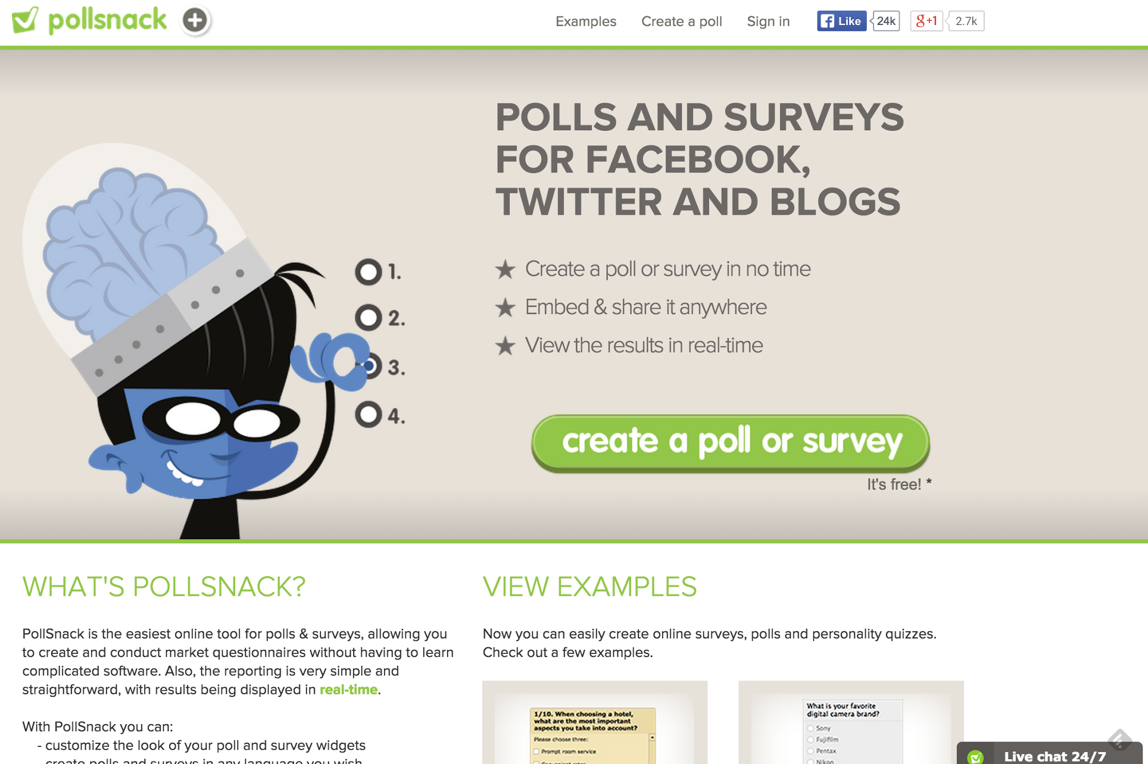
QuizSnack/ProProfs (quiz widget)
Notes:
PollSnack: http://www.pollsnack.com/
ProProfs:http://www.proprofs.com/
PlayBuzz: http://www.playbuzz.com/

Slide 24
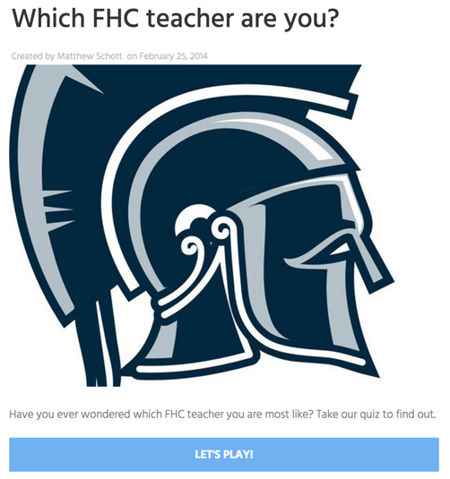
QuizSnack/ProProfs (quiz widget)
Journalists at Francis Howell Central High School in Cottleville, Missouri used a quiz tool called PlayBuzz to allow users to discover which teacher they are most like, a timely feature for Teacher Appreciation Week.

Slide 25
QuizSnack/ProProfs (quiz widget)
Insert interactive polls into op/eds and commentary.
Let the readers have a voice.
Don’t use to collect data, just for interactivity.
Ideas: ‘What’s your style?’ in a fashion or trend feature, reader opinions on the topic of an op/ed, compare yourself to survey results, compare self to national research.

