Slide 1
Finding and sourcing infographic data for Piktochart
Web

Slide 2
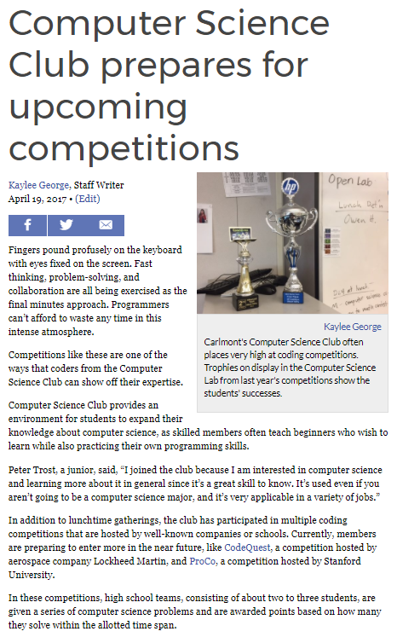
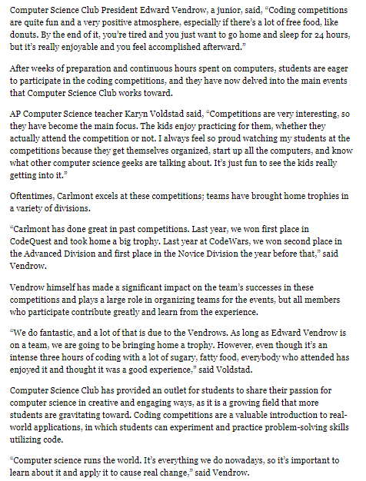
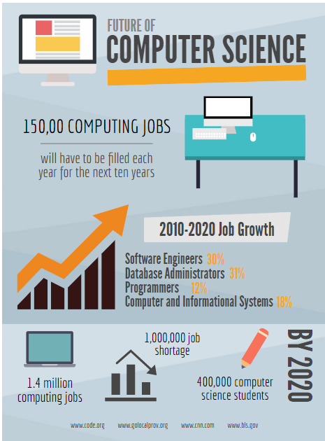
Student samples
This article about the Computer Science Club includes a Piktochart about the future of computer science.

Slide 3
Student samples
This article about the political gridlock includes a Piktochart about the amount that congress has had recently.

Slide 4
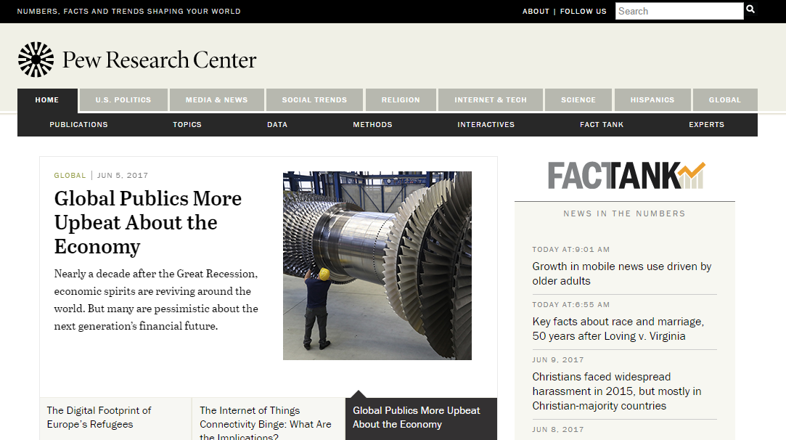
Find a data source
Find a reputable source for your data (like http://www.pewresearch.org/ )

Slide 5
Decide on a topic of interest

Slide 6
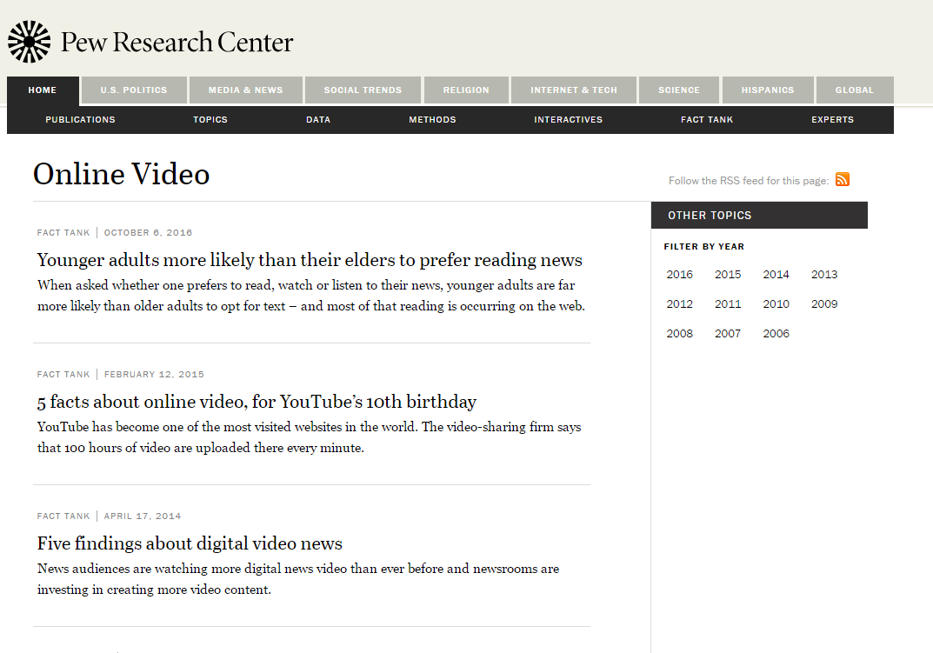
Decide on a topic of interest

Slide 7
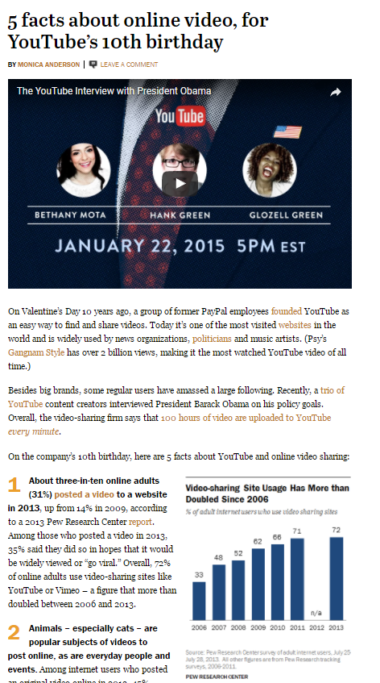
Read, understand, and find interesting facts for your graphic

Slide 8
Use short chunks of information
31 percent of online adults posted a video in 2013

Slide 9
Take note of the source
31 percent of online adults posted a video in 2013
http://www.pewinternet.org/2013/10/10/main-findings/

Slide 10
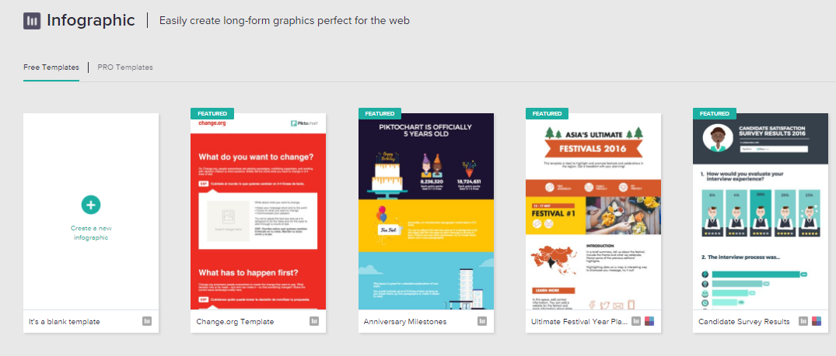
Choose a Piktochart template
(or create your own)

Slide 11
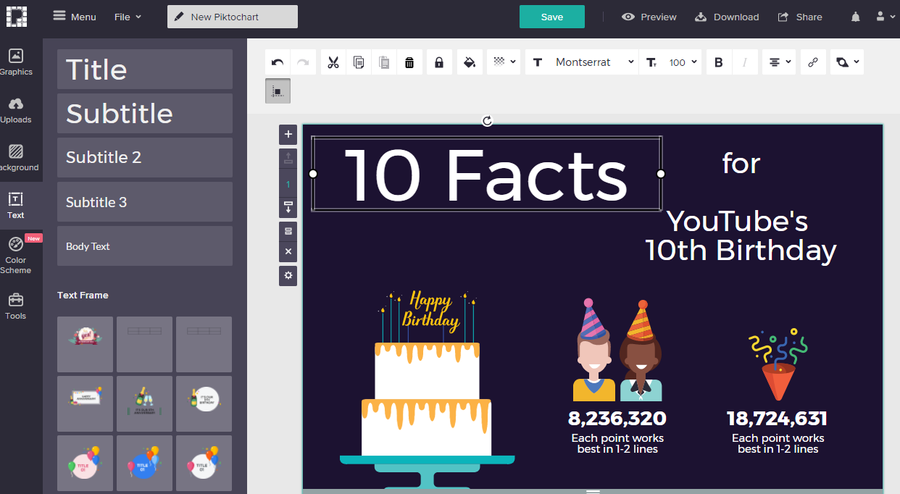
Customize with your title and data

Slide 12
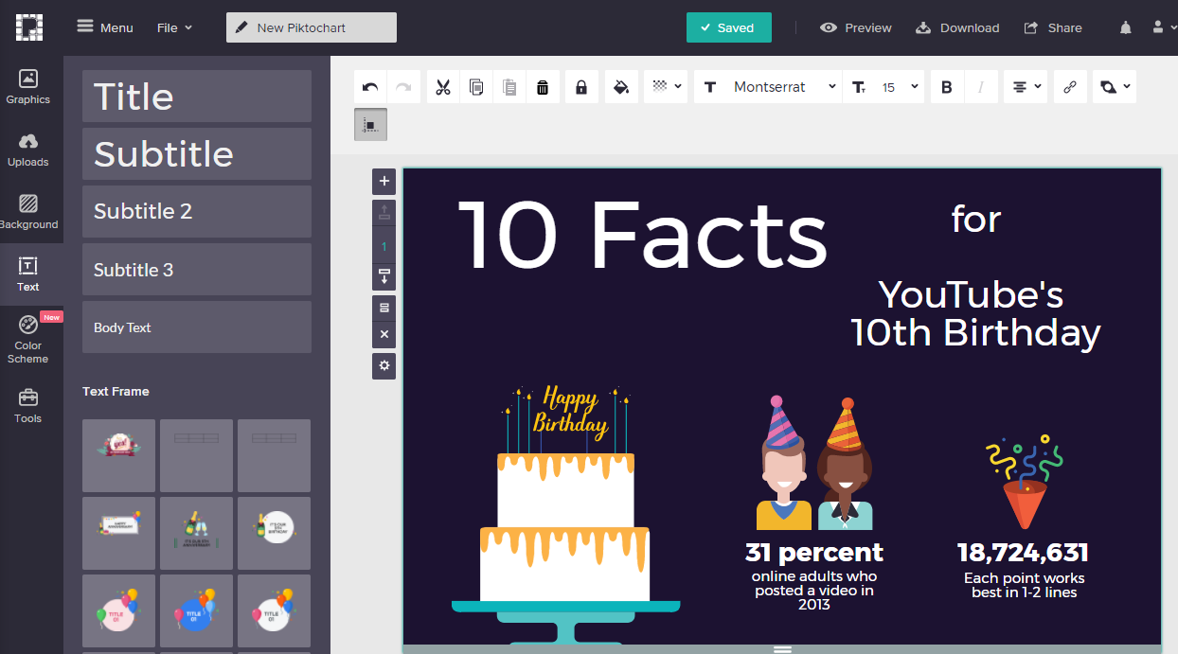
Customize with your title and data

Slide 13
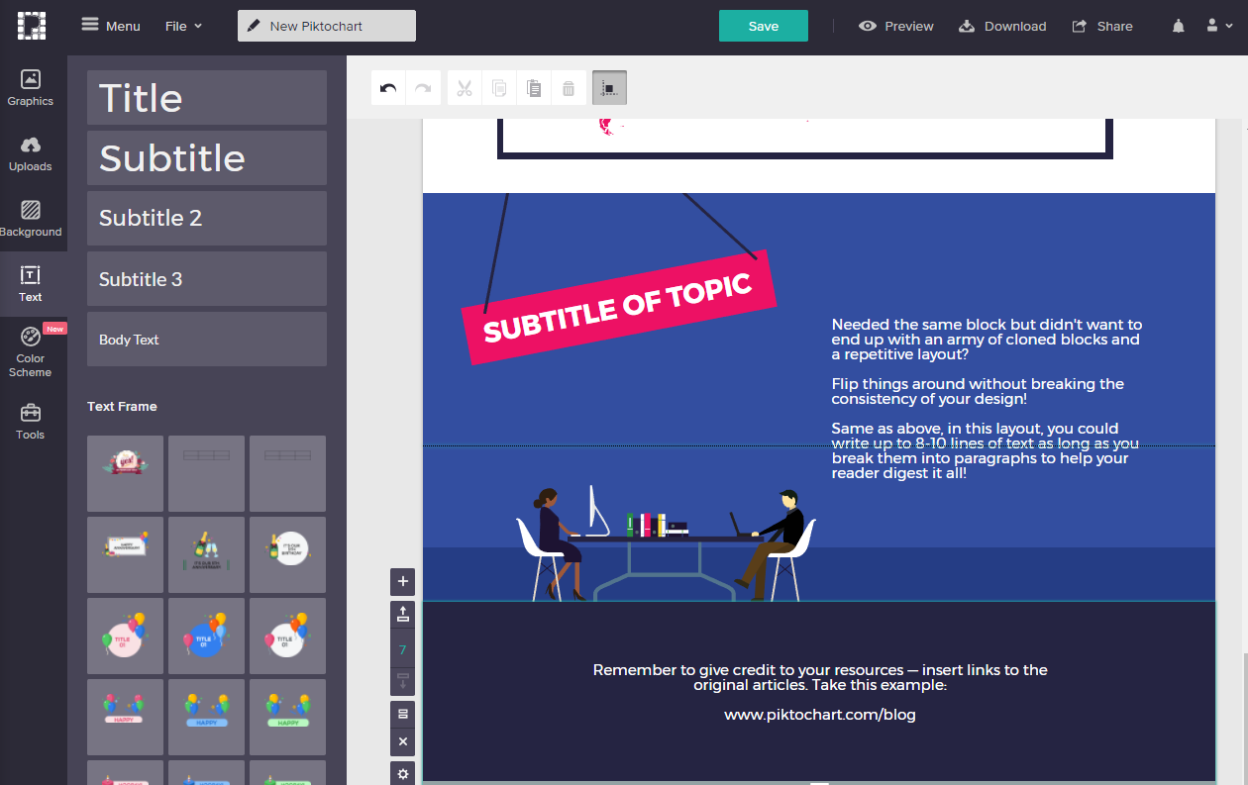
Add sources

Slide 14
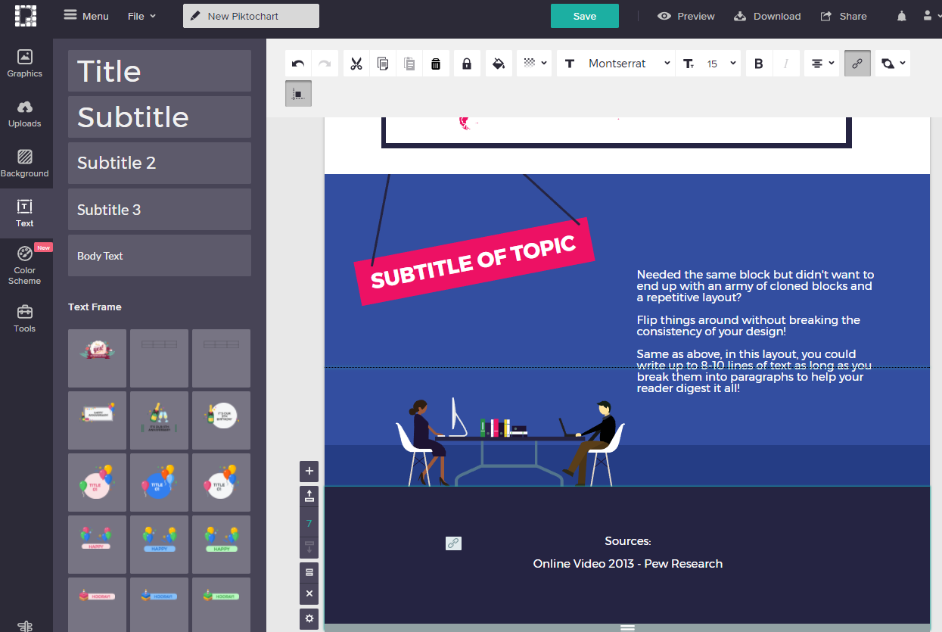
Add sources (and hyperlink)

