Slide 1
Basic HTML and Embed Codes
Web

Slide 2
HTML
HTML is a markup language for describing web documents (web pages).
HTML stands for Hyper Text Markup Language. A markup language is a set of markup tags.

Slide 3
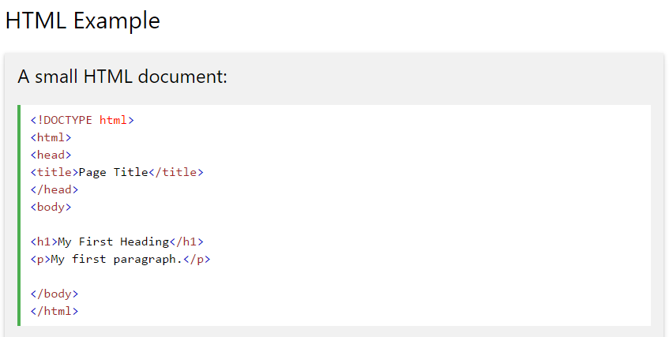
The basics...
http://www.w3schools.com/

Slide 4
The DOCTYPE declaration defines the document type to be HTML
http://www.w3schools.com/

Slide 5
The text between <html> and </html> describes an HTML document
http://www.w3schools.com/

Slide 6
Text between <head> and </head> provides information about the document
http://www.w3schools.com/

Slide 7
Text between <title> and </title> provides a title for the document (appears in browser)
http://www.w3schools.com/

Slide 8
Text between <body> and </body> is what will appear on the web page
(and how it will look)
http://www.w3schools.com/

Slide 9
Text between <h1> and </h1> is content that looks like a heading
http://www.w3schools.com/

Slide 10
Multiple heading options
http://www.w3schools.com/

Slide 11
Text between <p> and </p> is content that is in its own paragraph
http://www.w3schools.com/
Notes:
Using this description, a web browser can display a document with a heading and a paragraph.

Slide 12
You can have as many paragraphs as you need
http://www.w3schools.com/

Slide 13
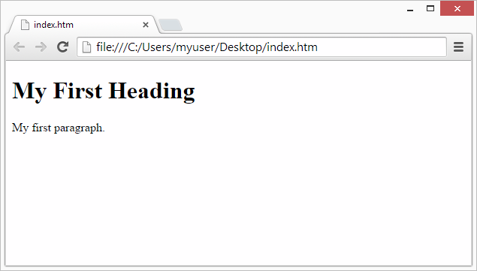
This is what it would look like in a web browser:
http://www.w3schools.com/

Slide 14
Adding a link
HTML links are defined with the <a> tag:
The link's destination is specified in the href attribute.
(the address is inside of the quotes)
Attributes are provide additional information about HTML elements.
http://www.w3schools.com/

Slide 15
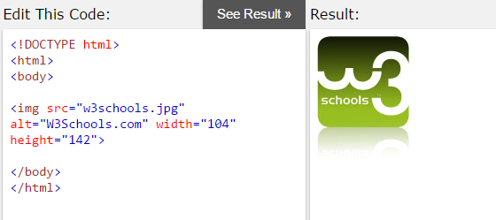
Adding an image
http://www.w3schools.com/
HTML images are defined with the <img> tag.
The source file (src), alternative text (alt), and size (width and height) are provided as attributes
(again, place these in quotes):
http://www.w3schools.com/

Slide 16
Embedding a video from YouTube
Upload the video to YouTube
Take a note of the video id
Define an <iframe> element in your web page
Let the src attribute point to the video URL
Use the width and height attributes to specify the dimension of the player
Add any other parameters to the URL

Slide 17
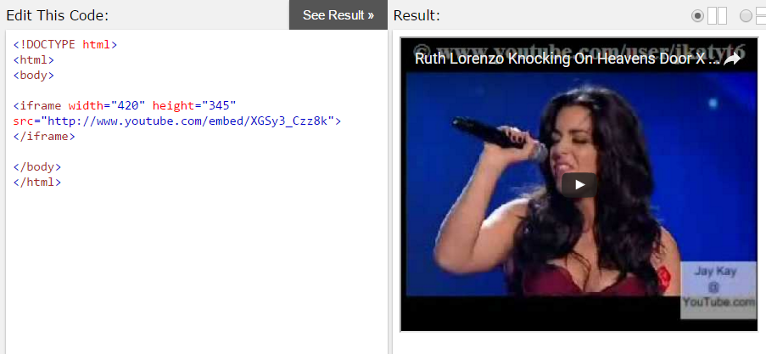
Example embed code
http://www.w3schools.com/
http://www.w3schools.com/

Slide 18
Demonstrate skills
Sign up for a free account on Code Academy
Complete this “Web Beginner Tutorial”
Complete Lessons 1-20
Check the next slide and complete
Lesson 21 to add a video

Slide 19
Embed a video
Go to YouTube, and find this video:
https://www.youtube.com/watch?v=z3dmx1GItWg
Note the video ID = z3dmx1GItWg
Somewhere within the page you created, use the <iframe> tag to embed this video.
COPY the HTML code you created and submit to your teacher as instructed

