Slide 1
Recording and editing a Podcast
Web Curriculum

Slide 2
Install Audacity
You can get Audacity here: http://audacity.sourceforge.net/

Slide 3
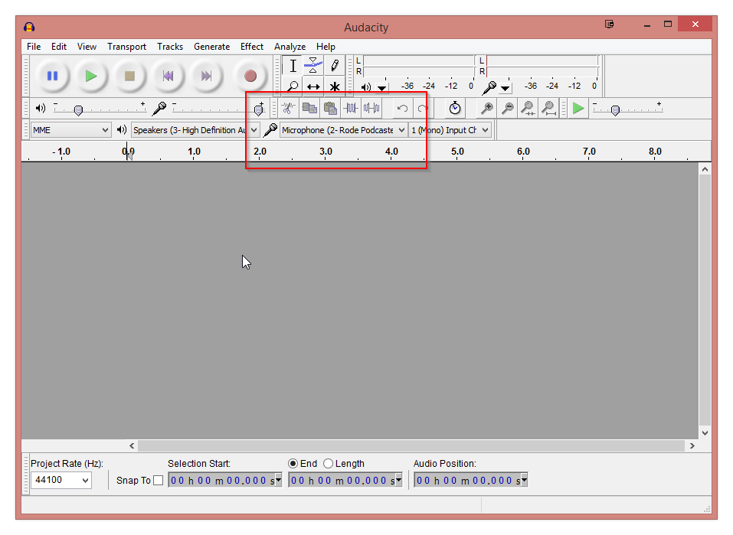
Record (option one - use Audacity)
Notes:
The first thing you’ll need to do is to select the Microphone you are going to be using from the Microphone-selector dropdown.
Once, you’ve done that. You are ready for a test recording. Just click the big red circle above to start recording.

Slide 4
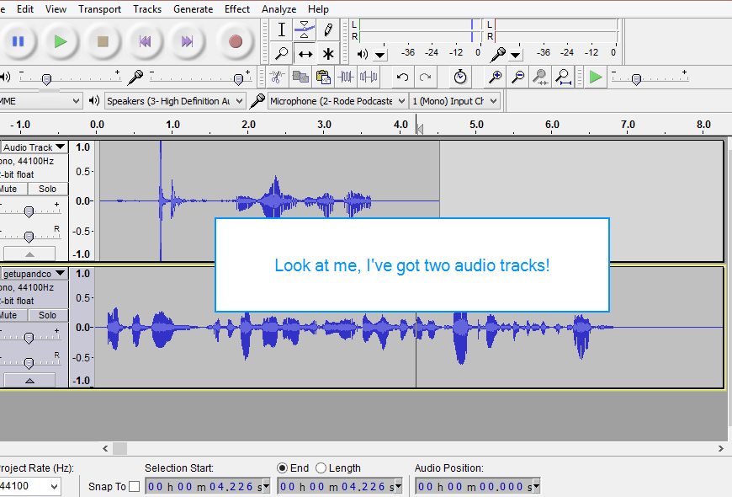
option 2 - IMPORT pre-recorded audio
Notes:
To add a new audio track to your project, simply drag and drop the file into Audacity. That’s it.
If you want to go around into the menu and do a File->Import->Audio and browse to your audio file, you can do that as well.

Slide 5
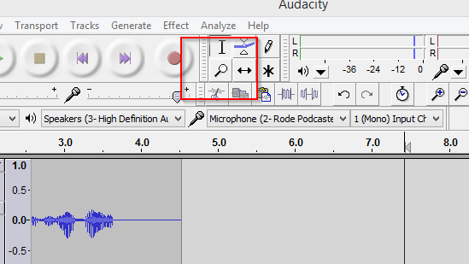
Edit
Notes:
Two quick navigation tips that will save you a lot of time:
First, we have zooming in and zooming out.
You’ll want to be able to zoom into a part of an audio track and zoom back out if you want to be able to accurately edit your audio.
Doing this in Audacity is fairly simple. You can either click the magnifying glass button in the menu bar and use a left-click to zoom in and a right-click to zoom out, or you can do it the easy way and hold down the Control or Command key while scrolling the middle mouse button either up or down.

Slide 6
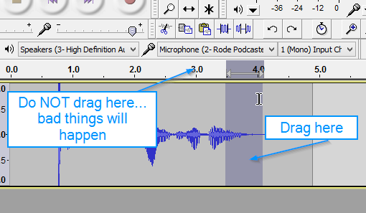
Edit
Notes:
You are going click and drag your mouse on the audio section you’d like to remove, see the diagram below: Now, a word of warning: you must drag on the bottom part of the track where the audio is, not at the top where the timeline is. Simply hit CTRL + X on a PC, Command + X on a Mac, or click the little scissors icon above the microphone selection dropdown to cut the audio.

Slide 7
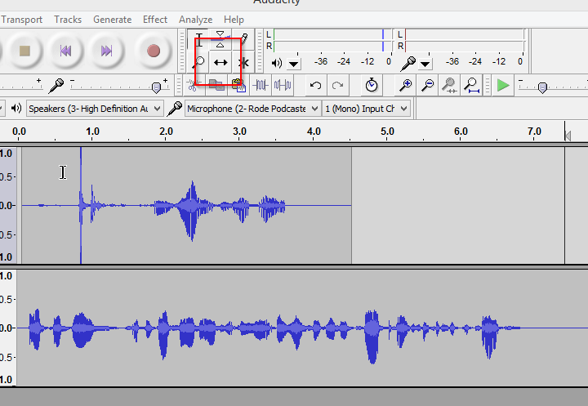
Edit
Notes:
Click on the tool that is that little double-arrow icon.
Click it once to go into “move-things-around” mode.
Once you are in “move-things-around” mode, you can simply drag on the audio tracks to move them forward or backward in relation to the master timeline and each other.

Slide 8
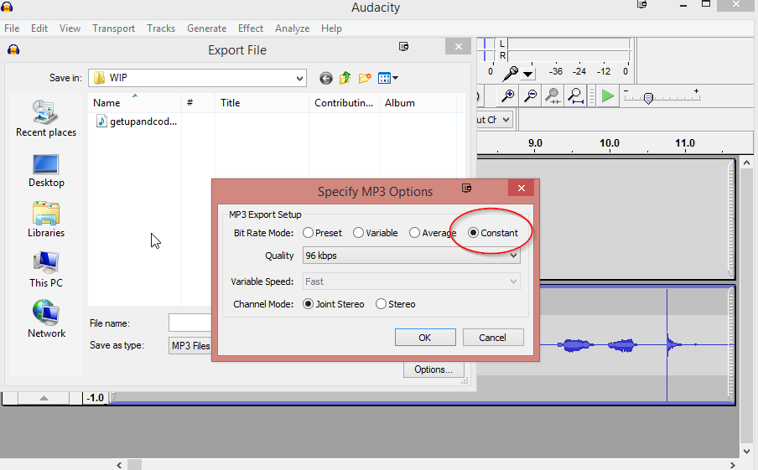
Export
Notes:
To export your podcast to an MP3, simply go to the File menu, select Export, then click Options to open up the export options window.
From here, you are going to want to select Constant for the Bit Rate Mode and 96 kpbs for the Quality selection.
(This will give you a good, quality sound, without too much bloat in the file size)
Click OK, choose where you want to save the file and name it and you are good to go.

