Slide 1
Elements of
Good Design
Design

Slide 2
This presentation will probably involve audience discussion, which will create action items. Use PowerPoint to keep track of these action items during your presentation
In Slide Show, click on the right mouse button
Select “Meeting Minder”
Select the “Action Items” tab
Type in action items as they come up
Click OK to dismiss this box
This will automatically create an Action Item slide at the end of your presentation with your points entered.
adapted from
Robin SawyerFirst Flight High School

Slide 3
The basics of design and layout
• Every designer works with three basic
visual elements
• Copy or text (words set in type)
• Graphics or art (photographs, artwork and lines)
• White space (blank areas on the page)

Slide 4
Formats and grids
• The physical size of the page is its page format.
Most city newspapers (dailies) use the broadsheet format (14 by 22 inches).
Student newspapers typically use the tabloid format, which is approximately 11 by 17 inches.
• The format will, generally, dictate the width of your columns.

Slide 5
Measurement
Most graphic designers use the following measurement units:
• 1 inch = 6 picas
• 1 pica = 12 points
• 1 inch = 72 points

Slide 6
Principles of design
Dominance
Every single page and every double-page spread should have one dominant element.
A dominant element is about 2.5 times larger than any other element on the spread.
The dominant element serves as the visual “entry point” to the page.
The action in a dominant photo should face into the spread rather than off the page.
Without a dominant, the reader’s eye will either bounce around from element to element or the reader will skip the page altogether.

Slide 7
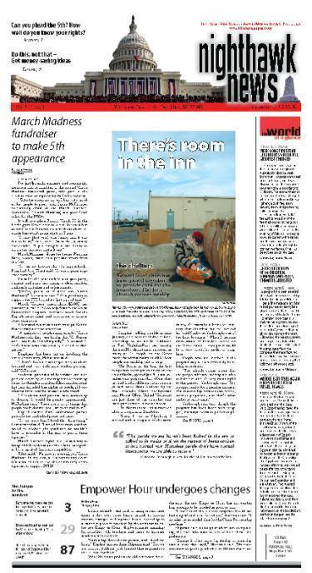
What’s it called?
teasers
flag/nameplate
4-deck headline
standing sig
byline
cutline (caption)
pull quote
jumpline
package (sidebar info compliments content of story)
refer (refers to a related story inside)

Slide 8
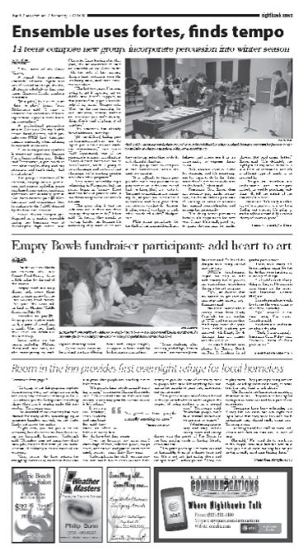
What’s itcalled?
main deck with subhead
folio
3-column photo
text / copy
gutter (white space between columns)
rule line
6-column format (standard format)
jump head
jump line
pull quote
4-column format (bastard measure)

Slide 9
Unity
One way to unify a page is by using consistent internal and external margins.
Internal margins: white space between copy and graphics.
Usually one pica between elements
It differs by publication. For example, one student newspaper uses two picas between unrelated items (two different stories, stories and ads, etc.) and one pica between related items (headline and story, photo and caption).

Slide 10
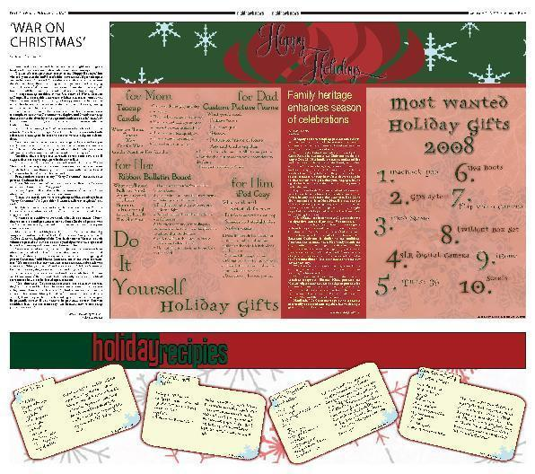
Unity on double-page spreads
Another name for a double-page spread is doubletruck.
Placing a dominant photo or art so that it runs across the center of the two pages helps to link the spread.

Slide 11
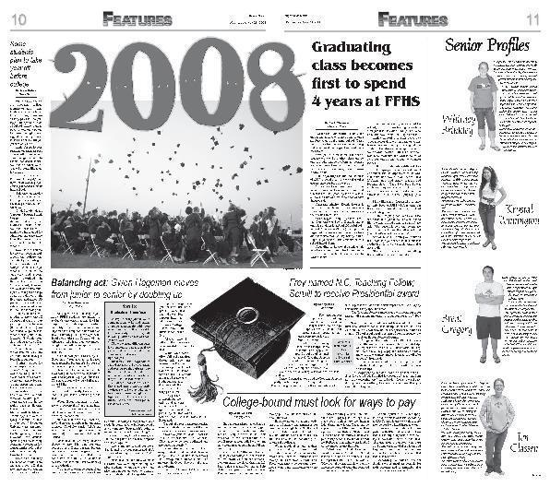
Unity on double-page spreads
Use an eyeline (one pica of horizontal white space that extends across the spread).
An eyeline should run at least six picas above or below the horizontal center of the spread.

Slide 12
Unity with type
With few exceptions, no more than three different type styles should be used in any publication.
(1) One style is chosen for the nameplate and the folios (standing sigs).
(2) A second is chosen for the headlines.
(3) The third is the text or body type.
The only acceptable variation is an occasional special type to achieve a specific purpose or communicate a definite idea for a major feature.

Slide 13
Contrast
One of the most important aspects of design is contrast.
Use of opposites in size, shape, weight and color or tone.
A design should feature one dominant photo or other graphic contrasted by several smaller photos or graphics with horizontal as well as vertical photos.
Different typefaces and the discreet use of screens also create contrast.

Slide 14
Repetition
Repetition (rhythm) involves duplicating a color, graphic or typographic element to hold a design together.
Yearbooks & Magazines
Template designs may use a specific headline design throughout a particular section.

Slide 15
Balance
Pages that are balanced can be folded in half vertically, with each half mirroring the other half of the page. This is called symmetrical balance.
Informally balanced pages feature weight distributed diagonally. This is preferred.
Big, bold graphic elements are placed toward the center,
White space, story copy, headlines and captions are pushed to the outside so that pages do not “weigh heavy” to one side or the other.

Slide 16
Consistency in newspaper
Certain elements of a publication should remain unchanged.
Newspaper and newsmagazine staffs should establish the following and keep them the same from issue to issue:
Byline style
Folio style
Standing sig style
Caption style
Nameplate or flag

Slide 17
Consistency in yearbook
Using the same page elements, typography and graphics throughout the theme pages, on the cover, and on the front and back endsheets creates a consistent publication.
Consistency within each section is established by using
The same grid/column structure
Headline design
Caption design
Repeating sidebar element(s)

Slide 18
Selecting and using type
From a design standpoint, the basic component of any story is copy – words set in type.
When choosing typefaces in general, choose a font that’s easy to read for body copy – columns of copy for stories.
Serif fonts (those with "feet") are usually easier to read in large chunks.

Slide 19
Typography guidelines
Consider mixing a serif and sans serif font for your main deck and subheads.
Set the leading in body copy at two points higher than your type size. (For example, 10-point body copy would be set with 12-point leading.)

Slide 20
Typography guidelines
Choose a font family for headlines that has many different varieties as a way of mixing things up visually on the page.
Roman
Italics
Bold
Bold italics
Semibold
Semibold italics

Slide 21
Modifying type vertically
Point size – Changing the point size changes the height of the font.
The bigger the point size, the taller the type.
A headline in 72-point type is one inch tall because there are 12 points in a pica and six picas in an inch(6 x 12 = 72).

Slide 22
Modifying type vertically
Leading (pronounced ledding) – the vertical spacing between lines of type – more specifically, it’s the distance from one baseline to the next.
Leading must accommodate ascenders (part of letter above standard baseline - b, d, f, k, l, t) and descenders (part of letter below standard baseline - g, y, p j).

Slide 23
The four basic page elements
Photo
Cutline
Headline
Text
These elements should appear in this order if they are related. NEVER put art between the headline and the start of the story.

Slide 24
Today’s headlines are
Generally written downstyle (like a sentence without end punctuation)
Run left aligned
Are usually wide rather than narrow.
Use decks optionally, as in this example:
Hula hoops have Americans all a-twirl
That ’60s trend
is back, and it’s
hotter than ever

Slide 25
Types of headlines
Kickers
These lead into headlines by using a word or phrase to label topics or catch your eye. They’re usually smaller than the main head, set in contrasting style or weight.
A TREND RETURNS
Hula hoops are on a roll

Slide 26
Types of headlines
Slammers
This two-part head uses a boldface word or phrase to lead into a contrasting main headline. Some papers limit these to special features or jump headlines.
Hula hoops: A hot new hit

Slide 27
Types of headlines
Raw Wraps
Most headlines cover all the text below; this
treatment lets text wrap alongside.
Hula hoops
are circling
the nation

Slide 28
Types of headlines
Hammers
Hammers use a big, bold phrase to catch your eye, then add a lengthier deck below. They’re effective, but used primarily for special stories.
Hoop-la
Hula hoops are sweeping the nation this summer

Slide 29
Types of headlines
Tripods
This head comes in three parts: a bold word or phrase (often call caps) and two lines of deck squaring off alongside. These are best reserved for special features.
HULA HOOPS:
They were hot in the ’60s,
but they’re hotter today

Slide 30
Types of headlines
Sidesaddle
This style lets you park the head beside, rather than above, the story. It’s best for squeezing a story — preferably one that’s boxed — into a show horizontal space.
Hula hoops are circling the nation this summer

Slide 31
How to size headlines on the page
Generally, from largest to smallest as you go down the page.
Page One broadsheet
54-72 point for the main story (five or six columns wide)
30-36 for a secondary story that is one or two columns wide
36-42 for the next story down that is four or five columns wide
24-30 for the next one-column head
30-36 for the next three- or four-column headline

Slide 32
Sidebars and infographics
A sidebar is any short feature that accompanies a longer story.
An infographic (short for informational graphic) blends text and illustrations to convey information visually — clarifying the facts with charts, maps or diagrams.

Slide 33
Types of sidebars
Fast-fact box
Bio box
List
Glossary
Checklist
Quiz
Q & A
Public-opinion poll
Quote collection

Slide 34
Types of infographics
Fever chart
Bar chart
Pie chart
Table
Map
Ratings
Timeline
Step-by-step guide
Diagram

Slide 35
General layout guidelines
All stories should be shaped like rectangles or squares.
Avoid placing any graphic element in the middle of a leg of type.
Avoid placing art at the bottom of a leg of type.
Text that wraps below a photo should be at least one inch deep.
In vertical layouts stack elements:
Photo
Cutline
Headline
Text

Slide 36
General layout guidelines
Every page should have a dominant piece of art.
A well-designed page is usually at least one-third art.
Avoid placing a photo or box directly on top of an ad.
Avoid boxing stories just to keep headlines from butting; it’s best to box stories only if they’re special or different.

Slide 37
General guidelines for text
The optimum depth for legs of text is between two and 10 inches.
Avoid planning legs of text more than 20 picas wide, or less than 10 picas.
Use italics, boldface, reverse, or any other special effects in small doses.
Type smaller than 8-point is often difficult to read. Use small type sparingly, and avoid printing it over a screen.

Slide 38
General guidelines for headlines
Every story needs a headline.
Headlines get smaller as you move down the page. Smaller stories get smaller headlines.
5-10 words is optimum for most headlines.
Never allow an art element to come between the headline and the start of a news story.
Don’t butt headlines. Vary their sizes, styles and the number of lines.

Slide 39
General guidelines for photos
Shoot photos of real people doing real things.
Directional photos should face the text they accompany.
When in doubt, run ONE big photo instead of TWO small ones.
When using two or more photos, make one DOMINANT - that is, substantially bigger than any competing photo.
Try to vary the shapes and sizes of photos on a page.

Slide 40
General guidelines for cutlines
To avoid confusion, run one cutline per photo; each cutline should “touch” the photo it describes.
When cutlines run beside photos, they should be at least six picas wide.
When cutlines run below photos, square them off as evenly as possible on both sides of the photo. They should not extend beyond either edge of the photo.

