Slide 1
Audience Involvement and Tragedy
Entrepreneurship

Slide 2
Central question
To what extent should journalists engage citizens as reporters through social media in tragic or dangerous circumstances?
Notes:
Pose the central question after completing the warm-up activity. Garner student thoughts as a baseline before moving to the rest of the presentation.

Slide 3
Directions
Take notes on each scenario.
Complete the third box for each scenario on your own or with a partner.

Slide 4
Scenario 1: Mass shootings
What happened?
A person, or group, shoot many people at one time, leading to a mass loss of life.
How was the story told by citizens?
Often the first details come from eyewitnesses who shoot video, tweet, or take pictures with phones.
Notes:
Examples to discuss: In the Virginia Tech Massacre, journalists turned to social media to get interviews because they were unable to get to Blacksburg and phone service went down. In other shootings, individuals have posted photos and videos from the events as they unfolded. Often, these pictures and videos are more graphic than what is normally shown on the news.

Slide 5
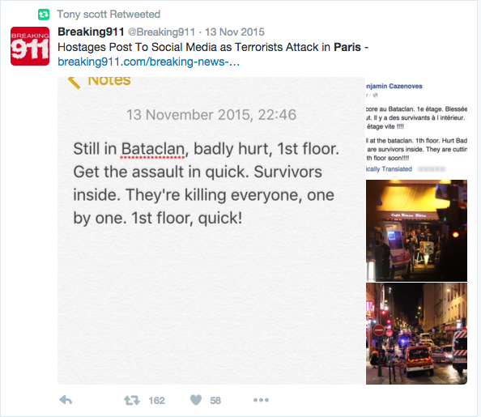

Slide 6
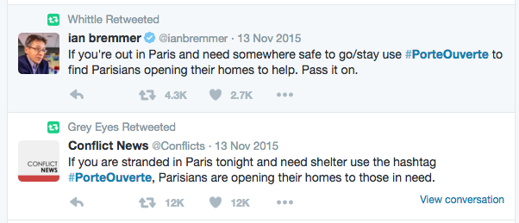

Slide 7
Scenario 1: Mass shootings
How do citizen journalists tell this story in a vital way?
Notes:
Because journalists are not there, citizen journalists capture the story as it is happening. This also ensures that the story is told in the moment rather than based on memory.

Slide 8
Scenario 2: Killing of Osama bin Laden
What happened?
American troops raided bin Laden’s hideout in Pakistan and killed him.
How was the story told by citizens?
A previously-unknown Pakistani Twitter user @ReallyVirtual unknowingly live-tweeted the event; his followers increased from 751 to 32,000 in one weekend.
Notes:
You can still find this Twitter user. He currently has more than 50,000 followers.

Slide 9
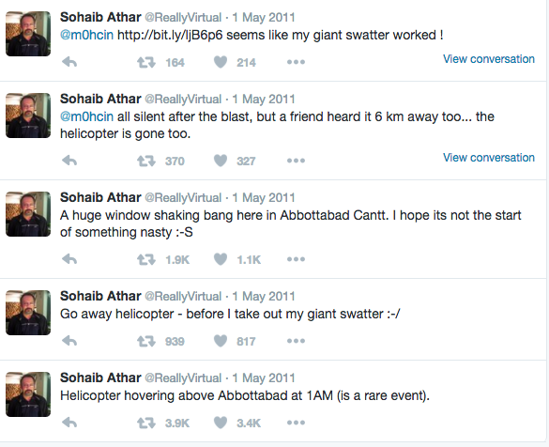

Slide 10
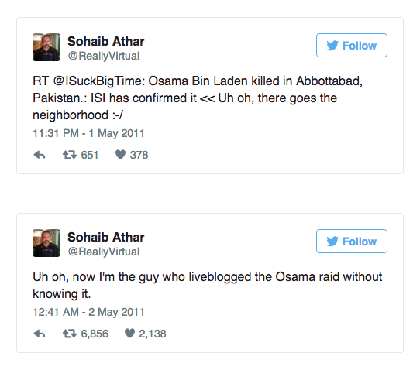

Slide 11
Scenario 2: Killing of Osama bin Laden
How did a citizen journalist tell this story in a vital way?
Notes:
It is unlikely Americans would have heard views from Pakistanis on the ground if this user (and others) had not tweeted about the event.

Slide 12
Scenario 3: Arab Spring
What happened?
Democratic demonstrations and uprisings spread across the Arab world in 2011.
How was the story told by citizens?
Many citizens turned to social media to spread their message and draw others to their cause while also telling media organizations their story.
Notes:
Social media was vital to the spread of democracy during the Arab Spring. Without it, these groups would not have been able to organize and communicate with those outside of their country.

Slide 13
Scenario 3: Arab Spring
How did citizen journalists tell this story in a vital way?
Notes:
The Arab Spring showed the power of social media for grassroots support.

Slide 14
Scenario 4: City riots
What happened?
Across the United States, citizens have been protesting various issues related to race and police brutality.
How was the story told by citizens?
Citizens take photos and post videos to show more of the riots than are shown through the professional media.
Notes:
Discuss the riots in Ferguson and Baltimore as examples, but students may raise other examples, too.

Slide 15
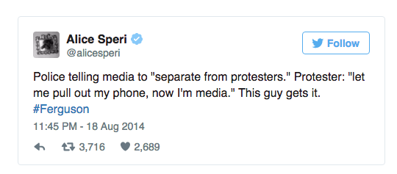

Slide 16
Scenario 4: City riots
How do citizen journalists tell this story in a vital way?
Notes:
Students might bring up examples of journalists being barred from reporting during the Ferguson riots. Some individuals may be more likely to talk to a friend than a member of the media due to distrust or fear for their own safety. However, citizen journalists in these situations may be more likely to break laws to get the story, which puts them in harm’s way.

Slide 17
Central question
To what extent should journalists engage citizens as reporters through social media in tragic or dangerous circumstances?
Notes:
Return to the central question. Challenge students to consider how citizen journalists in these scenarios perform a vital role, but also put themselves in harm’s way to get this story. To what extent should journalists encourage this by requesting stories and footage from citizens?

