Slide 1
Publication Rooms
Leadership and Teambuilding

Slide 2
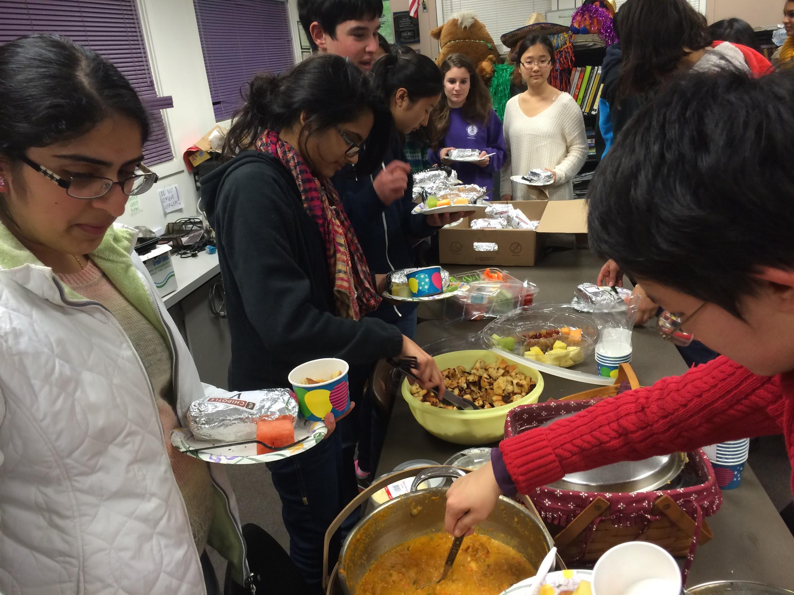
Michelle Balmeo’s classroom
Monta Vista High School
Cupertino, California

Slide 3
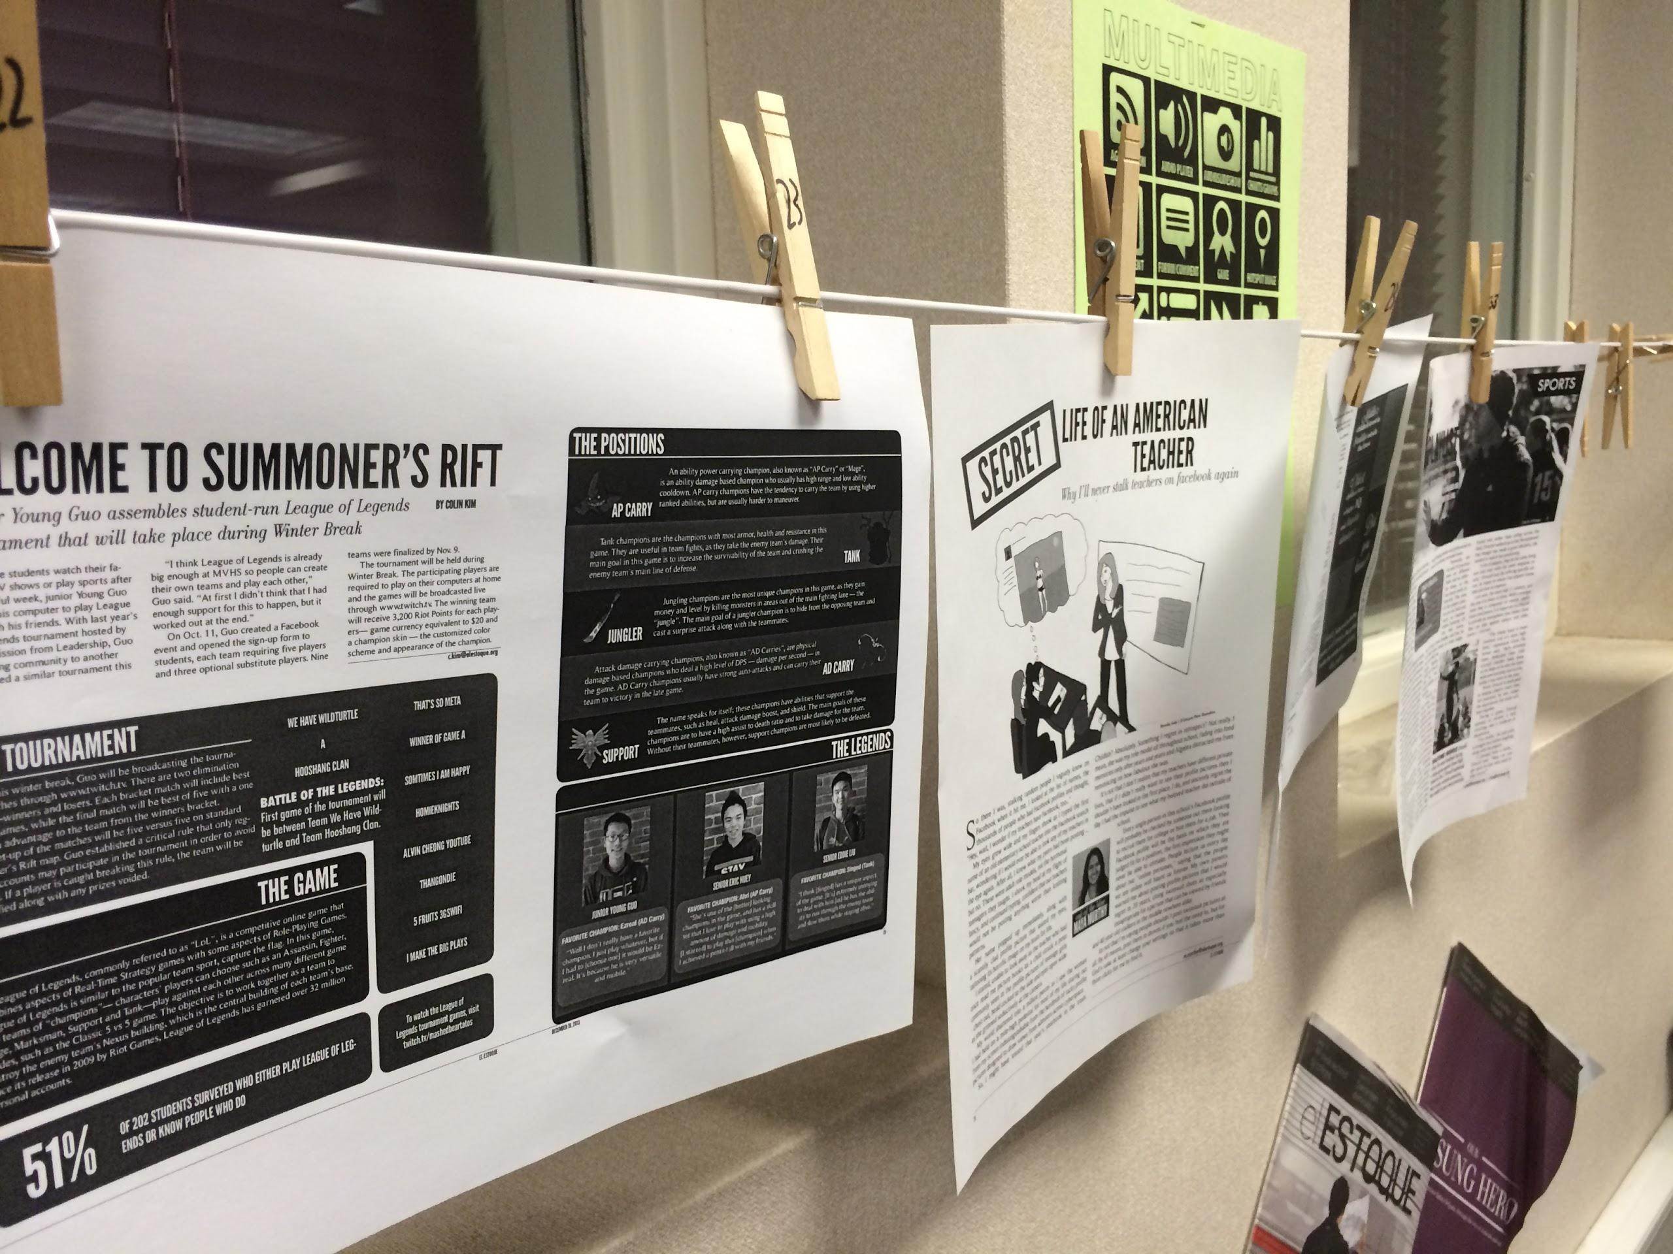

Slide 4
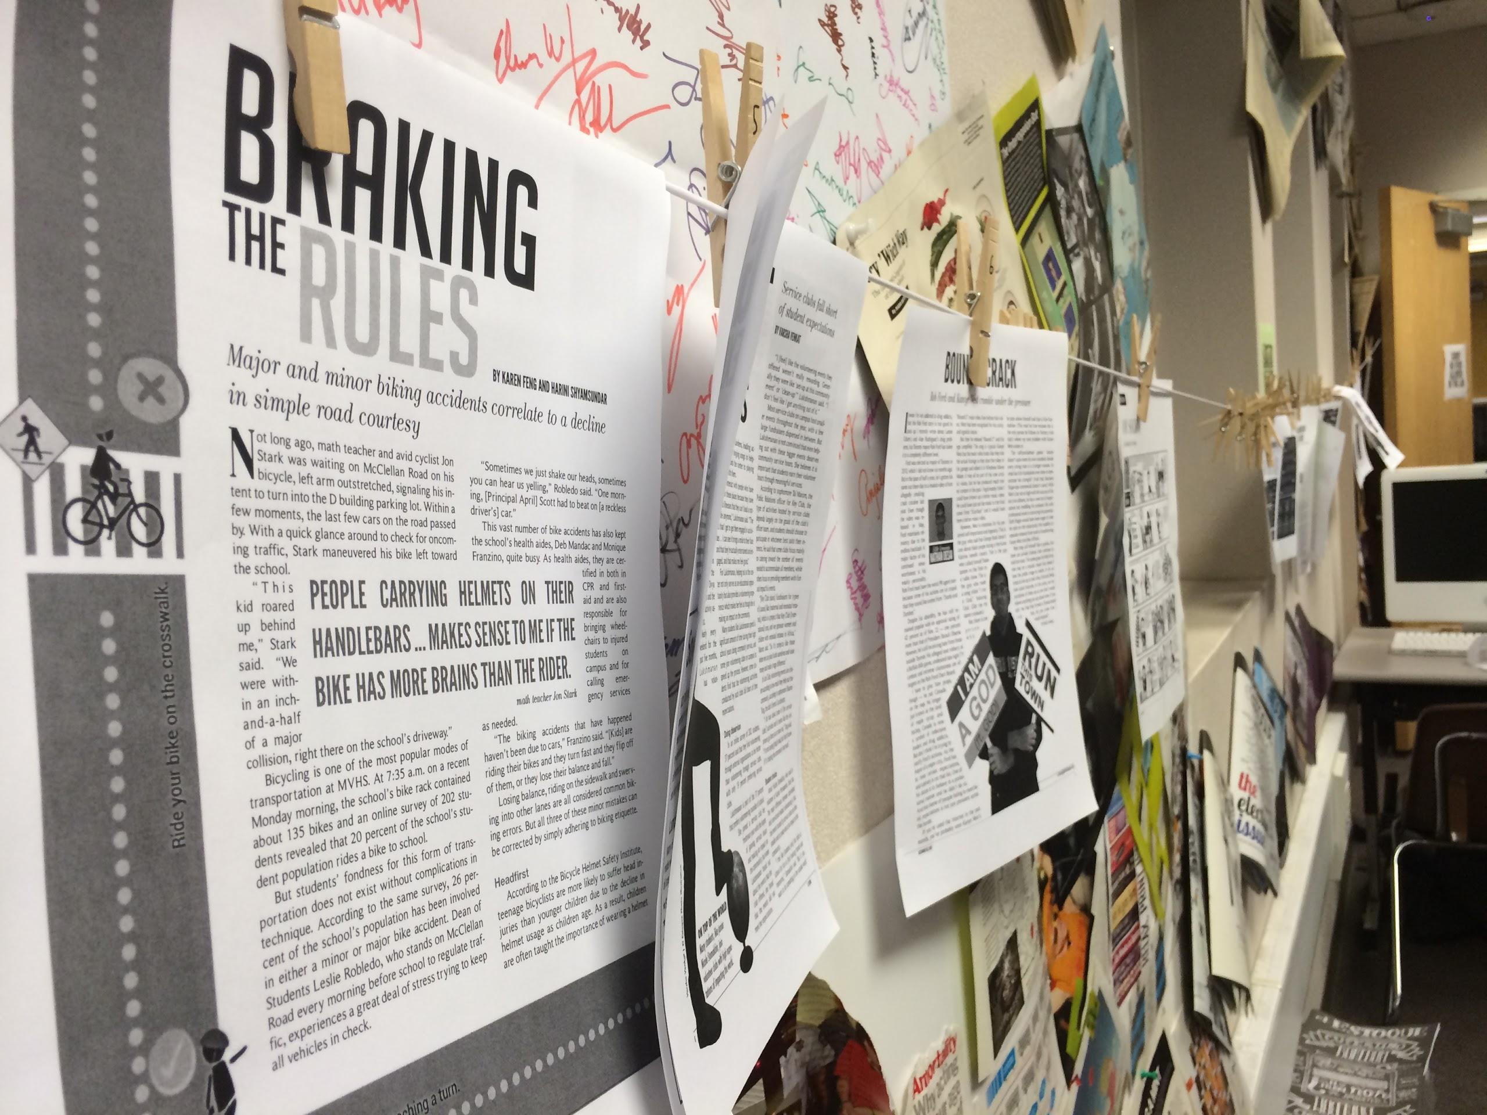

Slide 5
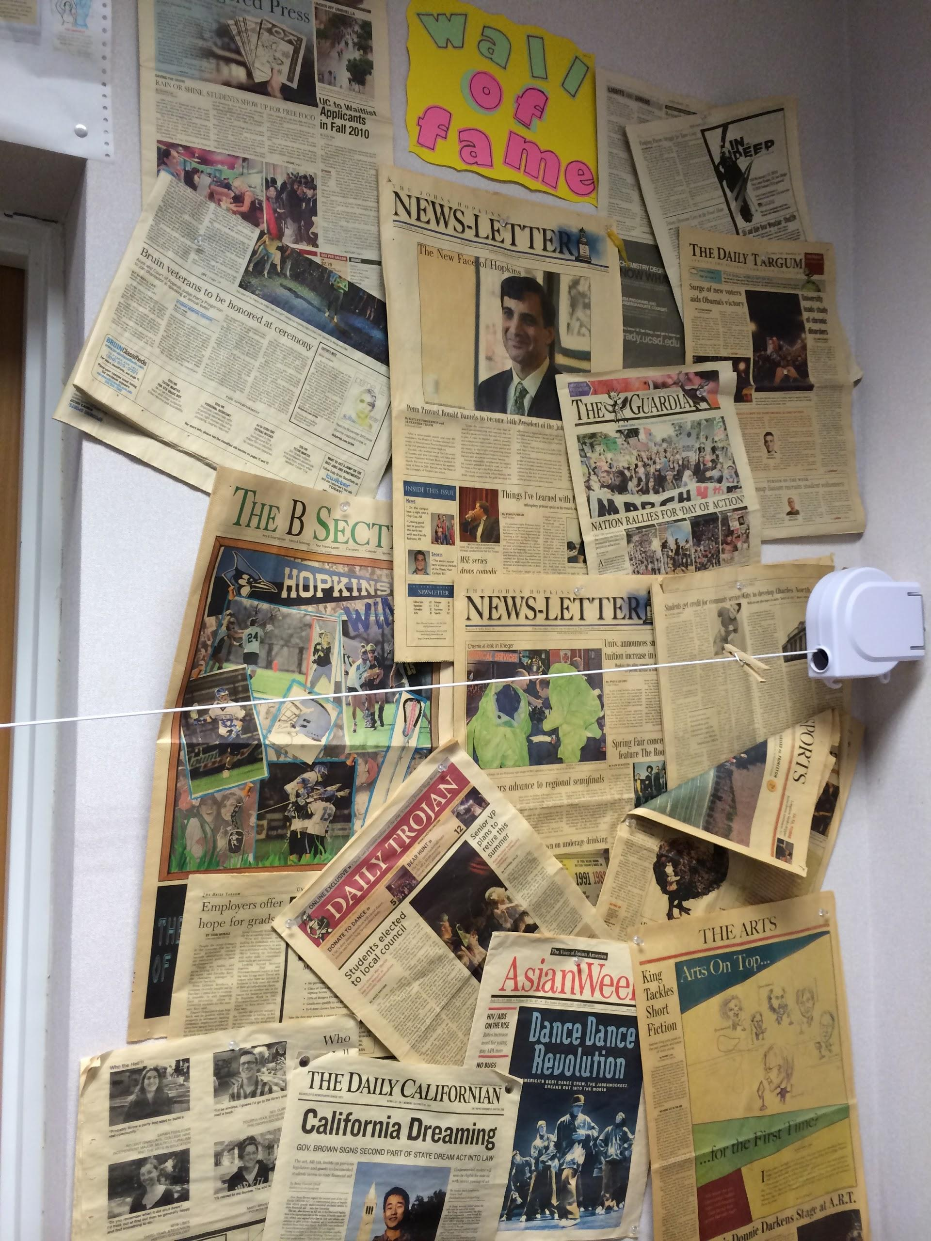

Slide 6
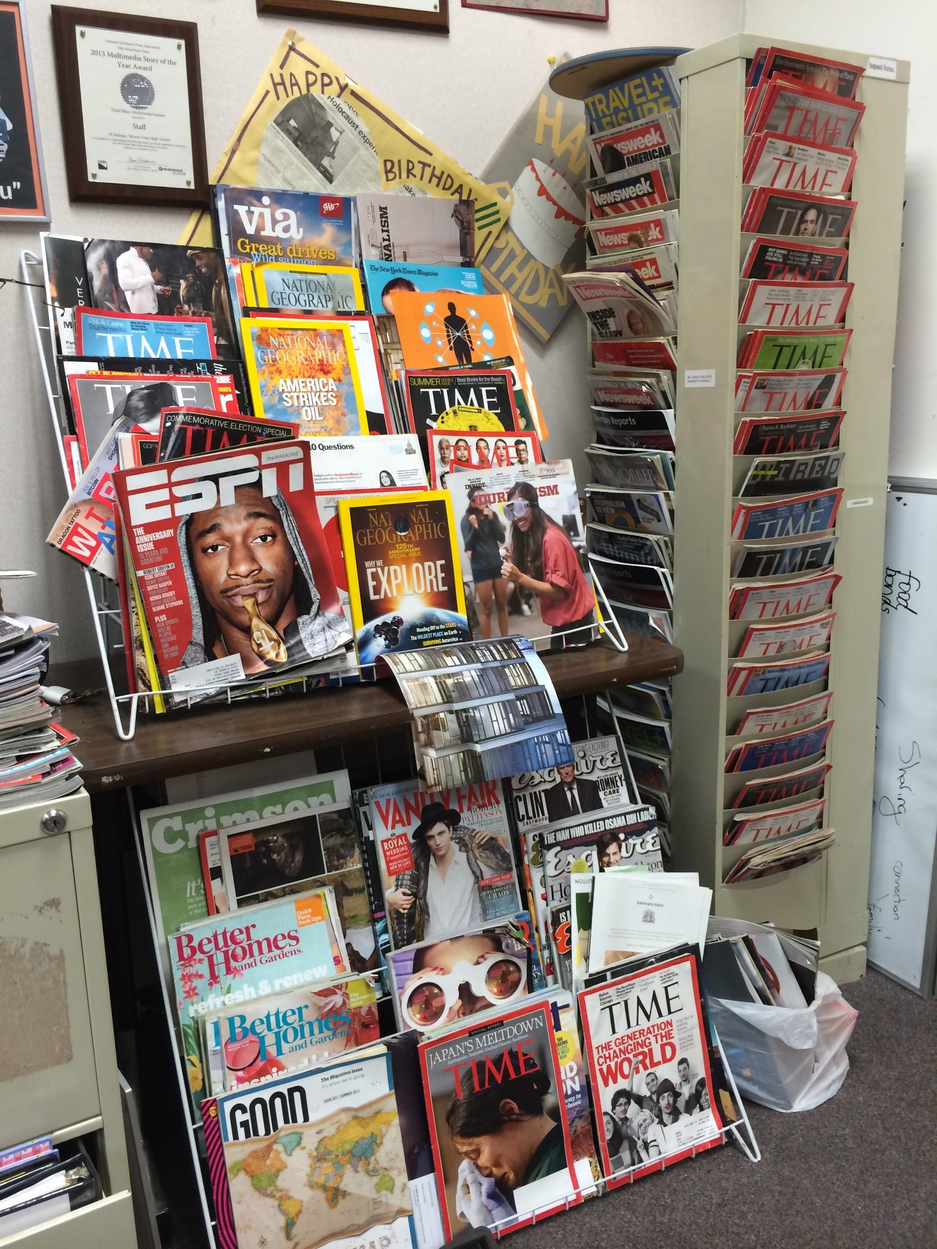

Slide 7
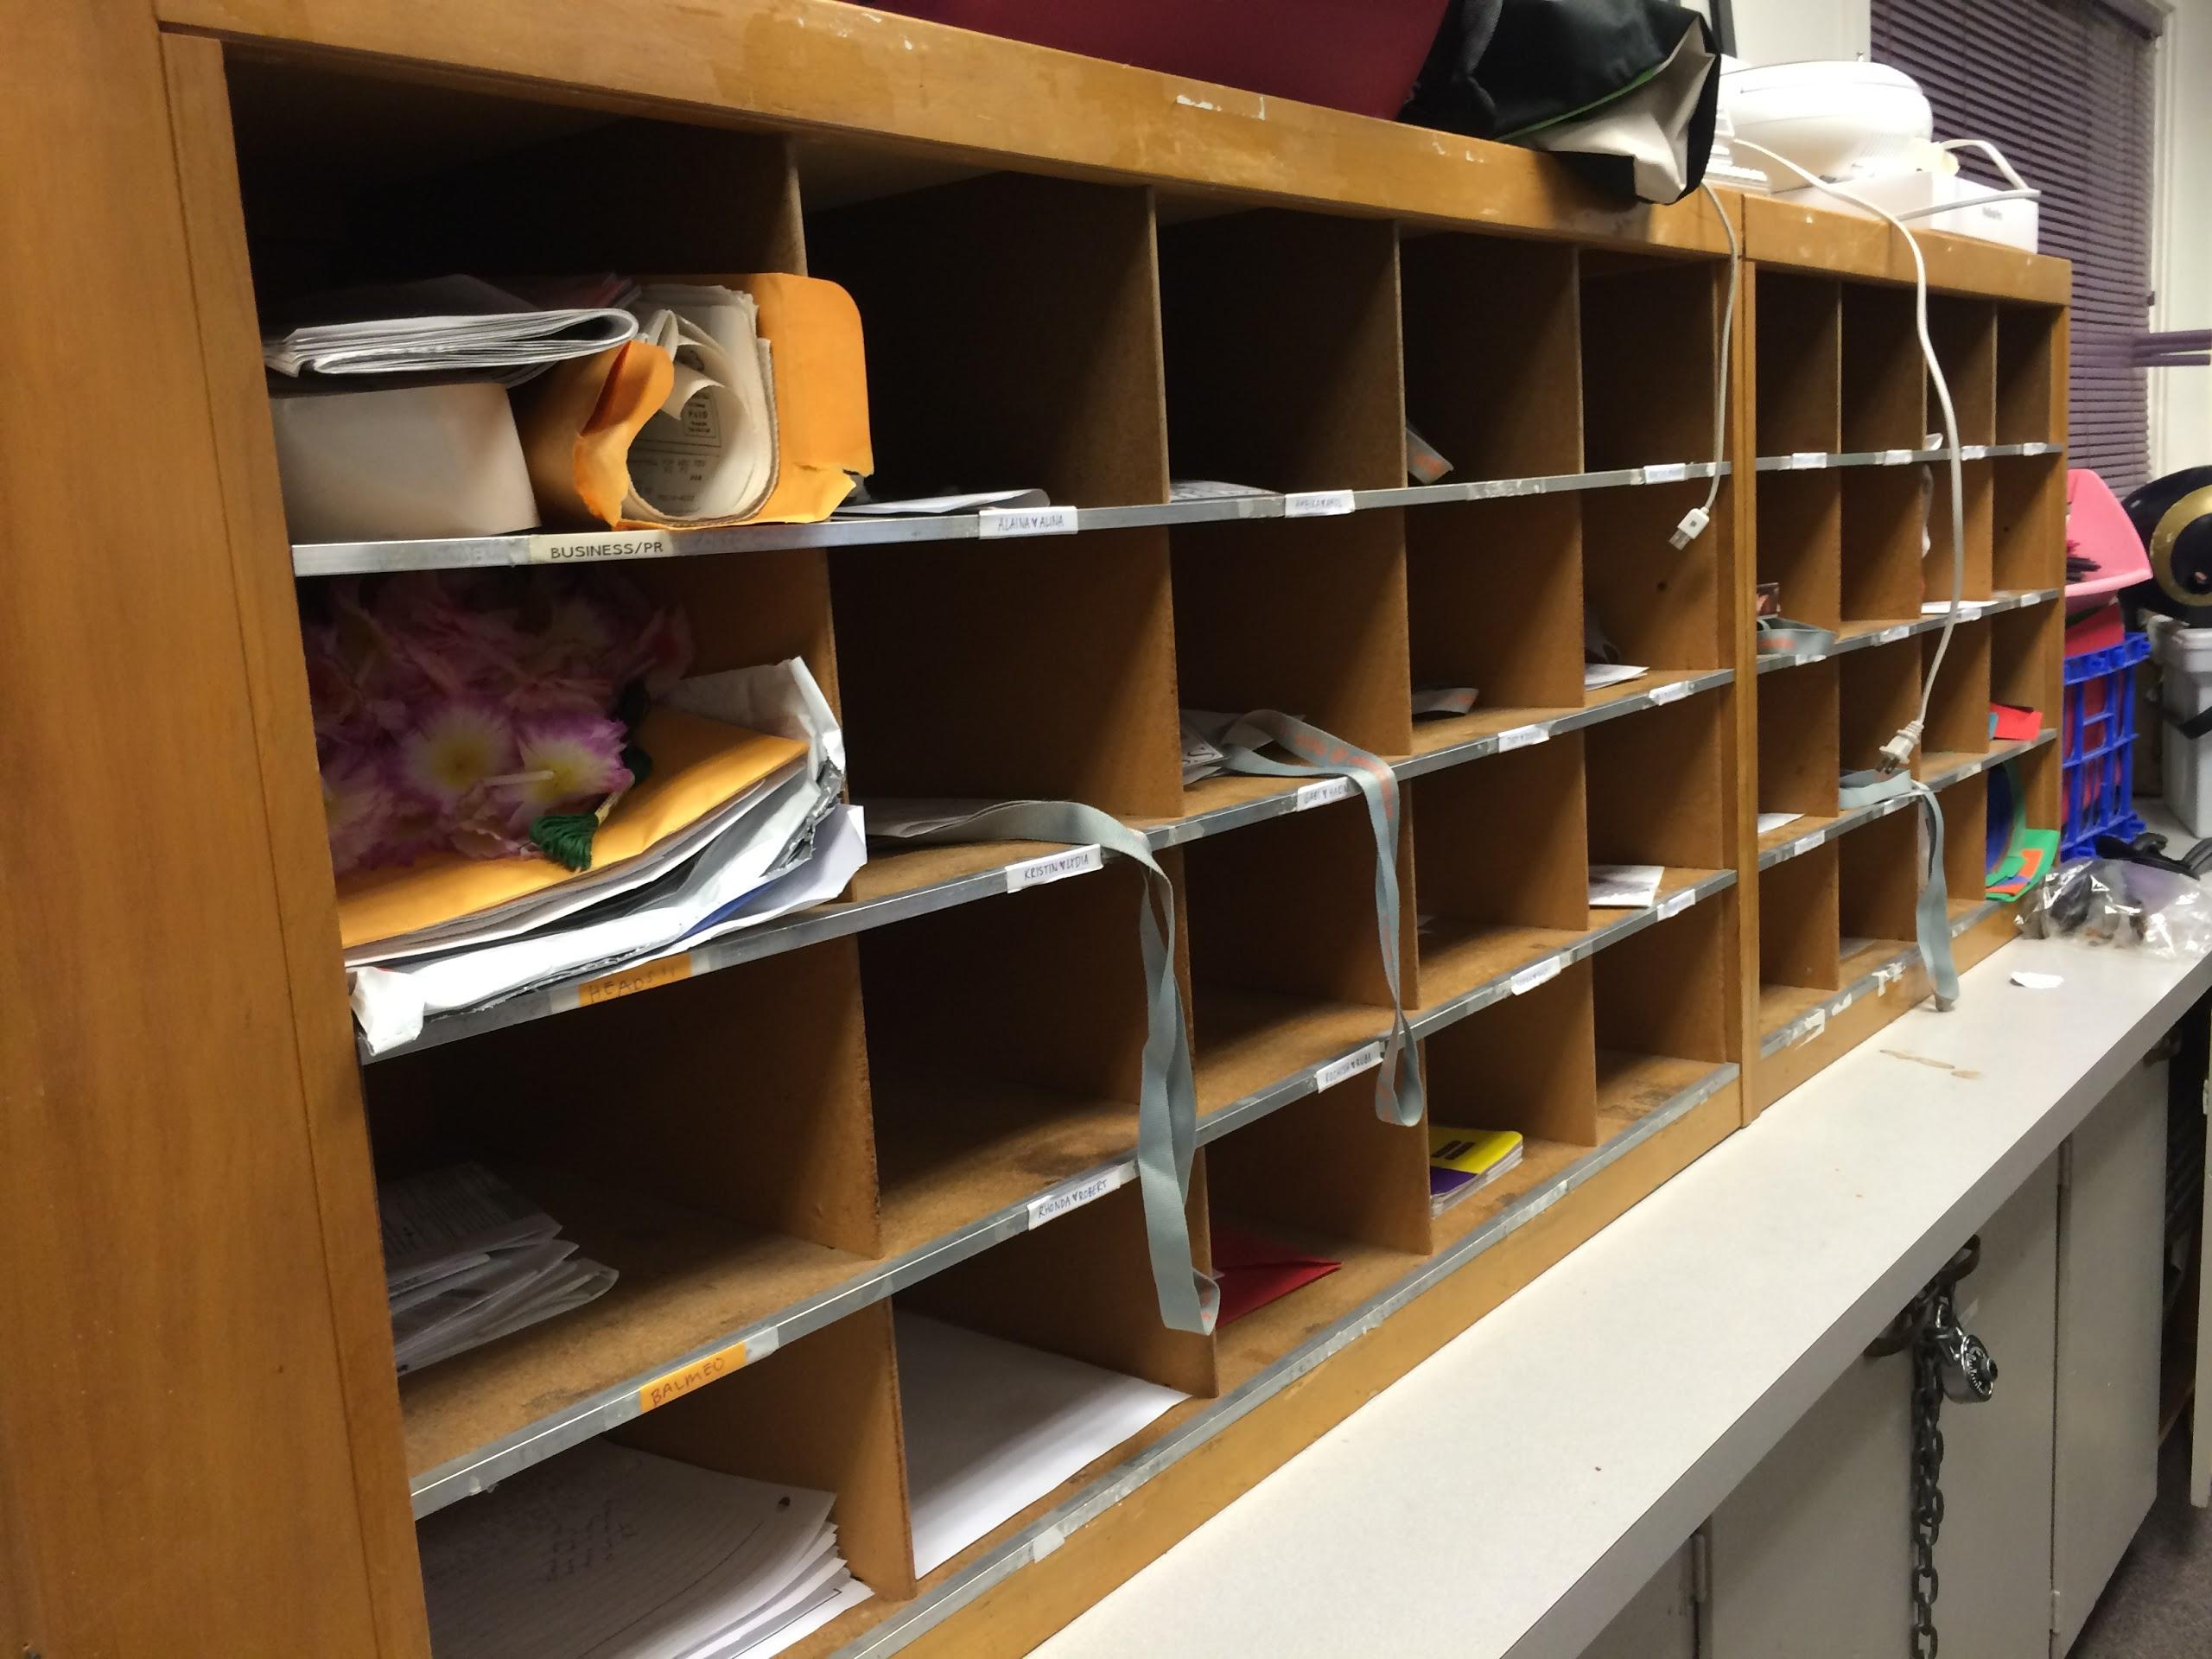

Slide 8
