Slide 1
Maestro Hands-on Approach to Whole Publications
By Beth L. Fitts
Mississippi Scholastic Press Association
mefitts@olemiss.edu

Slide 2
Seeing the Total Maestro Picture
Part 1: Whole Publication Approach allows staff ownership and great reader-interest-related coverage
Part 2: The Centerpiece Package Approach allows reporters, designers and photographers to work together to plan all elements for an interesting, informative and visual module.

Slide 3
Part 1:
WHOLE PUBLICATION

Slide 4
Buck Ryan’s Keys to Success
1. Leadership Commitment
2. A Master Trainer
3. Time, Repetition and Attention to Detail

Slide 5
Step 1: Teamwork
FORM PERMANENT MAESTRO TEAMS (SECTIONS) WITH A STANDING MAESTRO TEAM LEADER FOR EACH
(Small staffs may combine two teams/sections.)

Slide 6
Selecting the Maestro Editor
This is generally the editor-in-chief of your publication
Advisers should have primary responsibility for this selection
Characteristics:
organized, a good writer and designer, tactful, responsible, confident, willing to listen

Slide 7
Selecting a Maestro Leader for each team/section
Adviser and editor can best make this determination.
Characteristics:
- a tactful people-person
- very responsible
- able to encourage his team members, pull group members into the process and help the editor finalize the content

Slide 8
Step 2: Brainstorming
- Move into maestro teams.
- The maestro editor will tell the teams to brainstorm, without comment or discussion X number of topics of their sections in the next issue.

Slide 9
Maestro Editor’s Role
- Move from group to group asking about ideas they have formed.
- Compliment, encourage and add ideas to the different teams’ lists.
- Announce time limits at one or two points in the allotted time to keep students on track.

Slide 10
Step 3: Prioritizing
- Maestro editor will instruct teams to discuss and analyze topics they have chosen and put them in order of importance to their readers. #1 is best.
- WHY WILL MY READER CARE? (If he will not care, drop the topic in priority.)
- Which are relevant to the most students?
- Which are timely, prominent or interesting to the reader?
- Which can we use to give the readers information they DO NOT KNOW?

Slide 11
Suggesting Modules
Teams should now decide which topic could most easily use infographics and additional sidebar information in each section. Designate that topic for a possible centerpiece module.
(Remember that modules can go on interior pages.)

Slide 12
Step 4: Leadership Team Time
- Times: Lunch, after school, dinner out
- Structure: Maestro editor and maestro leaders come together with their maestro sheets to discuss and analyze topics for the various sections.
- Final approval of topics are made.
- Reporter assignments are discussed and balanced.

Slide 13
Step 5: Assignments
- Maestro editor types up all assignments
- Topic of article/Student reporter assigned
- Type of article
- Description/angle of article
- Possible authority sources
- Deadline(s)
Note: Students may write articles for other sections as well as their own.

Slide 14
Adviser input
- Adviser input at this stage is suggested, but not required.
- The maestro editor e-mails and/or prints a copy of article assignments for adviser.
- They discuss, make changes and finalize.
- Maestro editor distributes assignments to staff.

Slide 15
Ready for Part II
Maestro editor and leaders should encourage or set up Maestro Module Meetings for reporters, designers and photographers to develop centerpiece modules on selected topics.

Slide 16
Part II
CENTERPIECE PACKAGE
TEAMWORK PLAN

Slide 17
Getting Started
This part of the process takes some of the most important articles in each section and makes them more reader-friendly by having key players make decisions to pull the reader into the package or module.
The key players are the reporter, the photographer, the designer and (sometimes) the maestro editor or maestro section editor.
Note: Several different maestro module teams may be working at the same time to develop modules in various sections of the paper.

Slide 18
Ryan’s Three Keys to Success
1. Leadership Commitment
2. A Master Trainer
3. Time, Repetition and Attention to Detail

Slide 19
Step 1: Make the Big Decision
To decide which of the article/topics should become the centerpiece module, ask three important questions to determine which topics would make the best modules:
1. Why will my reader care?
2. What will he want to know?
3. How can we best present that information?

Slide 20
Ryan’s Think Like a Reader Keys
- Summarize the story in 30 words or less
- Answer the questions, I’m a busy reader; why should I care? and What will make me stop and look at this story?
- Brainstorm what questions would immediately come to a readers’ mind about the story.

Slide 21
Step 2: Build the Team
Have a plan as to whom the Maestro Module Team should involve. The maestro section leader or page designer usually call for the team meeting, but others may do so. Usually the team will meet after the reporter does the initial interviews. Be sure teams meet at the Maestro table away from distractions.

Slide 22
Step 3: Discuss and Plan the Package
- Discuss and summarize the topic and what Question 1 would be. What is the major fact readers would want to know about the topic? What are supporting facts they need?
How would each fact best be presented to the reader?
- Think PHOTO, HEADLINE, CUTLINE and LEAD when deciding how to present information. This sequence is the order in which most readers’ eyes travel when they look at the printed page. If they find the photo interesting, they look at the headline when the cutline under the picture, then the lead. If all those items are done well, the reader will be drawn into the article itself.
- Remember alternative copy is important for visual entry points.

Slide 23
Centerpiece Plan
STORY IDEA _______________________________
A. Describe it in 30 words or less_________________
B. Discuss WHY SHOULD THE READER CARE?
QUESTIONS THE READER MIGHT HAVE:
1.
2.
3.

Slide 24
Visual of Maestro Plan
^{READY:}
Start with an IDEA for the topic for your maestro package.
^{SET:}
Do some preliminary reporting on the topic.
^{GO:}
^{Begin Steps AB123}
A. REFOCUS on the topic and SUMMARIZE it in 30 words or less. (The basics of this summary should be in your headline
^{once you start to design.)}
^{B. WHY WILL THE READER CARE?}
What will make them stop and look at the package?
Remember to keep going back to this question during the process.
^{1. Answer 1:} ^{Reason they will care}
2. Answer 2: Reason they will care
3. Answer 3: Reason they will care
(Be practical and specific with your 1,2,3 answers;
^{you will use them again.)}

Slide 25
Visual Continued
^{NOW....}
WHERE DO YOU USE THE AB123 INFO ^{IN YOUR DESIGN?}
^{Remember that the questions}
(Why will the reader care?) will determine the design and should be -answered in one of four spots:
^{- THE FOCAL POINT PICTURE}
^{- THE HEADLINE}
- CUTLINES/CAPTIONS, QUOTES, LISTS, CHARTS, ECT.
^{- THE LEAD}
The picture and headline should work as a “1-2 punch” to pull the reader into the page.

Slide 26
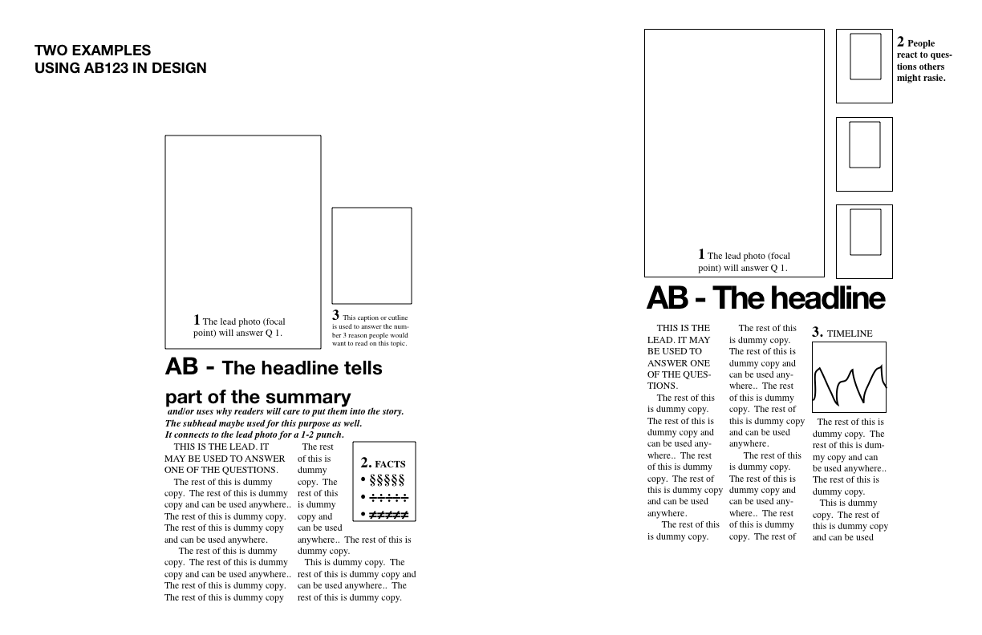

Slide 27
Step 4: Distribute Jobs
- With each question, photographers should ask for and offer suggestions as to what types of pictures would be good for the package.
- Reporters should take note of information they should (and should not) include in the main article. What info should go in a sidebar article?
- Page designers should use the dummy sheet to sketch out a possible design of the page using the elements planned by the three-person team. Designers should consider what would make the reader stop and look at this story. Where are possible reader entry points on the page? How should other unrelated articles (if there are any) be placed on the page?

Slide 28
Important
- Throughout this process team members should remember to ask, Why will my reader care? If the reader will not care, disregard that aspect of the topic or rethink the angle.

Slide 29
Step 5: Set Deadlines
- Next meeting: Establish another meeting time to fine tune the elements of the module once team members have collected information.
- Last Meeting: Print a rough draft of the page and ask for improvement ideas from all team members.
- Finalize and enjoy the IMPACT of design combined with great content.

Slide 30
Good Luck! Have Fun!
If you want to make your publication better, you have to give this method a try. It really works. One word of caution: The first time you try it, you should call your editor and section leaders together BEFORE you do it in class. Leadership commitment is a key in the success of this process. Also, the adviser will probably help explain and lead in the approach the first time or two, but as quickly as possible, the maestro editor should take control. This is a student publication, so naturally the students should lead whenever possible. Being in charge will also create wonderful confidence and leadership skills in your editor. Also, and most importantly, don’t give up after trying this method one time. It gets easier every issue until it runs like clockwork.

