Slide 1
Video Basics: Shooting and Editing
Multimedia Broadcast

Slide 2
Video camera terms
Focus
Manual mode
The camera has a focus “ring” or a function through an electronic menu that allows you to control the point of focus
Auto mode
The camera determines the focus for you

Slide 3
Video camera terms
Iris ring
Professional level cameras will have an iris ring that allows you to adjust the aperture of the camera
Smaller cameras usually have this feature through a menu or setting
Aperture
A ring that allows you to select the amount of light let through the lens

Slide 4
Video camera terms
Tripod
It is best to use a tripod in most productions.
If you don’t plan on using one, make sure to ask yourself, why?
That is, do you have a legitimate reason not to?
Monopod
A leg alone that usually screws directly into the bottom of your camera.
Often used with DSLRs or in situations where you know you will have to move often and quickly.

Slide 5
Script writing terms in practice
WS – wide shot
MS – medium shot
CU – close-up
ECU – extreme close- up
LS – long shot
POV – point of view
Split into groups
of 2-3
Write a two-column script that shows someone completing a simple task (getting a book from their locker, getting a drink of water, etc.)
Film the short production

Slide 6
Script writing terms in practice
WS – wide shot
MS – medium shot
CU – close-up
ECU – extreme
close-up
LS – long shot
POV – point of view
Be careful to not film jump-cuts.
Jump-cuts are when something in the shot jumps abruptly.
For example, if the subject is on the right side of the hallway on the WS then on the left side in the CU.

Slide 7
Script writing terms in practice
Avoid continuity errors.
These can be something as simple as your talent wearing a different shirt or holding a book in one hand in one shot and in another hand in the next shot.
Keep a shot-log of everything that you film with your group and in what order.
WS – wide shot
MS – medium shot
CU – close-up
ECU – extreme
close-up
LS – long shot
POV – point of view

Slide 8
Editing terms
Asset
Any video clip, graphic, audio, etc., you import to use in your project
Timeline or sequence
The place where you assemble and edit all of your assets to get a desired product
Track
What you place your video and audio assets into insider of your video editor

Slide 9
Editing terms
Import
The process of bringing in assets to your project
Capture
The process of digitizing footage shot on a camera that uses a tape
Batch capture
The process of digitizing a collection of clips shot on a camera that uses a tape

Slide 10
Editing terms
Single track editing
Usually found in free or inexpensive programs
This method only allows you to assemble one layer of video at a time
Multi-track editing
Found on all mainstream editing programs
Allows you to layer video and audio to composite a desired look
Compositing
The process of layering video to blend elements together to get a desired look

Slide 11
Editing terms
Time indicator or marker
The arrow or line that shows the current place and time you are viewing in your timeline
Scrub
Dragging the time indicator through the timeline to see what you have edited so far
In point
The point that you place the time indicator to tell the editor where you want the video to start or be placed
Out point
The point that you place the time indicator to tell the editor where you want the video to end or finish

Slide 12
Editing terms
J-Cut
Disconnecting the video and audio to allow you to have the audio play before you see the video
L-Cut
Disconnecting the video and audio to allow you to have the audio play after the video has finished playing
Cut
Switching between one shot and the next

Slide 13
Editing terms
B-Roll
Footage that can be used to reinforce the idea that interviewees or documentaries are talking about
Effect
Usually represented by filters that change the overall appearance of the video clip or audio sources that you apply it to
Depending on your editor, these filters are usually customizable

Slide 14
Editing terms
Transition
A effect that blends two shots together to move from one clip to the next
Dissolve
As one clip fades out, the other fades in
Fade
An effect that generally goes from fully visible to not visible
Wipe
One clip replaces another off screen in the predetermined direction

Slide 15
Editing terms
Render
A process that many editing programs requires you to run in order to see effects or animations that you have applied inside of your timeline
Export
The process that allows you to save a playable video file from the project you have been editing

Slide 16
Editing practice: importing
Edit together your simple task that you filmed earlier
When importing your assets, rename the video clips to something that matches what you shot.
Use your shot-log as a resource
For example
instead of 00195.mov
WS_jiminhallway.mov
Be sure to keep your file extension!

Slide 17
Editing practice: audio
Use music to make your video more interesting.
Use a fade in and fade out audio transition to make the music start and stop subtly.
Speaking can be used but is not required in this early project.

Slide 18
Editing practice: graphics
Name your project
Create a simple title screen using the graphics editor.
Give yourself some credit
Create simple credits using the graphics editor.

Slide 19
Editing practice: exporting
Export your simple task when you are happy with the way it has been edited.
Be sure that your finished project is playable on the computer that you are using outside of your editor.

Slide 20
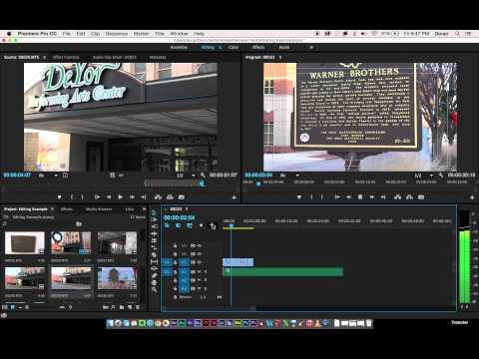
Editing Demo – Try This!

Slide 21
A short profile
You will now create a short, personal profile of one of your classmates.
Conduct a pre-interview with your assigned partner.
Find something interesting about the subject.
Does the subject have a unique talent, skill or hobby, play in a band, heavily involved in a sport, video game fanatic, etc.?

Slide 22
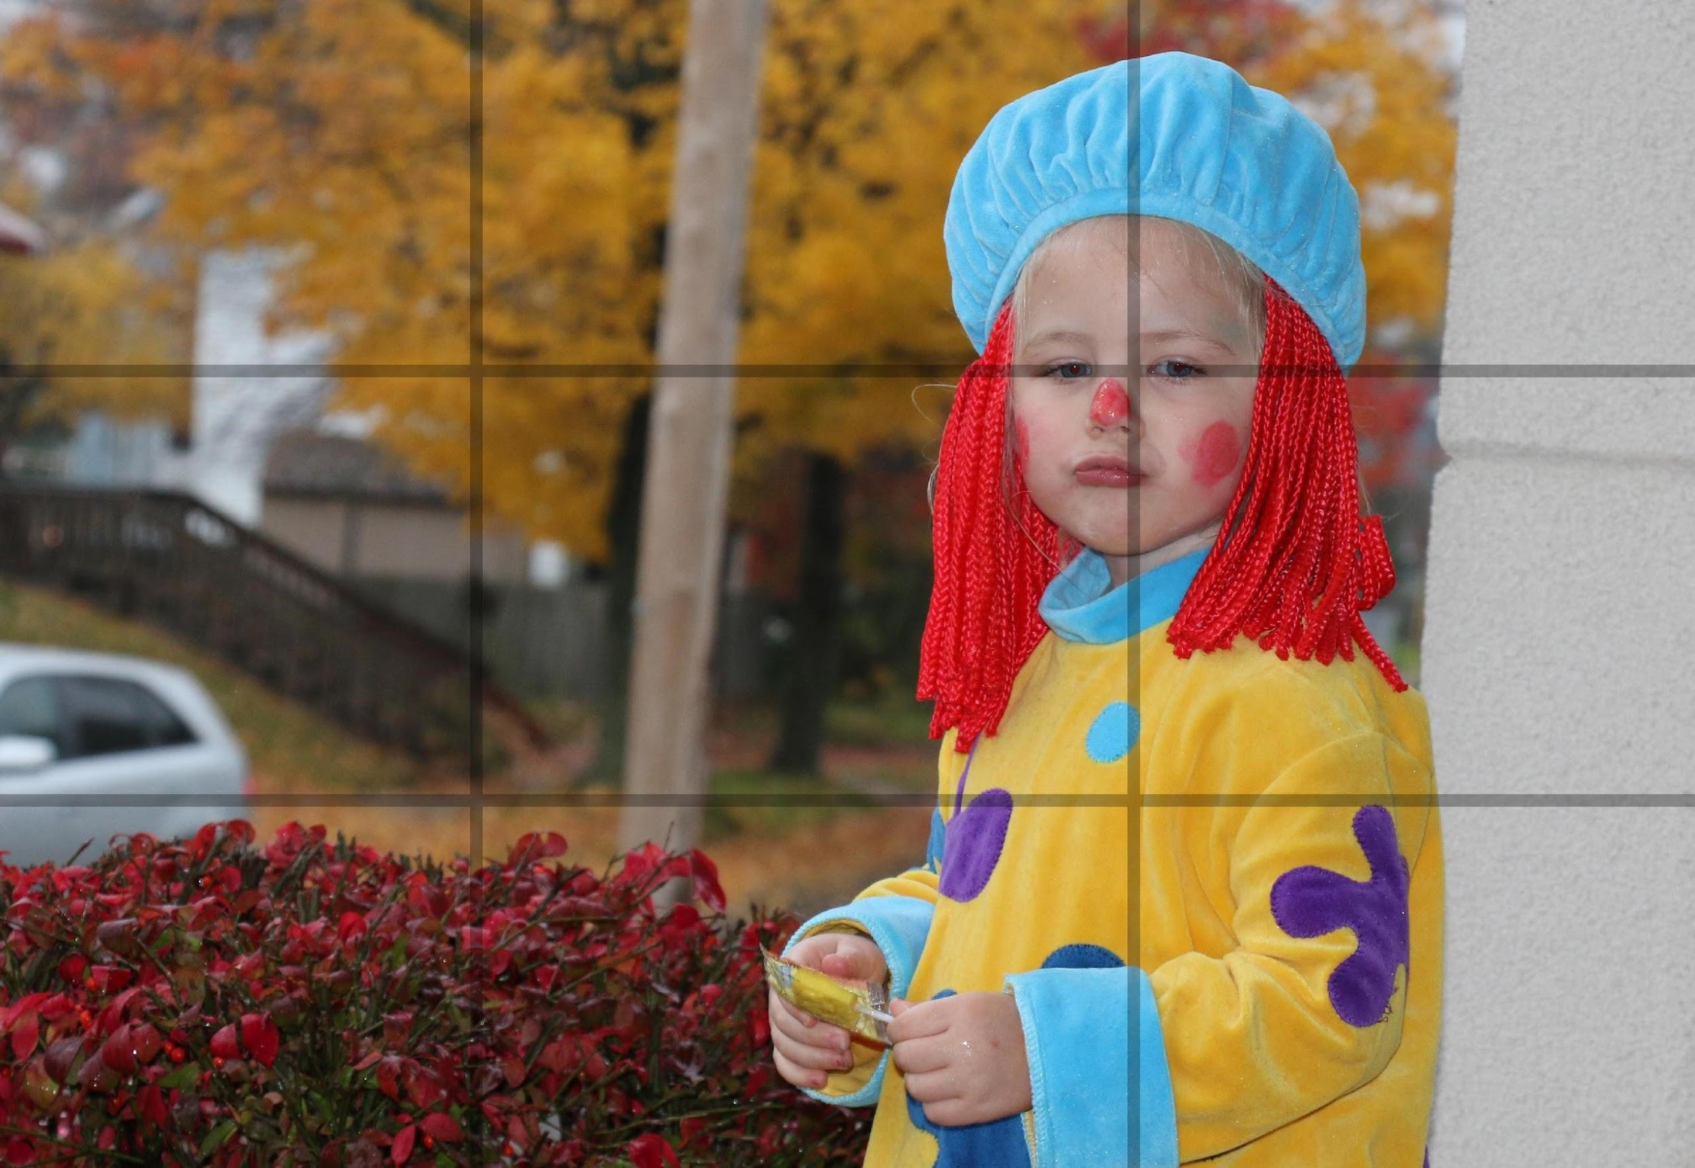
A short profile
Then, conduct a real interview on camera
Requirements
Use a tripod
Use a microphone
Use the Rule of Thirds
Use B-roll of the subject
Use music under the subject’s voice and balance your levels to an acceptable level
Export your finished profile as a playable movie file.
Rule of Thirds Example

Slide 23
Highlight a location
Pick an area around your school or surrounding location.
Consider the cafeteria, gym, auditorium, guidance office, monument, hall of fame, front office, etc.
Investigate
Talk to people who are involved with this area.
Find out what takes place here.

Slide 24
Highlight a location
Write a two-column script that will result in a video that is 60 seconds long.
Be descriptive and tell a story about the place.
Record a VO that fills at least 45 of the 60 seconds.
Include creative shots that make the obvious more interesting.

Slide 25
Highlight a location
Previous shots
New shots to also try
WS – wide shot
MS – medium shot
CU – close-up
ECU – extreme close-up
LS – long shot
POV – point of view
Low angles
Place the camera on or near the floor and aim up
High angles
Hold the camera over your head, or shoot from a raised location
Depth shot
Show people or objects in the foreground and the background
Reflection shot
Try to find something like glass or water to film a reflection to film
Linking shot
Pan the camera from one object to another to show a “linking” or connection between the two

Slide 26
Highlight a location
Create a title that identifies your location.
Put credits on your finished edit.
Export your finished project as a playable file.
Use a descriptive name for your file:
LastName_Location

